Slide 2

In 1995, Yann LeCun and Yoshua Bengio introduced the concept of convolutional neural networks.
.`
Yann LeCun, Director of AI Research, Facebook
Founding Director of the NYU Center for Data Science
Professor of Computer Science, The Courant Institute of Mathematical Sciences, New York University
Famous paper: http://yann.lecun.com/exdb/publis/pdf/lecun-01a.pdf proceedings of IEEE
Gradient-based learning applied to document recognition

Slide 3
What are Convolutional Neural Networks and how they work???

Slide 4
CNNs are MLPs with a special structure.
CNN is a specialized kind of neural network for processing the data which has the grid like topology.
Examples of such data are :
Images which can be considered as a 2D (224x224 grayscale) or 3channeled (coloured RGB) grid of pixels,
Time series data which can be thought of as the 1D grid taking samples at regular time intervals

Slide 5
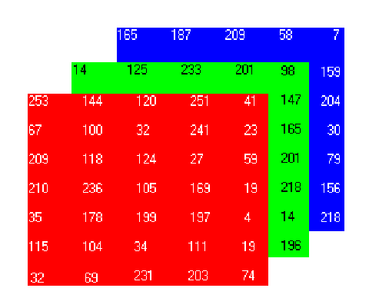

Slide 6
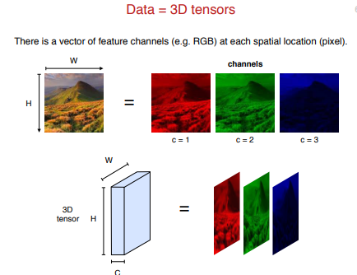

Slide 7
Comparison of CNN
with
MLP

Slide 8
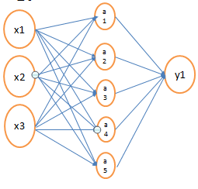
Number of Parameters (weights) assuming (i)biases present
(ii) Biases absent
As the dimensionality of the data increases the number of parameters in the model also increases.

Slide 9
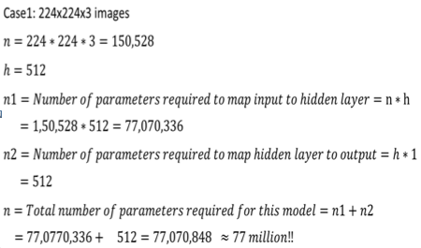
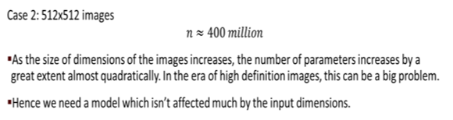
Huge number of parameters (weights) are required when inputs are high dimensional.

Slide 10
One of the major reasons for overfitting is that you don’t have enough data to train your network.
Apart from Regularization, another very effective way to counter Overfitting is Data Augmentation.
It is the process of artificially creating more images from the images you already have by changing the size, orientation etc of the image.
It can be a tedious task but fortunately, this can be done in Keras using the ImageDataGenerator instance.

Slide 11
Data Augmentation is simply creating fake data. You use the data in the existing train set to create variations of it. This does two things —
Increases the size of your training set
Regularizes your network
Any method that modifies the learning algorithm in a way that is intended to reduce the generalization error but not the training errors is called
REGULARISATION.

Slide 12
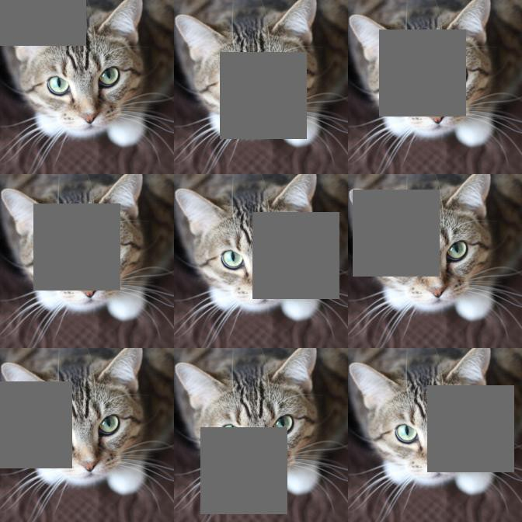
Cutout Regularisation.- a form of augmenting your data to handle occlusion.
Occlusion- an extremely common challenge in real-world applications, especially in the areas of robotics and self-driving cars.
By applying a form of occlusion to the training data, we effectively adapt our network to be more robust to it.

Slide 13
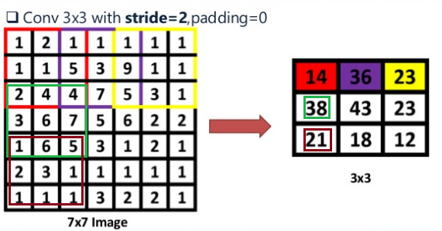

Slide 14
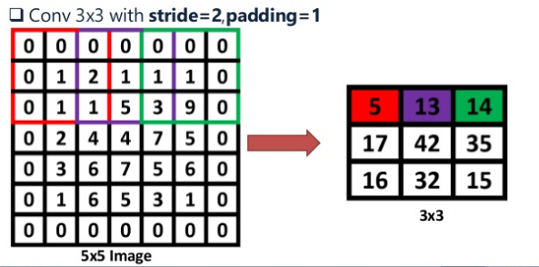

Slide 15
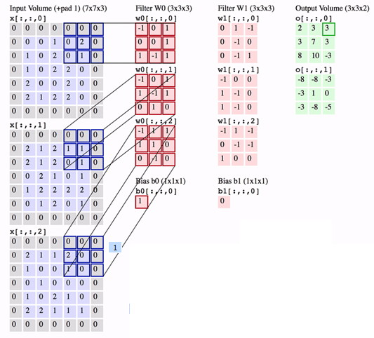
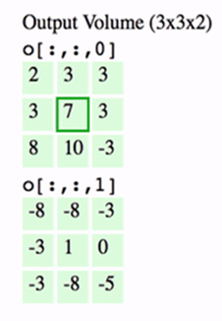
Show the positioning of kernels on image to get in convolved image 7

Slide 16
What does a 1x1 convolutional layer do?
A 1x1 convolution operation without padding and with Stride of 1 ALTERS the depth dimension of an input volume ( W x H x D) leaving its width and height intact [ [(W-1) /1] +1=W ]
Normally applied in intermediate layers, not to input layer
n x n convolution matrix, not only squashes the depth dimension of an input volume , but -alter the width and height of the input volume too, depending on Filter size, padding and stride.

Slide 17
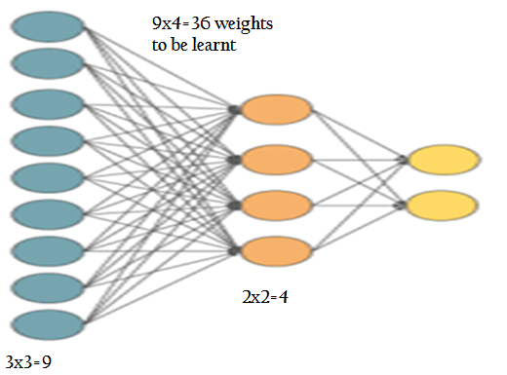
Connecting concept of MLP with Convolutional Neural Network?
Input : single channel image of 3x3 image
Filter : 2x2
Feature map : 2x2; W= H= [ ((3-2)/1 )+ 1] = 2
Output : image 1, and image 2

Slide 18
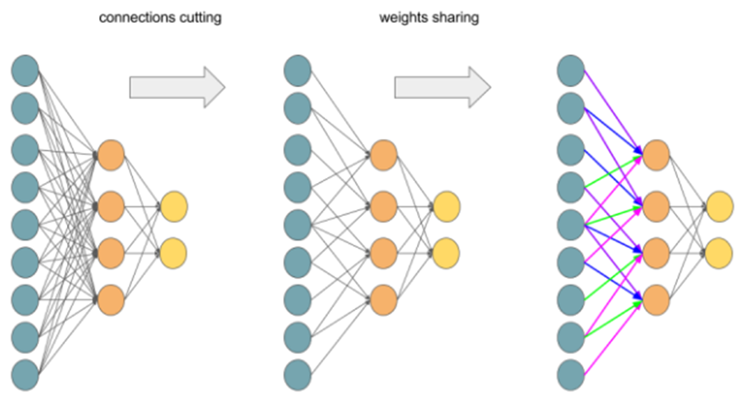

Slide 19
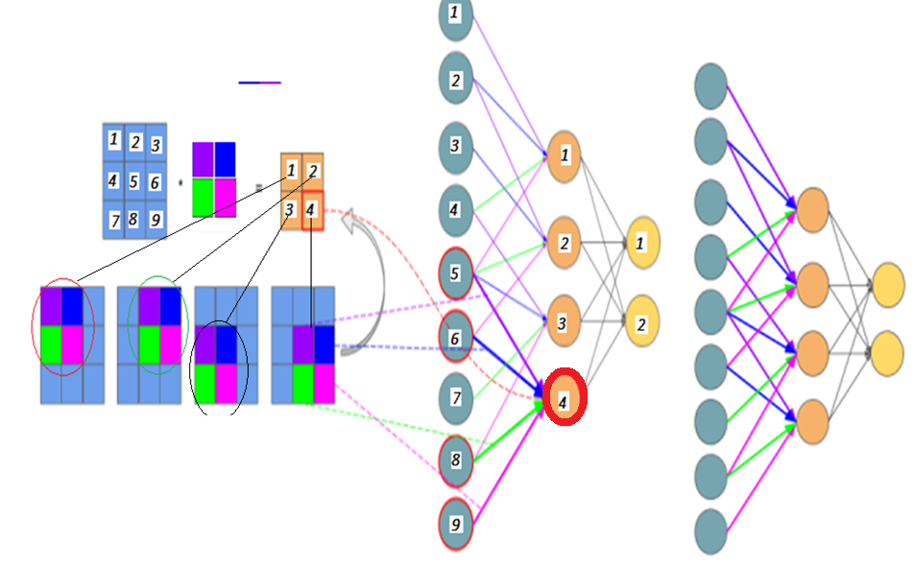
5-4 (purple),6-4(Blue),
8-4(Green ),9-4( Magentta)
No. of weights : 2x2=4
Out of 16 weights, shared weights : 4 weights
FC it would have been 9x4=36

Slide 20
Pooling layer is also called subsampling or downsampling
Pooling is mostly used immediately after the convolutional layer to reduce the spatial size but retains the most important information(depth).
Only width and height are changed not depth.
Pooling can be of different types: Max, Average, Sum etc.

Slide 21
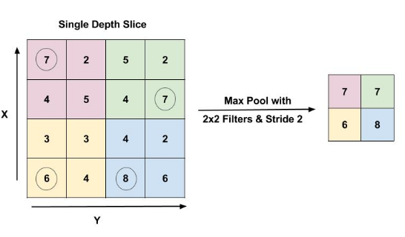
In case of Max Pooling, define a window) and take the largest element from the feature map within that window.
A filter of size 2x2 with a stride of 2
reduces the spatial size of the input to half. [(4-2)/2 ]+1 =2

Slide 22
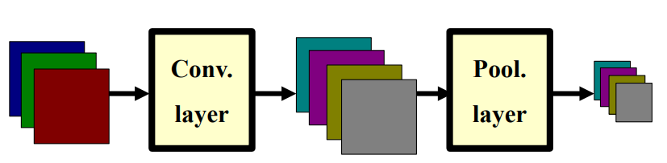
Any observations on number of channels ?
After Pooling, Number of channels in output will remain the same ( depth of the output will remain same as input).

Slide 23
Fully Connected layer
every neuron in the previous layer is connected to every neuron on the next layer like normal FFNN.
The output from the convolution and pooling layers represent high-level features of the input image.
The purpose of the Fully Connected layer is to use features extracted from Conv+Pooling layers for classifying the input image into various classes using SOFTMAX function

Slide 24
