Slide 1
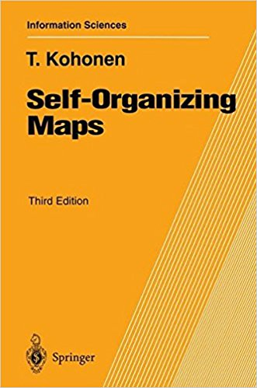
About this book: The Self-Organizing Map (SOM) - one of the most realistic models of the biological brain function in the unsupervised learning category.
Many fields of science have adopted SOM as a standard analytical tool in : statistics, signal processing, control theory, financial analysis, experimental physics, chemistry and medicine.

Slide 2
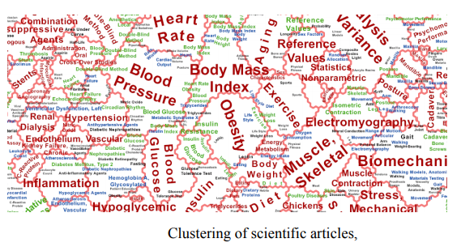
Massive document collections can be organized using a SOM. It can be optimized to map large document collections while preserving much of the classification accuracy

Slide 3
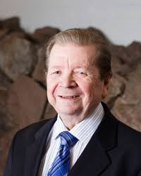
An interesting architecture based on competitive learning process by
Finish Professor Teuvo Kohonen [ Helsinki University of Technology, Laboratory of Computer and Information Science, Neural Network Research centre, Finland ] introduced in 1990
called
SELF-ORGANIZING MAPS

Slide 4
Competitive learning
In competitive learning, neurons compete among themselves to be activated.
While in Hebbian learning, several output neurons can be activated simultaneously, in competitive learning, only a single output neuron is active at any time.
The output neuron that wins the “competition” is called the winner-takes-all neuron or simply the winning neuron.

Slide 5
Kohonen’s SOM is a widely-used ANN model based on the idea of
self-organized or unsupervised learning
SOM / KOHONEN MAPS combines
competitive learning with
topology preserving mapping , i.e.
Nearby input patterns should activate Nearby output units on the map

Slide 6
In a competitive neural network, the neurons ‘compete’ to be activated.
Activation is a function of distance from a selected data point.
The neuron closest to the data point — that is, with the highest activation — ‘wins’, and is moved towards the data point, attracting some of its neighbourhood.
competitiveness allows learning topology

Slide 7
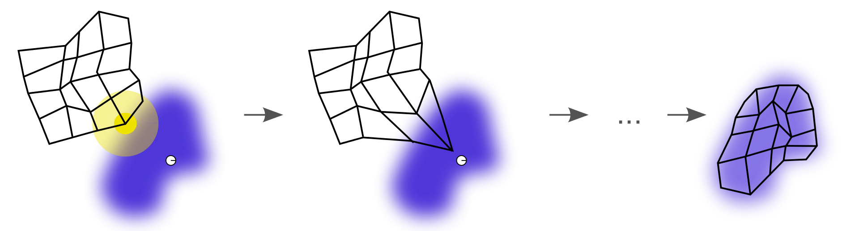

Slide 8
Feature-mapping Kohonen model
it is a very useful technique for clustering analysis, and exploring data.

Slide 9
Kohonen Maps

Slide 10
Kohonen Maps
The input x is given to
all the units at the same
time

Slide 11
Kohonen Maps
The weights
of the winner unit
are updated
together with the weights of
its neighborhoods

Slide 12
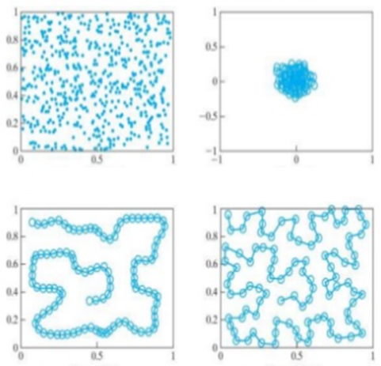
Input Distribution
Initial weights
10,000 iteration
Ordering Phase
90,000 iteration
Converging Phase

Slide 13
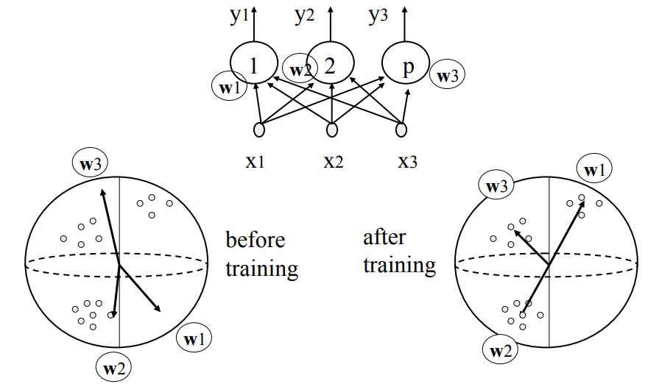

Slide 14
The overall effect of the competitive learning rule resides in moving the synaptic weight vector W_{j} of the winning neuron j towards the input pattern X. The matching criterion is equivalent to the minimum Euclidean distance between vectors.

Slide 15

DISTANCE(DISIMILARITY ) MEASURE
A distance function provides distance between the elements of a set.
MINKOWSKI DISTANCE
The Minkowski distance between two n-dimensional variables X and Y is defined as :
p = 1 is equivalent to the Manhattan distance and
p = 2 is equivalent to the Euclidean distance.
Although p can be any real value, it is typically set to a value between 1 and 2.
For values of p less than 1, the formula above does not define a valid distance metric since the triangle inequality is not satisfied.

Slide 16
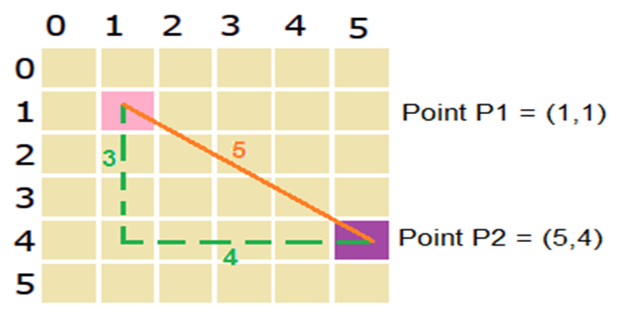
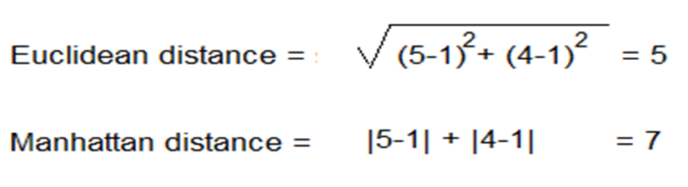
DISTNCE MEASURE

Slide 17
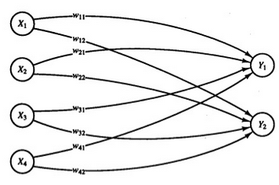
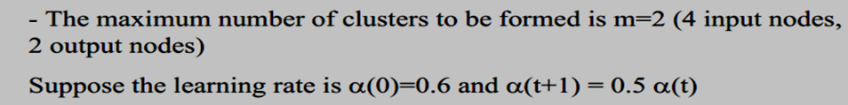
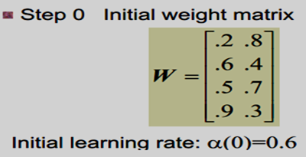
P1 (1,1,0,0) ; P2(0,0,0,1)
P3 (1,0,0,0) ; P4(0,0,1,1)

Slide 18
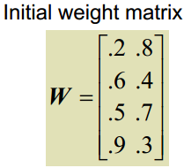
P1 (1,1,0,0)
Step 4: Input vector(1) is closer to o/p node 2, so
j=2 is winner node and weights associated with node 2 are updated

Slide 19
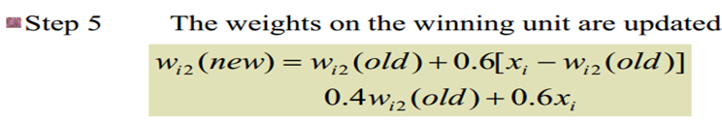
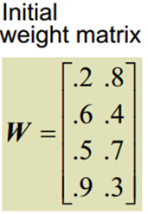
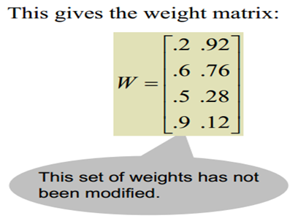
Calculate new weights [P1=1,1,0,0]
Input was 1100
w₁₂ (.8 to .92) and w₂₂ (.4 to .76) have increased, so distance will decrease from 11
w₃₂ (.7 to .28) and w₄₂ (.3 to .12) decreased so distance will decrease from 00

Slide 20
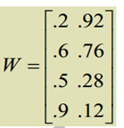

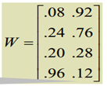

Calculate new weights
Input 0 0 0 1
w₁₁ and w₂₁ and w₃₁
have decreased
w₄₁ increased

Slide 21



Only W₁₂ increased and all others decreased Input 1 0 0 0

Slide 22
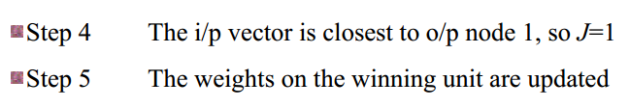
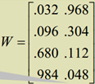
w₁₁ and w₂₁ decreased
w₄₁ and w₃₁ increased,

Slide 23
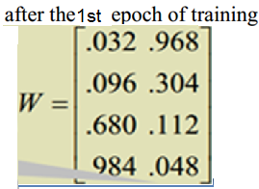
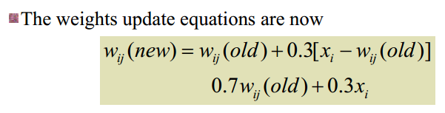
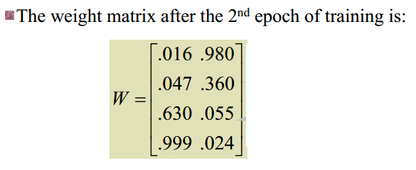
P1= (1,1,0,0) ; P2=(0,0,0,1)
P3= (1,0,0,0) ; P4=(0,0,1,1)

Slide 24
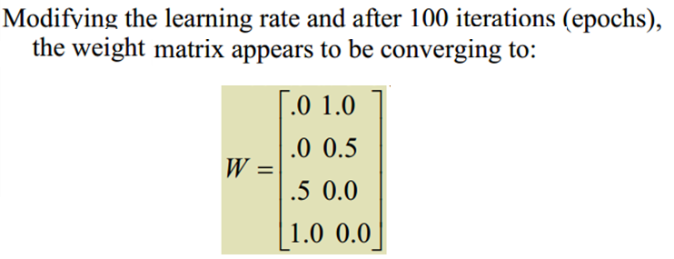
In first iteration
After 100 iterations, distance from node 2 has decreased from 0.98 to 0.25, and distance from node 1 has increased from 1.86 to 3.25

Slide 25
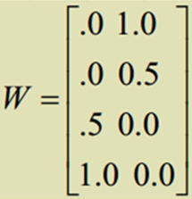
P1 =(1,1,0,0)
1100(s1) is in cluster 2
weights do not change ,s1 is in cluster 2

Slide 26
Winner is Node 1,weights do not change( α too small), input 2 is in cluster 1

Slide 27
Winner is Node 2,weights do not change, input 3 is in cluster 2

Slide 28
Winner is Node 1,weights do not change, input 4 is in cluster 1

Slide 29
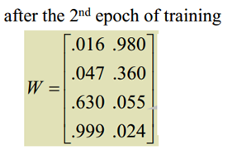

Avg of vectors in c1 : 0,0,0.5,1
Avg of vectors in c2 : 1,0.5,0,0

