Slide 2
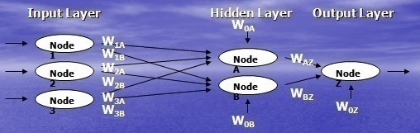

Slide 3
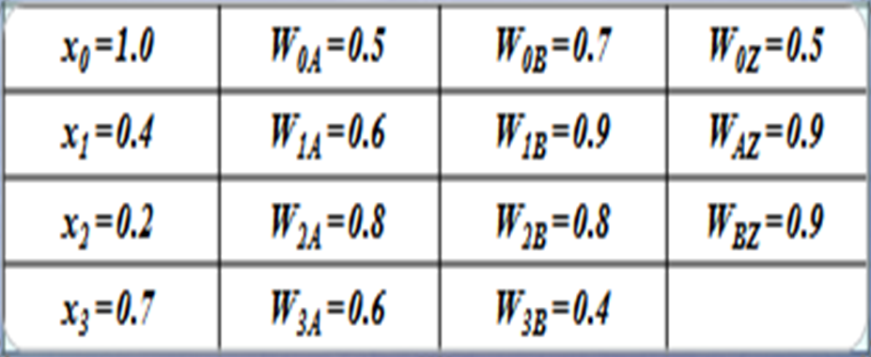
Calculate output of Node A, B & Z,
logsigmoid is the activation function

Slide 4

Calculate output of Node A, B & Z

Slide 5
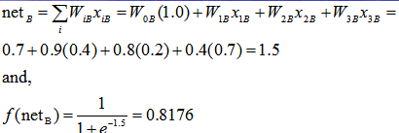

Slide 6
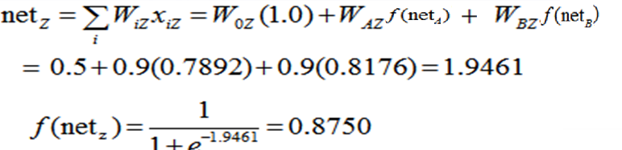
Calculate output of Node A, B & Z

Slide 7
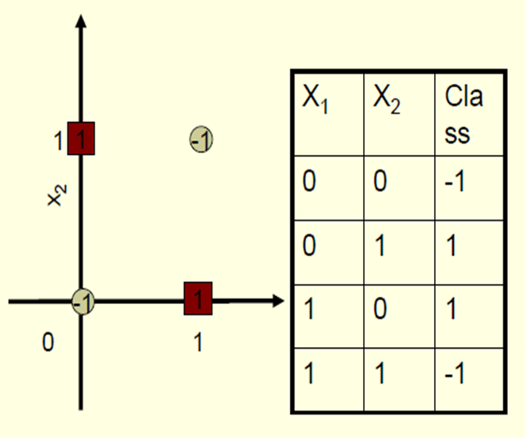
XOR- BINARY INPUT, BIPOLAR OUTPUT

Slide 8
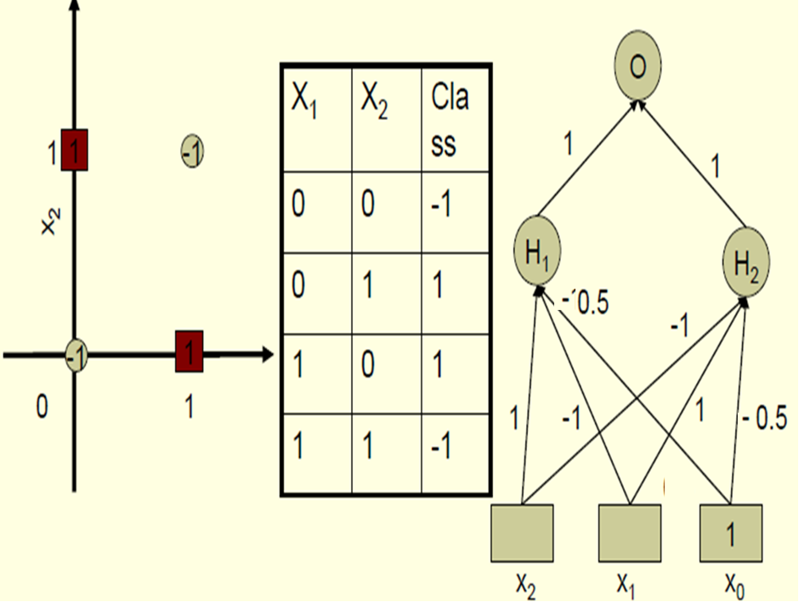
Bipolar Activation function with threshold 0
Bipolar Activation function with threshold 0

Slide 9
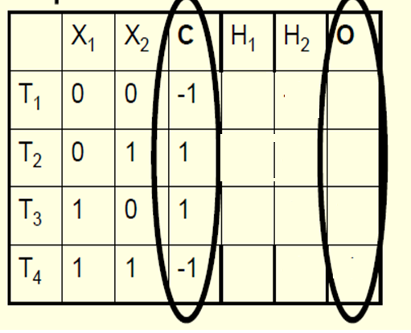
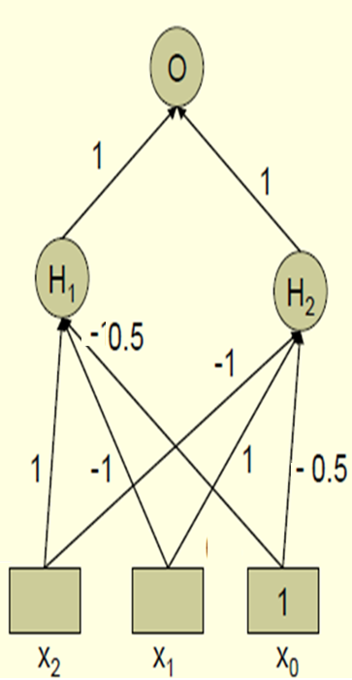


Fill the entries: output of H₁ and H₂ and O
Bipolar Activation function with threshold 0

Slide 10
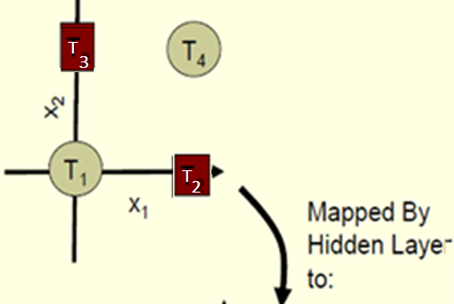
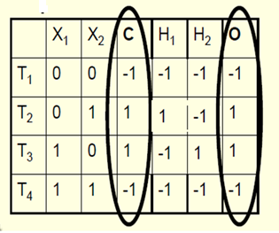
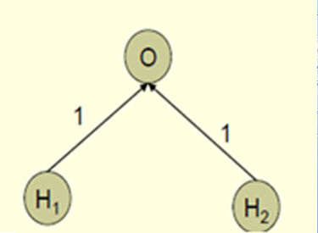
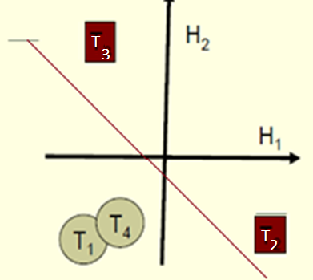
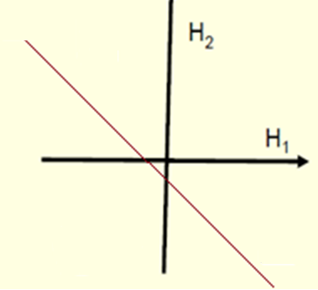
Put T₁ T₂ T₃ T₄ on H₁ H₂ plane

Slide 11
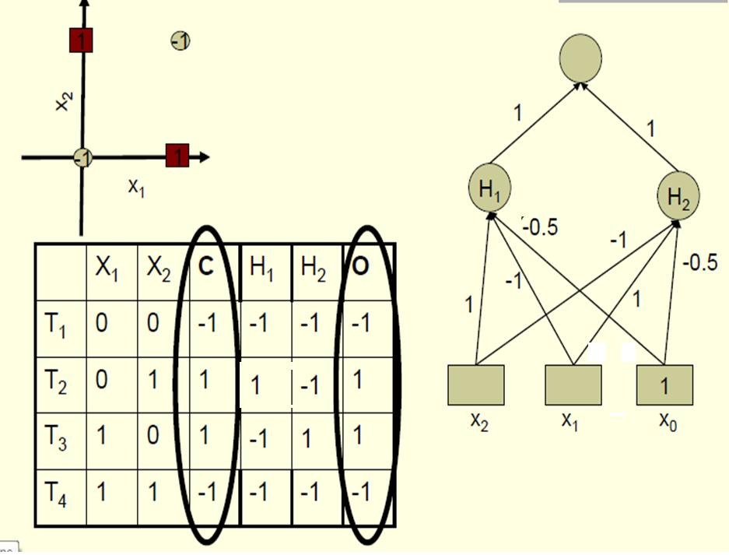

Slide 12
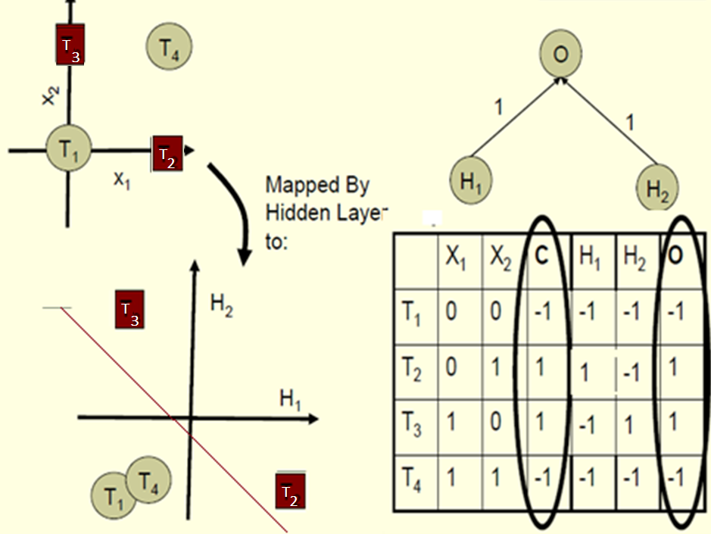

Slide 13
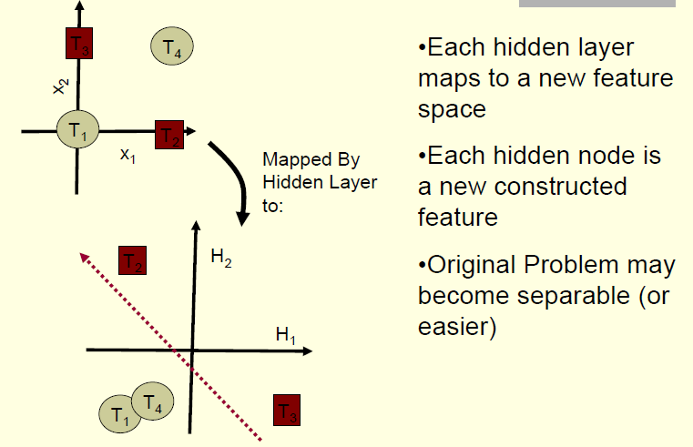
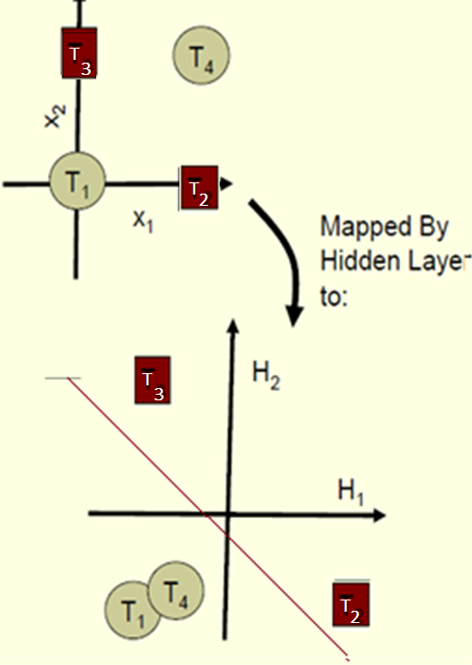

Slide 14
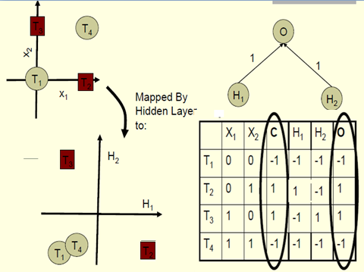

Slide 15
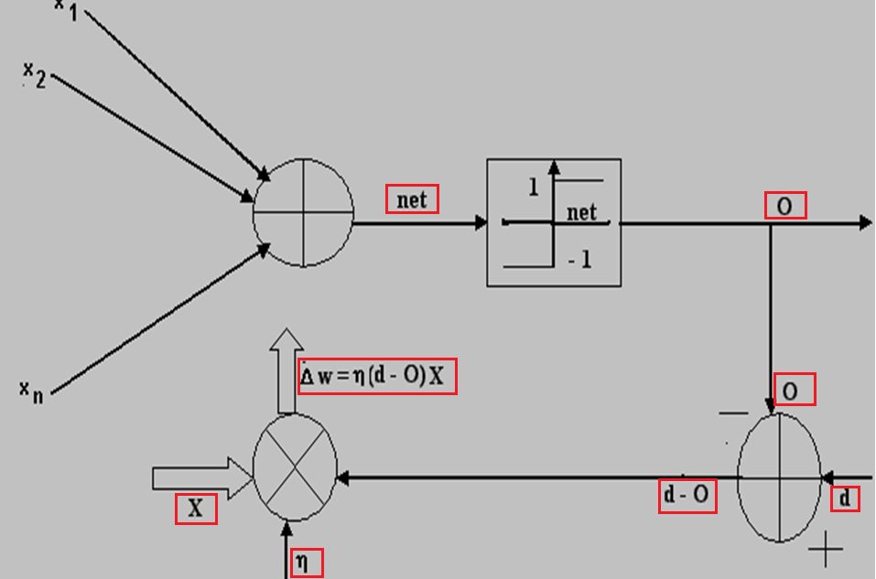
Perceptron Learning Rule

Slide 16
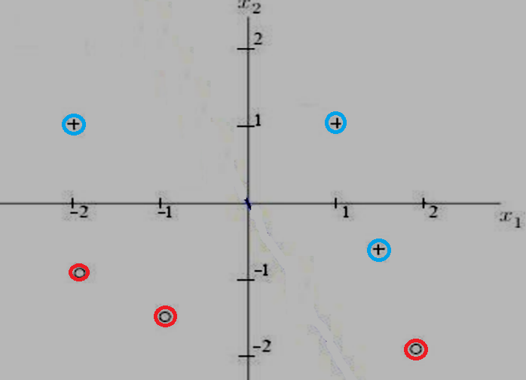
“+” points to one side of line, target output =1,
“0” points to other side of line, target output=0
P1 (1,1),
P2(2,-2),
P3(-1,-1.5),
P4(-2,-1),
P5(-2,1),
P6(1.5,-.5)
Use Perceptron learning to separate SIX points in two classes
Activation Fuction :
unipolar step (0/1),Threshold value is Zero,

Slide 17
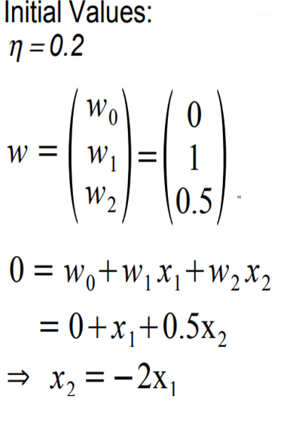
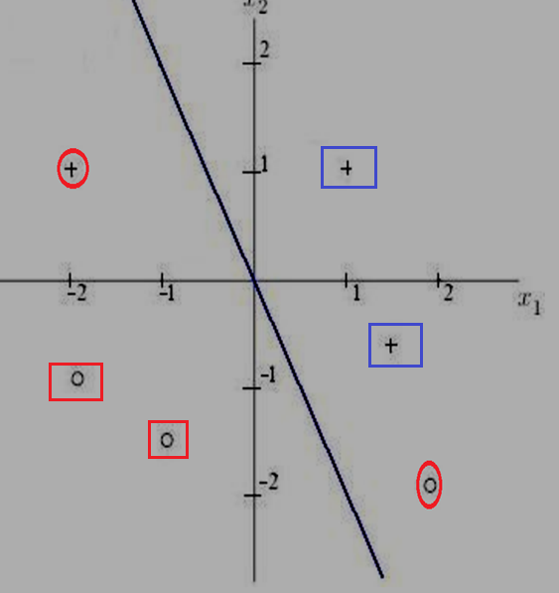
One”+” point and one “o” point is misclassified with initial set of weights and biases

Slide 18
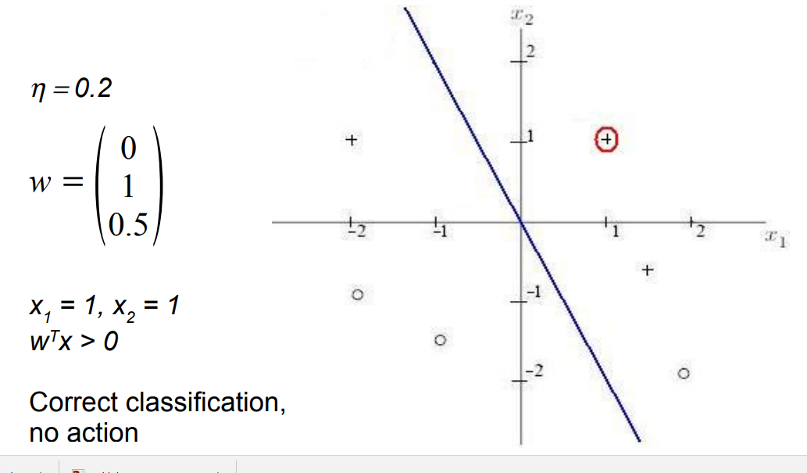
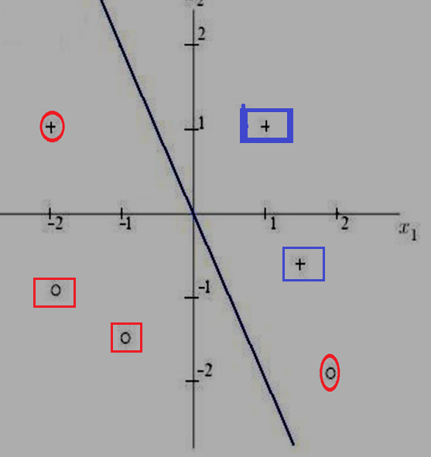
P1(1,1), bias(b =w₀=0, x₀=1)
Output y= f(bx₀+ w₁x₁ +w₂x₂) = f(0*1+1*1+0.5*1) = f(1.5) =1,
correct classification NO CHANGE in weights/biases

Slide 19
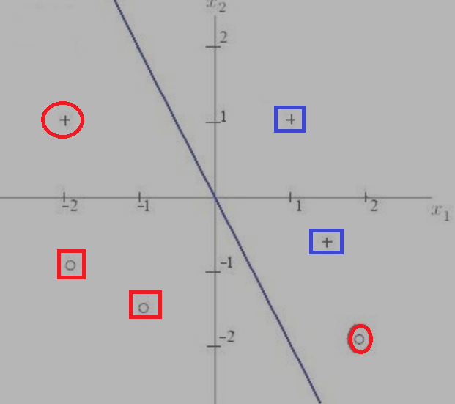
P2(2,-2)
INCORRECT CLASSIFICATION,

Slide 20
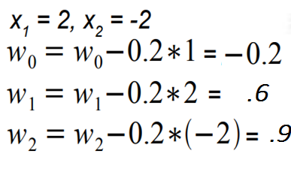
P2(2,-2) , x₁= 2, x₂ = -2, bias(b= w₀ = 0, x₀= 1) , w₁ = 1, w₂ = 0.5
Output :y = f(bx₀+ w₁x₁ +w₂x₂)= f( 0*1+1*2+0.5*-2)
= f(1.0) = 1; Output should be “0
INCORRECT CLASSIFICATION,
so change weights/bias,
Δw = η(t - 0)X = 0.2(0 -1)X = -0.2X
Calculate new weights

Slide 21
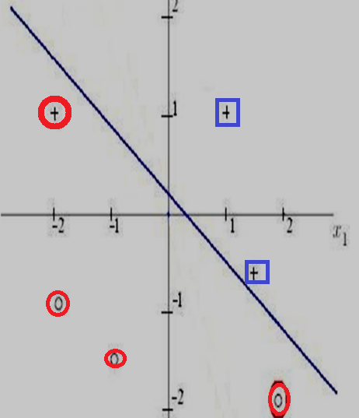

Slide 22
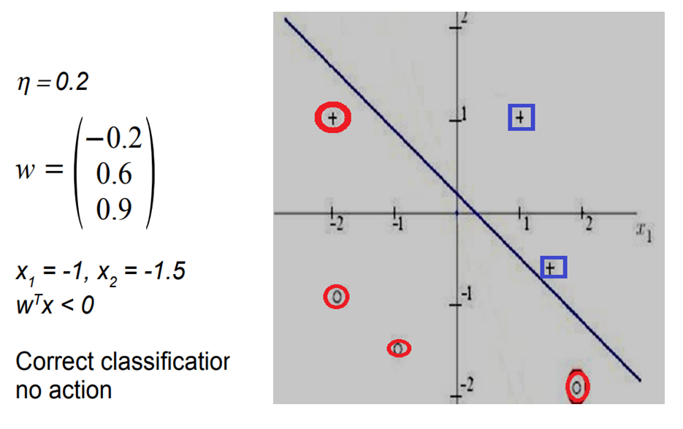
P3(-1,-1.5) , b = -0.2, w₁ = 0.6, w₂ = 0.9
Output = y = f(bx₀+ w₁x₁ +w₂x₂)
= f( -0.2*1+0.6*(-1)+0.9*-1.5)=f(-2.15)=0
Output should be “0) CORRECT CLASSIFICATION, so NO change in weights/biases

Slide 23
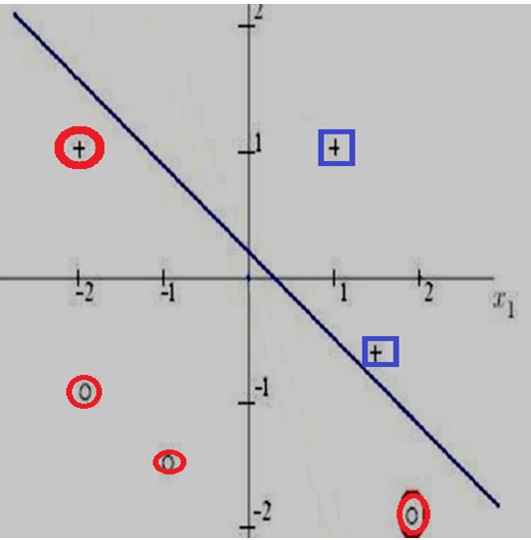

Slide 24
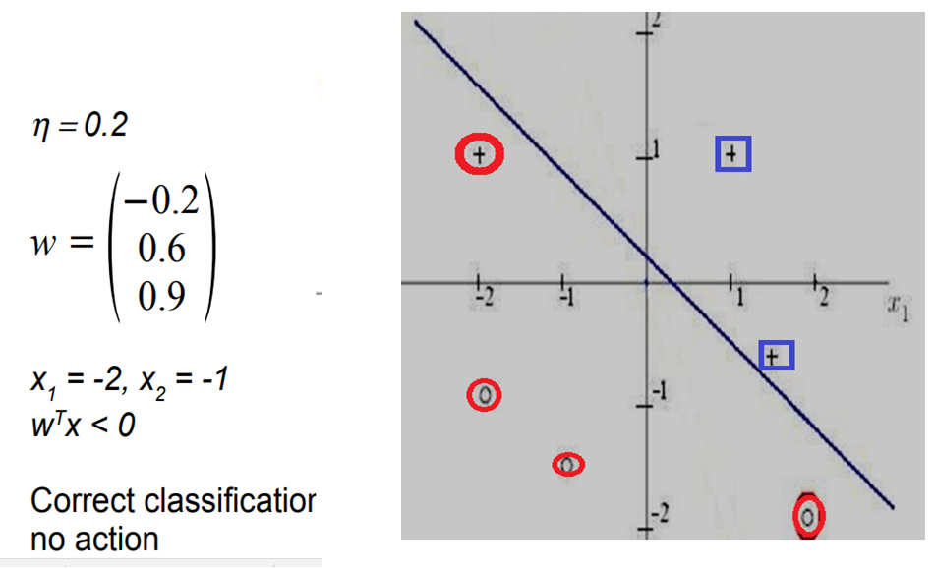
P4(-2,-1)
Output= y= f( -0.2*1+0.6*-2+0.9*-1)=f(-2.3)=0
Output should be “0) CORRECT CLASSIFICATION, so NO change in weights/biases

Slide 25
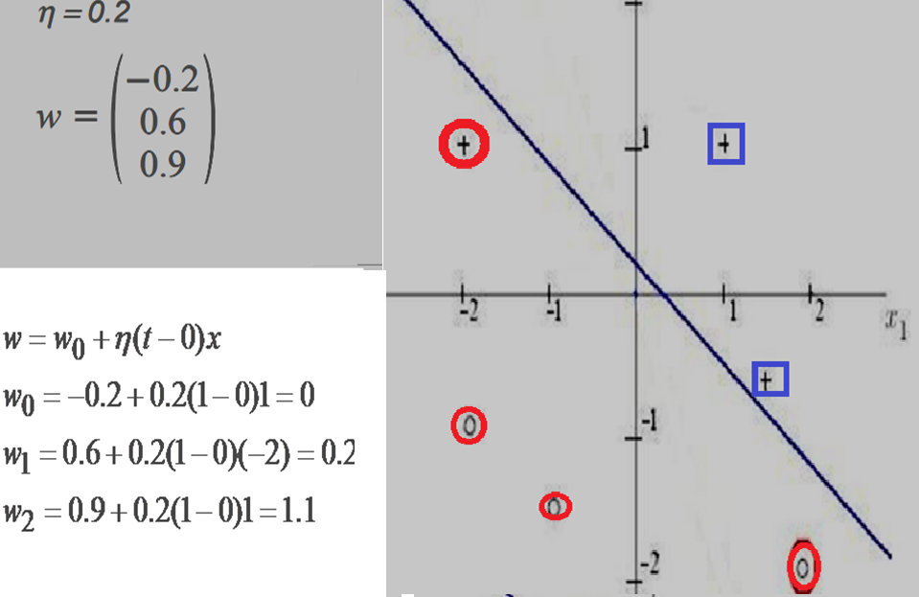
P5(-2,1)
Output: y = f( -0.2*1+0.6*-2+0.9*1) = f(-0.5) = 0
Output should be “1” for”+”) INCORRECT CLASSIFICATION, so change in weights/biases

Slide 26
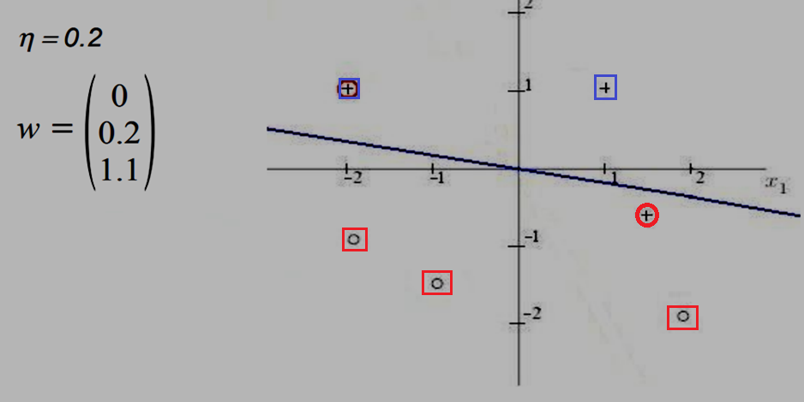

Slide 27
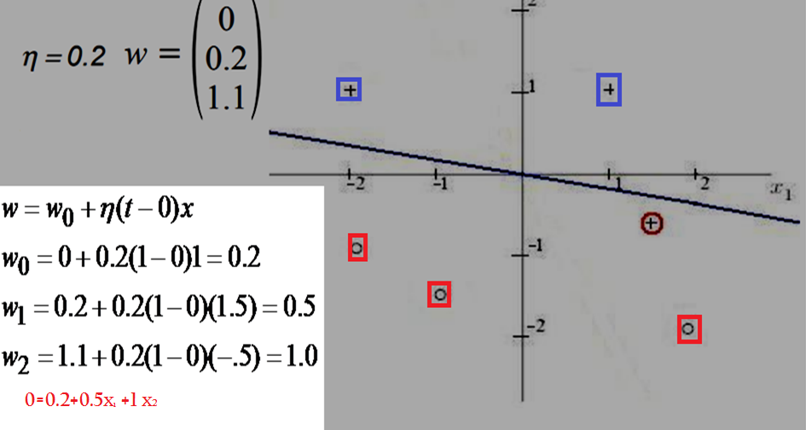
P6(1.5,-.5)
Output: y= f( 0*1+0.2*1.5+1.1*(-.5))=f(-0.2)=0
Output should be “1” for”+”) INCORRECT CLASSIFICATION, so change in weights/biases

Slide 28
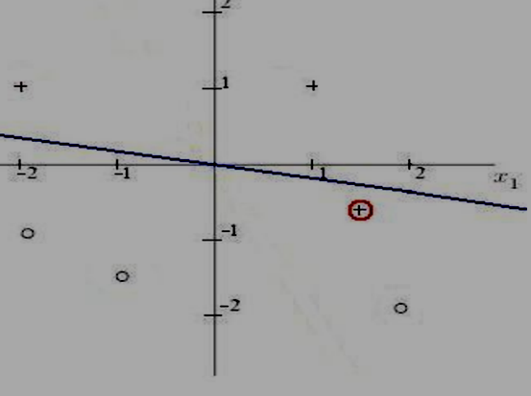
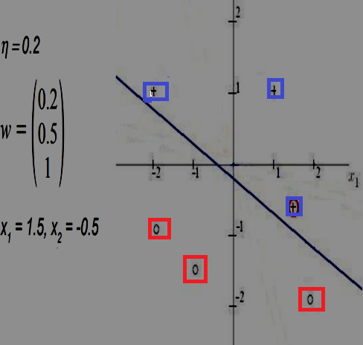
CORRECT CLASSIFICATION AFTER SIXTH POINT IS GIVEN

Slide 29
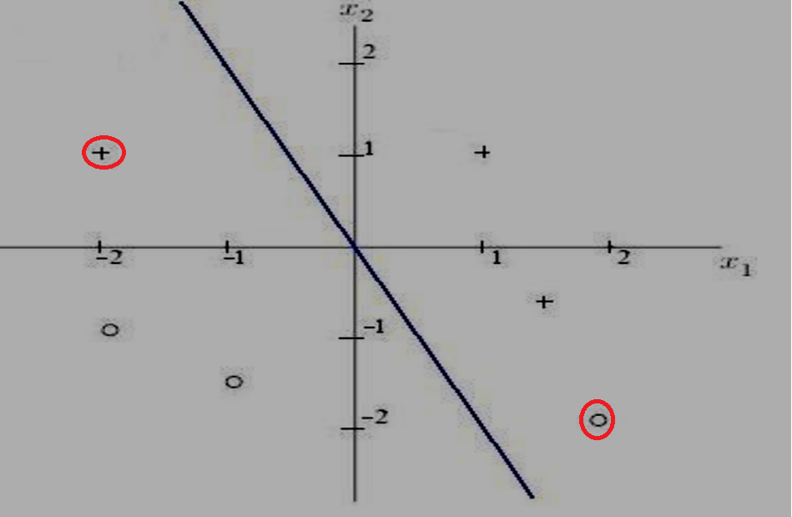

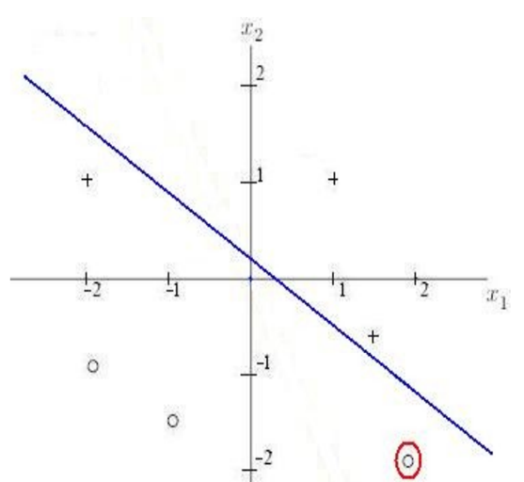
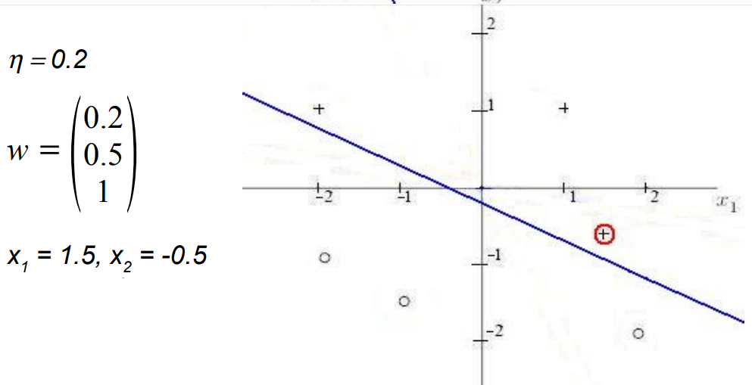
1
2
3
4

Slide 30
Fundamentals of Neural Networks,
by
Laurene Fausett

Slide 31
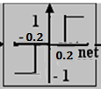
AND GATE
x₁ | x₂ | y
1 | 1 | 1
1 | 0 | -1
0 | 1 | -1
0 | 0 | -1
https://med.nyu.edu/chibi/sites/default/files/chibi/file2.pdf

Slide 32
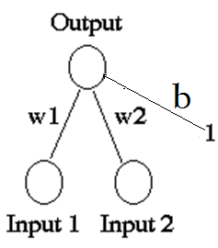
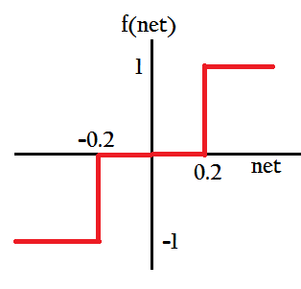
x₁ | x₂ | y
1 | 1 | 1
1 | 0 | -1
0 | 1 | -1
0 | 0 | -1
A Perceptron for the AND function:
Binary inputs ( 0/1)
Bipolar targets ( ±1)
Initial weights and bias equal to 0,
threshold = ±0.2 = θ
Learning rate =1

Slide 33
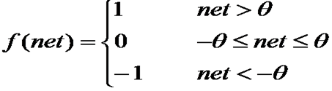

Slide 34
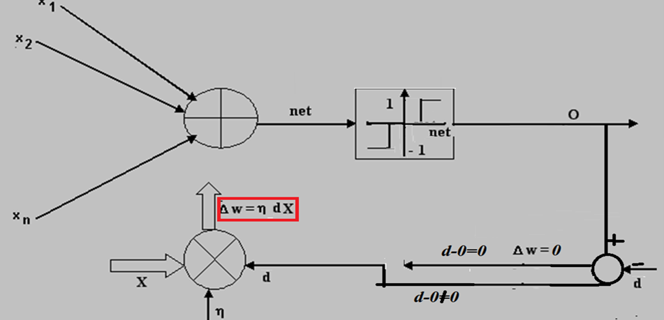

Rule Given
This Perceptron learning rule is simila]
Similar to Hebbian Supervised learning,
In PL, initial weight matrix could be zero or random
In Hebbian learning Initial weight matrix is zero,

Slide 35
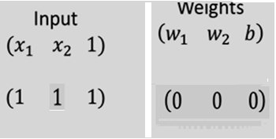
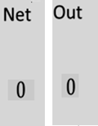
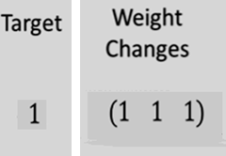
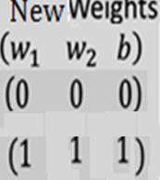
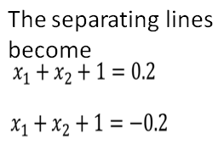
Presenting the first input (1,1)
η=1
Based on new weight (1 1 1) and
input (x₁ ,x₂ ,b ),
output = w₁x₁+ w₂x₂ + b
= x₁+ x₂+ 1
Write and Draw Equations for separating lines

Slide 36
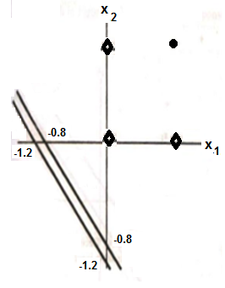

x₁ | x₂ | y &f(net), net =x₁ + x₂ +1
1 | 1 | y=1 f(net)= f(3)=1
1 | 0 | y=-1 f(net) =f(2)=1 not-1
0 | 1 | y=-1 f(net) =f(2)=1 not-1
0 | 0 | y=-1 f(net) =f(1)=1 not-1

Slide 37
Finally, the results for the tenth epoch are:
INPUTS NET OUTPUT TARGET WEIGHT WEIGHTS
CHANGES (2,3,-4)
(1 1 1) | 1 | 1 | 1 | (0 0 0) | (2 3 -4)
(1 0 1) | -2 | -1 | -1 | (0 0 0) | (2 3 -4)
(0 1 1) | -1 | -1 | -1 | (0 0 0) | (2 3 -4)
(0 1 1) | -1 | -1 | -1 | (0 0 0) | (2 3 -4)
Based on new weights (2 ,3, -4) net =2x₁ +3x₂ - 4
Separating line : 2x₁ + 3x₂ -4 = ±0.2
x₁ | x₂ | Y & f(net),net=2x₁ +3x₂ -4
1 | 1 | y=1, f(net)=f(1)=1
1 | 0 | y=-1, f(net)=f( -2)=-1
0 | 1 | y=-1, f(net)=f(-1)=-1
0 | 0 | y=-1, f(net)=f(-4)=-1

Slide 38
Positive response is given by all points such that
2x₁ + 3x₂ - 4 > 0.2
With boundary line
x₂ = -(2/3) x₁ + (7/5)
Negative response is given by all points such that
2x₁ + 3 x₂ – 4 < -.2
With the boundary line
x₂ = - (2/3) x₁ + (19/15)
DRAW

Slide 39
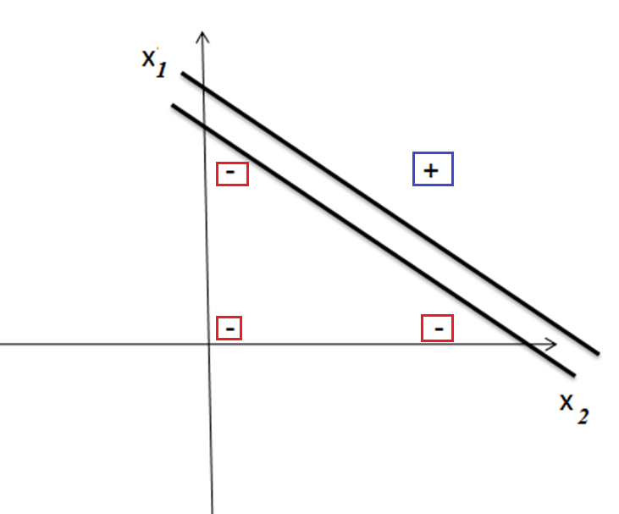

Slide 40

The Delta Rule(DR)
Developed by Widrow and Hoff,
also called Least Mean Square (LMS) method.
Delta rule is a gradient descent learning rule for updating the weights of the inputs to artificial neurons in a SINGLE LAYER NEURAL NETWORK.
It is a special case, a basis for the more general backpropagation algorithm for MLP

Slide 41

EXAMPLE OF DELTA LEARNING EXAMPLE

Slide 42

All 4 weights associated with each input node are initially set to 0,
learning rate (epsilon) = 0.25
Activation function is Linear

Slide 43


Slide 44
Initial weights W⁰ = (0,0,0,0),
Pattern 1 (1, -1, 1, -1) with W⁰ = (0,0,0,0)
net =0, output = f(net) = 0= output, Target = 1
Δw¹ = 0.25 (1-0)X = 0.25X, X= 1, -1, 1, -1,
Δw¹ = 0.25, -0.25, 0.25, -0.25
W¹ = W⁰ [0,0,0,0] +
Δw¹ [0.25, -0.25,0.25,-0.25]
W¹= [0.25, -0.25,0.25,-0.25]

Slide 45
For pattern 2 (1, 1, 1, 1),
with W¹ =(0.25, -0.25, 0.25, -0.25)
net = 0.25x1 - 0.25x1 + 0.25x1 - 0.25x1 = 0 = f(net)=output, target=1
Δw² = 0.25(1-0)X =0.25X, X= 1, 1, 1, 1
Δw² = 0.25, 0.25, 0.25, 0.25
W²= W¹[ 0.25,-0.25,0.25,-0.25] +Δw²[0.25,0.25,0.25,0.25]
= [0.5, 0, 0.5, 0]

Slide 46
For pattern 3 (1, 1, 1, -1),
with W² =(0.5, 0, 0.5, 0)
net = 0.5x1+ 0x1 + 0.5x1 + 0x(-1) = 1 = f(net)=output
target = -1
Δw³ = 0.25(-1-1)X = -0.5X, X= 1, 1, 1, -1
Δw³ = -0.5,-0.5, -0.5, 0.5
W³ = W² +Δw³ = [0, -0.5, 0,0.5]

Slide 47
For pattern 4 (1, -1, -1, 1),
with W³ =(0, -0.5, 0, 0.5)
net = 0x1 -0.5x(-1) + 0x(-1) + 0.5x(1) = 1= f(net)=output target = -1
Δw⁴ = 0.25(-1-1)X= -0.5X , X= 1, -1, -1, 1
Δw⁴ = -0.5,0.5,0.5, -0.5
W⁴ = W³ +Δw⁴ = [ -0.5, 0,0.5,0]
At the end of this training ii.e. after one Epoch[ defined as an important period in history or an era] Epoch comes to us, via Medieval Latin, from Greek epochē, meaning "cessation" or "fixed point.".
the total sum of squared errors after one epoch =
1² + 1² + (-2)² + (-2)² = 10, will keep on changing weights till E<ε

