Slide 1
Coloring Black and White Image
CSCI 8955: Advance Data Analytics
Project Update
Chirag Jain
Pranay Reddy Armoor
Vamsi Nadella

Slide 2
Problem Description:
We present a convolutional-neural-network-based system that faithfully colorizes black and white photographic images without direct human assistance.
Data:
Training data - Colored images
Testing data - Colored images
Data Sets:
https://groups.csail.mit.edu/vision/SUN/hierarchy.html
http://lear.inrialpes.fr/~jegou/data.php

Slide 3
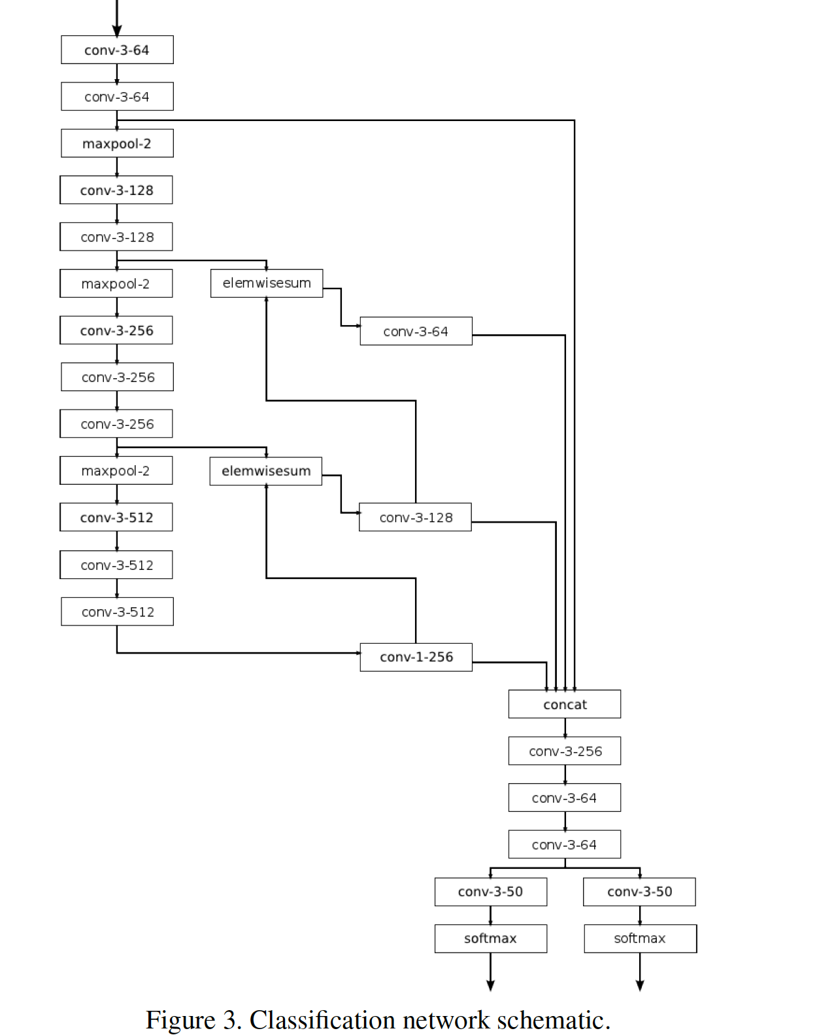
Model: -Convolutional Neural network

Slide 4
Training
Reads images of pixel dimension 224 224 and 3 channels corresponding to red, green, and blue in the RGB color space.
The images are converted to CIELUV color space.
The black and white luminance L channel is fed to the model as input. The U and V channels are extracted as the target values.

Slide 5
Testing
The model accepts a 2242241 black and white image.
It generates two arrays, each of dimension 224 224 1 , corresponding to the U and V channels of the CIELUV color space.
The three channels are then concatenated together to form the CIELUV representation of the predicted image.

Slide 6
References:
https://blog.floydhub.com/colorizing-b&w-photos-with-neural-networks/
http://richzhang.github.io/colorization/
http://tinyclouds.org/colorize/

