Slide 1
PRAGMATIC ANALYSIS OF OBJECT CLASSIFICATION USING CNN
By: Chirag Sharma
Reg.no: 18MCA1009
Guide: Prof. Bharathi Raja S

Slide 2
ABSTRACT
Deep learning refers to a sub-field of Machine Learning i.e., based on learning level of representations, corresponding to a hierarchy of features, factors, concept where higher level of concepts are defined from lower level ones and vice-versa. The network is trained to look for different features, such as edges, corners and color differences, across the image and to combine these into more complex shapes. In this research we will study about how the convolutional neural network (CNN) works, different layers of convolutional neural network and how classification is done in convolutional neural network. We will use this knowledge to create image processing model that can be used in wide varieties of images.

Slide 3
WORKING PRINCIPLE OF CNN
In CNN every image is represented in the form of pixel values and it compare images piece by piece.
CNN is generally use to analyze visual image by processing data with grid like topology. A CNN is also known as conNet.
There are basically three layers in neural network that is:-INPUT LAYER, HIDDEN LAYER and OUTPUT LAYER.
Convolutional Neural Network works on different layers that is:- INPUT LAYER, CONVOLUTION LAYER, ReLu LAYER, POOLING LAYER, FULLY CONNECTED LAYER, OUTPUT LAYER.

Slide 4
In CNN if any of the layer from this fails to perform their task then the process will never be executed.

Slide 5
Different layers of CNN
CNN have following layers: 1.) Input layer 2.) Convolution layer 3.) Pooling layer 4.) Fully Connected layer 5.) Output layer

Slide 6
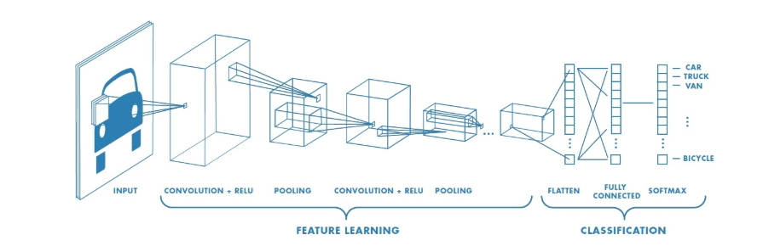
Layers of CNN

Slide 7
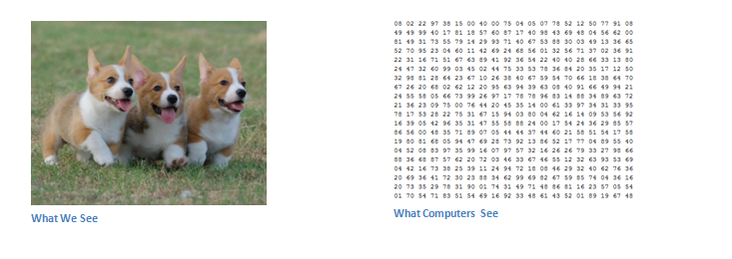
INPUT OUTPUT IMAGE

Slide 8
WHAT WE WANT THE COMPUTER TO DO
CNN would take an image.
Pass that through a series of convolutional, pooling and fully connected layer and get the output.
The output can be a single class or probability of classes that best describes the image.

Slide 9
CNN architecture

Slide 10
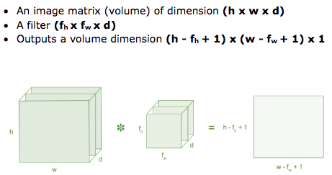
CONVOLUTIONAL LAYER
Convolutional is the first layer to extract features from an input image.
Convolutional preserves the relationship between pixel by learning image, features using small squares of input image.
It is the mathematical operation that takes two inputs such as image matrix and a filter or kernel.

Slide 11
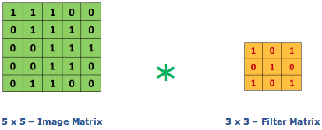
Consider a 5 x 5 whose image pixel values are 0, 1 and filter matrix 3 x 3 as shown in below
Then the convolution of 5 x 5 image matrix multiplies with 3 x 3 filter matrix which is called “Feature Map”

Slide 12
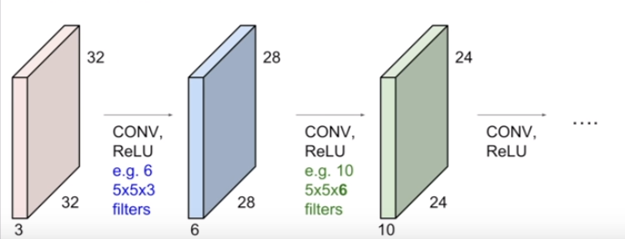
We can have multiple filter. This also move over the given input image of 32*32*3.
Second input filter of 5*5*3 will produce second slice.
If we have 6, 5*5 filters, we’ll get 6 separate activation maps.
We stack them up to get a new image of new size.
preview: convnet is a sequence of convolutional layer, inter spread with activation function.

Slide 13
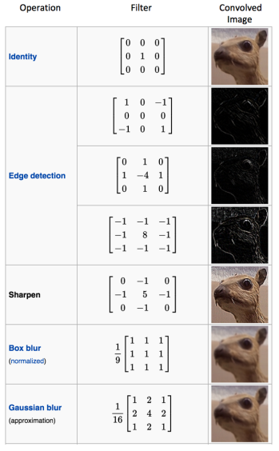
Some coman filters

Slide 14
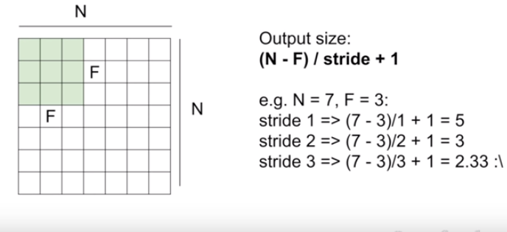

Slide 15
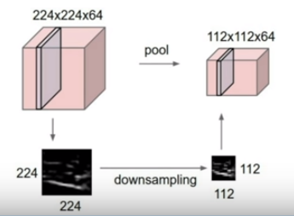
Pooling layer
Makes the representation smaller and more manageable.
Operate over each activation map independently.

Slide 16
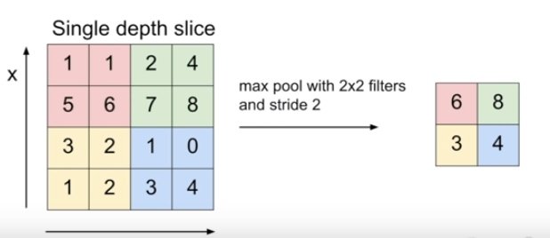
Max pooling
Single depth slice
Select the maximium value from each block to make the final result.
In pooling we need not to overlapping.

Slide 17
CLASSIFIER

Slide 18
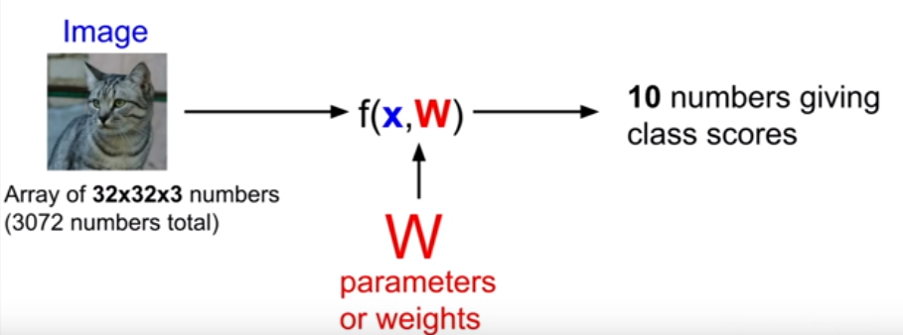
Parametric approach : Linear Classifier
Here x is the input image, w is the parameter.

Slide 19
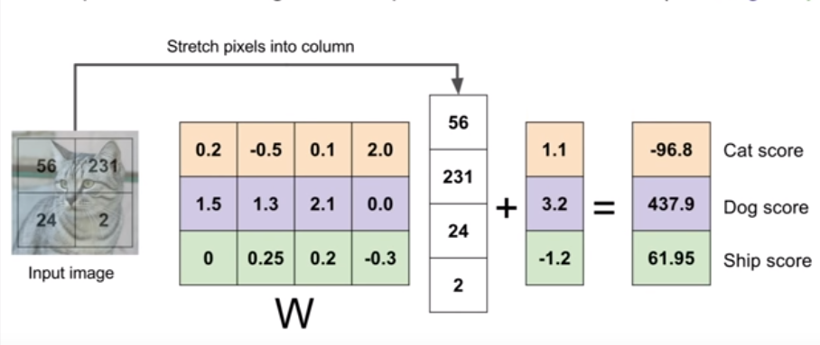
In test time we do not need the actual training data, we only need the parameter W. F(x,W)=Wx + b
Here b is the biased data.

Slide 20
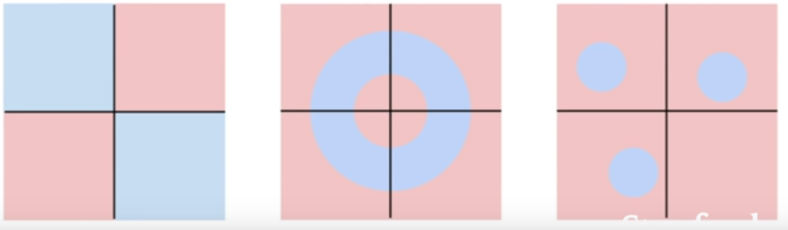
Three cases where linear classifier fails.
This is the case where it is practically not possible to draw a single line to classify the image into two different partition.
Loss function
Optimization

Slide 21

Loss function
To find better W for classification.
A loss function tells hoe good the current classifier is.
L=1/N $\sum_{k}{}F\left(xi,W\right),yi$

Slide 22

MULTI-CLASS SVM LOSS
It “wants” the correct class for each image to a have a score higher than the incorrect classes.
The SVM “wants” a certain outcome in the sense that the outcome would yield a lower loss.
.
Here ∆ is some fixed margin.

Slide 23

.
The minimum loss can be 0, and the maximum loss will be infinite.
Let us take one example:
Suppose that we have three classes that receive the scores s=[13,−7,11], and that the first class is the true class . Also assume that Δ is 10
=(-10+8)
= -2 =>0

Slide 24
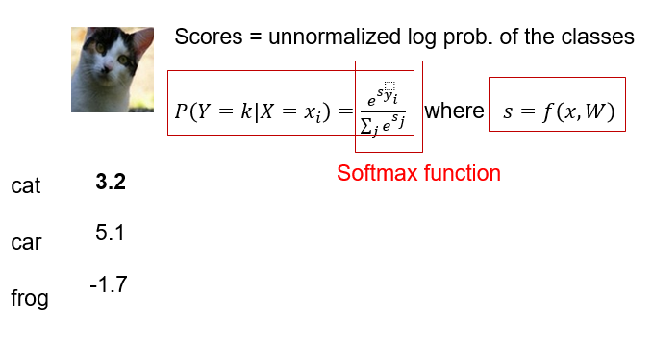
SOFTMAX CLASSIFIER(Multinomial Logistic Regression)

Slide 25
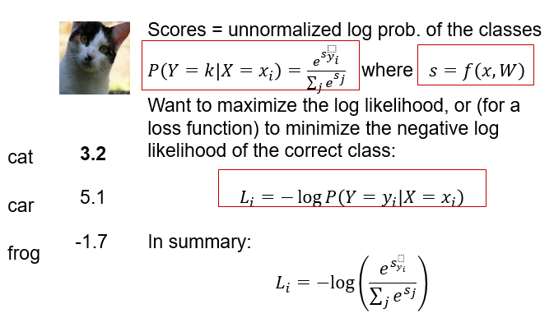

Slide 26
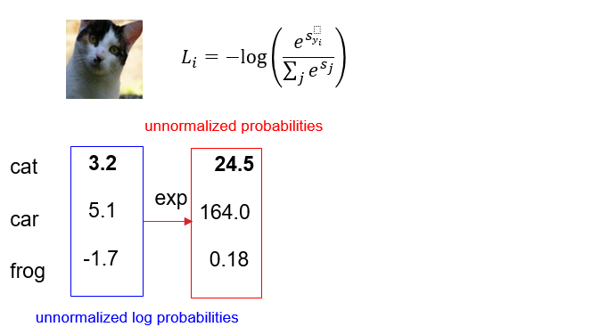

Slide 27
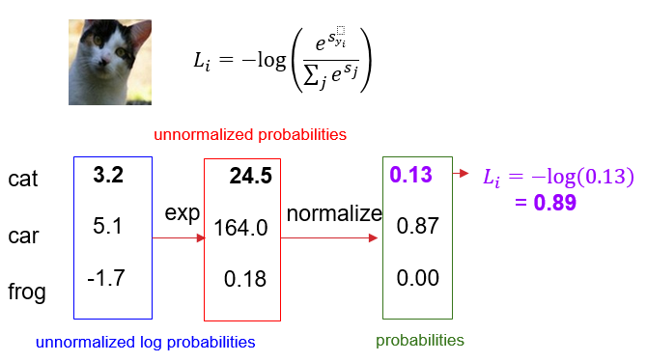

Slide 28
OUTPUT OF IMAGE LOADING FROM THE OUTSIDE DATASET AND PASSING IT TO THE CNN LAYERS

Slide 29
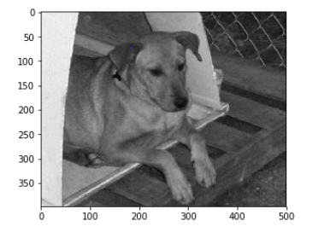

Slide 30
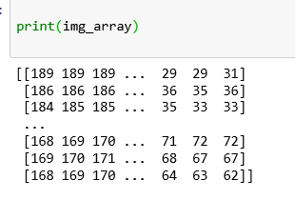

Slide 31

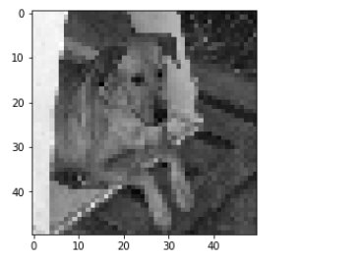

Slide 32
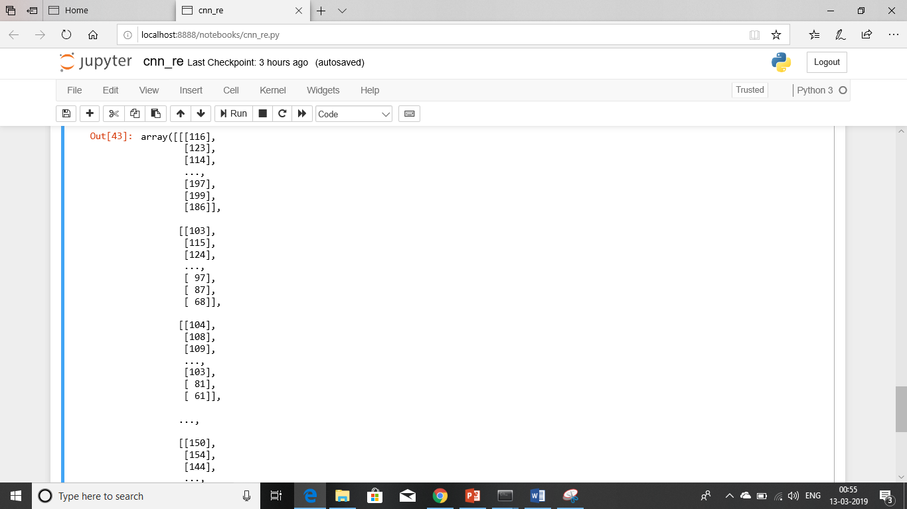

Slide 33
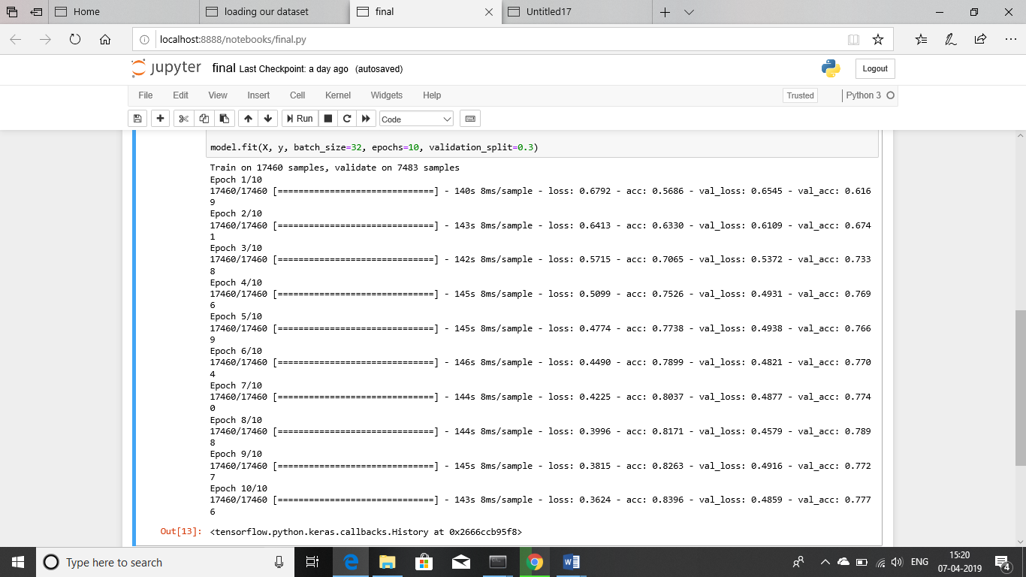

Slide 34
Plan of action till next review
In the next review we will understand the more existing algorithm for classification.
We will try to implement the algorithm and see the error and faults.
We will put the loaded image in the CNN layers.

Slide 35
References
Convolutional neural networks for document image classiﬁcation, Le Kang, Jayant Kumar, Peng Ye, Yi Li, and David Doermann, 2014
Github.io/objectdetection_using CNN
https://in.mathworks.com/solutions/deep-learning/convolutional-neural-network.html
https://in.mathworks.com/help/deeplearning/ug/introduction-to-convolutional-neural-networks.html
https://becominghuman.ai/building-an-image-classifier-using-deep-learning-in-python-totally-from-a-beginners-perspective-be8dbaf22dd8

Slide 36
THANK YOU

