Slide 1
Crown Kitchen
GUIDED BY SUBMITTED BY
DR. PRIYANKA MEHTA CHIRAG SARVAIYA
SAMIR SARVAIYA

Slide 2
INDEX
INTRODUCTION
About Us
Vision & Mission
DATA FLOW DIAGRAM USER PANEL
DATA FLOW DIAGRAM ADMIN PANEL
Task dependency diagram
ER Diagram
HOME PAGE
ABOUT US
MEET OUR TEAM & OUR VALUES
CONTACT US
PAYMENT
PAYMENT CONFFORMD
OUR MENU
RESERVATION PAGE
REGISTER PAGE
LOGIN PAGE
PROFILE
ADMIN LOGIN PAGE
ADMIN DASHBROD
Location & Hours
Contact & Follow Us

Slide 3
INTRODUCTION
Crown Kitchen
Authentic Italian dining • Since 2017
Welcome to , The Crown Kitchen a modern dining destination blending classic recipes with innovative to create a memorable culinary experience. With a focus on fresh, locally sourced ingredients, our restaurant strives to deliver exceptional service in a welcoming atmosphere. At The Restaurant, guests can enjoy diverse menu options ranging from authentic regional dishes to international , each prepared with attention to detail and passion for great food.

Slide 4
About Us
At our restaurant, we believe that great food brings people together. Our mission is to create memorable dining experiences through exceptional cuisine, outstanding service, and a welcoming atmosphere. We're committed to using fresh, locally-sourced ingredients to craft dishes that delight our guests and celebrate the rich flavors of our region.

Slide 5
Vision & Mission
Vision : Our vision is to produce and sell locally sourced food and drink that are so delicious and satisfying that every customer who leaves our store wants to return
Mission: Serve fresh, honest food in a welcoming atmosphere. And Our mission is to make customers happy by sharing our family's authentic different recipes with the world

Slide 6
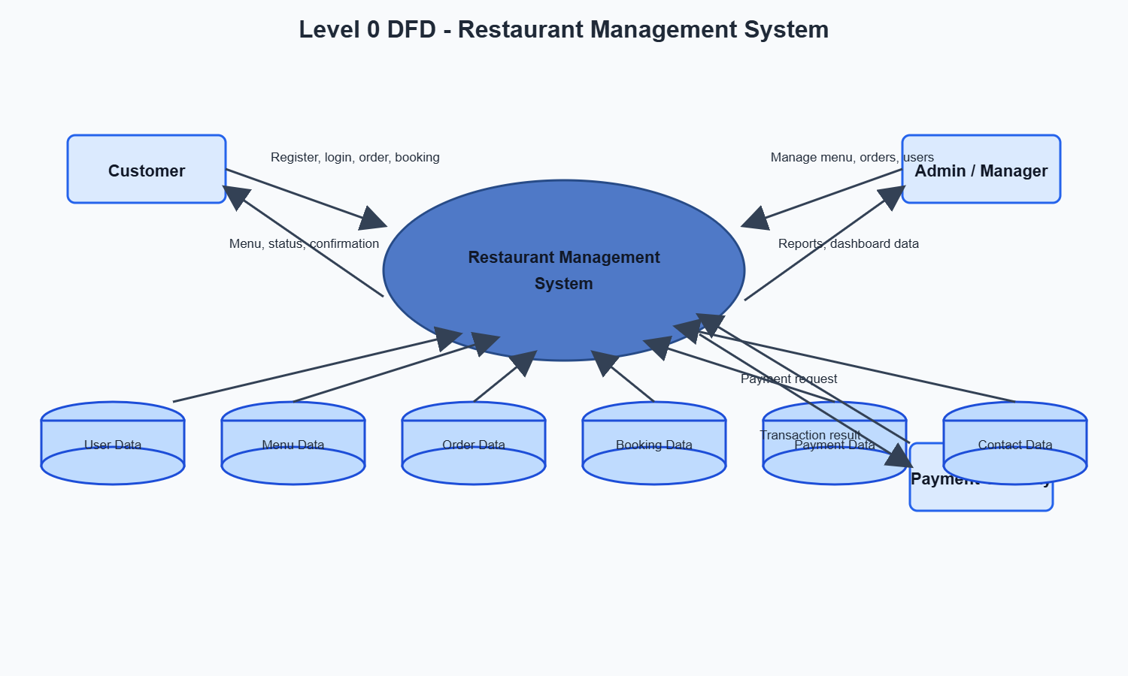
DATA FLOW DIAGRAM USER PANEL

Slide 7
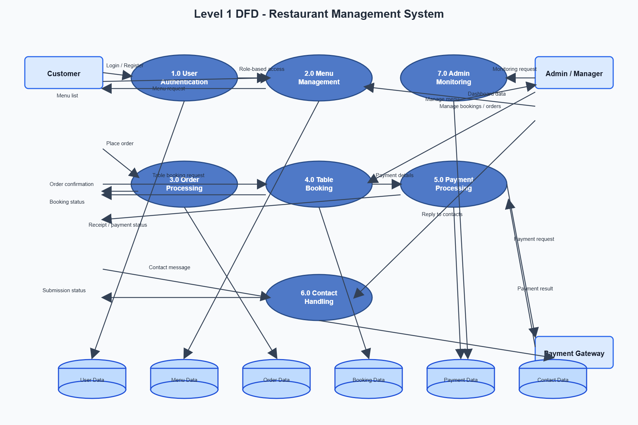
DATA FLOW DIAGRAM ADMIN PANEL

Slide 8
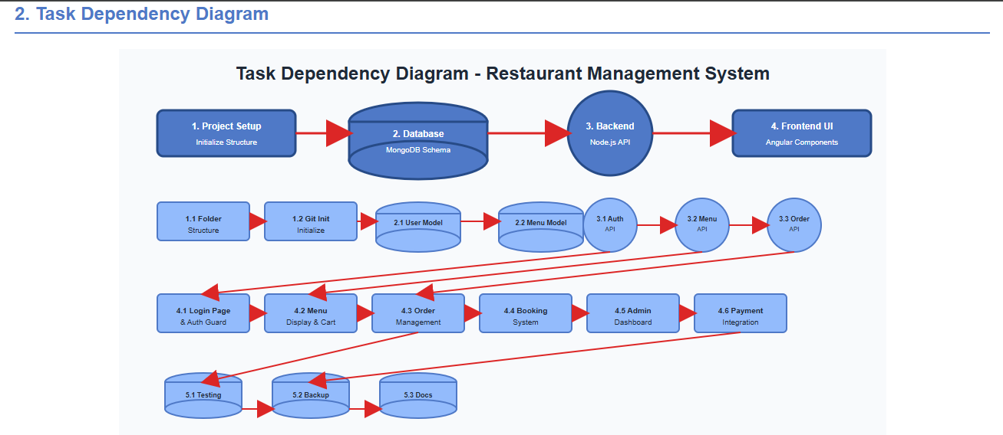
Task dependency diagram

Slide 9
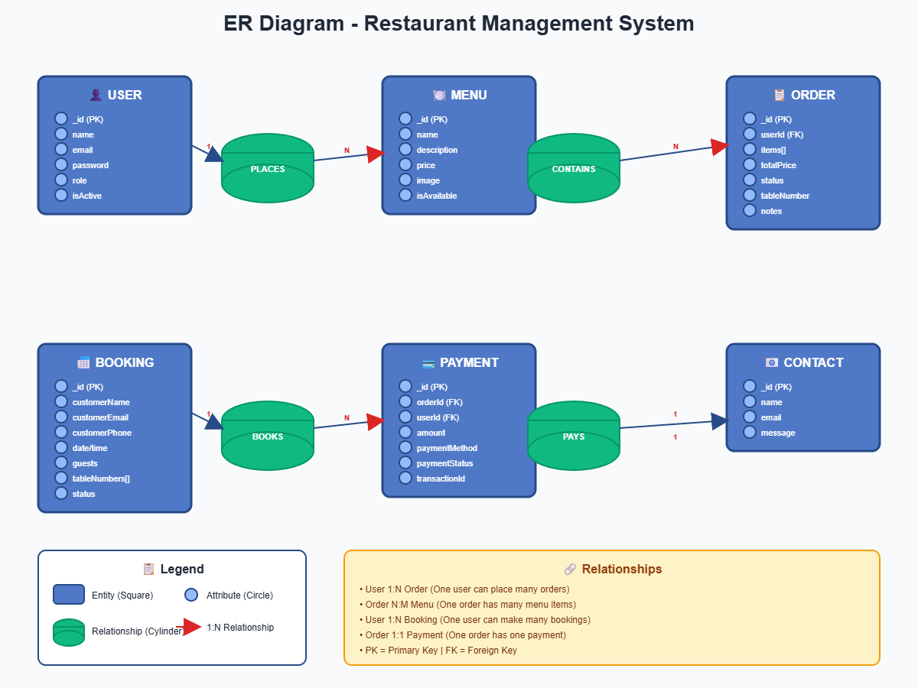
ER Diagram

Slide 10
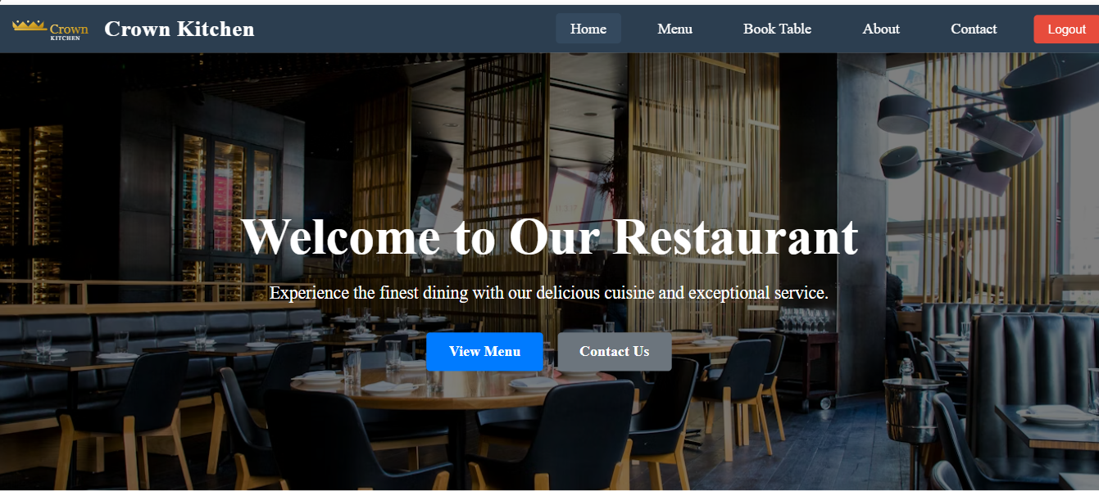
HOME PAGE

Slide 11
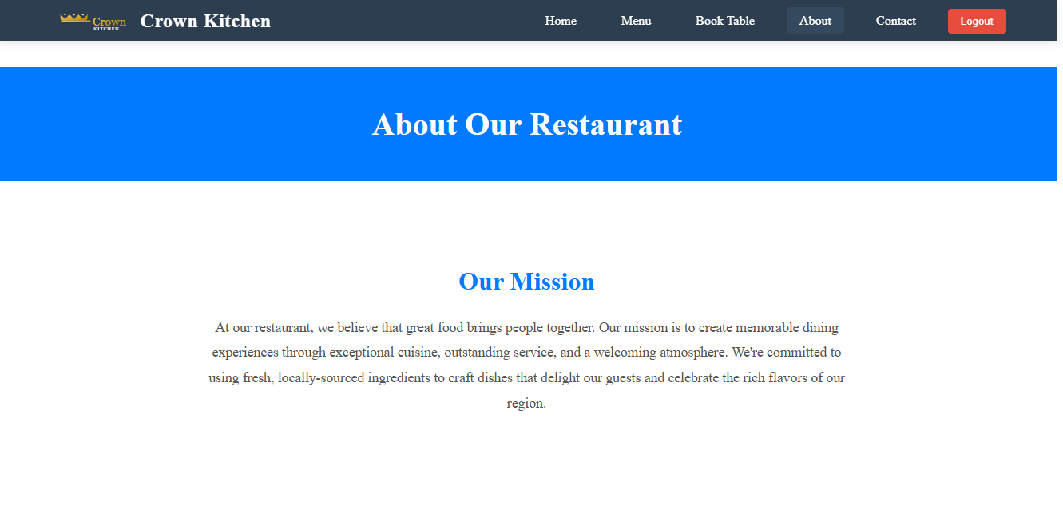
ABOUT US

Slide 12
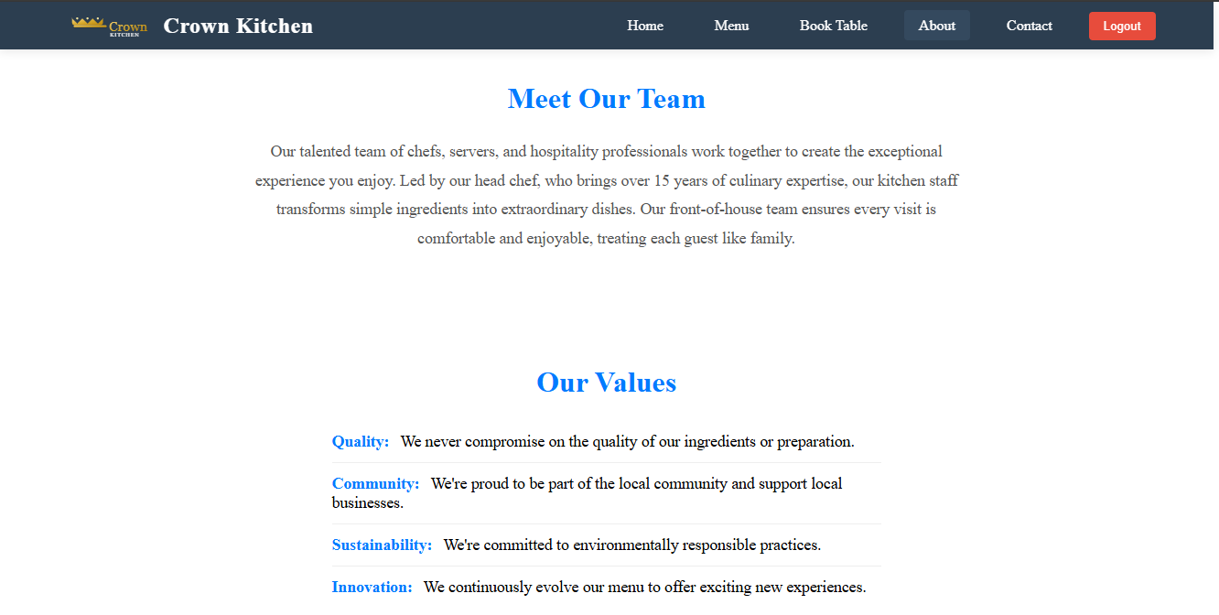
MEET OUR TEAM & OUR VALUES m

Slide 13
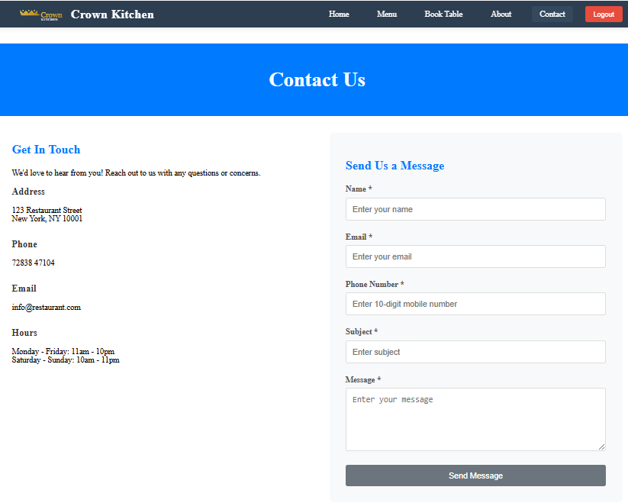
CONTACT US

Slide 14
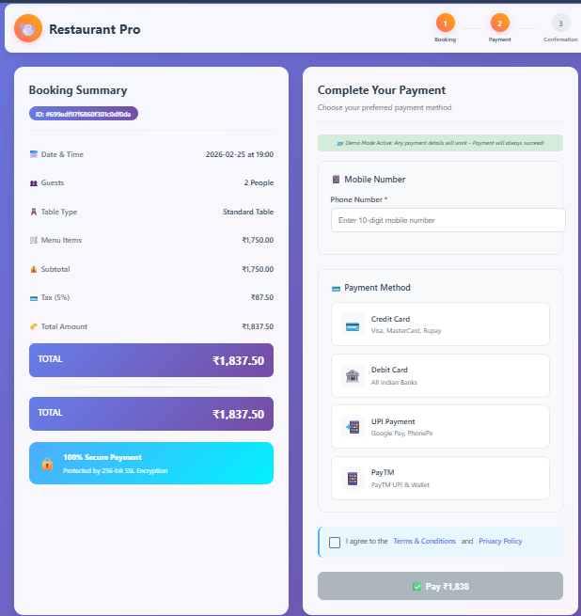
PAYMENT

Slide 15
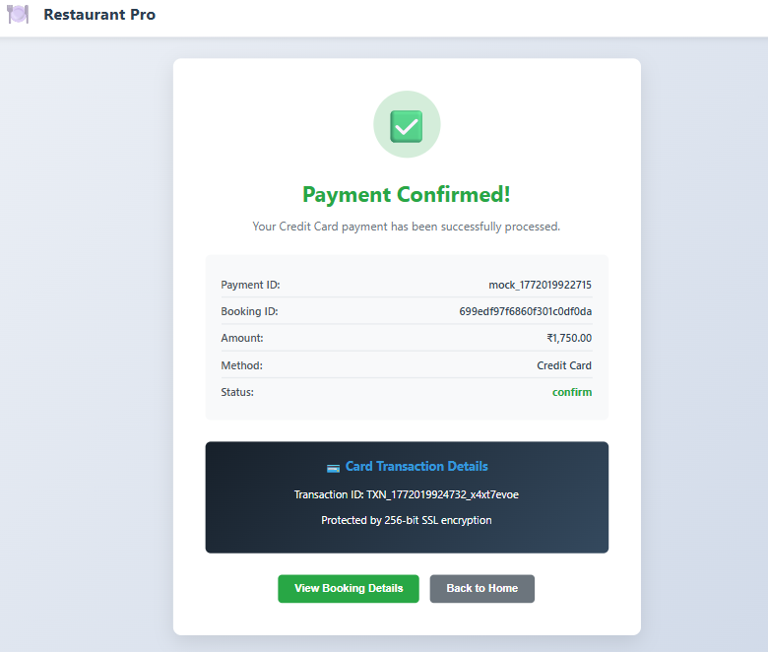
PAYMENT CONFFORMD

Slide 16
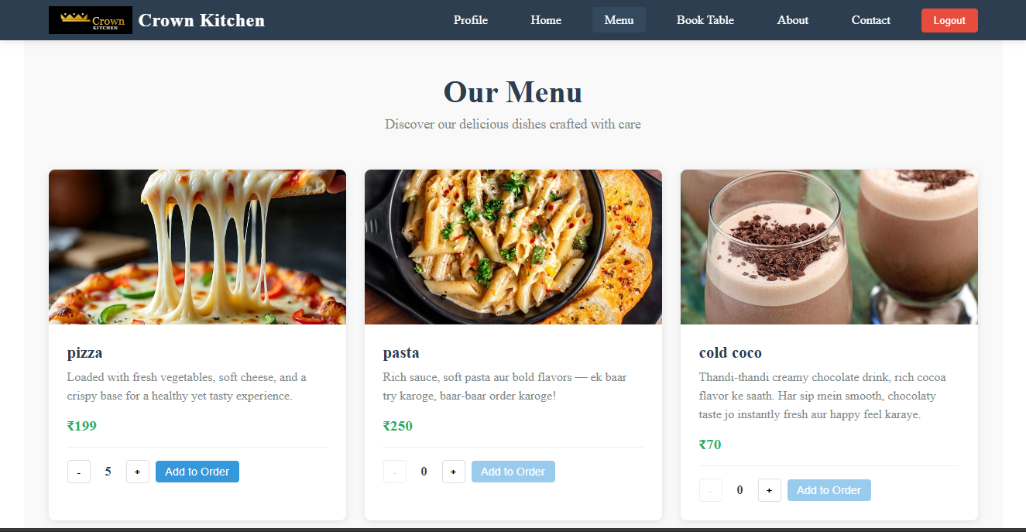
OUR MENU

Slide 17
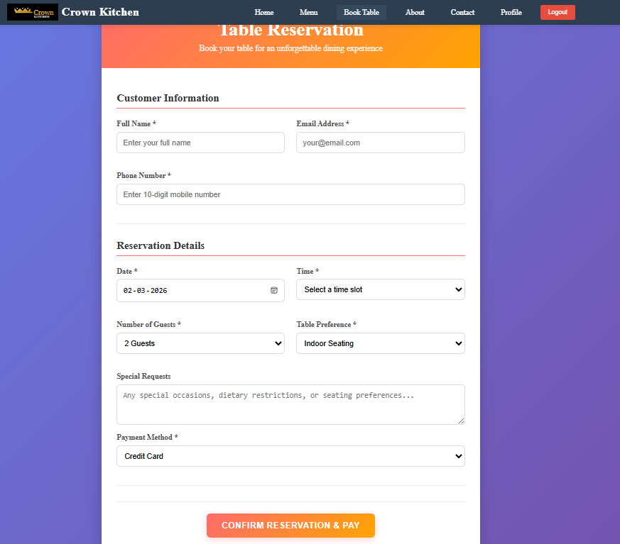
RESERVATION PAGE

Slide 18
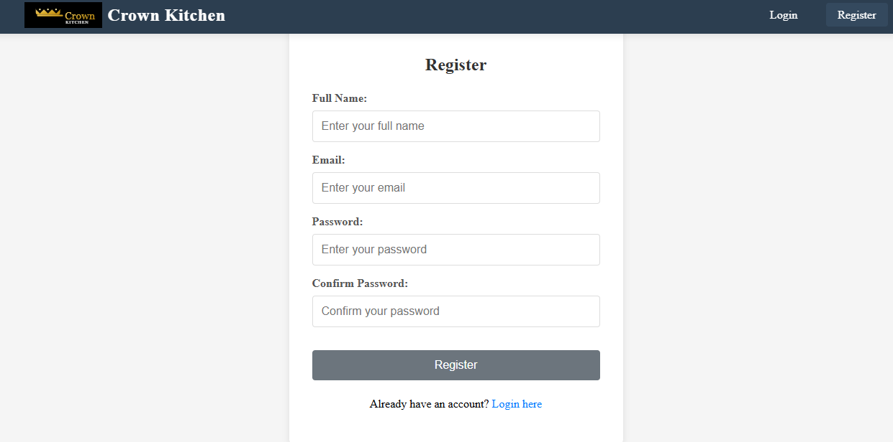
REGISTER PAGE

Slide 19
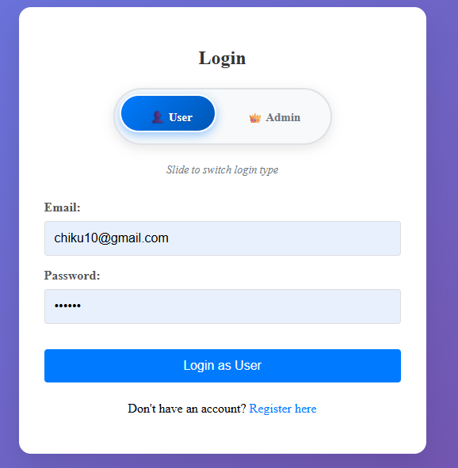
LOGIN PAGE

Slide 20
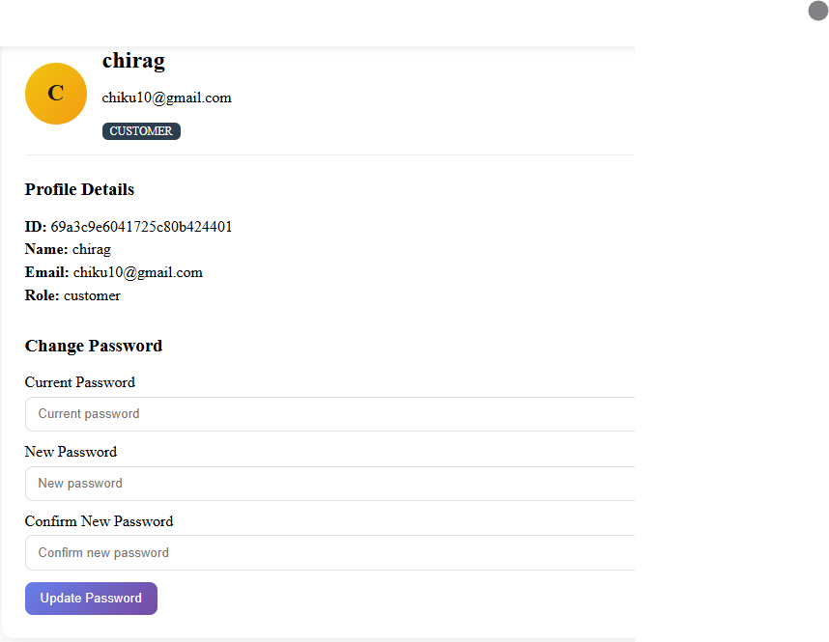
PROFILE

Slide 21
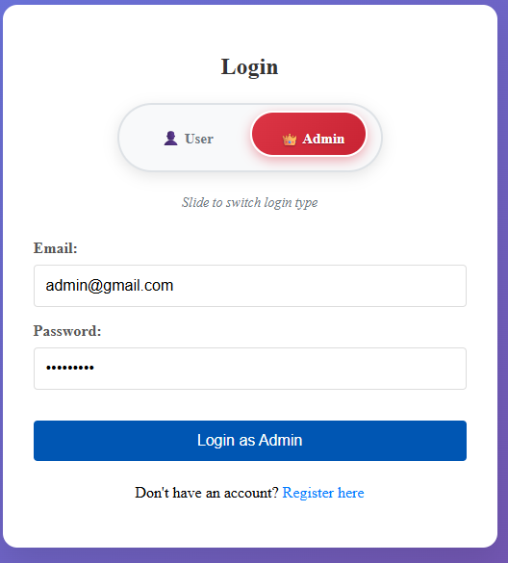
ADMIN LOGIN PAGE

Slide 22
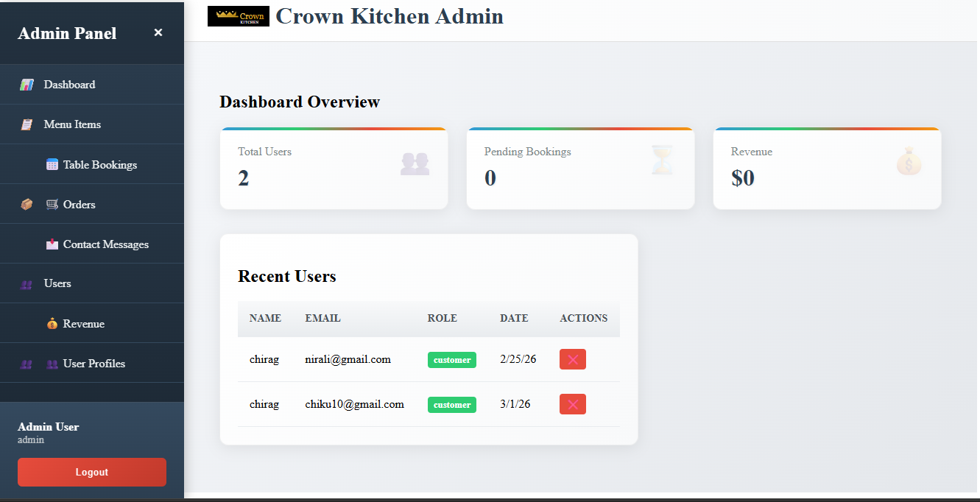
ADMIN DASHBROD

Slide 23
Location & Hours
Location :123 restaurant Street New York, NY 10001.
Time : Monday - Friday 11:00AM to 10:00PM.
Saturday - Sunday 10:00AM to 11:00PM.

Slide 24
Contact & Follow Us
Phone: 7283847104
6359523759
Email: crownkitchen@yhoo.com
Instagram: @ crown_kitchen
Facebook : crown_kitchen

Slide 25
THENK YOU

