Slide 1

Project Seminar on
Machine Learning based Antenna
Design Selection
in partial fulfillment of
VII Semester Bachelor of Engineering (B.E.)
in
Electronics Engineering
PROJECT PHASE- I (ENP 455)
CHIRAG DAVE B-05
BHAVESH MODANI B-13
AAYUSH VISHWAKARMA B- 25
OMKAR MARKANDEY B- 61
Guided by
Dr.(Mrs.) A.A Khurshid
Department of Electronics Engineering
Shri Ramdeobaba College of Engineering and Management,
Ramdeo Tekadi, Gittikhadan, Katol Road, Nagpur 440013, India.
Session 2021-22

Slide 2
Table of Contents
1. Introduction
2. Literature Review
3. Motivation
4. Objective
5. Methodology
6. Working Principle
7. Software/Hardware Implementation
8. Discussion on Results
9. Conclusion
10. Future Scope
11. References

Slide 3
Introduction
Antenna design is a key component in communication systems, requiring optimization of various parameters such as gain and return loss. Traditional methods are time-consuming and rely heavily on expert knowledge.
This project aims to leverage machine learning models to predict antenna performance metrics, thus reducing the reliance on manual simulations.

Slide 4
Literature Review
S.N | Type of Robot | Nature of Work | Key points | Author | Journal
1. | Eye Bolt Shape Slotted Microstrip Patch Antenna | Design and Prediction | XGBoost for return loss prediction, 5.5 dB gain, 87% efficiency" | J. M. Joshiba and D. Judson | Sadhana (2024)
2. | Various Antenna Types | Review | Deterministic, stochastic, and surrogate models for optimization | N. S. Kumar and U. D. Yalavarthi | ICACSE Journal of Physics: Conference Series (2021)
3. | Yagi-Uda Antenna for N77 5G Band | Prediction | Random Forest Regression, 3.3–4.2 GHz bandwidth, 7.95 dB gain | M. A. Haque, M. A. Rahman, S. S. Al-Bawri | Physica Scripta(2024)
4. | Quasi-Yagi-Uda Antennas for 5G n78 Band | Design and Optimization | Gaussian Process Regression for gain prediction and optimization | J. L. Pérez et al | IEEE Access(2023)

Slide 5
5. | Antennas for Biomedical and Sub-6GHz Applications | Optimization | Bayesian Linear Regression for resonant frequency and gain prediction | P. Smith, J. Kim, and A. B. Rogers | IEEE Transactions on Antennas and Propagation (2023)
6. | Microstrip Antenna | Dimension Prediction | Auto-Metric Graph Neural Network with Sheep Flock Optimization | Prabhakar, D., Karunakar, P., Rao, S. V. R., & Srinivas, K. | Intelligent Systems with Applications (2021)
7. | Smart Antenna | ML for interference rejection, spectrum efficiency, and signal processing | Deterministic, stochastic, and surrogate models for optimization | M. Sadiq, N. B. Sulaiman, M. M. Isa, and M. N. Hamidon | Heliyon (2022)
8. | Antenna Design and Radar Signal Processing | Review | Deep learning for design optimization and radar target classification | Y. Kim | IEICE ISAP Archives (2018)
9. | Compact Microstrip Antenna | Modeling | Gaussian Process Regression for resonant frequency prediction | Sharma, K., & Pandey, G. P. | International Journal of Electronics and Communications(2021)

Slide 6
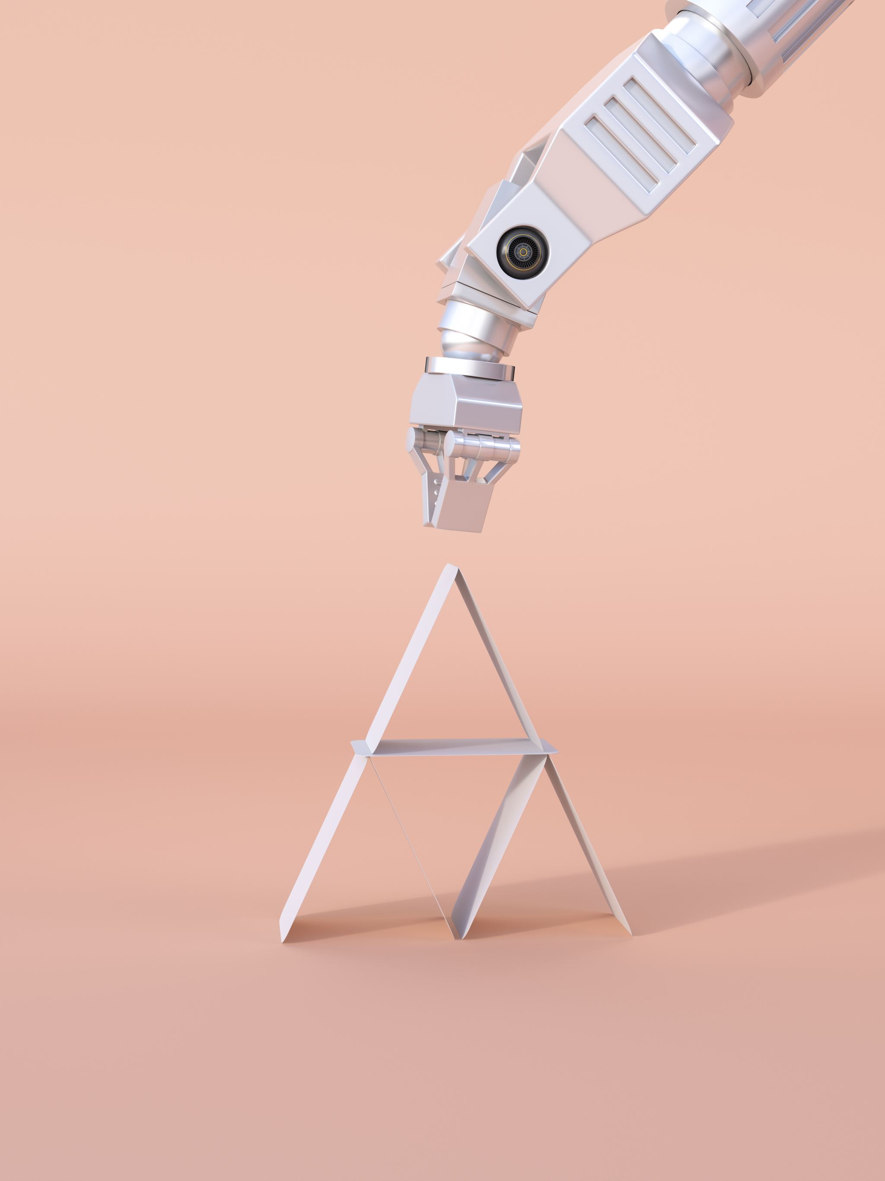
Motivation
Traditional antenna design is time-consuming, resource-intensive, and reliant on expert knowledge.
This project aims to streamline the process of predicting antenna design parameters by using machine learning models trained on frequency and S11 (return loss) data.
By automating optimization, the project seeks to reduce design time and cost while improving accuracy, offering a faster and more efficient approach to antenna development.

Slide 7
Objective
1.Design a rectangular patch antenna optimized to achieve maximum gain, broad bandwidth, and minimal return loss.
2.Develop machine learning models to predict antenna design parameters based on inputs such as frequency and S11 (return loss).
3. Evaluate and select the most accurate model for optimizing antenna design parameters.

Slide 8
Methodology
1. Data Collection: Generate antenna design data using HFSS software.
2. Data Preprocessing: Normalize, scale, and split the data.
3. Model Training: Evaluate models such as Random Forest regressor, Xgboost, and Support Vector Machines.
4. Model Deployment: Use trained models to predict antenna performance for new designs.

Slide 9
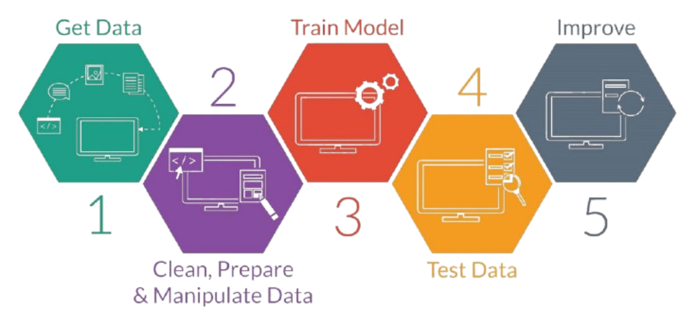
Working Principle
Data Collection:
A dataset is created from multiple antenna designs, capturing performance metrics like length of patch, width of patch, frequency return loss etc.
2. Data Preprocessing:
The dataset is cleaned, normalized, and split into training, validation, and test sets.
3. Model Selection and Training:
Various machine learning models are trained to predict performance metrics based on the design parameters.
4. Optimization and Prediction:
The trained models predict the performance and parameters of new antenna designs, offering optimizations for key metrics like return loss.

Slide 10
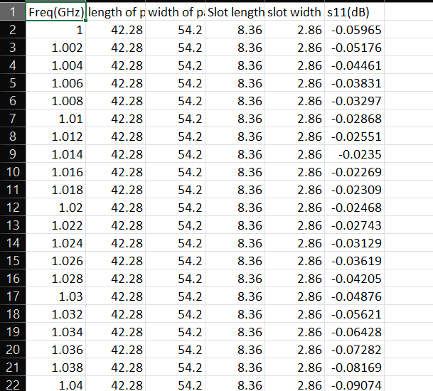
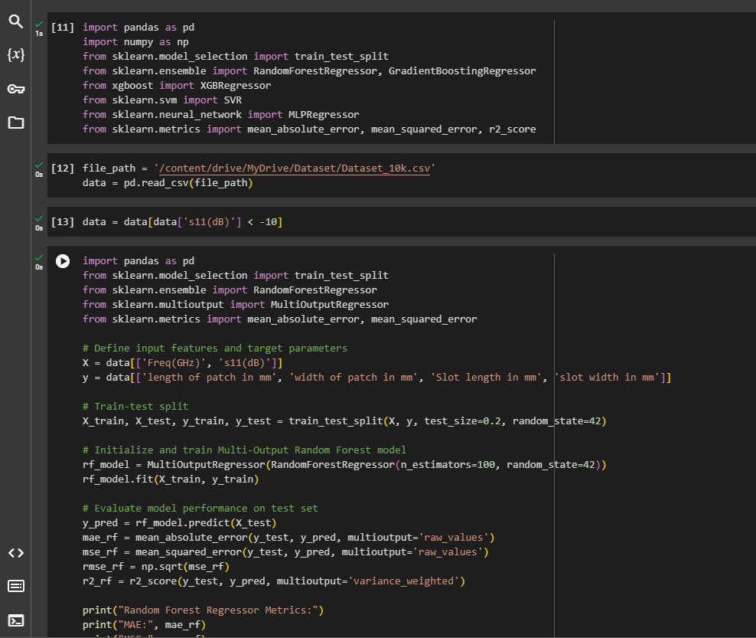
Software Implementation
1. Dataset:
The dataset was filtered to include samples with
S11 values less than -10 dB, focusing on high-performance
antenna designs.
Key Parameters: Frequency(1-3GHz), patch dimensions (length
and width), slot dimensions and S11 (Return Loss).
Total Samples: Approximately 10,000 samples.
2. Algorithms Used:
Random Forest Regressor: Employed for multi-output
regression, effective for predicting multiple design
Parameters simultaneously.
XGBoost: Used to enhance predictive performance,
capturing complex relationships between frequency
and design dimensions.

Slide 11
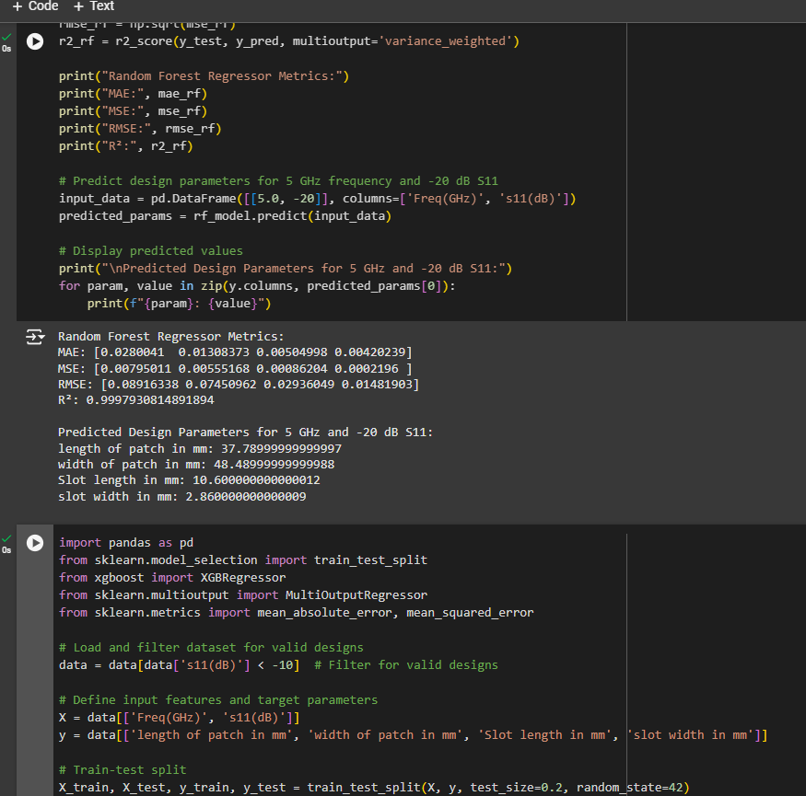
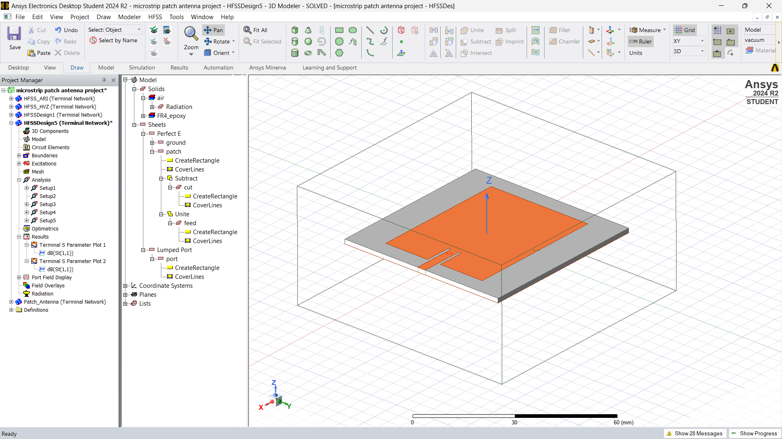
Support Vector Machines (SVM): Utilized to validate
predictions and serve as a comparative model.
MLP Regressor (Neural Network): Applied for deep
learning-based predictions, providing an advanced
approach for complex patterns in the dataset.
Prediction Example: Predicted Design Parameters for 5
GHz Frequency and -20 dB S11.
3. HFSS Testing:
Purpose: Validate the predicted design parameters
through simulation.
Testing S11 at 5 GHz:
Parameter Input: Entered the predicted parameters
(length, width, slot dimensions) into HFSS.
Frequency Sweep: Ran a frequency sweep,
centering around 5 GHz.
S11 Analysis: Assessed the S11 plot at 5 GHz to confirm
return loss within the desired range.

Slide 12
Discussion on results:
Comparison of Algorithms:
The Error Metrics were calculated for each design parameter i.e. Length of Patch, Width of Patch, Slot Length, Sloth Width.
Based on Error Metrics such as Mean Absolute Error(MAE), Mean Squared Error, Root Mean Squared Error(RMSE), Coefficient of determination(R^{2).}
Best Results came out for Random Forest regressor using which the design parameters were predicted further.
Machine Learning Algorithms Used | MAE | MSE | RMSE | R²
1. Random Forest Regressor | [0.0280041, 0.01308373, 0.00504998, 0.00420239] | [0.00795011, 0.00555168, 0.00086204, 0.0002196 ] | [0.08916338, 0.07450962, 0.02936049, 0.01481903] | 0.9997930814891894
2. XgBoost | [0.47336509, 0.57463428, 0.22648307, 0.00472059] | [5.52530845e+00 8.82579782e+00 1.37407017e+00 2.71113096e-04] | [2.35059747, 2.97082443, 1.17220739, 0.01646551] | 0.7768778800964355
3. Support Vector Machine | [2.77968274, 3.63106002, 1.31859811, 0.035] | [2.04601460e+01 3.42224728e+01 5.52755682e+00 1.22500000e-03] | [4.5232893, 5.84999768, 2.35107567, 0.035 ] | 0.14568448485423371
4. MLP Regressor | [2.41759892, 4.18092414, 1.54397727, 0.03990916] | [1.30493043e+01 2.58655972e+01 4.50904341e+00 2.62179690e-03] | [3.61238207, 5.08582316, 2.12345083, 0.05120349] | 0.38383779115412636

Slide 13
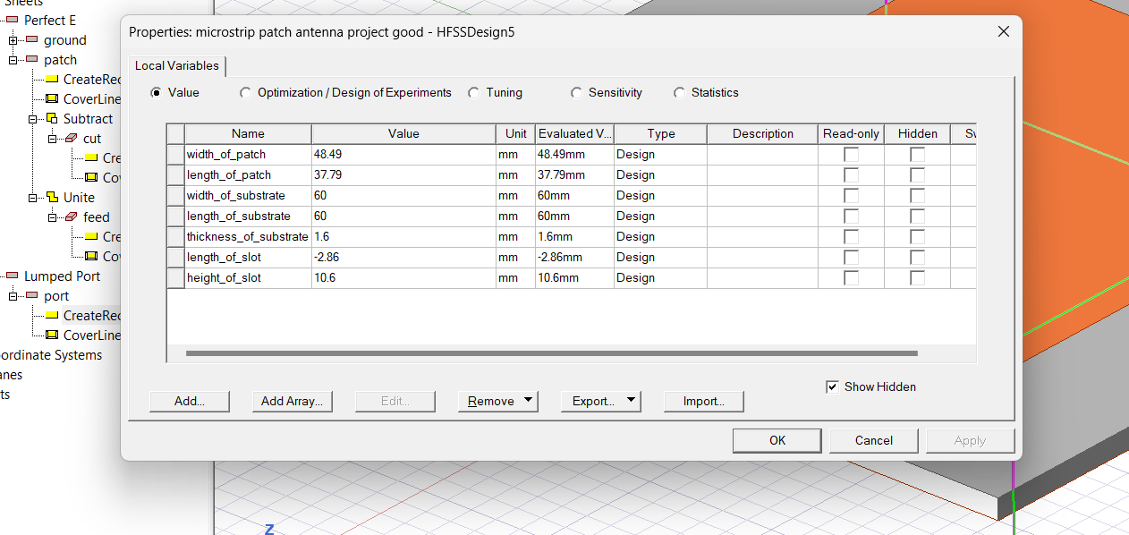
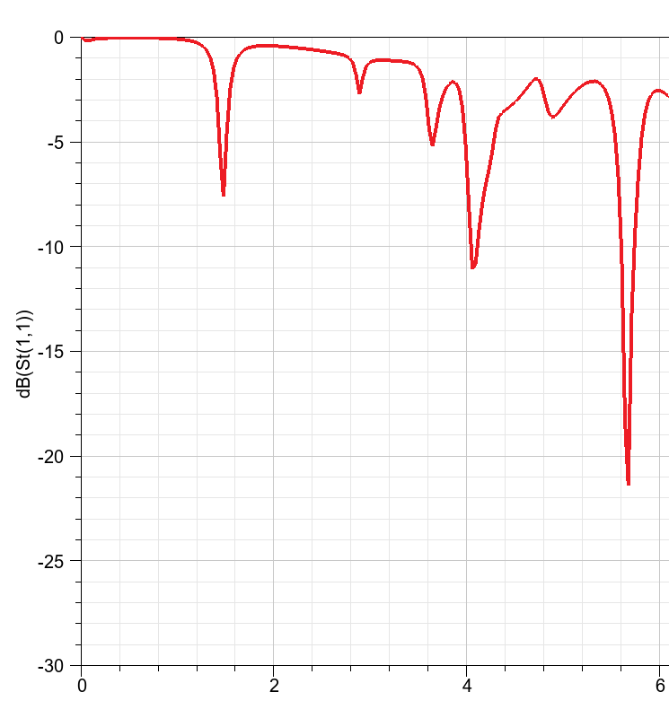
2. Predicted Parameters: For Freq: 4.5-6GHz, s11:(-10)-(-25)dB
Freq(GHz) s11(dB) length of patch width of patch Slot length slot width
0 4.500 -25.00 37.680782 48.482224 10.599922 2.859924
1 4.500 -21.25 37.788395 48.490101 10.599922 2.859924
2 4.500 -17.50 37.788395 48.490101 10.599922 2.858300
3 4.500 -13.75 37.790062 48.490128 10.600206 2.859971
4 4.500 -10.00 37.789337 48.489819 10.599922 2.859924
5. 4.875 -25.00 37.680782 48.482224 10.599922 2.859924
and so on………
3. HFSS Simulations:
After the testing the parameters on a rectangular patch antenna for the Freq- 5GHz and s11- -20dB in HFSS, we obtained following s11 plot.
Other Antenna parameters were set according to needs like length of substrate, width of substrate etc., and dielectric constant was same i.e. 4.4(FR4).
The Antenna resonated at a frequency of 5.8 GHz with a return of loss of around -21 dB.

Slide 14
Conclusion
A) Key Findings
This project successfully applied machine learning models—Random Forest(Best prediction), XGBoost, SVM, and MLP Neural Network—to predict optimal design parameters for a microstrip antenna, streamlining the traditional design process.
Testing the predicted parameters for a target of 5 GHz and S11 -20 dB in HFSS resulted in a resonant frequency of 5.8 GHz with S11 at -21 dB, demonstrating the model’s effectiveness in predicting near-target parameters.
B) Challenges Faced:
Limited Data & Feature Selection : Insufficient samples initially required simulation-based data augmentation & Identifying critical features like S11 was essential to avoid misleading predictions.
Accuracy Limitations: Achieving exact target frequency predictions (e.g., 5 GHz) proved difficult, often needing fine-tuning.
C) Future Improvements
Dataset Expansion: Incorporating more samples with varied dielectric constants and substrates for broader model training.
Hyperparameter Optimization and additional feature Engineering: Fine-tuning each model’s parameters more extensively could further enhance prediction accuracy & Exploring other features, like substrate material type or additional geometric factors, could refine prediction accuracy.

Slide 15
Future Scope
1. Implement deep learning techniques for more complex antenna designs.
1
2. Extend machine learning models to optimize other RF components.
2
3. Fabricate and test real-world prototypes to validate model predictions.
3

Slide 16
References
[1] J. M. Joshiba and D. Judson, "An Eye Bolt Shape Slotted Microstrip Patch Antenna Design and Return Loss Prediction Using Machine Learning," Sadhana, vol. 49, no. 77, pp. 1-5, 2024. https://doi.org/10.1007/s12046-024-02433-y
[2] N. S. Kumar and U. D. Yalavarthi, "A Comprehensive Review on Machine Learning-Based Optimization Algorithms for Antenna Design," ICACSE Journal of Physics: Conference Series, vol. 1964, no. 062098, pp. 1-6, 2021. https://doi.org/10.1088/1742-6596/1964/6/062098
[3] M. A. Haque, M. A. Rahman, S. S. Al-Bawri, et al., "Machine Learning-Based Approach for Bandwidth and Frequency Prediction for N77 Band 5G Antenna," Physica Scripta, vol. 99, no. 026005, pp. 1-11, 2024. https://doi.org/10.1088/1402-4896/ad1d40
[4] J. L. Pérez et al., "Design and Optimization of Quasi-Yagi-Uda Antennas for 5G n78 Band Using Machine Learning," IEEE Access, vol. 11, pp. 3289-3301, 2023. https://doi.org/10.1038/s41598-023- 39730-1
[5] P. Smith, J. Kim, and A. B. Rogers, "Machine Learning-Assisted Optimization of Antennas for Biomedical and Sub-6GHz Applications," IEEE Transactions on Antennas and Propagation, vol. 71, no. 4, pp. 2000-2012, Apr. 2023.
[6] Prabhakar, D., Karunakar, P., Rao, S. V. R., & Srinivas, K. “Prediction of microstrip antenna dimension using optimized auto-metric Graph Neural Network”. Intelligent Systems with Applications, 21, 200326, 2021. https://doi.org/10.1016/j.iswa.2024.200326
[7] M. Sadiq, N. B. Sulaiman, M. M. Isa, and M. N. Hamidon, "A review on machine learning in smart antenna: Methods and techniques," Heliyon, vol. 8, no. 9, pp. 1–15, Sep. 2022. https://doi.org/10.18421/TEM112-24
[8] Y. Kim, "Application of machine learning to antenna design and radar signal processing: A review", IEICE ISAP Archives(Conference), 2018.
[9] Sharma, K., & Pandey, G. P. “Efficient modelling of compact microstrip antenna using machine learning”. International Journal of Electronics and Communications (AEÜ), 135, 153739, 2021. https://doi.org/10.1016/j.aeue.2021.153739

