Slide 1

Project Seminar on
Machine Learning based Antenna
Design Selection
in partial fulfillment of
VII Semester Bachelor of Engineering (B.E.)
in
Electronics Engineering
PROJECT PHASE- I (ENP 455)
CHIRAG DAVE B-05
BHAVESH MODANI B-13
AAYUSH VISHWAKARMA B- 25
OMKAR MARKANDEY B- 61
Guided by
Dr.(Mrs.) A.A Khurshid
Department of Electronics Engineering
Shri Ramdeobaba College of Engineering and Management,
Ramdeo Tekadi, Gittikhadan, Katol Road, Nagpur 440013, India.
Session 2021-22

Slide 2
Table of Contents
1. Introduction
2. Literature Review
3. Motivation
4. Objective
5. Working Principle
6. Software/Hardware Implementation
7. Discussion on Results
8. Conclusion
9. Future Scope
10. References

Slide 3
Introduction
Antenna design is a key component in communication systems, requiring optimization of various parameters such as gain and return loss. Traditional methods are time-consuming and rely heavily on expert knowledge.
This project aims to leverage machine learning models to predict antenna performance metrics, thus reducing the reliance on manual simulations.

Slide 4
Literature Review
S.N | Type of Robot | Nature of Work | Key points | Author | Journal
1. | Eye Bolt Shape Slotted Microstrip Patch Antenna | Design and Prediction | XGBoost for return loss prediction, 5.5 dB gain, 87% efficiency" | J. M. Joshiba and D. Judson | Sadhana (2024)
2. | Various Antenna Types | Review | Deterministic, stochastic, and surrogate models for optimization | N. S. Kumar and U. D. Yalavarthi | ICACSE Journal of Physics: Conference Series (2021)
3. | Yagi-Uda Antenna for N77 5G Band | Prediction | Random Forest Regression, 3.3–4.2 GHz bandwidth, 7.95 dB gain | M. A. Haque, M. A. Rahman, S. S. Al-Bawri | Physica Scripta(2024)
4. | Quasi-Yagi-Uda Antennas for 5G n78 Band | Design and Optimization | Gaussian Process Regression for gain prediction and optimization | J. L. Pérez et al | IEEE Access(2023)

Slide 5
5. | Antennas for Biomedical and Sub-6GHz Applications | Optimization | Bayesian Linear Regression for resonant frequency and gain prediction | P. Smith, J. Kim, and A. B. Rogers | IEEE Transactions on Antennas and Propagation (2023)
6. | Microstrip Antenna | Dimension Prediction | Auto-Metric Graph Neural Network with Sheep Flock Optimization | Prabhakar, D., Karunakar, P., Rao, S. V. R., & Srinivas, K. | Intelligent Systems with Applications (2021)
7. | Smart Antenna | ML for interference rejection, spectrum efficiency, and signal processing | Deterministic, stochastic, and surrogate models for optimization | M. Sadiq, N. B. Sulaiman, M. M. Isa, and M. N. Hamidon | Heliyon (2022)
8. | Antenna Design and Radar Signal Processing | Review | Deep learning for design optimization and radar target classification | Y. Kim | IEICE ISAP Archives (2018)
9. | Compact Microstrip Antenna | Modeling | Gaussian Process Regression for resonant frequency prediction | Sharma, K., & Pandey, G. P. | International Journal of Electronics and Communications(2021)

Slide 6
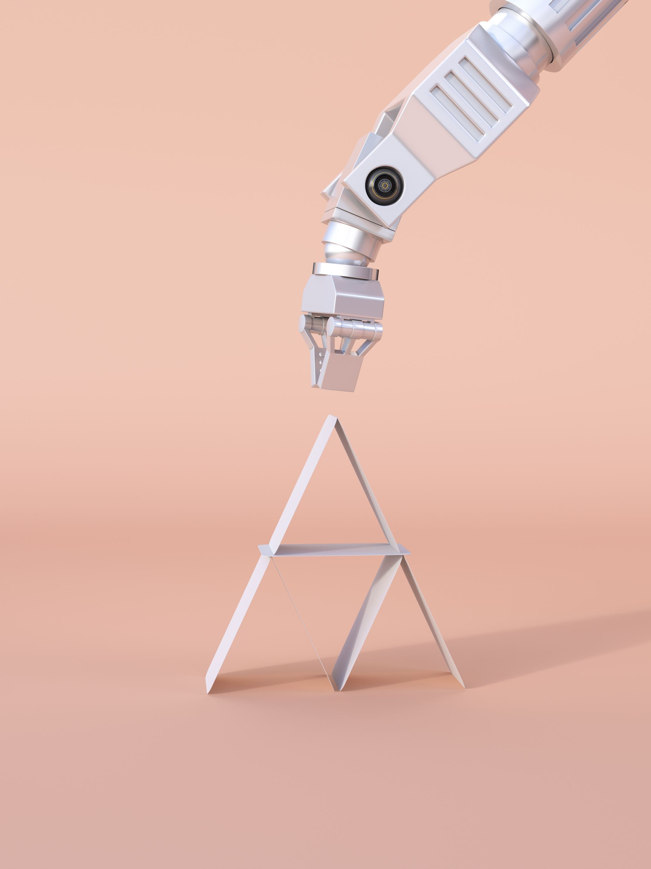
Motivation
Traditional antenna design is time-consuming, resource-intensive, and reliant on expert knowledge.
This project aims to streamline the process using machine learning to predict key performance metrics like resonant frequency, return loss, and gain.
By automating optimization, the project seeks to reduce design time and cost while improving accuracy, offering a faster and more efficient approach to antenna development.

Slide 7
Objective
1. Design a rectangular patch antenna optimized for maximum gain, bandwidth, and minimal return loss.
2. Develop machine learning models to predict antenna design parameters based on parameters like frequency and gain.
3. Compare and select the best model for antenna optimization.

Slide 8
Working Principle
Data Collection:
A dataset is created from multiple antenna designs, capturing performance metrics like gain, bandwidth, and return loss.
2. Data Preprocessing:
The dataset is cleaned, normalized, and split into training, validation, and test sets.
3. Model Selection and Training:
Various machine learning models (Linear Regression, Random Forest, ElasticNet) are trained to predict performance metrics based on the design parameters.
4. Optimization and Prediction:
The trained models predict the performance of new antenna designs, offering optimizations for key metrics like gain or return loss.
1. Data Collection: Generate antenna design data using HFSS software.
2. Data Preprocessing: Normalize, scale, and split the data.
3. Model Training: Evaluate models such as Linear Regression, ElasticNet, and Random Forest.
4. Model Deployment: Use trained models to predict antenna performance for new designs.

Slide 9
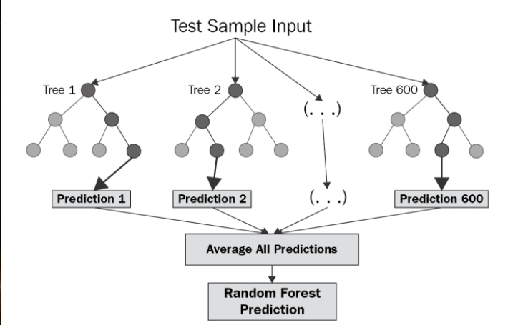
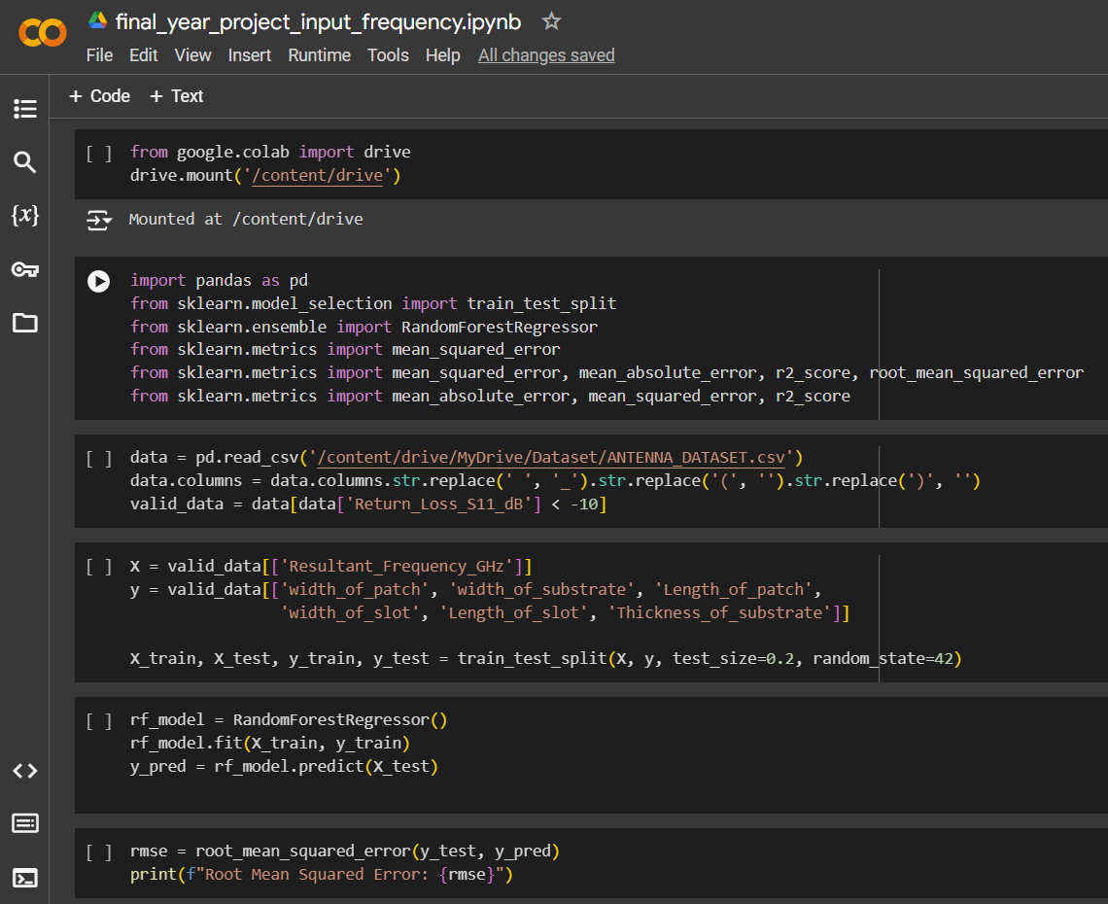
Software Implementation
Models Implemented:
Random Forest Regressor
RMSE (Initial): 3.58
The model predicted antenna design parameters based on input frequency.
Example Predicted Design Parameters for a 5.5 GHz input frequency:
[37.48, 50.21, 35.74, 0.58, 6.00,
1.46025 ]

Slide 10
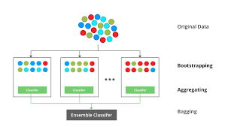
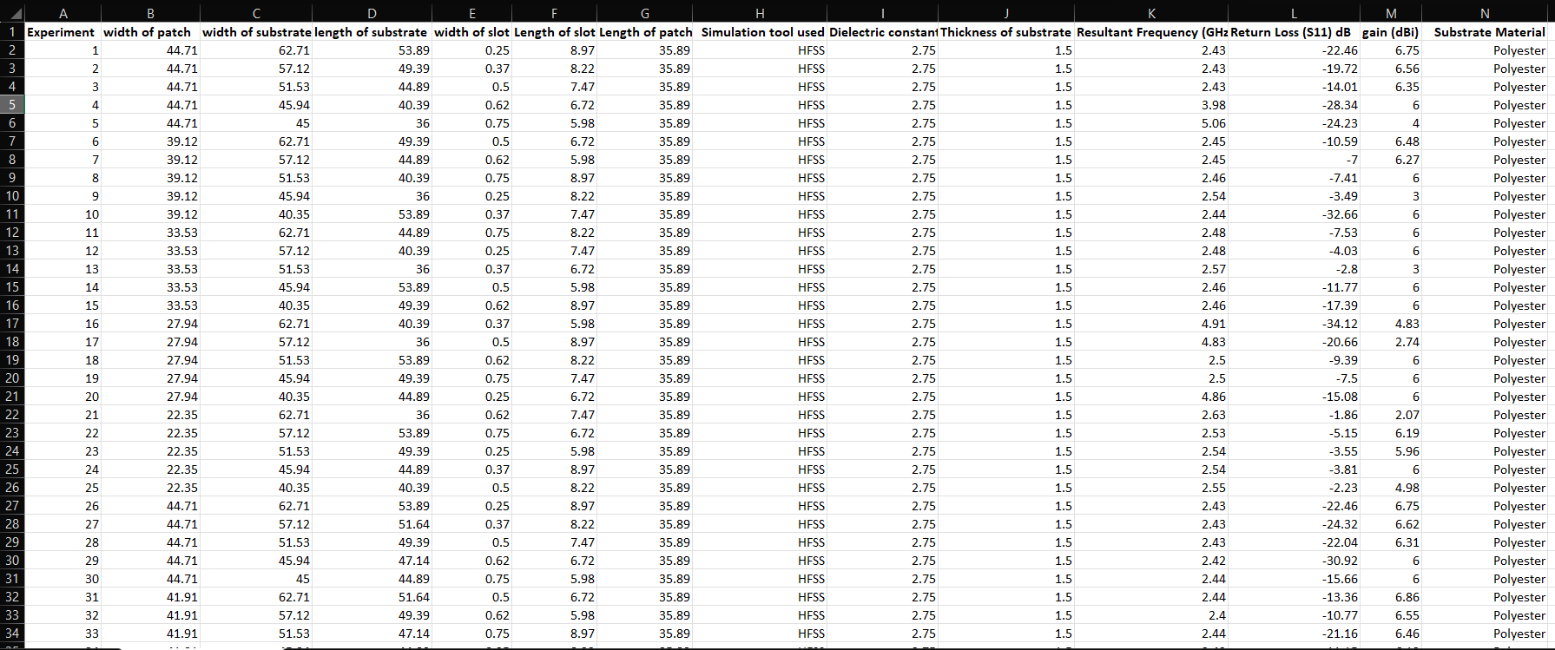
Software Implementation
XGBoost:
RMSE (Initial): 3.61
Performed slightly better than the Random Forest model in capturing the relationships between input features and antenna design parameters.
2. Data Preprocessing:
Scaling: Applied StandardScaler to normalize input features.
Filtering: Only antenna designs with S11 < -10 dB were used to ensure valid data.

Slide 11
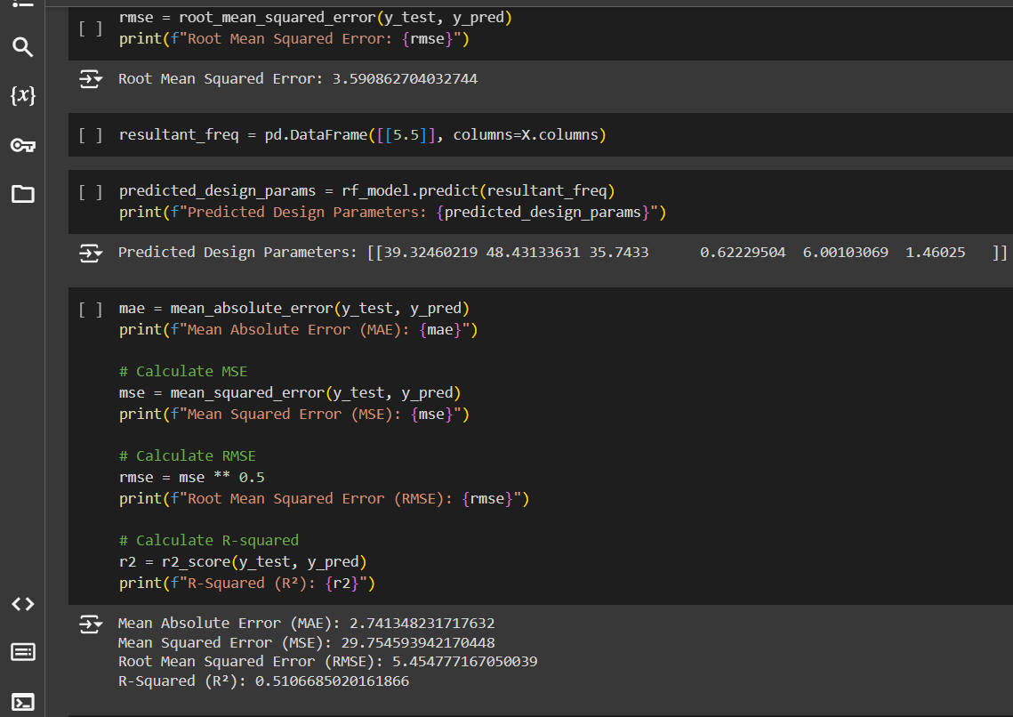
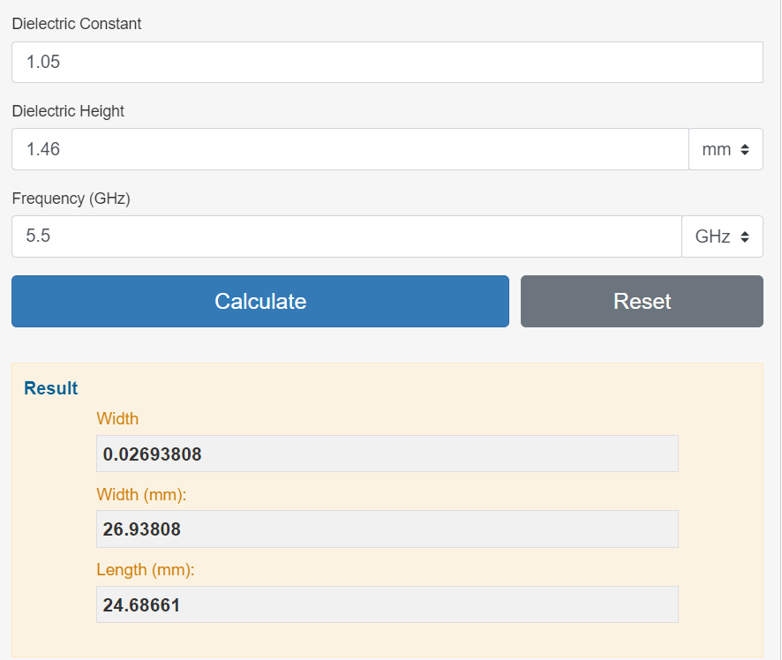
Discussion on results:
1) Random Forest Regressor:
Initial RMSE: 3.58
Predicted Design Parameters for 5.5 GHz
[37.48, 50.21, 35.74, 0.58, 6.00, 1.46025 ]
Error Metrics:
MAE: 2.74
MSE: 29.65
R²: 0.51 (explains 51% of the variance)
2) XGBoost:
RMSE: 3.61

Slide 12
Conclusion & Next Steps
Progress So Far:
(i) Random Forest Regressor:
Initial RMSE: 3.58, with reasonable predictions of antenna design parameters.
(ii) XGBoost:
RMSE: 3.61, showing slight improvement over Random Forest.
B) Challenges:
Further data collection or optimization may improve the performance of both models.
C) Next Steps:
Continue tuning XGBoost to reduce RMSE further. Gather additional data for improved model training.
Compare final results from Random Forest and XGBoost after full tuning.
Implement more algorithms like Neural networks and support vector machines.

Slide 13
Future Scope
1. Implement deep learning techniques for more complex antenna designs.
1
2. Extend machine learning models to optimize other RF components.
2
3. Fabricate and test real-world prototypes to validate model predictions.
3

Slide 14
References
[1] J. M. Joshiba and D. Judson, "An Eye Bolt Shape Slotted Microstrip Patch Antenna Design and Return Loss Prediction Using Machine Learning," Sadhana, vol. 49, no. 77, pp. 1-5, 2024. https://doi.org/10.1007/s12046-024-02433-y
[2] N. S. Kumar and U. D. Yalavarthi, "A Comprehensive Review on Machine Learning-Based Optimization Algorithms for Antenna Design," ICACSE Journal of Physics: Conference Series, vol. 1964, no. 062098, pp. 1-6, 2021. https://doi.org/10.1088/1742-6596/1964/6/062098
[3] M. A. Haque, M. A. Rahman, S. S. Al-Bawri, et al., "Machine Learning-Based Approach for Bandwidth and Frequency Prediction for N77 Band 5G Antenna," Physica Scripta, vol. 99, no. 026005, pp. 1-11, 2024. https://doi.org/10.1088/1402-4896/ad1d40
[4] J. L. Pérez et al., "Design and Optimization of Quasi-Yagi-Uda Antennas for 5G n78 Band Using Machine Learning," IEEE Access, vol. 11, pp. 3289-3301, 2023. https://doi.org/10.1038/s41598-023- 39730-1
[5] P. Smith, J. Kim, and A. B. Rogers, "Machine Learning-Assisted Optimization of Antennas for Biomedical and Sub-6GHz Applications," IEEE Transactions on Antennas and Propagation, vol. 71, no. 4, pp. 2000-2012, Apr. 2023.
[6] Prabhakar, D., Karunakar, P., Rao, S. V. R., & Srinivas, K. “Prediction of microstrip antenna dimension using optimized auto-metric Graph Neural Network”. Intelligent Systems with Applications, 21, 200326, 2021. https://doi.org/10.1016/j.iswa.2024.200326
[7] M. Sadiq, N. B. Sulaiman, M. M. Isa, and M. N. Hamidon, "A review on machine learning in smart antenna: Methods and techniques," Heliyon, vol. 8, no. 9, pp. 1–15, Sep. 2022. https://doi.org/10.18421/TEM112-24
[8] Y. Kim, "Application of machine learning to antenna design and radar signal processing: A review", IEICE ISAP Archives(Conference), 2018.
[9] Sharma, K., & Pandey, G. P. “Efficient modelling of compact microstrip antenna using machine learning”. International Journal of Electronics and Communications (AEÜ), 135, 153739, 2021. https://doi.org/10.1016/j.aeue.2021.153739

