Slide 1
Enhancing Cluster Labeling using Wikipedia
Search Engine Architecture, Spring 2017, New York University
Abhinav Gupta and Chirag Maheshwari

Slide 2
Introduction
Massive amounts of textual data have brought about the need for efficient techniques that can organize the data in manageable forms.
One of the popular approaches for organizing textual data is the use of clustering algorithms.
In many applications of clustering, particularly in user interface based applications, human users interact directly with the created clusters.

Slide 3
Introduction (contd.)
We must label the clusters so that users can understand what the cluster is about.
A popular approach for cluster labeling is to apply statistical techniques for feature selection.
This is done by identifying “important” terms in the text that best represent the cluster topic.

Slide 4
Introduction (contd.)
However, a list of significant keywords, or even phrases, will many times fail to provide a meaningful readable label for a set of documents.
The suggested terms, even when related to each other, tend to represent different aspects of the topic underlying the cluster.

Slide 5
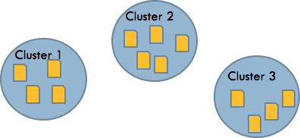
Document Clustering
A method of aggregating a set of documents such that:
Documents within cluster are as similar as possible.
Documents from different clusters should be dissimilar.

Slide 6
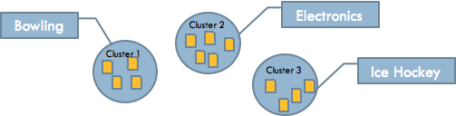
Cluster Labeling
To assign each cluster a human readable label that can best represent the cluster.

Slide 7
Cluster Labeling (contd.)
Traditional method is to pick the label from the important terms within the cluster.
The statistically significant terms may not be a good label.
A good label may not occur directly in the text.

Slide 8
Approach
Utilizing the external resource to help the cluster labeling.
Besides the important terms extracted from the cluster, the metadata of Wikipedia such as title and category is used to serve as candidate label.

Slide 9
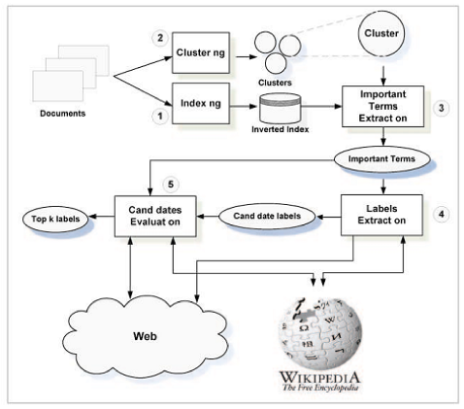
A General Framework

Slide 10
Step-1: Indexing
Documents are parsed and tokenized.
Term weight are determined by tf-idf.
We stored tf and idf on disc partitioned by document

Slide 11
Step-2: Clustering
Create coherent clusters for which documents within a cluster share the same topics.
Given the document collection D, return a set of document clusters C={C1,C2,…,Cn}.
A cluster is represented by its centroid of the cluster's documents.

Slide 12
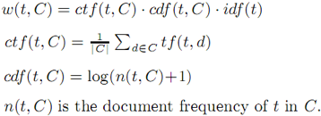
Step-2: Clustering (contd.)
The term weight of the cluster's centroid is slightly modified:

Slide 13
Step-3: Important terms extraction
Given a cluster , find a list of important terms ordered by their estimated importance.
This can be achieved by:
Selecting the top weighted terms from the cluster centroid.
Use the Jensen-Shannon Divergence(JSD) to measure the distance between the cluster and the collection.
Each term is scored according to its contribution to the JSD distance between the cluster and the collection.

Slide 14
Step-4: Candidate Label Extraction
Extract candidate labels for cluster C (denoted L(C)) from two type of source:
Document content
Consider the set of important terms themselves as potential labels for the cluster.
Possible to get less semantic words representing the cluster.

Slide 15
Step-4: Candidate Label Extraction (contd.)
Wikipedia
Execute a query q against the Wikipedia, the result is a list of documents D(q) sorted by their similarity score to q.
For each document d in D(q), we then consider both the document’s title and the set of categories associated with the document as potential candidate cluster labels.

Slide 16
Step-5: Scoring Candidate Labels
MI(Mutual Information) Judge
Score each candidate label by its pointwise mutual information with the cluster's important terms.
SP(Score Propagation) Judge
Propagate the document score to the candidate label.
Document score can be the original score of the IR system or the rank(d)⁻¹

Slide 17
Mutual Information - MI Judge
The Mutual Information (MI) judge scores each candidate by the average pointwise mutual information (PMI) of the label with the set of the cluster’s important terms, with respect to a given external textual corpus.
Reflects the “semantic distance” of the label from the cluster content.
Labels that are “closer” to the cluster content are preferred.

Slide 18


Mutual Information - MI Judge (contd.)
The PMI between two terms is measured by:
The probability of a term is approximated by the maximum likelihood estimation

Slide 19

Mutual Information - MI Judge (contd.)
Given a candidate label l in L(C), the following score is assigned to l:
where w(t) denotes the relative importance of important term t in T(C)
We used the popular nltk Brown corpus for getting the ngram counts.

Slide 20
Score Propagation - SP Judge
Score Propagation (SP) judge, scores each candidate label with respect to the scores of the documents in the result set associated with that label.
This judge propagates documents’ scores to candidates that are not directly associated with those documents, but share common keywords with other related labels.

Slide 21

Score Propagation - SP Judge (contd.)
Given a candidate label l in L(C), by summing over the set of all documents in D(q) associated with label l, we obtain an aggregated weight for l, which represents the score propagation from D(q) to l:
Score(d) = 1 / Rank (d) ranking position

Slide 22


Score Propagation - SP Judge (contd.)
After scoring the labels, we score the label keywords as follows:
Finally, the score assigned to each candidate label l is set by the average score propagated back from its keywords. Formally:
where n(l) denotes the number of l’s unique keywords

Slide 23
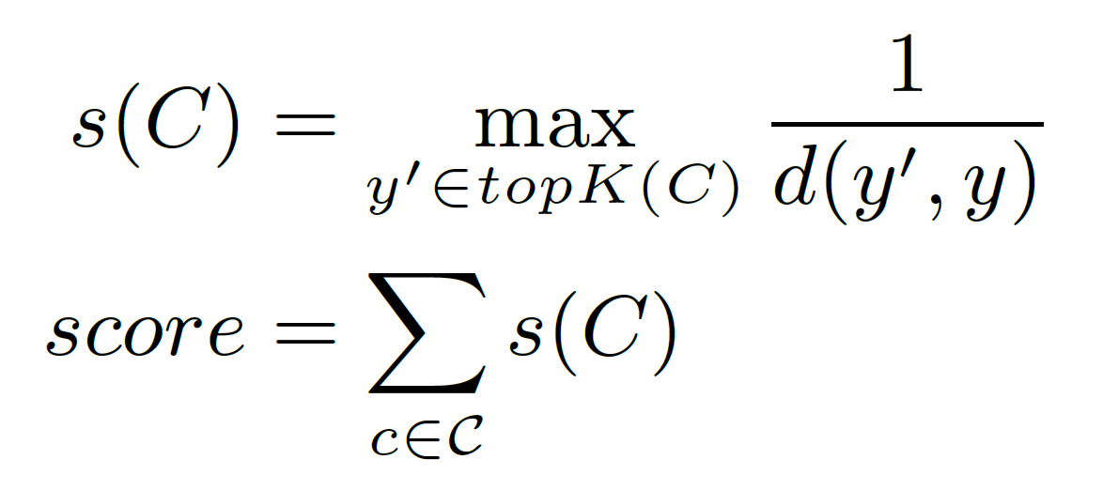
Scoring Results
The final score is calculated on the basis of distance between the ground truth and predicted cluster descriptor

Slide 24
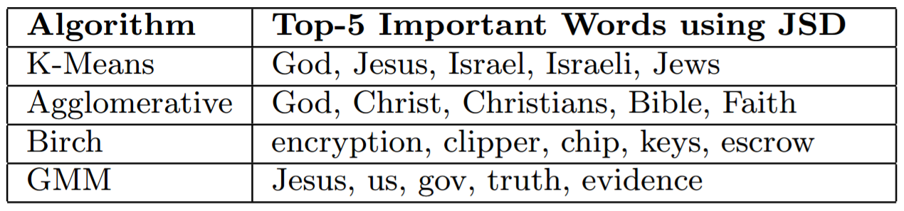
Results - I (Comparing clusters)

Slide 25
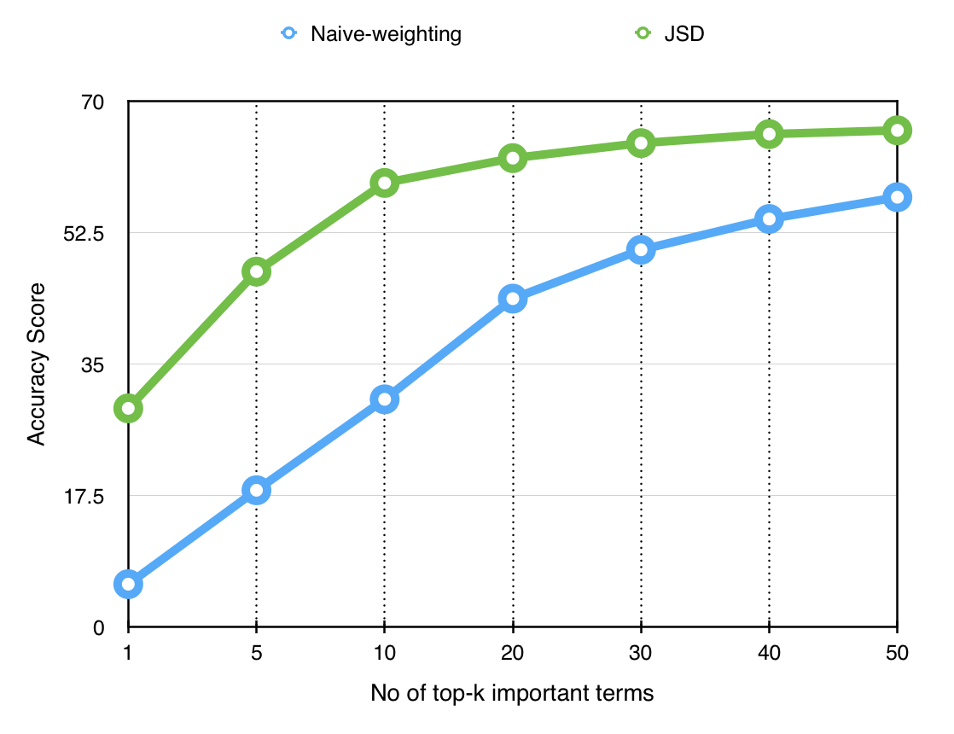
Results-II (Comparing Term Weighing)

Slide 26
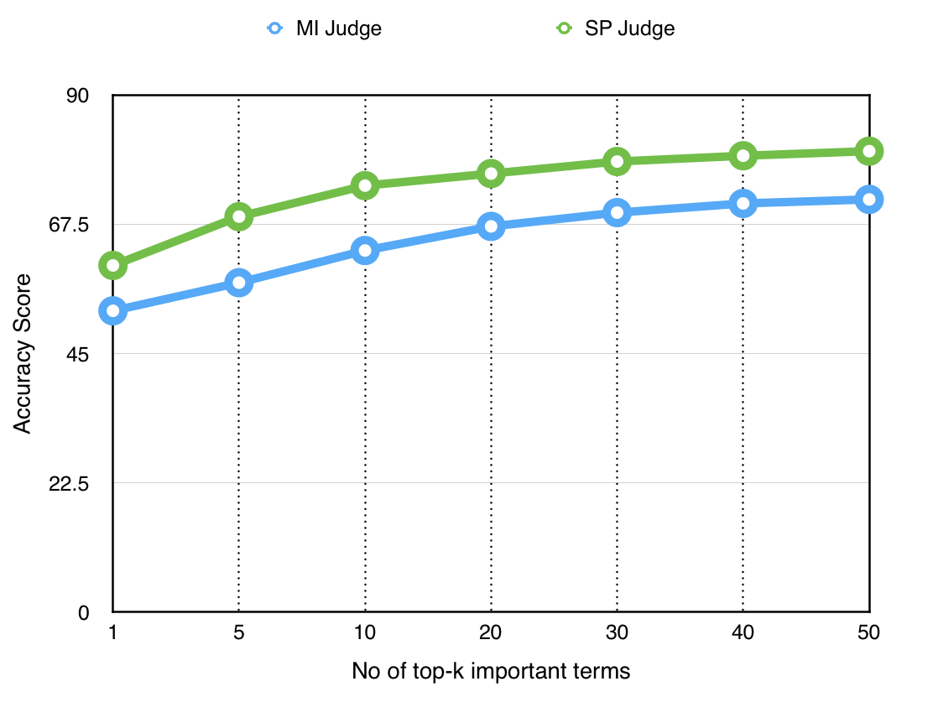
Results - III (Comparing MI and SP Judge)

Slide 27
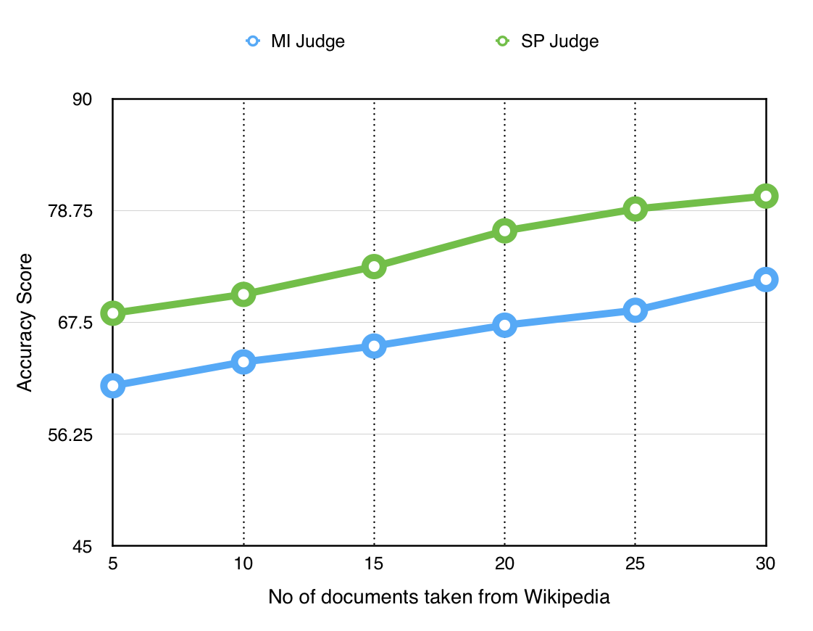
Results - IV (Wikipedia Documents)

Slide 28
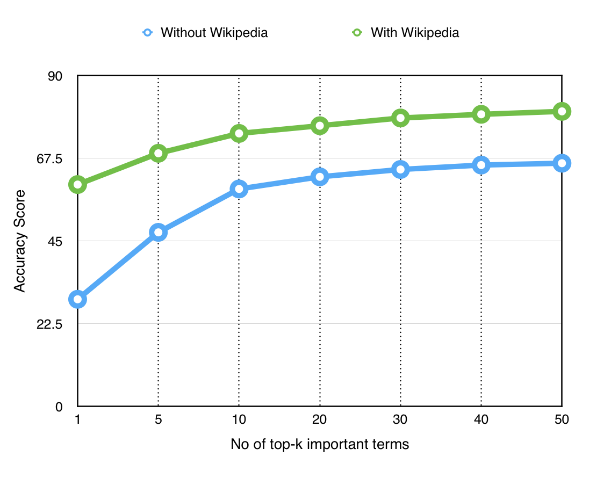
Results - V (Usage of Wikipedia)

Slide 29
Conclusion
Proposed a general framework for solving cluster labeling problem.
The metadata of Wikipedia can boost the performance of cluster labeling.
The proposed method has good resilience to noisy clusters.
Developing such a collection specific decision making as part of the labeling framework is left for further research.

