Slide 1
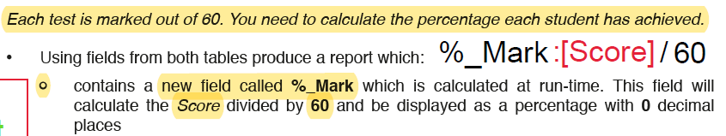
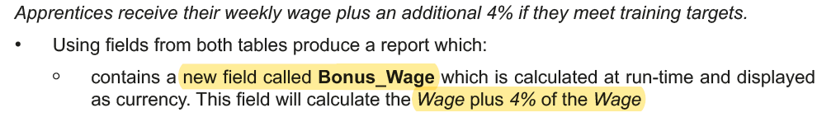
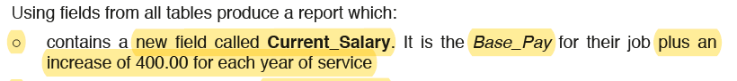
Bonus_Wage:[Wage]+([Wage] *0.04)
Current_Salary: [Base_Pay]+([Years_Service]*400)

Slide 2
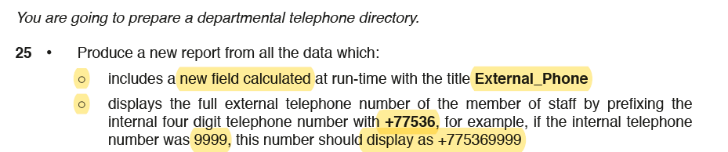
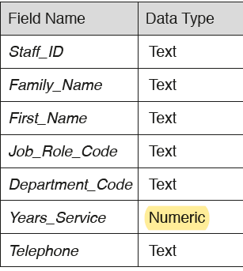
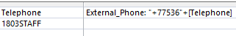
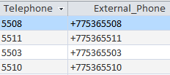
External_Phone:"+77536"+[Telephone]
Make sure the datatype for the Telephone field is set to Text.

Slide 3
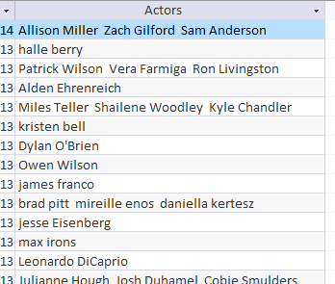
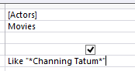
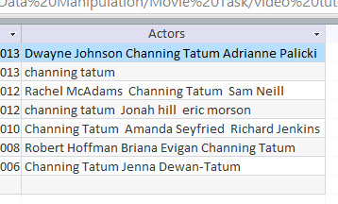
Query – Search Criteria
Wild Card – Sometimes a field may contain more than one word. To find something specific you need to write a wildcard search. Like “*Channing Tatum *”
Between | Between 01/01/2010 And 02/02/2012 Between 100 And 150
Or | North Sea Or Irish Sea
Not | Not “Horror”
<90 | Less than <90
>90 | More than >90
>=90 | More than and equal to >=90
37*____ | Fields starts with 37
____*37 | Fields Ends with 37
Only field containing Channing Tatum are shown

Slide 4
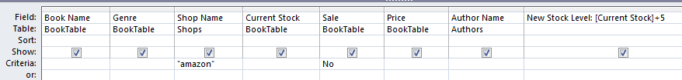
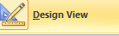
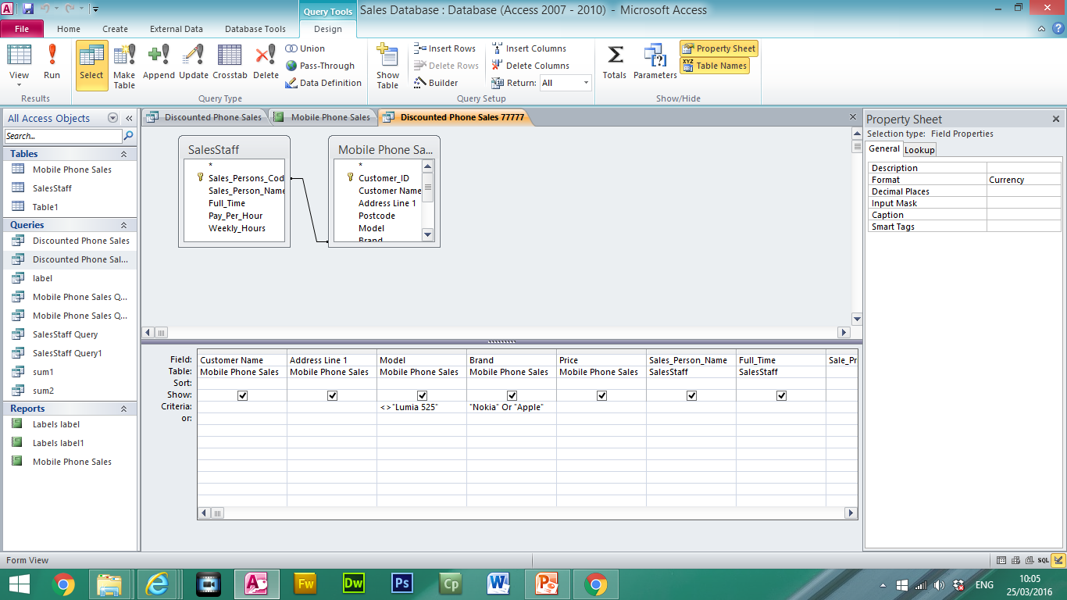
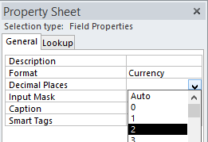
Calculated Run Time Formulas in the Query
Calculated Run time is used when we have to calculate specific values using data from existing fields.
Enter New Calculated Run Time Field here
New Stock Level:[Current Stock]+5
Number of Books Added to Stock
Name of new field
Required Field in Square Brackets
In Design View using the Property Sheet the formatting can be set for the new field.

Slide 5
Wild Card – Sometimes a field may contain more than one word. To find something specific you need to use a wildcard search.
________ *__________* _________ _________
Query 1: Science Employees
New Field:
Search Criteria
Query | Shows only the fields Staff_ID, FullName, Job_Desription and Faculty in this order Includes the heading Science Employees at the top of the page Shows only the records where the Faculty contains Science Includes a new field calculated at run-time with the title FullName. This field should include the First_Name and Family_Name e.g. Yasar Ahmad
Report | is sorted by Faculty in ascending order, then by FullName in ascending order is displayed on a single page in portrait orientation with all data fully visible includes your name on the report in the Report Header.

Slide 6
Between | Between 01/01/2010 And 02/02/2012 Between 100 And 150
Query 2: Project End Dates
New Field:
Search Criteria
Query | Shows only the fields Family_Name, First_Name, Years_Service, Project_Started and Project_End in this order Includes the heading Project End Dates at the top of the page Shows only the records where the Years Service is more than and equal to 5 and equal to and less than 10. Also Projects which started in 2017. Includes a new field calculated at run-time with the title Project_End. This field will add 3 years to the Start Date.
Report | is sorted by Projected_Started in ascending order, then by Year_Service in ascending order is displayed on a single page in Landscape orientation with all data fully visible includes your name on the report in the Report Header.

Slide 7
Or | North Sea Or Irish Sea
Not <> | Not “Horror”
Query 3: Employee Pay Rise
New Field:
Search Criteria
Query | Shows only the fields Family_Name, First_Name, Department, Job_Role_Code, New_Pay, Bonus_Pay in this order Includes the heading Employee Pay Rise at the top of the page Shows only the records where the Department is Biology, Chemistry or Maths and the Job_Role_Code excludes AD or HO. Includes a new field calculated at run-time with the title New_Pay. This field will calculate the Base_Pay plus 15% of the Base_Pay. Includes a new field calculated at run-time with the title Bonus_Pay. This field will calculate 17.5% of the Base_Pay.
Report | Is sorted by Department in ascending order, then by New_Pay in ascending order Is displayed on a single page in Landscape orientation with all data fully visible includes your name on the report in the Report Footer. Calculate the average of the Bonus_Pay and place below the column. Include a suitable label.

Slide 8
<90 | Less than <90
>90 | More than >90
>=90 | More than and equal to >=90
Date before 2018 | <01/01/2018 <=31/12/2017
Date after 2018 | >=01/01/2018 >31/12/2017
Query 4: New Salary
New Field:
Search Criteria
Query | Shows only the fields Family_Name, First_Name, Year_Service, Project_Started Includes the heading New Salary at the top of the page Shows only the records where the Years_Service is equal to or greater than 10 and the Projects have started in 2017 or after. Includes a new field calculated at run-time with the title New_Salary. This field will calculate the Base_Pay plus an increase of 400.00 for every years service.
Report | Is sorted by Year_Service in ascending order, Is displayed on a single page in Landscape orientation with all data fully visible includes your name on the report in the Report Footer. Calculate the total New_Salary and place below the column. Include a suitable label.

Slide 9
37*____ | Fields starts with 37
____*37 | Fields Ends with 37
Query 5: Telephone Number
New Field:
Search Criteria
Query | Shows only the fields Family_Name, First_Name, Staff_ID, Telephone and Full_Telephone in this order Includes the heading Telephone Number at the top of the page Shows only the records where the Staff_ID either: begins with PU ends with 111 Includes a new field calculated at run-time with the title Full_Telephone. This field will prefix the internal telephone number with +9555 e.g. +9555 5609
Report | Is sorted by Family_Name in ascending order Is displayed on a single page in Portrait orientation with all data fully visible includes your name on the report in the Report Footer. Calculate the number of staff members and place below the Staff_ID

