Slide 1
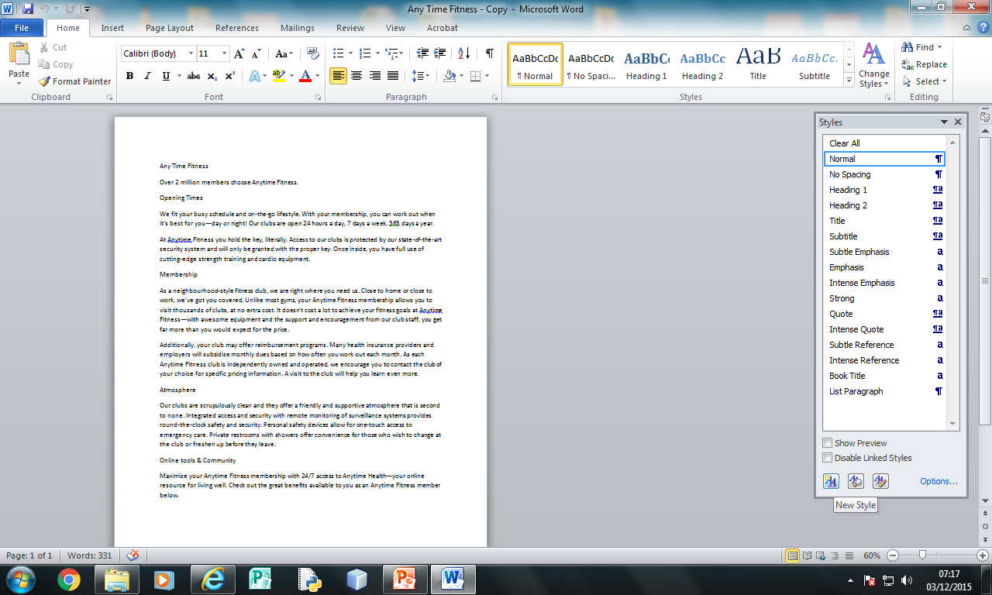
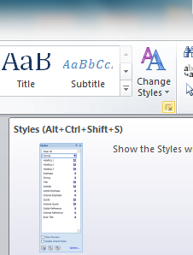
To create text styles click on Home >> Tab under Change Styles
Click new Style

Slide 2
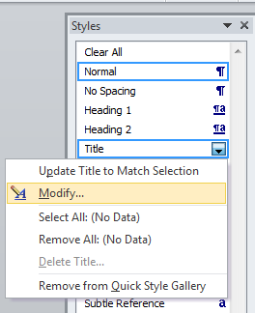
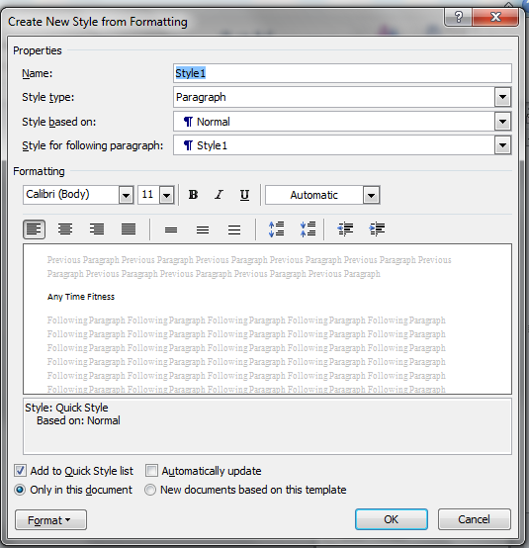
Text Formatting
Existing Styles can also be modified e.g. Title
Alignment
Line Spacing

Slide 3
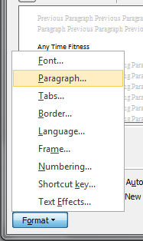
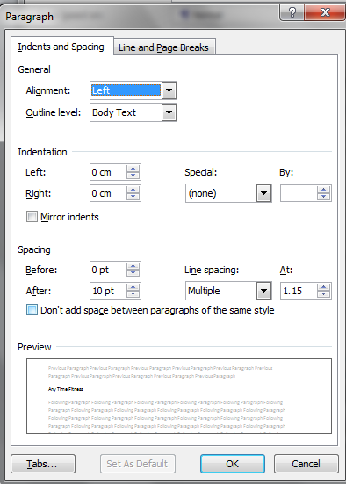
To add spacing click on Format >> Paragraph
Edit After to add spacing after a text style.
Tip: Refer to current font size

Slide 4
Title: San Serif Font, 22, Bold, Purple and centre aligned.
Subheading: Serif Font, Italic, 18, grey, left aligned.
Sub Titles: San Serif Font, 14, Bold, black, italic, underlined, left aligned and one clear line space after a subheading.
Body: Serif Font, 12, black, 1.5 line Spacing, fully justified, and one clear line space after paragraph.

Slide 5
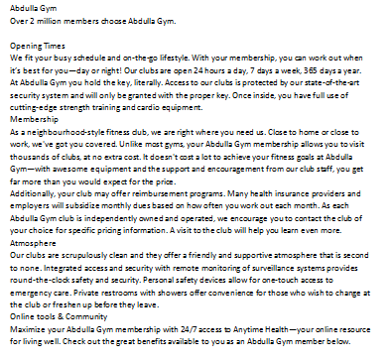
Title:
Subheading:
Sub Titles:
Body:
The rest of the
Text.

