Slide 1
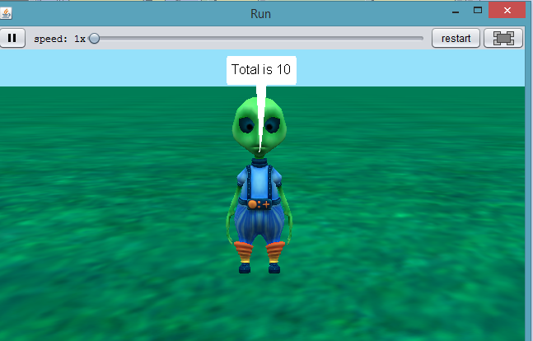
Objectives
Understand the use of Variables.
Understand how to assign and input values into variables.
Understand how to join (Concatenate) and print variables statements.
Understand how to perform calculations using variables.
Outcomes
Task 1 | Intro to Variables
Task 2 | Concatenate
Task 3 | Employee Pay

Slide 2
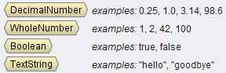
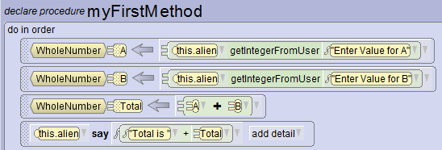
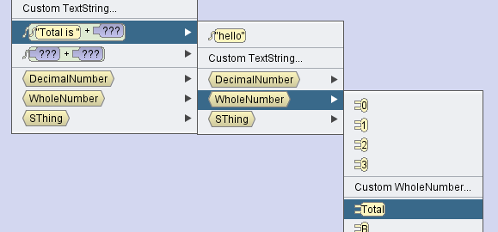
Variable: Placeholder to store values which can be called upon later in the program.
Data Types:
Task 1: Intro to Variables.
Create a program which will allow you to enter two values to be stored in separate variables (A & B).
The variables will then be added into a Total variable and then outputted

Slide 3
Task 1: Fill in the blanks and complete the crossword
Variable: Placeholder to values which can be called upon later in the .
1D
Data Types
1A
2A
3A
1 Down: 0.25
1 Across: Yes/No, True/False
2 Across: 1, 3, 6
3. Across: “hello”

Slide 4
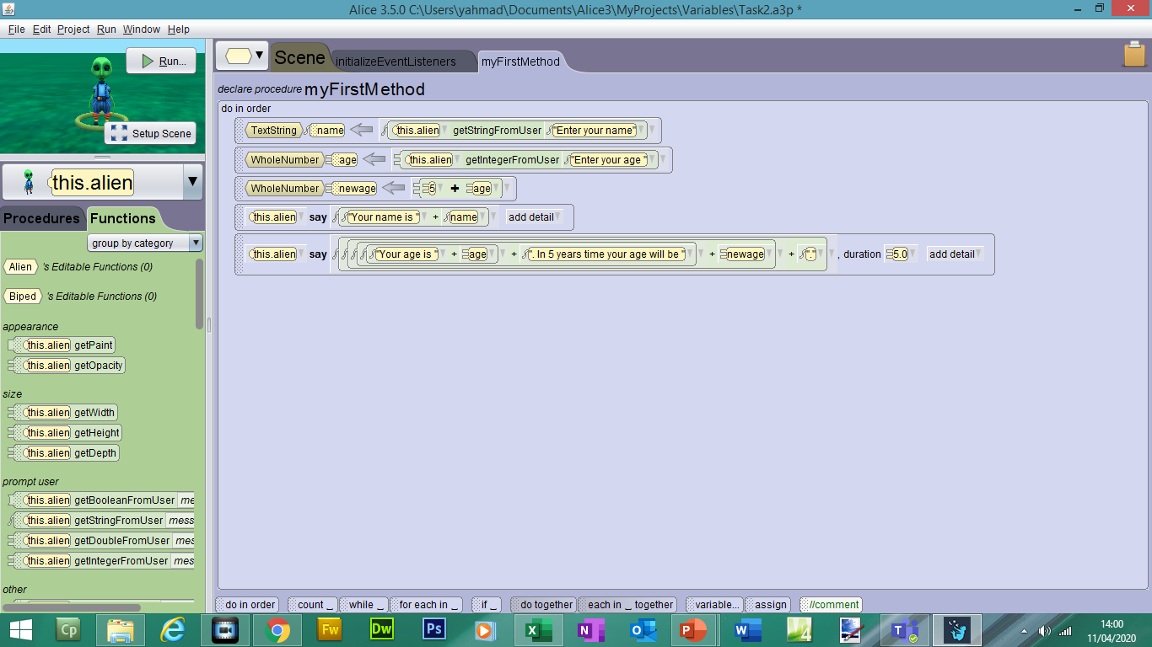
Concatenate: to join two or more text strings into one string.
Task 2: Concatenate
Create a program which will allow you to enter your name and age in two separate variables.
Create a variable which will add 5 years to your age.
Output your name and age in a text string. Also include your age in 5 years time.
name is set to text string datatype
age and newage set to WholeNumber datatype

Slide 5
Task 2: Fill in the blanks and write instructions
Write down the steps to create the program shown in Task 2:

Slide 6
Task 3: Employee Pay (Extension)
You will be making a program to work out the employees weekly and monthly pay.
You need to include suitable variables including:
Name
jobtype (part time/fulltime)
hours (per week)
payperhour
weeklypay = Hours * Payperhour
monthlypay = Weeklypay * 4
You need to print the following statements:
“Your name is __________. You are a __________ employee.
You have worked _______ hours this week and your pay per hour is _____.
Your weekly pay is _______. Your monthly pay is ________.

Slide 7
Task 3: Employee Pay (Extension)
Write down the steps to create the program shown in Task 3:

