Slide 1
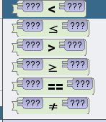
Objectives
Understand the use of IF and Nested IF statements in Alice 3.
Understand the use of the different operators in Alice 3.
Understand the following terms, IF and ELSE.
Outcomes
Task 1 | Part Time or Full Time
Task 2 | Stock Level
Task 3 | Fast Food Options
Task 4 | Extension (Create your own program)
Operators
Less Than
Equal to or Less Than
More Than
Equal to or More Than
Equal
Not Equal

Slide 2
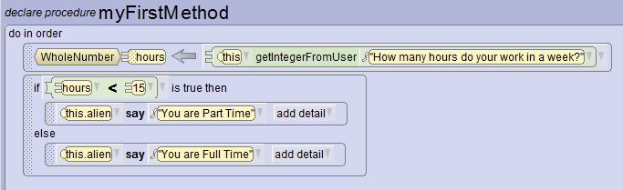
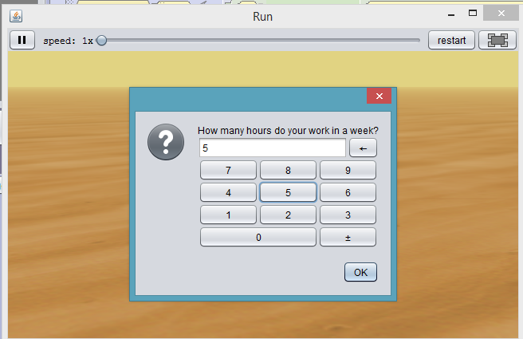
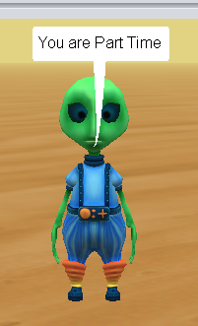
Task 1: Part Time or Full Time
Create a program which will work out whether you are either a part time or fulltime employee based on the numbers of hours inputted.
TRUE: Less than 15 hours – Part Time
ELSE: 15 hours or more – Full Time
IF Statement
1 Logical Test

Slide 3
Write down the steps to create the program shown in Task 1:

Slide 4
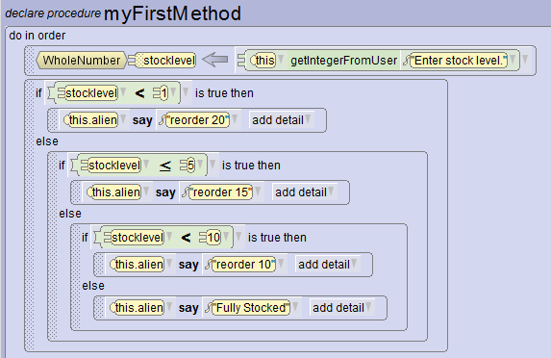
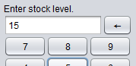
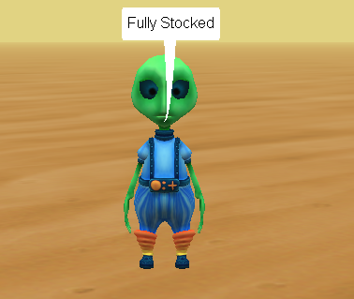
Task 2: Stock Level
Create a program which will work out the reorder amount based on the stock level.
TRUE: Less than 1 – Reorder 20
TRUE: Less than 5 – Reorder 15
TRUE: Less than 10 – Reorder 10
ELSE – Fully Stocked
Nested IF Statement
Multiple Logical Tests

Slide 5
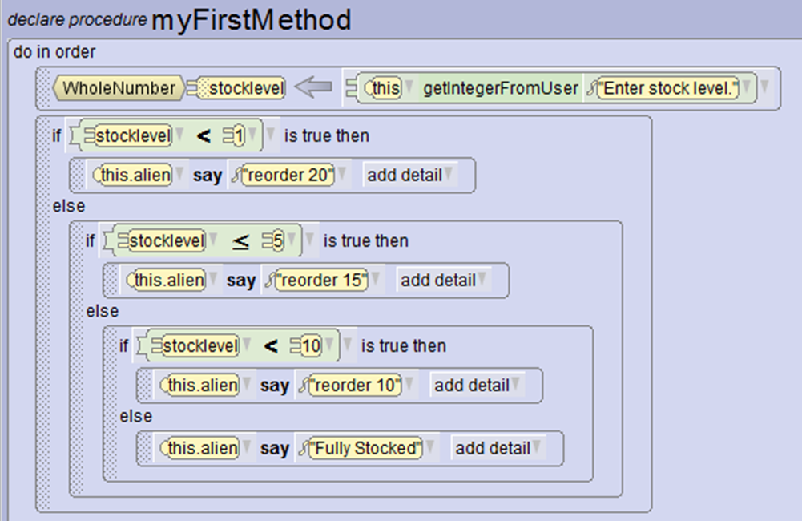
Write down the steps to create the program shown in Task 2:

Slide 6
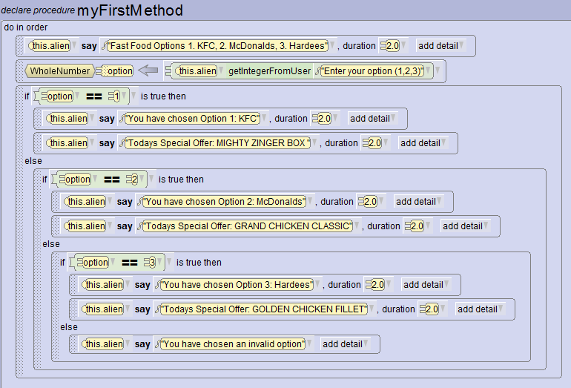
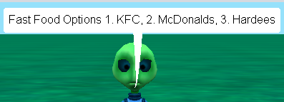
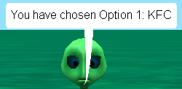

Task 3: Fast Food Options
Create a program which will allow you to view the special offers from a range of Fast Food Restaurants depended on your input.
1- KFC, 2 McDonalds, 3 - Hardees

Slide 7
Write down the steps to create the program shown in Task 3:

Slide 8
Extension
Can you make your own program containing variables and If/Nested Statements?

