Slide 1
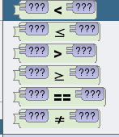
Objectives
Understand the use of IF and Nested IF statements in Alice 3.
Understand the use of the different operators in Alice 3.
Understand the following terms, IF and ELSE.
Understand how to create a procedure (method) in Alice.
Outcomes
Task 1 | Create dance procedures
Task 2 | Create dance options Nested IF
Task 3 | Extension (Create your own program)
Operators
Less Than
Equal to or Less Than
More Than
Equal to or More Than
Equal
Not Equal

Slide 2
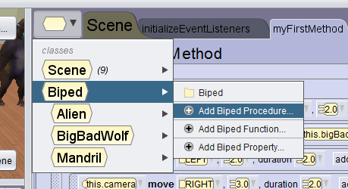
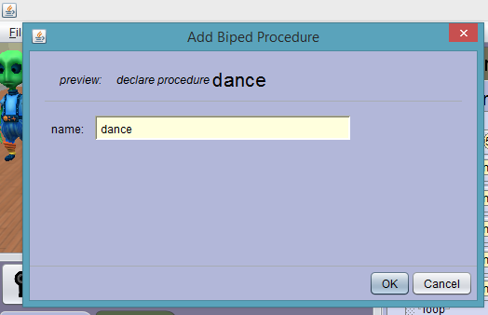
Task 1: Create your dance procedures
Click the ICON to left of Scene >> Biped >> Add Biped Procedure
Name the procedure

Slide 3
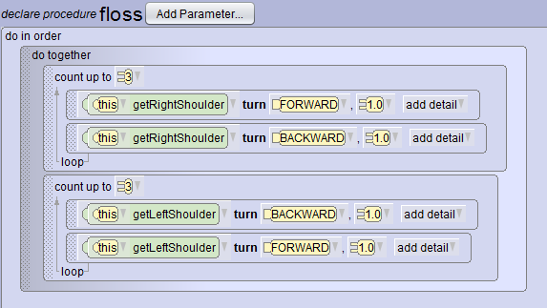
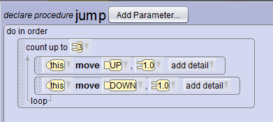
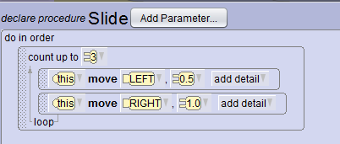
Task 1: Create your dance procedures

Slide 4
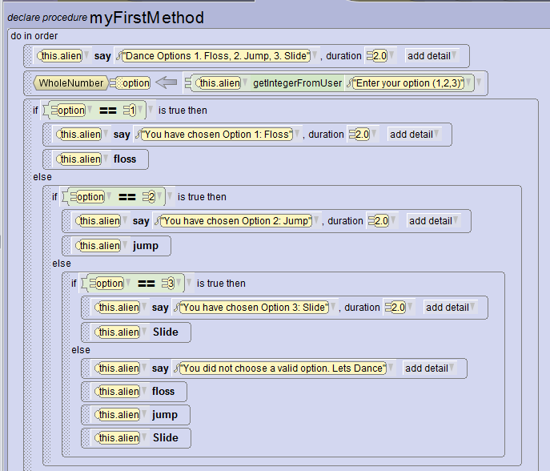
Task 2: Dance Options
Create a program which will allow you to choose a dance option.
TRUE: Option equal to 1 – Floss
TRUE: Option equal to 2 – Jump
TRUE: Option equal to 3 – Slide
ELSE – All dances will be performed
Nested IF Statement
Multiple Logical Tests

Slide 5
Write down the steps to create the program shown in Task 2:

Slide 6
Extension
Can you make your own program containing variables, procedures and If/Nested Statements?

