Slide 1
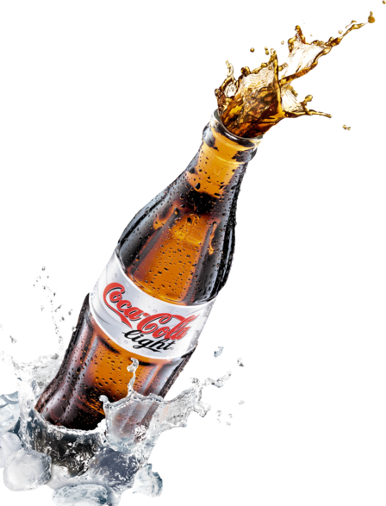


Codex Food and Beverage Industry
2023
Marketing Team insights
Prepared By CHIRAG KANSAGARA

Slide 2
CONTENTS
About Codex
Task
Insights
Recommendations

Slide 3
About codex Codex is aiming to make its mark in the Indian market. A few months ago, they launched their energy drink in 10 cities in India. They conducted a survey in those 10 cities and received results from 10k respondents
TASK
AS A MARKETING DATA ANALYST MY TASK IS TO CONVERT THESE SURVEY RESULTS TO MEANINGFUL INSIGHTS WHICH THE TEAM CAN USE TO DRIVE ACTIONS.

Slide 4
Insights
Demographic
Insights
Consumer
Preference
Competition
Analysis
Marketing Channels
Brand Penetration
Purchase
Behavior
Product
Development

Slide 5
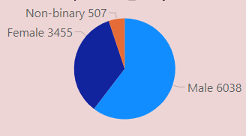

Demographic Insights
1 .Who prefers energy drink more? (male/female/non-binary?)
Clearly Shows Male Prefer energy drink more
About 60% Consumers are Male followed by Female 34% and Non Binary
Conclusion

Slide 6
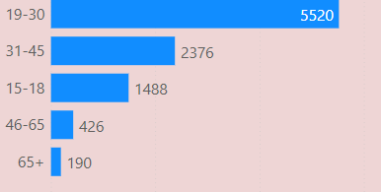
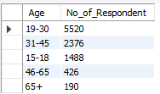
Demographic Insights
2. Which age group prefers energy drinks more?
Age group 19-30 prefer energy drinks the most about 55% of all consumers
Conclusion

Slide 7
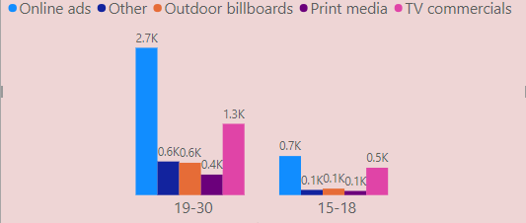
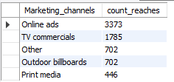
Demographic Insights
3. Which type of marketing reaches the most Youth (15-30)?
Conclusion
Online ads(about 48%) reaches the most to the youth followed by TV commercials

Slide 8
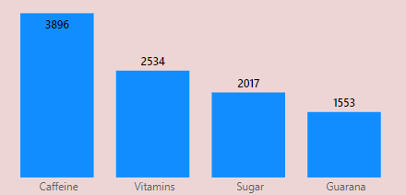

Consumer Preferences
1. What are the preferred ingredients of energy drinks among Respondents ?
Caffeine is the most preferred ingredient in energy drinks (about 39%) followed by Vitamins, Sugar, Guarana
Conclusion

Slide 9
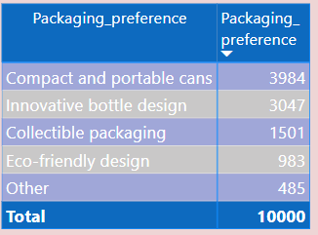
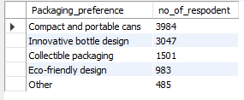
Consumer Preferences
2. What packaging preferences do respondents have for energy drinks?
Compact and Portable Cans are most preferred packaging(about 40%) followed by Innovative Bottle Design(about 30%) and Others
Conclusion

Slide 10
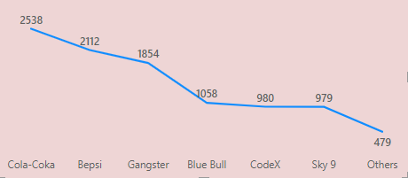
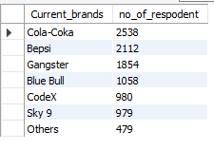
Competition Analysis
1. Who are the current market leaders ?
Conclusion
Cola- Coka is the market leader(about 25%) followed by Bepsi, Gangster .Codex comes at 5th position.

Slide 11
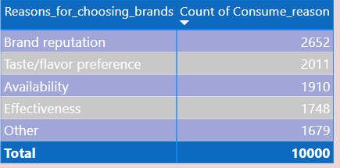
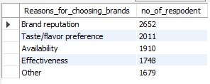
Competition Analysis
2. What are the primary reasons consumers prefer those brands over ours ?
Brand Reputation (about 26%) is the primary reason consumers prefer those brands over CodeX
Conclusion

Slide 12
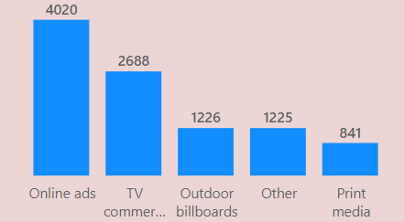
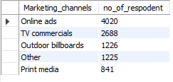
Competition Analysis
3. How effective are different marketing strategies and channels in reaching our customers ?
Online Ads is The Most effective Marketing Channels(about 40%) followed by TV Commercials
Conclusion

Slide 13
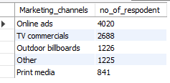
Marketing Channels and Brand Awareness
1. Which marketing channel can be used to reach more customers?
Online Ads is The Most effective Marketing Channels(about 40%) followed by TV Commercials
Conclusion

Slide 14
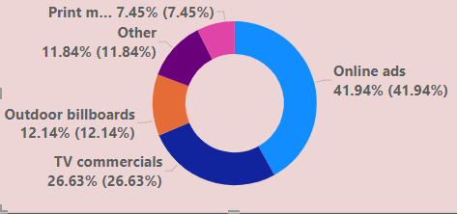
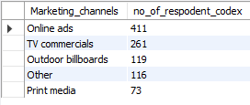
Marketing Channels and Brand Awareness
2. How effective are different marketing strategies and channels in reaching our customers?
Online Ads is the most effective marketing channel(about 42%) to reaching our customers followed by TV commercials
Conclusion

Slide 15
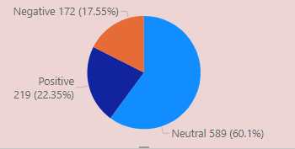

Brand Penetration
1. What do people think about our brand? (overall rating)
60% People have Neutral perception about our brand
Conclusion

Slide 16
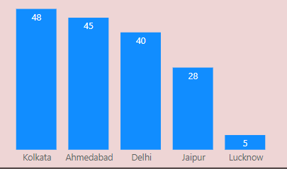
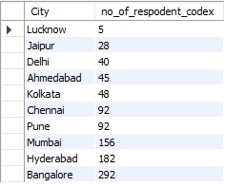
Brand Penetration
2. Which cities do we need to focus more on?
Codex need to focus more on Lucknow, Jaipur, Delhi, Ahmedabad, Kolkata
Conclusion

Slide 17
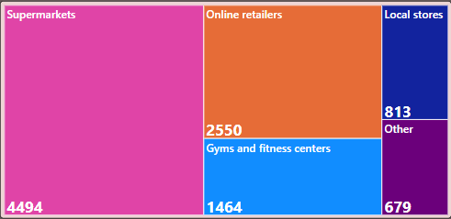
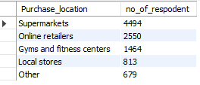
Purchase Behavior
1. Where do respondents prefer to purchase energy drinks?
Supermarkets (about 45%) is the most preferred location to purchase energy drinks
Conclusion

Slide 18
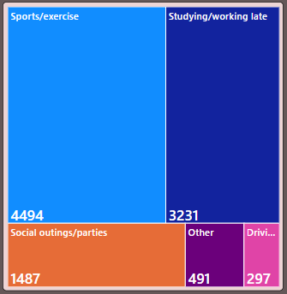
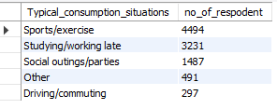
Purchase Behavior
1.What are the typical consumption situations for energy drinks among respondents?
Sport/Exercise is the most typical consumption situations (about 45%) for energy drinks followed by Studying/working late(32%) and
Social outings/parties(15%)
Conclusion

Slide 19
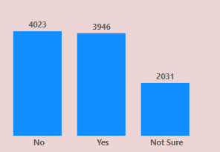

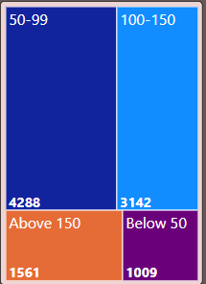

Purchase Behavior
3. What factors influence respondents' purchase decisions, such as price range and limited edition packaging?
About 40% consumers say that limited edition packaging influences purchase decision.
If price range of energy drink is 50-99 people tend to purchase more
Conclusion

Slide 20
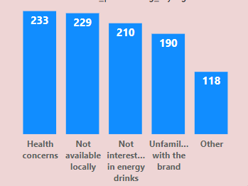
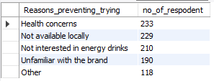
Product Development
Which area of business should we focus more on our product development(Branding/taste/availability)?
Codex should improve their drink by using healthy ingredients and reducing sugar content.
Much focus should also be on availability should be freely available at locally
Conclusion

Slide 21

Secondary Insights
Immediate improvements to the product ?
The ideal price of our product ?
Marketing campaigns, Offers, and Discounts ?
A brand ambassador Who ? And Why ?
Our target audience Who ? And Why ?

Slide 22



Immediate improvements to the product ?
First of all improve energy drink by reducing sugar content , adding healthier ingredients and enhance flavor ranges.
Ensuring the product is available to consumers particularly in local markets, super markets and online stores

Slide 23
The ideal price of our product ?
Optimal price of the drink should be between 50-99 so it would be accessible to more number of consumers and thus increases sales

Slide 24
Marketing campaigns, Offers, and Discounts
Price should be between 50-99 it should be controlled so don’t go over Rs.150
According to survey print media is very less effective than other types hence money invested on it will be put into rewards
We can provide discount on pack of 6 cans or introducing special rated gift set packs which can increases sale

Slide 25
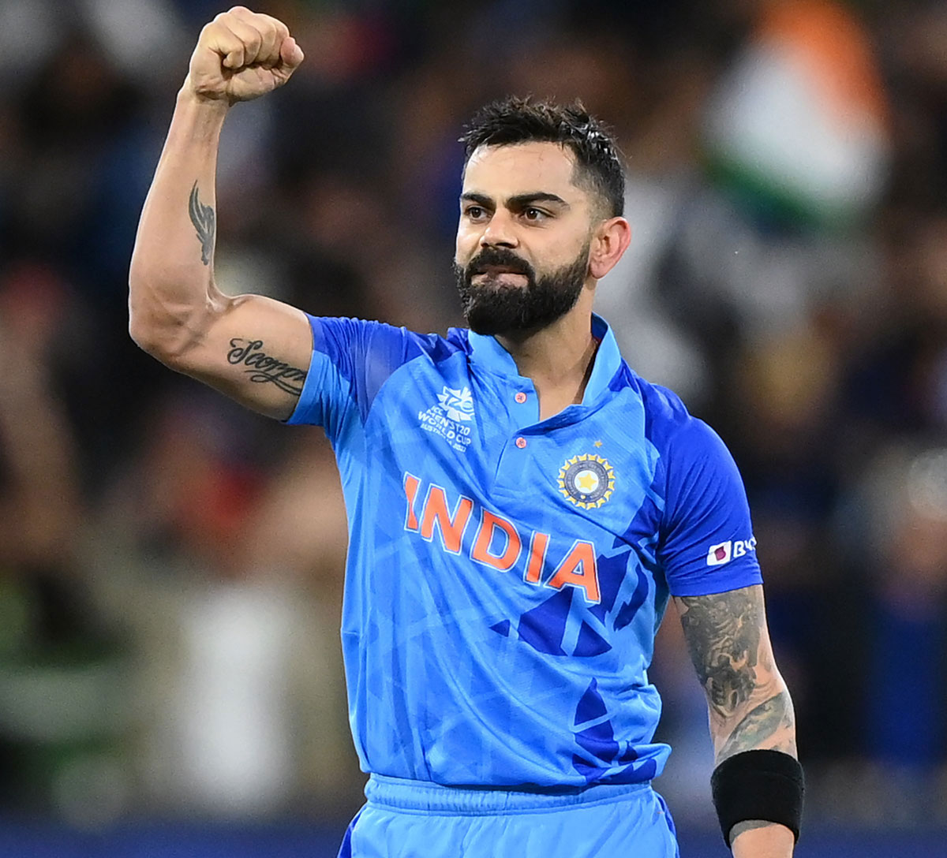
A brand ambassador Who ?
And Why ?
Virat Kohli
One of the fittest and very health conscious known for his discipline towards his game and fitness which is perfect for branding of healthy
energy drink
He is youth icon ,widely followed on social media and does have many
endorsement

Slide 26
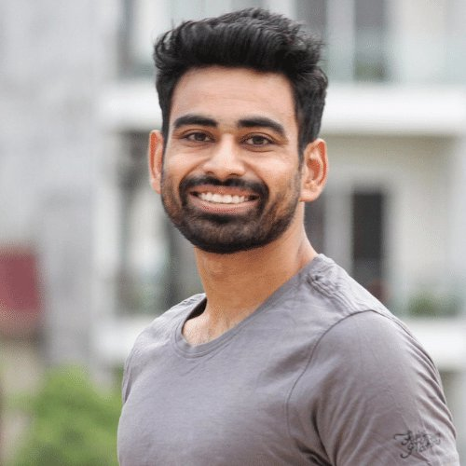
A brand ambassador Who ?
And Why ?
Vivek Mittal
Well known fitness Youtuber with 7.5 M subscriber very famous in social media about his fitness related content
He is youth icon during his journey he has gained immense love and
faith from his followers can be ideal as brand ambassador

Slide 27
Our target audience Who ? And Why ?
CodeX has reached consumers between the age of 19-45 but it should also think about 12-18 aged people who also prefer energy drinks more
In order to appeal to this age group the marketing strategy and product survey should be done appropriately according to age group

Slide 28


Recommendation for Codex
Improving energy drink quality with healthy natural ingredient with low sugar content, increasing flavor ranges
Made freely available to more local markets, shops, malls for easy availability
Targeted ideal price should be between 50—99 as it is preferred by most respondents
Target the youth(12-45)age group as they are more inclined to have energy drink , focus on expanding the targeted age group ae well(12-18)
Virat Kohli or Vivek Mittal Should be approached for the brand ambassador
Locations with lower sales should be focused more with exclusive discounts, coupons and offers
Finding new customers with positive perception which increases the brand reputation

Slide 29


