Slide 1

United Courier
Website Overview • October 2026

Slide 2
Software USP — Why United Courier Platform
One platform for 8+ carriers — UPS, ShipUniversal, ShipGlobal, Overseas, Primus, Flying Tigers, PostShipping, SELF — single manifest flow for all
Exact service routing by service_id — same method name under many providers always hits the right carrier API + service code
Wallet-first billing — recharge (cash/online/API), auto-deduction only after successful booking, full transaction ledger

Slide 3
Software USP — Operations Power
3 order flows — customer self-booking, admin COD, admin Prepaid with auto carrier booking at creation
Bulk upload with guardrails — ServiceType + destination + zone-wise rates, HSN / reference / state validations, per-row rollback
Labels for every need — carrier labels, custom 4x6 courier labels (BOX X OF N), A4 invoice labels, manifest documents
Full shipment lifecycle — draft, ready, packed, manifested, pickup, dispatch, delivered + dispute / cancel / not-received handling

Slide 4
Software USP — Compliance, Tracking & Openness
KYC with verification — GSTIN / Aadhaar / PAN checked via Cashfree, CSB-IV and CSB-V profiles, LUT / bond support
Tracking everywhere — AWB + reference multi-search, public track page, per-package labels with barcodes
NOT_IMPLEMENTED services run internally like SELF — no failed carrier calls, wallet still charged correctly
Open no-auth APIs — wallet recharge, tracking update, COD close + token-based manifest APIs; CMS-driven public website with free tools

Slide 5
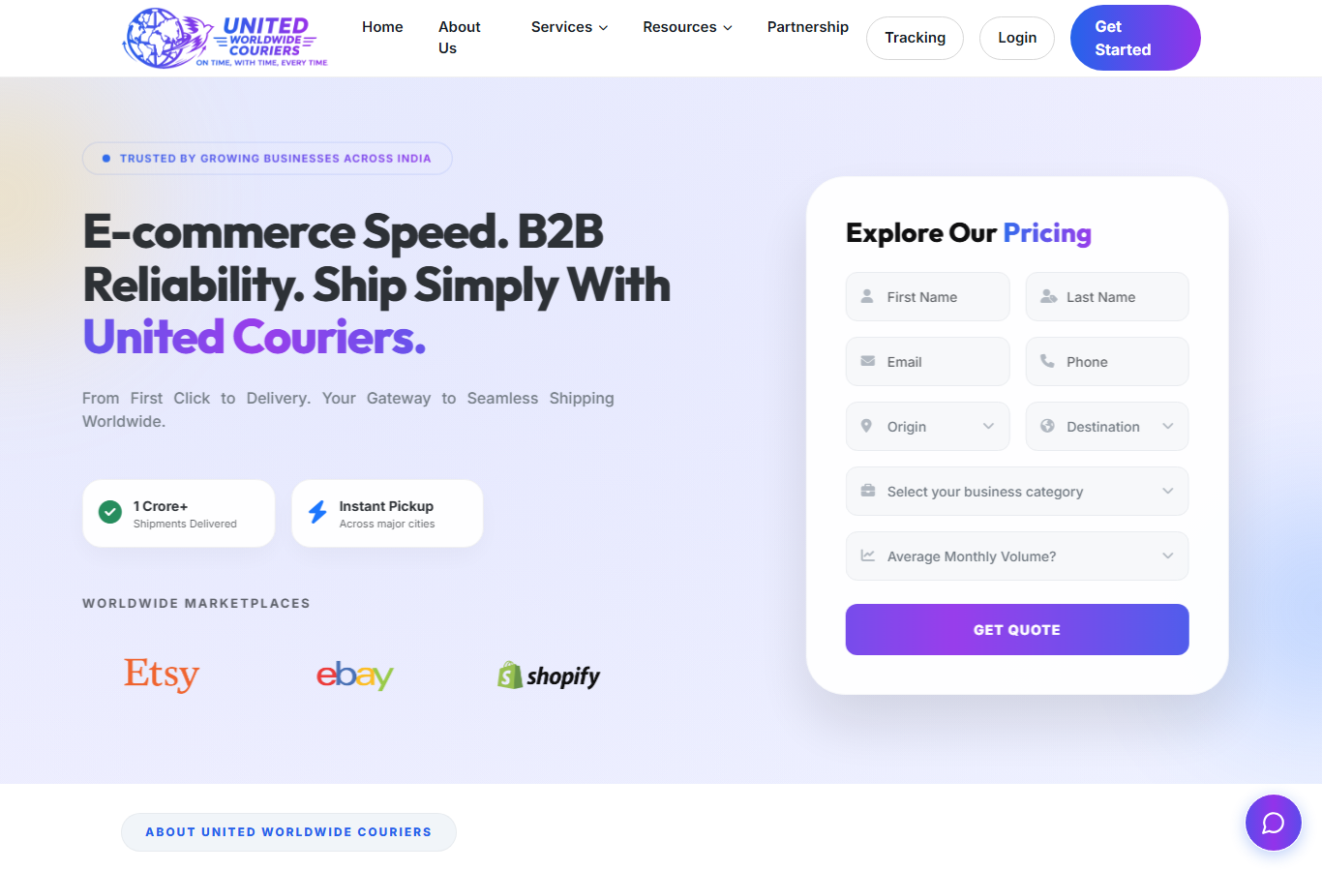
Home Page ( / )
Main landing page with services, tracking entry and key highlights.

Slide 6

About Us ( /about )
Company profile, mission and strengths.

Slide 7

Services ( /service )
Courier and logistics service offerings.

Slide 8
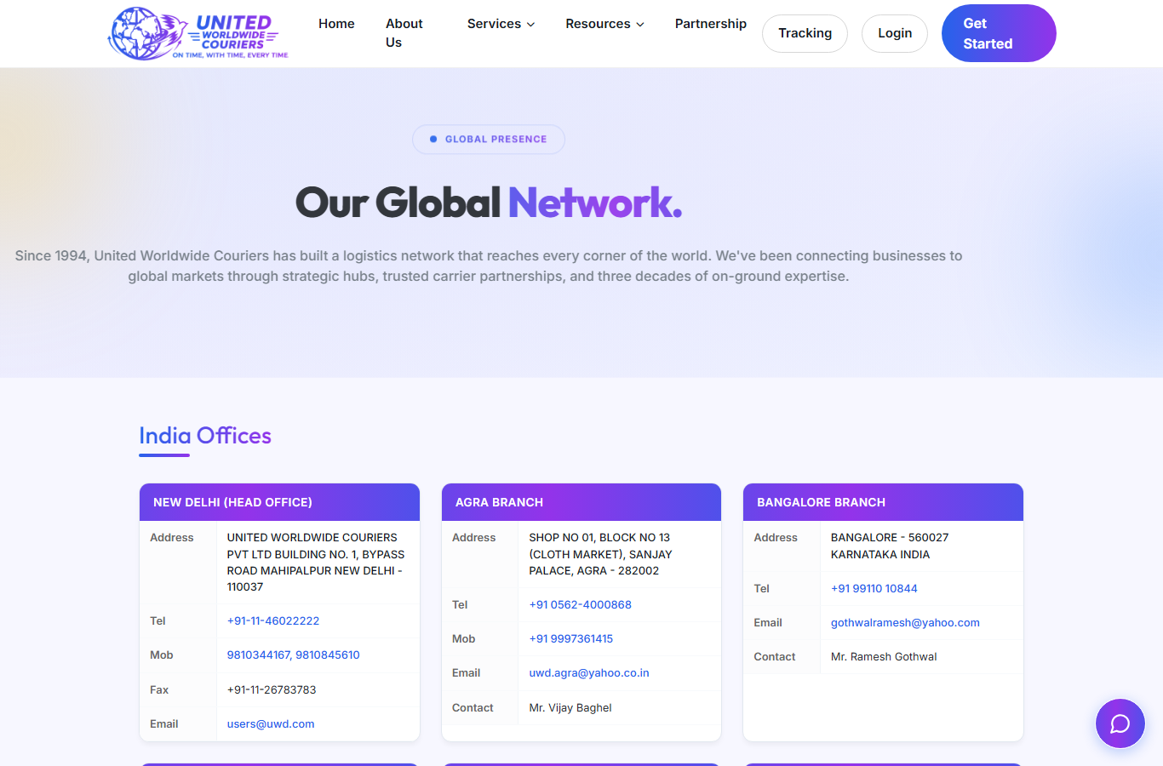
Network ( /network )
Global delivery network coverage.

Slide 9
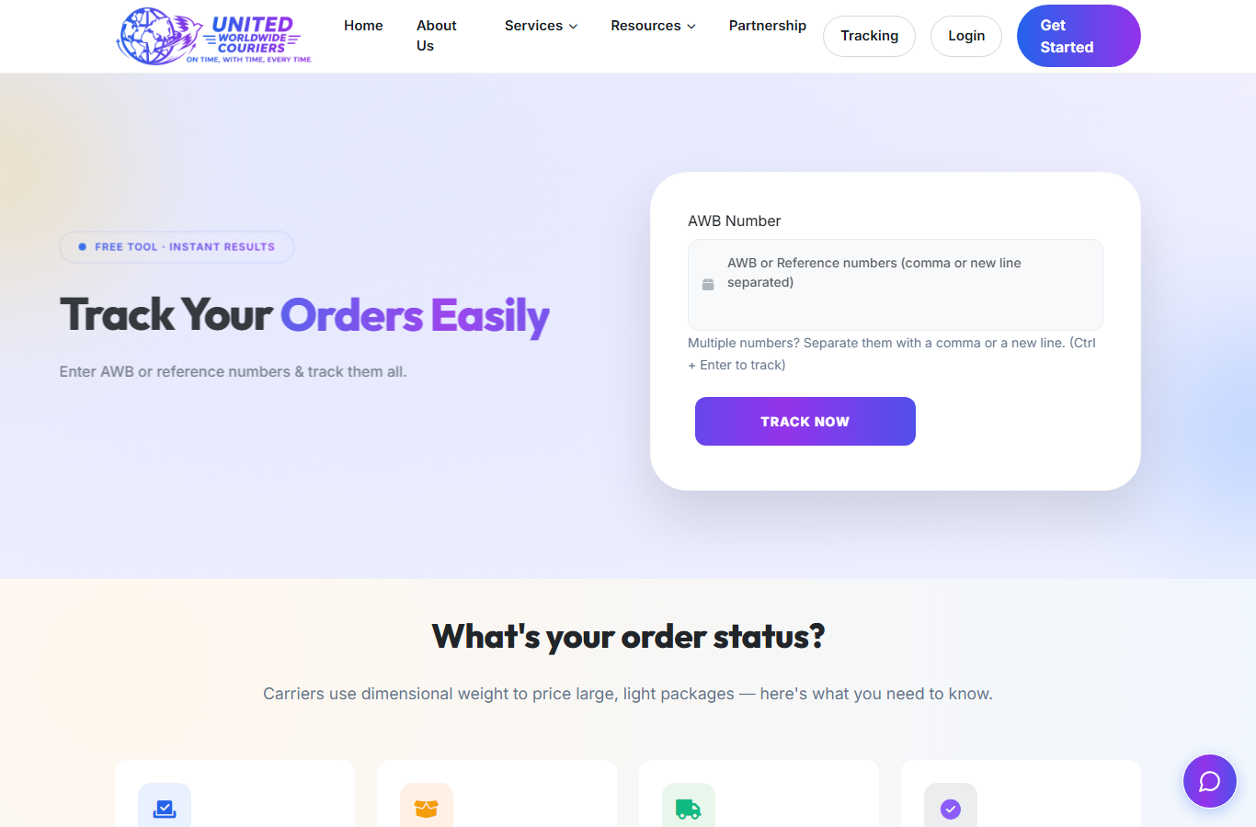
Track Order ( /tracking )
Live shipment tracking by AWB / reference number.

Slide 10
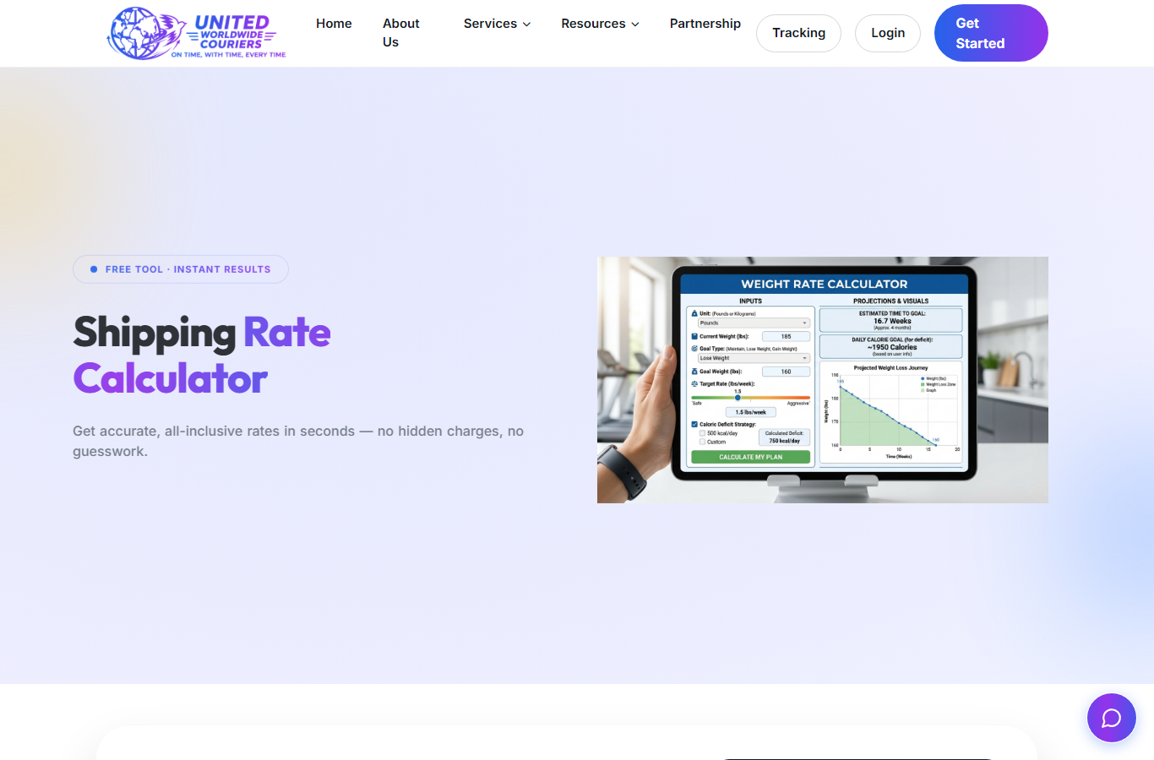
Shipping Rate Calculator ( /shipping-rate-calculator )
Instant rate check by destination, weight and service.

Slide 11
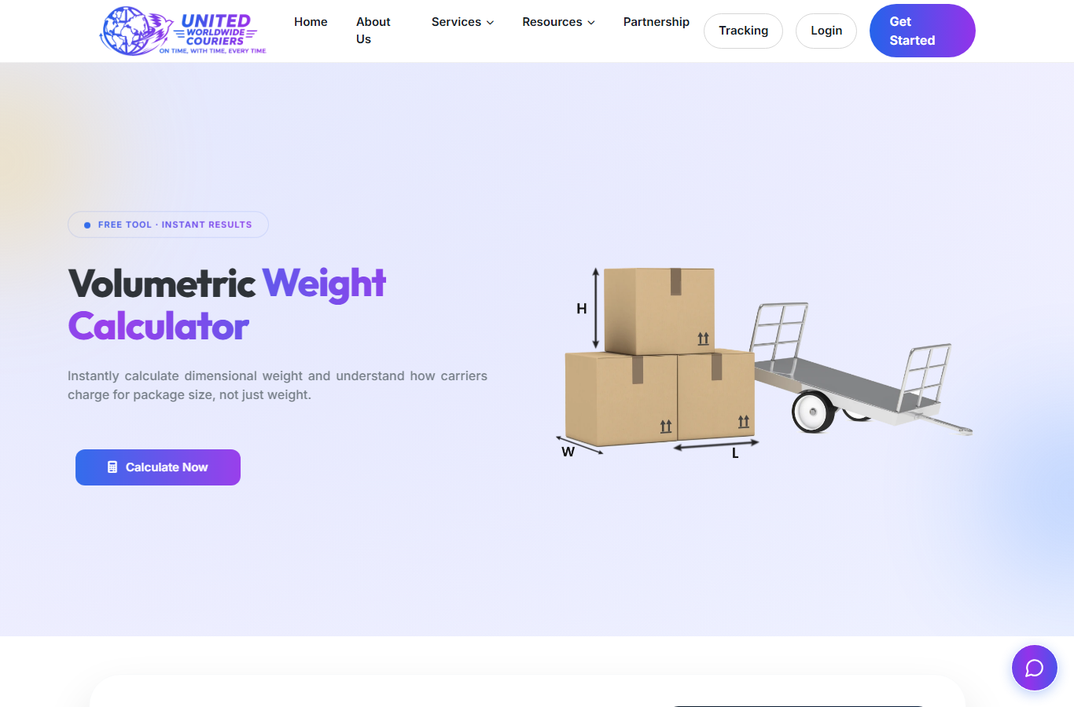
Volumetric Calculator ( /volumetric-calculator )
Volumetric weight calculator for packages.

Slide 12
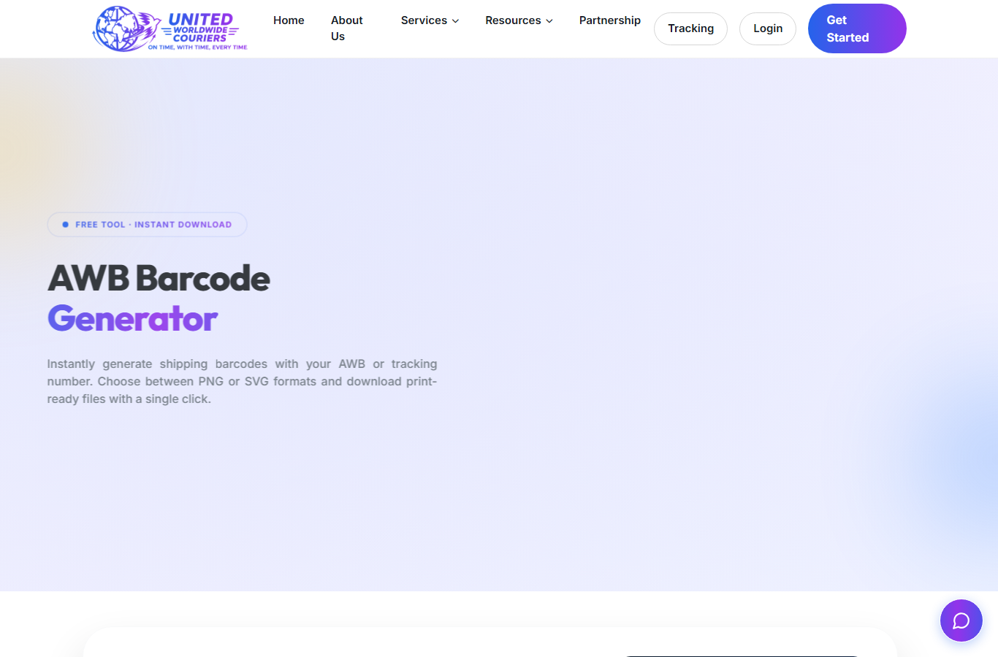
Barcode Generator ( /barcode-generator )
Free AWB barcode generator tool.

Slide 13
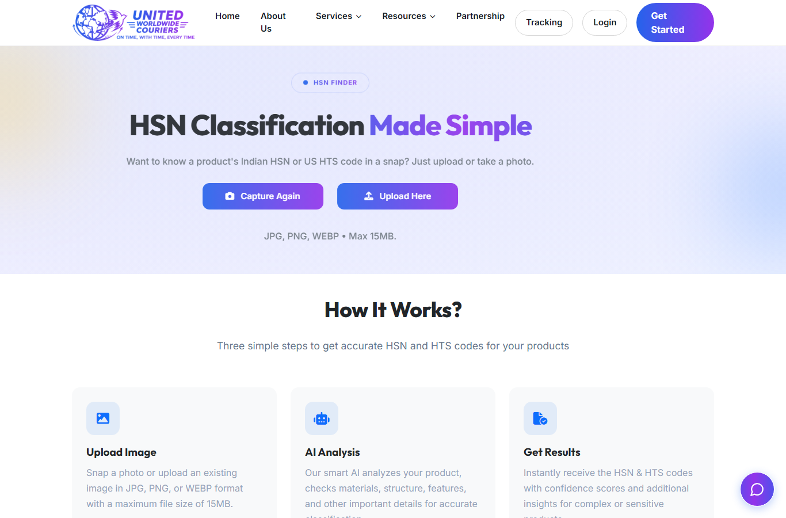
HSN Finder ( /hsn-finder )
HSN code lookup for invoice items.

Slide 14

Currency Calculator ( /currency-calculator )
Currency conversion helper.

Slide 15
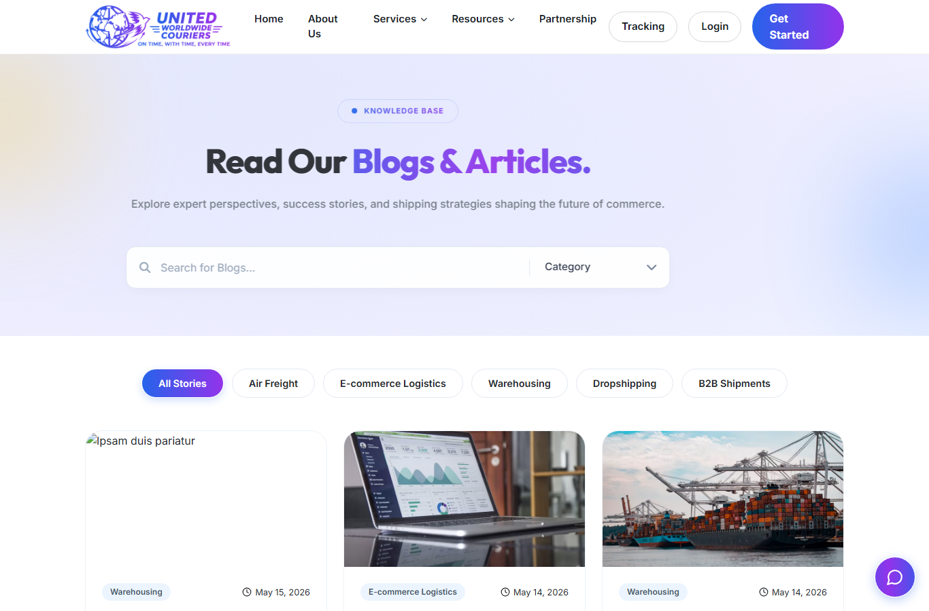
Blogs ( /blogs )
News, guides and logistics articles.

Slide 16
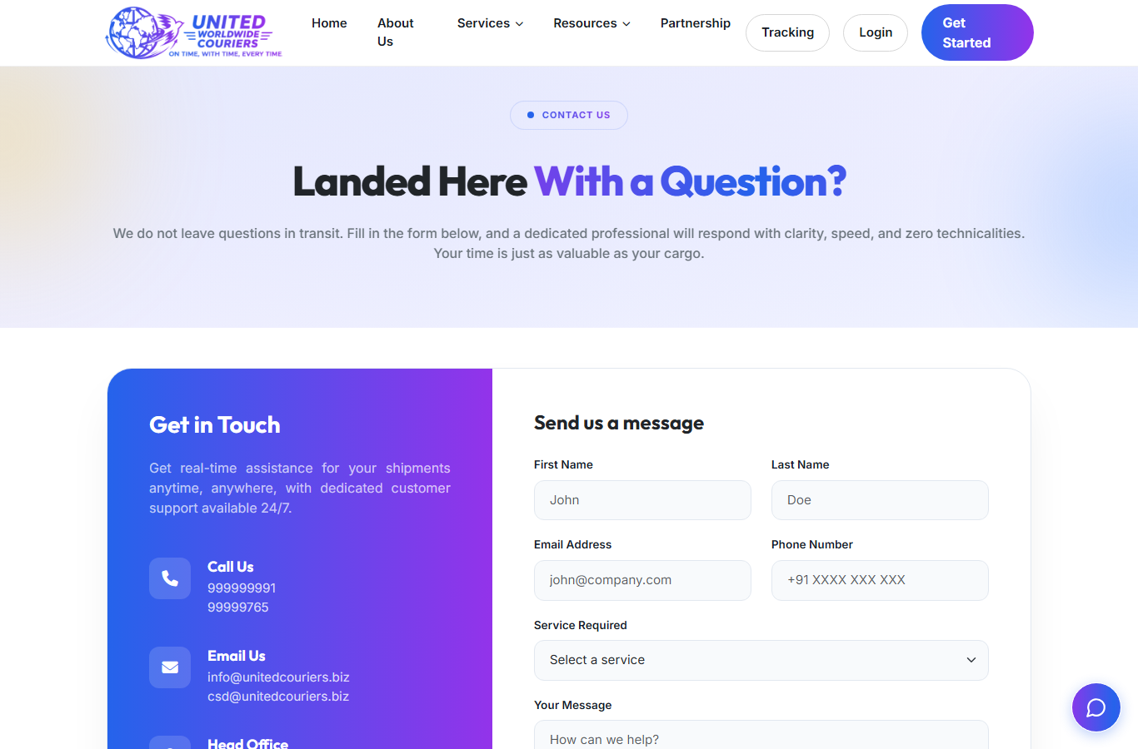
Contact Us ( /contact-us )
Enquiry form and contact details.

Slide 17
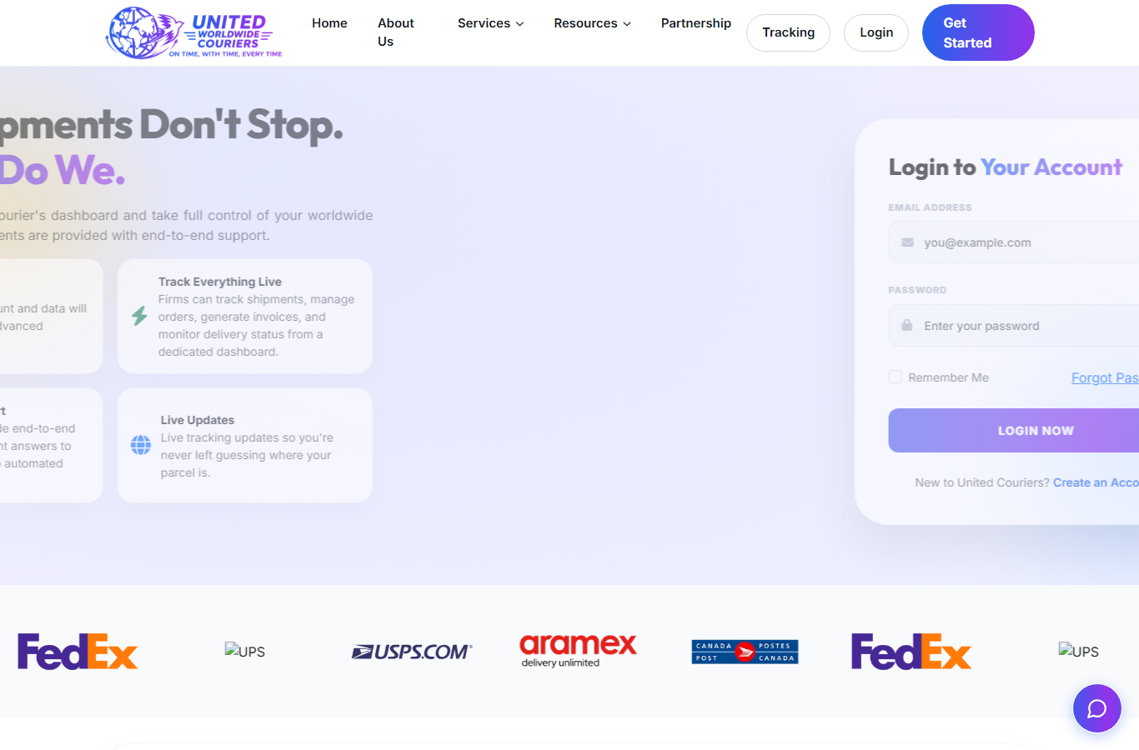
Customer Login ( /login )
Customer portal entry point.

Slide 18
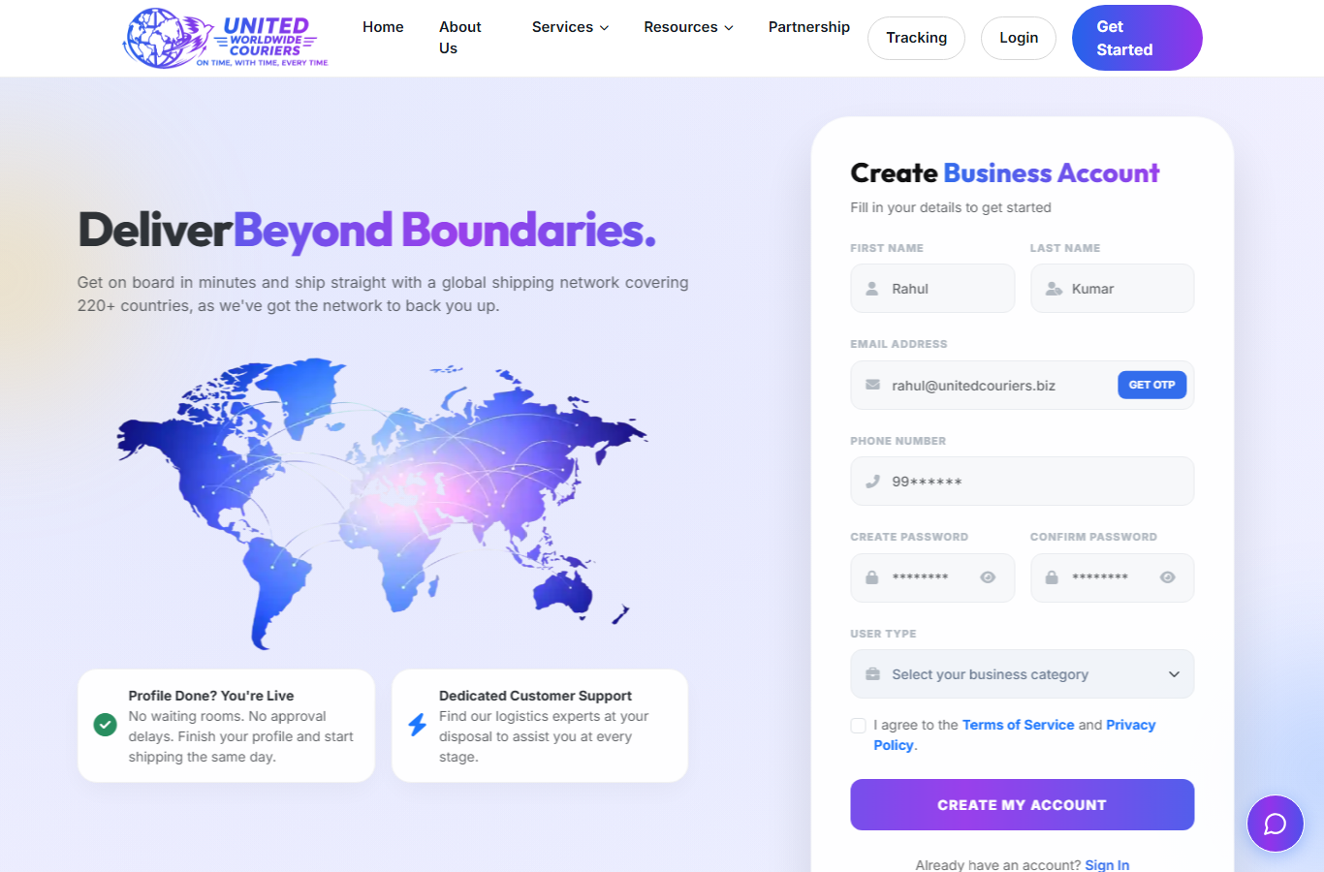
Customer Registration ( /get-started )
New customer onboarding with KYC.

Slide 19
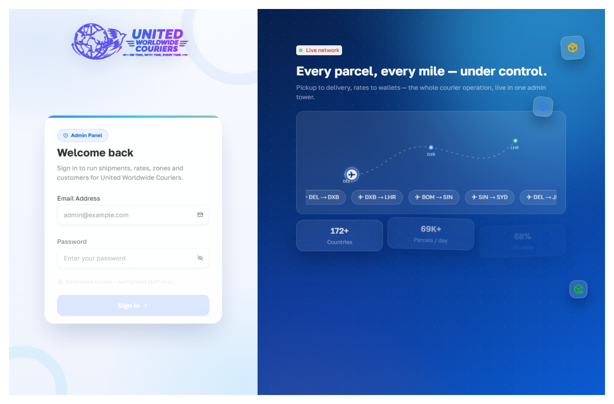
Admin Login ( /admin )
Back-office admin entry point.

Slide 20
Customer Panel (login required)
Create Shipment — shipper, consignee, invoice items, saved consignees
Bulk Upload — Excel shipments with preview, zone-wise rates, validations
View All Shipments — print label (A4 + 4x6), pay, pack, manifest
Manifests — detail, label, document, close, assign for pickup
Wallet — recharge, transactions, shipment-wise deduction

Slide 21
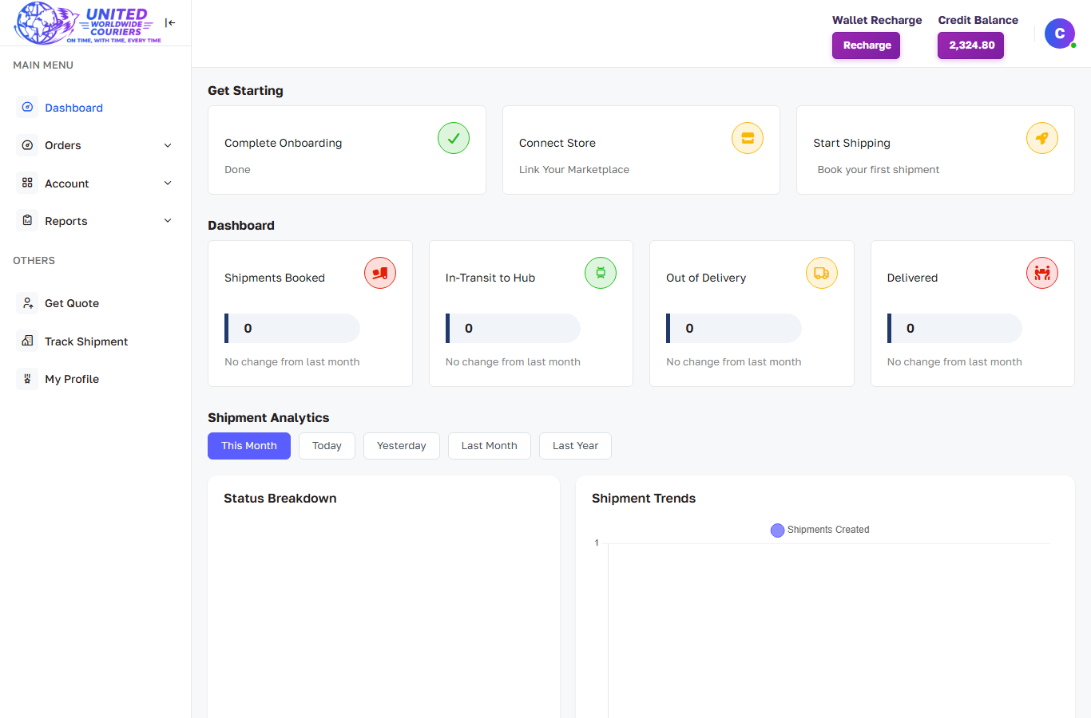
Customer Dashboard
Shipment stats, analytics, wallet balance and quick actions.

Slide 22
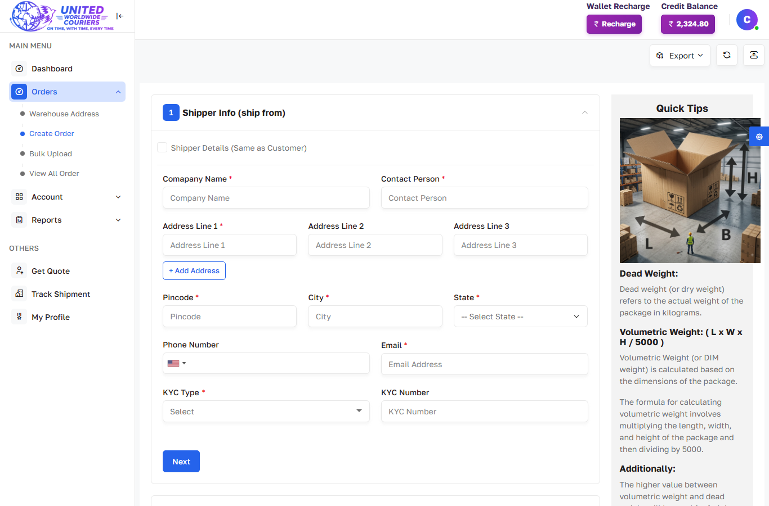
Customer — Create Shipment
Shipper info form with warehouse, exporter-customer and CSB prefill.

Slide 23
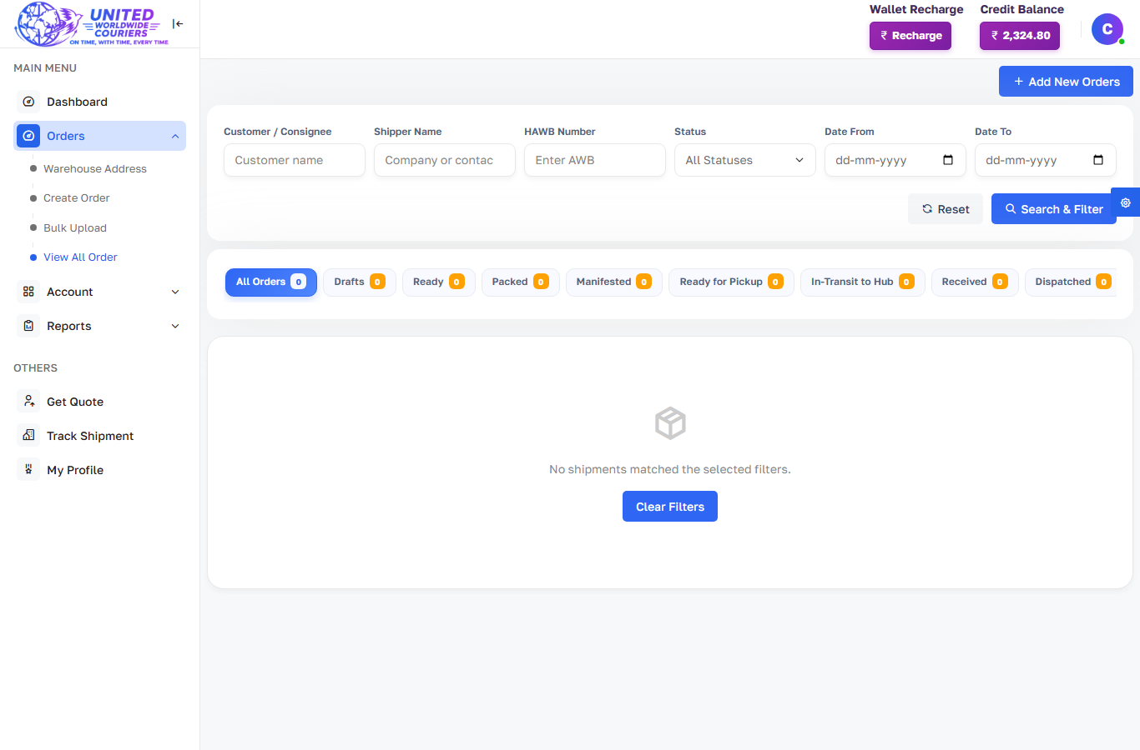
Customer — View All Shipments
All shipments with print, pay, pack and manifest actions.

Slide 24
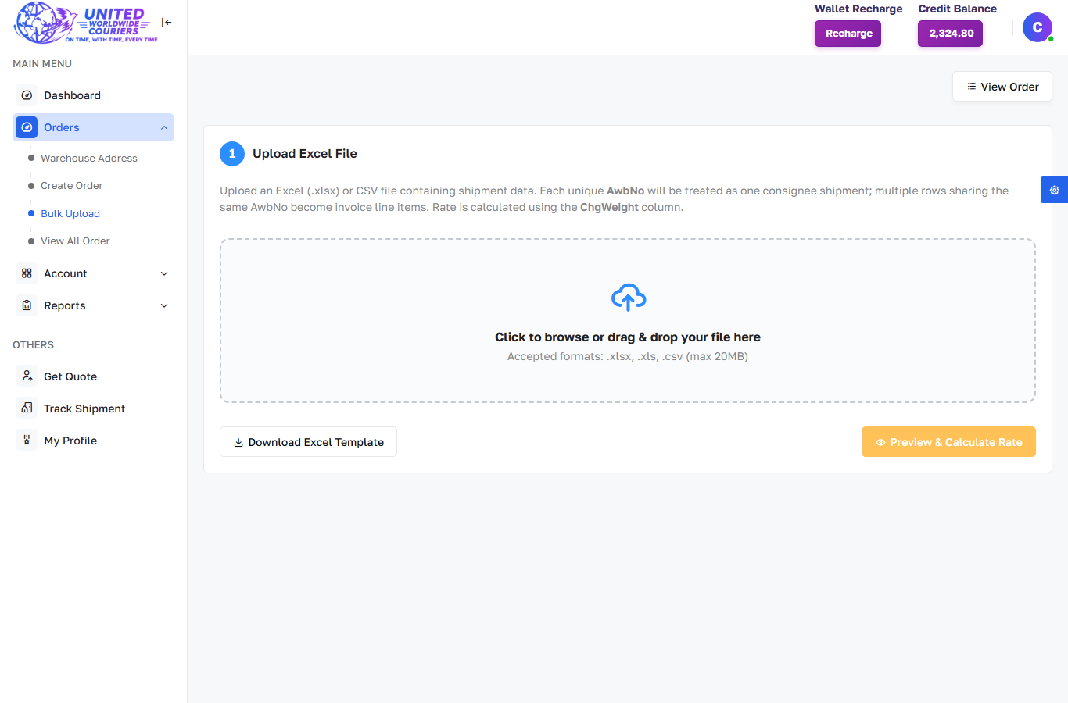
Customer — Bulk Upload
Excel bulk shipment upload with preview and validations.

Slide 25
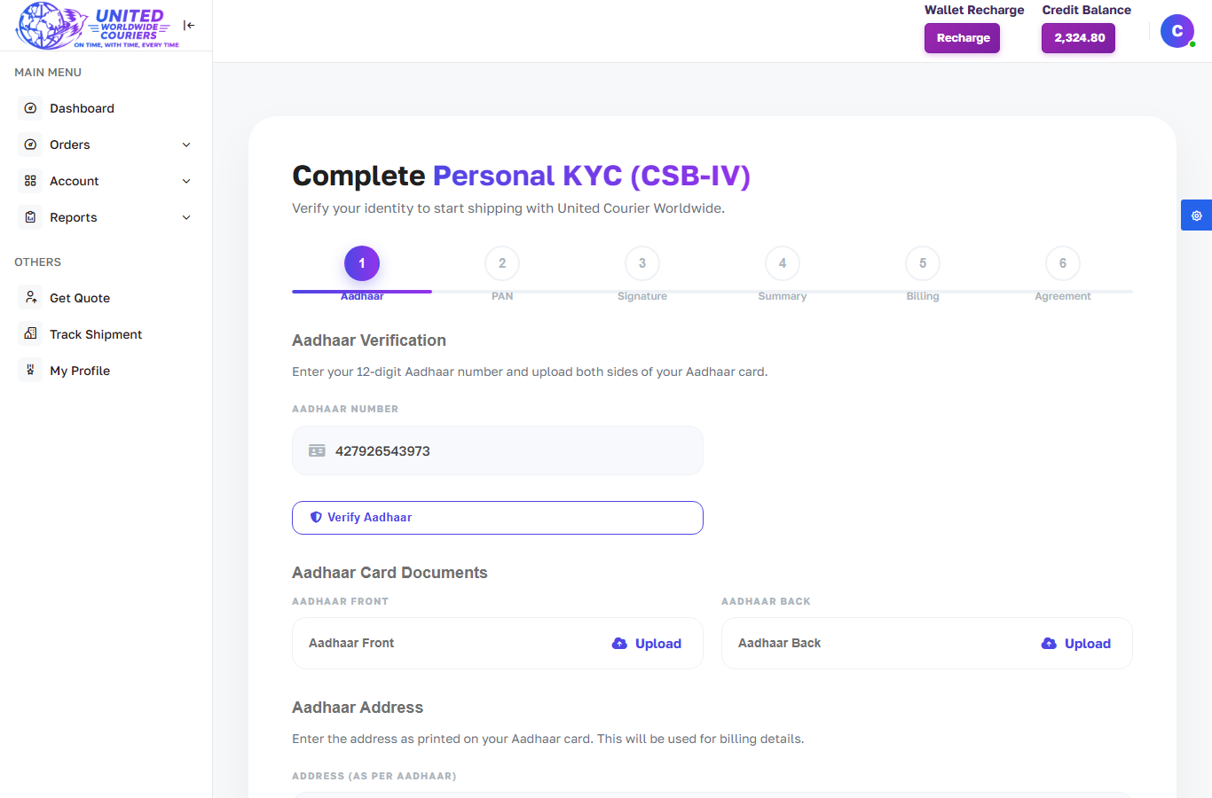
Customer — KYC Personal
Personal KYC submission with document verification.

Slide 26
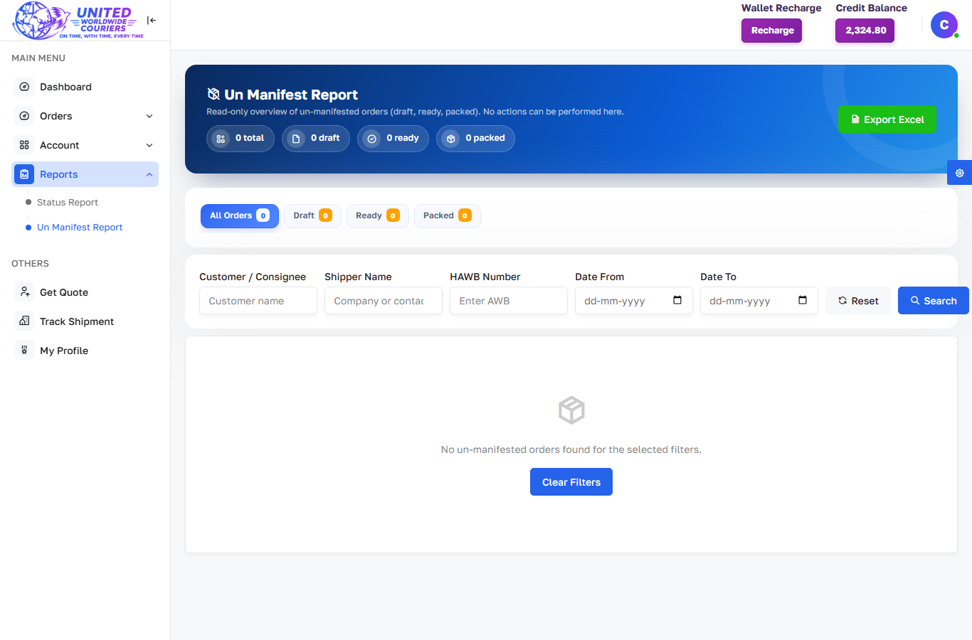
Customer — Un-Manifest Report
Draft/ready/packed (un-manifested) shipments report.

Slide 27
Admin Panel (login required)
Manage Orders — all orders, dispute, cancel, not-received, NOT_IMPLEMENTED data
Manage COD / Prepaid — create order, all orders, manifests, labels
Rates — upload/match courier rates, zones, countries
Wallet — customer recharge, transactions, dispute deductions
Website CMS — home, blogs, calculators, barcode generator content

Slide 28
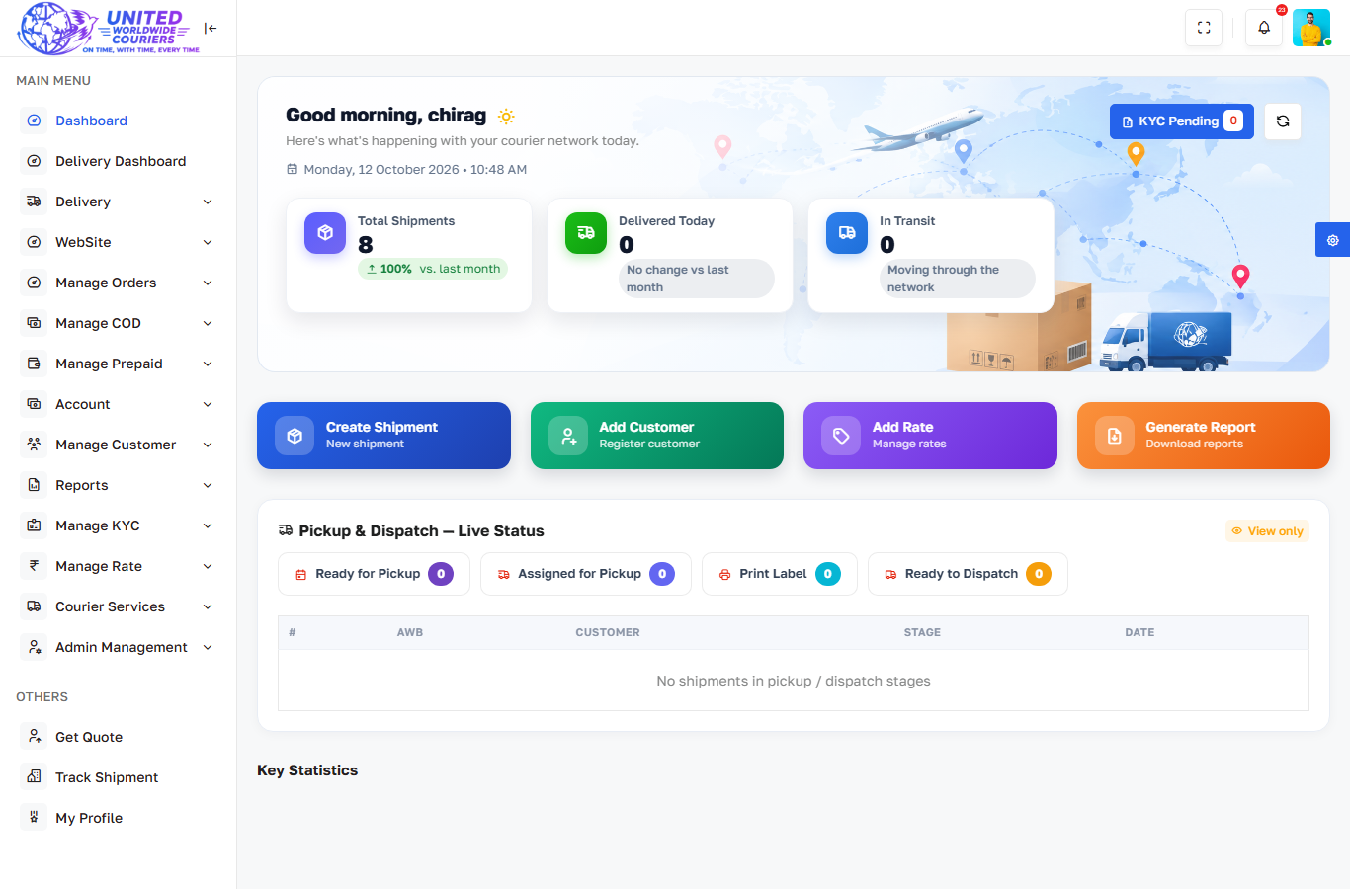
Admin Dashboard
Network-wide stats, pickup/dispatch live status and shortcuts.

Slide 29
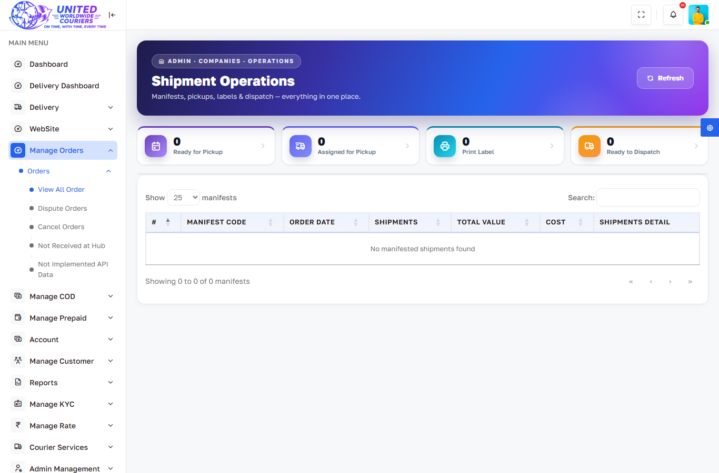
Admin — All Orders (Companies)
Every shipment with pickup, receive and dispatch actions.

Slide 30
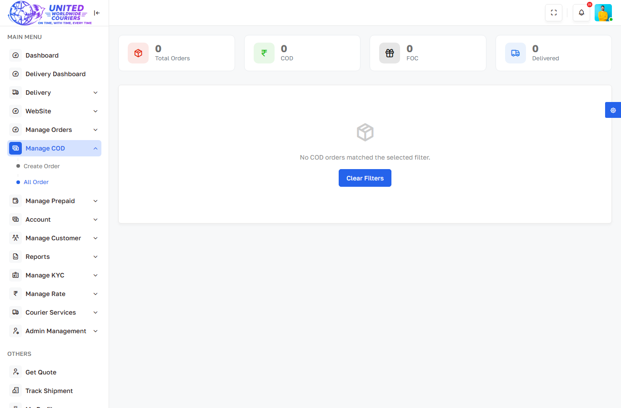
Admin — COD All Orders
Cash-on-delivery orders with labels and close-order flow.

Slide 31
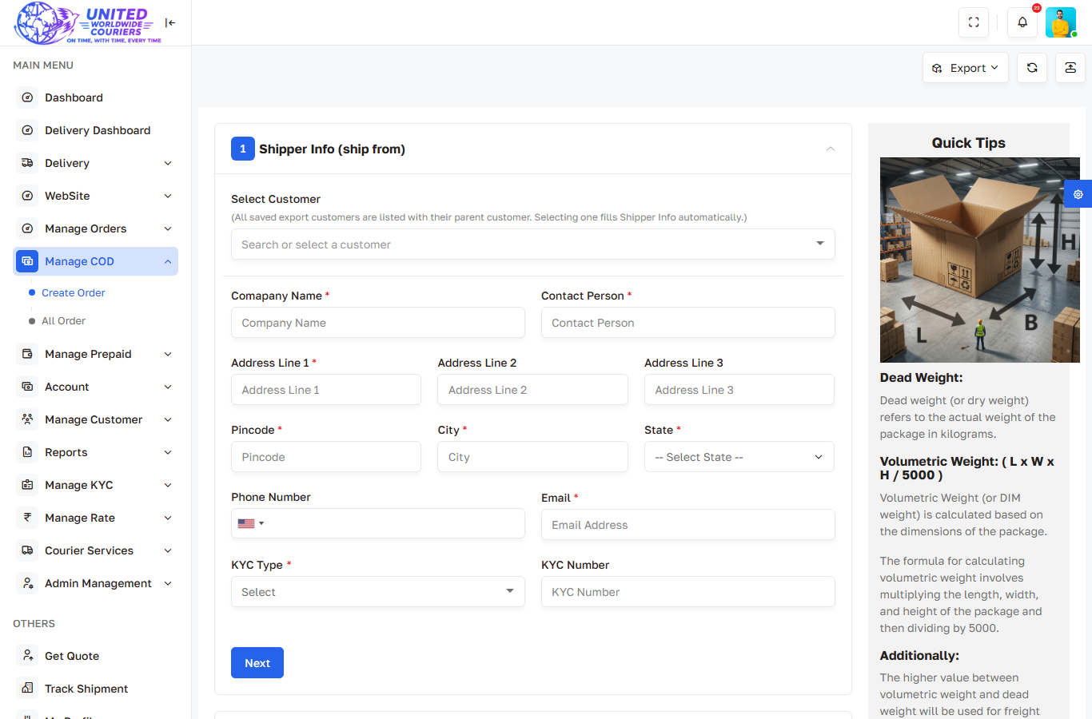
Admin — COD Create Order
COD order creation with exporter customer + bill-to.

Slide 32
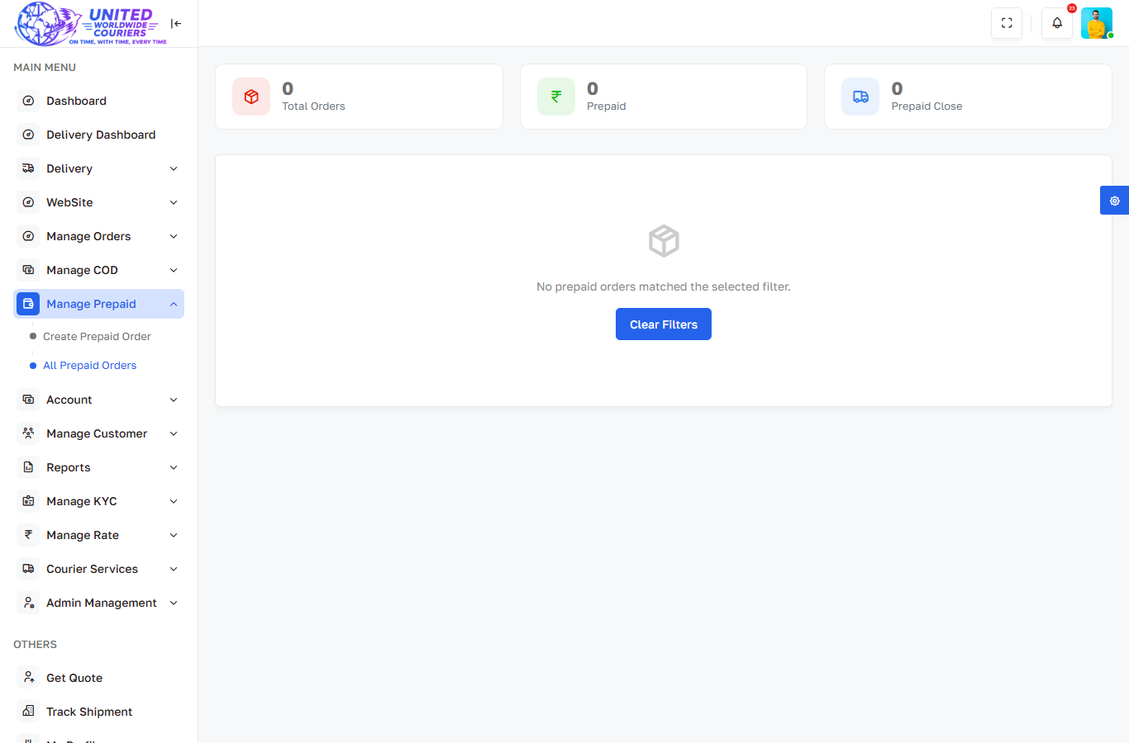
Admin — Prepaid All Orders
Prepaid orders with manifests and labels.

Slide 33
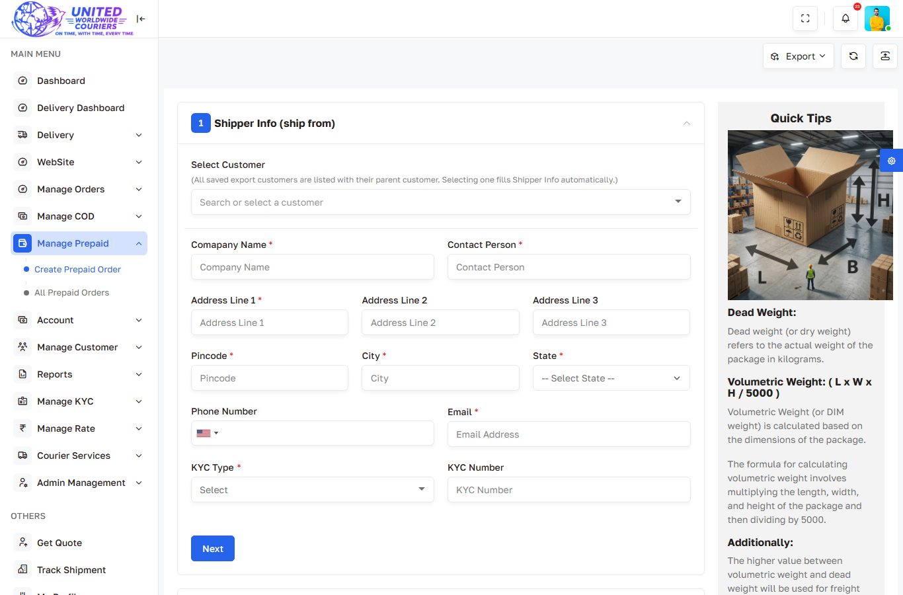
Admin — Prepaid Create Order
Prepaid order creation with carrier booking.

Slide 34
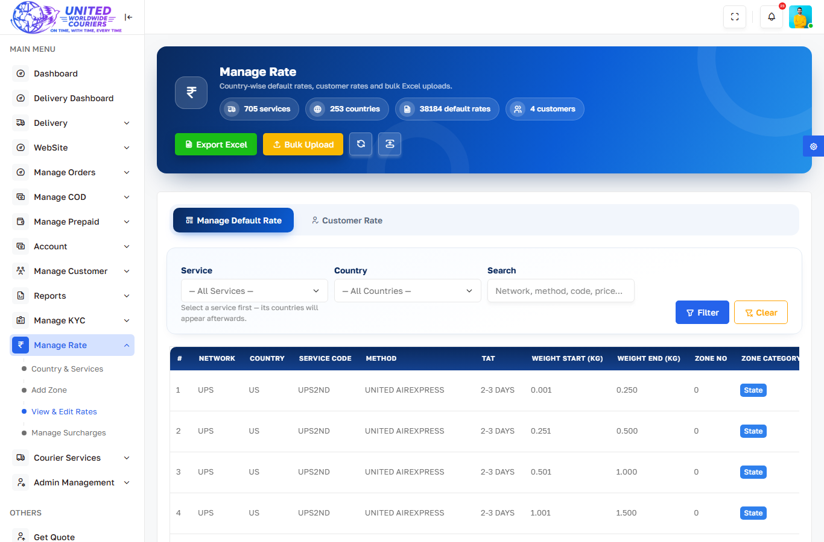
Admin — Manage Rates
Courier rate upload, zones and country mapping.

Slide 35
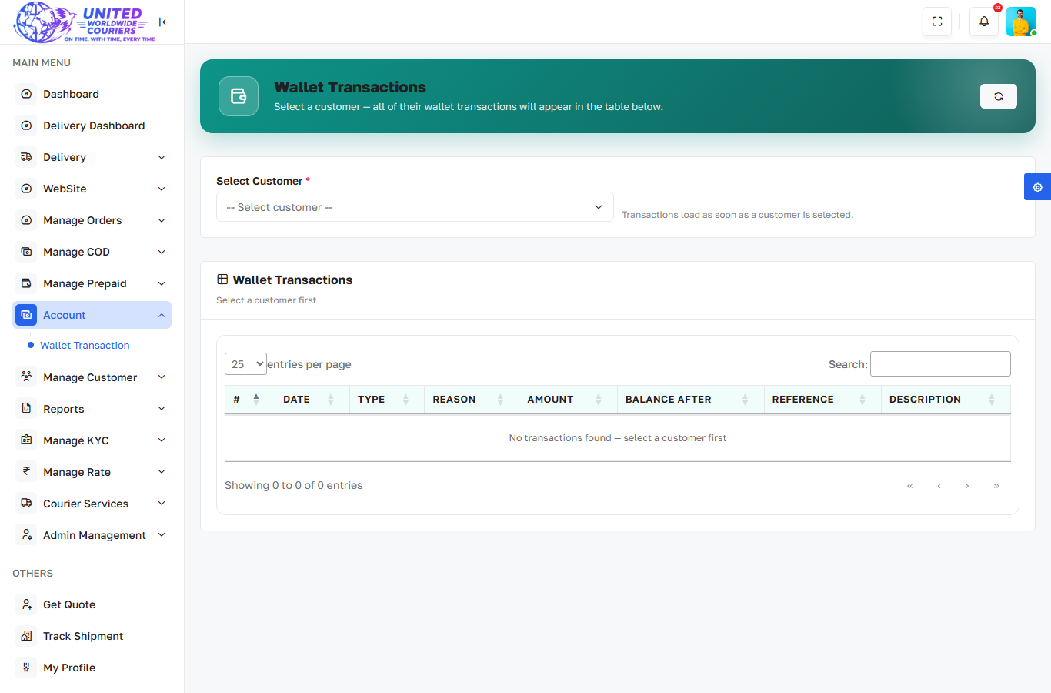
Admin — Wallet Transactions
Customer wallet credits, debits and dispute charges.

Slide 36
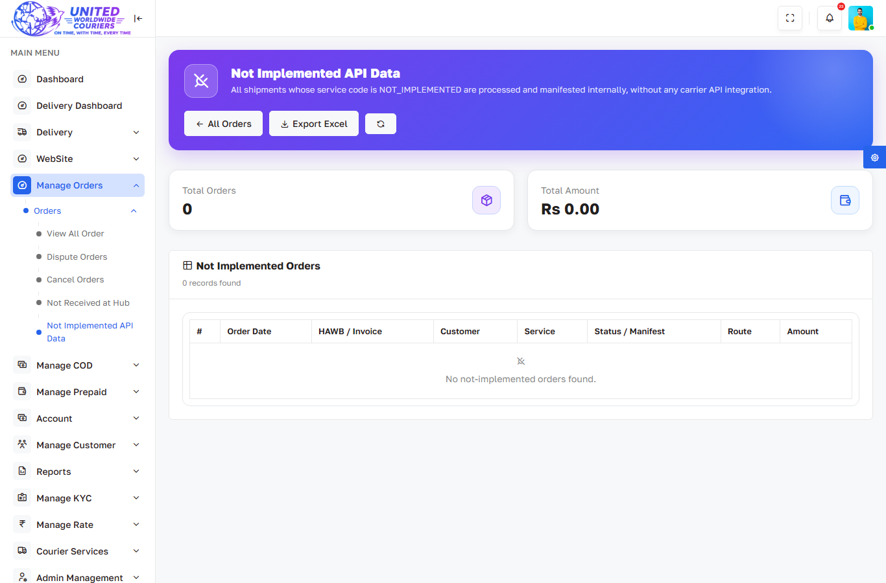
Admin — Not Implemented API Data
NOT_IMPLEMENTED service orders with Excel export.

Slide 37
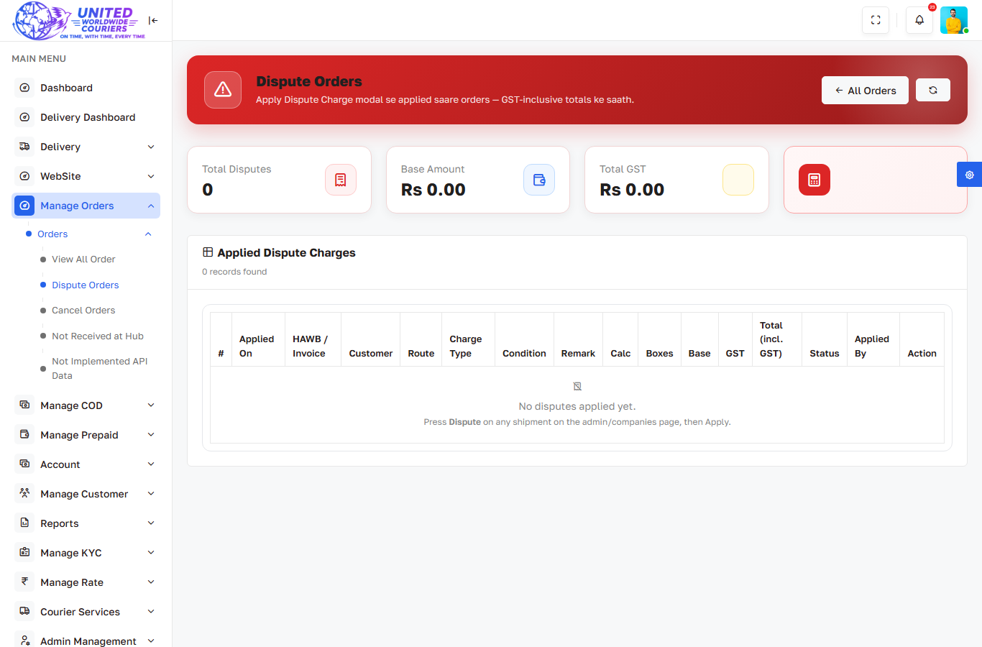
Admin — Dispute Orders
Disputed shipments with charge handling.

Slide 38
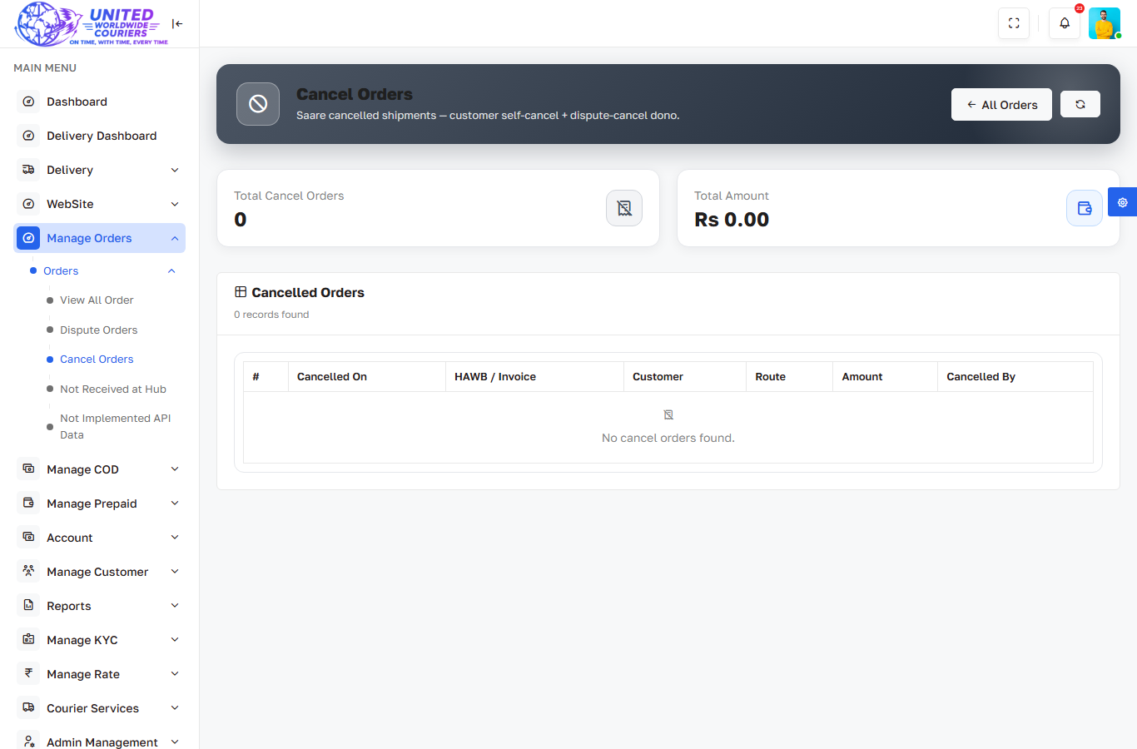
Admin — Cancel Orders
Cancelled shipments audit.

Slide 39
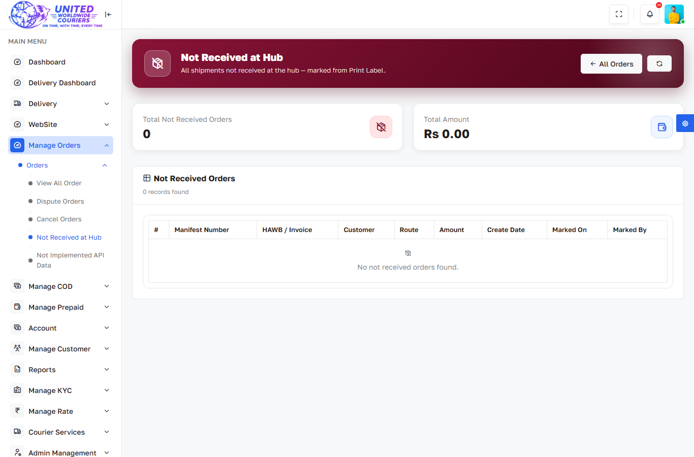
Admin — Not Received at Hub
Hub non-receipt tracking.

Slide 40
Open APIs (no auth)
POST /api/wallet-recharge — {customer_code, recharge_type, amount}
POST /api/update-tracking — {awb_number, tracking_number} (NOT_IMPLEMENTED only)
POST /api/close-cod — close COD/FOC order by AWB
POST /api/v1/... — token-based customer manifest APIs

Slide 41
Thank You
United Courier • unitedcouriers.biz

