Slide 1
Blood Glucose Forecasting Chirag Ahuja 19th November 2019

Slide 2
Project analysis slide 2
RoadMap
Problem Summary
Data Analysis
Approach
Features
Label
Machine learning model used
Loss function
Accuracy Measure
Result
Next Steps

Slide 3
Project analysis slide 2
Problem Summary
Problem Statement
Build a ML algorithm which can make predictions of future(60 minutes) blood glucose values, based on previously measured values(of blood glucose, heart rate and activity).
Aim
Diabetic people get early warnings to mitigate the effects(strokes, heart attack etc) of diabetes. These early warning gives them motivation to exercise.
Data Set
Distance Activity Data
Heart Rate Data
Blood Glucose Data

Slide 4
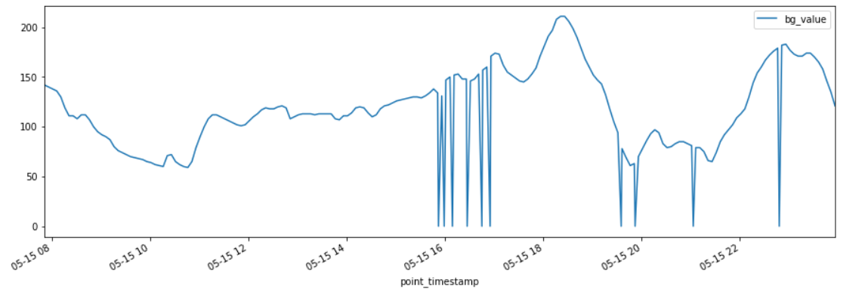
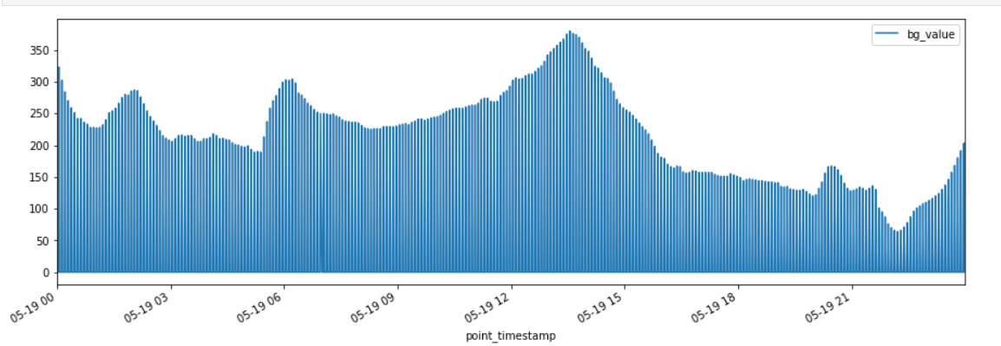
Project analysis slide 2
Data Analysis
Blood Glucose variation across a day
Blood Glucose
Blood Glucose
Time
Time
05-15 08 : 15 May 8 AM
Missing values are marked zero
Inference : Blood Glucose varies at each hour of day. Maybe hour of the day could be an important feature because it correlates with when the person had food.

Slide 5
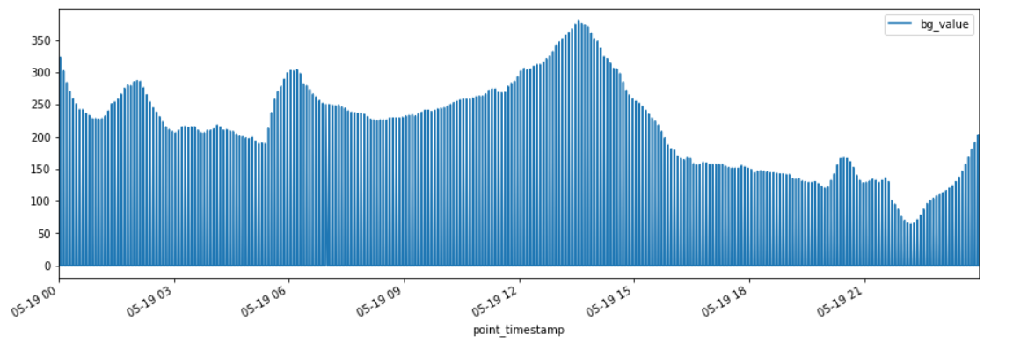
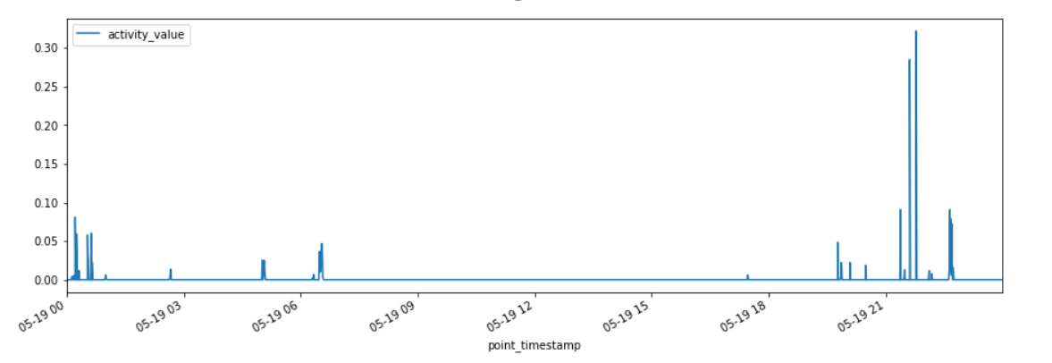
Project analysis slide 2
Data Analysis
Blood Glucose
These 2 graphs are aligned in x axis(i.e. time)
Activity Value
Time
Inference : Looking at the above figures it seems that activities does affect blood glucose(but it has a delayed effect).

Slide 6
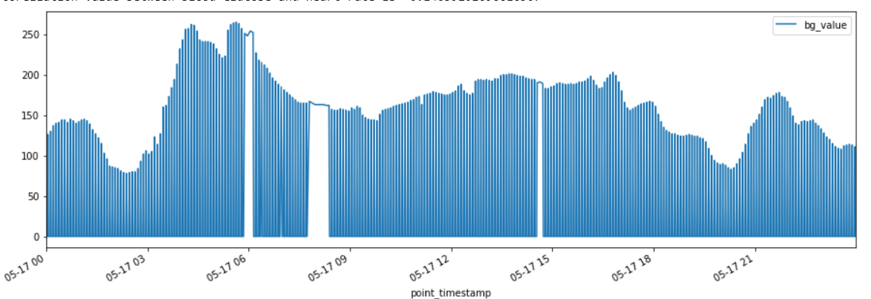
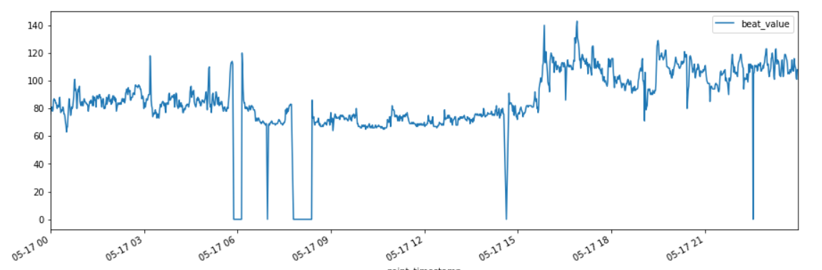
Project analysis slide 2
Data Analysis
Blood Glucose
These 2 graphs are aligned in x axis(i.e. time)
Heart Rate
Time
Inference : Looking at the above figures it seems that heart rate does affect blood glucose(but it has a delayed effect).

Slide 7
Project analysis slide 2
Approach
Features :
Blood Glucose Values : Mean of last 2,5,10,15 samples
Using variation in previous samples of blood glucose to predict future values.
Heart Rates Values : Mean of last 2,5,10,15,20 samples
Using Heart rate value as we have seen that it impacts blood glucose.
Hour of the day
Label
12 Blood Glucose values for next hour (at an interval of 5 minutes).
Machine Learning Model used : Random Forest
Loss Function : mean squared error
Accuracy Measure : Clarke Error Grid

Slide 8
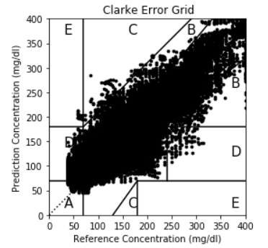
Project analysis slide 2
Results
Test Accuracy (40% values of dataset)
Clarke Zone A + Clarke Zone B = 94%
R-squared Value : 0.84

Slide 9
Project analysis slide 2
Next Steps
Use Activity Data as features to ML Model
Error Analysis of samples in Clarke Zone C, D & E.
Find a metric to compare the similarity of two timeseries.
Use LSTM on this problem.

Slide 10
Thank You

