Slide 1
DDoS attack detection using Deep Learning
Cyber Security (IT750)
Submitted By:
Chirag Bavishi (222IT005)
Jay Koradiya (222IT014)

Slide 2
Problem Statement
To leverage the power of deep learning algorithms to analyze network traffic patterns and identify anomalous behavior associated with DDoS attacks. The project will involve collecting and pre-processing a large dataset of network traffic, designing and training a deep learning model, and evaluating the model's performance in terms of accuracy, precision and recall.

Slide 3
Lierature Review
Paper Name | Author | Journal | Methodology | Summery
A Hybrid Deep Learning Approach for Replay and DDoS Attack Detection in a Smart City[1] | ASMAA A., ABBAS JAMALIPOUR, KUMUDU S. | IEEE Access, 2021 | To address this problem, the authors propose a deep learning approach that combines the strengths of both convolutional neural networks (CNNs) and long short-term memory (LSTM) networks. The approach involves analyzing the traffic patterns of incoming data packets and using the CNN to extract features, followed by the LSTM to analyze the temporal relationships between the extracted features. | The authors conducted experiments using real-world traffic data from a smart city environment and compared the performance of their approach to other commonly used methods. The results showed that the proposed approach was able to accurately detect and prevent replay and DDoS attacks, outperforming other methods.
AE-MLP: A Hybrid Deep Learning Approach for DDoS Detection and Classification[2] | YUANYUAN WEI , JULIAN JANG, FARIZA SABRINA,AMARDEEP SINGH, WEN XU | IEEE Acess, 2021 | The proposed method compares two deep learning models: an autoencoder (AE) and a multi-layer perceptron (MLP). The AE is used for unsupervised feature learning to extract meaningful features from network traffic data. The MLP is used as a classifier to distinguish between normal traffic and DDoS attacks based on the learned features. | The authors evaluated the performance of the proposed method using the NSL-KDD dataset, and compared it with other state-of-the-art methods. The results showed that the proposed AE-MLP method outperformed other methods in terms of detection accuracy and classification accuracy.

Slide 4
Continued...
Paper Name | Author | Journal | Methodology | Summery
An Evolutionary SVM Model for DDOS Attack Detection in Software Defined Networks[3] | KSHIRA SAGAR SAHOO , BATA KRISHNA, KSHIRASAGAR NAIK, SOMULA RAMASUBBAREDDY | IEEE Acess, 2021 | The proposed approach an evolutionary algorithm with a Support Vector Machine (SVM) model to enhance the accuracy of DDoS attack detection in SDNs. The evolutionary algorithm is used to optimize the SVM parameters to improve its performance in detecting DDoS attacks. The SVM model is trained using a set of features extracted from network traffic data, such as packet size, packet rate, and payload size. | The authors evaluated the performance of the proposed approach using the KDD Cup 1999 dataset, which contains both normal and attack traffic. The results showed that the proposed evolutionary SVM model outperformed other state-of-the-art methods in terms of accuracy, precision, and recall in detecting DDoS attacks.
Protocol-Based Deep Intrusion Detection for DoS and DDoS Attacks Using UNSW-NB15 and Bot-IoT Data-Sets[4] | MUHAMMAD ZEESHAN , QAISER RIAZ, MUHAMMAD AHMAD BILAL, MUHAMMAD K. SHAHZAD1 | IEEE Acess, 2021 | The paper evaluates the performance of the proposed system on various metrics such as accuracy, precision, recall, and F1-score. The results show that the proposed system achieves high accuracy and outperforms existing IDS systems on both datasets. | The paper concludes that the proposed deep learning-based IDS can effectively detect DoS and DDoS attacks by leveraging protocol-based features from network traffic data. It also highlights the importance of using publicly available datasets for training and evaluating IDS systems to promote transparency and reproducibility in the field of cybersecurity.

Slide 5
Dataset
We have used CoAP-DDoS dataset for the experiment.
It consists network traffic with around 10,00,000 attack traffic and normal traffic.
Attribute for traffic single are taken from Wireshark consists attributes like frame length, header length, source IP, port etc.
We have taken 25 attributes from the dataset.

Slide 6
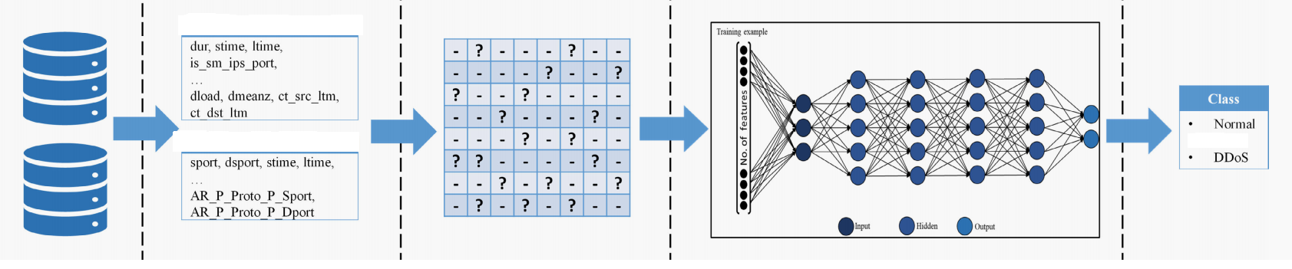
Methodology

Slide 7
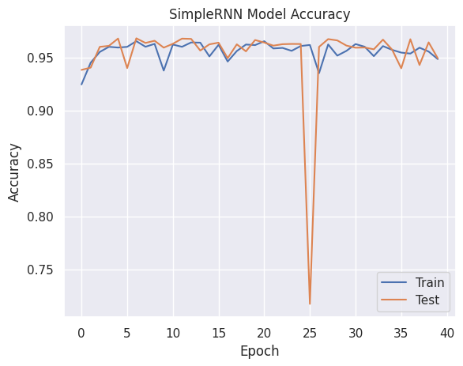
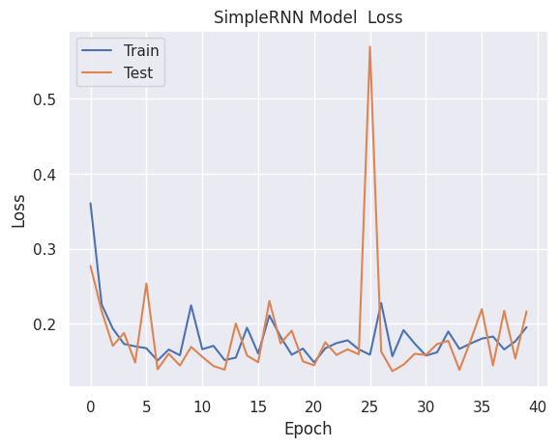
Results
1) Simple RNN

Slide 8
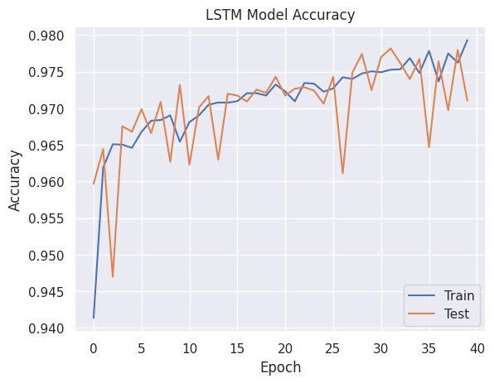
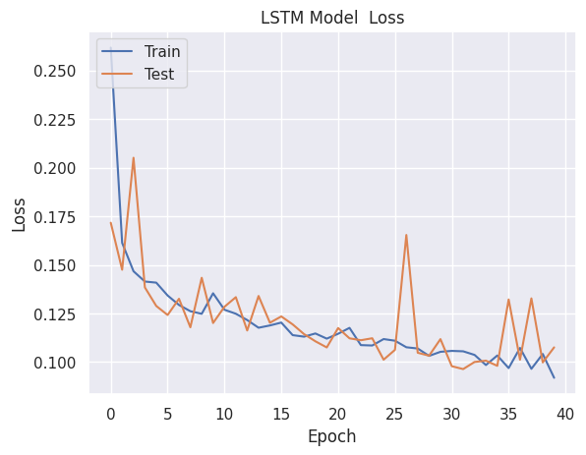
Results
2) LSTM

Slide 9
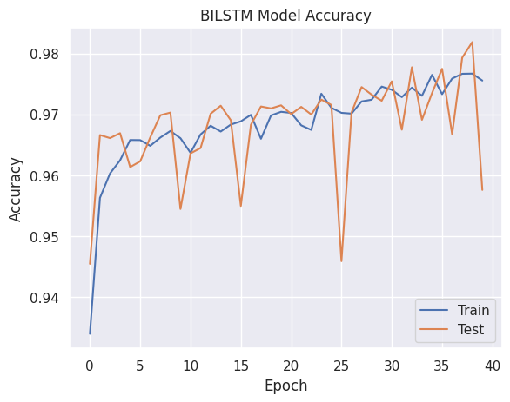
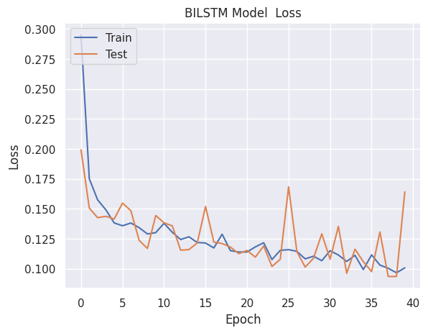
Results
3) Bi-Directional LSTM

Slide 10
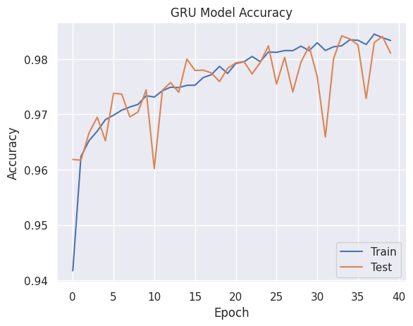
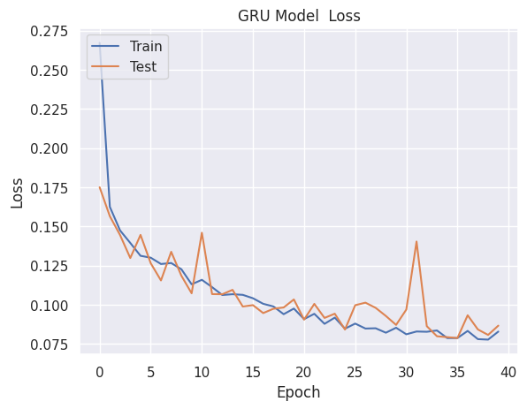
Results
4) GRU

Slide 11
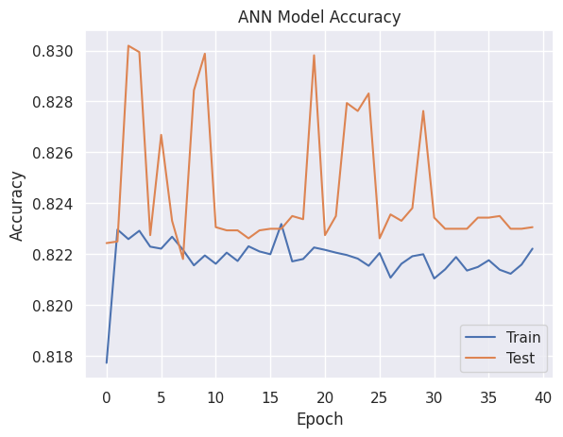
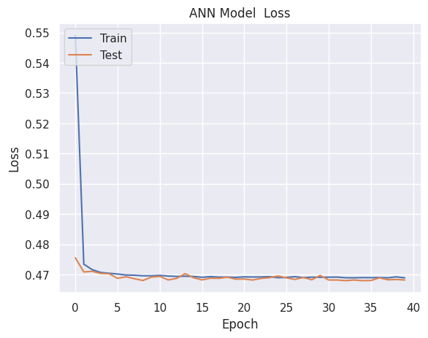
Results
5) ANN

Slide 12
Results
Accuracy, Recall and Precision comparison of various deep learning models
 | RNN | LSTM | BLSTM | GRU | ANN
Accuracy | 94.87% | 97.08% | 95.65% | 98.07% | 82.38%
Precision | 91.22% | 94.47% | 92.07% | 96.49% | 75.65%
Recall | 99.19% | 99.95% | 99.91% | 99.74% | 95.74%

Slide 13
Refrence
[1] Elsaeidy, Asmaa A., Abbas Jamalipour, and Kumudu S. Munasinghe. "A Hybrid Deep Learning Approach for Replay and DDoS Attack Detection in a Smart City." IEEE Access 9 (2021): 154864-154875.
[2] Wei, Yuanyuan, Julian Jang-Jaccard, Fariza Sabrina, Amardeep Singh, Wen Xu, and Seyit Camtepe. "Ae-mlp: A hybrid deep learning approach for ddos detection and classification." IEEE Access 9 (2021): 146810-146821.
[3] Sahoo, Kshira Sagar, Bata Krishna Tripathy, Kshirasagar Naik, Somula Ramasubbareddy, Balamurugan Balusamy, Manju Khari, and Daniel Burgos. "An evolutionary SVM model for DDOS attack detection in software defined networks." IEEE Access 8 (2020): 132502-132513.
[4] Zeeshan, Muhammad, Qaiser Riaz, Muhammad Ahmad Bilal, Muhammad K. Shahzad, Hajira Jabeen, Syed Ali Haider, and Azizur Rahim. "Protocol-based deep intrusion detection for dos and ddos attacks using unsw-nb15 and bot-iot data-sets." IEEE Access 10 (2021): 2269-2283.

