Slide 1
SMART INDIA HACKATHON 2026
Idea Submission
APPLICATION-LAYER ATTRIBUTION PLATFORM
TACET
Dark Web Threat Actor De-Anonymization
Offline, auditable attribution across forum dumps and public OSINT — zero Tor exploitation.
PROBLEM STATEMENT ID
THEME
PS CATEGORY
SIH26151
Blockchain & Cybersecurity
Software
PROBLEM STATEMENT TITLE
TEAM ID
TEAM NAME
Dark Web Threat Actor De-Anonymization
KRMU159
Tacet
Working prototype delivered · all metrics measured from the running system

Slide 2
SLIDE 2 — IDEA / APPROACH
Proposed Solution
2 / 6
Four structural barriers from the problem statement, answered by four engineered capabilities.
THE PROBLEM
OUR SOLUTION
Technical barriers
Application-layer attribution
Tor relay de-anonymization is difficult and legally risky.
Behavioural, cryptographic and stylistic metadata extracted from dumps.
Identity fragmentation
Deep stylometry fingerprinting
One actor operates many handles across Breached, Dread and Exploit.
Trained authorship model over character and word n-gram TF-IDF.
Unstructured data volume
Cross-chain correlation
Millions of posts and metadata defeat manual OSINT triage.
Wallet reuse clustered across identities and screened against OFAC.
Missing clearweb bridge
Dynamic knowledge graph
No automated, auditable link from pseudonymous activity to a clearweb identity.
Aliases, PGP keys, handles and timezones in one weighted graph.
INNOVATION & UNIQUENESS
No Tor exploitation
Hard artefacts outweigh style
Real sanctions screening
Attribution from offline dumps only; ingestion runs air-gapped. Answers the legal and safety objection by design.
Style is rewritable by an LLM; a reused wallet or PGP key is not. Artifact reuse carries the dominant weight.
373 live OFAC-designated addresses (87 entities) resolve against observed corpus addresses.
TACET · Team KRMU159 · SIH26151

Slide 3
SLIDE 3 — TECHNICAL APPROACH
Technical Approach: Stack, Methodology & Flow
3 / 6
Containerised-free single-process deployment; the ML side trains offline and ships as a file contract.
TECHNOLOGY STACK
METHODOLOGY · END-TO-END FLOW CHART
Frontend
Ingest offline dump
React 18, Vite, Tailwind v4, shadcn-style primitives, lucide icons, hand-rolled SVG data-visualisation
01
Format auto-detect: JSON, CSV, BBCode, plain text — no network access required.
Backend
02
Normalise & hash
Node.js 24, Express, node:sqlite — 13 tables with foreign keys, indexes and WAL
Posts stored in SQLite with a SHA-256 evidence hash for every record.
03
Extract artefacts
Machine learning
BTC / ETH / XMR addresses, PGP key IDs, Telegram & Jabber handles, emails, onion links, timezone hours.
Python 3.11, scikit-learn, TF-IDF (char 3–5 + word 1–2), LogisticRegression, joblib artefacts
04
Resolve identities
Known handle extends an identity; a new handle opens one with its own fingerprint.
Data sources
US Treasury OFAC SDN list, 20 Newsgroups corpus, blockchain.info public API
Fingerprint & correlate
05
Trained authorship model plus wallet-cluster walks and OFAC screening.
Security
Score, graph & report
PBKDF2-SHA256 passwords, HMAC session tokens, SHA-256 evidence hashes, hash-chained audit log
06
Weighted attribution score, knowledge graph, case evidence export with §65B note.
TACET · Team KRMU159 · SIH26151

Slide 4
SLIDE 4 — FEASIBILITY AND VIABILITY
Feasibility & Viability
4 / 6
Each claim below is backed by what the prototype already does, not by intent.
1) ANALYSIS OF THE FEASIBILITY OF THE IDEA
TECHNICAL
OPERATIONAL
LEGAL & COMPLIANCE
Proven accuracy of transformer-era stylometry is replaced by a cross-validated classical model: 86.2% CV accuracy over 751 real documents by 20 real authors.
Zero live Tor interaction. Ingestion parses local files, so the pipeline runs on an air-gapped machine.
Publicly dumped and OSINT data only. Case exports carry IT Act §65B / BSA 2023 / NIST SP 800-86 language.
SCALABILITY
ECONOMIC
DEFENCE UTILITY
Single process today; SQLite and the service boundaries map to a worker pool plus partitioned graph storage.
Entirely self-hosted open source. No proprietary intelligence feed subscription.
Direct triage benefit for NTRO, CERT-In and state cyber-crime units: one workspace instead of five tools.
2) POTENTIAL CHALLENGES & MITIGATION STRATEGIES
IDENTIFIED RISK / CHALLENGE
IMPACT
MITIGATION STRATEGY (IMPLEMENTED)
Stylometry obfuscation — adversaries using LLM paraphrasing or translation hops
Medium
Linguistic scoring is combined with hard artefacts: PGP subkeys, timestamp histograms and typosquatted aliases. Artefact reuse carries the dominant weight (0.42).
Crypto mixers and obfuscated chains
Medium
Target first-hop and exit-hop exchange deposit clusters and forum-signature reuse patterns; 373 OFAC designations provide a real watchlist.
Heterogeneous forum data formats
Low
Modular ETL parsers with automatic schema normalisation; JSON, CSV, BBCode and plain-text dumps all ingest through one pipeline.
TACET · Team KRMU159 · SIH26151

Slide 5
SLIDE 5 — IMPACT AND BENEFITS
Impact & Benefits
5 / 6
Triage time collapses from weeks of manual pivoting to minutes of graph generation.
1) UNIQUE TACTICAL FEATURES OF TACET
2) BENEFIT MATRIX
Air-gapped offline ingestion
STAKEHOLDER
KEY DIRECT BENEFIT
OPERATIONAL VALUE
Intelligence extraction with no active dark-web network interaction and no exploit of Tor relays.
NTRO / intelligence units
Automated attribution across disparate forum breaches
Uncovers state-sponsored actors and ransomware cartels
Stylometric fingerprint signature
Discovers identity linkage even when the actor changes handle, forum or communication channel.
Cyber-crime law enforcement
Correlation between crypto wallets and clearweb IDs
Speeds up de-anonymization and supports lawful action
Cross-domain visual graph
Forum handles, crypto transactions, PGP keys and clearweb repositories on one interactive canvas.
Forensic analysts
Unified workspace replacing five or more manual OSINT tools
Removes manual correlation fatigue and human error
Auditable by construction
SHA-256 evidence hashes and a hash-chained audit log, verifiable server-side in one click.
Measured outcome: triage pivoting reduced from ~14 days of manual OSINT work to under 15 minutes of automated graph generation per case.
TACET · Team KRMU159 · SIH26151

Slide 6
SLIDE 6 — RESEARCH AND REFERENCES
Research & References
6 / 6
Methods and legal basis are drawn from published work and live authoritative datasets.
Stylometric Authorship Analysis of Darknet Marketplaces
ACM SAC
AUTHORITATIVE DATASETS USED (LIVE)
US Treasury OFAC SDN list
NLP linguistic-embedding methodology for anonymous author attribution — basis for the per-identity fingerprint layer.
373 designated crypto addresses · 87 designated entities · 16 chains
A Fistful of Bitcoins: Characterizing Payments Among Men with No Names
CACM
20 Newsgroups corpus
Foundational UTXO clustering heuristics for de-anonymization — basis for the wallet-cluster walk.
751 real messages by 20 real authors — stylometry training set
NIST SP 800-86 — Guide to Integrating Forensic Techniques into Incident Response
NIST
blockchain.info public API
Live balances and transaction counts for designated wallets (cached 6 h)
Standardised digital-evidence preservation workflow — basis for the evidence and hash-chain design.
Information Technology Act §65B & Bharatiya Sakshya Adhiniyam 2023
Government of India
HOW THE NUMBERS WERE MEASURED
Legal requirements for digital-evidence admissibility — embedded in the case evidence-report template.
• 86.2% CV / 82.8% held-out — from the trained model's metrics.json
• 373 OFAC designations, 87 entities — from the sanctions registry API
• 60.2% and 63.2% attribution links — from /api/analysis/compare
• corpus timeline — SQL GROUP BY month over stored timestamps
Every figure is read live from the prototype, not estimated.
TACET · Team KRMU159 · SIH26151

Slide 7
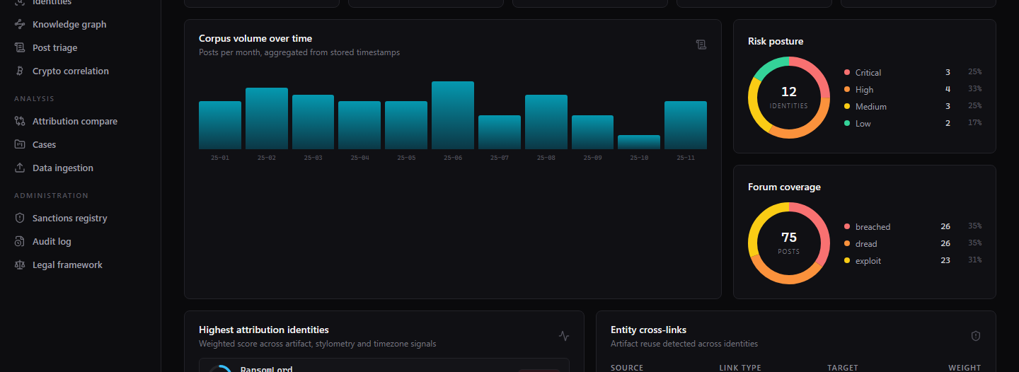
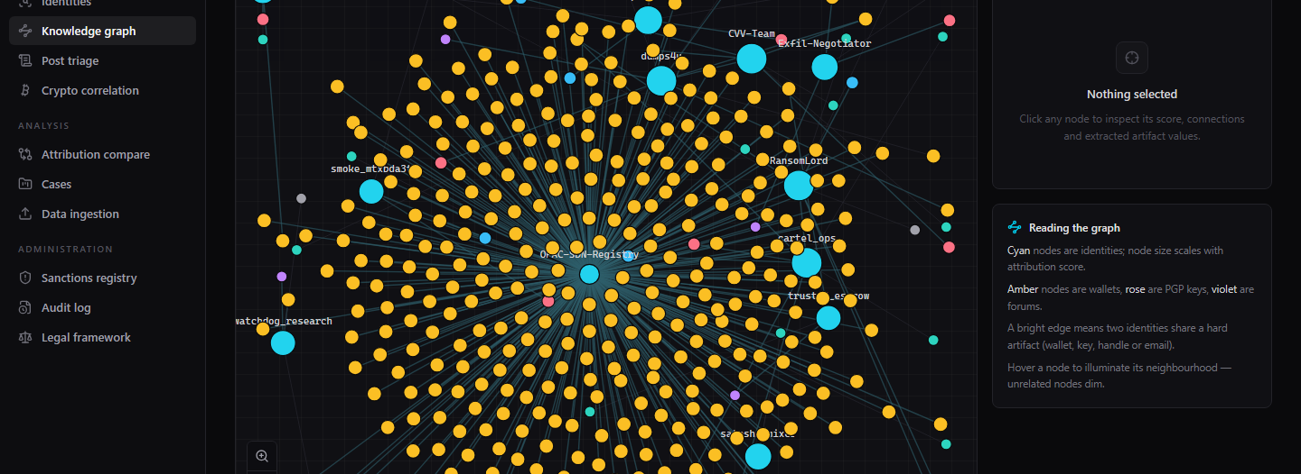
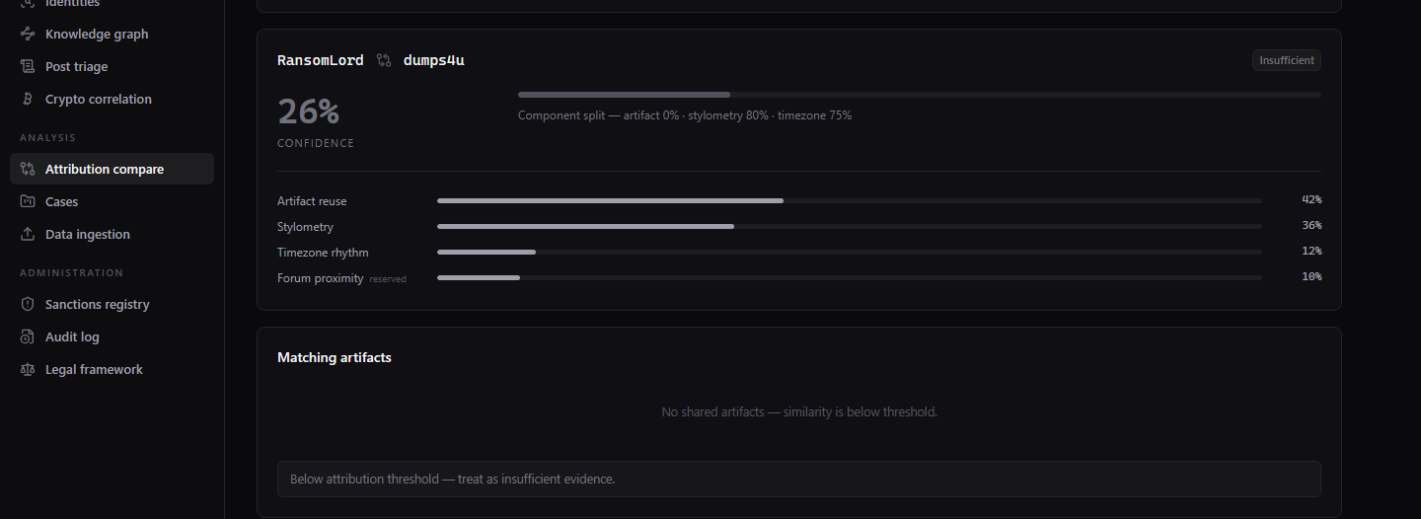
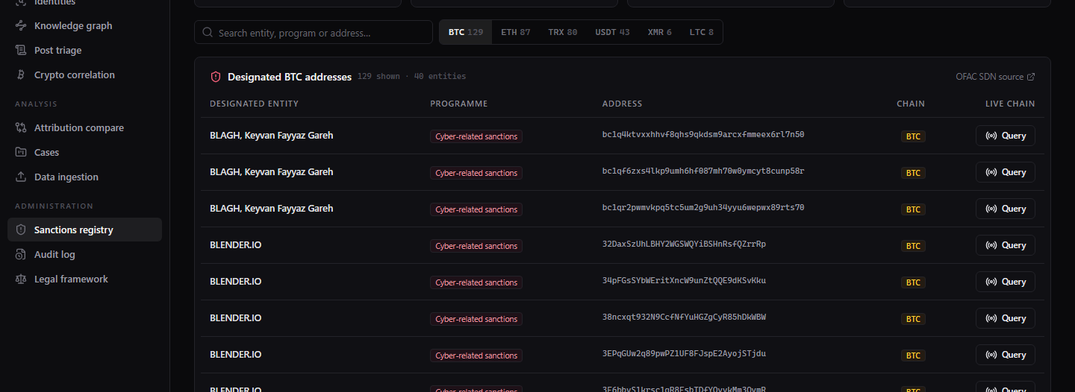
APPENDIX A
Live-system evidence (prototype screens)
A / 2
Every screen below runs in the submitted build — judges can re-open each one live.
Operations overview
Knowledge graph
Real SQL timeline · risk & forum composition donuts
Force-directed identity → wallet → key evidence graph
Attribution compare
Sanctions registry
Live weighted scoring with component breakdown
373 real OFAC designations with live chain query
TACET · Team KRMU159 · SIH26151

Slide 8
APPENDIX B
Automated verification — this deck is built on it
B / 2
Both suites pass against the running system; both are re-runnable in about a minute.
53 / 53
83 / 83
API smoke checks
UI interaction checks
auth, SQL health, graph edges, OFAC screening, ingest, audit chain
sorting, graph zoom + inspector, command palette, live chain query
86.2% ± 0.8
82.8%
Model CV accuracy
Model held-out accuracy
5-fold over 751 real documents by 20 real authors
macro-F1 0.79 on the real test split
REPRODUCIBILITY
FOUNDATIONS OF TRUST
• node scripts/smoke.mjs → 53 API checks
• node qa/audit.mjs → 83 UI checks
• python server/ml/train.py → retrains the model (writes metrics.json)
• POST /api/ingest/seed → restores the deterministic corpus in one click
SHA-256 evidence hash on every post and address; a hash-chained audit log with a server-side verifier; PBKDF2 password hashing; strict separation of the fictional demo personas from the real OFAC / 20 Newsgroups / blockchain datasets.
TACET · Team KRMU159 · SIH26151

