Slide 1

Project Title - Seasonal Agriculture Performance Analysis
Student Name :-Chavda Chirag Laxmanbhai
College Name- Gandhinagar University
AICTE STU ID : STU6960e9dc5b1461767959004

Slide 2

PROBLEM STATEMENT
Agricultural activities are influenced by seasonal variations in environmental conditions, farming practices, resource availability and market conditions. As a result, agricultural performance may differ from one season to another.
However, raw agricultural data does not clearly explain how agricultural performance changes across seasons or what patterns can be observed in different seasonal conditions.
The problem is to analyze the given agricultural dataset and investigate seasonal differences in agricultural performance by identifying meaningful patterns, trends, relationships and variations within the available data.

Slide 3
Project Description
Domain: Agriculture
Tools: Python, Pandas, NumPy, Matplotlib, Seaborn
Dataset: 4000 farm records | 3 Seasons | 8 Crops | 8 States | 28 Features
Goal: Investigate seasonal agricultural performance patterns

Slide 4

WHO ARE THE END USERS?
- Farmers – to plan crops seasonally
- Agricultural Officers – for regional planning
- Government Policy Makers – for resource allocation
- Agricultural Research Institutions
- Agribusiness Companies

Slide 5

Technology Used
  - Python 3
  - Pandas – Data cleaning & manipulation
  - NumPy – Numerical analysis
  - Matplotlib – Data visualization
  - Seaborn – Statistical plots
  - Jupyter Notebook – Development environment
  - GitHub – Version control & submission

Slide 6
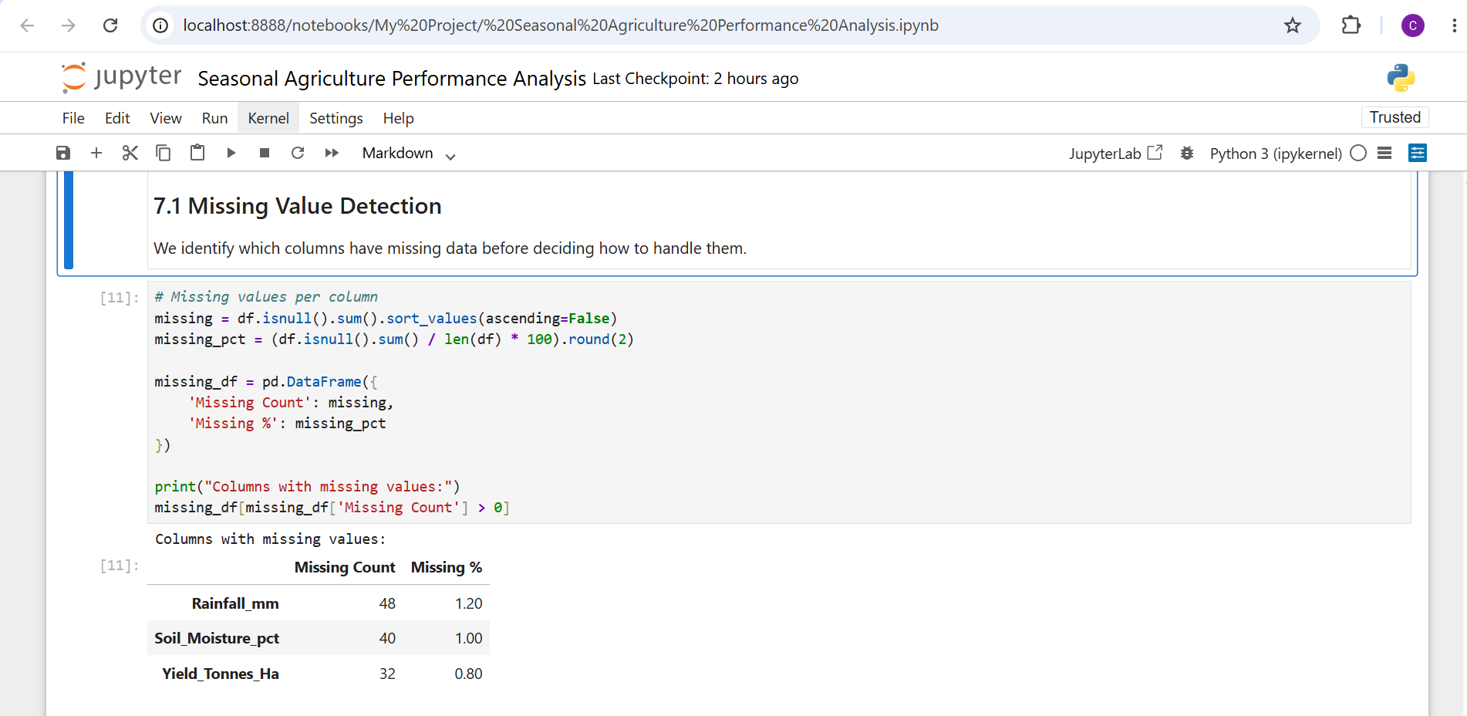
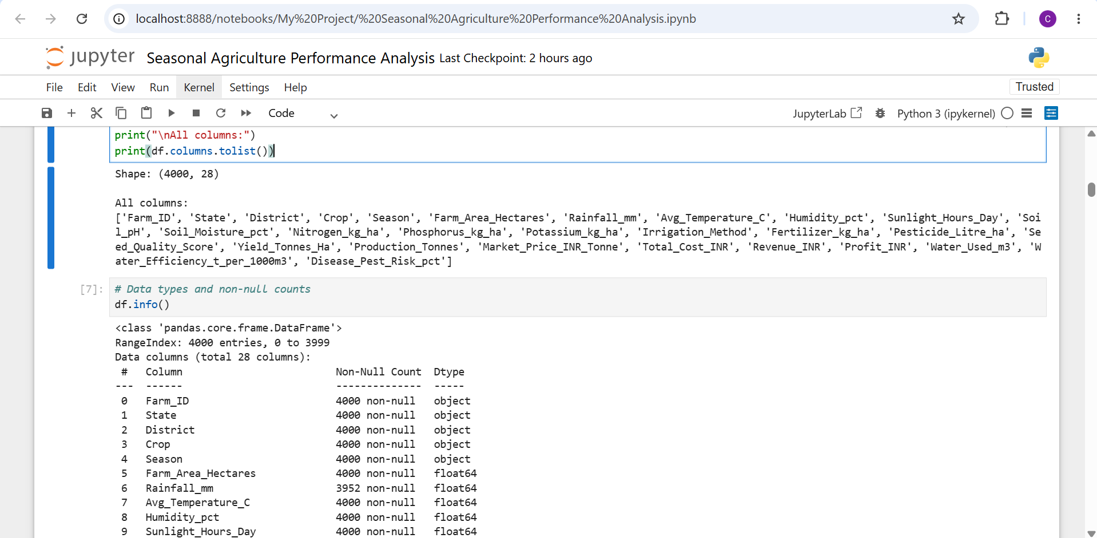
RESULTS
Data Overview & Cleaning

Slide 7
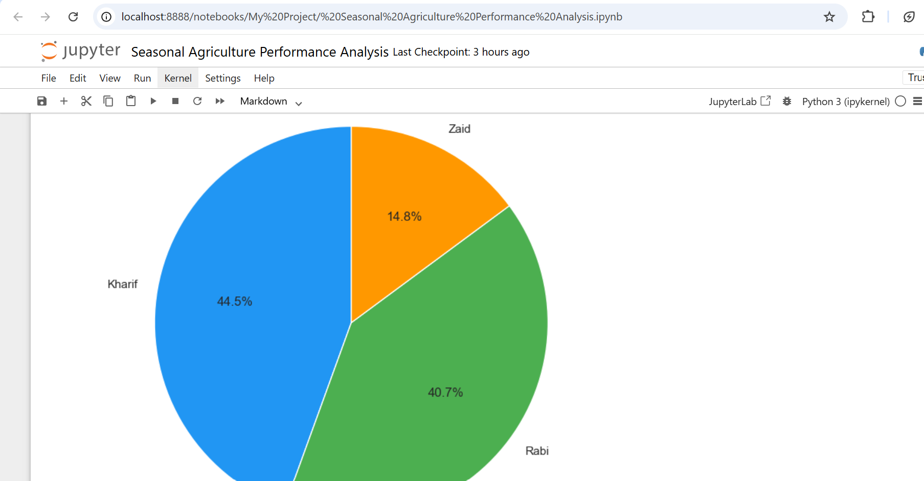
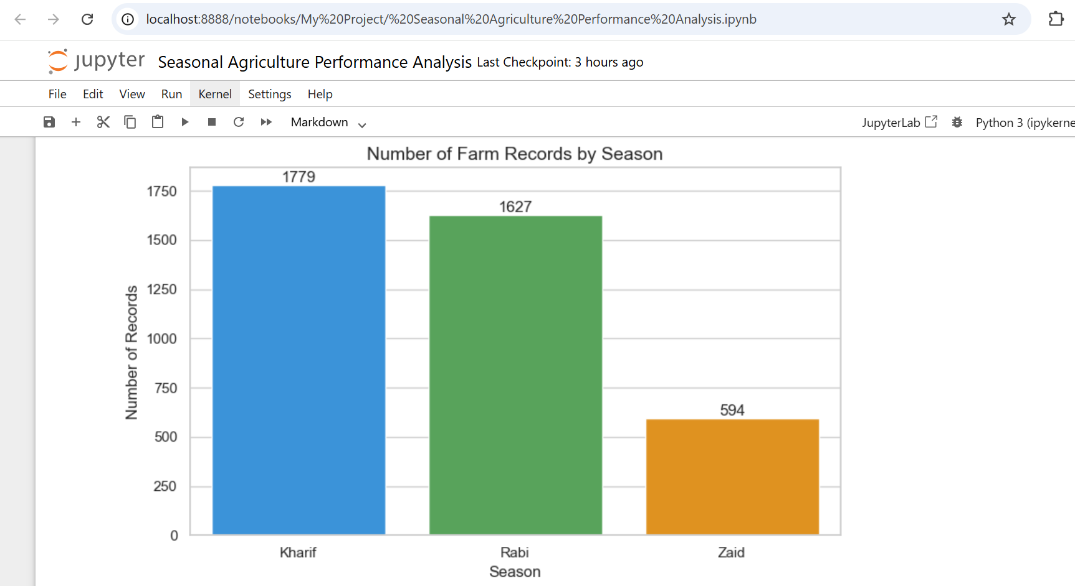
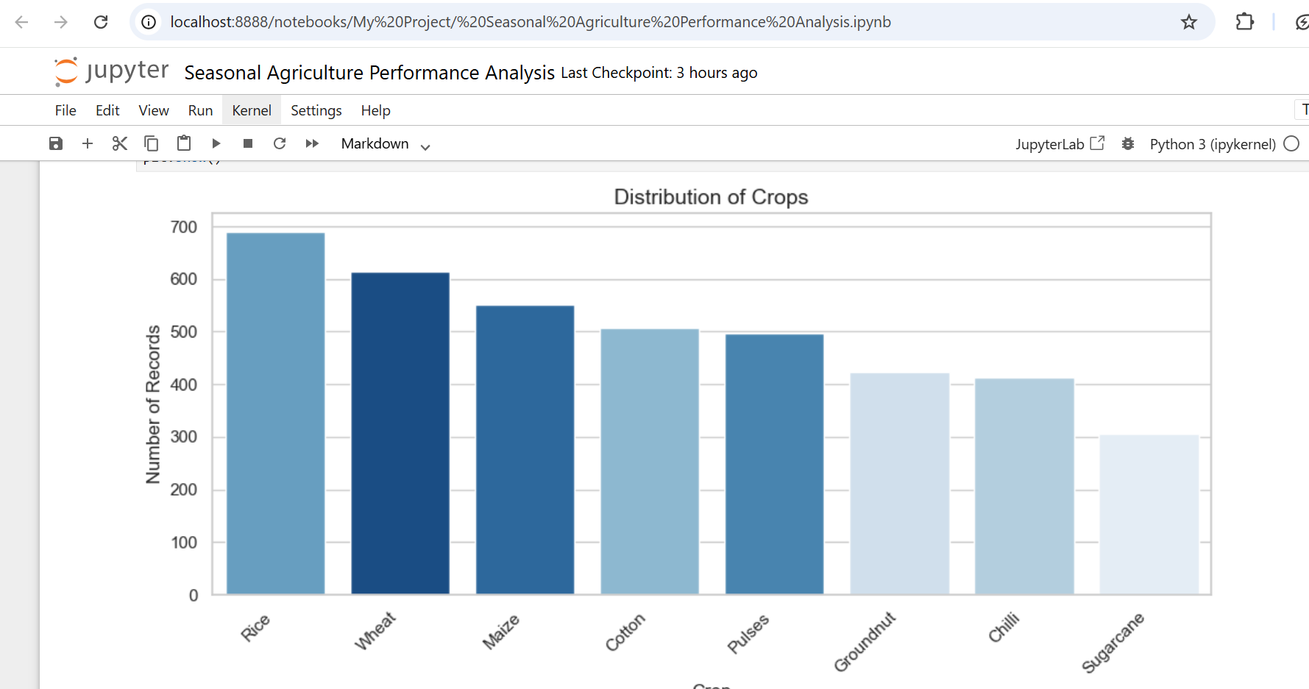
RESULTS
Univariate Analysis

Slide 8
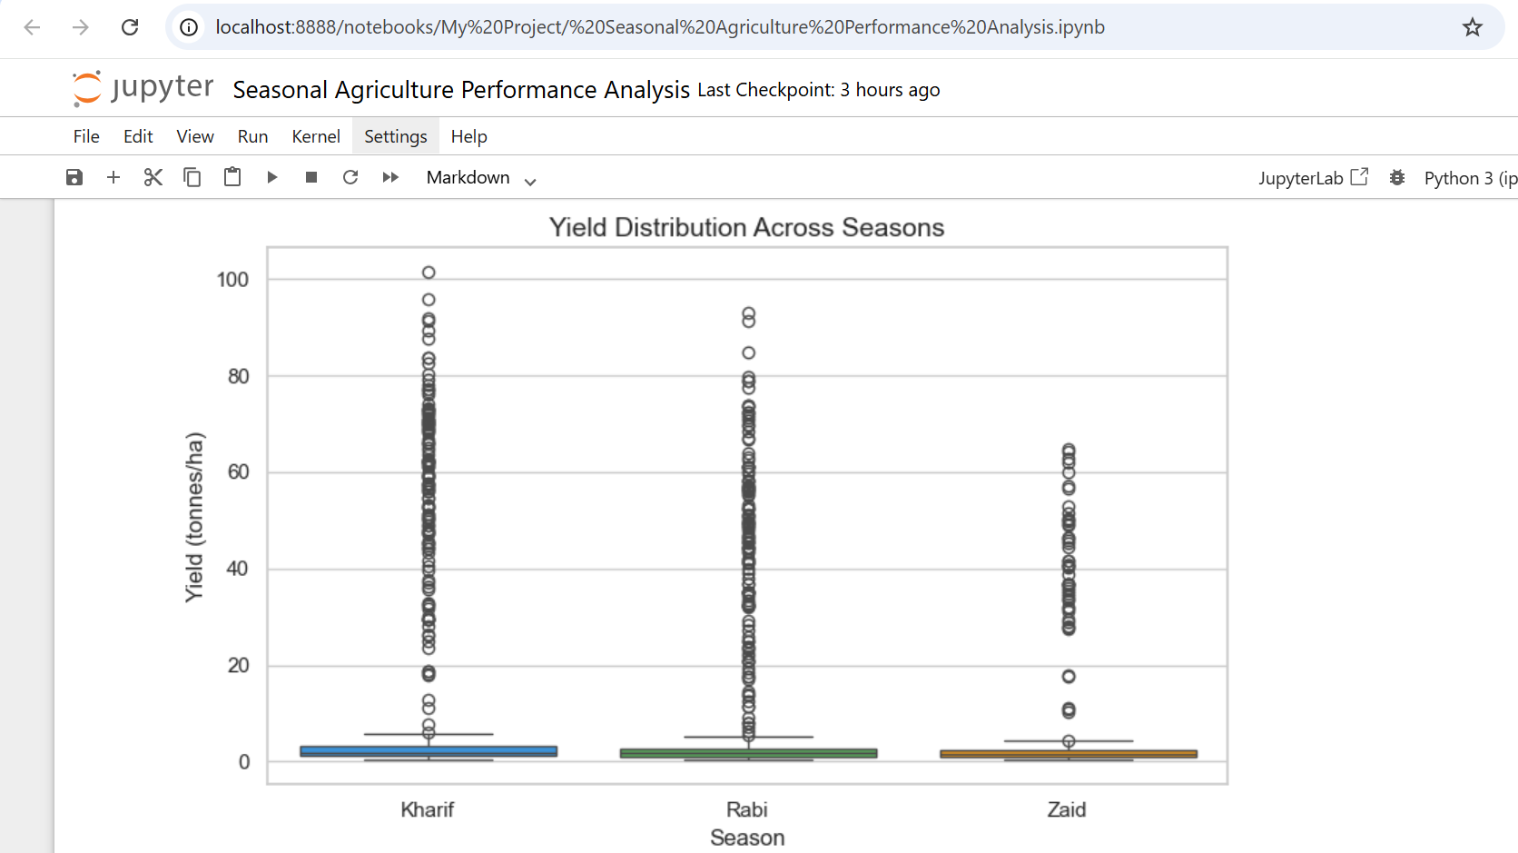
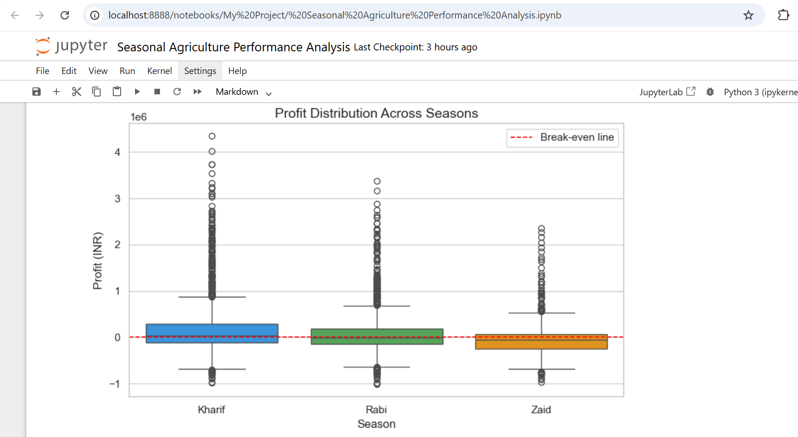
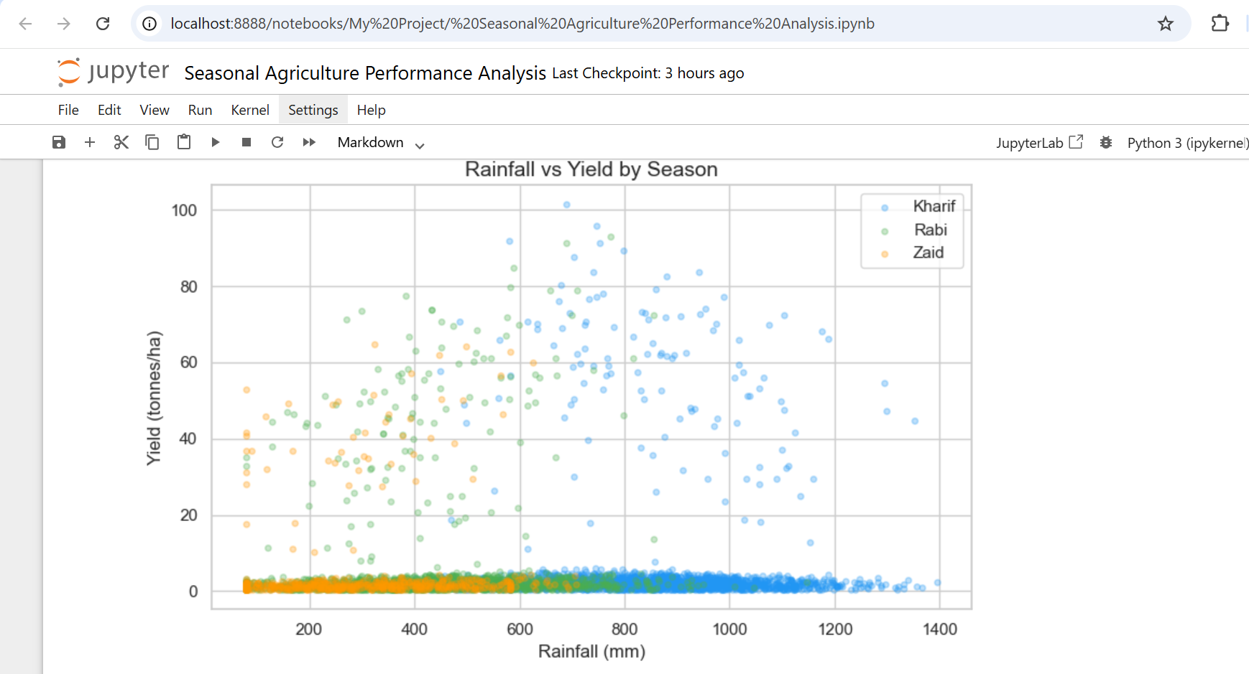
RESULTS
Bivariate Analysis

Slide 9
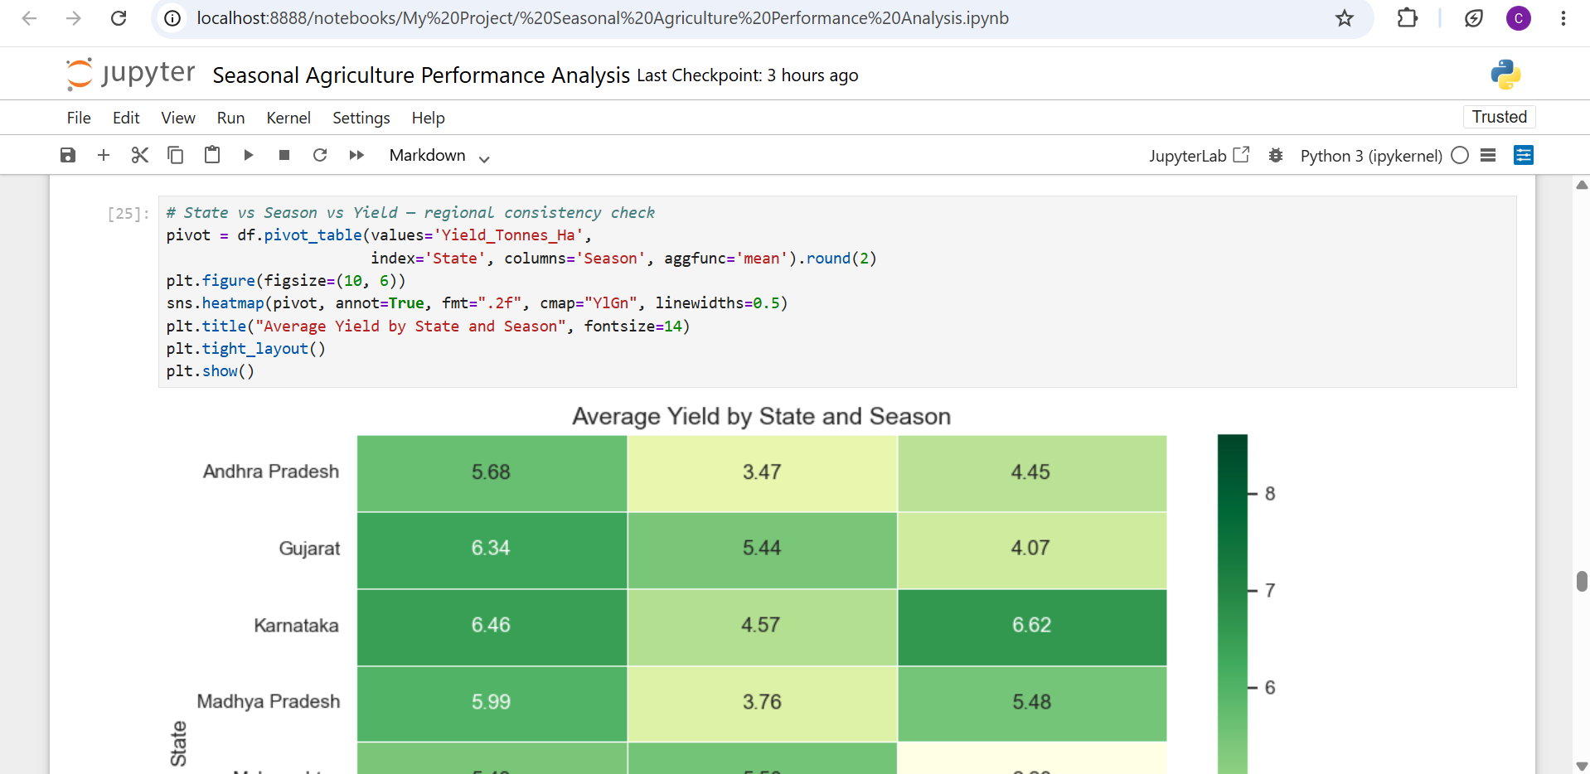
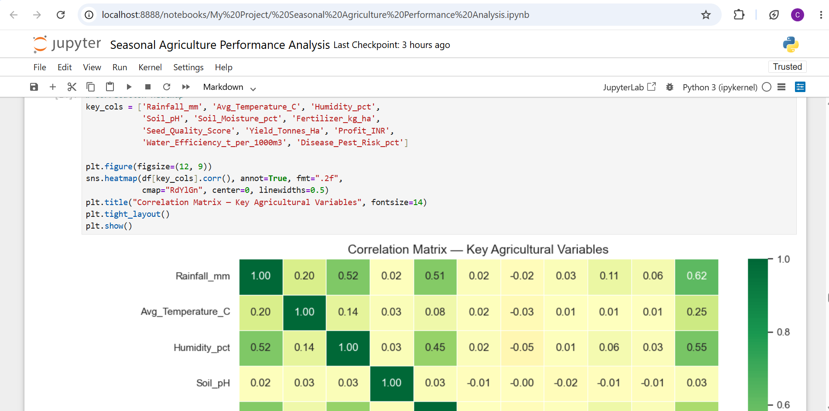
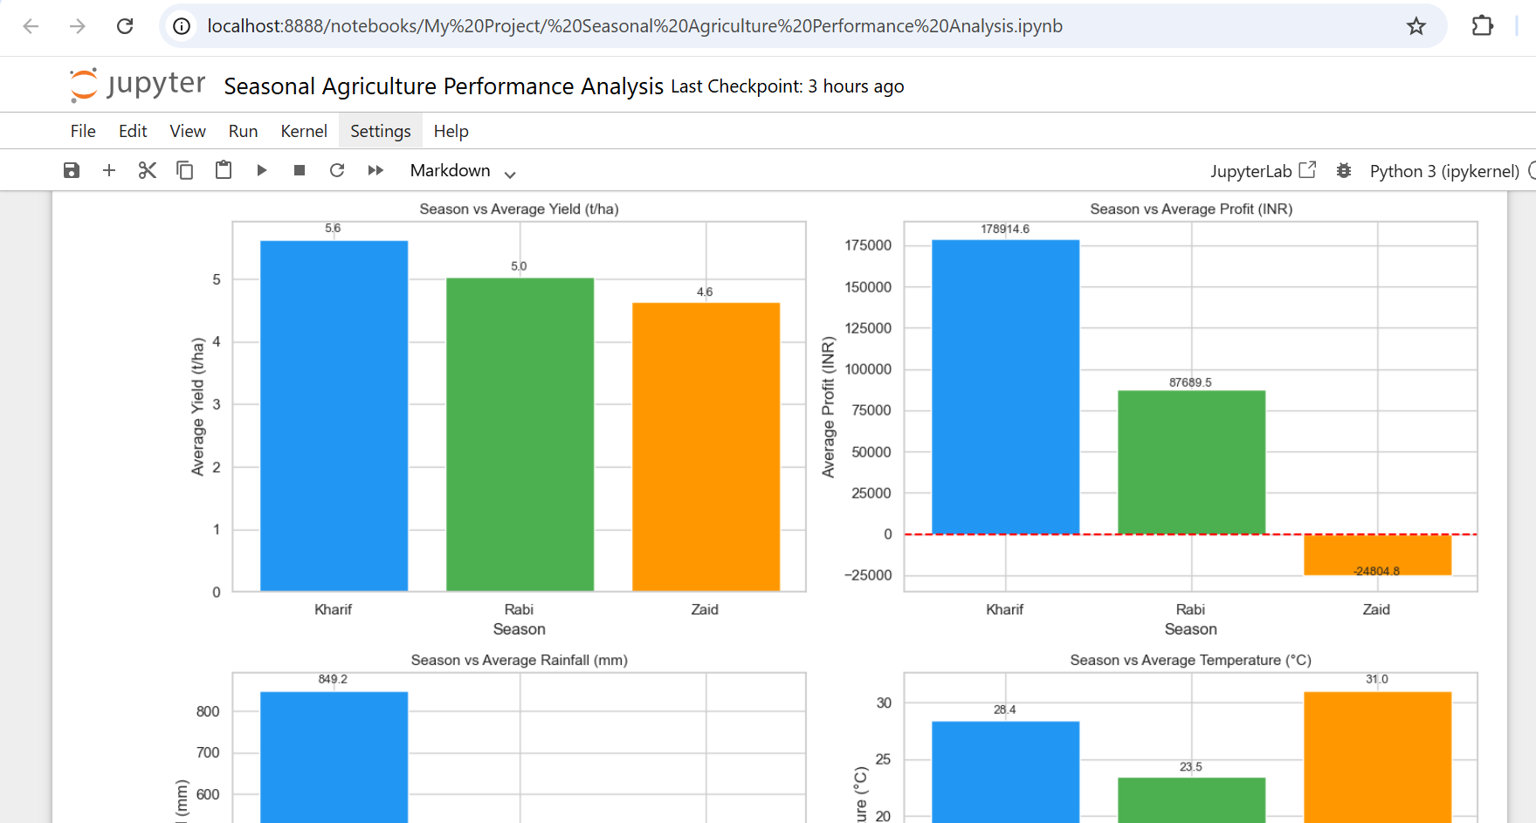
RESULTS
Multivariate & Seasonal Analysis

Slide 10
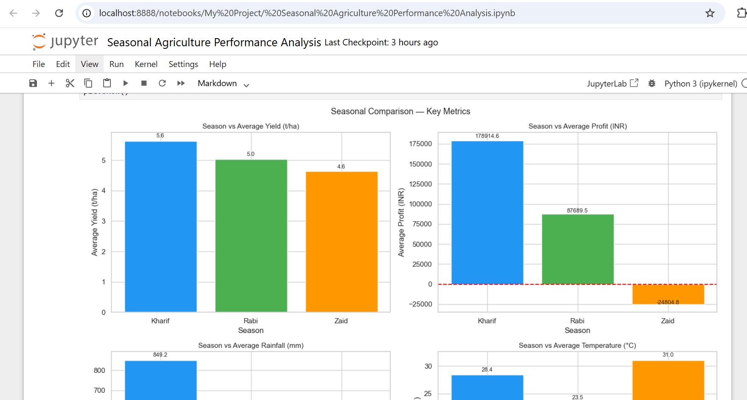
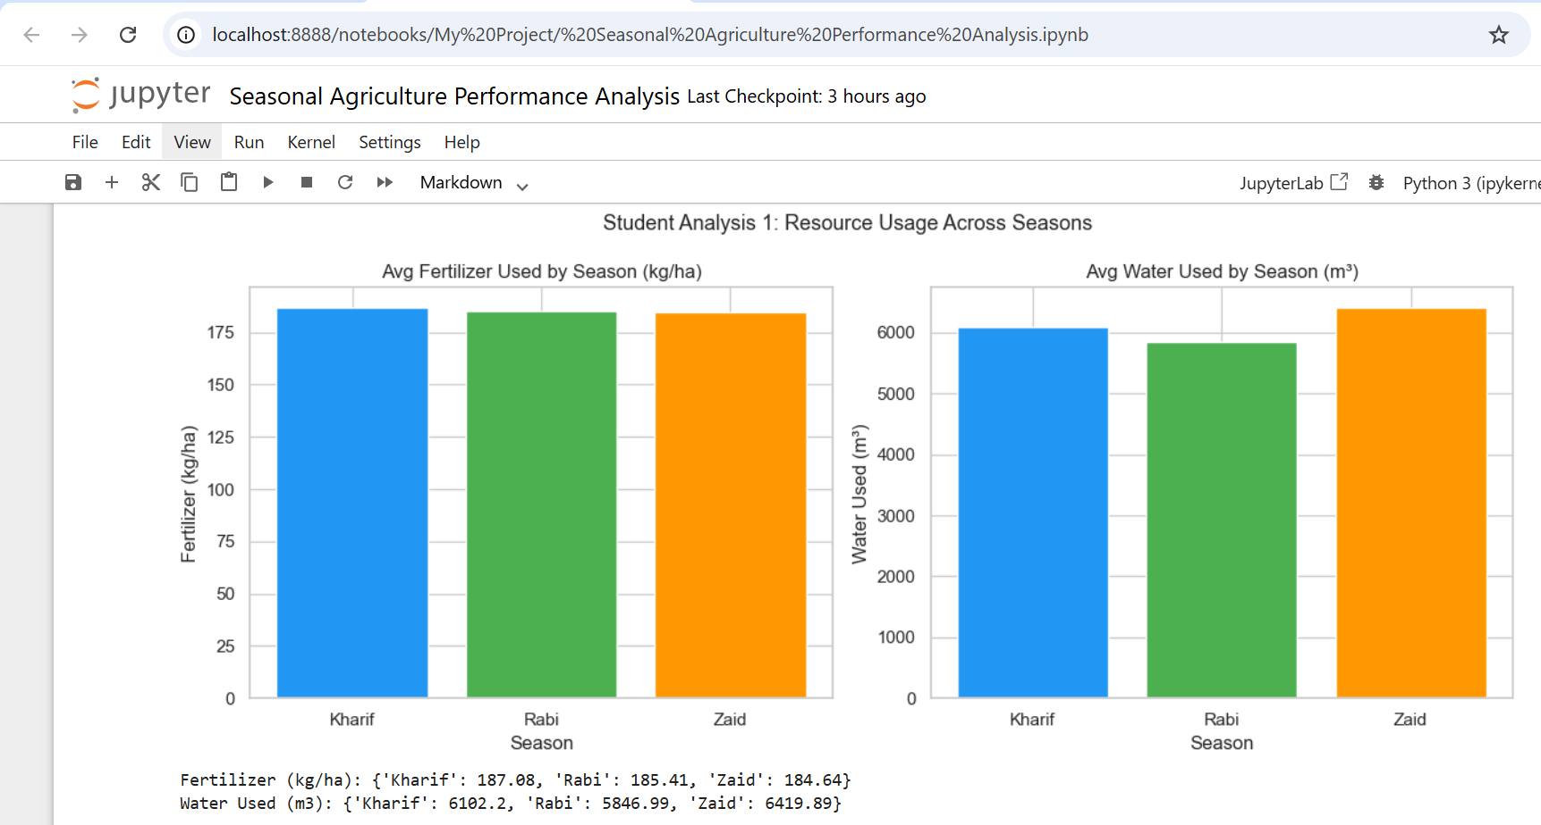
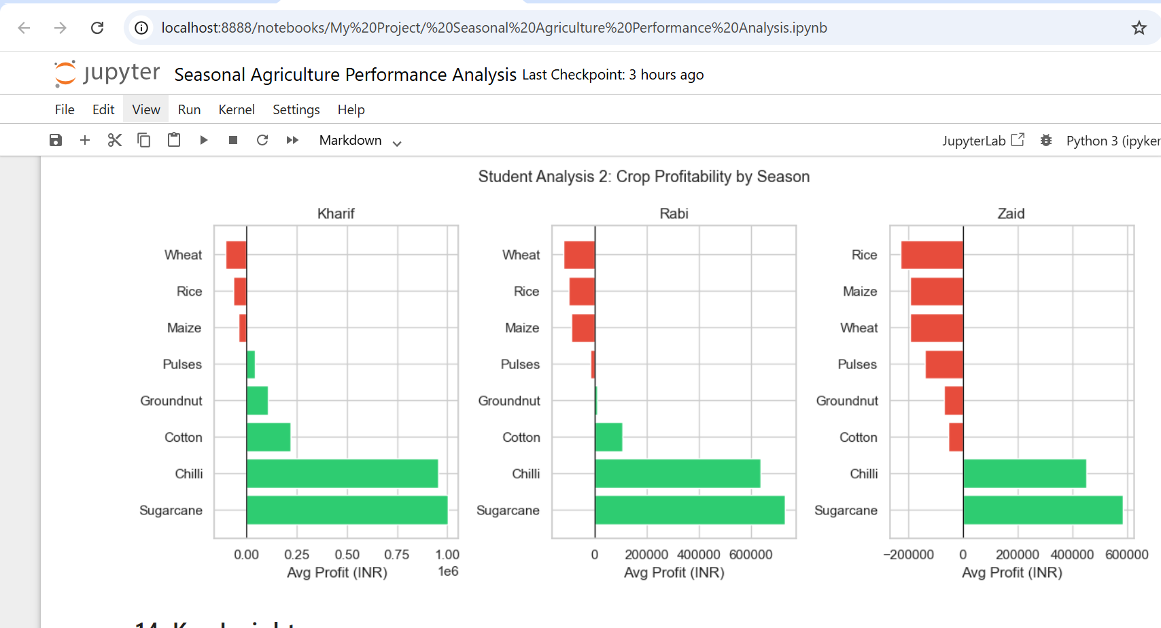
RESULTS
Student Analyses & Key Findings

Slide 11
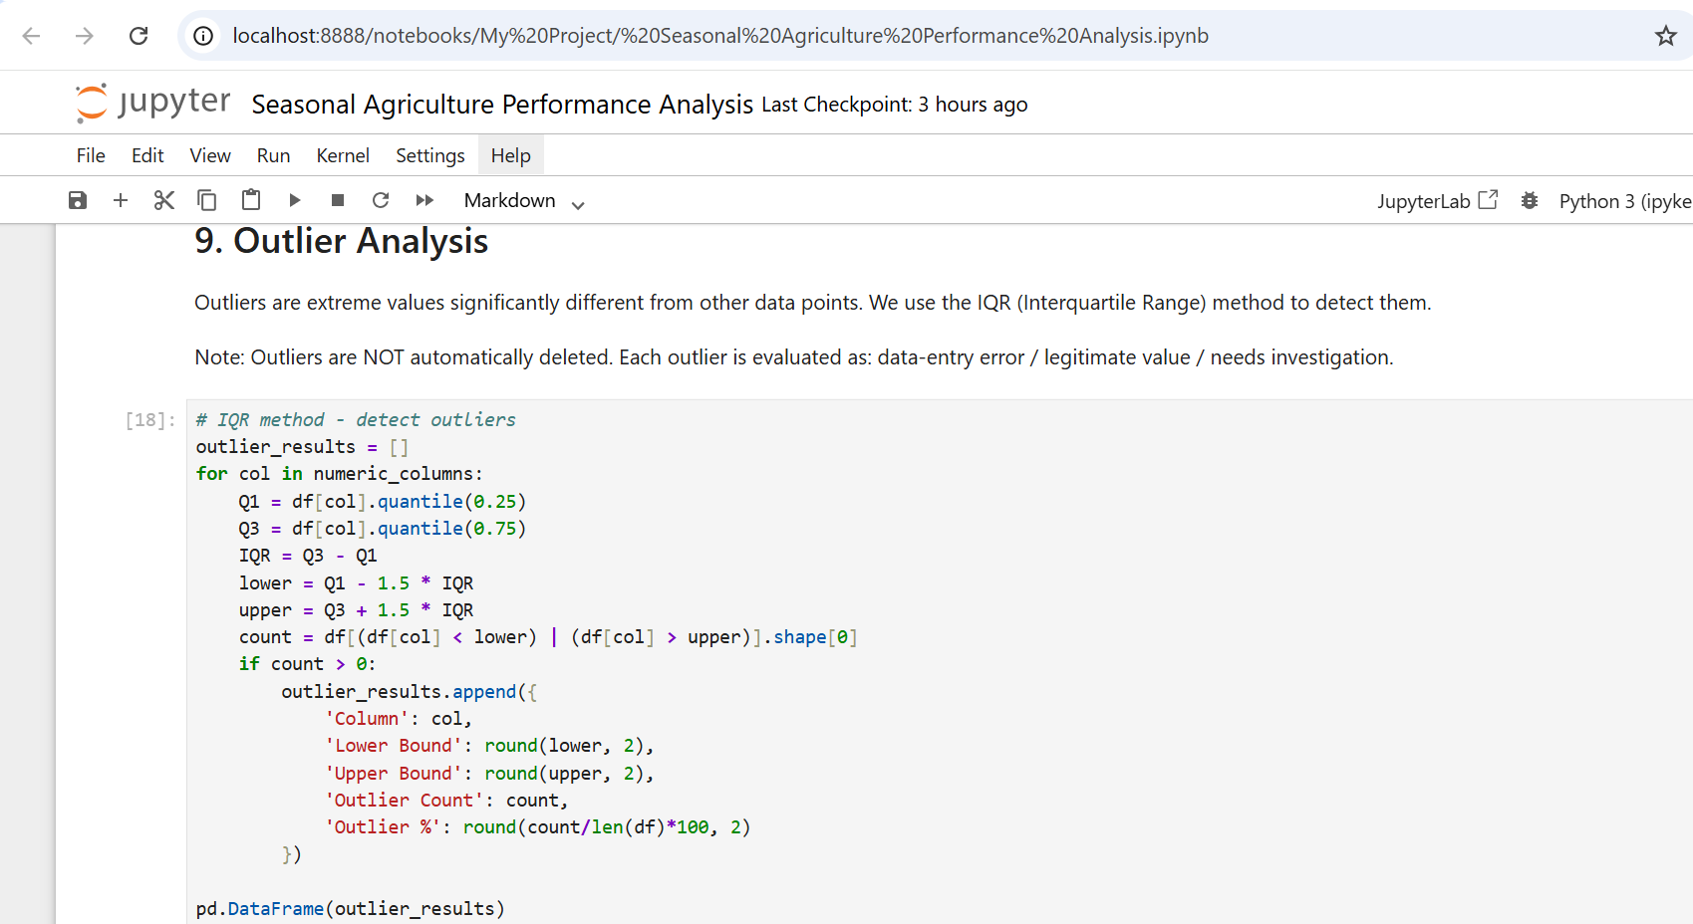
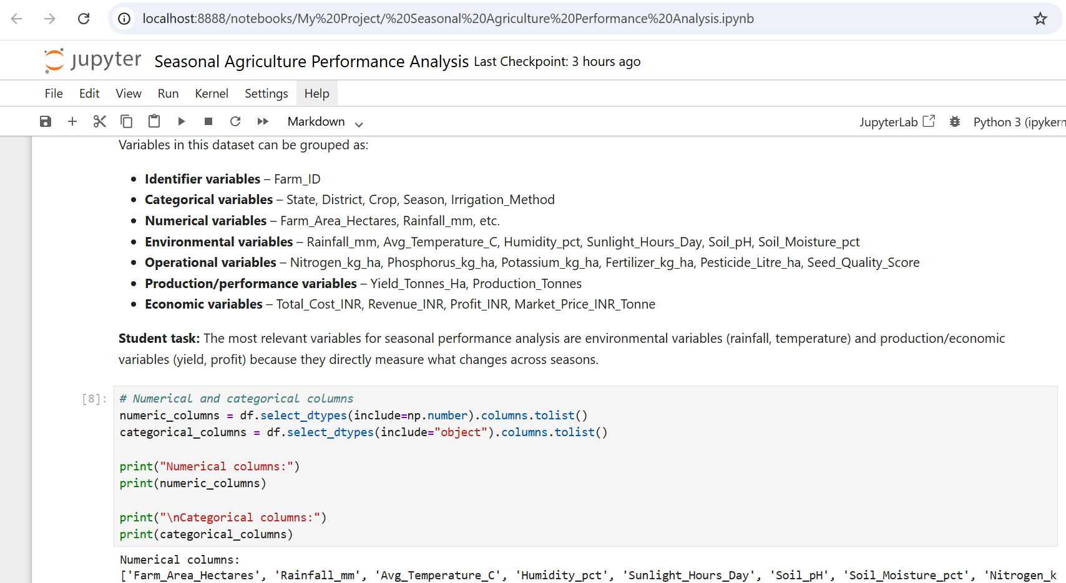
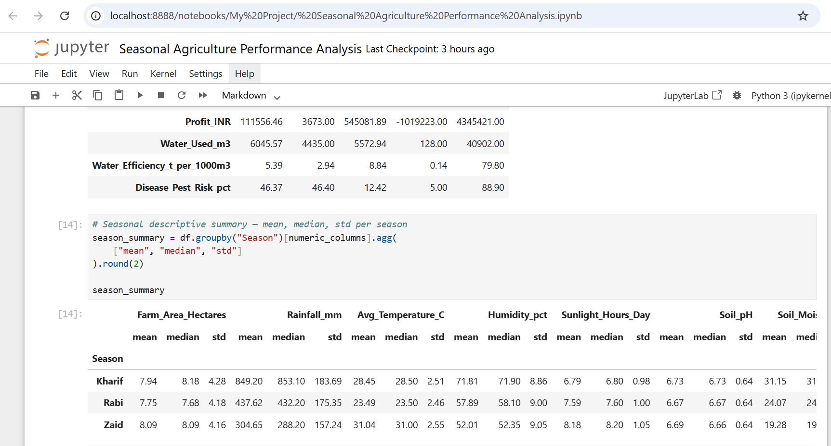
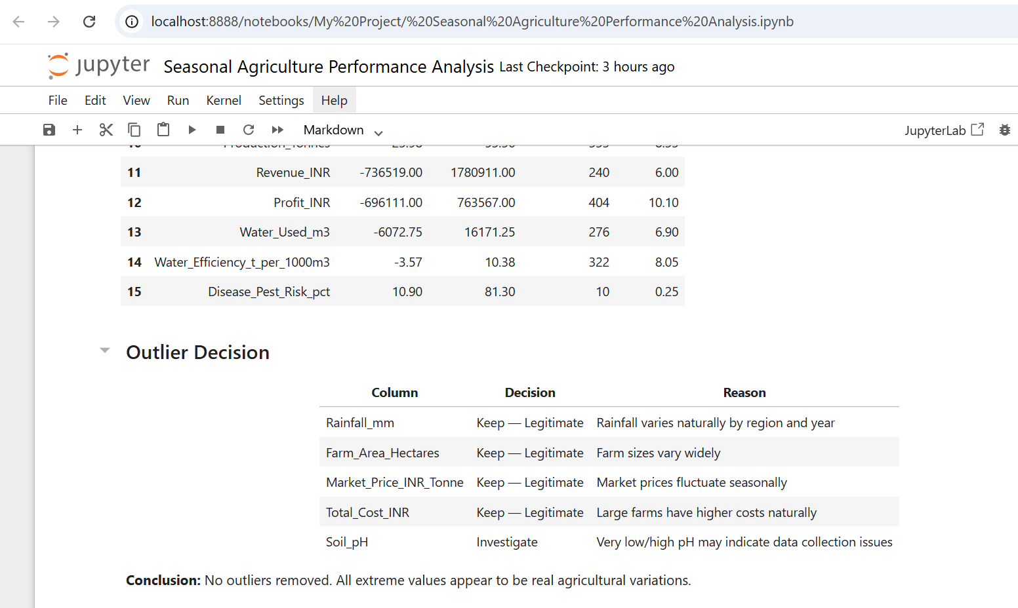
RESULTS
Outlier Analysis

Slide 12
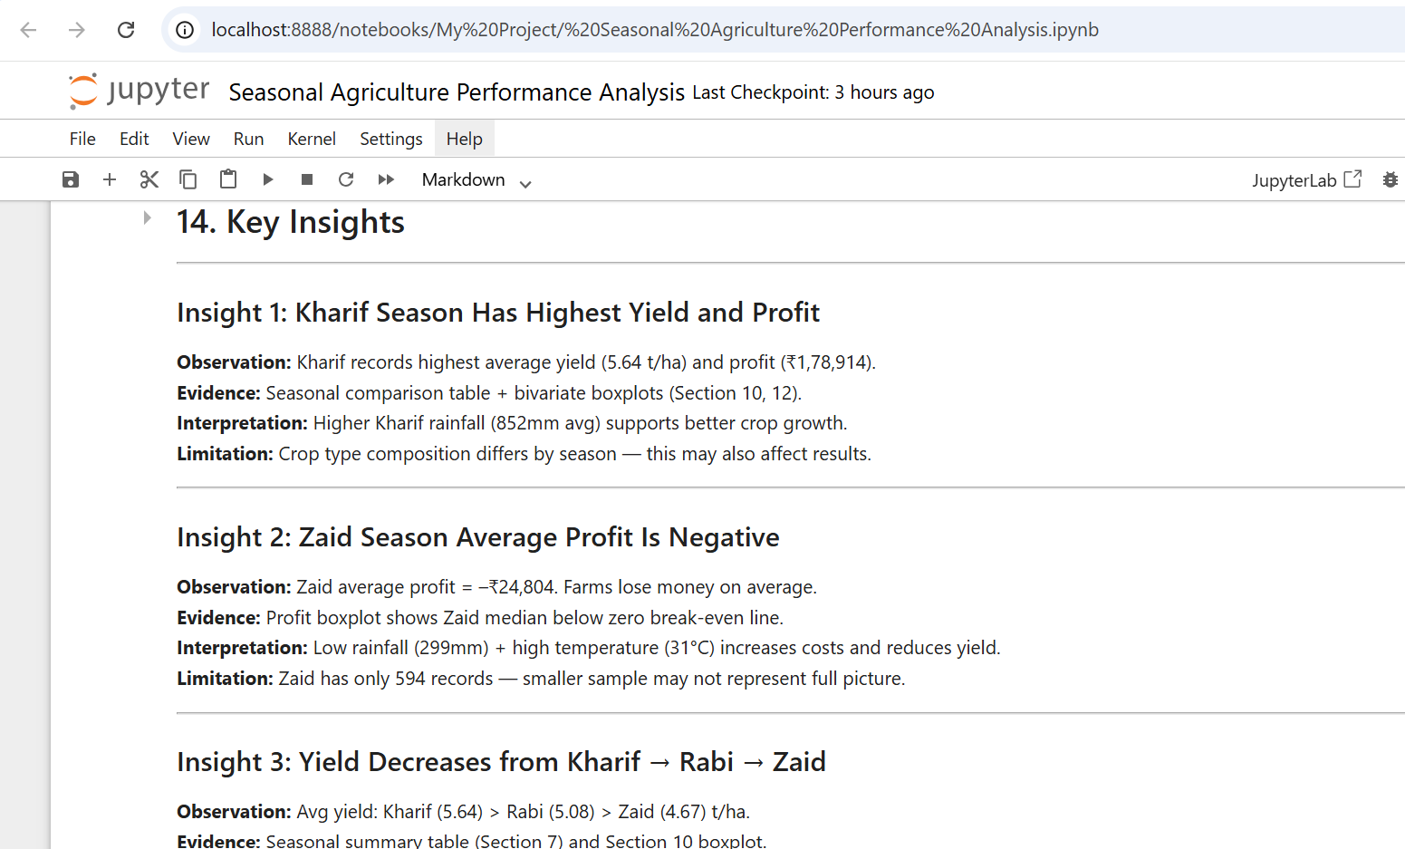
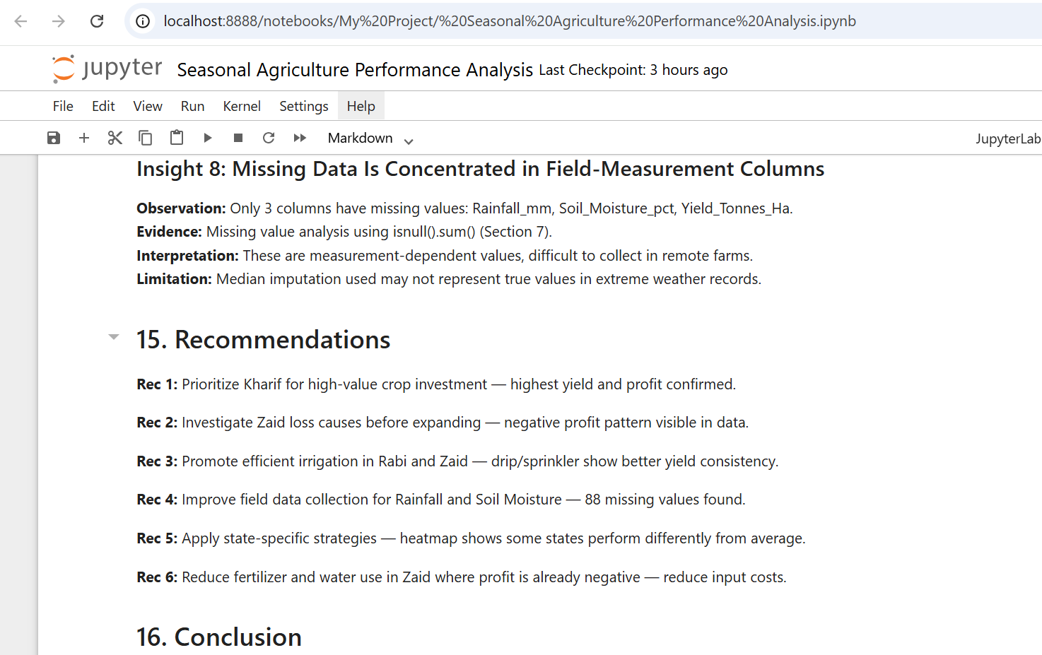
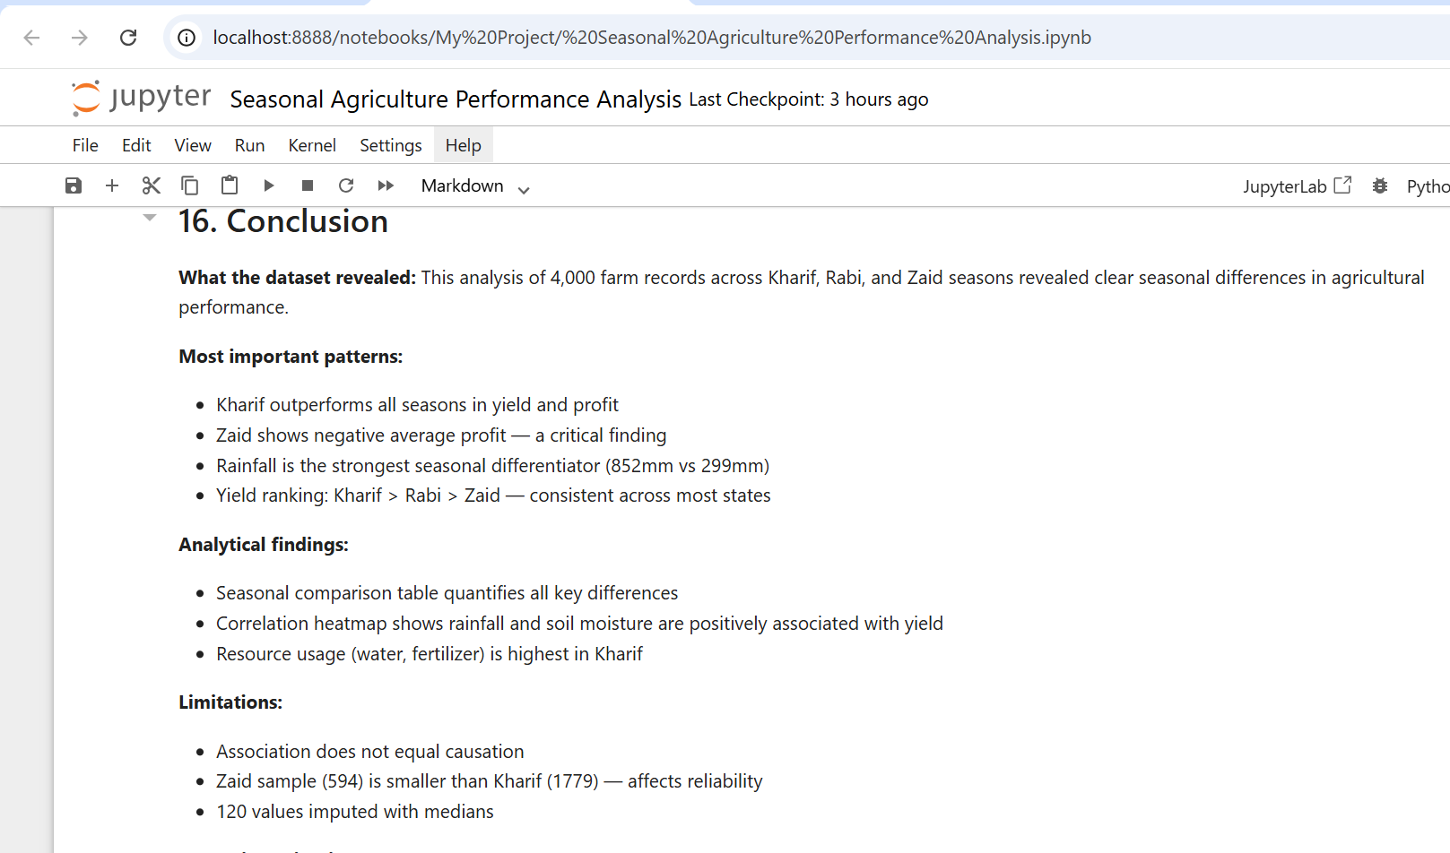
RESULTS
Insight , Recommendations & Conclusion

Slide 13
Future scope
- Integrate real-time weather data for live predictions
- Include year-over-year trend analysis
- Expand dataset to cover more Indian states
- Add soil test report data for deeper analysis
- Build crop recommendation system using ML
- Include market price forecasting

Slide 14
GitHub Link
https://github.com/chiragchavda05-data/-Seasonal-Agriculture-Performance-Analysis

Slide 15
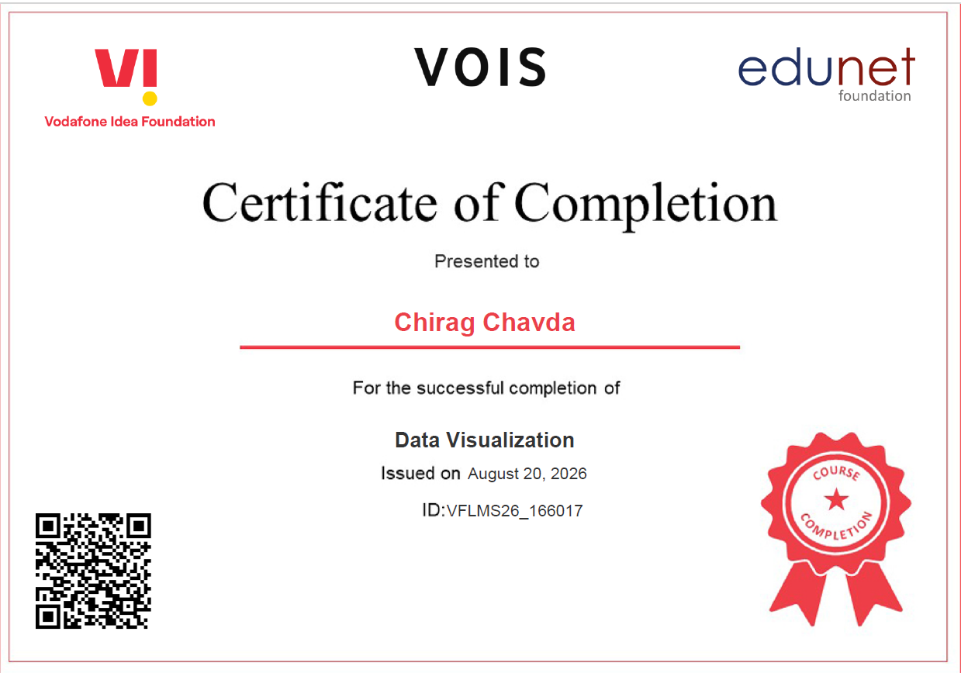
VOIS Course completion certificate -
Course name- Data Visualization

Slide 16
Thank you
.
.

