Slide 1

Project Title -
Health_Care_Analytics_For_Doctor_Visits_TIRTC
Name :- Chavda Chirag Laxmanbhai
AICTE Student Id :-STU6960e9dc5b1461767959004

Slide 2

PROBLEM STATEMENT
India's healthcare system serves millions of patients daily,
but understanding what drives people to visit a doctor
remains unclear.
This project analyzes the Healthcare dataset to answer
three connected questions:
1. Does illness count and chronic condition increase doctor visits?
2. Does income level and insurance type affect healthcare access?
3. Do gender and reduced activity days influence visit frequency?
Dataset: 5190 patient records with 13 columns including
visits, gender, age, income, illness, insurance type and more.

Slide 3
Project Description
The Healthcare dataset contains 5190 records of patients
with information on their demographics, health conditions,
income, insurance coverage and number of doctor visits.
The analysis was done in three phases, each targeting
one problem statement:
Phase 1 focused on illness count and chronic conditions
and their direct impact on how often patients visit doctors.
Phase 2 explored the financial side — whether income level
and type of insurance coverage changes a patient's
frequency of doctor visits.
Phase 3 looked at gender differences and how many days
of reduced physical activity relate to more doctor visits.
All three phases together answer one bigger question —
what actually makes a patient visit the doctor more?

Slide 4

WHO ARE THE END USERS?
Hospitals and Clinics
-To understand which type of patients visit most frequently
and plan their resources accordingly.
Health Insurance Companies
-To study how insurance type affects patient behavior
and design better coverage plans.
Government Health Departments
-To identify low income groups who need better
healthcare access and support.
Data Analytics Students
-To practice real-world healthcare data analysis
using Python and visualization tools.

Slide 5

Technology Used
Python 3
Core programming language used for the entire analysis.
Pandas
Used for loading data, groupby operations, filtering
patients by gender, income group and insurance type.
Matplotlib
Used for scatter plots, bar charts, pie charts,
boxplots and horizontal bar charts.
Seaborn
Used for heatmaps, histplots, lineplot and
correlation matrix visualization.
Jupyter Notebook
All code, outputs and observations written
and run in one place.
CSV Dataset
Healthcare Analytics dataset with 5190 patient
records and 13 columns.

Slide 6
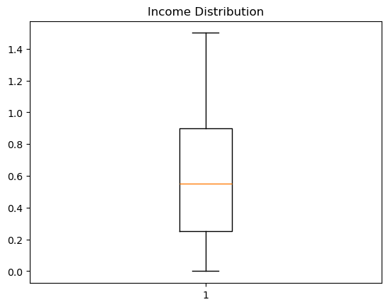
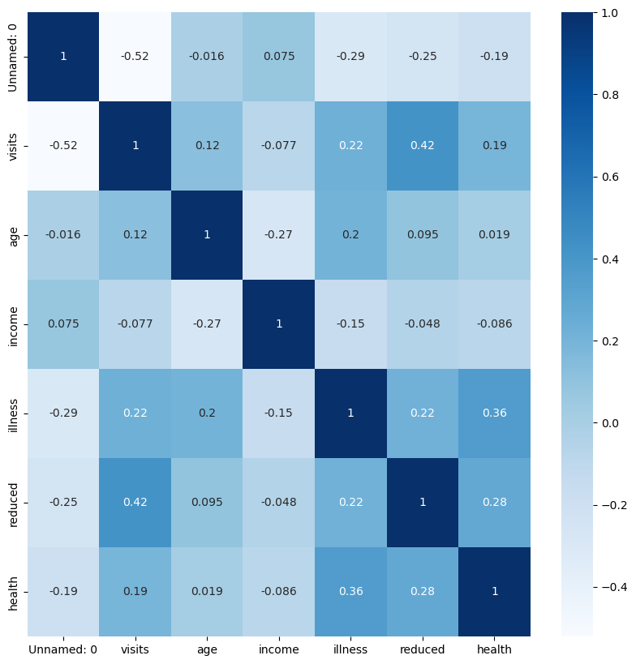
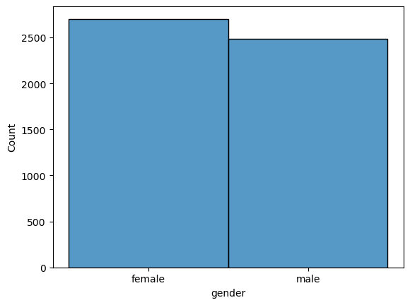
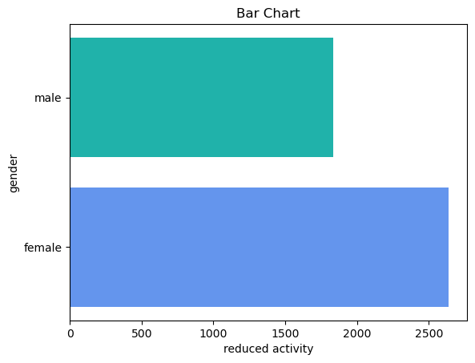
RESULTS

Slide 7
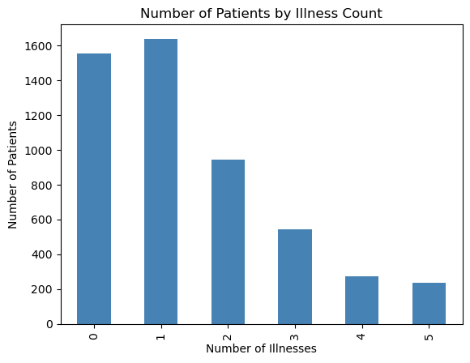
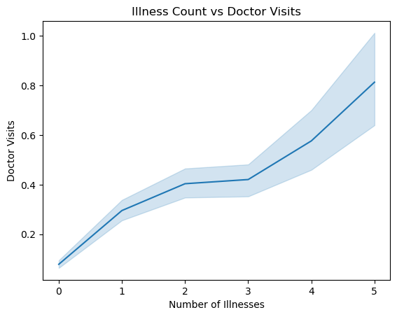
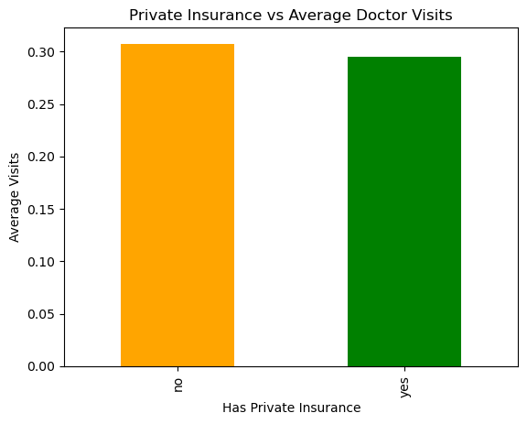
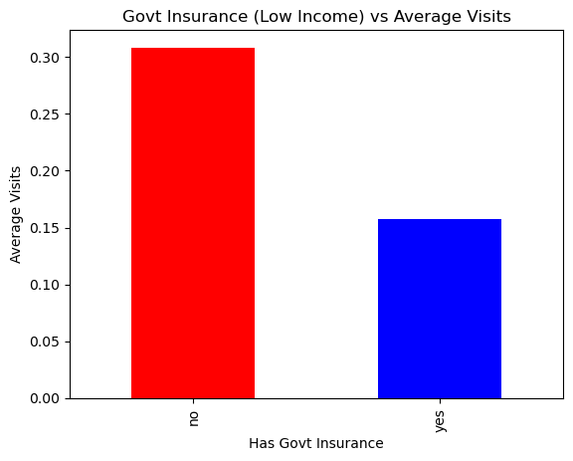
RESULTS

Slide 8
LINKS
Github :-
Colab :-
https://github.com/chiragchavda05-data/HealthCare-Analytics-For-Doctor-Visits
https://colab.research.google.com/drive/12Uet7Ft3xa-FEHs9I4HZmE7JtCkkTvg4

Slide 9
Thank you
.
.

