Slide 1
Course Outcome for PCI
Course Outcomes of Course Name: Programming In C i.e. PCI(22226) Year of Study: 2017-18
C204. 1 | Develop flowchart and algorithm to solve problems logically.
C204.2 | Write simple ‘C’ programs using arithmetic expressions..
C204.3 | Develop ‘C’ programs using control structure.
C204.4 | Develop ‘C’ programs using arrays and structures.
C204.5 | Develop/Use functions in C programs for modular programming approach.
C204.6 | Develop ‘C’ programs using pointers.

Slide 2
Chapters
1.Program Logic Development:- 8M
2.Basics of C:- 10M
3.Control Structures:- 12M
4.Array and structure:- 14M
5.Functions:- 14M
6.Pointers:-12 M
Total =70 marks

Slide 3
UNIT 1
Program Logic Development

Slide 4
Problem Definition
What is a problem
Problem is defined as a situation or condition which needs to solve to achieve the goal.

Slide 5
What are the steps in Problem Solving
1.Define the problem
2.Data gathering
3.Decide effective solution
4.Implement and evaluate the solution
5.Review the results

Slide 6
Steps in Problem Solving
1.Define the problem:-
A situation or condition which needs to solve to achieve the goal is called problem.
Defining the problem also helps in finding a target for what you want to achieve

Slide 7
Steps in Problem Solving
2.Data gathering:-
It is the process to create a list of required data to solve the problem.
Gathering of data may contain key terms, some assumptions, previous experience and also opinions of other peoples towards the problem.

Slide 8
Steps in Problem Solving
3.Decide effective solution
After gathering the details about the problem and their symptoms, finding the list of solutions is the main goal.
Among the list of solutions choose a solution which is effective ,efficient and has less side effects.

Slide 9
Steps in Problem Solving
4.Implement and evaluate the solution
The selected solution must be implemented and then evaluate to check whether the expected output is generated or not.
The implementation of a solution involves planning and execution of that task.
Evaluation is process of checking whether the solution is as per expectations or not.

Slide 10
Steps in Problem Solving
5.Review the results
Verify the result by applying variant inputs to know the success of the problem solution.

Slide 11
Problem Solving Techniques
1.Algorithm
2.Flowchart

Slide 12
Fundamental Of Algorithm
Notion of an Algorithm:
In 825 Abu Jafar :A Persian mathematician wrote a book which contains the generic methods for solving certain category of problems.
He is the one who presented this type of methods first time

Slide 13
What is Algorithm
Algorithm is set of ordered instructions which are written in simple English language.
Algorithm defines the step by step logic for a program to solve specific problem.
Algorithm helps the programmer to write actual logic of a problem on paper and validate it with the help of paper and pencil and correct it if any fault is noticed.

Slide 14
Characteristics of an Algorithm
1.Input
2.Output
3.Definiteness
4.Effectiveness
5.Finiteness

Slide 15
Characteristics of an Algorithm
1.Input:- An algorithm should accept one or more inputs.
2.Output:- An algorithm should generate some output.
3.Definiteness:- Each instruction should be clear.
4.Effectiveness:- Each instruction should have proper meaning to produce the final result.
5.Finiteness:- The algorithm must terminate after fixed number of steps.

Slide 16
Conventions Used In Algorithm
1.Algorithm name
2.Comments
3.Input and output
4.Steps
5.Variables
6.Assignment statement
7.If statement
8.Repeat statement
9.End of algorithm

Slide 17
Keywords used in Algorithm
1.Steps in algorithm
2.Starting of Algorithm
3.Variable declaration in algorithm
4.Variable initialization in algorithm
5.Accepting inputs from user in algorithm
6.Processing statements in algorithm

Slide 18
Keywords used in Algorithm
7.Conditional statements in algorithm
8.Repeat-until statements in algorithm
9.Displaying outputs of algorithm

Slide 19
Algorithm Development Steps
1.Define the problem
2.Identifying the inputs
3.Identifying the outputs
4.Identifying the sequences of steps to be processed

Slide 20
Example of Algorithms
Write an algorithm to calculate area of a circle
Name Algorithm: calculate area of circle
Input: Radius
Output: Area
Step1:Start
Step2:Declare variables pi=3.14,radius and area
Step3:Read values for radius //accept the radius value
Step4:Calculate area of circle and assign the result to area
Step 5:Display value of area
Step6:Stop

Slide 21
Write an algorithm to find addition of 2 numbers
Name Algorithm: addition of 2 numbers
Input: 2 numbers
Output: addition
Step1:Start
Step2:Declare variables no1,no2,add
Step3:Read values for no1 and no2
Step4:Calculate addition of two numbers and assign the result to add.
Or add= no1+no2
Step 5:Display value of add
Step6:Stop

Slide 22
Write an algorithm to find addition of 3 numbers
Name Algorithm: addition of 3 numbers
Input: 3 numbers
Output: addition
Step1:Start
Step2:Declare variables x,y,z,add
Step3:Read values for x,y,z
Step4:Calculate addition of three numbers and assign the result to add.
Or add= x+y+z
Step 5:Display value of add
Step6:Stop

Slide 23
Write an algorithm to calculate and display the area and perimeter of a rectangle
Name Algorithm: area and perimeter of rectangle
Input: length and breadth
Output: area and perimeter
Step1:Start
Step2:Declare variables length,breadth, area ,perimeter
Step3:Read values for length and breadth
Step4:Calculate area and perimeter by
area= length*breadth
perimeter =(2*length)+(2*breadth)
Step 5:Display value of area and perimeter
Step6:Stop

Slide 24
START
Declare variables length,breadth,area and perimeter
Accept length and breadth
Calculate area=length*breadth
Calculate perimeter =(2*length)+(2*breadth)
Display value of area and perimeter
STOP

Slide 25
Write an algorithm to swap(exchange) the two numbers
Name of Algorithm: swap the two numbers
Input: 2 numbers, temp
Output: swap numbers
Step1:Start
Step2:Declare variables a,b,temp
Step3:Read values for a and b i/p a=10 b=20
Step4:swap the numbers by o/p a=20 b=10
temp=a temp=10
a=b a=20
b=temp b=10
Step 5:Display value of a and b
Step6:Stop

Slide 26
START
Declare variables a,b,temp
Accept value of a and b
temp=a
a=b
b= temp
Display changed value of a and b
STOP

Slide 27
Develop an algorithm to find the greater of two numbers
Name of Algorithm : Greater number
Input: Two numbers
Output: The greater number among two numbers
Step1: Start
Step2: Declare variables no1,no2
Step3: Read values for no1,no2
Step4: if no1>no2
Display no1 is greater number
else
Display no2 is greater number
Step5: Stop

Slide 28
Write an algorithm to accept 2 numbers and display its product
Name Algorithm: Product of 2 numbers
Input: 2 numbers
Output: Product
Step1:Start
Step2:Declare variables no1,no2,product
Step3:Read values for no1 and no2
Step4:Calculate product of two numbers and assign the result to product.
Or product= no1*no2
Step 5:Display value of product
Step6:Stop

Slide 29
start
Declare variables no1,no2,product
Accept the value of no1,no2
Product=no1*no2
Display the value of product
Stop

Slide 30
What is Flowchart
Flowchart is graphical representation of an algorithm.
The flowchart allows breaking the complex problems into parts.
Processing and finding errors occurred during problem solving become quicker and accurate as compared to working with algorithms.

Slide 31
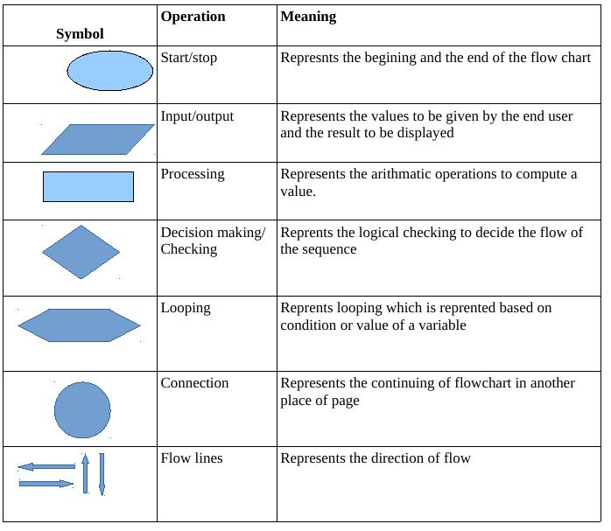
Symbols of Flowchart

Slide 32
Examples of Flowchart
Draw flowchart to Calculate area of circle
START
Declare variables radius,pi and area
Accept radius from user as an input
Calculate area=3.14*rad*rad
Display value of area
STOP

Slide 33
Draw flowchart for addition of 2 numbers
START
Declare variables no1,no2,add
Accept the value of no1 and no2 as an input
Calculate add=no1+no2
Display value of add
STOP

Slide 34
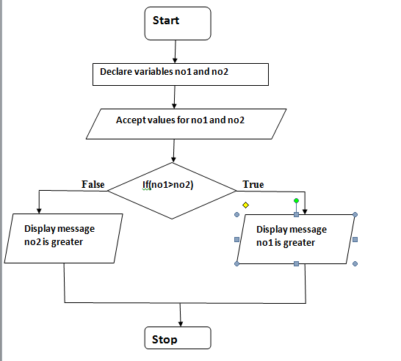
Draw flowchart to find the greater of two numbers

Slide 35
Algorithm | Flowchart
Algorithm is step by step procedure to solve the problem | Flowchart is a diagram created by different shapes to show the flow of data
Algorithm is complex to understand | Flowchart is easy to understand
In algorithm plain text are used | In flowchart symbols/shapes are used
Algorithm is the pseudo code for the program | Flowchart is just graphical representation of that logic
Algorithm is easy to debug | Flowchart it is hard to debug

Slide 36
Write an algorithm to fine whether enter number is even or odd
Name of Algorithm : number is even or odd
Input: number
Output: number is even or odd
Step1: Start
Step2: Declare variable number
Step3: Read value for number
Step4: if(number % 2==0)
Display number is even
else
Display number is odd
Step5: Stop

Slide 37
start
Declare variable number
Read the value of number
if(no%2==0)
False
true
Number is odd
Number is even
stop

