Slide 1
Pointer
Definition:- Pointer is a variable who stores the memory address of another variable.
Variable store the values. e.g. int no store 5.
E.g. ptr store address of no , so ptr is a pointer.
no
ptr
5
65524
value
Address of location
65524
Ptr contains address of no. variable
Ptr is a pointer

Slide 2
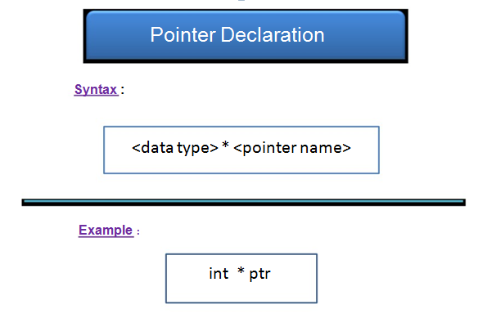

Slide 3
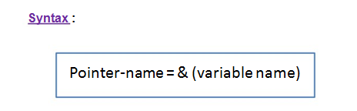
How to access a pointer
Example: ptr = &no;

Slide 4
void main()
{
int no=10; //value 10 is assigned to no variable
int *ptr; // pointer declaration
ptr = &no; //assigning address of number to pointer ptr
}

Slide 5
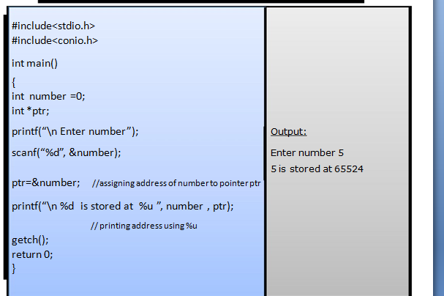
WAP to accept a number from the user and print it with its address

Slide 6
WAP to find product of two numbers using pointers
void main()
{
int no1,no2;
int *p1,*p2 ; //pointer declaration
clrscr();
printf(“\n Enter the value for no1 and no2:”);
scanf(“%d %d “,&no1,&no2);
p1= &no1; //assigning address of no1 to p1
p2=&no2; // assigning address of no2 to p2
printf(“\n %d * %d =%d”,(*p1) * (*p2));
getch();
}

Slide 7
Output:-
Enter value for no1 and no2: 25 10
25 * 10=250

Slide 8
Write a program to Print values of variables and their addresses.
void main()
{
int a=5,b=10;
clrscr();
int *p1,*p2;
p1=&a;
p2=&b;
printf("\n Value of a=%d",a);
printf("\n Address of a=%u“,p1);
printf("\n Value of b=%d",b);
printf("\n Address of b=%u“,p2);
getch();
}

Slide 9
WAP to swap the two values using pointer
void main( )
{
int a,b;
int *p1,*p2,temp;
clrscr();
printf(“\n Enter value for a and b:”);
scanf(“%d %d”,&a, &b);
printf(“\n Before swapping a=%d b=%d”, a,b);
p1=&a; //assigning address to p1
p2=&b; //assigning address to p2

Slide 10
temp = a;
a=*p2;
b=temp;
printf(“\n After swapping: a=%d and b=%d”, a, b);
getch();
}
o/p:Enter value for a and b: 10 20
Before swapping a= 10 b=20
After swapping: a =20 b=10

Slide 11
Develop a program to swap two numbers using pointer and add swapped numbers also print their addition.
void swap(int *a,int *b)
{
int temp;
temp=*a;
*a=*b;
*b=temp;
}

Slide 12
void main()
{
int x,y,sum;
printf("\n Enter value for x:");
scanf("%d",&x);
printf("\n Enter value for y:");
scanf("%d",&y);
swap(&x,&y);
printf("\nx=%d",x);
printf("\ny=%d",y);
sum=x+y;
printf("Sum of x+y = %d",sum);
}

Slide 13
Write a program to accept two numbers from user and perform addition, subtraction, multiplication and division operations using pointer.
void main()
{
int no1,no2,*ptr1,*ptr2,result;
clrscr();
printf("Enter no1:");
scanf("%d",&no1);
printf("\nEnter no2:");
scanf("%d",&no2);
ptr1=&no1; //assigning address of no1
ptr2=&no2; //assigning address of no2
result=*ptr1+*ptr2;

Slide 14
printf("\n Addition=%d",result);
result=*ptr1-*ptr2;
printf("\n Subtraction=%d",result);
result=*ptr1**ptr2;
printf("\n Multiplication=%d",result);
result=*ptr1/(*ptr2);
printf("\n Division=%d",result);
getch();
}

Slide 15
Pointer Arithmatic operators
Pointer arithmetic is related with the arithmatic operations with the pointers.
Basic operations + , - , *, / can be done using pointer notation.
As * pointer indicates the value whose address is stored in pointer.

Slide 16
Example:
result = *p1 + *p2;
sum sum + *p1;
x= 5 + *p1 / *p2;
Y= *p1 - *p2;

Slide 17
Pointer with function(call by reference)
When addresses are passed to the function as an arguments instead of values then function is said to be call by reference.

Slide 18
WAP to swap the value of variables using call by reference
void swap(int *, int *); //declaring function
main()
{
int a,b;
clrscr();
printf(“\n enter value for a and b:”);
scanf(“%d %d “,&a,&b);
printf(“\nBefore swapping a: %d \t b: %d”,a,b);
swap(&a,&b); //function call
printf(“\n After swapping a: %d \t b:%d”,a,b);
return 0;
}

Slide 19
void swap(int *x, int *y)
{
int temp;
temp = *x;
*x = *y;
*y = temp;
}

Slide 20
WAP to add numbers till the position entered and display result by call by reference function
int add( int *); //function declaration with pointer as an argument
void main( )
{
int position;
int *ptr; //pointer declaration
clrscr();
printf(“\n Enter the position:”);
scanf(“%d”,&position);
ptr=&position;
printf(”Sum = %d”, add(ptr)); //function call
getch();
}

Slide 21
int add( int *p)
{
int i=0;
int sum=0;
for(i=1; i<=(*p); i++)
{
sum =sum + i ;
}
return sum;
}
o/p:
Enter the position : 10
Sum=55

Slide 22
Array and pointer
Array is collection of same data type.
To array we can assign the address to its zeroth element and rest of the elements can be easily accessed by the pointer.
Array location
0
1
2
3
4
Array elements
5 | 7 | 18 | 19 | 21
Memory address
1000
1002
1004
1006
1008

Slide 23
Example:
int no= [5,7,18,19,21];
Now we can use the pointer to assign base address to it.
int *ptr;
ptr = &no[0];
Now above statement will store the base address of the array element i.e. 0th element.

Slide 24
WAP to accept array elements and print them using pointer
void main()
{
int no[5],i=0;
int *ptr; // pointer declaration
clrscr();
for(i=0;i<=4;i++)
{
printf(“\n enter the number:”);
scanf(“%d”,&no[i]);
}

Slide 25
ptr = &no[0]; //assigning base address to the pointer
for(i=0;i<=4;i++) // print array elements
{
printf("\n %d is stored at %u",*ptr, ptr);
ptr++;
}
getch();
}

Slide 26
Output:
enter the number:2
enter the number:7
enter the number:9
enter the number:11
enter the number:19
2 is stored at 65516
7 is stored at 65518
9 is stored at 65520
11 is stored at 65522
19 is stored at 65524

Slide 27
WAP to find out string length using pointer and function
int length(char *); //declaration of function with char pointer
void main()
{
char str[10];
char *ptr;
clrscr();
printf(“\n Enter the string:”);
scanf(“%s”,str);
ptr=&str[0]; //assigning base address to the pointer
printf(“\n length of string = %d”,length(ptr));
getch();
}

Slide 28
int length(char *p)
{
int cnt=0;
while(*p!=NULL)
{
cnt ++;
p++;
}
return cnt;
}

Slide 29
WAP to compute sum of all elements stored in an array using pointer
void main( )
{
int no[5],i=0,sum=0;
int *ptr;
clrscr();
for(i=0;i<=4;i++)
{
printf(“\n enter the number:”);
scanf(“%d”,&no[i]);
ptr=&no[i];
sum= sum + (*ptr);
}
printf(“\n Sum of array numbers =%d”,sum);
getch();
}

Slide 30
Output:-
enter the number: 4
enter the number:2
enter the number:3
enter the number:6
enter the number:1
Sum of array numbers= 16

Slide 31
#include<stdio.h>
int main()
{
char *ptr;
char str[]=”MAHARASHTRA STATE BOARD OF
TECHNICAL EDUCATION”;
ptr=str;
ptr=ptr+11;
printf(“%s”, ++ptr);
return 0;
}
Output :
STATE BOARD OF TECHNICAL EDUCATION

Slide 32
Array of Pointers
Array of pointers is formed by declaring its capacity with it.
We can declare array of pointers as follows:
syntax:
datatype *arrayname[size];
Example:
char *str[5];

Slide 33
void main()
{
char *str[5]={“abc”, ”pqr”,”xyz”,”rgb”,”nmk”};
int i=0;
clrscr();
for(i=0;i<=4;i++)
{
printf(“\n %d element=%s”,i,str[i]);
}
getch();
}

Slide 34
Output:
0 element = abc
1 element = pqr
2 element = xyz
3 element = rgb
4 element = nmk

Slide 35
Pointer with structure
Pointer can be declared of structure type.
We can declare pointer to whole structure.
The ‘->’ operator is used to point to the members of the structure.
Syntax:
struct structurename
{
variables;
};struct *ptr;

Slide 36
Example
struct movie
{
char moviename[20];
char actorname[10];
int year;
};
struct movie *ptr;

Slide 37
WAP for demonstration of structure with the pointer
void main()
{
struct movie
{
char moviename[20];
char actorname[10];
int year;
};
struct movie *ptr;
clrscr();

Slide 38
printf(“\n Enter movie name:”);
scanf(“%s”,ptr->moviename);
printf(“\n Enter movie actor:”);
scanf(“%s”,ptr->actorname);
printf(“\n Enter release year:”);
scanf(“%d”,&ptr->year);

Slide 39
printf(“\n Movie name is %s”,ptr->moviename);
printf(“\n Actorname is %s”,ptr->actorname);
printf(“\n Release year is %d”,ptr->year);
getch();
}

Slide 40
Definition type casting:
The conversion of one data type to another is known as type casting.
For example,
x=int (7.5) means 7.5 is converted to integer by truncating it i.e. 7
b=(int) 22.7/(int) 5.3 means 22.7 will be converted to 22 and 5.3 to 5
so answer will be 22/5=4

Slide 41
WAP to read the n numbers of values in an array and display it in reverse order
void main()
{
int a[max],i,n;
clrscr();
printf("\n Enter number of elements:");
scanf("%d",&n);
printf("\n Enter array element:");
for(i=0;i<n;i++)
{
scanf("%d",&a[i]);
}
printf("\n Array elements in reverse order:");
for(i=n-1;i>=0;i--)
{
printf("\t%d",a[i]);
}
getch();
}

Slide 42
Write the use of &
The use of &:- The & is a unary operator it means it has only one operand.
The address of operator is used to access the memory address of operand.
Ex:
int no;
printf(“\n enter the number:”);
scanf(“%d”,&no);

Slide 43
Write the use *
The * operator is a unary operator and it is used to access the value of variable located at specified address given in operand.
Example: ptr=&no;
*ptr:- it points to the value stored at location specified in ptr.

