Slide 1
Practical 1: Implement a c program to perform following operations on array create,display ,insert and delete.

Slide 2
WAP to create and display the array elements
void main()
{
int a[10],n,i=0;
clrscr();
printf("\n enter the size of array:");
scanf("%d",&n);

Slide 3
printf("\n Enter the array numbers:");
for( i=0;i<=n-1;i++)
{
scanf("%d",&a[i]);
}

Slide 4
printf("\n The array elements are:\n");
for(i=0;i<=n-1;i++)
{
printf("\n The element %d is present at %d",a[i],i);
}
getch();
}

Slide 5
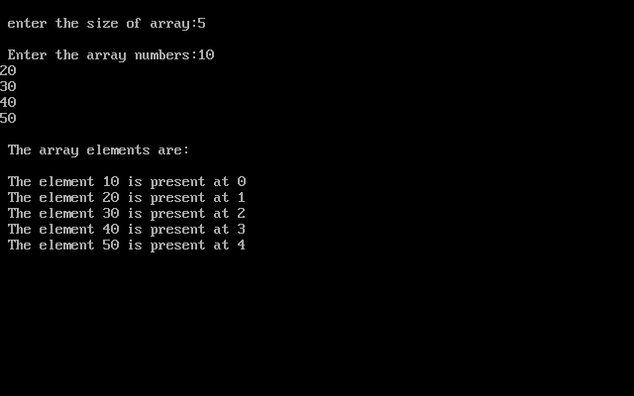
output

Slide 6
WAP to insert an element in array
void main()
{
int a[10],n,i=0,value,position;
clrscr();
printf("\n enter the size of array:");
scanf("%d",&n);
printf("\n Enter the array numbers:");
for(i=0;i<=n-1;i++)
{
scanf("%d",&a[i]);
}

Slide 7
printf("\n enter the position for the new element:");
scanf("%d",&position);
printf("\n enter the new element to be inserted:");
scanf("%d",&value);

Slide 8
for(i=n-1; i>=position; i--)
{
a[i+1]=a[i];
}
a[position]=value;
n=n+1;
for(i=0;i<=n-1;i++)
{
printf("\n The element %d is present at %d",a[i],i);
}
getch();
}

Slide 9
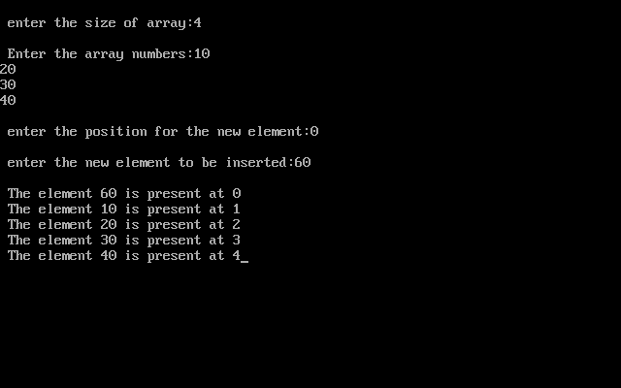

Slide 10
WAP to delete an element from the array
void main()
{
int a[10],n,i=0,position,value;
clrscr();
printf("\n enter the size of array:");
scanf("%d",&n);

Slide 11
printf("\n Enter the array numbers:");
for(i=0;i<=n-1;i++)
{
scanf("%d",&a[i]);
}

Slide 12
printf("\n enter the position of the element to be deleted:");
scanf("%d",&position);
value=a[position];
for(i=position;i<=n-1;i++)
{
a[i]=a[i+1];
}
n=n-1;
printf("\n the deleted element is =%d", value);

Slide 13
for(i=0;i<=n-1;i++)
{
printf("\n %d is stored at %d location",a[i],i);
}
getch();
}

Slide 14
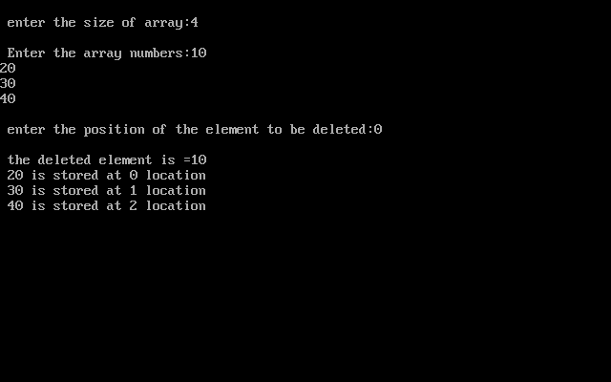

Slide 15
WAP to search an element from array
void main()
{
int a[10],n,i=0,search;
clrscr();
printf("\n enter the size of array:");
scanf("%d",&n);

Slide 16
printf("\n Enter the array numbers:");
for(i=0;i<=n-1;i++)
{
scanf("%d",&a[i]);
}

Slide 17
printf("\n enter the number to be search:");
scanf("%d",&search);
for(i=0;i<=n-1;i++)
{
if(a[i]==search)
{
printf("\n the element is present at position %d",i);
break;
}
}

Slide 18
if(i==n)
{
printf("\n the search is unsuccessful");
}
getch();
}

Slide 19
