Slide 1

4.Linked List
Linked List is a linear collection of data elements called as NODE.
Node have 2 parts:
Information/Data Field
Link/Address Field

Slide 2
Information Field/Data Field :-
It contains the information/data of the elements.
Linked Field /Address Field:-
It contains address of the next node in the list

Slide 3
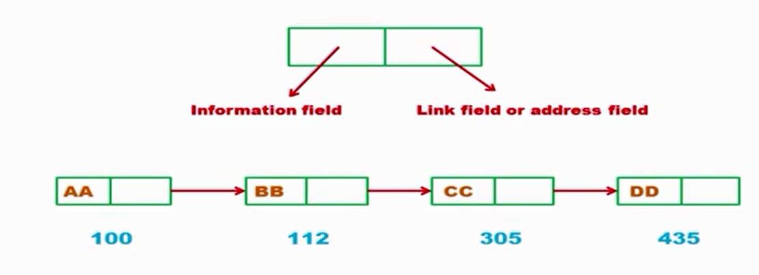

Slide 4
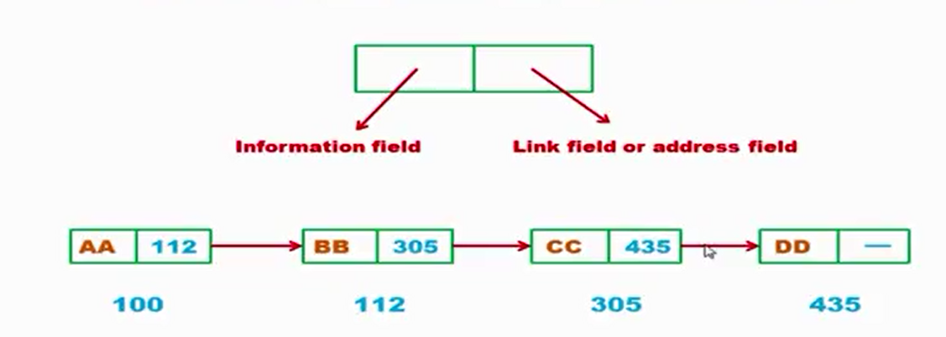

Slide 5
Node:- The structure combination of Data and its link to the next structure is called as NODE.
DATA | Link
NODE

Slide 6
Address:- It stores the address of the next node of Link List.
Pointer:- A data type used to point to the address of the next node.
Information field /data field:- It contains the information/data of the elements.

Slide 7
Next Pointer:- The link which points to the next node of the link list.
Null pointer :- It signifies the end of link list ,when the next points to NULL
Empty List: It signifies no data in the link list

Slide 8
Types of Link List
1. Linear link list/Singly Link List
2.Circular Link List

Slide 9

Linear/Singly Link List
A singly linked list is a type of linked list that is unidirectional, that is, it can be traversed in only one direction from head to the last node (tail).
In Linear Link list each node of the linear list points to the next successive node.
In linear list there is no way to traverse back.

Slide 10
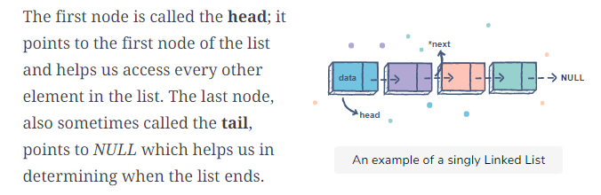

Slide 11
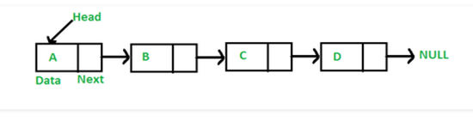
In above fig. The head points to the data value “A”
The node storing the value “D” is the last node of the list .The NULL value indicates the end of the list

Slide 12
Operations on Linked List:-
Traversing all the elements in a linked list
Searching for an element in the linked list
Insertion of an element
Deletion of an element

Slide 13
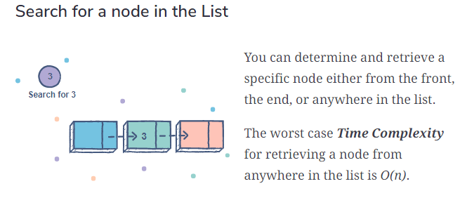

Slide 14
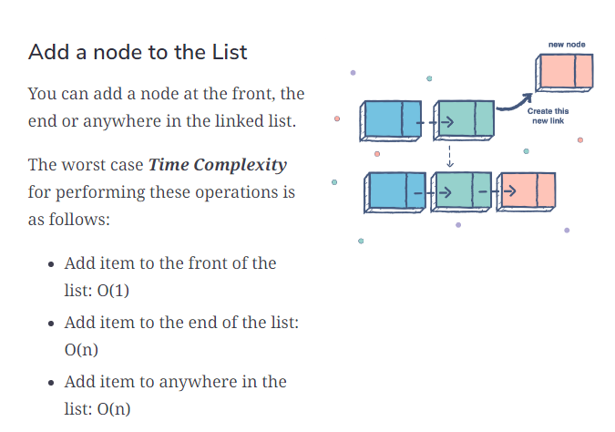

Slide 15
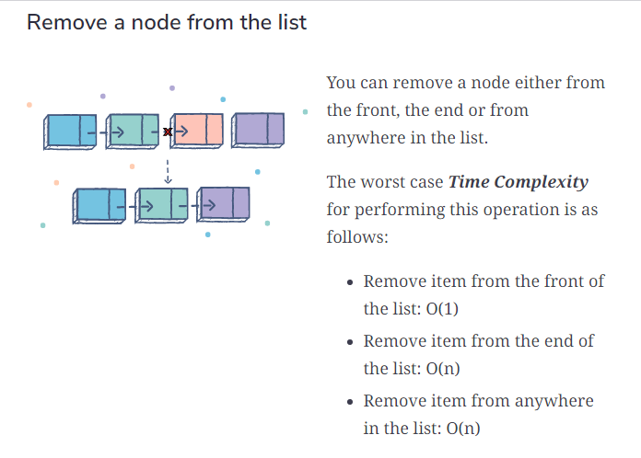

Slide 16
How to declare a Node in Linear Linked List
struct node
{
int data;
struct node *next;
};

Slide 17
Insertion of an element
1. Insert an element at the beginning of the list
2. Insert an element at the middle position/anywhere in the list
3.Insert an element at the end of the list

Slide 18
Deletion of an element
1. Delete an element from the beginning of the list
2. Delete an element at the middle position/anywhere from the list
3.Delete an element from the end of the list

Slide 19
Advantages of Linear Linked List
1. Accessibility of a node in the forward direction is easier.
2.Insertion and deletion of nodes are easier.

Slide 20
DisAdvantages of Linear Linked List
1.Accessing the preceding node of a current node is not possible as there is no backward traversal.
2.Accessing a node is time consuming

Slide 21
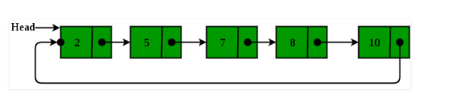
Circular Linked List
In a circular link list address of the last node points to the first node of the list.
The circular link list have neither a beginning nor an end.

Slide 22
Fig. Circular Link List
Circular linked list is a linked list where all nodes are connected to form a circle. There is no NULL at the end

Slide 23
Advantages of Circular Link List
A circular link list has no beginning and no ending.
We can traverse a circular list in any direction either forward or backward
It saves time when we have to go to the first node from the last node.

Slide 24
DisAdvantages of Circular Link List
It is not easy to reverse the link list
If proper case is not taken then the problem of infinite loop can occur.

Slide 25
Linear Linked List | Circular Linked List
Next field of the last node is set to NULL | Next field of the last node is connected back to the Head node.
Head pointer points to first node | Head pointer points to last node
Insertion at the end has O(n) time complexity | Insertion at end has O(1) time complexity
Searching algorithm terminates on finding the NULL pointer | Searching algorithm terminates on coming to first node.
Not suited for implementing queue data structure | It can be used for queue data structure

Slide 26
Create a Singly Linked List
To create a linked list we will create the nodes one by one and add them to the end of the list.
The list will be pointed to by a pointer called list which stores the address of the first node of the list

Slide 27
Algorithm to create a Singly Linked List
1.Start
2.List =NULL
3.Accept number of nodes to be created in variable n=5
4.Counter=1
5.Create a new node and store address in new node
6.If list is NULL then
List=temp=newnode i.e.Newnode is the first node
Else
Attach newnode to temp
Move temp to the last node

Slide 28
Algorithm to create a Singly Linked List
7. Increment counter
8.If counter<=n
Goto step 5
9.Stop

Slide 29
Print the contents of Singly Linked List
void print(node *p)
{
while(p!=NULL)
{
printf(“\n %d”,p->data)
p=p->next;
}
}

Slide 30
Traversing a Linked List
Traversal of a linked list always starts from the first node.
To traverse a linked list in the forward direction ,a pointer type variable is assigned the address of the first node.
p=head;
while(p!=NULL)
p=p->next ; // next field of the node pointed by p contains address of the next node
head
5
1
9
3
P

Slide 31
Searching a Linked List
1.Initalize the current pointer with the beginning of the list ,i.e current=head
2.Compare the key value with the current node value
i.e current->data==key
If match then display “element is found”
3.Otherwise move the current pointer to point to the next node in the list .
i.e. current=current->next
And go to step 2 till the list is not over

Slide 32
Inserting a new data at the beginning of the list
1.Obtain the space for new node
2.Assign data to the data field of the new node
3.Set the next field of the new node to the beginning of the linked list
4. Change the reference pointer of the linked list to point to the new node.

Slide 33
void insert_beg()
{
int num;
t=(struct node*)malloc(sizeof(struct node));
printf("Enter data:");
scanf("%d",&num);
t->data=num;
if(start==NULL) //If list is empty
{
t->next=NULL;
start=t;
}
else
{
t->next=start;
start=t;
}
}

