Slide 1
Course Outcome POD:Principals Of Database(22321)
Use fundamental concepts of database in a database system
Choose relevant data model to solve a problem
Develop relational databases using ER modeling approach
Apply constraints for data integrity in Relational database
Apply data normalization and de-normalization techniques on database.

Slide 2
Chapter Names
Unit 1 : Basics of database and architecture :12M
Unit 2: Data models and database types:12M
Unit 3: Database design using ER model:14M
Unit 4: Relational database Model:18M
Unit 5: Normalization:14M

Slide 3
Chapter 1 12 Marks
Basics of Database and Architecture

Slide 4
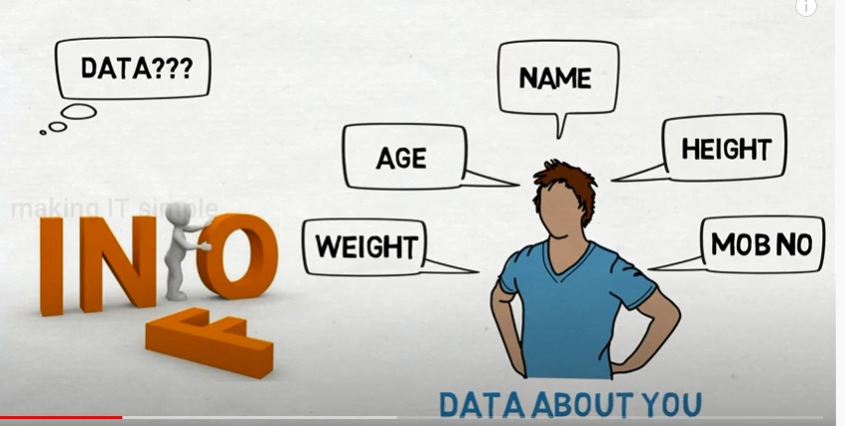
Data
Data is an information and unorganized fact that is required to be processed to make it meaningful.
In simple words data can be facts(things) related to any object in consideration. Data is stored in table format(row and column).
User input is known as data.
For example your name, age, height, weight, etc are some data related to you.

Slide 5
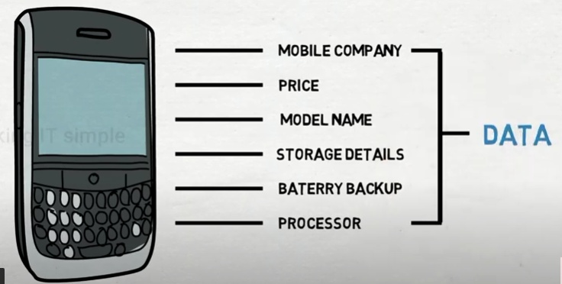
Another example

Slide 6
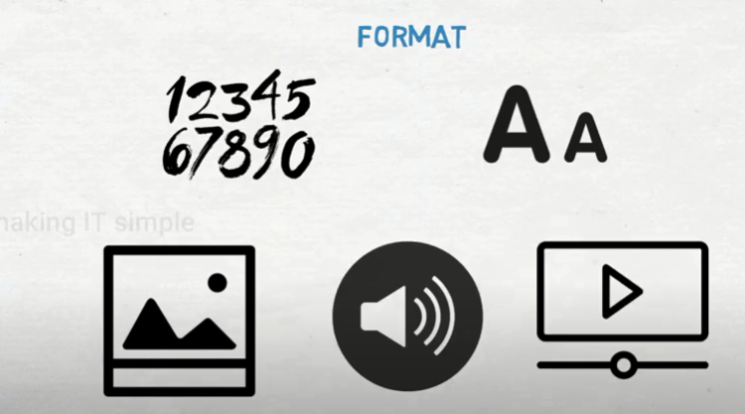
So Data can be in any format like numbers,text,pictures,audio,videos etc

Slide 7
information
Information is a set of data which is processed in a meaningful way according to the given requirement.

Slide 8
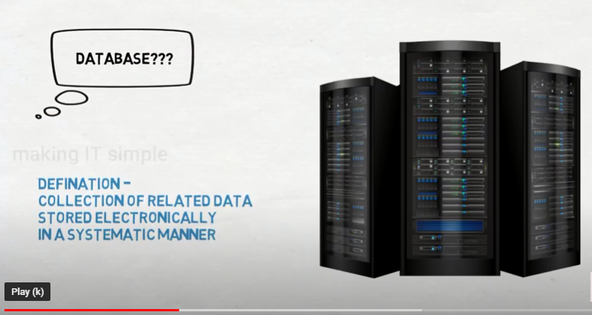
Database
So database is a container who store the data
The collection of related data is termed as database which is organized in such a way that it can be easily retrieved and managed.
Example: online telephone directory, electricity service provider,mobile company data

Slide 9
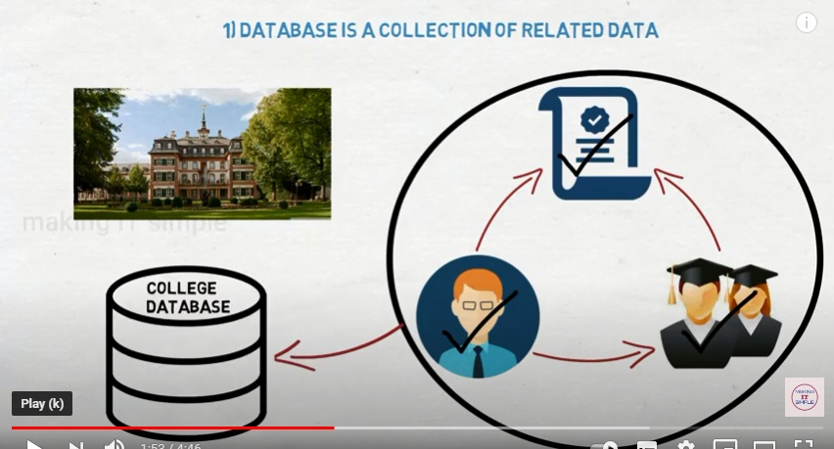
Consider college database example

Slide 10
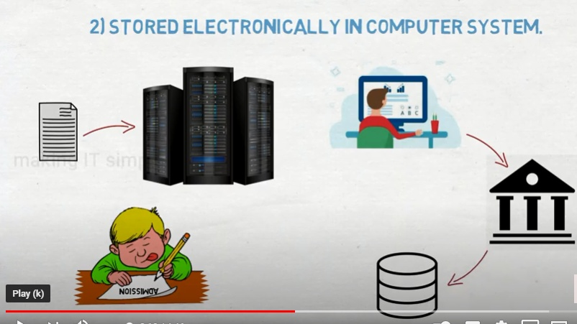

Slide 11


Database Management System(DBMS)
Database is a container who stores the data
Where as Database management system(DBMS) is a system software which manages the data .
It can perform various tasks like creation, retrieval, insertion, modification and deletion of data to manage it in a systematic way as per requirement.

Slide 12
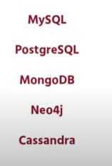
DBMS PRODUCTS
MS Access
MySql
Oracle
SQL Server
IBM DB2
PostgreSQL
Amazon SimpleDB (cloud based) etc.
DB2
TeamSQL

Slide 13
Purpose of Database Systems
The main purpose of database systems is to store and manage the data.
Consider a university database that keeps the data of students, teachers, courses, books etc.
To manage this data we need to store this data somewhere where we can add new data, delete unused data, update outdated data, retrieve data, to perform these operations on data we need a Database management system that allows us to store the data in such a way so that all these operations can be performed on the data efficiently.

Slide 14
Characteristics of Database Management System
Real-world entity :database should be able to store every type of information present in the real world.
Relation-based tables: database should be able to relate entities/tables in database by means of relation.
Isolation of data and application: database is a system which provides the platform to store the data and the data is the one which allows the database to work.
Less redundancy: there should not be any repetition of data in database.

Slide 15
Characteristics of Database Management System
Query Language: Dbms must use strong query language. Once Database is created, this helps the user to retrieve and manipulate data.
Multiuser and Concurrent Access: multiple user must be able to access the same database without affecting the other users simultaneously.
Security :There must be security means each user should have their own levels of rights to see the database.
Database should also supports ACID properties .i.e. while performing any transaction database makes sure that the real purpose of the data should remain as it is.

Slide 16
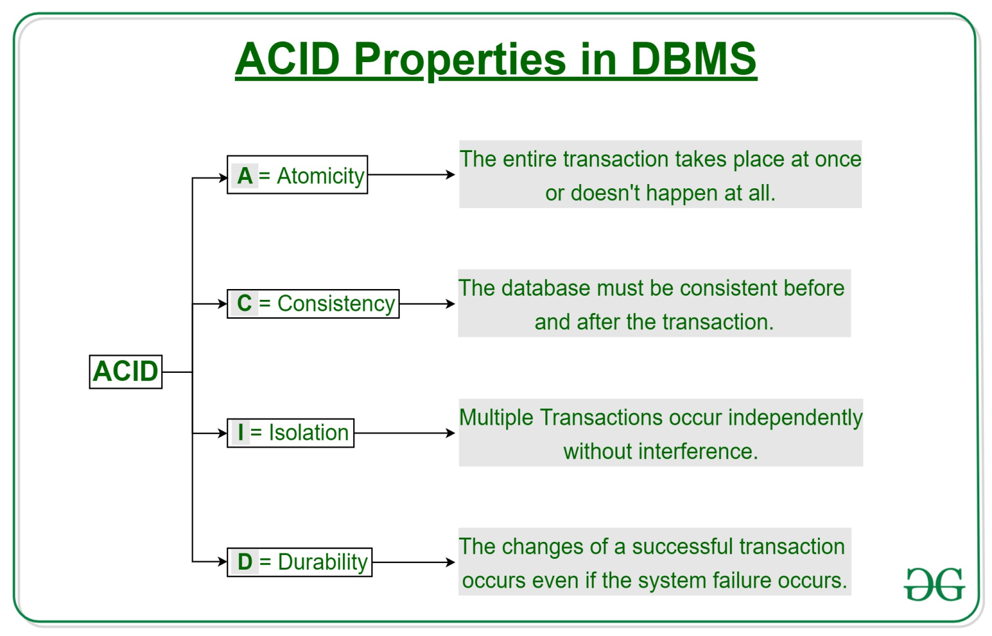

Slide 17
Database Applications – DBMS
Telecommunication: There is a database to keeps track of the information regarding calls made, network usage, customer details etc.
Industry: Where it is a manufacturing unit, warehouse or distribution center, each one needs a database to keep the records of ins and outs.
Banking System: For storing customer info, tracking day to day credit and debit transactions, generating bank statements etc.
Sales: To store customer information, production information and invoice details.

Slide 18
Database Applications – DBMS
Airlines: To travel though airlines, we make early reservations, this reservation information along with flight schedule is stored in database.
Education sector: Database systems are frequently used in schools and colleges to store and retrieve the data regarding student details, staff details, course details, exam details, payroll data, attendance details, fees details etc.
Online shopping: store the product information, your addresses and preferences, credit details and provide you the relevant list of products based on your query.
Manufacturing , Credit Card transactions ,Railway reservation etc.

Slide 19
File Processing System
Traditional file processing system is a computer based system in which all the information is stored in various computer files.
Initially the system seems to be useful but as requirement of data processing and size of data increases, the drawbacks of this system comes in picture.

Slide 20
Drawbacks of File system
Data redundancy: Data redundancy refers to the duplication of data, lets say we are managing the data of a college where a student is enrolled for two courses, the same student details in such case will be stored twice, which will take more storage than needed. Data redundancy often leads to higher storage costs and poor access time.
Data inconsistency: Data redundancy leads to data inconsistency, lets take the same example that we have taken above, a student is enrolled for two courses and we have student address stored twice, now lets say student requests to change his address, if the address is changed at one place and not on all the records then this can lead to data inconsistency.
Data Isolation:Because data are scattered in various files, and files may be in different formats, writing new application programs to retrieve the appropriate data is difficult.

Slide 21
Drawbacks of File system
Dependency on application programs: Changing files would lead to change in application programs.
Atomicity issues: Atomicity of a transaction refers to “All or nothing”, which means either all the operations in a transaction executes or none. It is difficult to achieve atomicity in file processing systems.
Data Security: Data should be secured from unauthorized access, for example a student in a college should not be able to see the payroll details of the teachers, such kind of security constraints are difficult to apply in file processing systems.
Poor data modeling of real world: it is difficult for file processing system to represent the complex data and interfile relationships.

Slide 22
Advantage of DBMS over file system
No redundant data: Redundancy removed by data normalization. No data duplication saves storage and improves access time.
Data Consistency and Integrity: As we discussed earlier the root cause of data inconsistency is data redundancy, since data normalization takes care of the data redundancy, data inconsistency also been taken care of as part of it

Slide 23
Advantage of DBMS over file system
Data Security: It is easier to apply access constraints in database systems so that only authorized user is able to access the data. Each user has a different set of access thus data is secured from the issues such as identity theft, data leaks and misuse of data.
Privacy: Limited access means privacy of data.
Easy access to data – Database systems manages data in such a way that the data is easily accessible with fast response times.

Slide 24
Advantage of DBMS over file system
Easy recovery: Since database systems keeps the backup of data, it is easier to do a full recovery of data in case of a failure.
Flexible: Database systems are more flexible than file processing systems.

Slide 25
Disadvantages of DBMS:
Increased costs: DBMS implementation cost is high compared to the file system
Complexity: Database systems are complex to understand
Performance: Database systems are generic, making them suitable for various applications. However this feature affect their performance for some applications
Frequent upgrade/replacement cycle:new functionalities are often added into DBMS by their vendors.sometimes these versions require hardware upgrades which increases expenses.

Slide 26
Dbms vs File Processing system
DBMS | File System
DBMS is a collection of data. In DBMS, the user is not required to write the procedures. | File system is a collection of data. In this system, the user has to write the procedures for managing the database.
DBMS gives an abstract view of data that hides the details. | File system provides the detail of the data representation and storage of data.
DBMS provides a crash recovery mechanism, i.e., DBMS protects the user from the system failure. | File system doesn't have a crash mechanism, i.e., if the system crashes while entering some data, then the content of the file will lost.
DBMS provides a good protection mechanism. | It is very difficult to protect a file under the file system.
DBMS contains a wide variety of sophisticated techniques to store and retrieve the data. | File system can't efficiently store and retrieve the data.
DBMS takes care of Concurrent access of data using some form of locking. | In the File system, concurrent access has many problems like redirecting the file while other deleting some information or updating some information.

Slide 27
Different types of database
Centralizes database: users from different locations can access this database from a remote location at the central database.
Operational database: this database contains information relating to the operations of an enterprise.
End user database: end user is the user of a software, application or a product. This is shared database which is shred by users and is meant for use by the end users.
Commercial database: this is a database that contains information which external users may require.
Personal database: databases are maintained, generally on personal computers.
Distributed database: databases have contributions from the common databases as well as the data captured from the local operations.

Slide 28
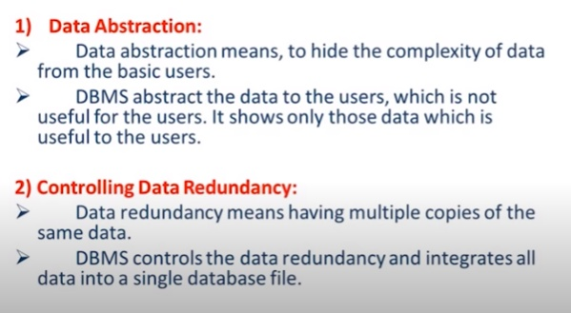
Advantages OF Database

Slide 29
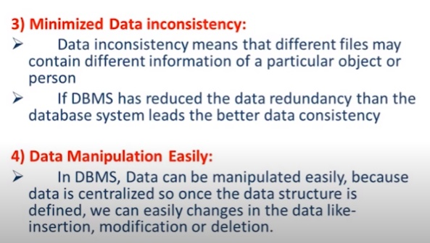
Advantages OF Database

Slide 30
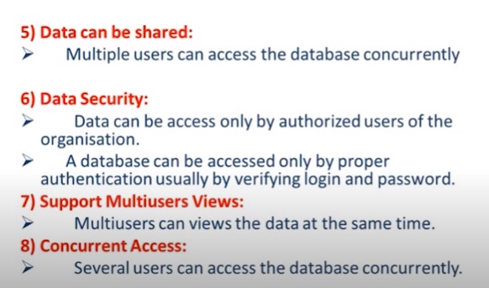
Advantages OF Database

Slide 31
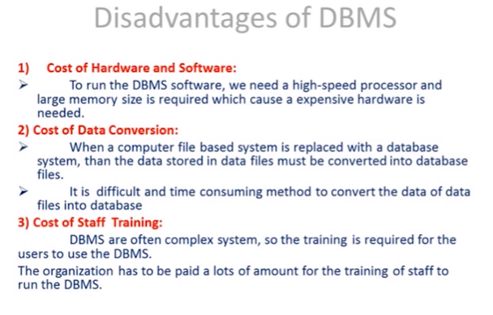

Slide 32
Component of Database
Hardware
Software
Procedures
People

Slide 33
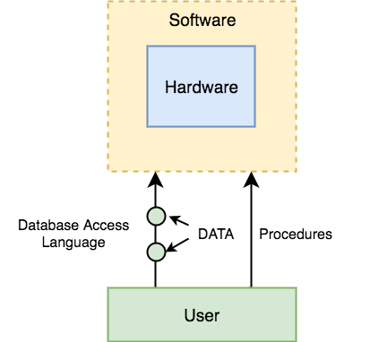

Slide 34
DBMS Components: Hardware
It contains a set of physical electronic devices like computers, I/O devices, storage devices etc.
When we run Oracle or MySQL on our personal computer, then our computer's Hard Disk, our Keyboard using which we type in all the commands, our computer's RAM, ROM all become a part of the DBMS hardware.

Slide 35
DBMS Components: Software
This is the main component, as this is the program which controls everything.
The DBMS software is more like a wrapper around the physical database, which provides us with an easy-to-use interface to store, access and update data.

Slide 36
DBMS Components: Procedures
Procedures refer to general instructions to use a database management system.
This includes procedures to setup and install a DBMS, To login and logout of DBMS software, to manage databases, to take backups, generating reports etc.

Slide 37
People
Database Administrators: Database Administrator or DBA is the one who manages the complete database management system. DBA takes care of the security of the DBMS, it's availability, managing the license keys, managing user accounts and access etc.
Application Programmer or Software Developer: This user group is involved in developing and designing the parts of DBMS.
End User: These days all the modern applications, web or mobile, store user data. How do you think they do it? Yes, applications are programmed in such a way that they collect user data and store the data on DBMS systems running on their server. End users are the one who store, retrieve, update and delete data.

Slide 38
Data Abstraction
Database systems are made-up of complex data structures.
To ease the user interaction with database, the developers hide internal irrelevant details from users.
process of hiding irrelevant details from user is called data abstraction.

Slide 39
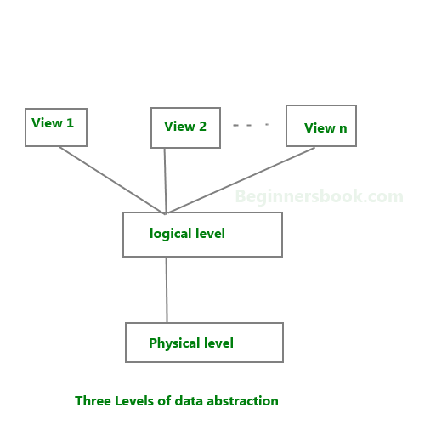
Levels Of Abstraction

Slide 40
Levels Of Abstraction
Physical level(Internal Level): This is the lowest level of data abstraction. It describes how data is actually stored in database. You can get the complex data structure details at this level.
Logical level(Conceptual level): This is the middle level of 3-level data abstraction architecture. It describes what data is stored in database.
View level(External Level): Highest level of data abstraction. This level describes the user interaction with database system.

Slide 41
DBMS languages
Database languages are used to read, update and store data in a database.
There are several such languages that can be used for this purpose; one of them is SQL (Structured Query Language).

Slide 42
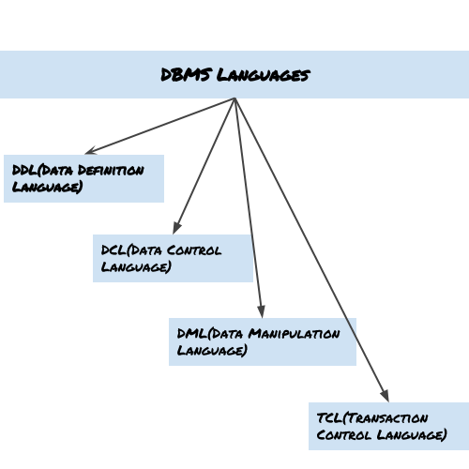

Slide 43
Data Definition Language (DDL)
DDL is used to define the data.(it means to define the database structure)
It is used for specifying the database schema(design of database). It is used for creating tables, schema, indexes, constraints (rules)etc. in database.
operations that we can perform on database using DDL:
To create the database instance(object) – CREATE
To alter the structure of database – ALTER
To drop database instances(object) – DROP
To delete tables in a database instance – TRUNCATE
To rename database instances – RENAME

Slide 44
Data Manipulation Language (DML)
DML is used for accessing and manipulating data in a database.
Two types:
1. Procedural DML :there is requirement of user to specify which data is required and how to get this data.
2. Declarative DML:there is requirement of user to specify which data is required and without specifying how to get this data.
The following operations on database comes under DML:
To read records from table(s) – SELECT
To insert record(s) into the table(s) – INSERT
Update the data in table(s) – UPDATE
Delete all the records from the table – DELETE

Slide 45
Data Control language (DCL)
DCL is used for granting and revoking user access on a database –
To grant access to user – GRANT
To revoke access from user – REVOKE

Slide 46
Transaction Control Language(TCL)
The changes in the database that we made using DML commands are either performed or rollbacked using TCL.
To persist the changes made by DML commands in database – COMMIT
To rollback the changes made to the database – ROLLBACK

Slide 47
Schema
The design of database is called as schema.
Types of schema:
Physical schema: the database designed at physical level called as physical schema i.e. how the data stored in the blocks of storage is described.
Logical schema: the database designed at logical level is called as logical schema. Developers and DBA work at this level.
View schema: the database designed at view level is called as view schema. This usually describes the end user interaction with database system.

Slide 48
Instances(object)
The collection of information stored in a database at a particular moment of time is an instance.
Example: student is an instance
and information of student is rollno,name ,address ,age,mobileno like this

Slide 49
Data Independence
The ability to modify the schema definition in one level without modifying the schema definition in a higher level is called as data independence.
Two types:
1. Physical data independence:
it is ability to modify the physical schema without causing application programs to be rewritten.
Modifications at physical level are occasionally necessary to improve performance.
2. Logical Data Independence:
It is the ability to modify the logical schema without causing application program to be rewritten.
Modification at the logical level are necessary whenever the logical structure of the database is altered.

Slide 50
Data Integrity
Data integrity is the accuracy ,completeness and reliability of data throughout its lifecycle.
Integrity constraints are a set of rules. It is used to maintain the quality of information.
Integrity constraints ensure that the data insertion, updating, and other processes have to be performed in such a way that data integrity is not affected.
Thus, integrity constraint(rules) is used to guard against accidental damage to the database.

Slide 51
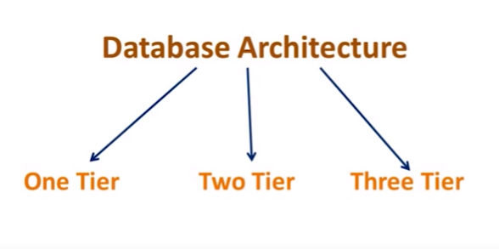
Architecture of database
There are three types of DBMS architecture:
1. Single tier architecture 2. Two tier architecture 3. Three tier architecture

Slide 52
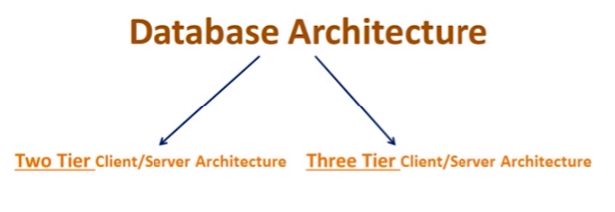

Slide 53
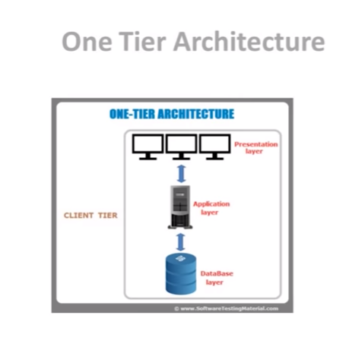
1-tier architecture
In 1-tier architecture, the DBMS is the only entity where the user directly sits on the DBMS and uses it.
Any changes done here will directly be done on the DBMS itself.

Slide 54
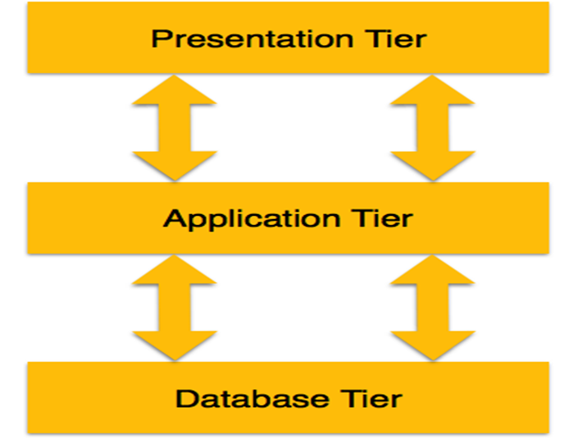

Slide 55
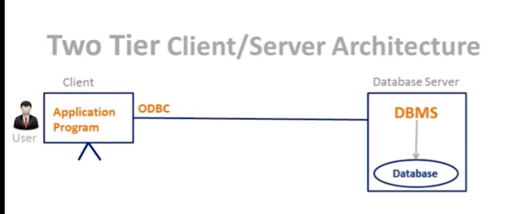
two-tier architecture
In two-tier architecture, the Database system is present at the server machine and the DBMS application is present at the client machine, these two machines are connected with each other through a reliable network ,
The application connection interface such as JDBC, ODBC are used for the interaction between server and client.

Slide 56
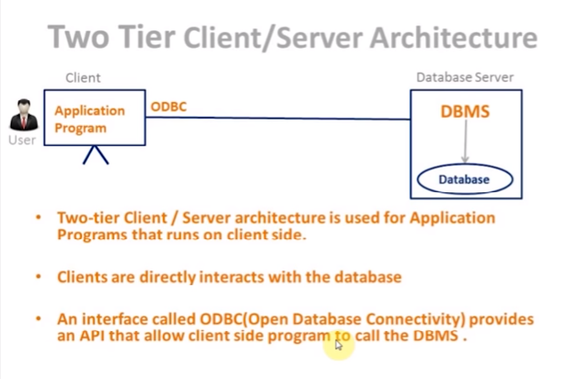

Slide 57
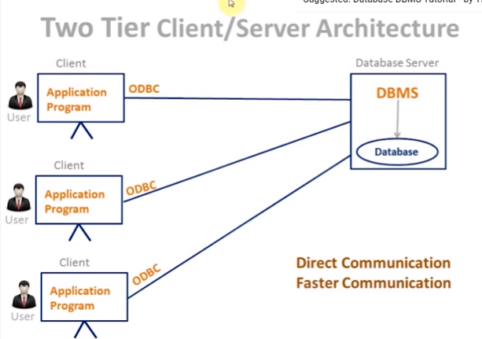
Example of 2 tier architecture: college ,business organization,company organization

Slide 58
Three tier architecture
Three tier architecture is most widely used architecture in todays world.
In this architecture the user layer, business layer and data layer are implemented independently by three different application.

Slide 59
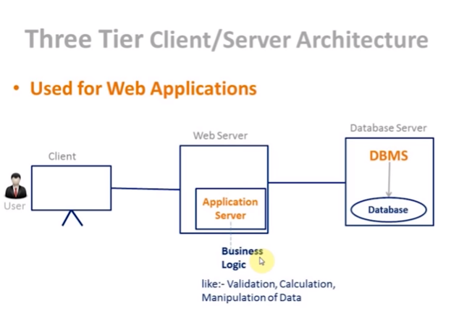

Slide 60
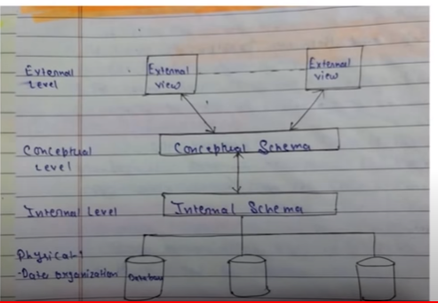

Slide 61
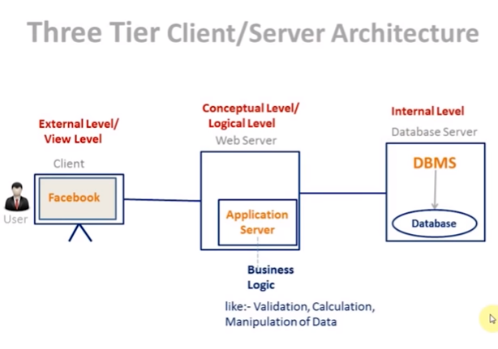

Slide 62
Disadvantages of three tier architecture
High installation cost.
Structure is more complex as compare to 1 & 2 tier architectures.

Slide 63
Applications of 3-tier architecture
E-commerce Websites
Database related Websites

