Slide 1
Unit II 12 marks
Data Models and Database Types

Slide 2
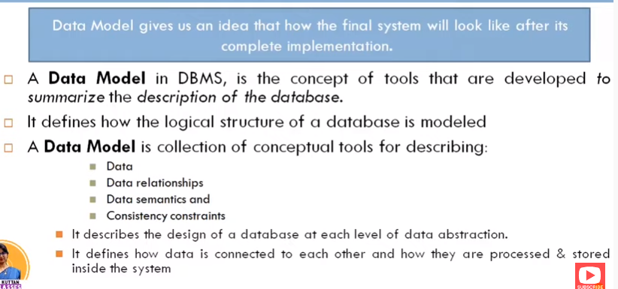
Data Model

Slide 3
DATABASE MODELs
A Database model defines the logical design and structure of a database and defines how data will be stored, accessed and updated in a database management system.
Types of database Model:
1.Hierarchical Model
2.Network database Model
3.Entity-relationship Model
4.Object Oriented data Model
5.Relational Model

Slide 4
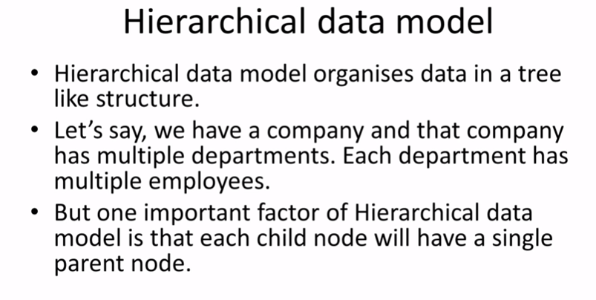

Slide 5
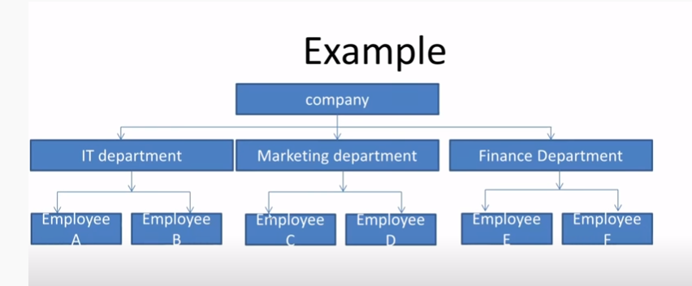
Hierarchical model example

Slide 6
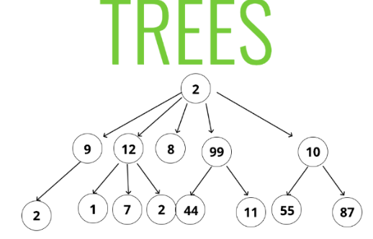
1.Hierarchical model
This database model organizes the data into a tree-like-structure, with a single root, to which all the other data is linked.
This model structure contains parent-child relationship.
Root of tree is parent which then branches into its children's.
one-to-many relationship between two different types of data.
There is business rule, the rule is that one parent can have many child nodes but one child can have only one parent node.

Slide 7
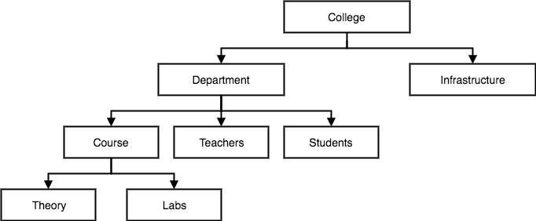
Hierarchical model Example
for example, one college can have many courses, many professors and of-course many students.

Slide 8
Advantages Of Hierarchical model
Simple to understand: due to hierarchical structure it is easy to understand. Most of time data have hierarchical relationship so easy to arrange the data.
Database Integrity: there is always parent child relationship between records on different level. Due to this inherent structure integrity gets maintained.
Efficient: the performance of this model is very efficient due to hierarchical structure.

Slide 9
disadvantages Of Hierarchical model
Complex implementation: only data independence is not enough for designer and programmer to build database system they need to have knowledge of physical data storage which may be complex.
Difficult to manage : any changes in a location of data needs change in all application programs.
Limitation in implementation

Slide 10
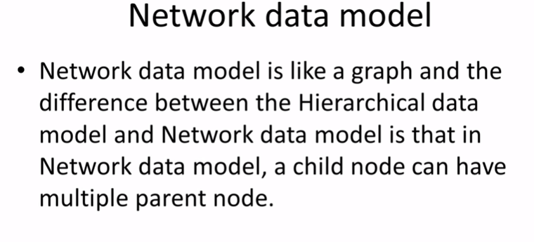

Slide 11
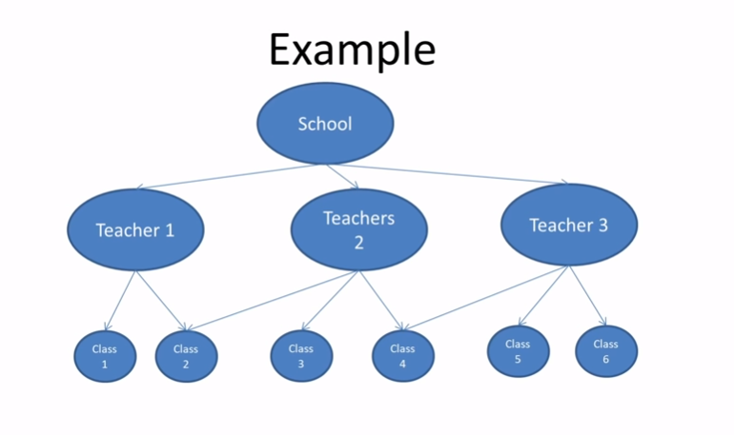
Network model example

Slide 12
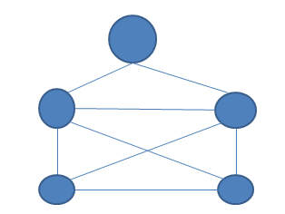
2)Network database model
This is an extension of the Hierarchical model.
In this model data is organized more like a graph, and are allowed to have more than one parent node.
In this database model data is more related as more relationships are established in this database model.
This database model was used to map many-to-many data relationships.
In network model data is represented as collection of records and relationship among data are represented by links which can be viewed as pointer.

Slide 13
Advantages Of Network model
Design is simple: there is no complex structure in this model so easy to design and understand.
It has capability to handle various relationship: this model can handle one to many and many to many relationship.
Easy to access: data access is easy and flexible than hierarchical model.

Slide 14
Disadvantages Of Network model
System complexity- All the records are maintained using pointers and hence the whole database structure becomes very complex.
Operational Anomalies- The insertion, deletion and updating operations of any record require large number of pointers adjustments.
Absence of structural independence-structural changes to the database is very difficult.

Slide 15
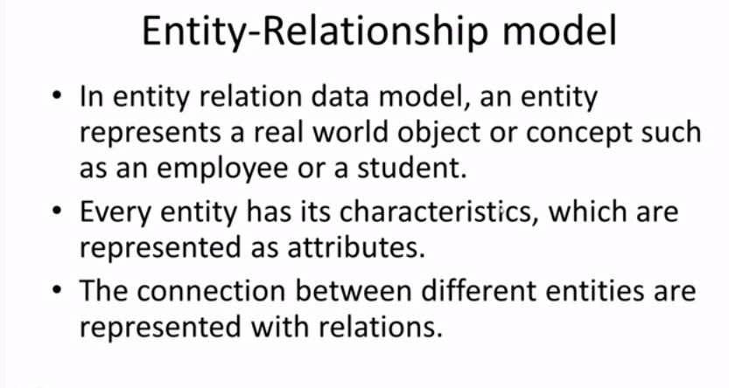
3.Entity-relationship Model

Slide 16
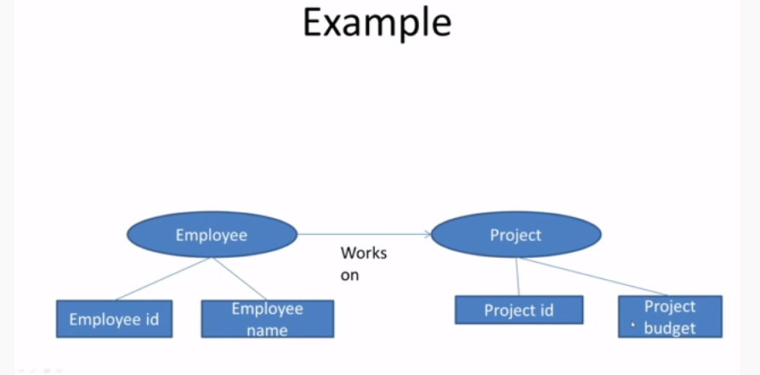
3.Entity-relationship Model example
entity
entity
attributes
attributes

Slide 17
3.Entity-relationship Model
In this database model, relationships are created by dividing object into entity and its characteristics into attributes.
Different entities are related using relationships.
E-R Models are defined to represent the relationships into pictorial form to make it easier for different stakeholders to understand.
This model is good to design a database, which can then be turned into tables in relational model

Slide 18
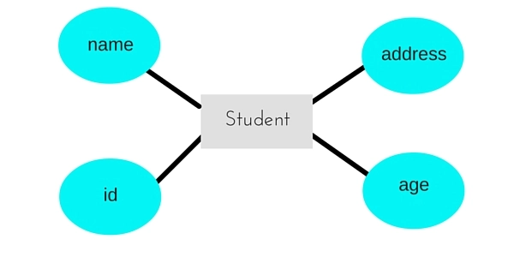
3) Entity-relationship Model
Let's take an example, If we have to design a School Database, then Student will be an entity with attributes name, age, address etc. As Address is generally complex, it can be another entity with attributes street name, pincode, city etc, and there will be a relationship between them.

Slide 19
Advantages of E-R model
Conceptually it is very simple: ER model is very simple because if we know relationship between entities and attributes, then we can easily draw an ER diagram.
Better visual representation: ER model is a diagrammatic representation of any logical structure of database. By seeing ER diagram, we can easily understand relationship among entities and relationship.
Effective communication tool: It is an effective communication tool for database designer.
Highly integrated with relational model: ER model can be easily converted into relational model(table format) by simply converting ER model into tables.
Easy conversion to any data model: ER model can be easily converted into another data model like hierarchical data model, network data model and so on.

Slide 20
Disadvantages of E-R model
Loss of information content: Some information may be lost or hidden in ER model
Limited relationship representation: ER model represents limited relationship as compared to another data models like relational model etc.
No representation of data manipulation: It is difficult to show data manipulation in ER model.

Slide 21
4.Object oriented data model
Object oriented data model is based upon real world situations.
These situations are represented as objects, with different attributes. All these object have multiple relationships between them.
It is an extension to E-R model with integration of concepts like object,method,encapsulation.
Object includes information about relationship between the facts within the object, as well as information about relationship with other objects.

Slide 22
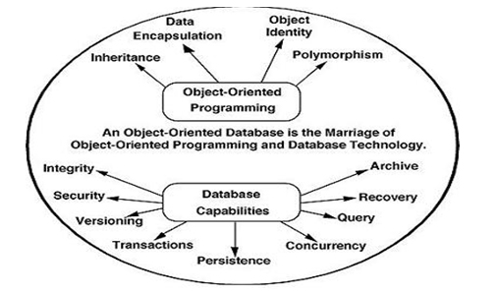
Object oriented data model

Slide 23
Advantages of object oriented model
This model supports inheritance ,due to this we can reuse attributes and functionalities.it reduces cost of maintaining data multiple times.
Due to inheritance and encapsulation this model become flexible.
We can bind each class with its attribute and functionality.
We can see each object as a real world entity in this model. Hence it is more understandable.

Slide 24
Disadvantage of Object-oriented databases
Object-oriented database are more expensive to develop.
In the Most organizations are unwilling to abandon and convert from those databases.

Slide 25
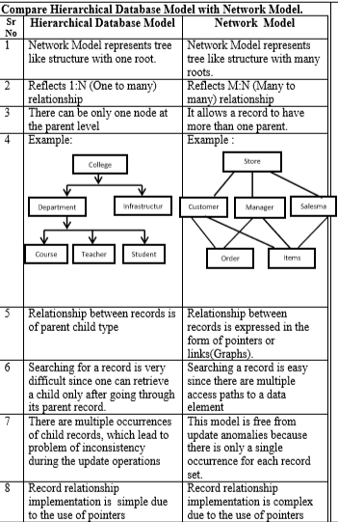

Slide 26
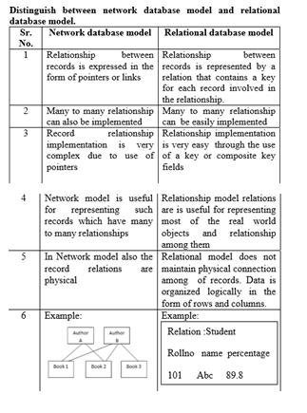

Slide 27
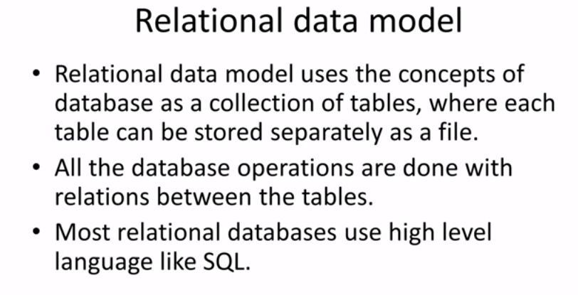
5)Relational Database Model

Slide 28
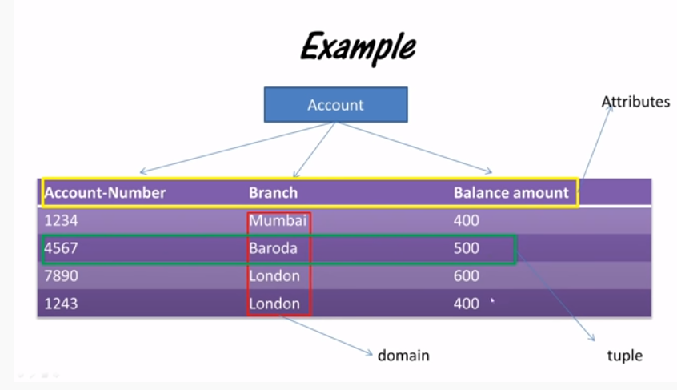
5)Relational Database Model example

Slide 29
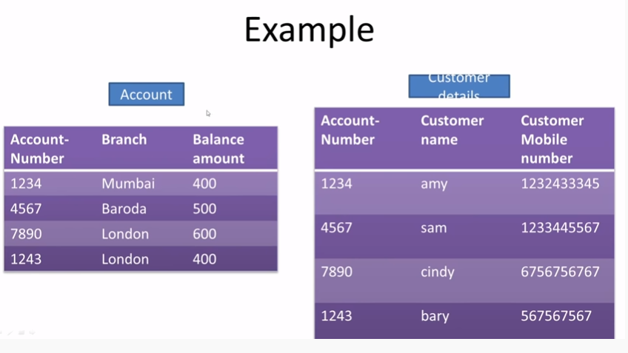

Slide 30
5)Relational Database Model
Relational Model was proposed by E.F. Codd to model data in the form of relations or tables.
After designing the conceptual model of Database using ER diagram, we need to convert the conceptual model in the relational model which can be implemented using any RDBMS languages like Oracle, SQL, MySQL etc.
Relational Model represents how data is stored in Relational Databases.
A relational database stores data in the form of relations (tables).

Slide 31
The relational model consists of three major components:
1.The set of relations and set of domains that defines the way data can be represented (data structure).
2. Integrity rules that define the procedure to protect the data (data integrity).
3. The operations that can be performed on data (data manipulation).

Slide 32
relational model:
Consider a relation STUDENT with attributes ROLL_NO, NAME, ADDRESS, PHONE and AGE shown in Table 1
ROLL_NO | NAME | ADDRESS | PHONE | AGE
1 | RAM | DELHI | 9455123451 | 18
2 | RAMESH | GURGAON | 9652431543 | 18
3 | SUJIT | ROHTAK | 9156253131 | 20
4 | SURESH | DELHI |  | 18

Slide 33
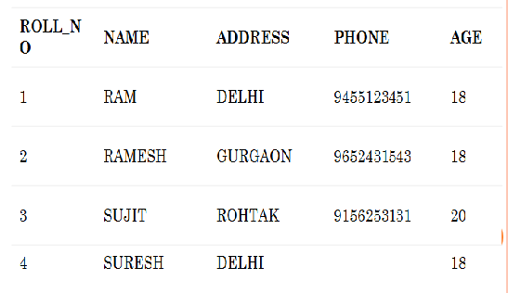
Relational Model Concepts
Attribute: Each column in a Table. Attributes are the properties which define a relation. e.g., Student Rollno, NAME,etc.
Tables – In the Relational model the, relations are saved in the table format.

Slide 34
Tuple (record)– It is nothing but a single row of a table, which contains a single record.
Cardinality: Total number of rows present in the Table.
Degree: The total number of attributes which in the relation is called the degree of the relation.

Slide 35
Properties of Relations
Name of the relation is distinct from all other relations.
Each relation cell contains exactly one atomic (single) value
Each attribute contains a distinct name
Attribute domain has no significance
tuple has no duplicate value
Order of tuple can have a different sequence

Slide 36
Domain
A Domain is defined as the set of all unique values permitted for an attribute.
This attribute domain decides which types of values are permitted in the attribute.
The type of value contains where string or numerical or date type.
The domain also decides some integrity constraints for values to be inserted in the database.

Slide 37
Example of Domain
Consider employee table, an emp_name attribute can have only string type of value with salary attribute can have only numeric values with specified range.
Domain restrict the data to be inserted with specific constraints, hence it is called as domain constraint

Slide 38
Attribute
An attribute is a characteristic of an entity like student ,employee.
Attributes are the descriptive properties owned by each entity.
Example:
consider employee table, so employee is an entity has attribute emp_id ,emp_name emp_designation,emp_salary etc.

Slide 39
different types of attributes
Simple attributes
Composite Attributes
Single Valued Attributes
Multivalued Attributes
Derived Attribute

Slide 40
different types of attributes
1) Simple attributes : Attributes that cannot be subdivided (i.e are atomic) into subparts are called as simple attributes.
E.g: Enroll_no, RollNo
2) Composite Attributes: The attributes which can be divided into subparts are called composite attributes.
E.g: attribute name could be structured as a composite attribute consisting of first_name,middle_name and last_name

Slide 41
3) Single Valued Attributes: The attribute has single value for a particular entity called as single valued attribute. E.g: Student_id ,
Student entity : rollno ,enrollment no

Slide 42
different types of attributes
4) Multivalued Attributes: The attribute has set of values for a specific entity called as multi valued attribute. E.g: Phone_no is multivalued attribute because employee may have zero, one or several phone no.

Slide 43
5) Derived Attribute: The value for this type of attribute can be derived from the values of other related attributes or entities. E.g: Customer entity has attribute age and date_of_birth. We calculate age from date_of_birth and current_date. Here age is derived attribute and date_of_birth is base or stored attribute

Slide 44
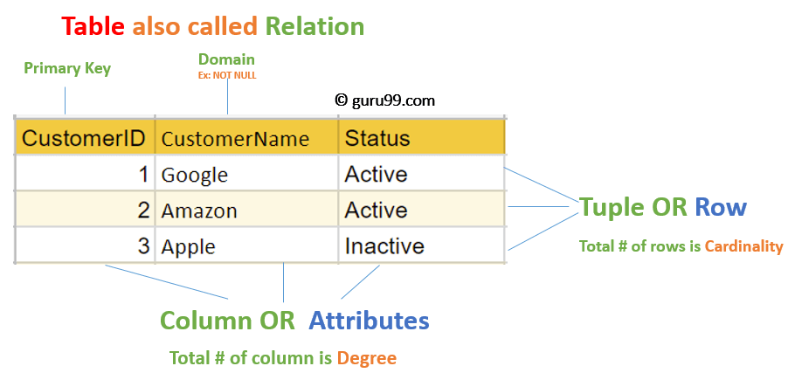
Tuples and relations
A single row of a table, which contains a single record for that relation is called a tuple.
Relation is sometimes used to refer to a table in a relational database but is more commonly used to describe the relationships that can be created between those tables in a relational database.

Slide 45
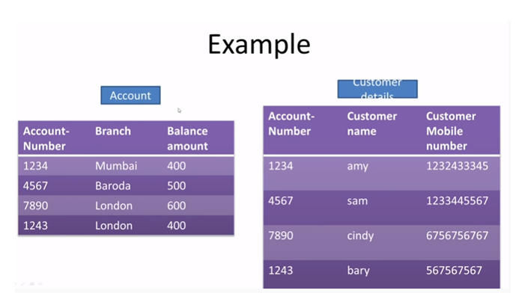
Tuples and relations
In relational databases, a relationship exists between two tables when one of them has a foreign key that references the primary key of the other table.

Slide 46
Tuples and relations
This single fact allows relational databases to split and store data in different tables
It is one of the features that makes relational databases such powerful and efficient stores of information.

Slide 47
Types of database system
1.Centralized Database System
2.Parallel Database System
3.Client/Server Database System
4.Distributed Database System

Slide 48
Centralized Database System:
1. A centralized database consists of a single data server into which all data are stored and from which all data are retrieved. All the data reside at a single location and all applications must retrieve all data from that location.
2. The centralized database system consists of a single processor together with its associated data storage devices and other peripherals. It is physically confined to a single location.
3. Data can be accessed from the multiple sites with the use of a computer network while the database is maintained at the central site

Slide 49
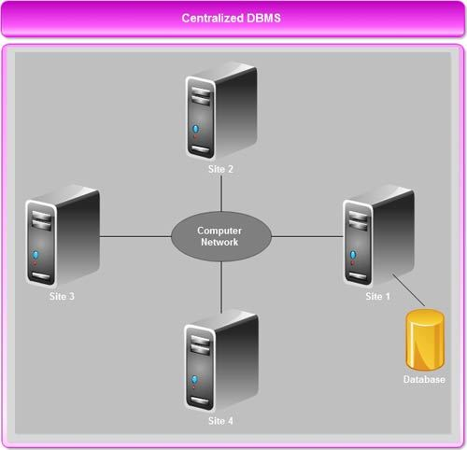
Centralized Database System:

Slide 50
Centralized Database System:
Example:
Consider a company developing a project. As the project consist of many different types of information like documents, plans, diagrams, etc. instead of having it stored on every project members system it can be stored in a database on server which can act as a centralized database from which all the project members will assess the information acting as clients.

Slide 51

advantages of centralized database system:
The data integrity(accuracy of message) is maximized
The data redundancy(duplication of data) is minimal.
Centralized database is much more secure.
Data is easily portable because it is stored at the same place.
The centralized database is cheaper than other types of databases as it requires less power and maintenance.

Slide 52
disadvantages of centralized database system:
Since all the data is at one location, it takes more time to search and access it. If the network is slow, this process takes even more time.
There is a lot of data access traffic for the centralized database.
Since all the data is at the same location, if multiple users try to access it simultaneously it creates a problem. This may reduce the efficiency of the system.
If there are no database recovery measures in place and a system failure occurs, then all the data in the database will be destroyed.

Slide 53
Parallel Database System
Companies need to handle huge amount of data with high data transfer rate. The client server and centralized system is not much efficient. The need to improve the efficiency so that the concept of Parallel Databases is used.
Parallel database system improves performance of data processing using multiple resources in parallel, like multiple CPU and disks are used parallel.
It also performs many parallelization operations like, data loading and query processing.

Slide 54
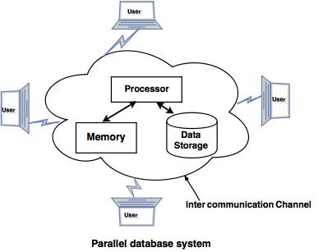
Parallel Database System

Slide 55
Advantages of Parallel Database System
Improve performance: The performance of the system can be improved by connecting multiple CPU and disks in parallel. Many small processors can also be connected in parallel.
Improve availability of data: Data can be copied to multiple locations to improve the availability of data. For example: if a module contains a relation (table in database) which is unavailable then it is important to make it available from another module.
Improve reliability: Reliability of system is improved with completeness, accuracy and availability of data.
Provide distributed access of data: Companies having many branches in multiple cities can access data with the help of parallel database system.

Slide 56
Disadvantages of Parallel Database System
1) Number of resources required is large thus cost is increased.
2) Also due to large number of resources complexity is increased

Slide 57
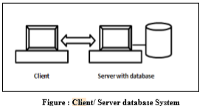
client / server database system

Slide 58
client / server database system
It has two logical parts –client and server.
The clients are the machines which requests for the service to the server.
Server is the machine which serves to the clients. Applications and tools of DBMS run on client.
DBMS software runs on server.
Computer networking allows some task to be executed on a server system and some tasks on client system.
This leads to development of client server architecture.

Slide 59
client / server database system
There are different types of client/server architecture such as
Two tier architecture
Three tier architecture.
In two tier architecture, client systems directly approach database servers whereas in three tier architecture, there exists a middle layer which acts as application server to receive and send requests from client machine to database server and vice versa.

Slide 60
advantages of client server database
(a) Client server system has cost effective platforms to support the applications. (b) Client offers graphical menu driven interface, which is superior to the traditional command line. (c) Client server environment facilitates in more productive work by the users and efficient use of existing data. (d) Client server database system is more flexible. (e) A single database on server can be shared across several distinct client systems.

Slide 61
Disadvantages of client / server database system
1. In initial phases, the programming cost is high. 2. There is a lack of management tools for performance monitoring and timing.

Slide 62
Distributed database system
A distributed database is a collection of multiple interconnected databases, which are spread physically across various locations that communicate via a computer network.
A distributed database is basically a database that is not limited to one system, it is spread over different sites, i.e, on multiple computers or over a network of computers.
A distributed database system is located on various sited that don’t share physical components.
This maybe required when a particular database needs to be accessed by various users globally.
It needs to be managed such that for the users it looks like one single database.

Slide 63
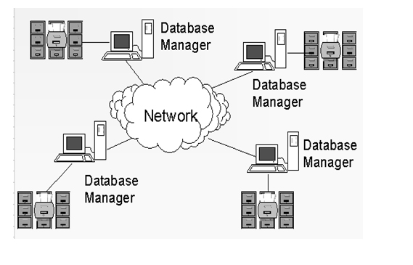
Distributed database system

Slide 64
Distributed database system
Types of Distributed System: 1. Homogeneous Database:
In a homogeneous database, all different sites store database identically. The operating system, database management system and the data structures used – all are same at all sites. Hence, they’re easy to manage.
2. Heterogeneous Database:
In a heterogeneous distributed database, different sites can use different schema and software that can lead to problems in query processing and transactions. Also, a particular site might be completely unaware of the other sites. Different computers may use a different operating system, different database application. They may even use different data models for the database. Hence, translations are required for different sites to communicate.

Slide 65
Advantage of Distributed databases
1.Better Response − If data is distributed in an efficient manner, then user requests can be met from local data itself, thus providing faster response .
2. More Reliable - When the data and DBMS software are distributed over several sites one site may fail while other sites continue to operate ,which makes database more reliable .
3. Easier Expansion - : Expansion can be easily achieved by adding processing and storage power to the existing network.
4. Improved Performance -These systems provide greater efficiency and better performance .
5.Resource Sharing -Since data is distributed, a group of users can easily share and use data of different sites

Slide 66
Disadvantage of Distributed databases
Need for complex and expensive software − DDBMS demands complex and often expensive software to provide data transparency and co-ordination across the several sites.
Processing overhead − Even simple operations may require a large number of communications and additional calculations to provide uniformity in data across the sites.
Data integrity − The need for updating data in multiple sites pose problems of data integrity.
Overheads for improper data distribution − Responsiveness of queries is largely dependent upon proper data distribution. Improper data distribution often leads to very slow response to user requests.

