Slide 1
Unit iii 14 marks
Database Design Using ER model

Slide 2
E-r model
The ER or (Entity Relational/Relationship Model) is a high-level conceptual data model diagram or It is logical data model
Conceptual level means It describes what data is stored in database.
Entity-Relation model is based on the real-world entities and the relationship between them.
ER modeling helps you to analyze data requirements systematically to produce a well-designed database.
So, it is considered a best practice to complete ER modeling before implementing your database.

Slide 3
ER Diagram stands for Entity Relationship Diagram, also known as ERD is a diagram that displays the relationship of entity sets stored in a database.
ER diagrams help to explain the logical structure of databases.
ER diagrams are created based on three basic concepts: entities, attributes and relationships.

Slide 4
Facts about ER Diagram Model
ER model allows you to draw Database Design
It is an easy to use graphical tool for modeling data
Widely used in Database Design
It is a GUI representation of the logical structure of a Database
It helps you to identifies the entities which exist in a system and the relationships between those entities

Slide 5
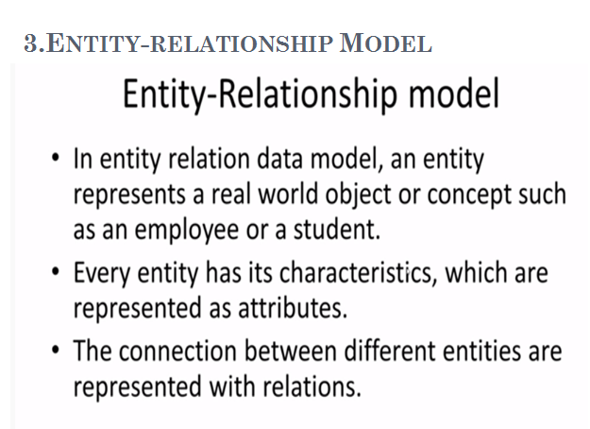

Slide 6
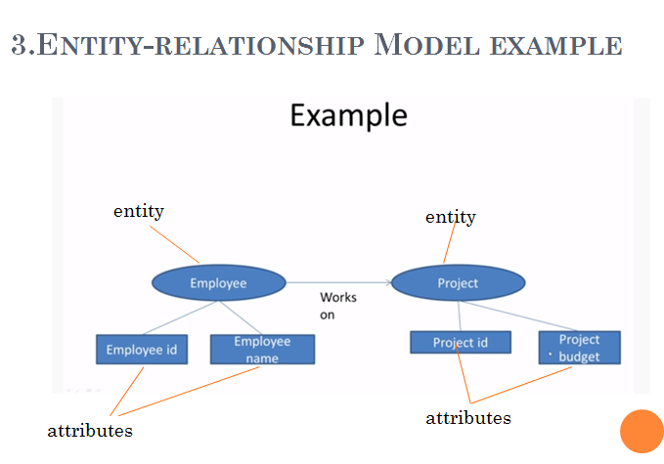

Slide 7
E-R Diagrams
E-R diagrams are used to model real-world objects like a person, a car, a company etc. and the relation between these real-world objects
An e-r diagram has following features:
E-R diagrams are used to represent E-R model in a database, which makes them easy to be converted into relations (tables).
E-R diagrams provide the purpose of real-world modeling of objects which makes them intently useful.
E-R diagrams require no technical knowledge & no hardware support.
These diagrams are very easy to understand and easy to create even by a naive user.
It gives a standard solution of visualizing the data logically.

Slide 8
E-R Diagram Components
Rectangles represent entity sets.
Ellipses represent attributes.
Diamonds represent relationship sets.
Lines link attributes to entity sets and entity sets to relationship sets.
Double ellipses represent multivalued attributes.
Dashed ellipses denote derived attributes.
Primary key attributes are underlined.

Slide 9
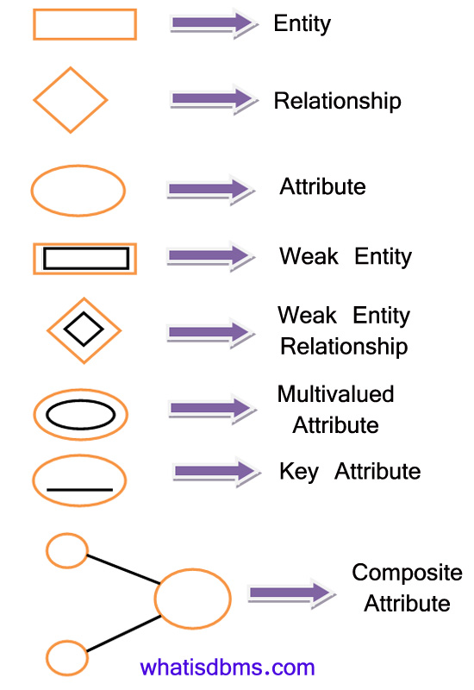

Slide 10
E-R Diagram
This model is based on three basic concepts:
Entities
Attributes
Relationships
Teacher
teaches
student
Teacher_id
name
rollno
name

Slide 11
Entity
Basic component of ER model.
An Entity may be an object with a physical existence – a particular person, car, house, employee – or it may be an object with a conceptual existence – a company, a job, or a university course.
An entity is any object in the system that we want to model and store information about.

Slide 12
Examples of entities:
Person: Employee, Student, Patient
Place: Store, Building
Object: Machine, product, and Car
Event: Sale, Registration, Renewal
Concept: Account, Course

Slide 13

Entity
Entities are usually recognizable concepts, either concrete or abstract, such a person, places, things, or events which have relevance to the database.
Rectangle represent entity

Slide 14
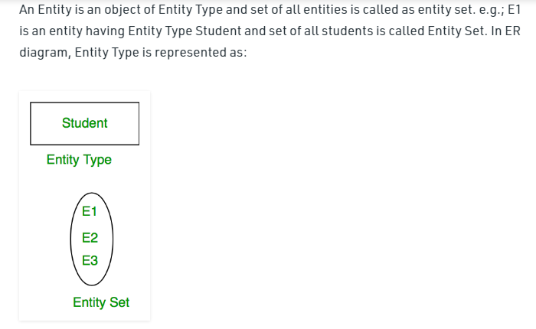

Slide 15
Entity Set
An entity set is a set of entities of the same type that share the same properties.
Example:
set of all persons, companies, trees, holidays.
Two types of entity set:
Strong Entity Set
Weak Entity Set

Slide 16

Strong entity set
An entity set that has a primary key is termed as strong entity set.
That means any element in the strong entity set can be uniquely identified.
A strong entity is complete by itself and is not dependent on any other entity type.
A Strong entity is represented by a Rectangle.

Slide 17
Weak entity set
An entity set that does not have a primary key is referred to as a weak entity set.
The existence of a weak entity set depends on the existence of a strong entity set; it must relate to the strong set via a one-to-many relationship set.
The discriminator (or partial key) of a weak entity set is the set of attributes that distinguishes among all the entities of a weak entity set.

Slide 18
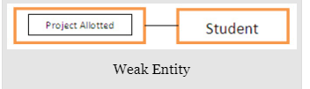
Weak entity set
The primary key of a weak entity set is formed by the primary key of the strong entity set on which the weak entity set is existence dependent, plus the weak entity set’s discriminator.

Slide 19
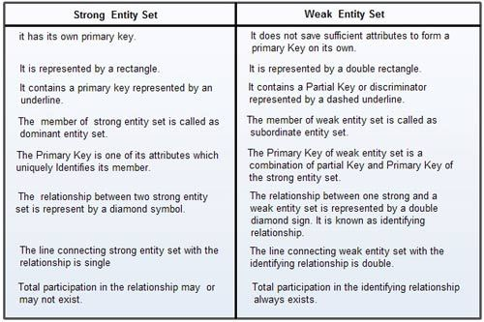
Difference Between Strong And Weak Entity

Slide 20
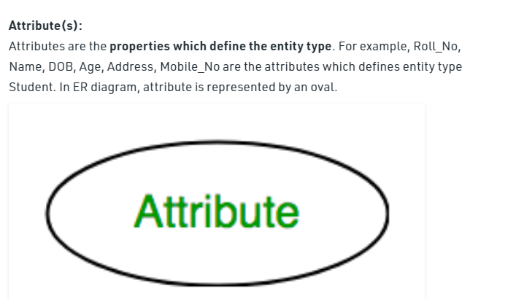

Slide 21
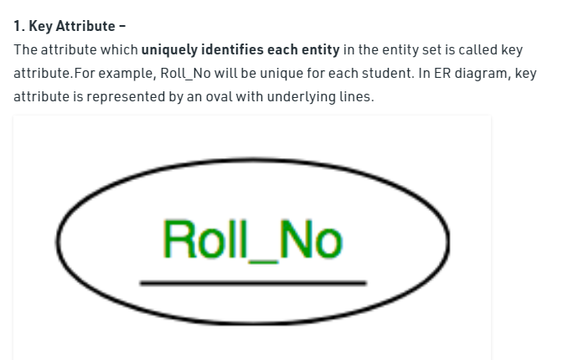

Slide 22
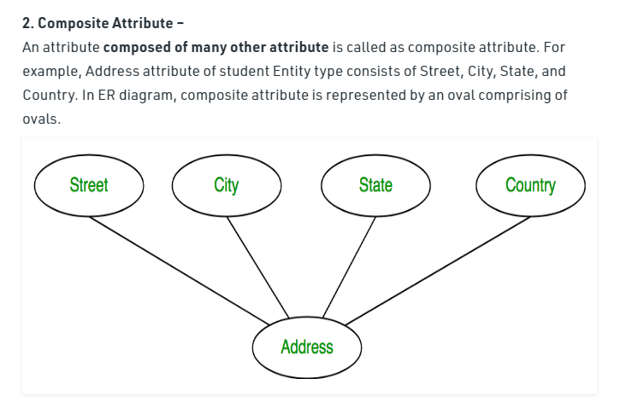

Slide 23
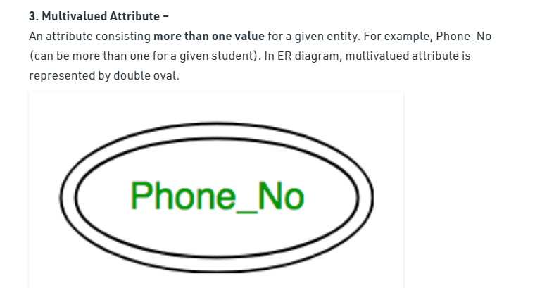

Slide 24
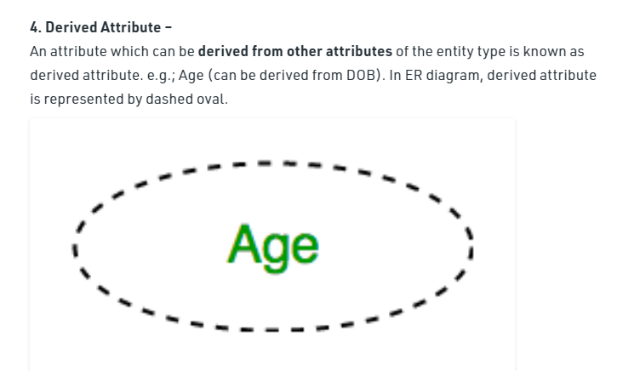

Slide 25
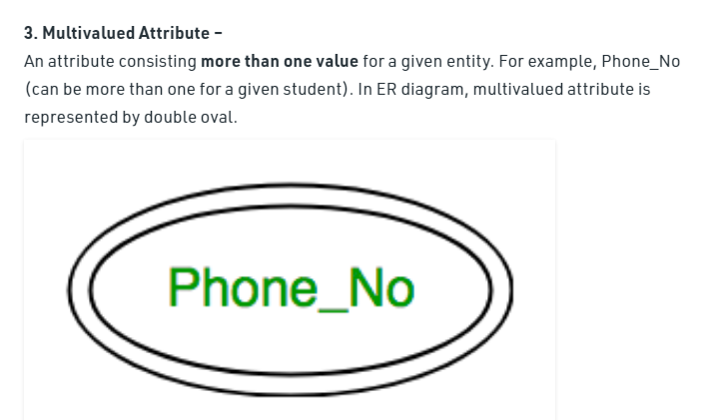

Slide 26
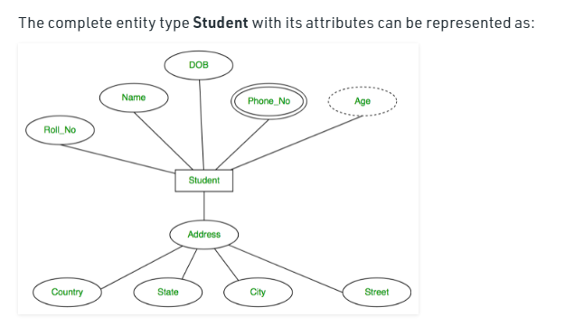

Slide 27
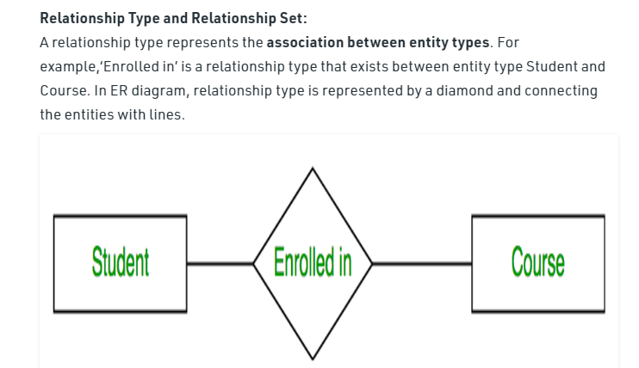

Slide 28
2.Relationship set:
Collection of all relationship of same type is called relationship set.

Slide 29

Relationship
The association among entities is called a relationship.
For example, an employee works at a department, a student enrolls in a course. Teacher teaches student.
Here, Works_at , Enrolls and teaches are called relationships.

Slide 30
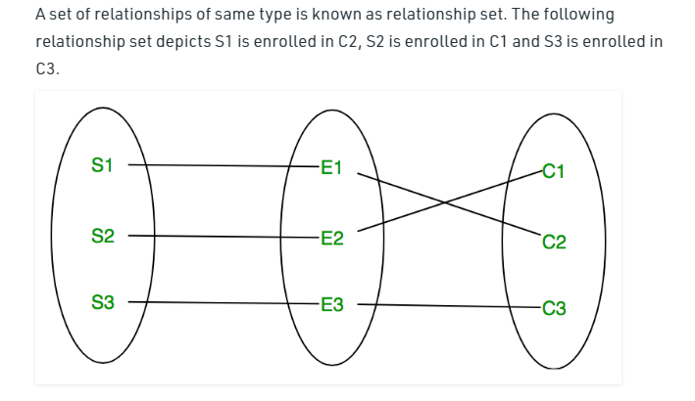

Slide 31
1.Degree of relationship:-
The number of different entity sets participating in a relationship set is called as degree of a relationship set.
It signifies the number of entities involved in a relationship.
Degree of a relationship can be classified into following types:
Unary relationship
Binary relationships
Ternary relationship
Quaternary relationship

Slide 32
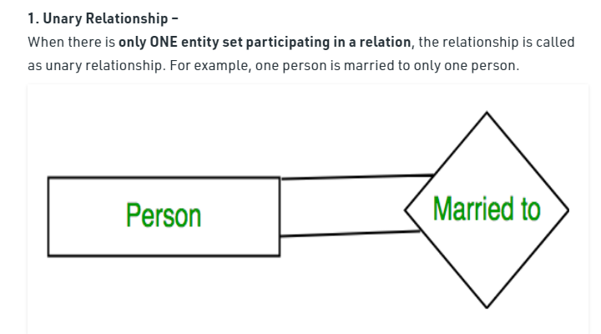

Slide 33
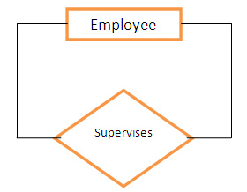
Types of Degree of relationship
Unary relationship:
If only single entity is involved in a relationship then it is a unary relationship.
For example, An employee(manager) supervises another employee.

Slide 34
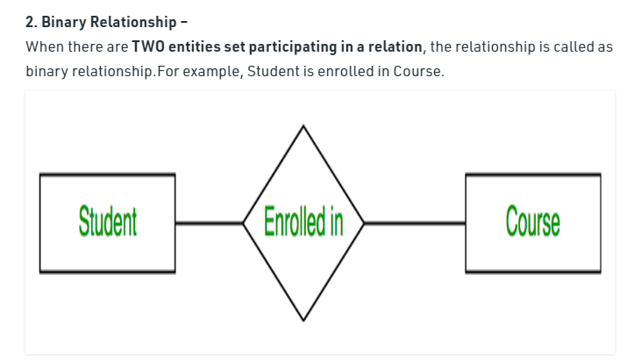

Slide 35
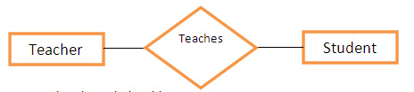
Types of Degree of relationship
Binary relationships:-
when two entities are associated to form a relation, then it is known as a binary relationship.
For example, teacher teaches student.

Slide 36
Types of Degree of relationship
Ternary relationships:-
when three entities are associated to form a relation, then it is known as a ternary relationship.
Quaternary relationships:-
when four entities are associated to form a relation, then it is known as a quaternary relationship.

Slide 37
Relationship
3.Mapping cardinality:
Mapping Cardinality is a data constraint that specifies how many entities an entity can be related to in a relationship
Different types of mapping cardinality: one to one ,one to many, many to one and many to many.

Slide 38
Cardinality
The number of times an entity of an entity set participates in a relationship set is known as cardinality.
Cardinality can be of different types:
1. One to one
2. Many to one
3. One to many
4. Many to many

Slide 39
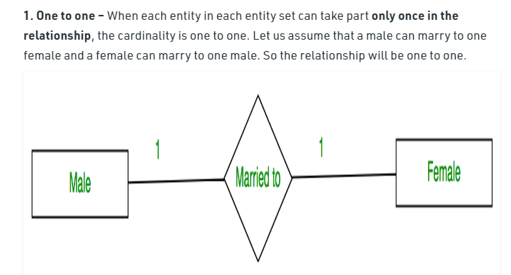
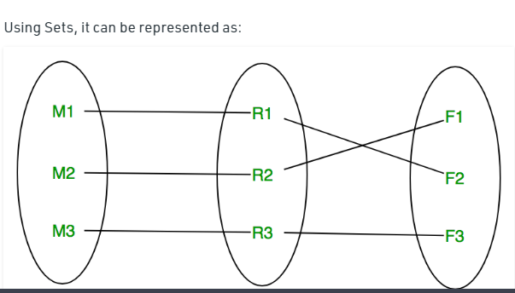

Slide 40
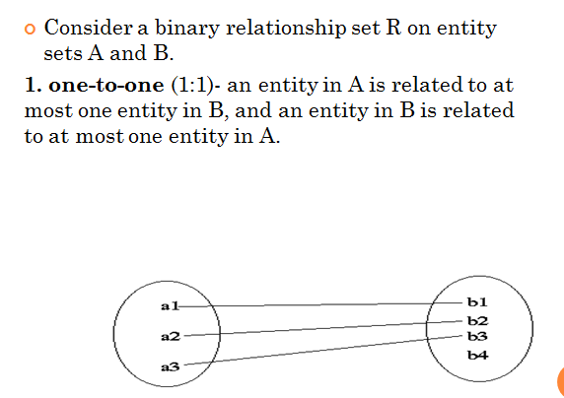

Slide 41
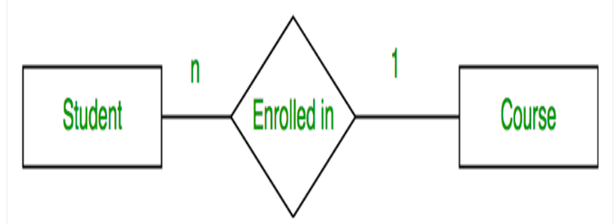
2. Many to one – When entities in one entity set can take part only once in the relationship set and entities in other entity set can take part more than once in the relationship set, cardinality is many to one. Let us assume that a student can take only one course but one course can be taken by many students. So the cardinality will be n to 1. It means that for one course there can be n students but for one student, there will be only one course.

Slide 42
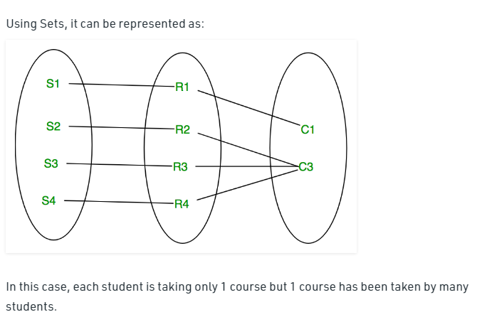
2.Many to one

Slide 43
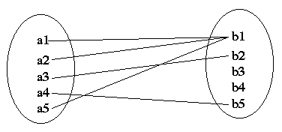
2.many-to-one(n:1) - an entity in A is related to at most one entity in B, but an entity in B is related to any number of entities in A.

Slide 44
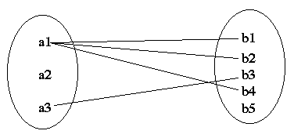
3. one-to-many (1:N)- an entity in A is related to any number of entities in B, but an entity in B is related to at most one entity in A.

Slide 45
3.many-to-one(n:1) - an entity in A is related to at most one entity in B, but an entity in B is related to any number of entities in A.

Slide 46
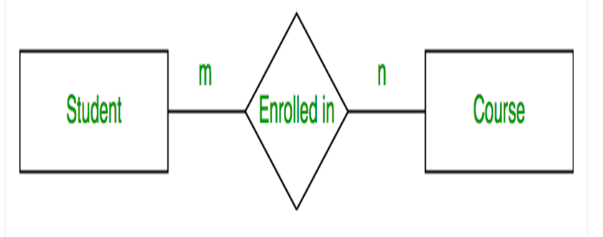
Many to many – When entities in all entity sets can take part more than once in the relationship cardinality is many to many. Let us assume that a student can take more than one course and one course can be taken by many students. So the relationship will be many to many.

Slide 47
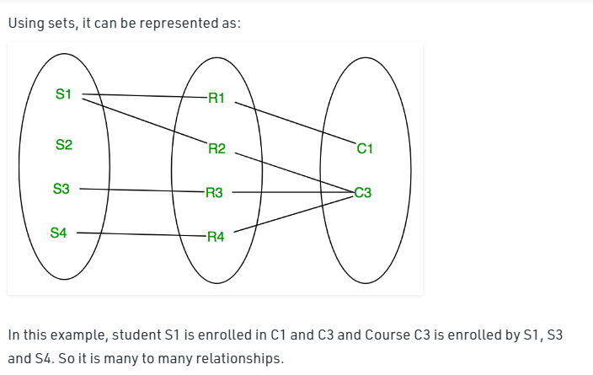
Many to many

Slide 48
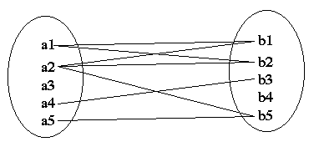
Different types of mapping cardinality
4. many-to-many - an entity in A is related to any number of entities in B, but an entity in B is related to any number of entities in A.

Slide 49
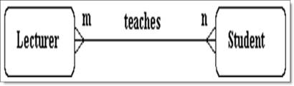
Different types of mapping cardinality
Many-to-Many (M:N) Relation:
One lecturer teaches many students and a student is taught by many lecturers, so it is a many-to-many (m:n) relationship where many occurrences in an entity relate to many occurrences in another entity.

Slide 50
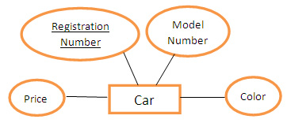
Attributes
Each entity has a set of properties.
These properties of each entity are termed as attributes.
For example, a car entity would be described by attributes such as price, registration number, model number, color etc.

Slide 51
Types of Attributes
An attribute can be characterized into following types:
1. Simple attribute:-
An attribute is classified as a simple attribute if it cannot be partitioned into smaller components.
For example, age and sex of a person.
simple attribute is represented by an oval.
2. Composite attribute:-
A composite attribute can be subdivided into smaller components which further form attributes.
For example, ‘name’ attribute of an entity “person” can be broken down into first name and last name which further form attributes.

Slide 52
Types of Attributes
3. Single valued attribute:-
If an attribute of a particular entity represents single value for each instance, then it is called a single-valued attribute.
For example, Ramesh, Kamal and Suraj are the instances of entity ‘student’ and each of them is issued a separate roll number.
4. Multi valued attribute
An attribute which can hold more than one value, it is then termed as multi-valued attribute.
For example, phone number of a person.

Slide 53
Types of Attributes
5. Derived attribute:
A derived attribute calculate its value from another attribute.
For example, ‘age’ is a derived attribute if it calculates its value from ‘current date’ & ‘birth date’ attributes.

Slide 54
Structure of Relational Database
In relational model, the data and relationships are represented by collection of inter-related tables.
Each table is a group of column and rows, where column represents attribute of an entity and rows represents records.
Stu_Id | Stu_Name | Stu_Age
111 | Ashish | 23
123 | Saurav | 22
169 | Lester | 24
234 | Lou | 26

Slide 55
DBMS Key
A DBMS key is an attribute or set of an attribute which helps you to identify a row(tuple) in a relation(table).( a key is an attribute to find a particular record from the table).
They allow you to find the relation between two tables.
Keys help you uniquely identify a row in a table by a combination of one or more columns in that table.
Different types of Key:
Super Key
Primary Key
Candidate Key
Alternate Key
Foreign Key
Composite Key

Slide 56
Different types of keys
Primary Key:
A primary key is an attribute in Relation(table) that uniquely identifies the rows in relation(table)
A key which is selected by the designer to uniquely identify the entity is called as Primary key.
A primary key cannot contain duplicate values and it can never contain null values (0)inside it.
Example:
In a Student table( Rollno , Name, Percentage) , Rollno is the primary key

Slide 57
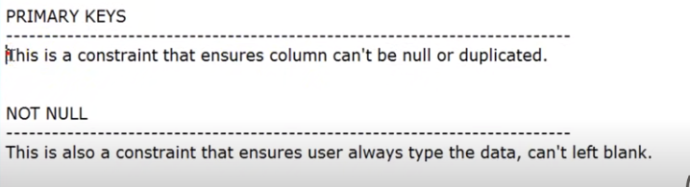

Slide 58
Different types of keys
Candidate key:
In a relation there may be a key or combination of keys which uniquely identify the record.Such a key is called as Candidate key.
Example : Consider a Student table (Rollno,Name,Percentage), if (Rollno) and( Name)both are unique then both are identified as candidate keys.
OR Consider a Student table (Rollno,Name,Percentage), if (Rollno ,Name) is unique , then (Rollno, Name) can be a candidate key if and only if Name and Rollno individually are not unique.

Slide 59
Different types of keys
FOREIGN KEY :
A FOREIGN KEY is a key used to link two tables together.
A FOREIGN KEY is a field (or collection of fields) in one table that refers to the PRIMARY KEY in another table.
It acts as a cross reference between tables because it references the primary key of another table, thereby establishing a link between them.

Slide 60
Different types of keys
Super key : A super key is a set of one or more attributes (columns), which can uniquely identify a row in a table.

Slide 61
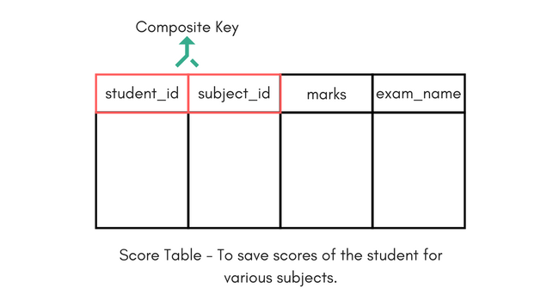
types of keys
Composite Key
Key that consists of two or more attributes that uniquely identify any record in a table is called Composite key. But the attributes which together form the Composite key are not a key independently or individually.

Slide 62
Composite Key :
In the above picture we have a Score table which stores the marks scored by a student in a particular subject.
In this table student_id and subject_id together will form the primary key, hence it is a composite key.

Slide 63
types of keys
Alternate key :
All the keys which are not primary key are called an alternate key. It is a candidate key which is currently not the primary key.
However, A table may have single or multiple choices for the primary key.
Example: student table.
StudID, Roll No, Email are qualified to become a primary key. But since StudID is the primary key, Roll No, Email becomes the alternative key.

Slide 64
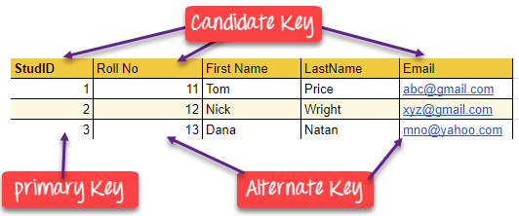
Student Table

Slide 65
Difference Between Primary key & Foreign key
Primary Key | Foreign Key
Helps you to uniquely identify a record in the table. | It is a field in the table that is the primary key of another table.
Primary Key never accept null values. | A foreign key may accept multiple null values.
Primary key is a clustered index and data in the DBMS table are physically organized in the sequence of the clustered index. | A foreign key cannot automatically create an index, clustered or non-clustered. However, you can manually create an index on the foreign key.
You can have the single Primary key in a table. | You can have multiple foreign keys in a table.

Slide 66
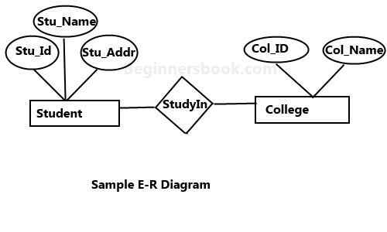
Sample ER diagram

Slide 67
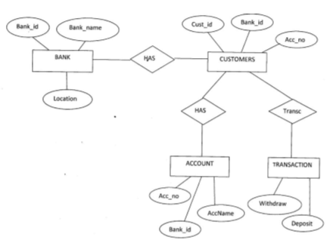
ER diagram Questions:
1. Draw ER diagram for Banking system, to represent a customer has account scenario. Identify entities with their attributes and draw a diagram

Slide 68
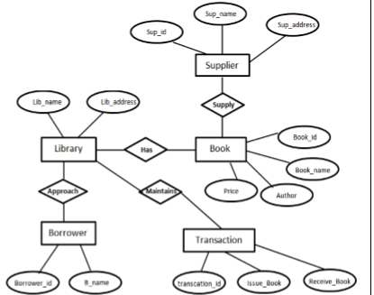
2. Draw ER diagram of library management system in which library maintain t he data of books, borrowers, issue return details, fine collection, supplier of books etc. Assume suitable data and display the relationship among entities.

Slide 69
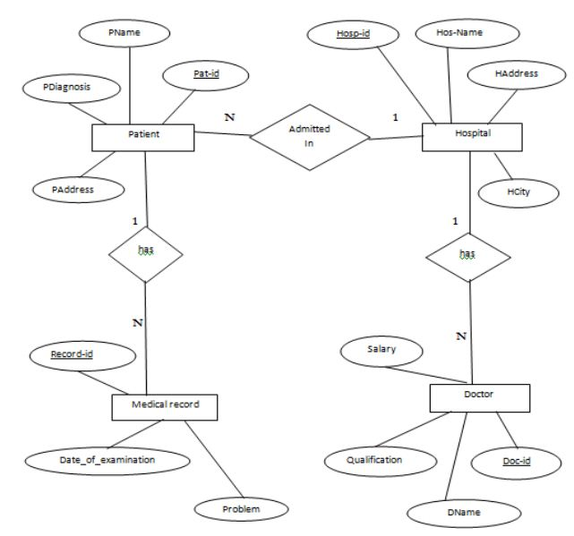
3. Er digram of hospital management

Slide 70
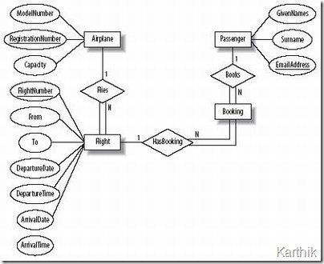
4.Er diagram for airline reservation system.

Slide 71
Shortcomings of er model
Limited constraints and specification
Loss of information content: some information be lost or hidden in ER model
Limited relationship representation:ER model represents limited relationship as compared to another data models like relationship model etc.
No representation of data manipulation: it is difficult to show data manipulation in ER model.
Popular for high level design: ER model is very popular for designing high level design.

Slide 72
Enhanced er model
Enhanced entity-relationship models, also known as extended entity-relationship models.
Enhanced ER is a high-level data model that incorporates the extensions to the original ER model. It is created to design more accurate database schemas.
EER reflects data properties and constraints more precisely. It also includes more complex requirements than traditional application.

Slide 73
Enhanced er model
EER model includes all modeling concepts of the ER model
In addition, EER includes: ▪
Subclasses and superclasses
Specialization and generalization
Category or union type
Attribute and relationship inheritance

Slide 74
Super class & Sub Class
Super class :Super class is an entity type that has a relationship with one or more subtypes.
An entity cannot exist in database merely by being member of any super class. For example: Shape super class is having sub groups as Square, Circle, Triangle.
Sub Class:Sub class is a group of entities with unique attributes.
Sub class inherits properties and attributes from its super class. For example: Square, Circle, Triangle are the sub class of Shape super class.

Slide 75
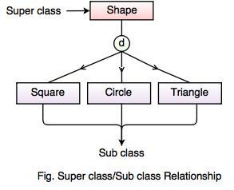
Subclass & Superclasss

Slide 76
Generalization:
Generalization is like a bottom-up approach in which two or more entities of lower level combine to form a higher level entity if they have some attributes in common.
In generalization, an entity of a higher level can also combine with the entities of the lower level to form a further higher level entity.
Generalization is more like subclass and superclass system, but the only difference is the approach. Generalization uses the bottom-up approach.

Slide 77
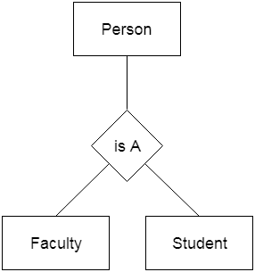
generalization
In generalization, entities are combined to form a more generalized entity, i.e., subclasses are combined to make a superclass.
For example, Faculty and Student entities can be generalized and create a higher level entity Person.

Slide 78
Specialization
Specialization is a top-down approach, and it is opposite to Generalization. In specialization, one higher level entity can be broken down into two lower level entities.
Specialization is used to identify the subset of an entity set that shares some distinguishing characteristics.
Normally, the superclass is defined first, the subclass and its related attributes are defined next, and relationship set are then added.

Slide 79
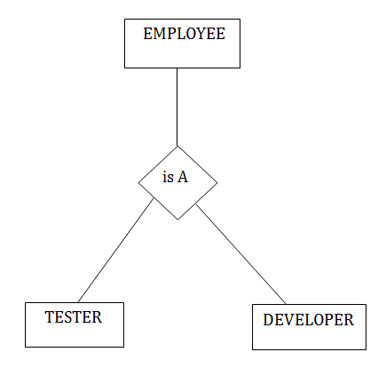
Specialization
For example: In an Employee management system, EMPLOYEE entity can be specialized as TESTER or DEVELOPER based on what role they play in the company.

Slide 80
aggregation
In aggregation, the relation between two entities is treated as a single entity. In aggregation, relationship with its corresponding entities is aggregated into a higher level entity.
For example: Center entity offers the Course entity act as a single entity in the relationship which is in a relationship with another entity visitor. In the real world, if a visitor visits a coaching center then he will never enquiry about the Course only or just about the Center instead he will ask the enquiry about both.

Slide 81
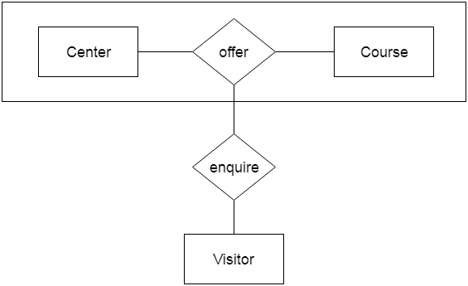
aggregation

