Slide 1
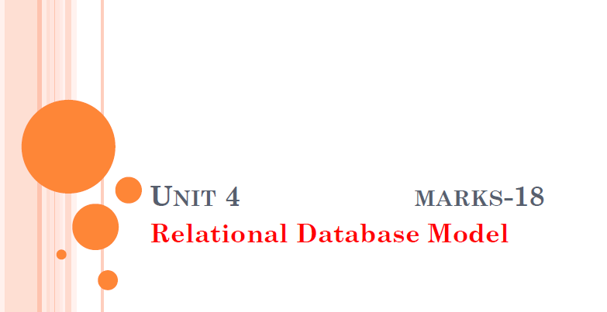

Slide 2

DATABASE SCHEMA
The overall design of a database is called schema.
The overall description of the database is called the database schema.
Schema represents the logical view of the entire database.
A schema contains schema objects like table, foreign key, primary key, views, columns, data types, stored procedure, etc.
In simple language Schema gives name of record ,data type,and constraints see example of employee
Constraints means eid not null(empty)

Slide 3
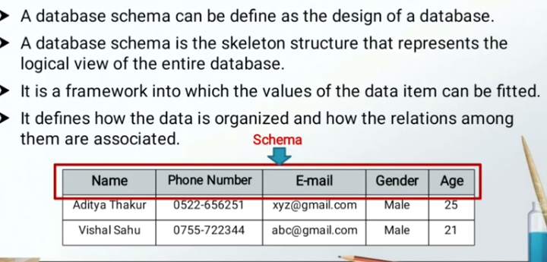

Slide 4
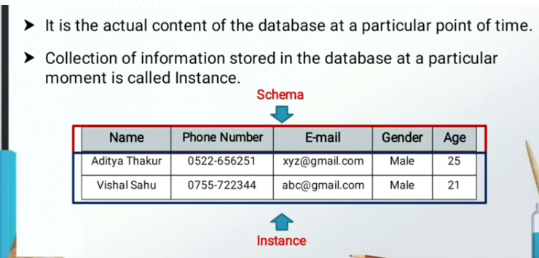
Instance

Slide 5
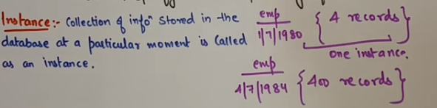

Slide 6
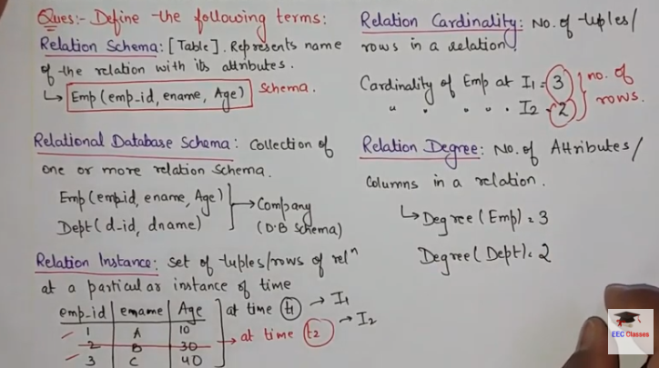

Slide 7
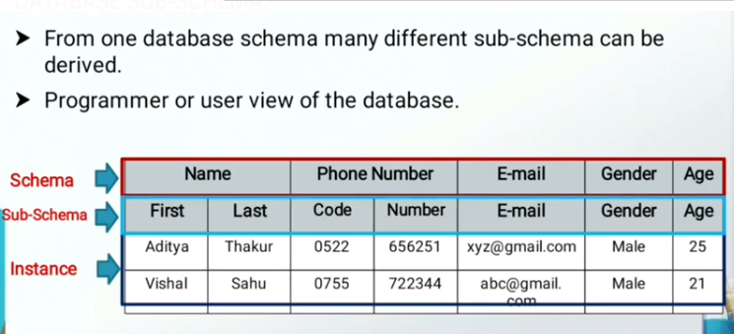
Subschema

Slide 8
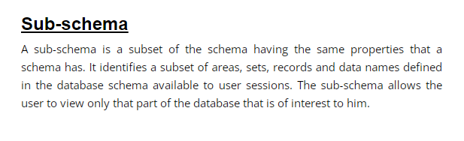


(

Slide 9
Schema categorized into three parts.
Physical Schema
Logical Schema
View Schema

Slide 10
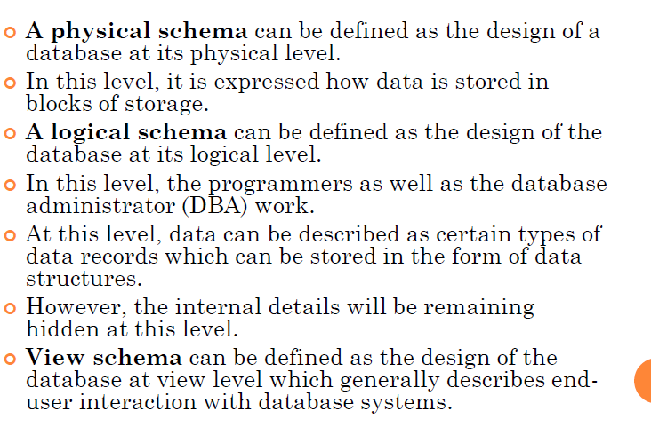

Slide 11
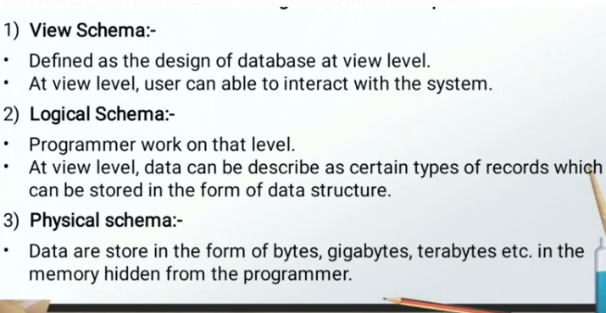

Slide 12
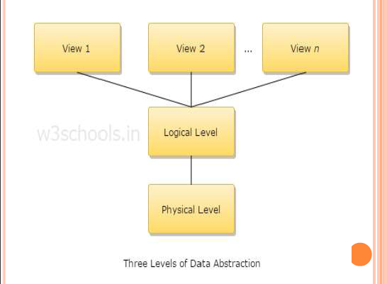

Slide 13
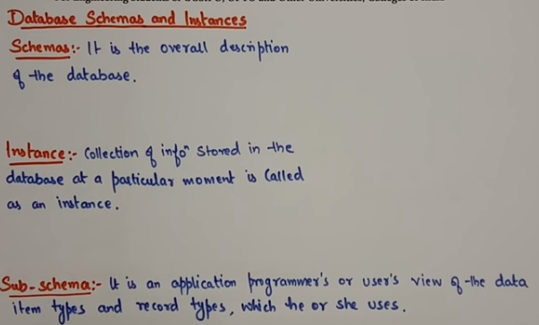

Slide 14
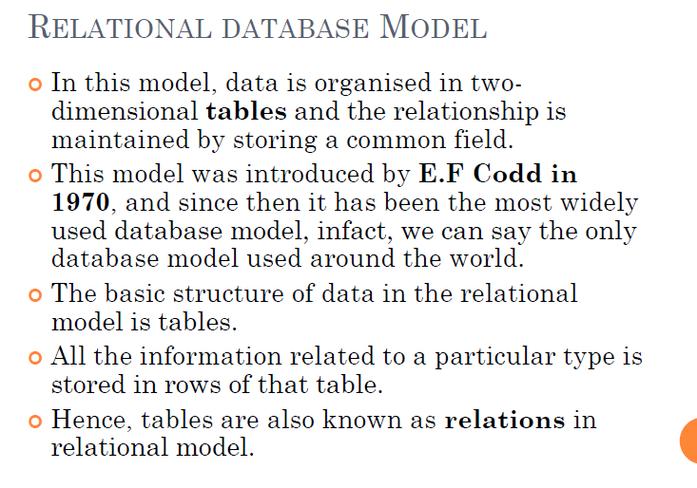

Slide 15
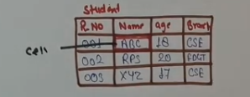
E.F.Codd Rules
The information Rule:-Every information in relational database must be stored in the cell of a table as a value.

Slide 16

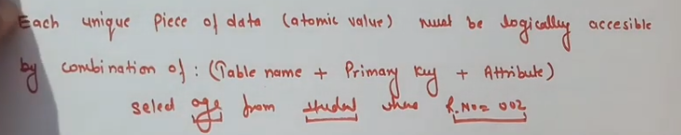
E.F.Codd Rules
2.Guranteed Access Rule: In simple language Whatever the data you save ,those data you should be able to access.

Slide 17
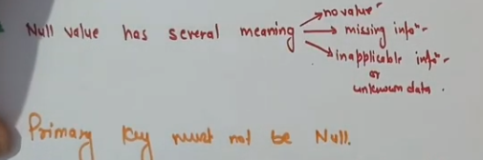

E.F.Codd Rules
3.Systematic treatment of null values:-

Slide 18

4.Active Online Catalog based on the relational model:-
The structure description of the entire database must be stored in an online catalog, known as data dictionary, which can be accessed by authorized users. Users can use the same query language to access the catalog which they use to access the database itself.

Slide 19
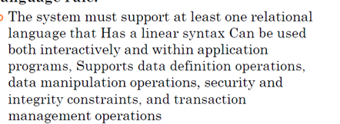
5. Comprehensive Data Sub-Language Rule/Powerful language:-

Slide 20

6. View Updating Rule:

Slide 21

7. High-Level Insert, Update, and Delete Rule
A database must support high-level insertion, updation, and deletion. This must not be limited to a single row, that is, it must also support union, intersection and minus operations to yield sets of data records.

Slide 22


8. Physical Data Independence:The data stored in a database must be independent of the applications that access the database. Any change in the physical structure of a database must not have any impact on how the data is being accessed by external applications.

Slide 23


9.Logical data independence:-
For example, if two tables are merged or one is split into two different tables, there should be no impact or change on the user application. This is one of the most difficult rule to apply.

Slide 24
10. Integrity Independence:
A database must be independent of the application that uses it. All its integrity constraints can be independently modified without the need of any change in the application. This rule makes a database independent of the front-end application and its interface.

Slide 25
11.Distribution Independence
The end-user must not be able to see that the data is distributed over various locations. Users should always get the impression that the data is located at one site only. This rule has been regarded as the foundation of distributed database systems.

Slide 26
12.Non-Subversion Rule:-
If a system has an interface that provides access to low-level records, then the interface must not be able to subvert the system and bypass security and integrity constraints.

Slide 27
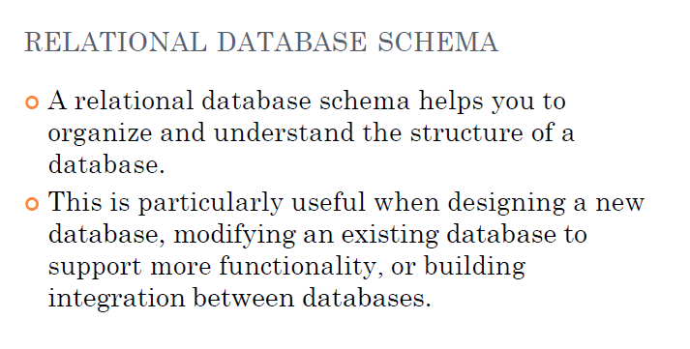

Slide 28
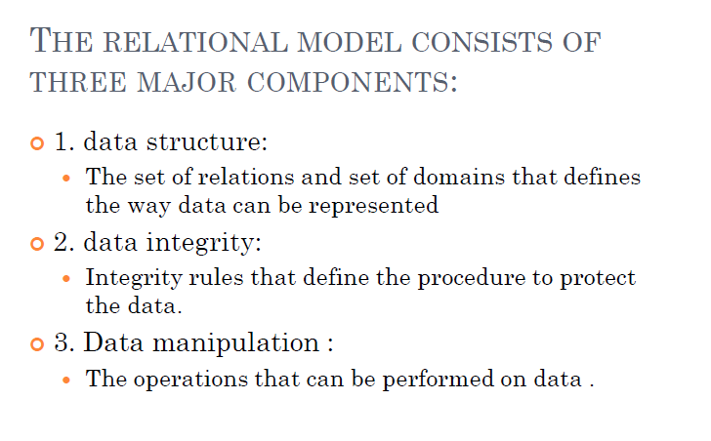

Slide 29
Constraints(set of rules)

Slide 30
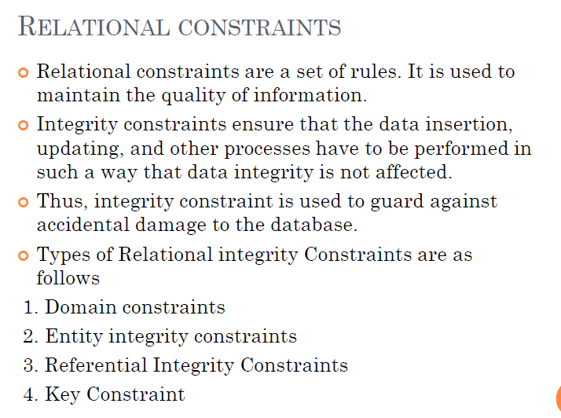

Slide 31
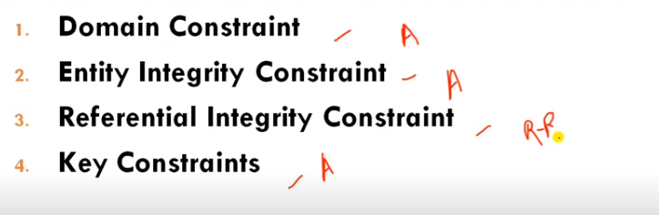

Slide 32
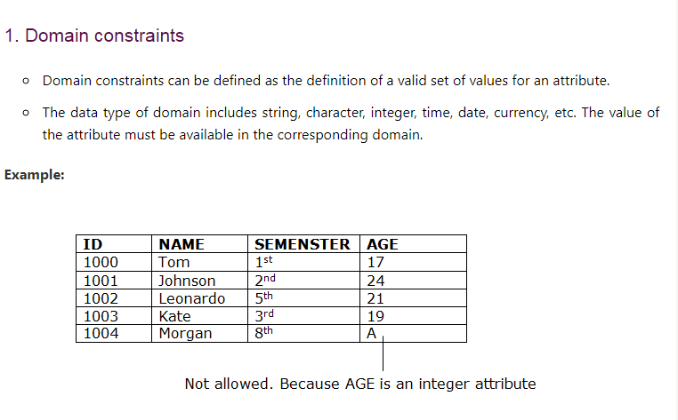
Domain means set of allowable values

Slide 33
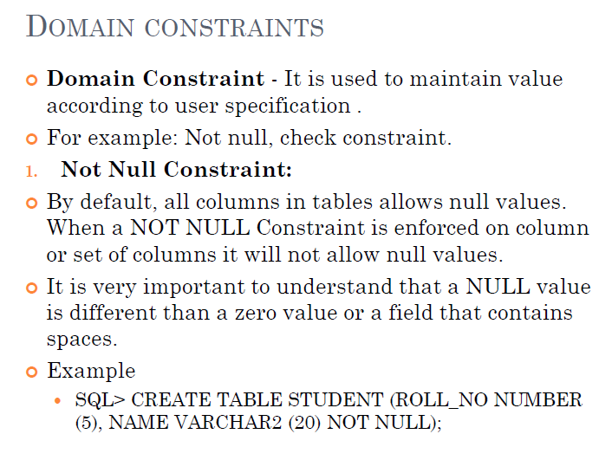

Slide 34
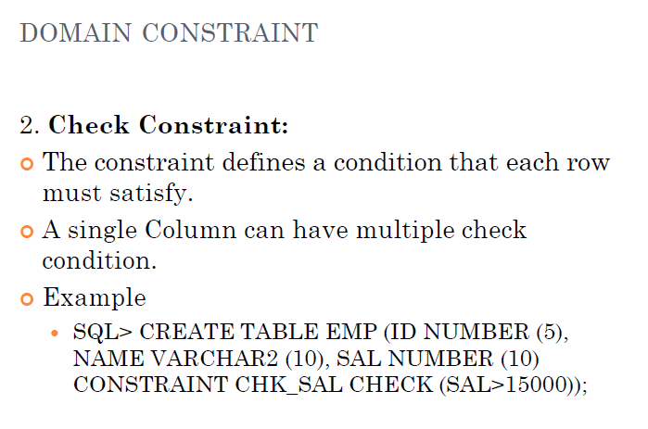

Slide 35
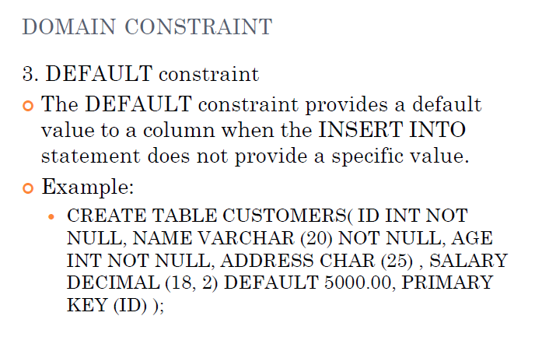

Slide 36
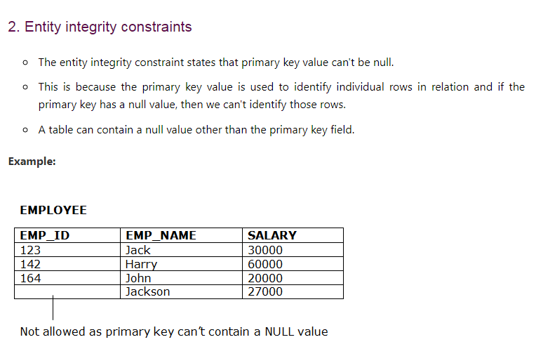

Slide 37
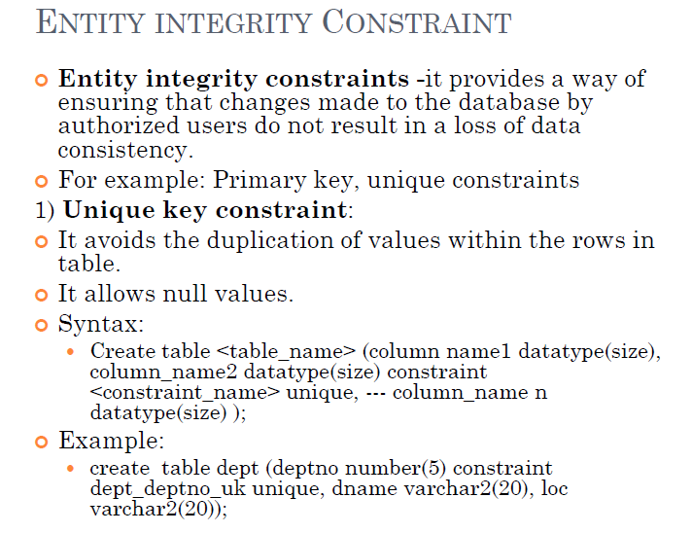

Slide 38
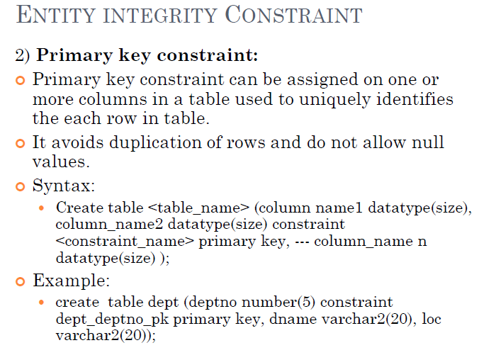

Slide 39
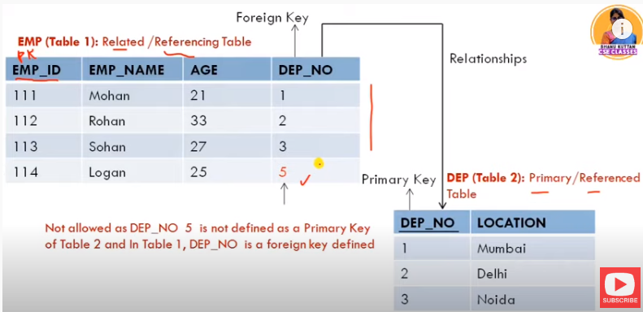
3. Referential Integrity Constraints
A referential integrity constraint is specified between two tables.
In the Referential integrity constraints, if a foreign key in Table 1 refers to the Primary Key of Table 2, then every value of the Foreign Key in Table 1 must be null or be available in Table 2.

Slide 40
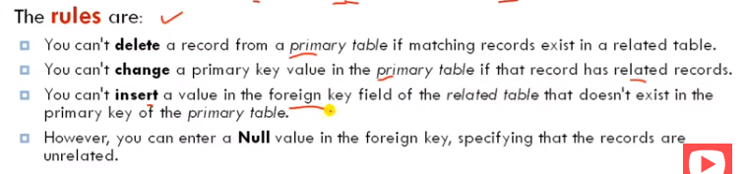

Slide 41
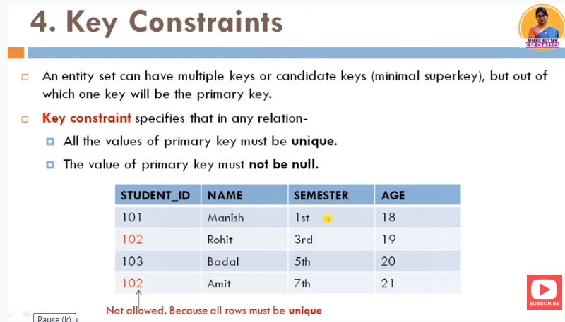

Slide 42
rollno | Student enrollment no | Name | address | subject
1 | 20005601
2 | 20005602
3 | 20005603

Slide 43
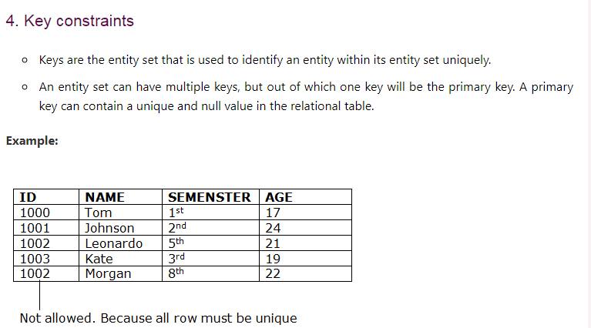

Slide 44
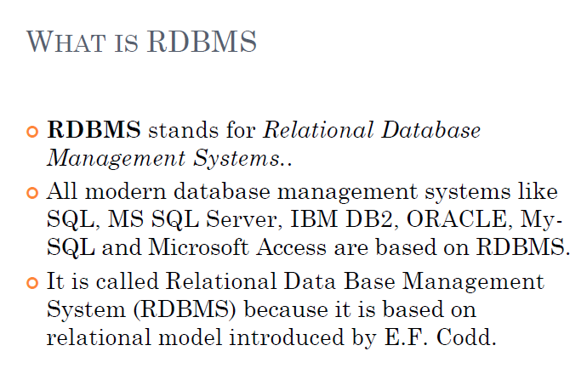

Slide 45
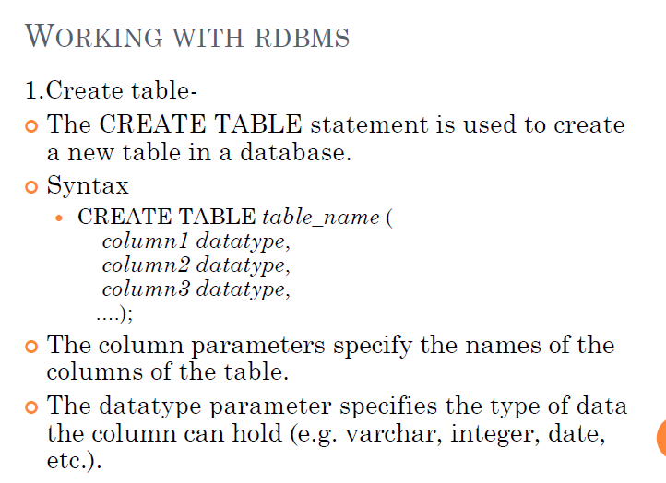

Slide 46
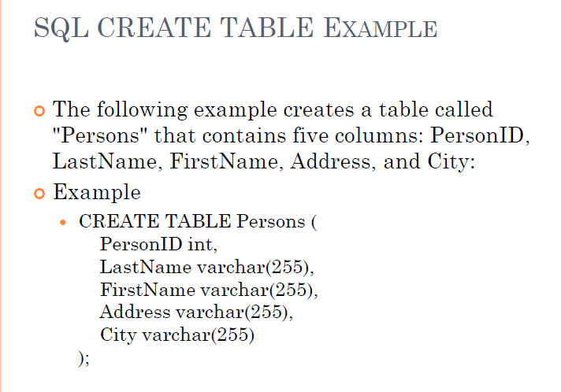

Slide 47
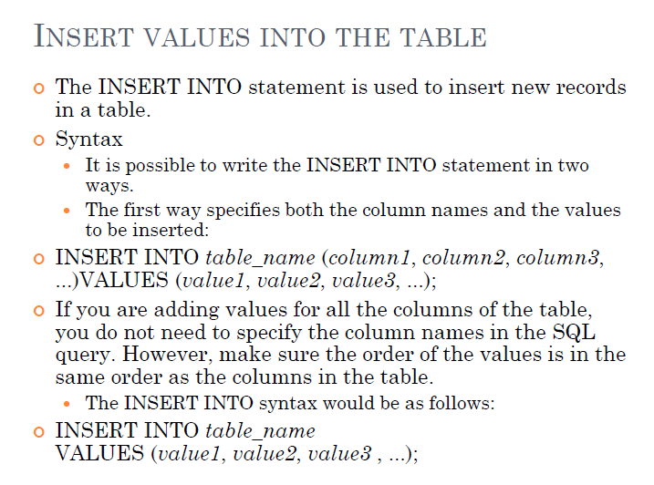

Slide 48
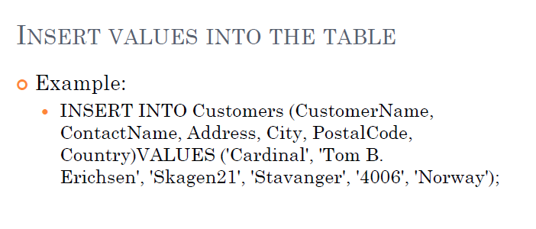

Slide 49
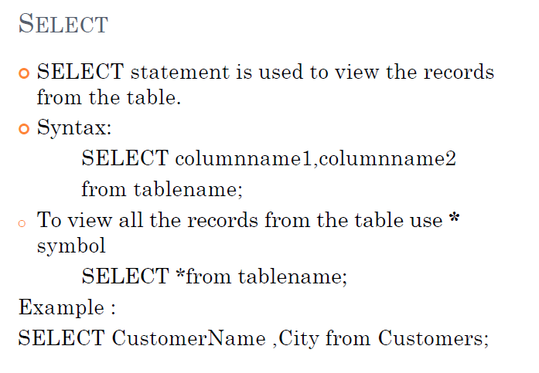

Slide 50
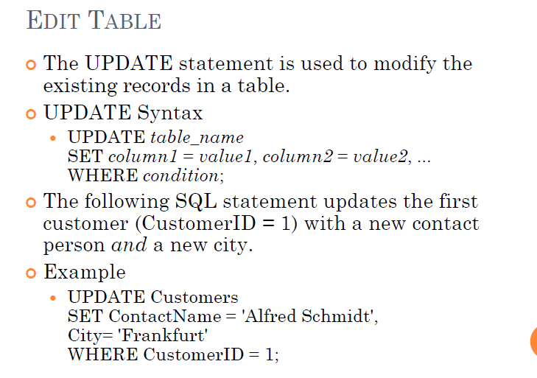

Slide 51
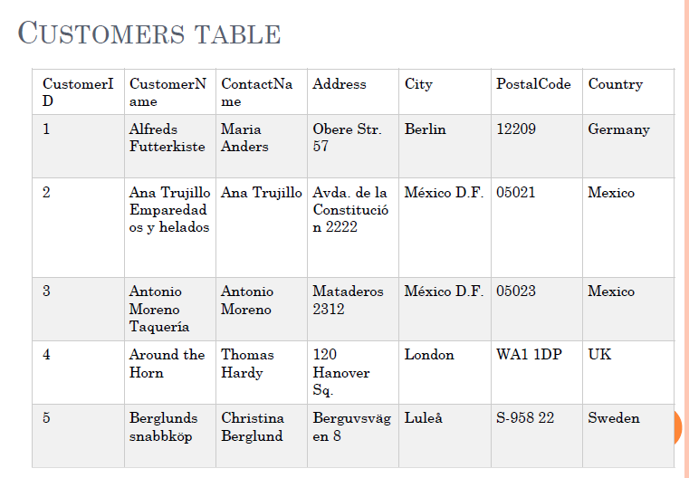

Slide 52
