Slide 1
Anomaly detection
Group-10:
Chirag Garg (210288)
Madhur Bansal (210572)
Manav Reddy V (210583)
Paritosh Pankaj (210702)
Vijay Soren (211163)
Course Instructor -
Dr. Amit Mitra

Slide 2
ABOUT THE DATA
Here we worked with the New York Taxi Dataset which contains the number of taxis used by the public from July 2014 to January 2015. There are in total 10,320 time instances. The total data is of 215 days.
TIME STAMP
Denotes the date and time, in between which the data has been recorded.
NUMBER OF PASSENGERS
Indicates the count of passengers who have reserved a taxi within 30-minute intervals.
2

Slide 3
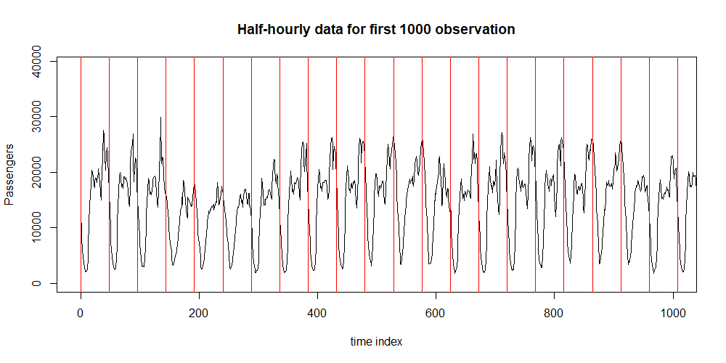

Slide 4
Objectives
Anomaly
Examined the dataset to detect any irregularities or anomalies.
Best Time to work
Conducted data analysis to pinpoint the peak time-period during a day with the highest probability for taxi drivers to find customers.

Slide 5
Procedure to find anomaly
Consolidated the data from 30-minute intervals to daily intervals to identify anomalies on specific days.
Examined and eliminated any existing trends or seasonality components in the data.
Assess whether the data is covariance stationary.
Determined p and q values for the ARMA process.
Conducted model fitting and obtained residuals by calculating the difference between observed and predicted values.

Slide 6
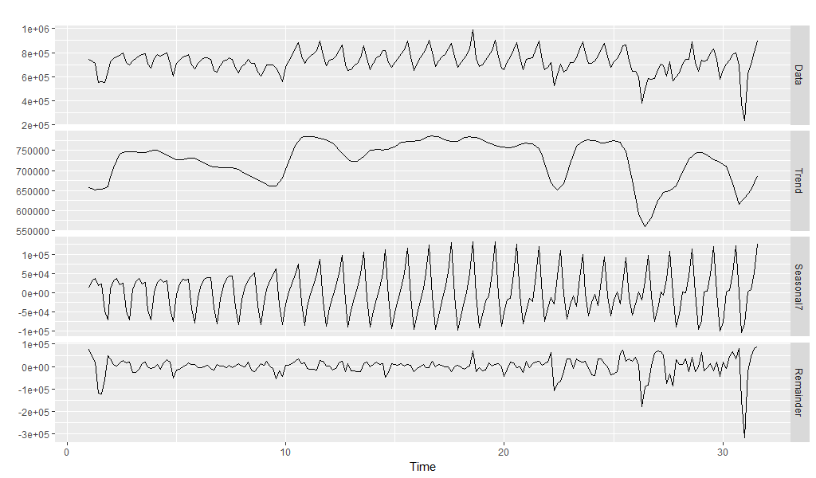

Slide 7
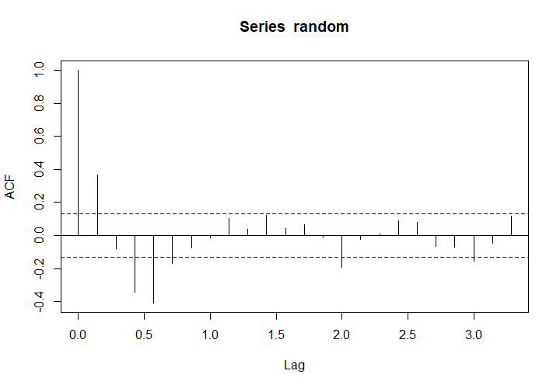
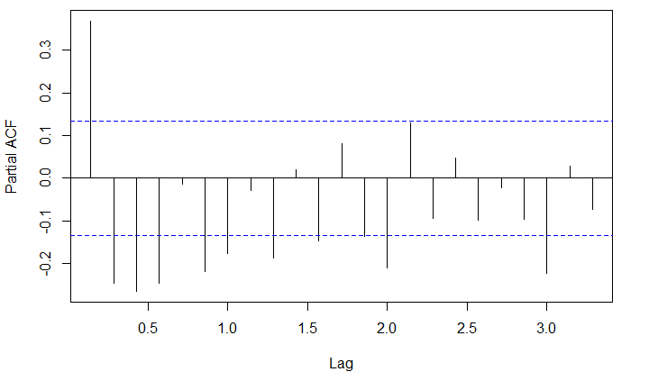

Procedure
Firstly, we plotted ACF and PACF plots, but we couldn’t come into a conclusion
So, we used BIC to estimate the orders of ARMA model
Through BIC, we got model as ARMA(2, 2) with coefficients –
Detected anomalies with a significance level of 5%.

Slide 8
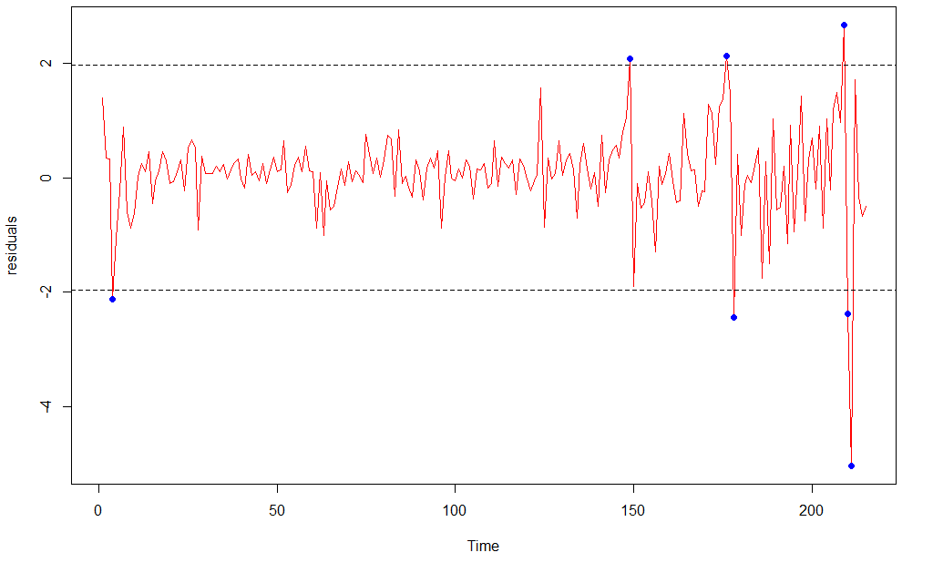
Residuals vs Time

Slide 9
Anomalies detected
In total, there are 7 anomalies out of 215 data points.
4th of July 2014 – America’s Independence day
26th of November 2014 – Thanksgiving day
23rd of December 2014 – Christmas Day
25th of December 2014 – Christmas Day
25th of January 2015 – Snow Storm
26th of January 2015 – Snow Storm
27th of January 2015 – Snow Storm

Slide 10
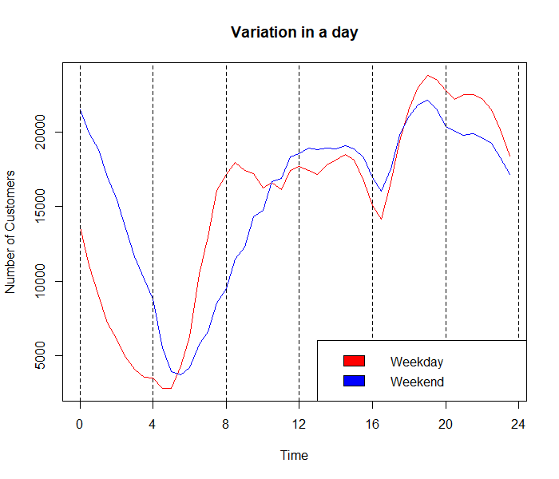
Procedure to find best time-period to work
Removed all the days where anomalies observed.
Calculated the average for all the 48 intervals in a day for two categories – weekdays and weekends.

Slide 11
Observations
In weekends, it is profitable to work at following intervals:
1) During night, the time interval from 6:00 pm to around 1:00 am has more customers.
2) During noon, the time interval from 10:00 am to 4:00 pm has more customers
In weekdays, it is profitable to work at following intervals:
1) During night, the time interval from 6:00 pm to around 11:00 pm has more passengers.
2) During noon, the time interval from 8:00 am to around 3:00 pm has more passengers.

Slide 12
Conclusion
We found seven anomalies in 215 days.
Anomalies occur either on the day of the festival or a natural calamity.
We observed that the time slots with higher passenger frequency occur on weekdays between 8 am to 3 pm and 6 pm to 11 pm, and on weekends between 10 am to 4 pm and 6 pm to 1 am.
It is also observed that weekdays have more working hours during the day, while the weekends have more working hours during the night.

Slide 13
THANK YOU !!

