Slide 1
SleepTwin
A sleep-driven digital twin that forecasts tomorrow's blood-sugar spike and morning BP surge for people with Type 2 Diabetes and Hypertension
Team WeBareBears · PCCOE · Happiest Health Digital Twin Challenge 2026 - Phase 1
Swati Sharma
Rohan Paramanand
Chirag Gajare
Model-based projection for clinical decision support. Research prototype.
Notes:
Introduce the team and the one-line idea.

Slide 2
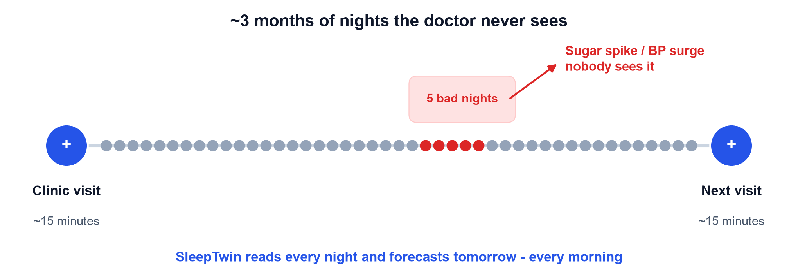
The problem: A Blind Spot between visits
~101 M
~315 M
~15 min
people with diabetes in India
people with hypertension
with a doctor every few months
Source: ICMR-INDIAB, Lancet Diabetes & Endocrinology 2023
SleepTwin · Team WeBareBears · PCCOE · all patient data simulated
2
Notes:
Smartwatches record sleep nightly but don't know the wearer's medical history.

Slide 3
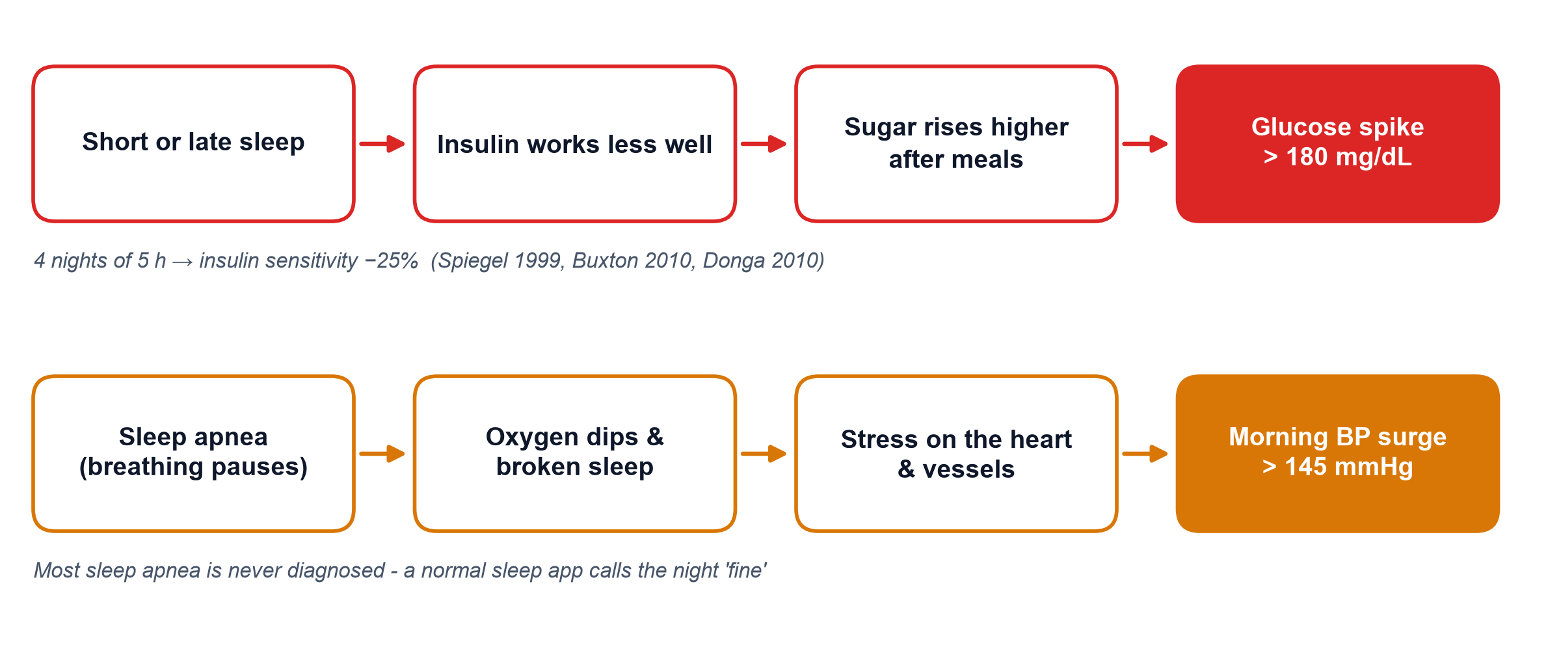
Why sleep? Two paths from a bad night to tomorrow's risk
Sleep is measured every night by consumer wearables - and it can be changed tonight.
SleepTwin · Team WeBareBears · PCCOE · all patient data simulated
3
Notes:
Top row: glucose path. Bottom row: blood-pressure path.

Slide 4
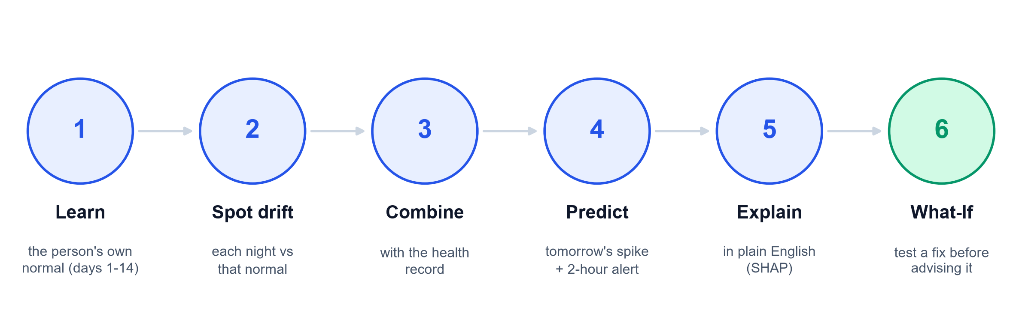
Our solution: A Digital Twin of each Patient
Two data streams in - the health record + daily wearable data - a personal forecast, an early warning, a reason and a tested fix out.
SleepTwin · Team WeBareBears · PCCOE · all patient data simulated
4
Notes:
A digital twin is a virtual copy of one patient, updated every day.

Slide 5
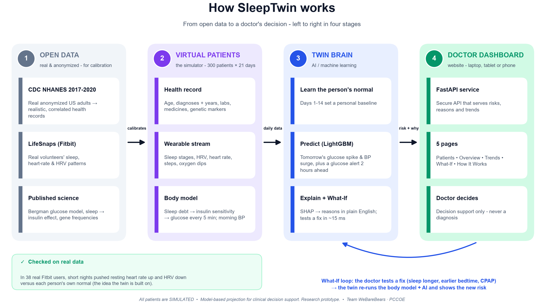
Notes:
Walk left to right: open data, virtual patients, twin brain, dashboard; then the What-If loop.

Slide 6
Two Data Streams + Sandbox compliance
Static: health record
Dynamic: wearables
Safe data only
✓ Demographics (age, sex, BMI)
✓ Diagnoses with years
✓ Lab results - latest + prior
✓ Medicines
✓ Genetic markers (simulated)
✓ Sleep stages every 5 min
✓ HRV + resting heart rate
✓ Steps
✓ Night-time oxygen dips
✓ CGM glucose every 5 min
✓ 300 virtual patients × 21 days
✓ Calibrated on NHANES (public, anonymized)
✓ Patterns from LifeSnaps (open, CC-BY-4.0)
✓ No real patients, no personal data
✓ Labelled 'Simulated' everywhere
Cohort: T2D 37% · prediabetes 29% · hypertension 52% · sleep apnea 26% (only 5% diagnosed)
SleepTwin · Team WeBareBears · PCCOE · all patient data simulated
6
Notes:
Both streams required by the challenge are present.

Slide 7
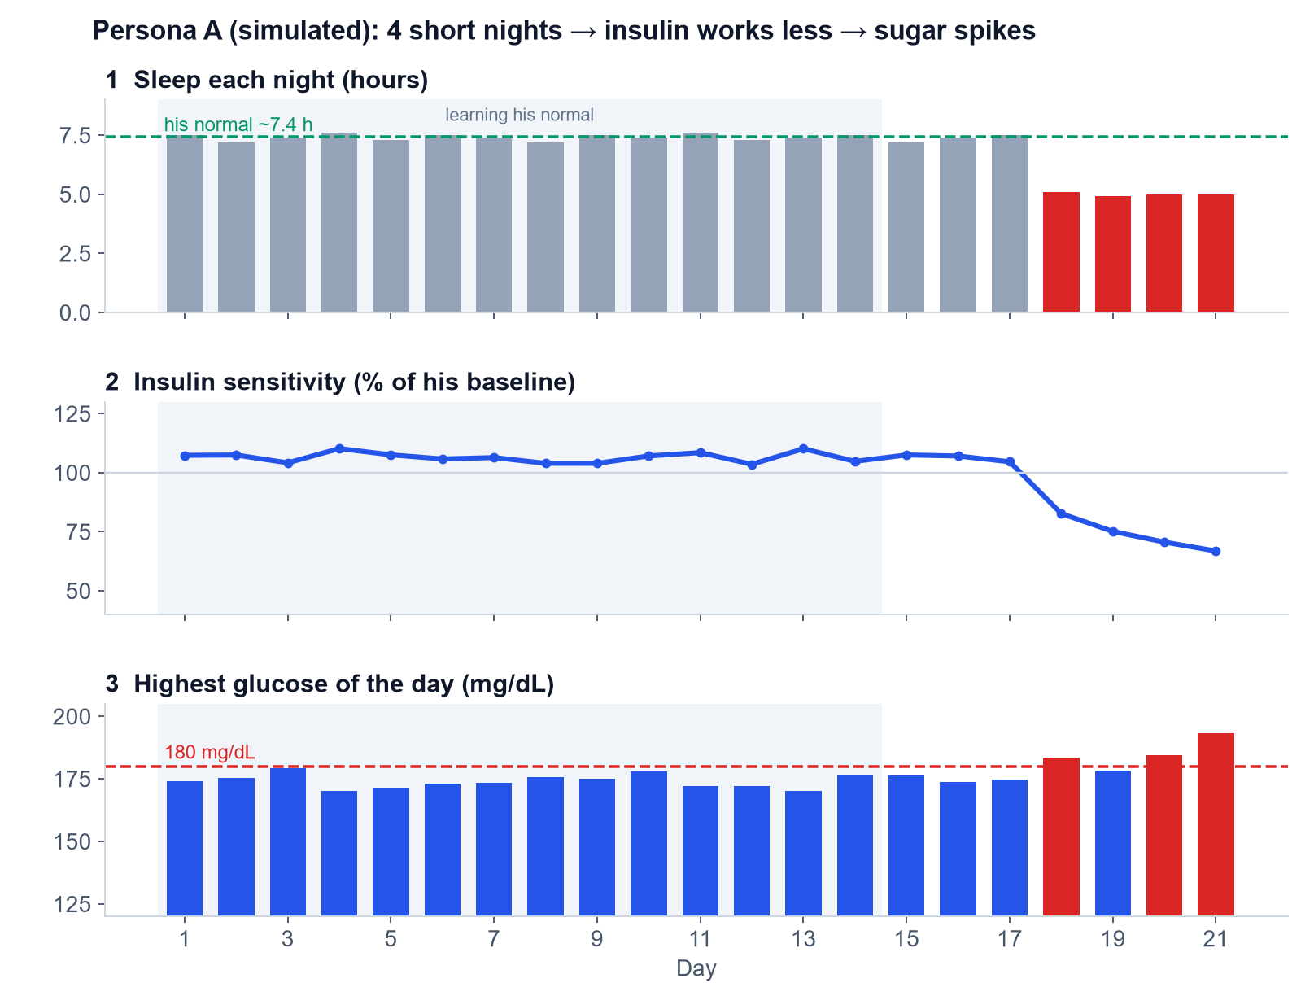
The simulator: How sleep reaches Blood Sugar
● Sleep debt = last 7 nights' shortfall, recent nights count more
● 4 nights of 5 h → insulin sensitivity −25% (matches sleep studies)
● Bergman glucose model turns meals + insulin sensitivity into CGM every 5 min
● Beta-blockers hide the heart-rate signal - HRV still shows the strain
● Honest limit: labels come from the same simulator
SleepTwin · Team WeBareBears · PCCOE · all patient data simulated
7
Notes:
Use persona A to show the chain: sleep drops, insulin sensitivity drops, peaks cross 180.

Slide 8
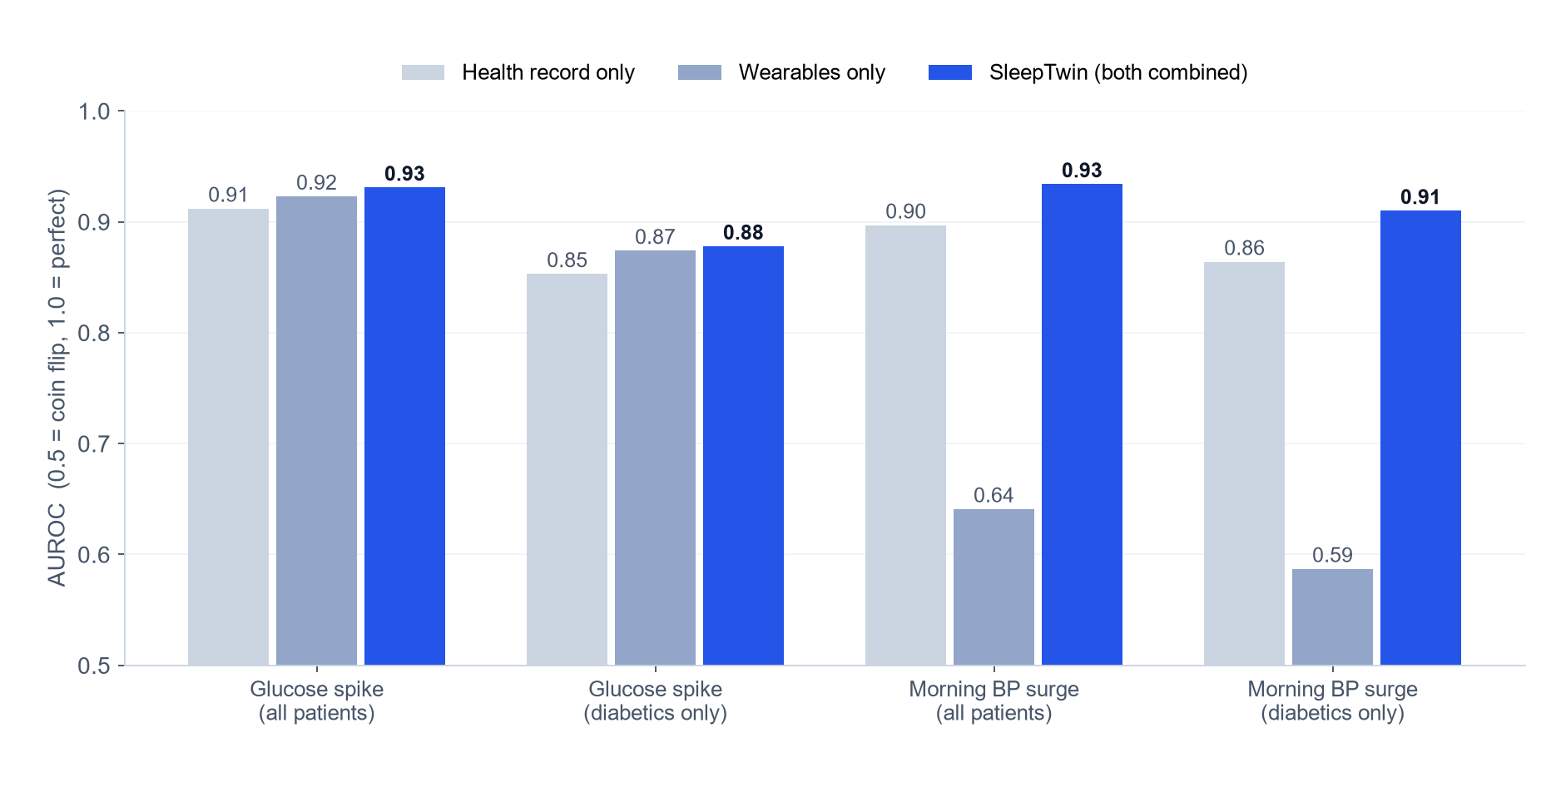
Does combining both data streams help? Yes.
2,100 patient-days, tested only on patients the model never saw (GroupKFold by patient). The gain is largest for diabetics - the same night means more for a high-risk patient.
SleepTwin · Team WeBareBears · PCCOE · all patient data simulated
8
Notes:
AUROC: chance the model ranks a real event above a quiet day.

Slide 9
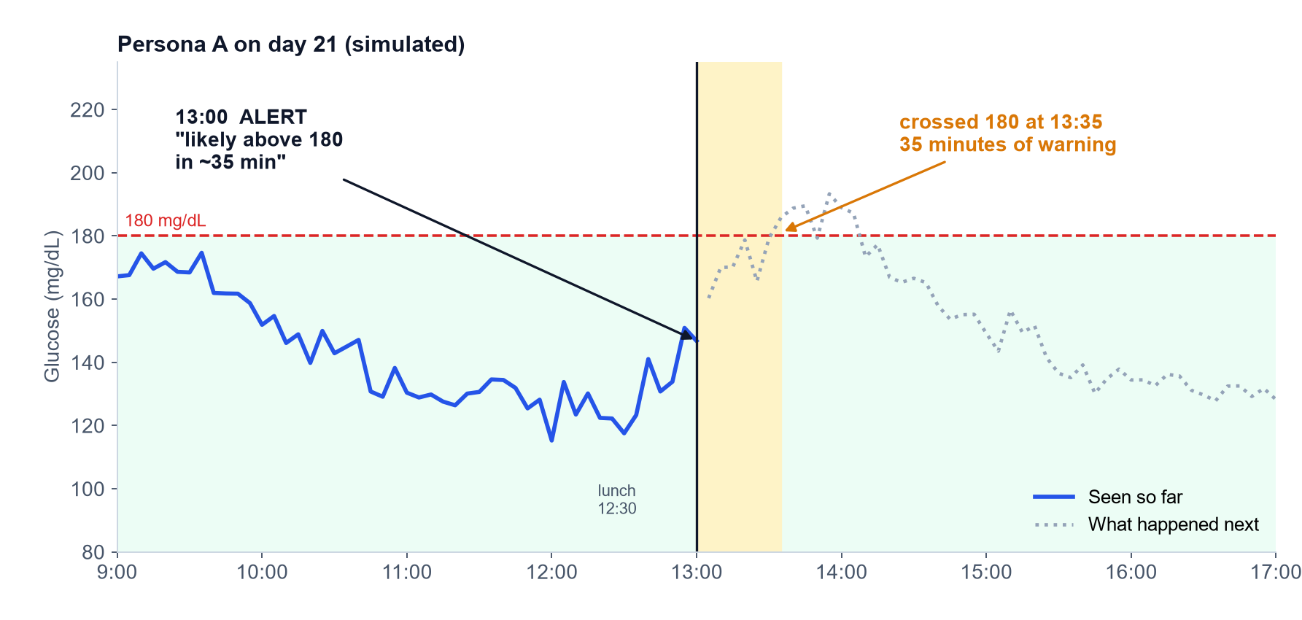
2-hour early warning for Glucose spikes
70 min
0.95
60%
median warning before a spike
accuracy (AUROC) vs 0.79 for a plain trend arrow
of spikes warned in advance
SleepTwin · Team WeBareBears · PCCOE · all patient data simulated
9
Notes:
Uses current glucose, its trend, the last meal, last night's sleep and the health record.

Slide 10
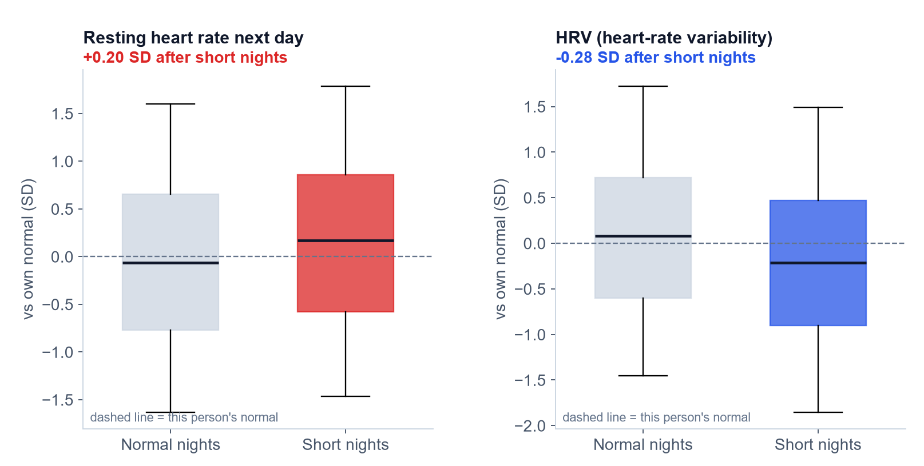
Checked on real people (LifeSnaps Fitbit data)
● 38 real users, 2,381 nights
● Short night = below that person's own usual
● Next-day resting HR: +0.20 SD (p = 0.0028)
● HRV: -0.28 SD (p = 2.4e-05)
● The twin's core idea - drift from your own normal - holds in real data
SleepTwin · Team WeBareBears · PCCOE · all patient data simulated
10
Notes:
Each person is compared with themselves, not with others.

Slide 11
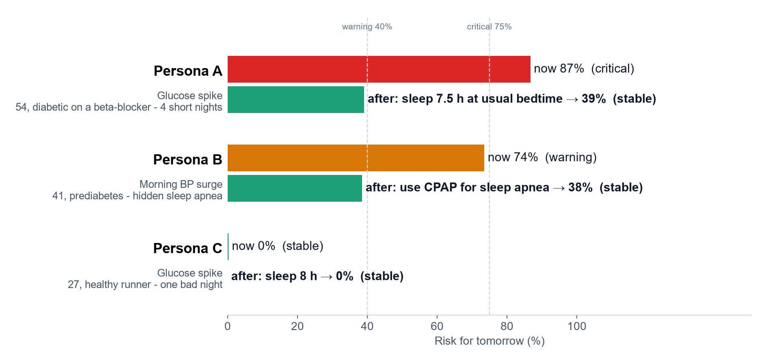
Outcome: Three Patients, Three Different Answers
The twin escalates the high-risk patient, finds a problem a sleep app would miss, and stays calm for a healthy person.
SleepTwin · Team WeBareBears · PCCOE · all patient data simulated
11
Notes:
All values come from the live What-If engine.

Slide 12
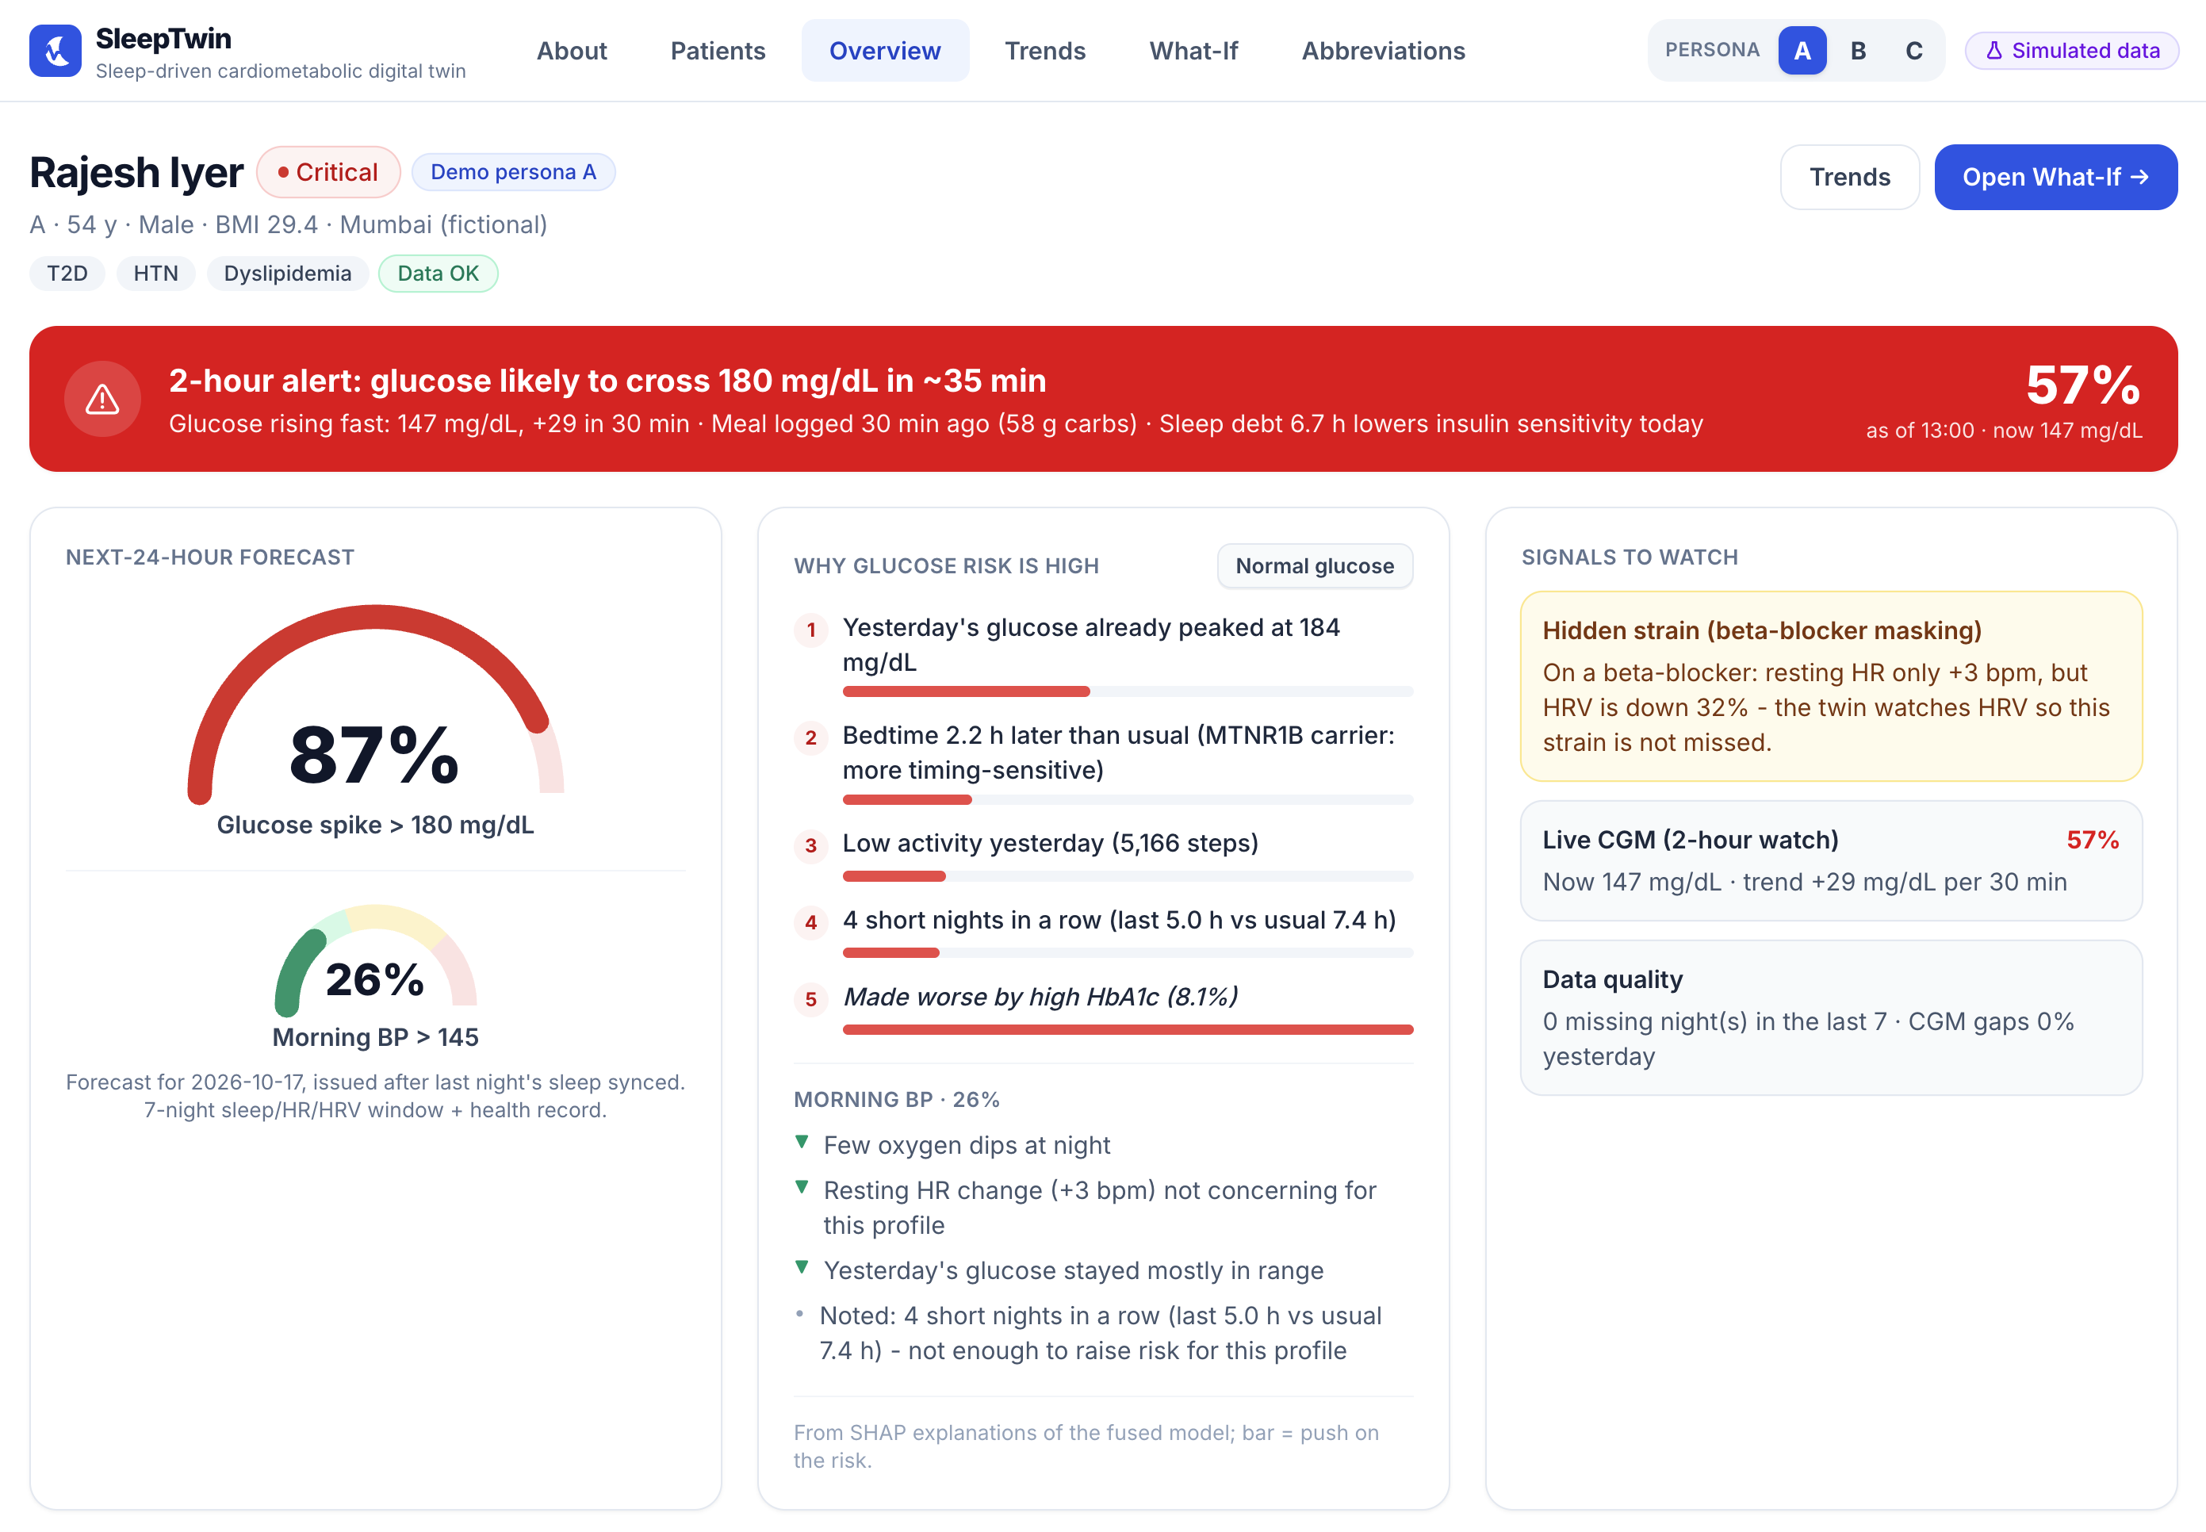
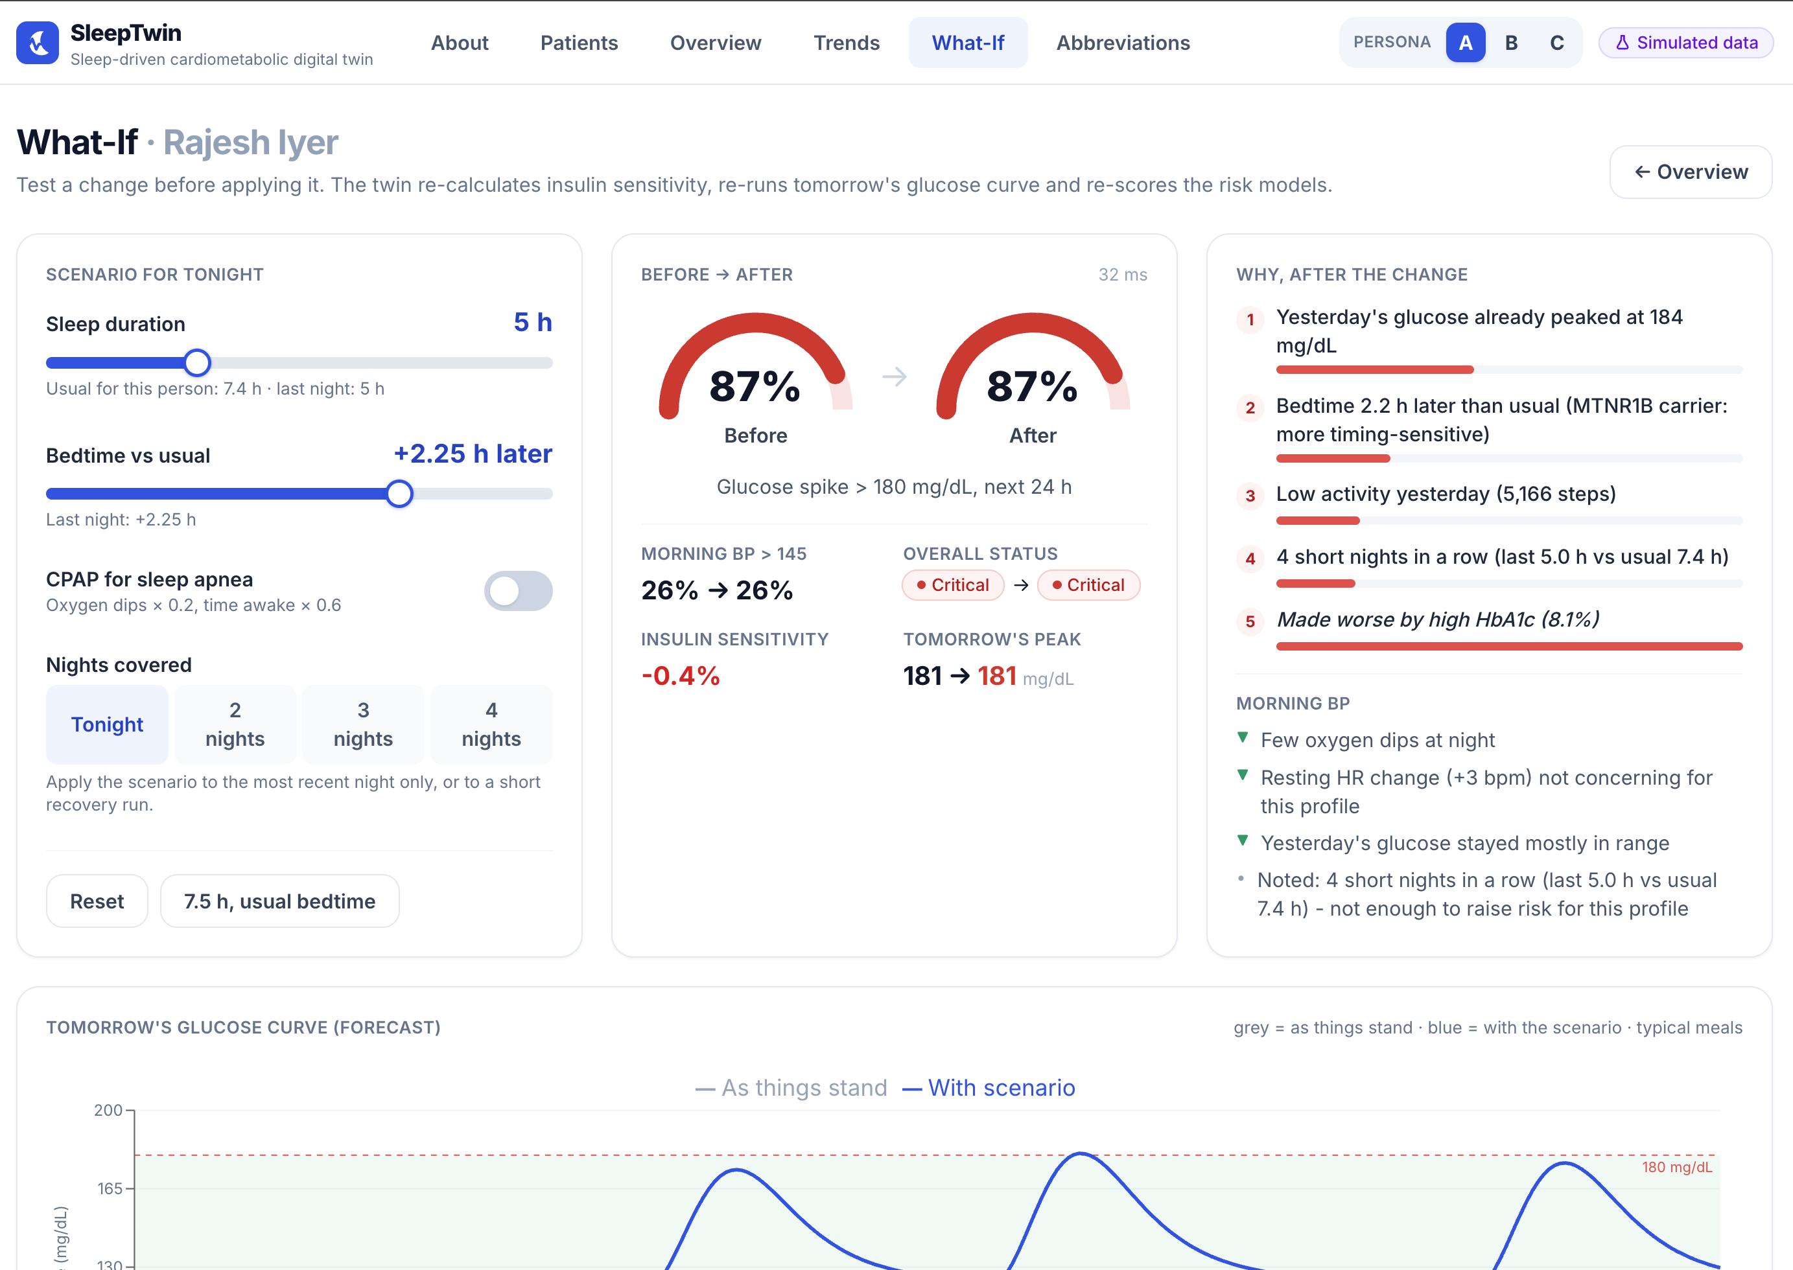
The Clinician Dashboard
Overview: risk, 2-hour alert, reasons, hidden-signal flags
What-If: move the sleep slider - risk and tomorrow's curve update
SleepTwin · Team WeBareBears · PCCOE · all patient data simulated
12
Notes:
Five pages: Patients, Overview, Trends, What-If, How It Works.

Slide 13
Limitations & Safety
Decision support only
Not clinically proven
Built safely
✓ Not a diagnosis
✓ The doctor stays in charge
✓ Disclaimer on every screen
✓ Trained on virtual patients
✓ Labels share the simulator's assumptions
✓ Needs real-data validation
✓ No real patient data
✓ Security-hardened app + API
✓ 0 known dependency vulnerabilities
Also: NHANES is a US population and genetic markers are simulated - Indian calibration is future work.
SleepTwin · Team WeBareBears · PCCOE · all patient data simulated
13
Notes:
Be upfront about what the prototype does not prove.

Slide 14
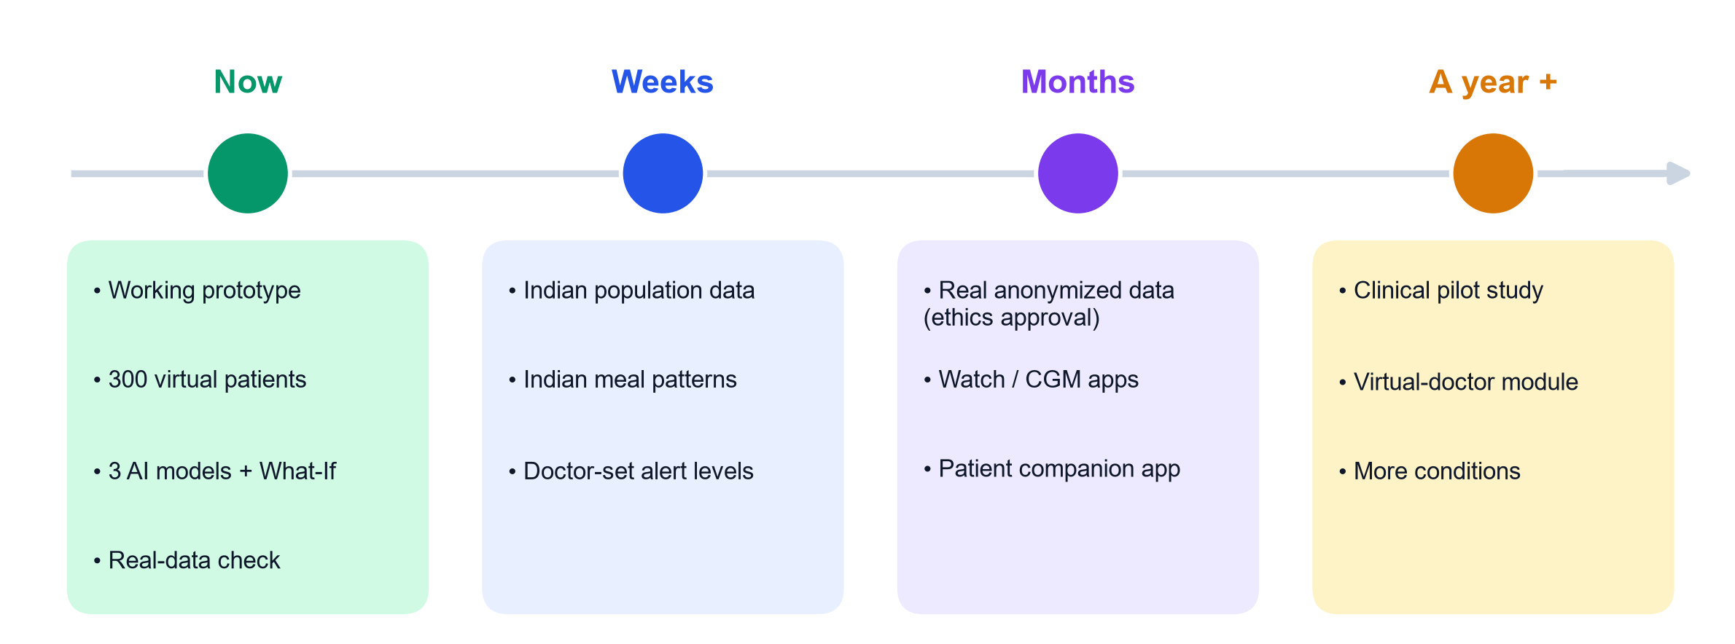
Roadmap & Fit with a Virtual Doctor Programme
SleepTwin can be the between-visit 'sleep + metabolism' module of a virtual doctor: forecast tomorrow, suggest tonight's fix.
SleepTwin · Team WeBareBears · PCCOE · all patient data simulated
14
Notes:
Close with the one-liner.

