Slide 1
Transformer

Slide 2
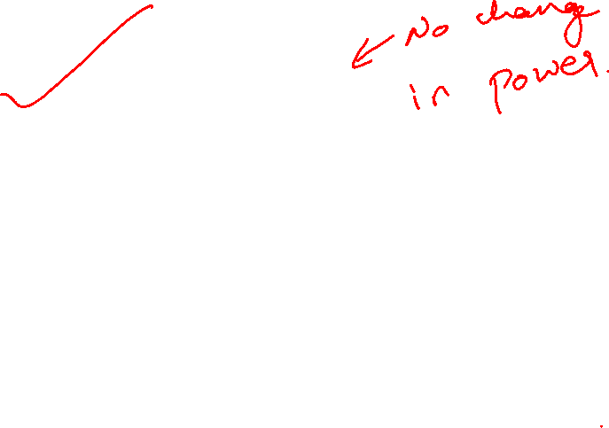
Transformer :
Machine to transform
levels of voltage and
current but not power or
volt-ampere.

Slide 3
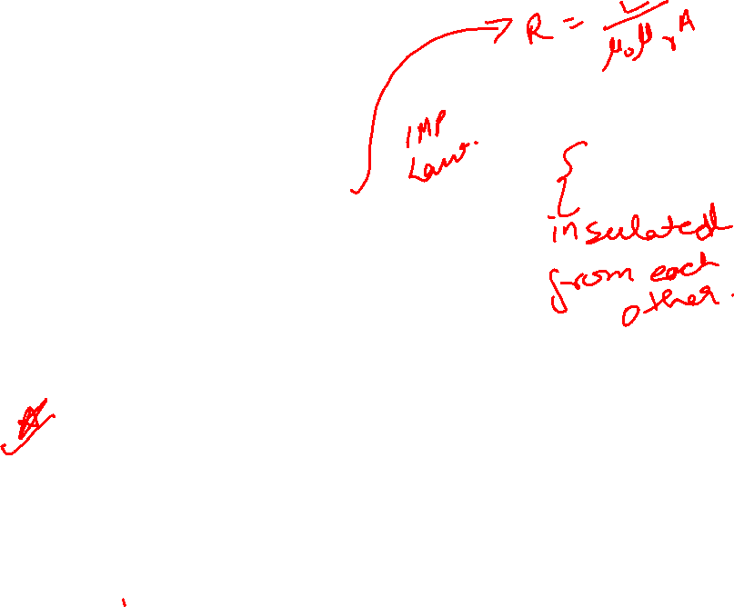



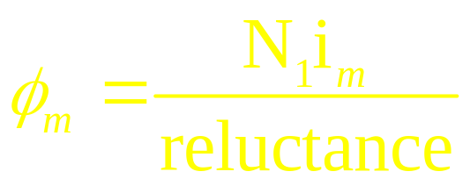
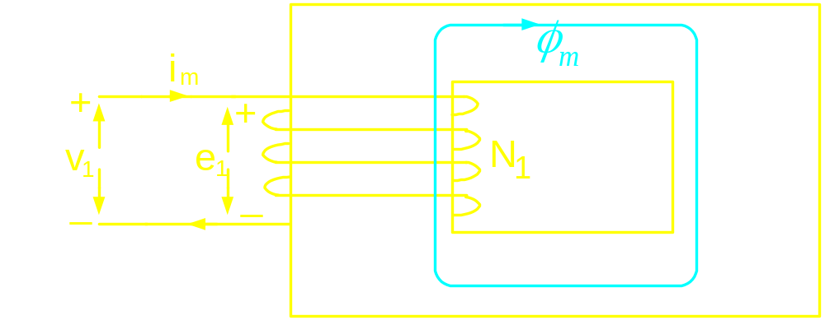
From ampere’s law:
Core
Winding
N₁ = no. of turns of the coil
i_{m} = current in the coil
Direction of flux
given by right
hand thumb
rule

Slide 4
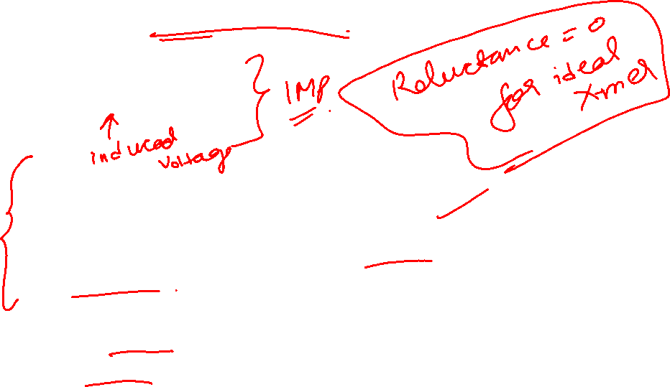
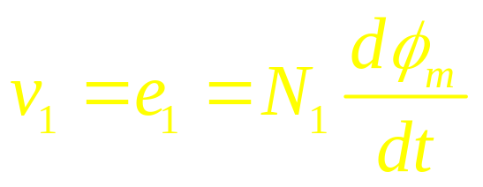
From Faraday’s law:
Magnitude of core flux is determined by the induced voltage and hence
applied voltage in case of an ideal
transformer.
For an ideal
transformer,
i_{m} = 0

Slide 5
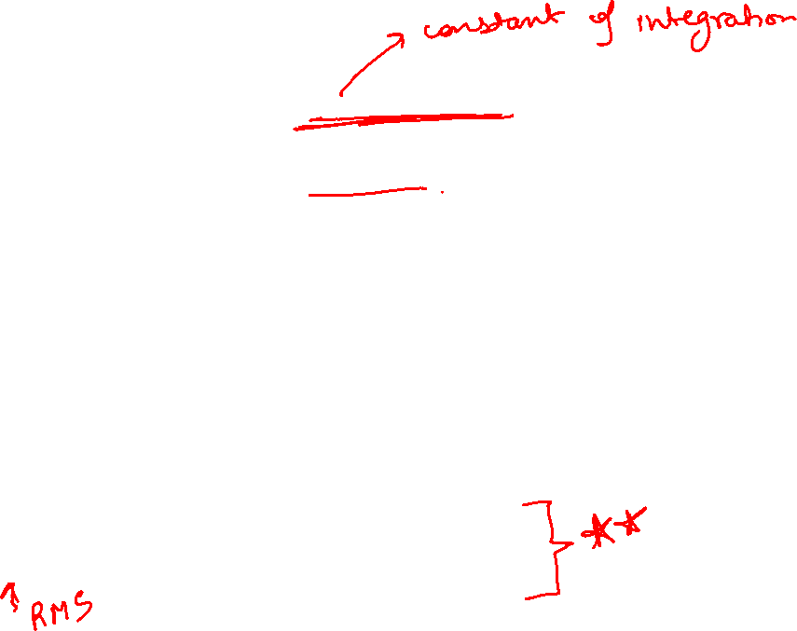

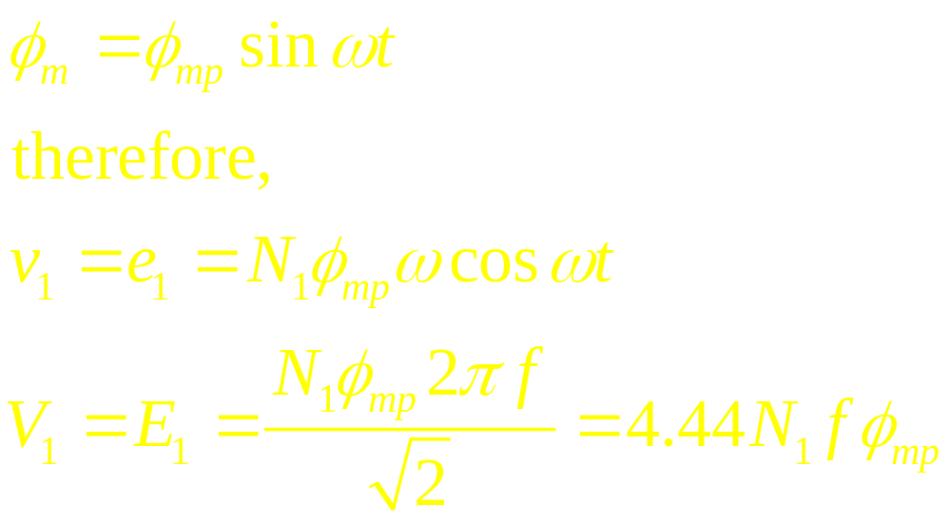
If v is sinusoidal, is also a sinusoid riding
on a dc component. In reality as the system
is lossy, at steady state dc componet will die
down to zero.
Let us assume,

Slide 6
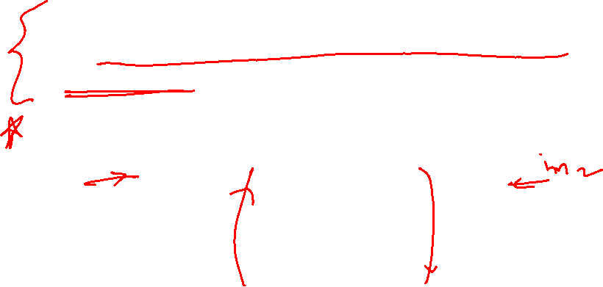
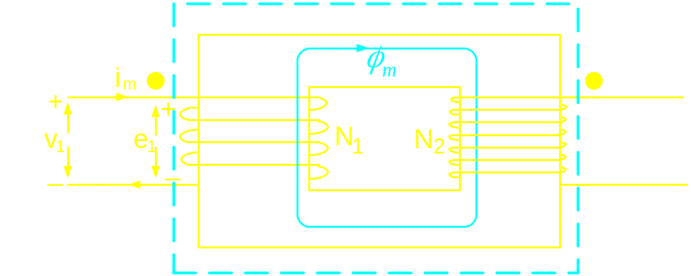
Dot convention
Gives information regarding the sense of winding:
current entering both the “dots” set fluxes which aid
each other

Slide 7
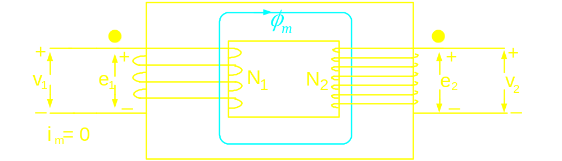

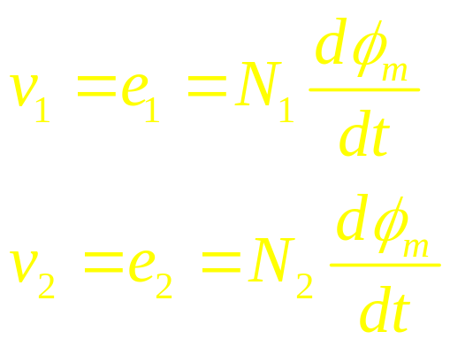
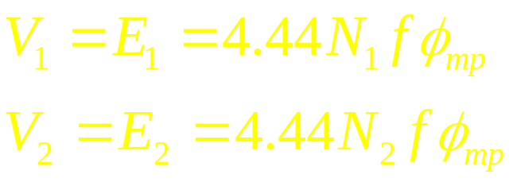
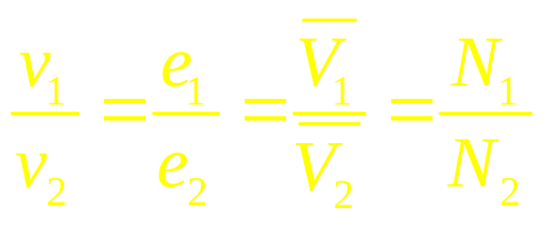
Voltage induced in winding 2
Ideal transformer: Recluctance of core material is zero
Therefore,
Polarity of induced voltage is given by
Lenz’s law : “dotted” terminals gets ‘
similar polarity

Slide 8

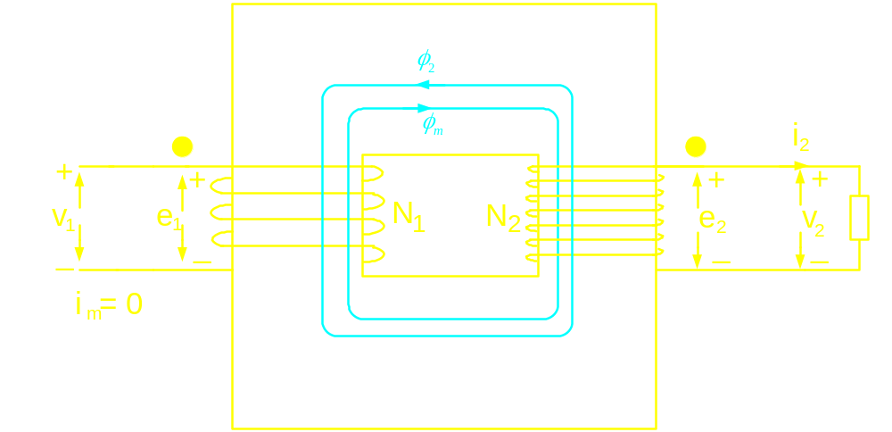
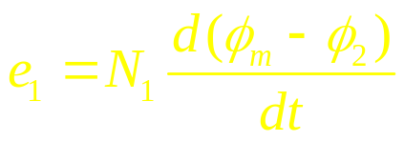
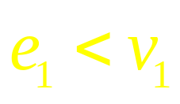


Ideal Transformer on load
v₁ being the applied voltage
remains same, but
Therefore,
Hence a current flows from v1 to “dot” terminal
of winding 1.
Flow of current in N₁ sets a flux in the core

Slide 9
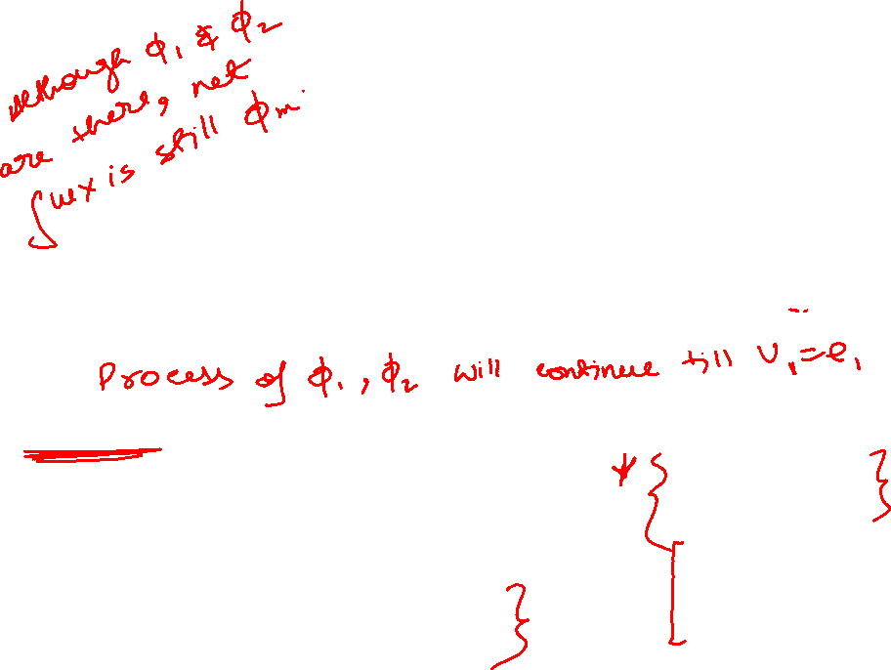
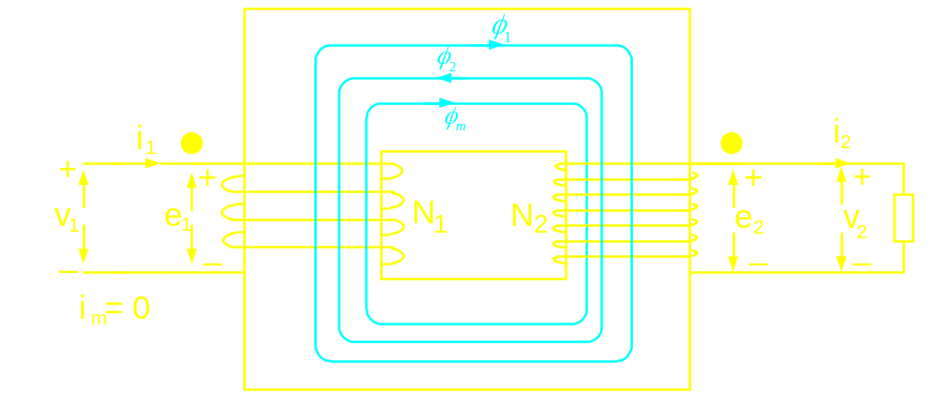
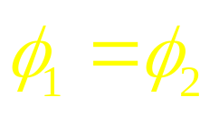
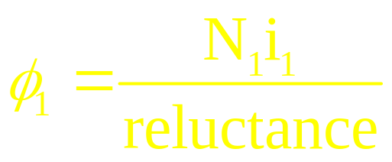
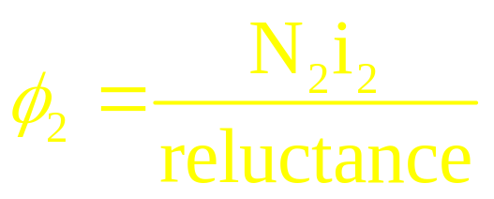
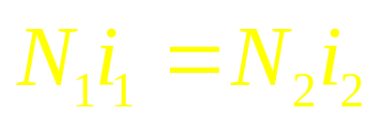
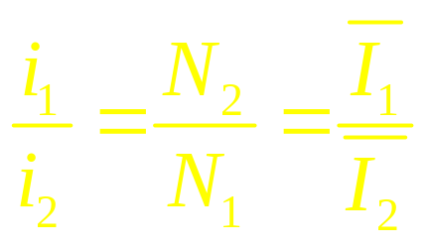
Ideal Transformer on load
Steady state will reach when,
Therefore at steady state
Power factors at both the sides remain the
same

Slide 10
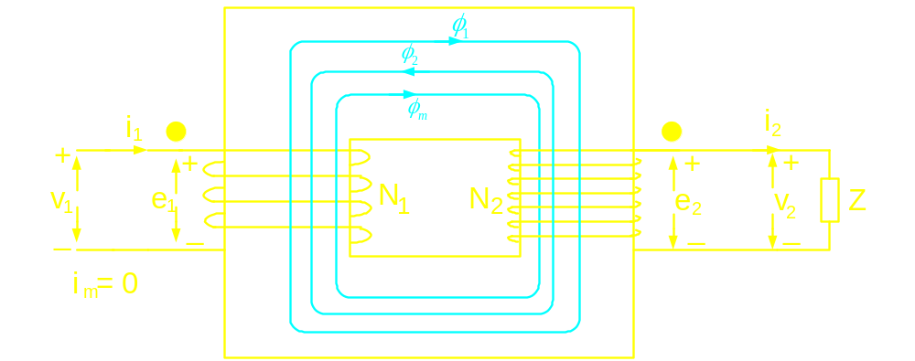


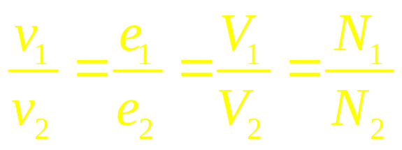

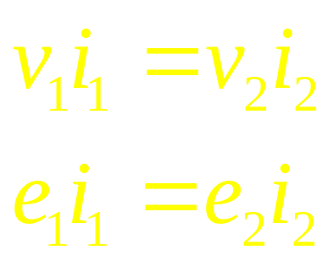
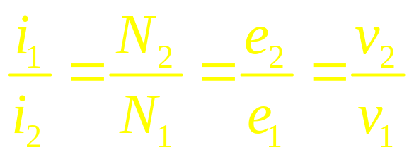
Ideal Transformer on load
Therefore,
Volt-amperes at both the sides are
same

Slide 11
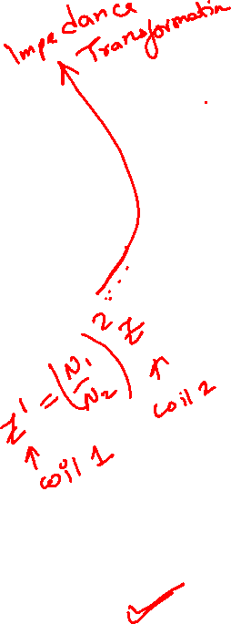
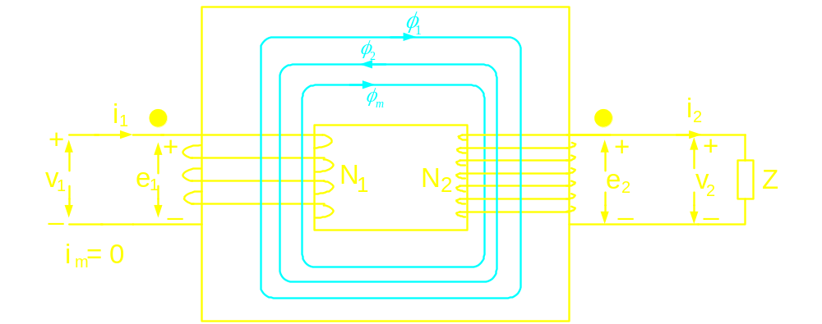
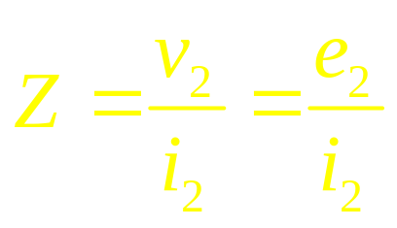
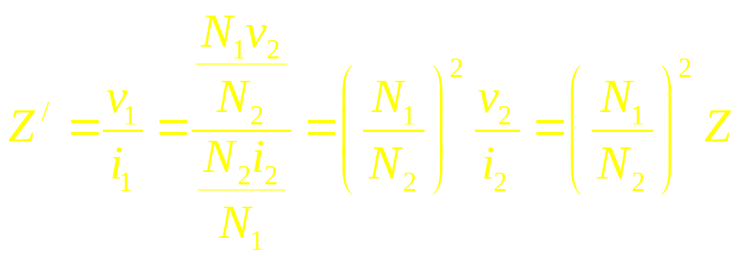
Ideal Transformer on load
Impedance seen by winding-2,
Impedance seen by winding-1,

Slide 12
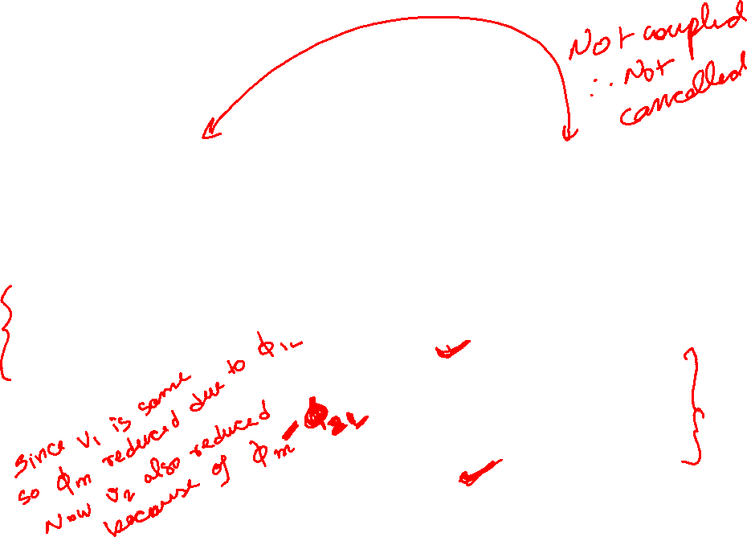
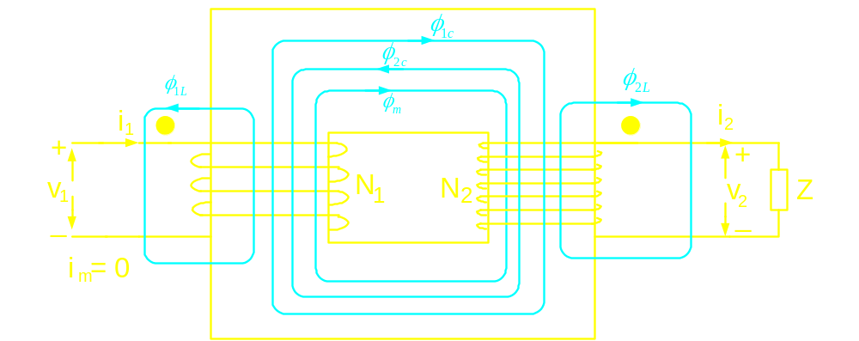
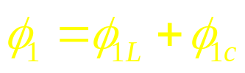
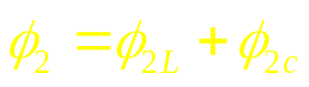
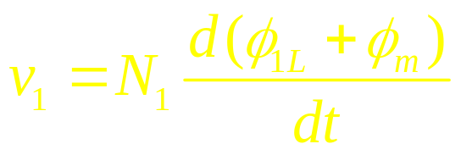
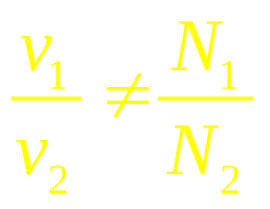
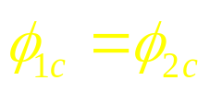
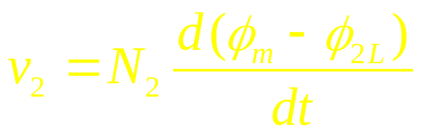
Flux pattern in a realistic transformer

Slide 13
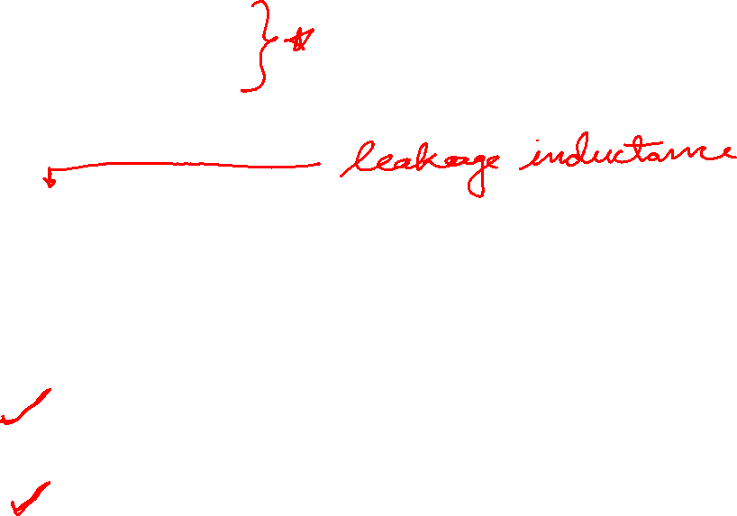
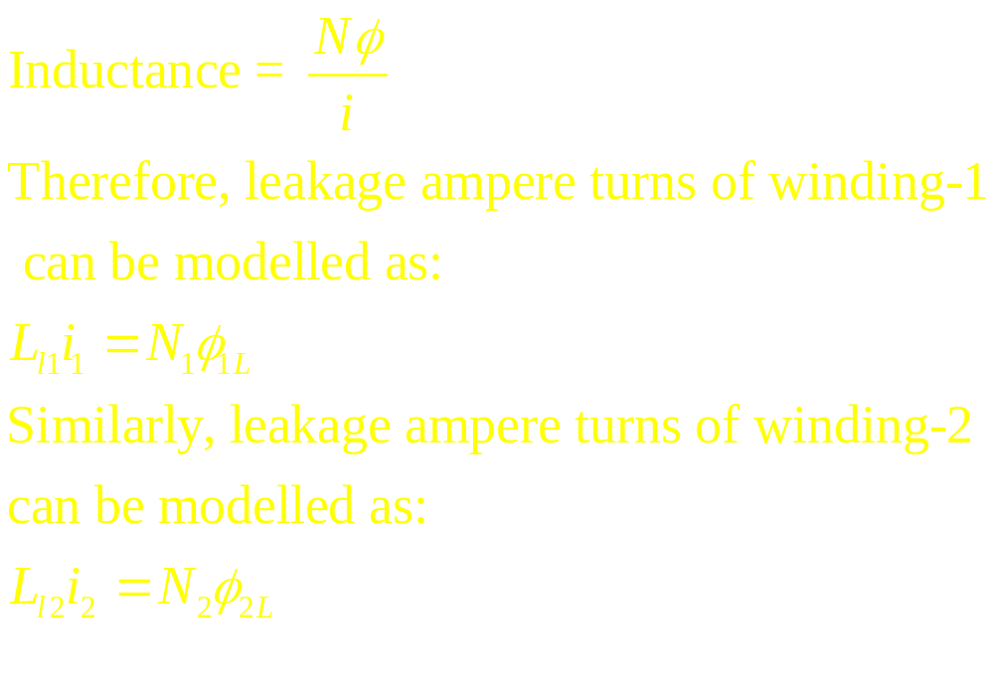
Moreover, winding-1 of a practical transformer will have a resistance
component: R₁
winding-2 of a practical transformer will have a resistance
component: R₂

Slide 14
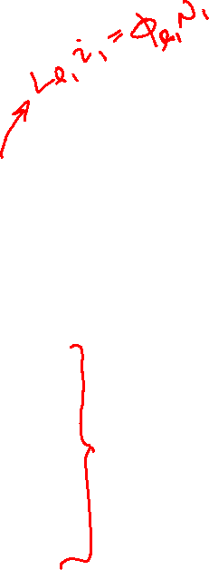
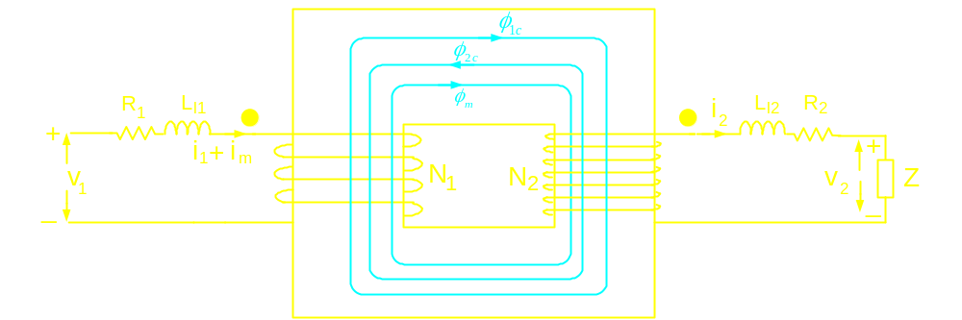
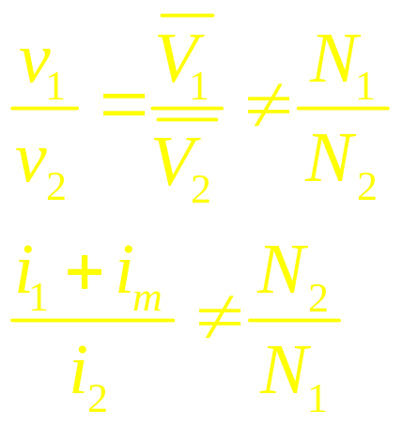
Circuit model of a realistic transformer

Slide 15
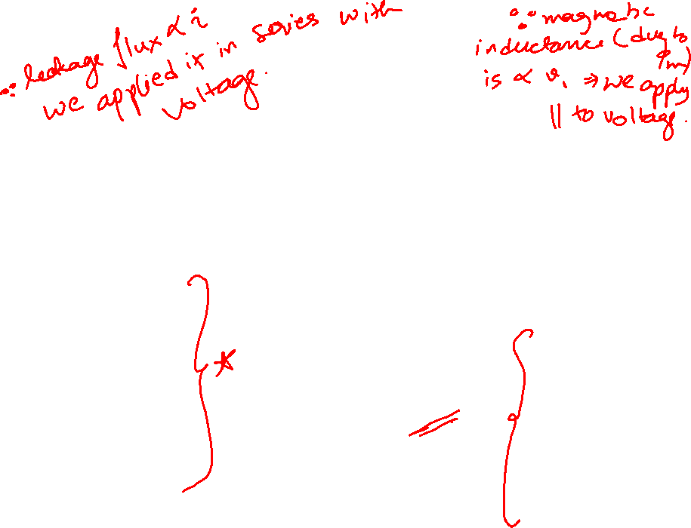
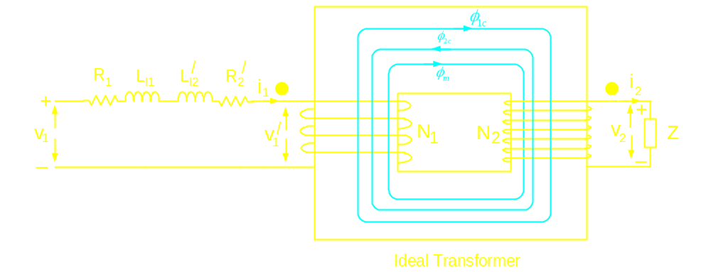

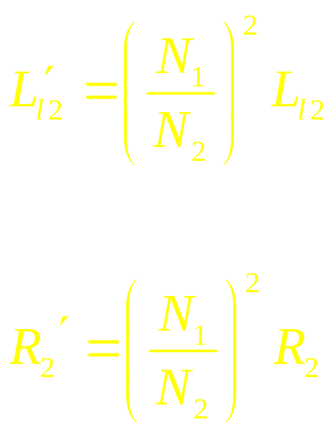
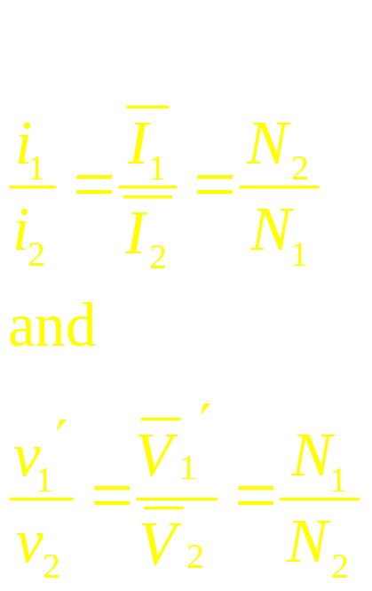

Circuit model of a realistic transformer

Slide 16
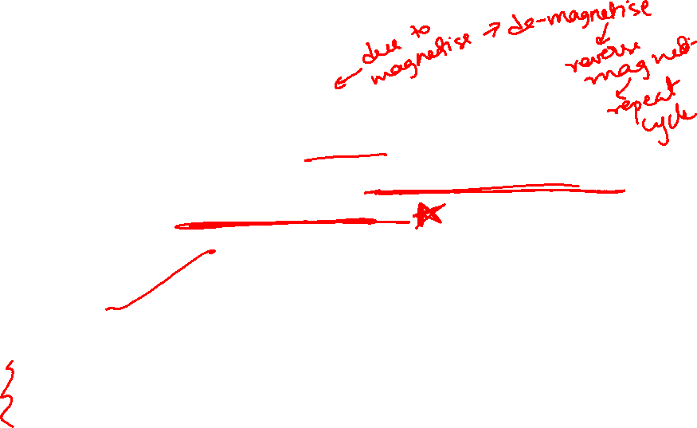
Losses in a transformer:
Iron Loss: Hysteresis Loss
Eddy current Loss
- Function of voltage for a given frequency
modelled by incorporating a resistance in
parallel to the source
Copper loss: Ohmic loss incurred in the windings
modelled by R₁ and R₂
To account for the magnetizing current: Incorporation of inductance in parallel to the source.

Slide 17


Complete circuit model of the transformer
I_{o} = No load current of the transformer,
accounts for no load loss and magnetizing
current

Slide 18

Applications of transformer:
Voltage matching
Voltage boosting for power transmission
Impedance matching
Isolation – voltage and current sensing

