Slide 1
Lecture 5

Slide 2
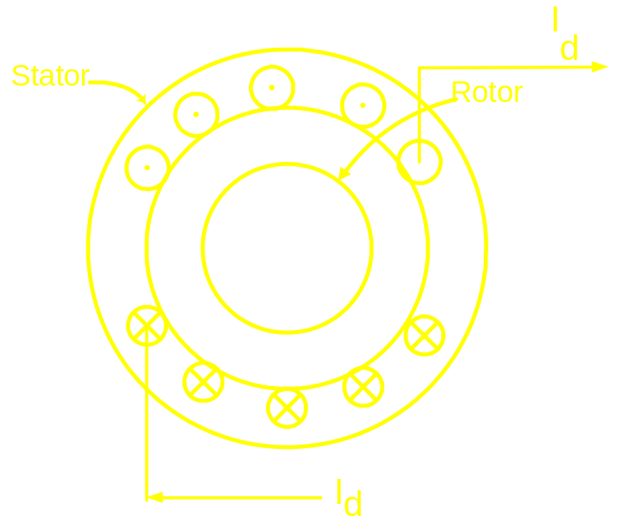
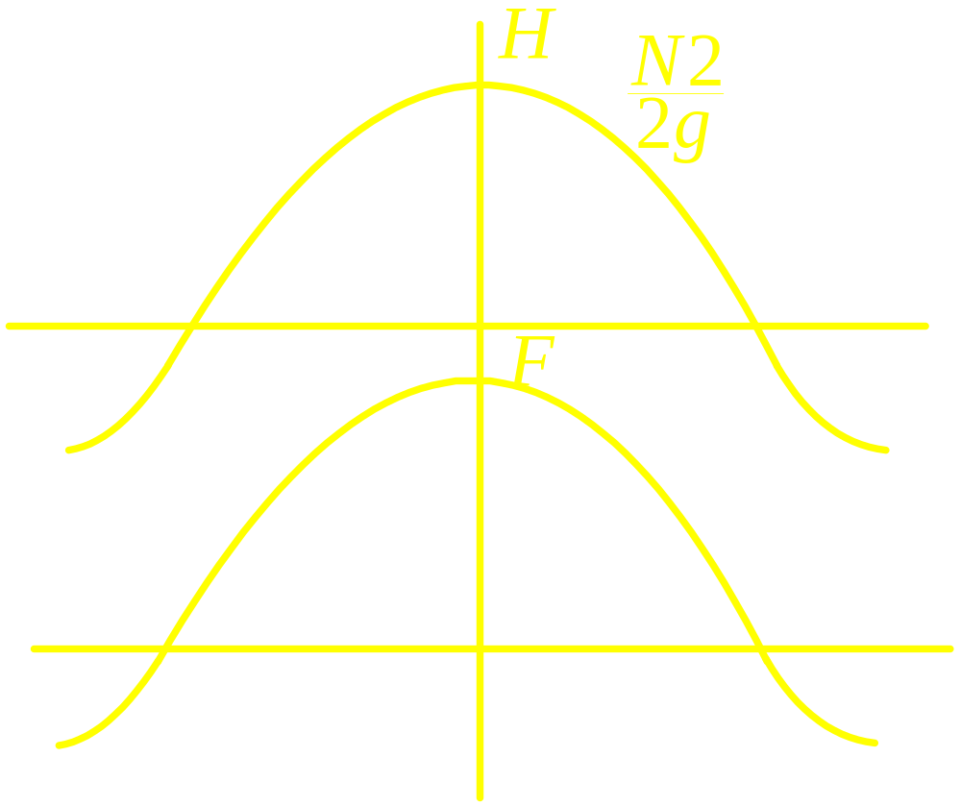

Slide 3


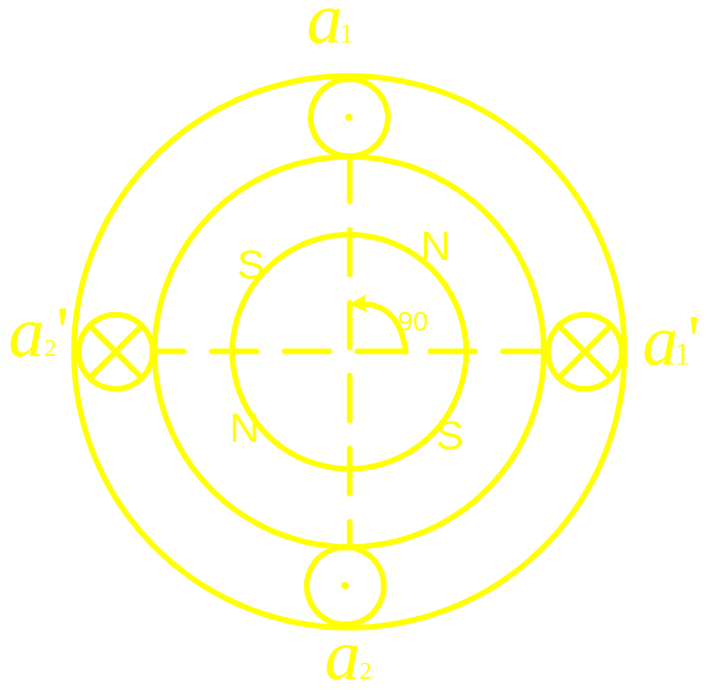
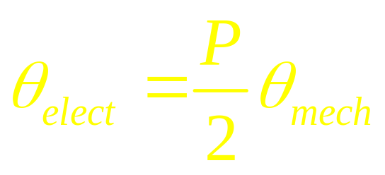
Four Pole Machine
Concept of electrical angle

Slide 4
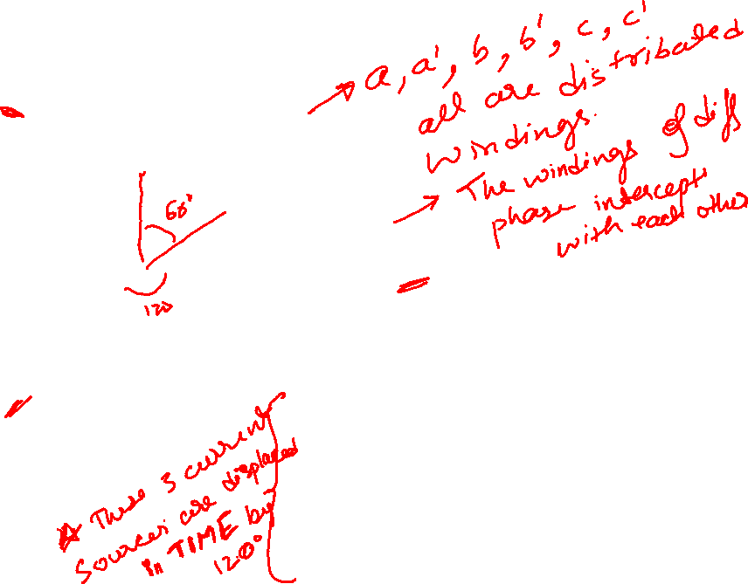
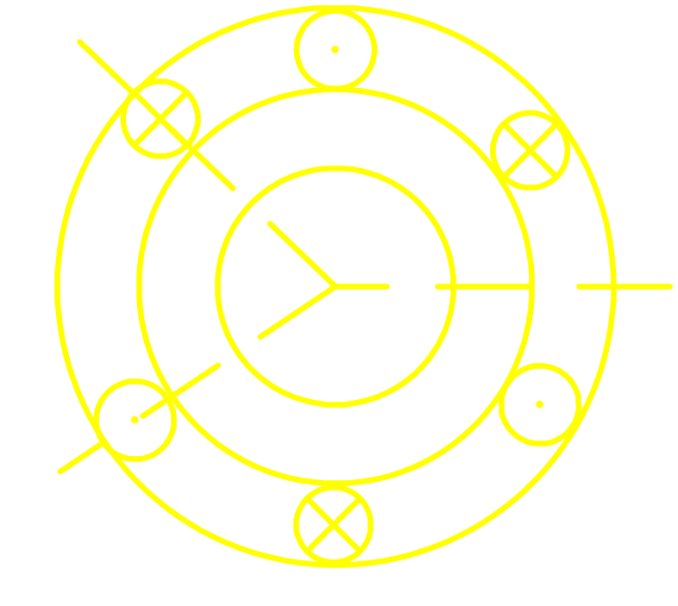

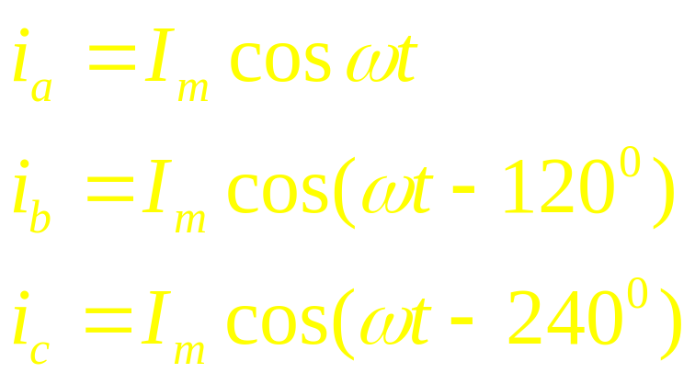
Three phase Machine
Phase-B
magnetic axis
a
c/
b/
Phase-A magnetic axis
b
Three current displace in TIME by 120 degrees are used to excite three coils displace in SPACE by 120 degrees
c
Phase-C
magnetic axis
a/

Slide 5
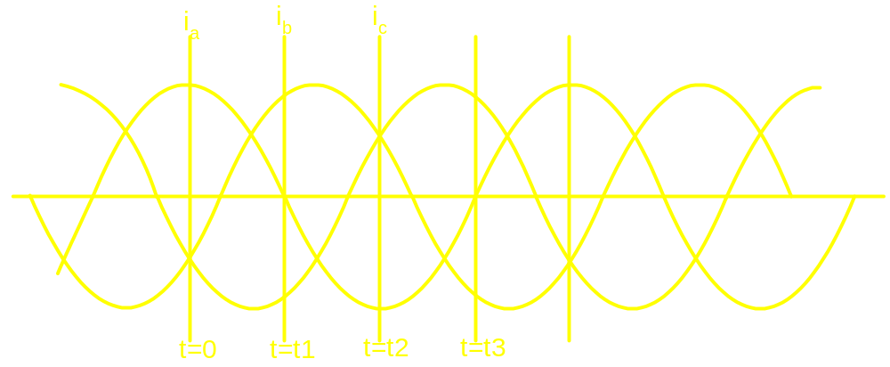
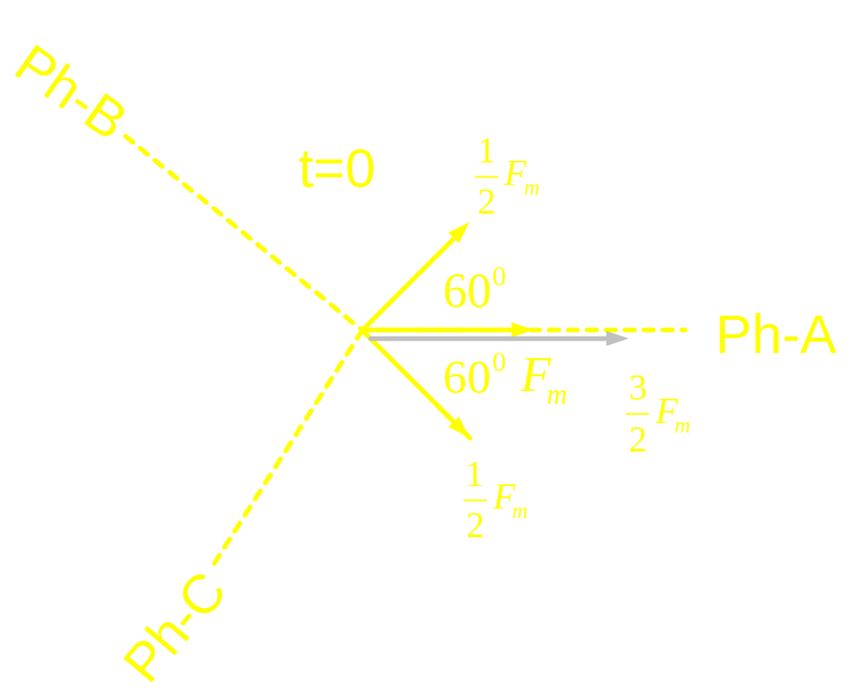
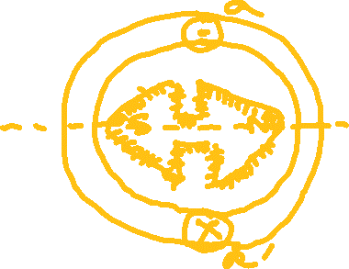

Slide 6
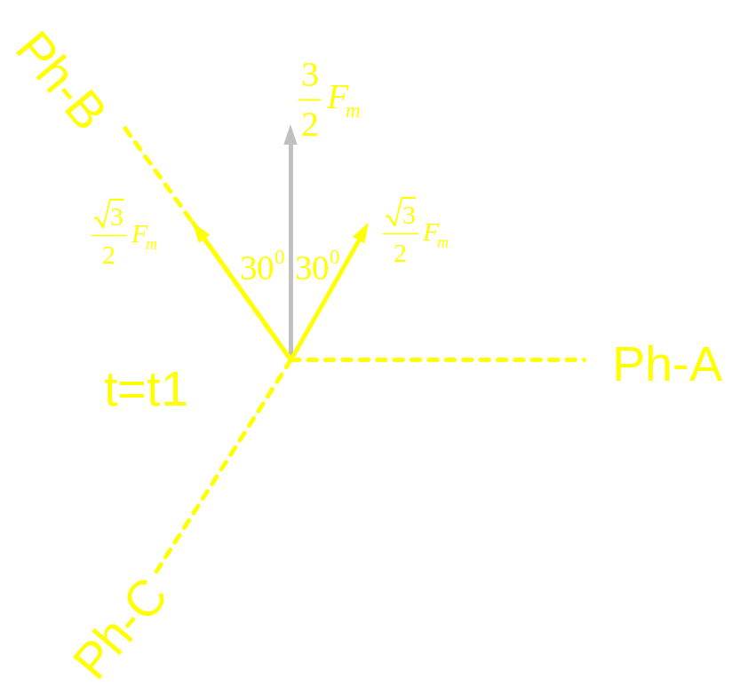
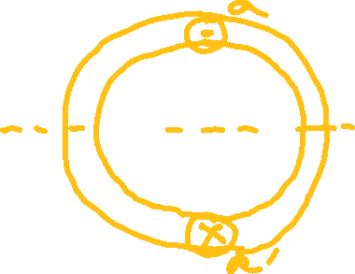


Slide 7
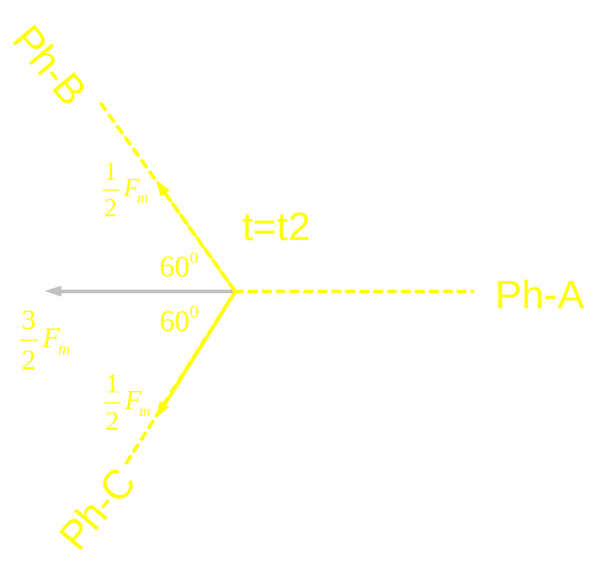
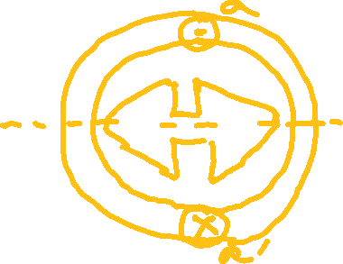


Slide 8
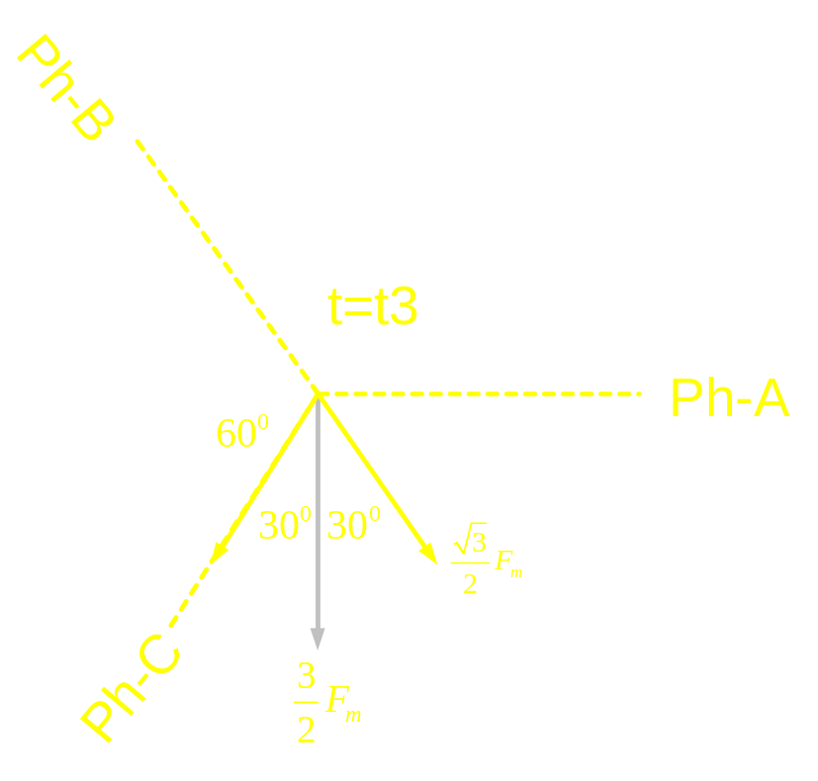





Slide 10

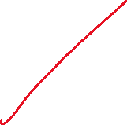

3 main inferences:
If we excite 3 coils which are displaced in space by 120 degrees by 3 currents displaced in time by 120 degrees
we’ll get a resultant magnetic field whose magnitude is constant but its location keeps on varying with time.
If the individual coils are ohmed for a 2-pole machine, resultant will also be a 2 pole machine.
Resultant magnetic field gets aligned along the magnetic axis of that coil which carries the maximum current
In one cycle of current waveform, the resultant magnetic field experiences 360 degree rotation. (true in case of a 2 pole machine)

Slide 11
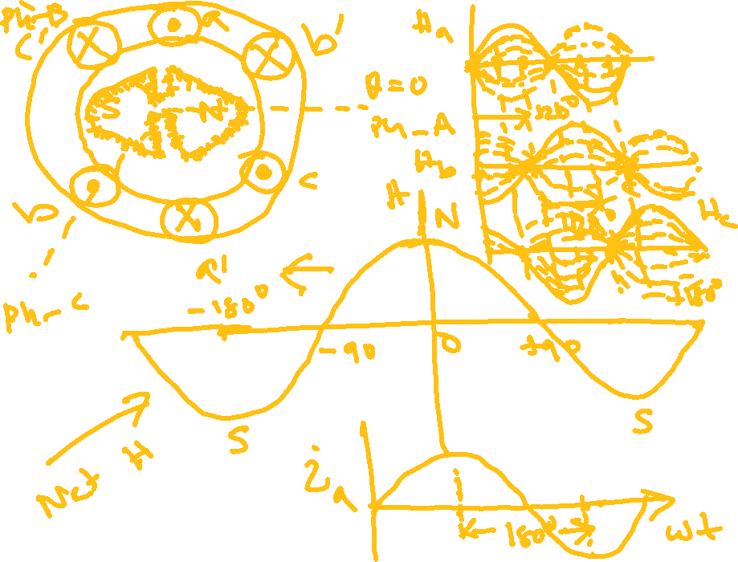

Slide 12
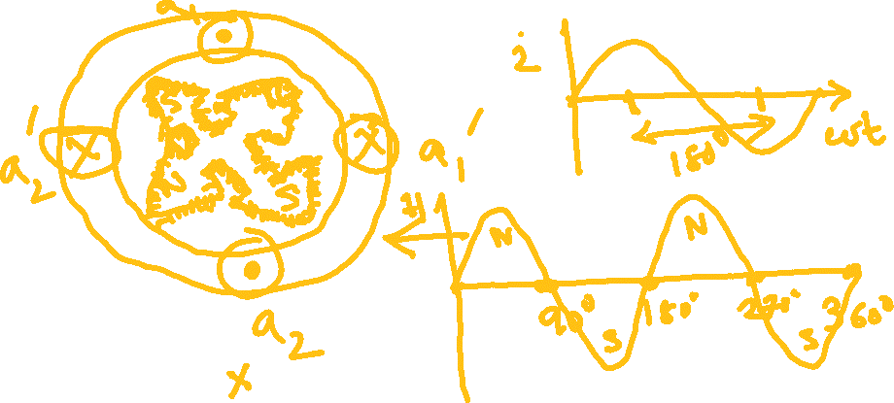
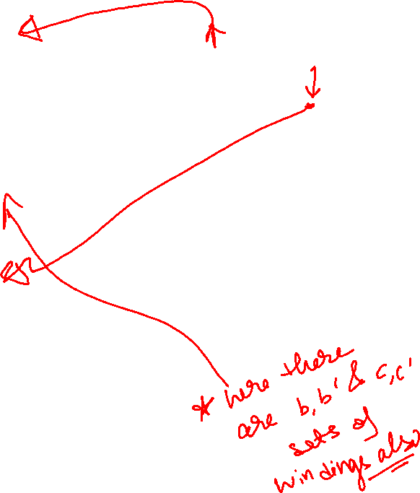




Slide 13
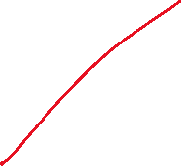






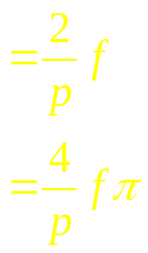


In one cycle of the current waveform, the
resultant mmf wave makes one revolution in
a 2 pole machine
In one cycle of the current waveform, the
resultant mmf wave makes 2/p revolutions in
a p pole machine
If the frequency of the current is f,
Revolution made in one sec
Angle traversed in one sec
rad

Slide 14
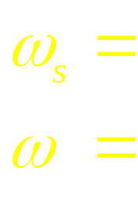
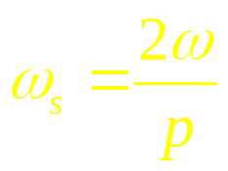
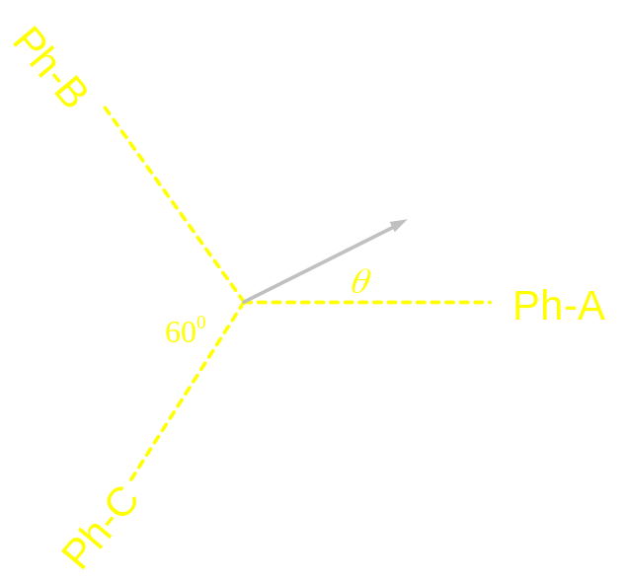
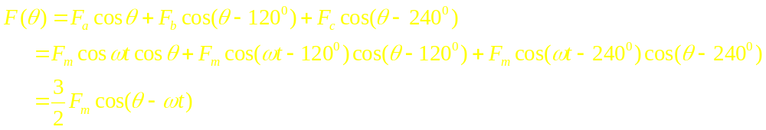










Speed of rot mag field in rad/sec
frequency of current in rad/sec

Slide 15
