Slide 1
⚡ AI-POWERED CYCLONE RESILIENCE PLATFORM
PRAHAR
Predictive Risk & Anticipatory Hazard Action Resource
Track-Based Cyclone Impact & Infrastructure Vulnerability Forecaster for Bay of Bengal & Coastal APAC
Google Earth Engine
Gemini 1.5 Flash
FastAPI & React
22 Indic Languages
Designed for District Magistrates, NDRF Commanders & State Disaster Authorities (OSDMA, WBDMD, APSDMA, TNDMA) to trigger anticipatory evacuations < T-12h before landfall.

Slide 2
Core Objectives
1. Track Telemetry
Ingest IMD, JTWC, Tide Gauges & Copernicus 30m GEE DEM in real-time.
2. Surge Modeling
Hydrodynamic coastal inundation envelopes across 3 surge hazard tiers.
3. Infrastructure Graph
Pinpoint severed CHCs, tripped substations, and cutoff shelters.
4. Multimodal SOPs
Gemini Flash auto-drafts tactical cadre directives in 22 Indic tongues.
5. Parametric Escrow
Automated smart escrow releases disaster liquidity at T-24h with 0 latency.
Our Mission: Transform reactive cyclone disaster relief into predictive, automated anticipatory action — protecting 170M+ coastal citizens across the Bay of Bengal & Coastal APAC.

Slide 3
The Coastal Vulnerability Gap
🔴 The Problem Today
▲ Fragmented Telemetry Silos
Cyclone tracks from IMD, bathymetry, power grids, and hospital directories exist in disconnected silos. No real-time spatial correlation.
▲ 12-24h Bureaucratic Response Lag
Current administrative dashboards operate post-landfall. Damage assessments occur 24-48 hours after coastal embankments are overtopped.
▲ Static Paper-Based Emergency SOPs
District Collectors rely on generic paper manuals unsuited for live dynamic water levels, leading to trapped civilians and submerged relief routes.
⚠️
"The storm surge inundated the coastal arterial highway before the evacuation buses were dispatched."
Without predictive, track-based infrastructure vulnerability modeling, relief forces deploy blindly after lifelines sever. Coastal districts lose critical power and emergency medical access within hours.

Slide 4
The PRAHAR Solution
1. Unified Geoprobe
Direct ingestion of live IMD track coordinates, JTWC advisories, Copernicus 30m DEM elevation, and OSM critical lifelines into a unified spatial graph.
2. Multimodal AI Triage
Gemini 1.5 Flash evaluates hydrological choke points, drafting role-directed SOPs and generating multi-lingual Web Speech broadcasts in 22 Indic languages.
3. Parametric Liquidity
Automated pre-landfall escrow releases emergency cash reserves at T-24h directly to SDRF accounts without bureaucratic verification delays.
💡 The 5-Minute District Collector Value: You don't have to decipher raw radar files. PRAHAR instantly highlights which bridge is severed, which hospital loses backup power, and where assault craft must be pre-staged.

Slide 5
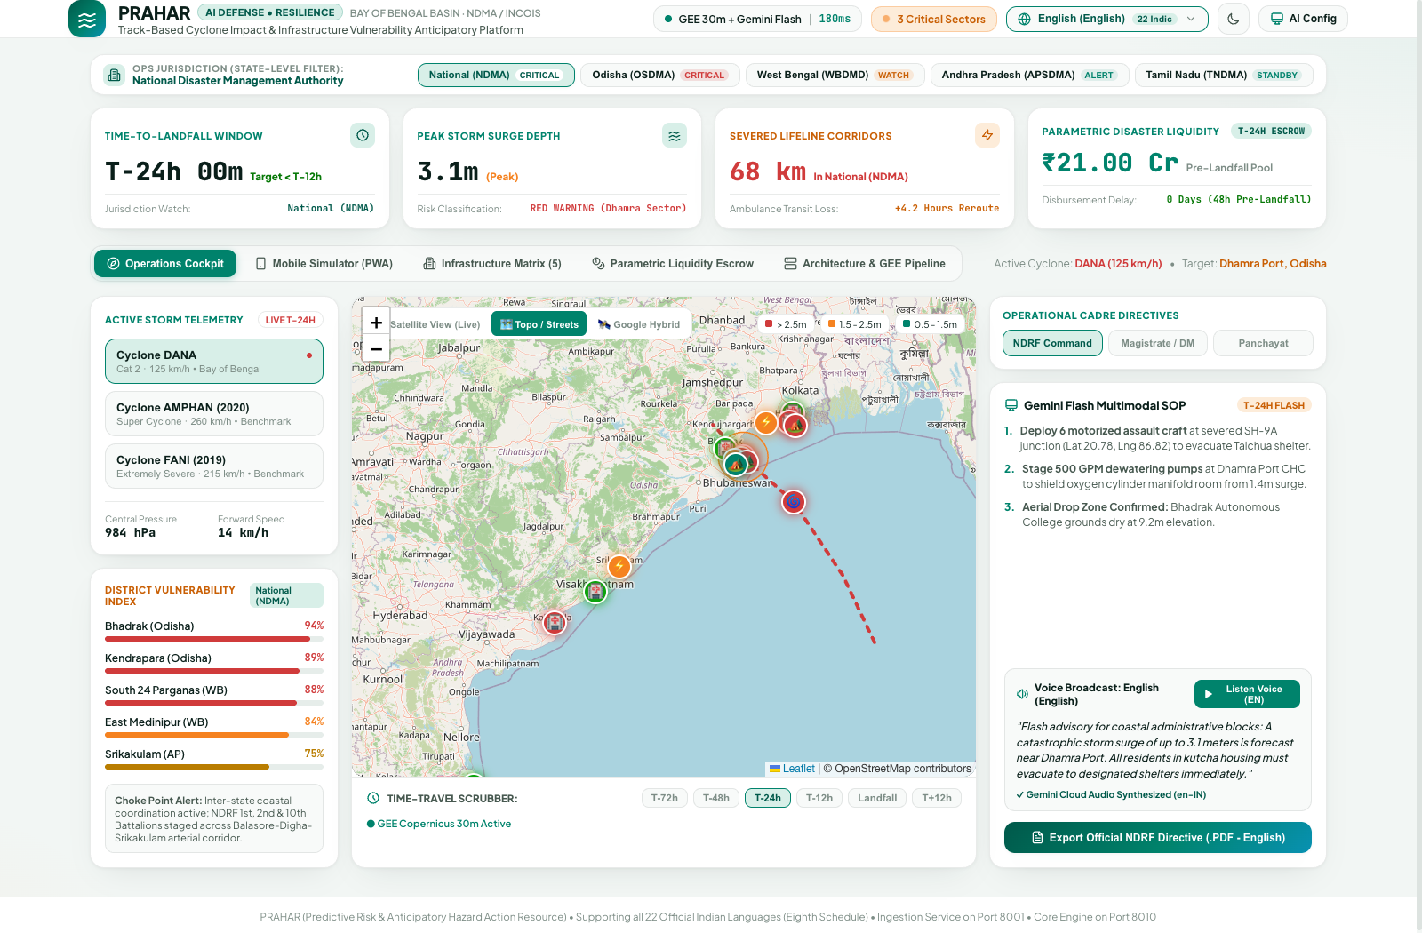
Live Operations Cockpit
Operational Capabilities
• Real-time Track Ingestion
Tracks active storms (e.g. Cyclone DANA 125 km/h) with 6-stage temporal waypoints.
• 3-Tier Surge Inundation
High-resolution polygons for >2.5m, 1.5-2.5m, and 0.5-1.5m forecast surge.
• District Vulnerability Index
Automated ranking of districts (Bhadrak 94%, Kendrapara 89%).
• Multimodal Directives
Gemini 1.5 Flash generates action orders for NDRF, DMs & Panchayats.

Slide 6
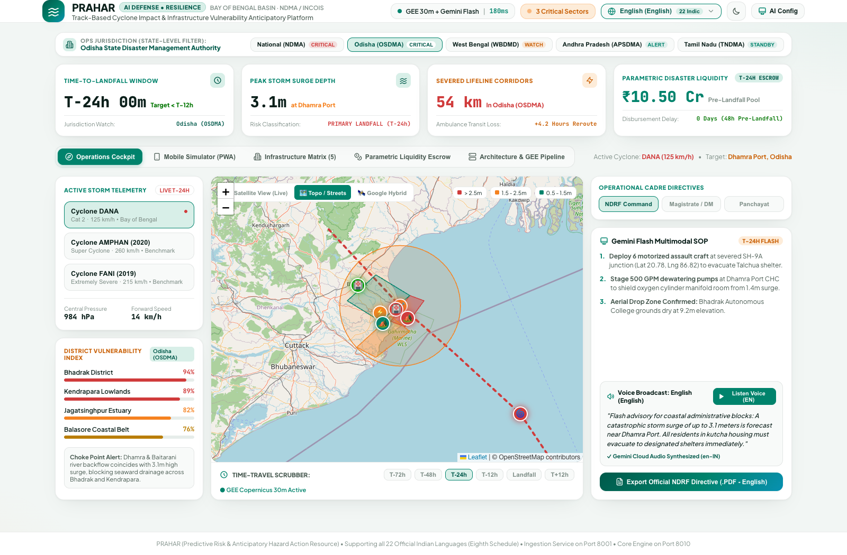
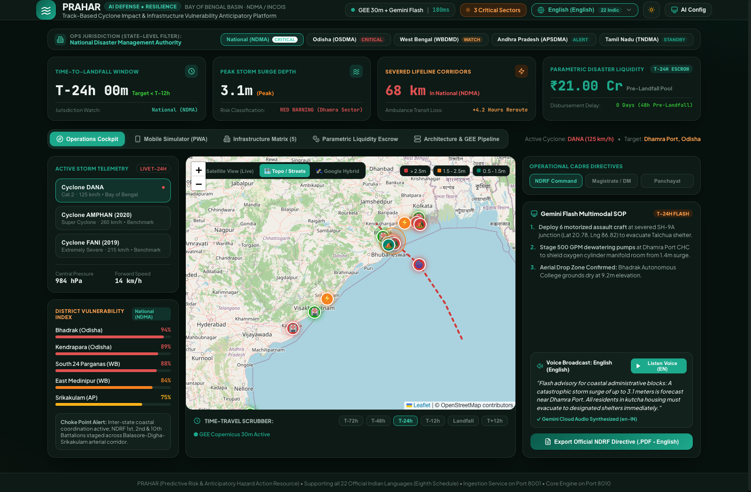
State Operations & 22 Official Indic Languages
🏛️ Multi-State Operational Jurisdictions
1-click filtering across National (NDMA), Odisha (OSDMA), West Bengal (WBDMD), Andhra Pradesh (APSDMA), and Tamil Nadu (TNDMA) automatically re-centers GIS and updates state-specific choke points.
🎙️ All 22 Eighth Schedule Indian Languages
Native translations and instant Web Speech audio broadcasts for Odia, Bengali, Telugu, Tamil, Hindi, Marathi, Gujarati, etc. Dark Mode supports 24/7 command center screening without visual fatigue.

Slide 7
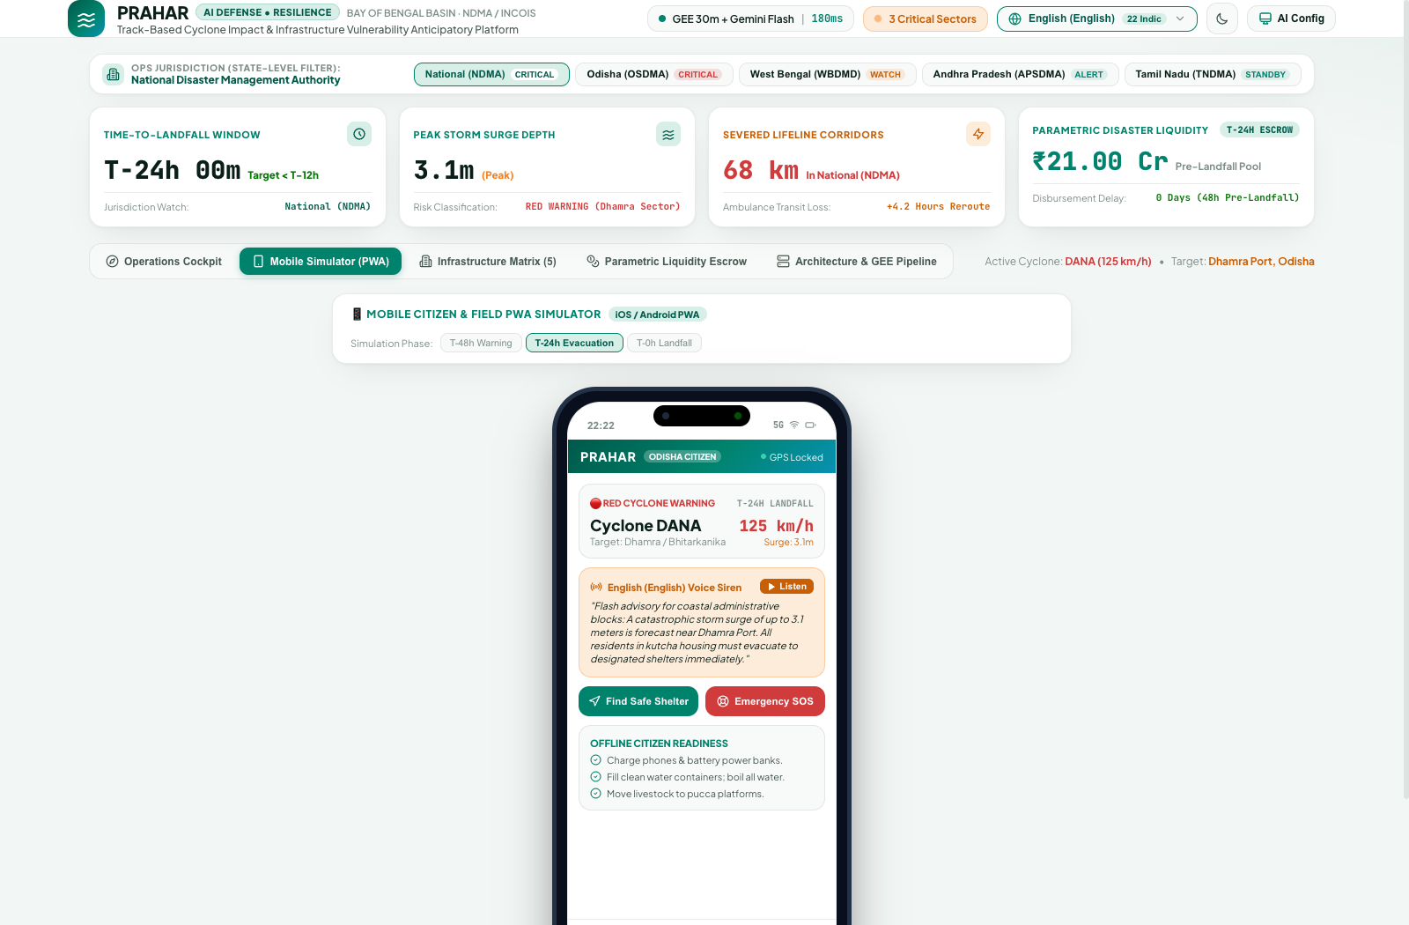
Mobile Citizen Simulator (PWA)
📱 Last-Mile Citizen Protection
✓ Offline-First Progressive Web App
Pre-caches elevation maps and shelter waypoints. Fully functional even when mobile towers lose power or backhaul connections.
✓ Safe Navigation to Multi-Purpose Shelters
Real-time routing diverts citizens away from flooded roads toward elevated shelters with verified remaining capacity.
✓ One-Tap SOS Distress Beacon
Broadcasts GPS coordinates, battery level, and family count to district emergency operations centers.
✓ Parametric Relief QR Pass
Digital QR credentials enable immediate ration and relief fund verification at local evacuation shelters.

Slide 8
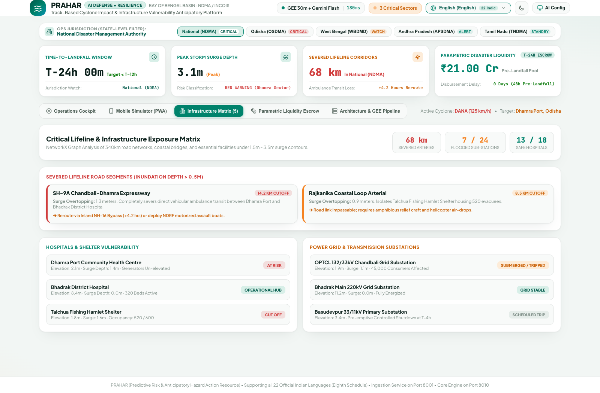
Infrastructure Vulnerability Matrix
5 Critical Lifeline Sectors
🏥 Primary Health Centers (CHCs)
Elevation vs surge calculation flags oxygen manifold flooding and power cutoffs before breach.
⚡ 33/11kV Substation Grids
Tripping predictions prevent equipment burnout and identify affected consumer counts.
🏕️ Multi-Purpose Cyclone Shelters
Live capacity tracking and road severance warnings dispatch amphibious assault craft.
🌉 Arterial Highways & Bridges
Identifies specific road cuts (e.g. SH-9A) causing ambulance reroutes of 4.2+ hours.

Slide 9
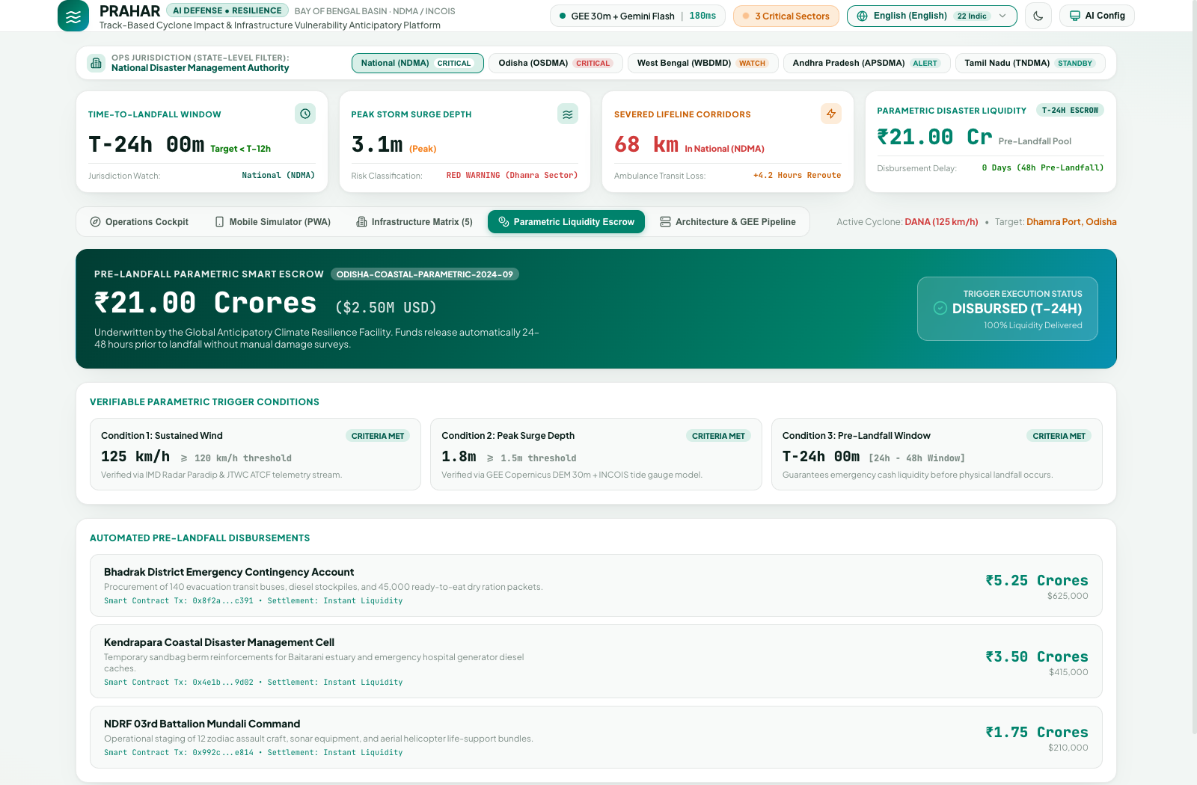
Parametric Escrow & Predictive Mathematical Model
Mathematical Vulnerability Formulation
Escrow Automation Protocol:
● Zero Claims Processing: Funds disburse automatically at T-24h once storm track & surge thresholds are met.
● Pre-Landfall Disaster Liquidity: Allocates ₹21.00 Cr pool directly to impacted coastal state SDRF accounts (e.g. ₹10.5 Cr Odisha, ₹5.25 Cr WB).
● Cryptographic Auditability: Every payout is recorded with verifiable blockchain-inspired hashes preventing administrative diversion.
V_dist = 0.45 * (S_peak / E_mean) + 0.35 * (C_sev / C_tot) + 0.20 * ρ_kutcha

Slide 10
System Architecture
1. External Feeds & Telemetry
• IMD / JTWC: Real-time cyclone tracks & cones
• Google Earth Engine: Copernicus DEM 30m, Sentinel-1 SAR
• OSM Overpass: Hospitals, Sub-stations, Arterial Bridges
• INCOIS / NOAA: Coastal Tide Gauges & Bathymetry
2. Ingestion Microservice (:8001)
• Async Ingestion Worker & Poller Daemon
• Track Normalizer & Cone of Uncertainty Generator
• GEE Elevation & Bathymetric Sampler
• OSM Infrastructure Feature Extractor
3. Core Simulation Engine (:8010)
• FastAPI 0.111 Application Core
• SLOSH Storm Surge & Inundation Model
• Compound River-Surge Backwater Engine
• NetworkX Infrastructure Severance Graph
• Parametric Escrow Controller & Gemini AI
4. Storage & Presentation Tier
• PostgreSQL / PostGIS Spatial DB & Redis Cache
• React 18 + TS + Leaflet GIS 3D Cockpit (:5174)
• T-72h to Landfall Temporal Playback Scrubber
• Role-Differentiated SOPs & 22 Indic Audio
⚡ Decoupled Pipeline: External Feeds ➔ Ingestion Worker (:8001) ➔ Spatial DB ➔ Core Engine (:8010) ➔ React GIS (:5174)

