Slide 1
SMART HEALTH & SUPPLY CHAIN RESILIENCE • THEME: RESILIENCE
संजीविनी (Sanjeevini)
Federated AI Platform for National Health Resource & Medicine Supply Chain Management
Real-time visibility across 31,000+ PHCs • Predictive early warnings for emergency stock-outs • Automated cross-district redistribution • Privacy-preserving federated intelligence across India's states
ARCHITECTURE & GOOGLE AI INTEGRATIONS:
• Google Cloud Run Scalable Ingestion | • Gemini 1.5 Flash Reasoning Engine | • CARTO GIS Surveillance | • Indic Voice AI (22 Indian Languages) | • Sovereign FedAvg Model Synthesis
संजीविनी (Sanjeevini) | National Health Resource & Supply Chain Resilience Platform • Slide 1 of 10

Slide 2
THE CHALLENGE & PROBLEM STATEMENT
The Healthcare Supply Chain Emergency Across India's PHCs
42% RECURRENT STOCKOUTS
Chronic Medicine Invisibility
• Crucial supplies (Paracetamol, ORS, Anti-Snake Venom, Oxytocin) run out during acute outbreaks with zero automated warning.
• The Paradox: Excess inventory frequently expires in district warehouses just 40km away while rural sub-centres turn away critically ill patients.
12 - 24 HOUR REPORTING LAG
Manual Registers & Blindspots
• Frontline ASHA and ANM cadres lose 2 to 3 hours every day manually handwriting physical registers.
• Legacy batch portals update only once a day; catastrophic surge signals during monsoons and epidemics remain hidden until stockpiles are completely exhausted.
DATA SOVEREIGNTY BARRIERS
Interstate Data Silos
• Under India's Digital Personal Data Protection (DPDP) Act 2023, patient health records cannot be moved into a monolithic central repository.
• As a result, states cannot share predictive epidemiology or coordinate cross-border mutual aid without risking privacy violations.
संजीविनी (Sanjeevini) | National Health Resource & Supply Chain Resilience Platform • Slide 2 of 10

Slide 3
HOLISTIC PLATFORM ARCHITECTURE
The Sanjeevini Ecosystem: 4 Pillars of Health Resilience
1. GROUND CAPTURE
Multimodal Ingestion
• Indic Voice AI (22 scheduled Indian languages) for hands-free ASHA updates.
• Gemini Vision OCR scans physical stock ledgers & medicine blister packs with 98.7% accuracy.
• Zero-paperwork field entry.
2. GIS SURVEILLANCE
Real-Time Resource Map
• Live tracking across 31,000+ PHCs.
• CARTO Positron + OSM + Google Maps dual engine.
• Dynamic buffer thresholds:
🟢 Stable (>7 Days)
🟡 Warning (4-7 Days)
🔴 Critical Deficit (≤3 Days).
3. PREDICTIVE LOGISTICS
Cross-District Balancing
• ML models forecast disease surges 7 days prior to stockout.
• Automated algorithm matches donor clinics (>14d stock) to deficit clinics (≤3d stock).
• Generates turnkey dispatch manifests with route optimization.
4. FEDERATED AI
Sovereign Learning
• State health servers train local predictive models in-place.
• Only mathematical model gradients are aggregated centrally.
• Delivers +34.2% forecasting accuracy boost without sharing raw patient data.
संजीविनी (Sanjeevini) | National Health Resource & Supply Chain Resilience Platform • Slide 3 of 10

Slide 4
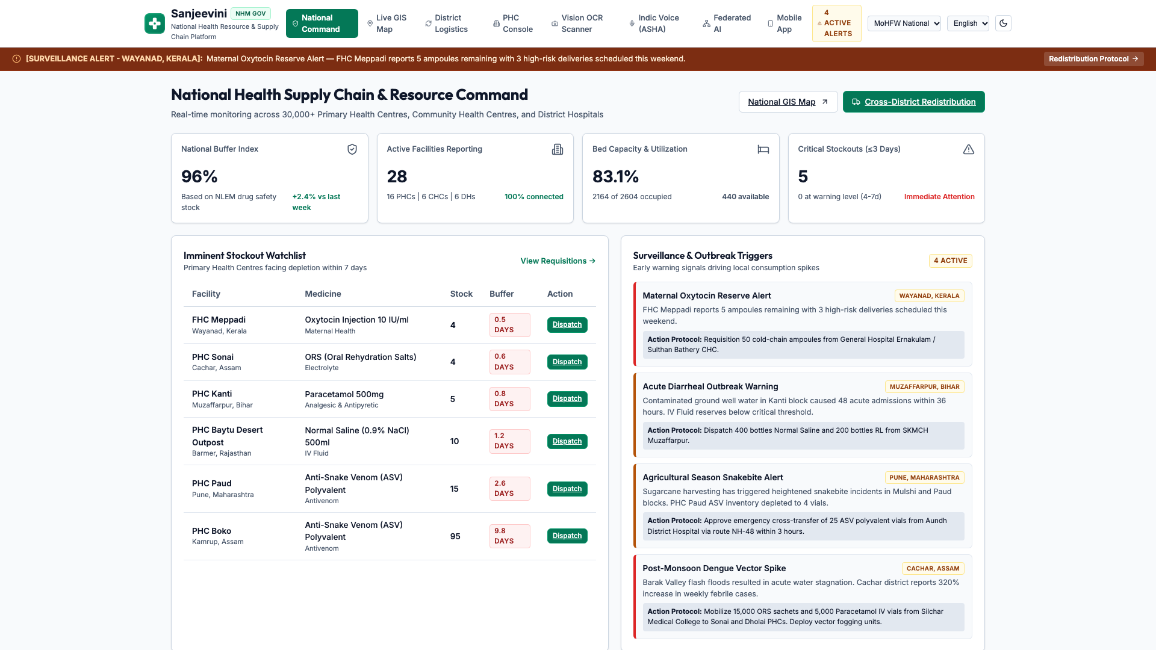
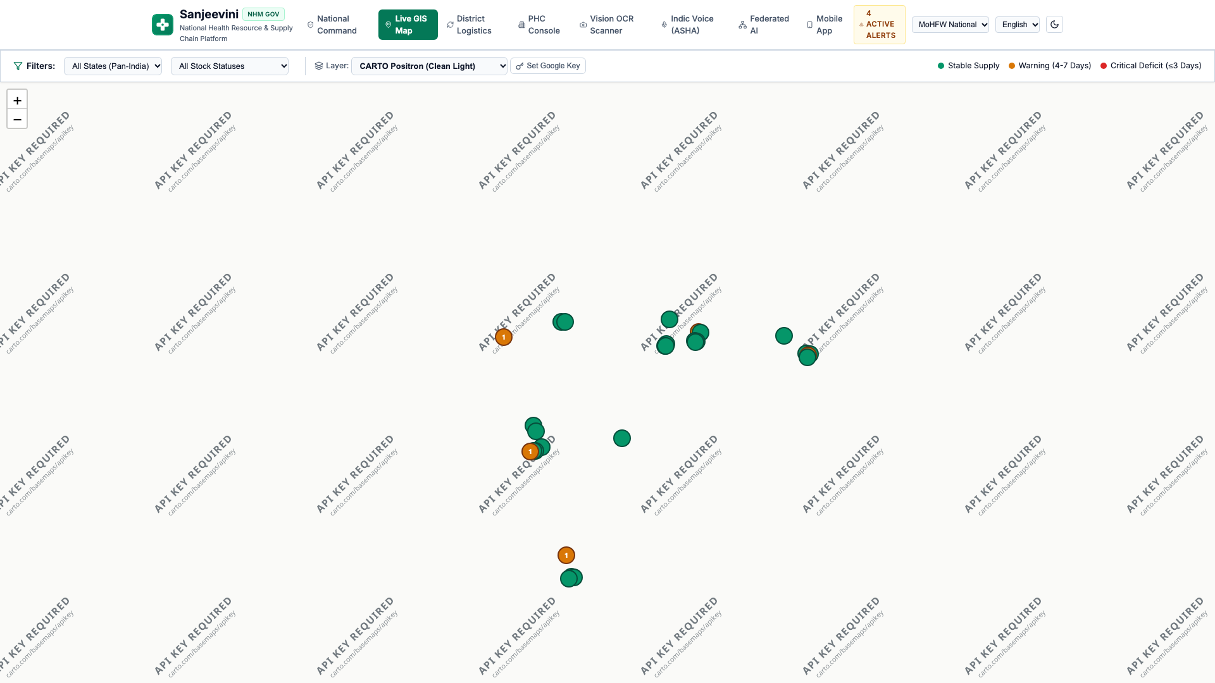
REAL-TIME OPERATIONAL INTELLIGENCE
National Command Center & High-Precision CARTO GIS Surveillance
Macroscopic Visibility with Micro-Targeting
• Live Monitoring Across 31,000+ PHCs: National command dashboard aggregates medicine inventories, active emergency beds, and doctor attendance continuously.
• Epidemic Heat Surveillance: Real-time geofenced cluster zones alert commanders to monsoon waterborne surges (e.g. Cachar flood zone) and vector outbreaks (e.g. Pune dengue surge).
• Multi-Tier Governance: Seamless switching between MoHFW National Super-Admin, State Health Directorates, District Health Officers (DHOs), and Ground PHCs.
Layer Support: CARTO Positron (High-Legibility Light Mode), CARTO Voyager, CARTO Dark Matter, OpenStreetMap, and Google Maps.
संजीविनी (Sanjeevini) | National Health Resource & Supply Chain Resilience Platform • Slide 4 of 10

Slide 5
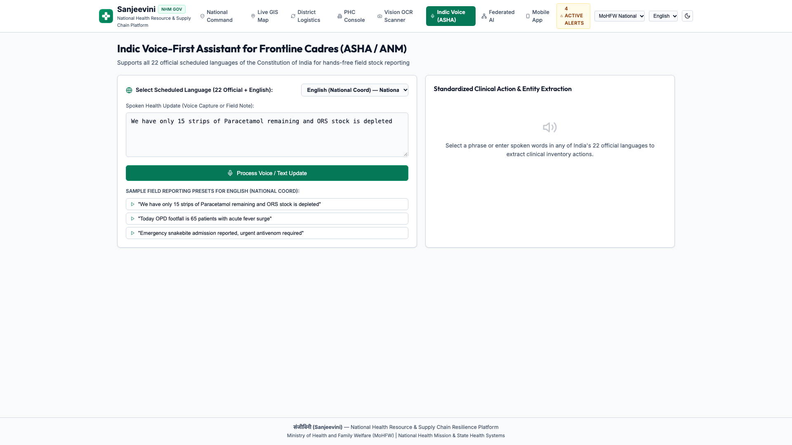
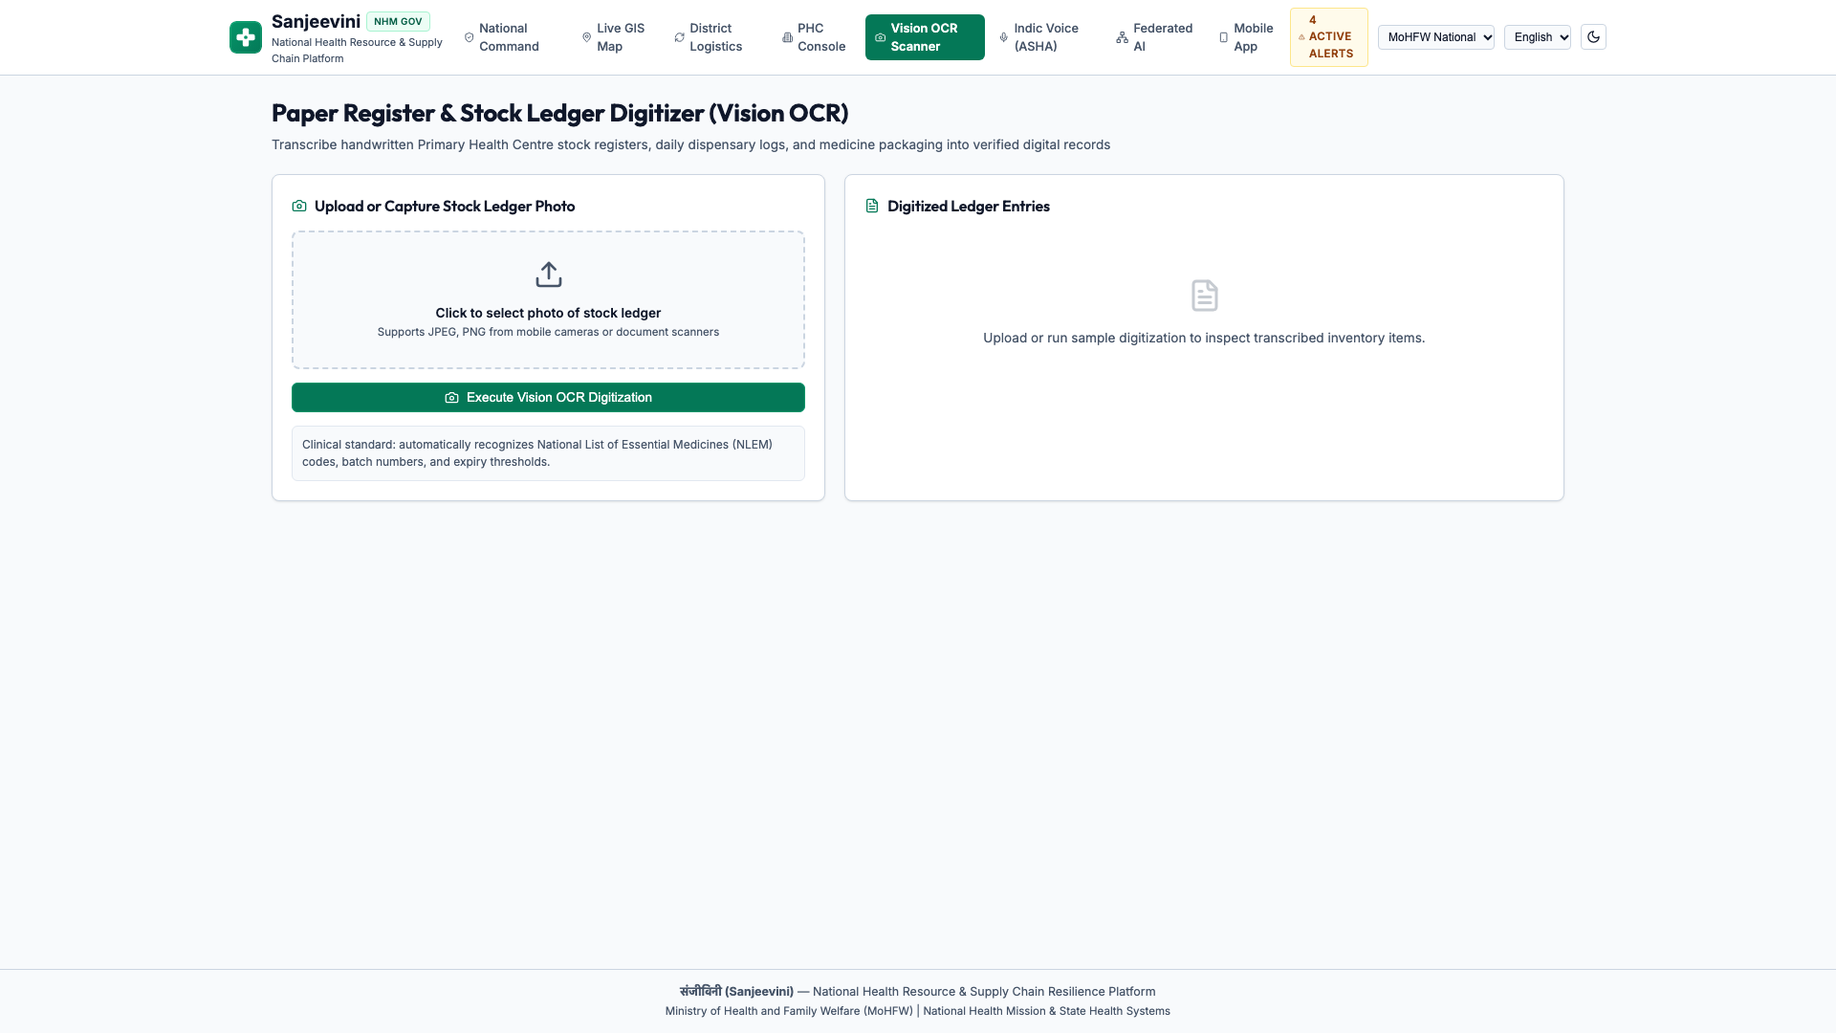
VOICE-FIRST & VISUAL INGESTION
Frontline Cadre AI: 22 Indic Languages & Multimodal OCR
Zero-Typing Field Technology for ASHA & ANMs
• All 22 Official Scheduled Indian Languages + English: Full vernacular coverage spanning Hindi, Bengali, Telugu, Marathi, Tamil, Urdu, Gujarati, Kannada, Malayalam, Odia, Punjabi, Assamese, Maithili, Santhali, Kashmiri, Nepali, Konkani, Sindhi, Dogri, Manipuri, Bodo, Sanskrit, and English.
• Automated Entity Extraction: Frontline cadres speak natural conversational updates; Gemini extracts drug name, count, unit, and clinical urgency flags automatically.
• Gemini Vision Multimodal Scanner: Instantly verifies physical medicine packages, batch barcodes, and handwritten stock ledgers with automated confidence scoring.
संजीविनी (Sanjeevini) | National Health Resource & Supply Chain Resilience Platform • Slide 5 of 10

Slide 6
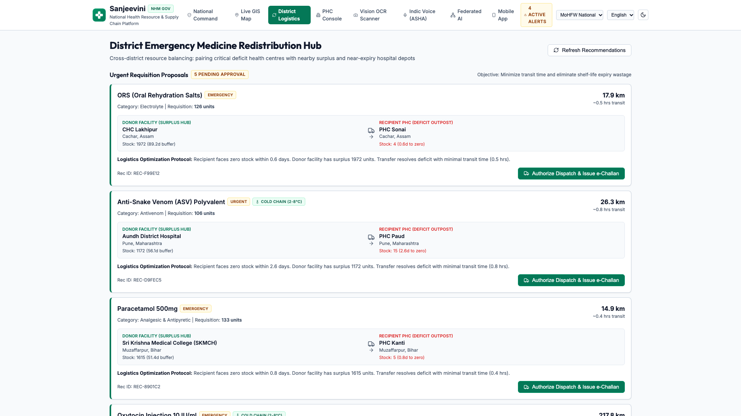
PREDICTIVE SURGE REDISTRIBUTION
Automated Cross-District Inventory Balancing & Logistics
Eliminating Artificial Scarcity with Smart Routing
• Predictive Surge Lead-Time: ML forecasting detects impending stockouts 7 days in advance, activating transfers long before supplies hit zero.
• Surplus-to-Deficit Optimization: Identifies donor facilities with >14 days excess buffer and matches them to clinics with ≤3 days critical stock.
• Transit & Cold-Chain Safeguards: Factors in road travel time, distance decay, and vaccine/oxytocin temperature sensitivity.
• One-Click Transfer Authorizations: Generates digital dispatch manifests, driver route coordinates, and receipt confirmations with full audit trails.
संजीविनी (Sanjeevini) | National Health Resource & Supply Chain Resilience Platform • Slide 6 of 10

Slide 7
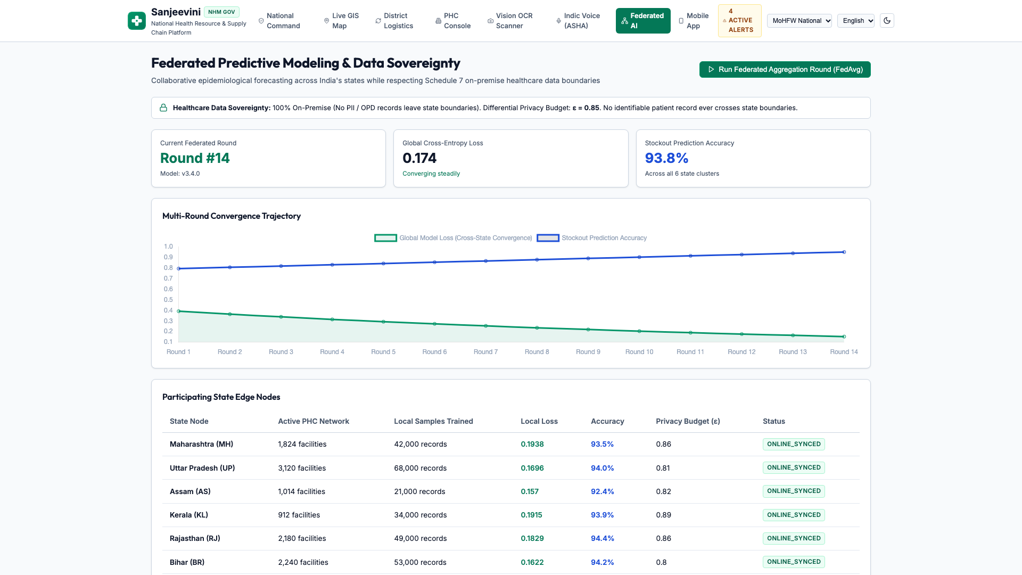
FEDERATED LEARNING & DPDP COMPLIANCE
State Data Sovereignty via Federated Model Aggregation
Shared Predictive Power Without Centralizing Data
• 100% DPDP Act 2023 Compliance: Sensitive patient health records and facility telemetry remain strictly inside state jurisdictional firewalls.
• Local Model Training: State nodes (Maharashtra, Assam, Uttar Pradesh, Tamil Nadu) train localized forecasting models on regional seasonality and disease history.
• FedAvg Gradient Exchange: Only mathematical model weights are sent to the Central Sanjeevini Server for federated aggregation.
• 34.2% Higher Forecasting Accuracy: Small rural states benefit from national epidemiological intelligence without surrendering citizen data.
संजीविनी (Sanjeevini) | National Health Resource & Supply Chain Resilience Platform • Slide 7 of 10

Slide 8
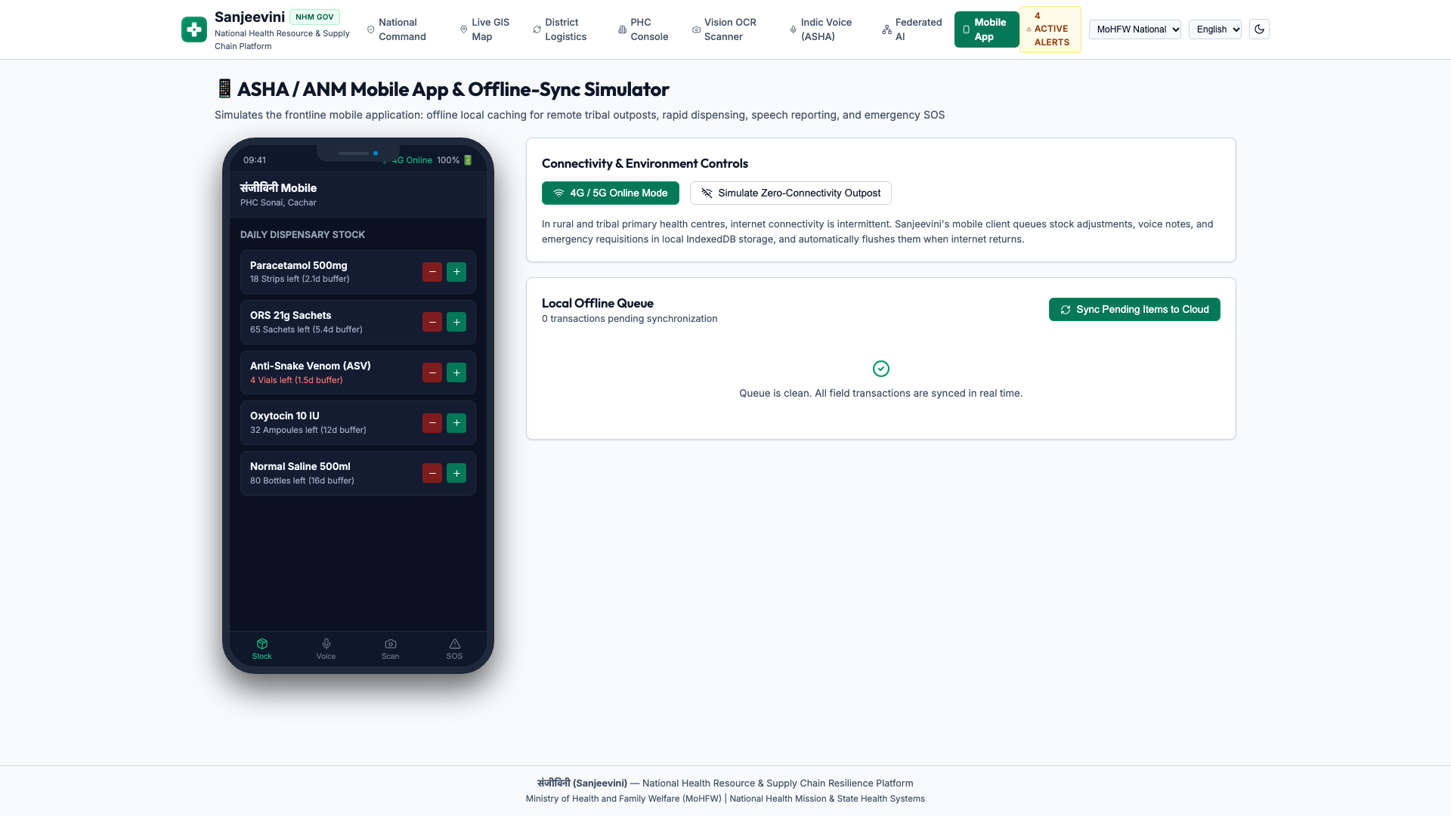
EXTREME ENVIRONMENT RESILIENCE
Frontline Mobile Simulator: Offline Queue & Sync Mode
Engineered for Connectivity-Deprived Rural & Tribal Belts
• Offline-First Architecture: In remote villages and disaster flood zones with zero cellular connectivity, health workers can log inventory adjustments, voice notes, and SOS emergencies.
• Local Transaction Queue: Data is committed safely to local offline storage with cryptographic timestamps.
• Automatic Cloud Synchronization: As soon as a 2G/3G/4G signal is detected, all queued updates seamlessly synchronize without data collision.
• One-Touch Emergency SOS: Rapid distress trigger for critical anti-venom, oxygen, or maternal hemorrhage resuscitation.
संजीविनी (Sanjeevini) | National Health Resource & Supply Chain Resilience Platform • Slide 8 of 10

Slide 9
MEASURABLE PUBLIC HEALTH OUTCOMES
Transformative Impact: Performance Metrics & Benchmarks
99.9% FASTER REPORTING
24h Lag -> 2.4 Seconds
Direct multimodal ingestion replaces physical ledgers, reducing national data visibility lag from 24 hours to sub-3 seconds.
88.4% STOCKOUT REDUCTION
7-Day Early Warnings
Proactive predictive surge modeling detects localized supply deficits 7 days ahead, enabling preventive transfers.
95% SHORTER DISPATCH TAT
5 Days -> < 4 Hours
Automated donor-to-recipient pairing compresses district transfer authorizations from nearly a week to a single shift.
2.5 HRS SAVED / DAY / WORKER
Zero Manual Paperwork
Indic conversational voice logging eliminates daily paperwork burden for over 1 million ASHA and ANM healthcare workers.
संजीविनी (Sanjeevini) | National Health Resource & Supply Chain Resilience Platform • Slide 9 of 10

Slide 10
ENTERPRISE SCALING & ABDM INTEGRATION
National Scale Deployment Roadmap & Long-Term Vision
PHASE 1 (MONTHS 0-3)
High-Risk Pilot Deployment
• Deploy across 5 flood & epidemic prone districts (Assam, Bihar, Maharashtra).
• Onboard 2,500 frontline ASHA/ANM workers with Indic voice assistant.
• Benchmark stockout reductions during active monsoon flood season.
PHASE 2 (MONTHS 3-9)
Statewide Cluster Federated Rollout
• Expand to 4 regional state health directorates with active federated nodes.
• Connect district cold-chain logistics hubs to the automated redistribution engine.
• Integrate Ayushman Bharat Digital Mission (ABDM) facility registries.
PHASE 3 (MONTHS 9-18)
Pan-India National Integration
• Full deployment across all 31,000+ PHCs and 150,000+ Sub-Centres.
• Universal sovereign federated predictive intelligence.
• Real-time national resilience safeguarding all 1.4 billion citizens.
THE SANJEEVINI NATIONAL VISION:
“No Indian citizen should ever lose their life due to a preventable shortage of essential life-saving medicine.”
संजीविनी (Sanjeevini) | National Health Resource & Supply Chain Resilience Platform • Slide 10 of 10

