Slide 1
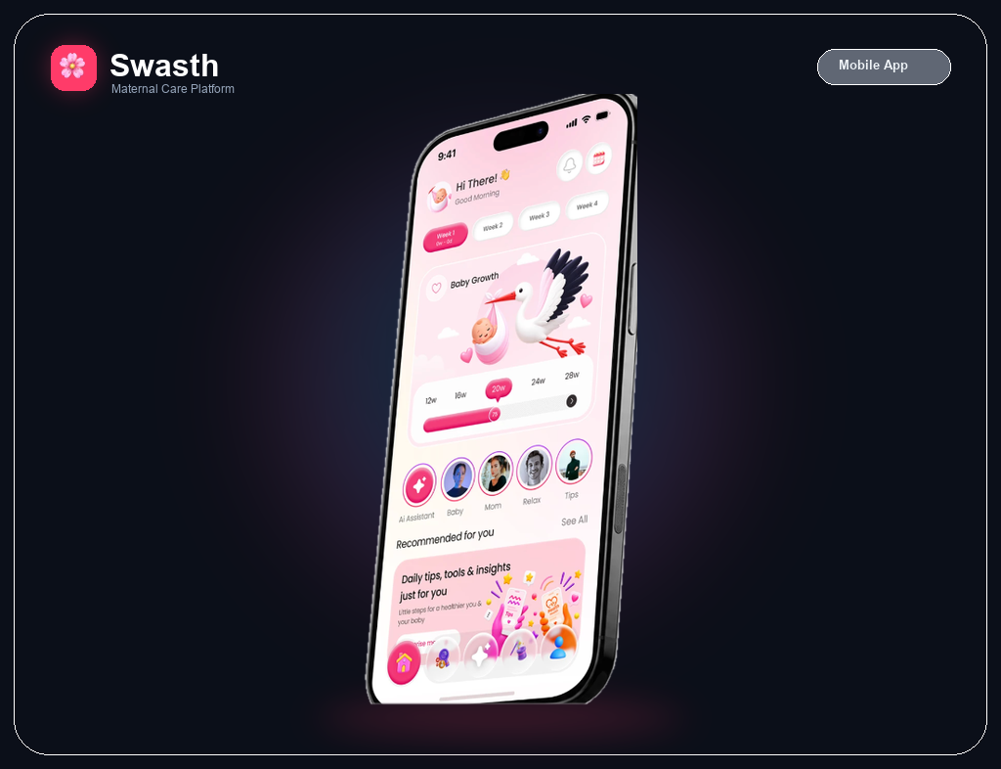
SWASTH (Maternal Health)
Track Every Moment with Care: From Pregnancy to the First 1,000 Days
Maternal & Women's Health Track | Patient & Caregiver Long-Term Engagement
• Modern 3D Stage Progress: Week-by-week fetal growth, trimesters & investigation schedulers
• Daily Garbh Sanskar Rituals: IQ, EQ, PQ, SQ micro-activities & soothing raga lullabies
• Hyperlocal Birth Clubs: Community peer circles with NeMo Guardrails safety moderation
• Multilingual Caregiver Sync: Voice & WhatsApp alerts for partners & elders in native dialects
• 24/7 Offline Sync: Zero data loss even without internet connectivity

Slide 2
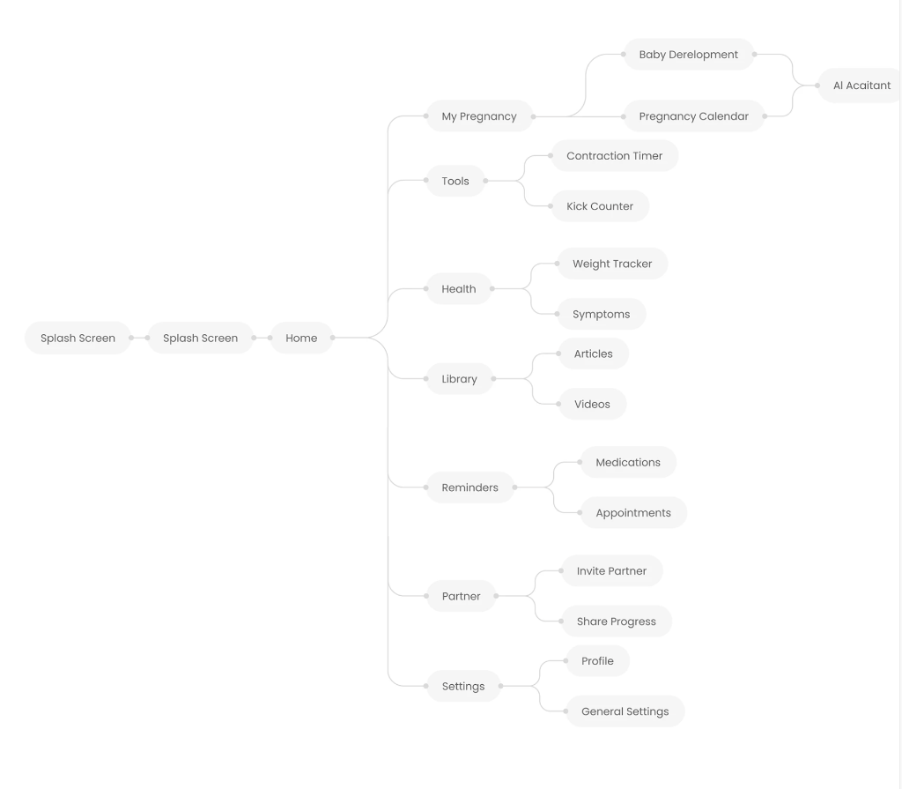
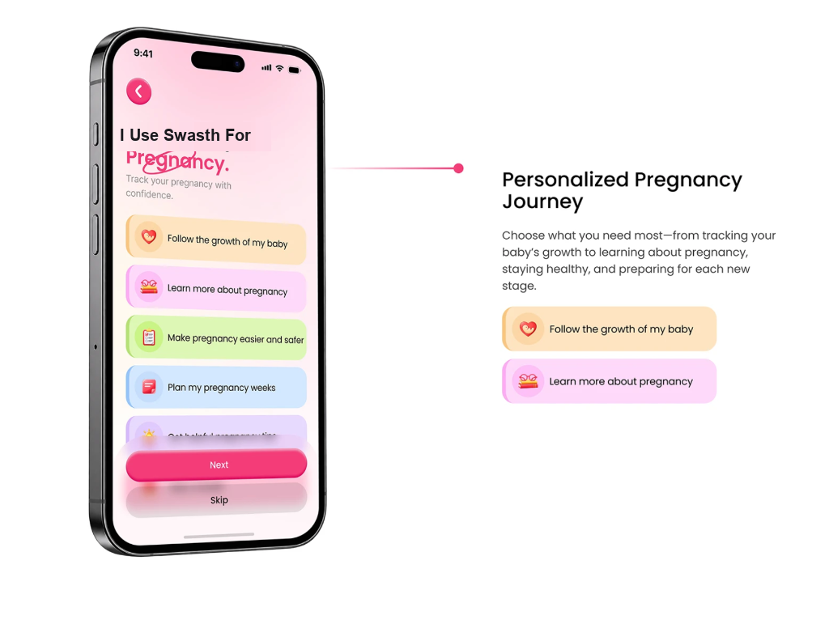
SWASTH · APP DESIGN & USER JOURNEY
App Information Architecture & Complete User Journey
CORE FLOW
Onboarding Intent
Follow baby growth, learn tips, and plan weeks safely.
Home & 3D Stage
Trimesters, baby size, daily 4Q rituals, and clinic slots.
Smart Tools
Contraction timer, kick counter, MCP card photo scanner.
Birth Clubs
Peer circles with NeMo Guardrails moderation.
Caregiver Hub
Partner sync via WhatsApp & voice alerts in dialects.

Slide 3
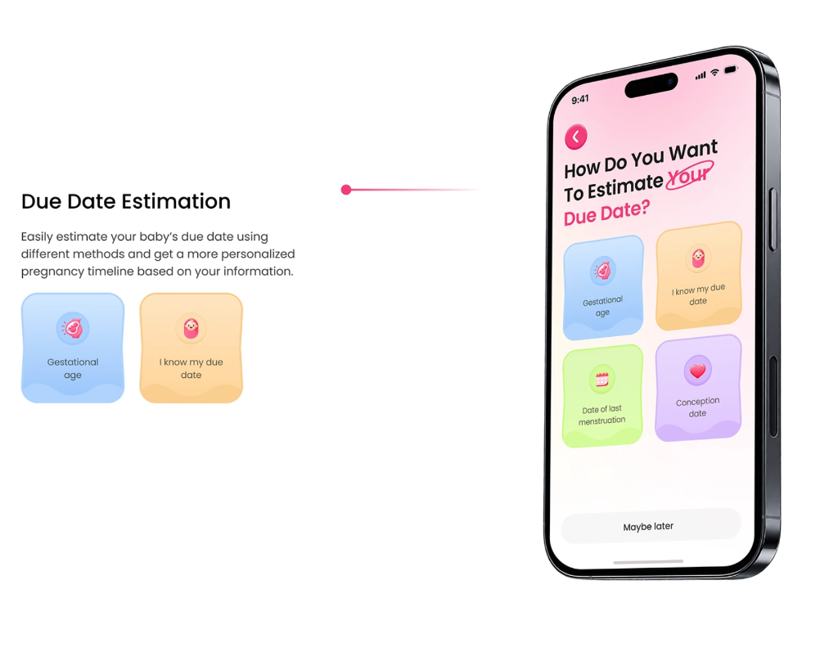
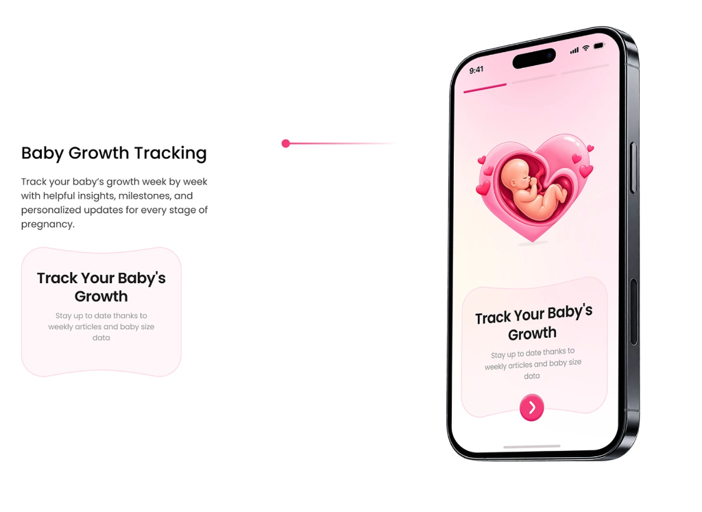
SWASTH · APP DESIGN & USER JOURNEY
Modern Design System: 3D Micro-Interactions & Due Date Setup
DESIGN HIGHLIGHTS
Flexible Due Date Estimation
Supports Gestational age, LMP date, Conception date, or manual due date.
Tactile 3D Visuals
Apple/peach baby size comparisons & joyful floating heart milestones.
Soft Pastel Tones
Warm rose (#E93B67) and lavender to eliminate clinical stress.
Caregiver First
Simple large buttons designed for low digital literacy.

Slide 4
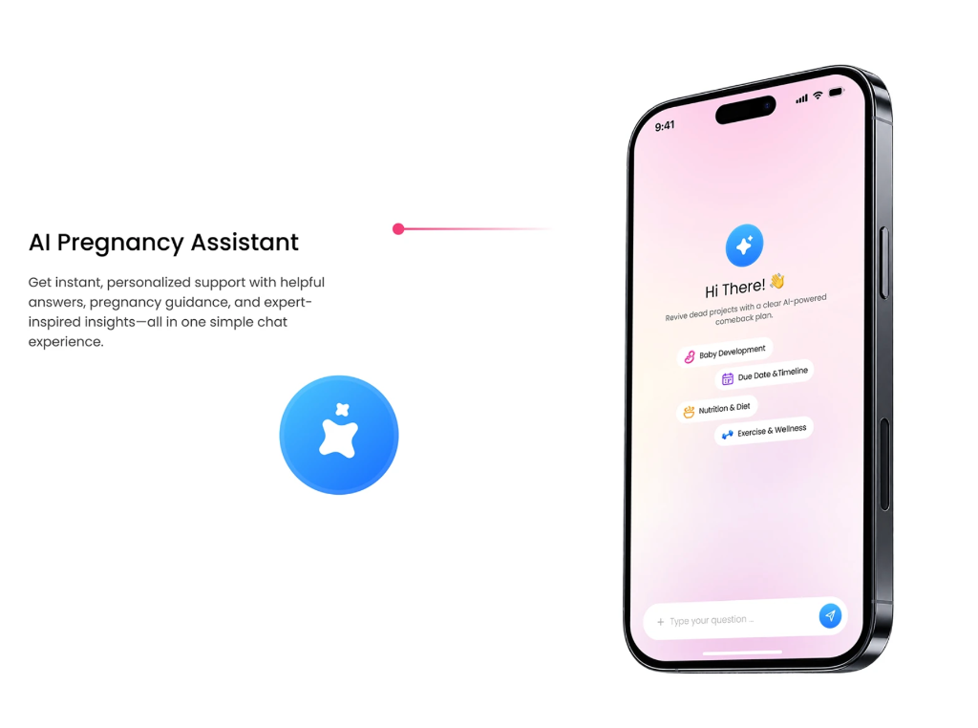
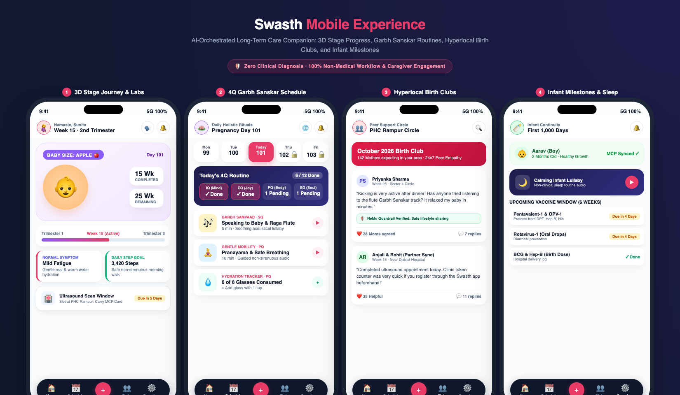
SWASTH · APP DESIGN & USER JOURNEY
AI Assistant Chat & Signature Experiences (Strictly Non-Clinical)
CORE EXPERIENCES
AI Companion Chat
NeMo Guardrail verified non-medical chat: Nutrition, timeline & wellness.
3D Stage Journey
Trimester rail, Apple-size fetal progress, ultrasound appointments.
4Q Garbh Sanskar
Daily 12 micro-habits & calming raga lullabies.
Birth Clubs
Hyperlocal mother circles with peer safety moderation.

Slide 5
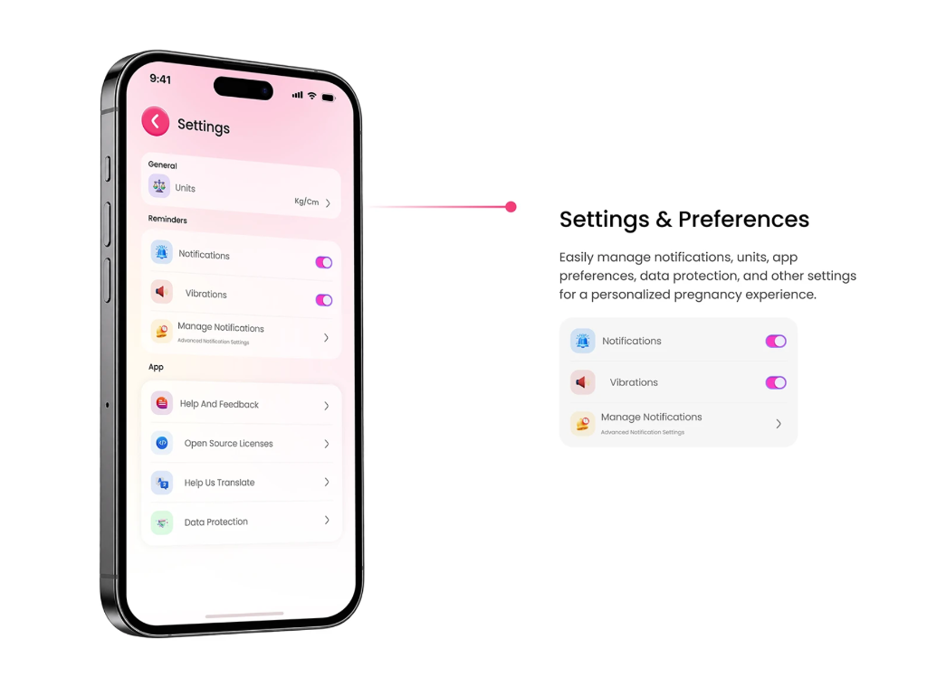
SWASTH · APP DESIGN & USER JOURNEY
Enterprise Architecture, Data Protection & 60-90 Day Impact
Unified Open-Source Stack
• Flutter Mobile App: Native 60-120 FPS iOS & Android with encrypted offline sync.
• React/TypeScript Web: Backup portal for care coordinators.
• Python (FastAPI): Single unified REST & WebSockets backend.
• NVIDIA Nemotron / Llama 3: Open-weights models served on vLLM with PagedAttention.
• Indic NLP: Open-source Whisper & AI4Bharat IndicTrans2 for 10+ Indian languages.
• Enterprise PostgreSQL: Row-level security & immutable audit trail.
Safety & 60-90 Day Impact
• 0% Diagnostic Advice: Strictly non-medical.
• NVIDIA NeMo Guardrails: Intercepts symptoms and routes to PHC emergency.
• Human-in-the-Loop: Clinicians review milestone rosters with 1-click approvals.
• 85% Drop in Admin Burden: Cuts manual ASHA/ANM due-list compilation to <1.5 hrs/week.
• 90%+ Vaccine Adherence: Reduces 6 to 14-week infant immunization dropouts.
• 4x Higher Engagement: Birth Clubs & caregiver WhatsApp synchronization.

