Slide 1
SWASTH (मातृ-स्वास्थ्य)
AI-Powered Multilingual Long-Term Care Companion, Birth Clubs & Continuity Platform
Maternal & Women's Health Track | Primary User: Patient & Caregiver | Use Case: Long-Term Care Engagement
• Daily Garbh Sanskar Micro-Activities • Hyperlocal Birth Clubs & Peer Support Circles
• Multilingual Caregiver Sync (Hindi, Malayalam, Tamil) • 24/7 Offline Access • Zero Diagnostic Risk
• Enterprise Open-Source Stack: Flutter + React + Python FastAPI + NVIDIA Nemotron / Llama 3 + PostgreSQL

Slide 2
SWASTH · MATERNAL & WOMEN'S HEALTH
The Unseen Crisis: Why Long-Term Maternal Care Breaks Down
The Post-Discharge Cliff
Maternal and infant care requires 1,000+ days across 4 ANC checks, delivery, and 7 vaccine cohorts.
Yet, over 25-30% of mothers and infants drop out of scheduled milestones within months after hospital discharge.
Administrative Overload & Isolation
Dropouts are rarely due to medical negligence—they stem from administrative friction and emotional isolation.
Caregivers navigate fragile paper MCP cards, unclear clinic timings, and lack peer circles in their neighborhood.
The 'Clinical App' Trap
Conventional health apps fail because they are cold and transactional. Patients open them only when an alert fires, leading to 80%+ abandonment in 30 days.
Without daily cultural rituals and peer community, long-term continuity collapses.

Slide 3
SWASTH · MATERNAL & WOMEN'S HEALTH
The Solution: Swasth's 'Daily Hook & Care Bridge' Engine
THE DAILY ENGAGEMENT HOOK
Garbh Sanskar Rituals & Hyperlocal Birth Clubs
• Daily 4Q Holistic Activities: 12 daily micro-habits across IQ, EQ (emotional), PQ (prenatal mobility), and SQ (spiritual calming).
• Hyperlocal Birth Clubs: Cohort circles based on expected delivery month and neighborhood/PHC radius for peer sharing and empathy.
• Garbh Samvaad & Raga Music: Soothing maternal lullabies, positive affirmations, and partner speaking sessions.
• Guardrail Moderation: NeMo AI guards peer questions against misinformation, instantly directing clinical symptoms to doctors.
THE HEALTHCARE CONTINUITY BRIDGE
Vaccination, Diet & Caregiver Continuity
• Smart Vaccine Tracker: Automates 6, 10, 14-week and 9-month immunization schedules with vernacular voice reminders.
• Stage Weaning & Diet Plans: Doctor-approved month-by-month infant food charts and maternal lactation nutrition.
• Family & Caregiver Sync: Syncs reminders with partners, grandmothers, and local ASHA/ANMs via WhatsApp and voice.
• 24/7 Offline Sync: Functions completely without internet, syncing encrypted data when signal resumes.
• Strict Non-Clinical Boundary: 0% diagnostic advice. Symptoms immediately route to primary health center emergency channels.

Slide 4
SWASTH · MATERNAL & WOMEN'S HEALTH
Full Alignment with SWASTH's 6 Core Pillars
01. Care Journey Companion
Stage-aware guidance tailored across planning, trimester weeks, and 0-24 month infancy. Clear guidance on what to prepare and when to visit.
02. Long-Term Engagement
Sustained adherence over months & years via Garbh Sanskar daily micro-habits, birth club peer communities, and milestone streaks.
03. Family & Caregiver Support
Caregiver synchronization tools empowering husbands and elders with localized voice/WhatsApp alerts, reducing stress on the mother.
04. Healthcare Navigation
Clear operational next steps across clinic token counters, lab tests, ultrasound schedules, and PHC-to-District referral handoffs.
05. Financial & Admin Support
Simplifies maternity schemes (PMMVY, JSY, JSSK) and hospital documentation so financial paperwork never delays care.
06. Longitudinal Journey Progress
A simple, visual timeline of completed, pending, and upcoming clinical and developmental milestones at a single glance.

Slide 5
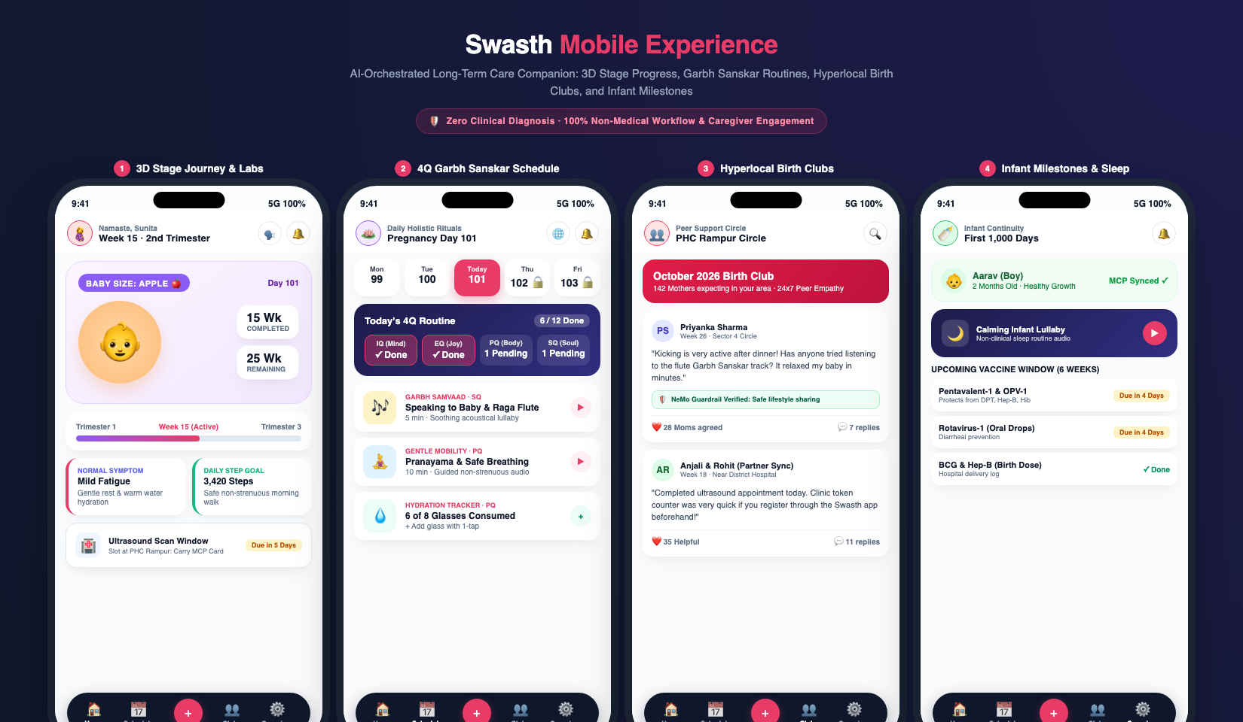
SWASTH · MATERNAL & WOMEN'S HEALTH
App Design Showcase: Daily Rituals, Tools & Birth Clubs
CORE SCREENS SHOWCASED
1. Daily 4Q Schedule
12 daily activities across IQ, EQ, PQ, and SQ with day-by-day progress tracking.
2. Smart Tools & Scanner
Quick access to MCP card scanner, water tracker, steps walk, and scheme aids.
3. Hyperlocal Birth Clubs
Connecting mothers in nearby PHC circles with AI guardrail-moderated peer sharing.
4. Vaccine & Diet Tracker
Upcoming 6/10/14-week vaccine cohorts and doctor-approved stage weaning meals.

Slide 6
SWASTH · MATERNAL & WOMEN'S HEALTH
Enterprise Open-Source Architecture: Speed & Reliability
Client Layer
Flutter Mobile App
(iOS & Android native 60 FPS)
+ React/TypeScript Web backup
Encrypted local offline store.
Single Unified API
Python (FastAPI)
Async microservices, REST & WebSockets, ABHA ID auth, sub-5ms indexed response times.
Agent Orchestration
LangChain / LangGraph
vLLM-accelerated open-weights models:
NVIDIA Nemotron / Llama 3 for sub-second milestone mapping.
Multilingual Voice
Open-source Whisper &
AI4Bharat IndicTrans2 / Bhashini
Native support for 10+ Indic languages and voice notes.
Data & Audit Ledger
Enterprise PostgreSQL
Encrypted row-level security, patient records, and append-only compliance audit trail.

Slide 7
SWASTH · MATERNAL & WOMEN'S HEALTH
Clinical Safety: Zero Diagnostic Risk & Guardrail Moderation
Strict Non-Clinical Boundary
• 0% Diagnostic Advice: Never provides medical risk scores, diagnostic labels, or lab test interpretations.
• 0% Treatment Prescriptions: Never suggests medications, dosage changes, or clinical therapies.
• Non-Clinical Scope: Limited strictly to administrative scheduling, nutrition reminders, non-strenuous lifestyle, and welfare schemes.
NVIDIA NeMo Guardrails
• Real-time semantic guardrails run directly in memory on every user prompt and response.
• Symptom Interception: If a mother mentions clinical symptoms (e.g. bleeding, severe pain, high fever), NeMo immediately halts automation.
• Safe Direct Protocol: Instantly delivers emergency clinic helpline numbers and maps nearest PHC.
Human-in-the-Loop & Auditability
• Clinician & ANM Oversight: Frontline staff review milestone rosters and due-lists with 1-click approvals.
• Append-Only Audit Trail: Every AI-generated recommendation, user interaction, and clinic override is permanently logged in PostgreSQL.
• Full Patient & Family Consent: Caregiver synchronization requires explicit verification.

Slide 8
SWASTH · MATERNAL & WOMEN'S HEALTH
Measurable Operational Outcomes within 60–90 Days
85% Drop
Frontline Admin Burden
Reduces ASHA/ANM time spent tallying paper due-lists from 10 hrs to <1.5 hrs/week.
90%+ Retention
Immunization Milestones
Reduces 6 to 14-week infant vaccine dropouts through localized caregiver voice alerts.
4x Higher
Caregiver & Peer Activity
Birth Clubs & WhatsApp synchronization drive proactive family and community involvement.
100% Safe
Regulatory Compliance
Full audit logging and zero unreviewed clinical recommendations.
EXECUTION & ROLLOUT ROADMAP
➔ Day 1–30 (Prototype & Guardrail Audit): Deploy Flutter mobile client + Python backend; benchmark open-source Nemotron on vLLM; validate NeMo non-clinical guardrails.
➔ Day 31–60 (Pilot with 5 PHCs & Birth Clubs): Onboard 500 expectant mothers & caregivers; launch 5 localized Birth Clubs; track daily Garbh Sanskar engagement and vaccine adherence.
➔ Day 61–90 (Longitudinal Scaling & Portal Integration): Synchronize with state HMIS/RCH registers; export verified administrative audit reports; expand vernacular voice models into 10+ dialects.

