Slide 1


Team Details
  Team name: OWLabs
  Team leader name: Chirag HS
  Problem Statement: Manufacturing: Intelligent Operations & Industrial Efficiency

Slide 2
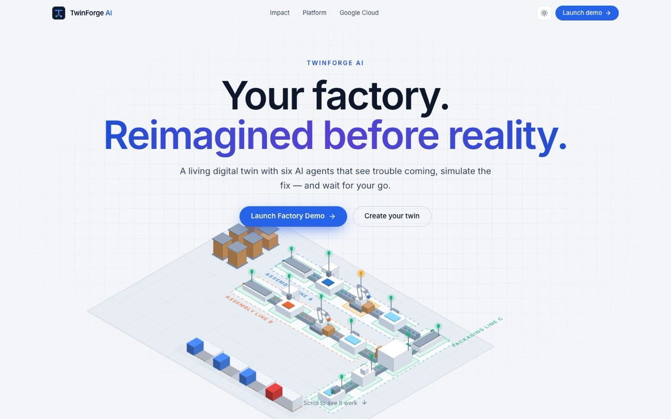



Brief about the idea
TwinForge AI
Your factory. Reimagined before reality.
TwinForge AI is a Google Cloud-powered industrial digital twin that connects factory operations, AI agents, and deterministic simulation to help manufacturers predict, optimize, and act with confidence.
Four intelligent capabilities.
• Predictive Maintenance — Anticipate equipment failures before they disrupt production.
• Demand Forecasting — Predict demand and optimize production plans.
• Supply Chain Intelligence — Identify disruptions and optimize materials, inventory, and deliveries.
• Visual Quality Inspection — Detect defects, improve first-pass yield, and reduce quality losses.
See. Understand. Simulate. Act.
Explore a live digital twin, investigate incidents with specialist AI agents, simulate alternative scenarios, and execute approved actions only after human authorization.
OUR PRINCIPLE
Language models explain, extract and orchestrate.
Numbers come from configured rules.
Suggestions come from the ontology.
Decisions come from people.

Slide 3



Opportunities
How is it different?
How will it solve the problem?
USP of the solution
Not a monitoring dashboard: the twin simulates forward, so options are compared before the plant changes.
Not a chatbot that guesses: agents compute every figure on a deterministic plant engine and show the evidence.
Not months of modelling: the Twin Builder drafts a twin from a drawing and a plain-language description.
Today, health, quality, materials and orders sit in separate systems, and comparing options by hand takes hours.
TwinForge joins them in one live twin, predicts trouble early and ranks plans on delivery, cost, risk and sustainability.
Demo crisis: the recommended plan avoids about 700 late units at about a quarter of the cost of carrying on (model estimates).
Models explain, configured rules compute, ontology suggests, people decide: every figure the AI states is checked against configured rules.
A person approves every plan, with rollback and a full audit trail; there is no control path to equipment.
Open by design: the same 12 tools are served over MCP, so other agents can use the twin, and still only propose.

Slide 4









List of features offered by the solution
Command Center
AI Operations
What-If Simulator
OEE, output, machine health, energy, scrap, shortages and delivery risk on one screen.
Predictive Maintenance to anticipate equipment failures, Demand Forecasting to optimize production planning, and Supply Chain Intelligence to identify disruptions.
Compare plans on more than ten levers; results recalculate instantly in the browser.
Digital Twin Studio
Approvals and audit
Visual Quality and CCTV
Topology, isometric, floor-plan and real-time 3D views of one live twin.
A person approves, the twin executes, and every step is recorded and reversible.
FPY, DPMO and defect Pareto, nine cameras, and AI visual checks a person confirms.
Twin Builder
Playground
Copilot on ADK + MCP
From a floor plan and a description to a running twin, with provenance on every element.
Drag machines and robots onto the floor, set automation rules, preview in 3D and apply.
Multi-agent copilot with visible tool calls; the same 12 tools are served over MCP.

Slide 5
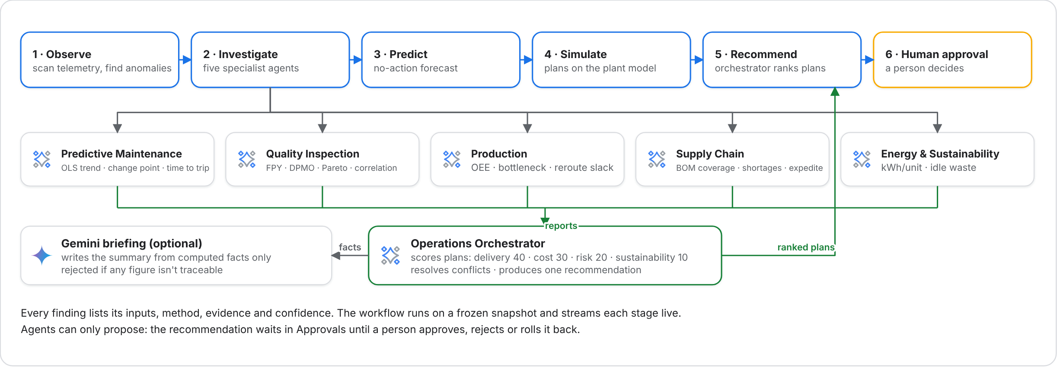
Process flow diagram or Use-case diagram
After approval
Execute the twin runs the plan as directives over simulated time
Audit every step recorded with links; any step can be rolled back

Slide 6
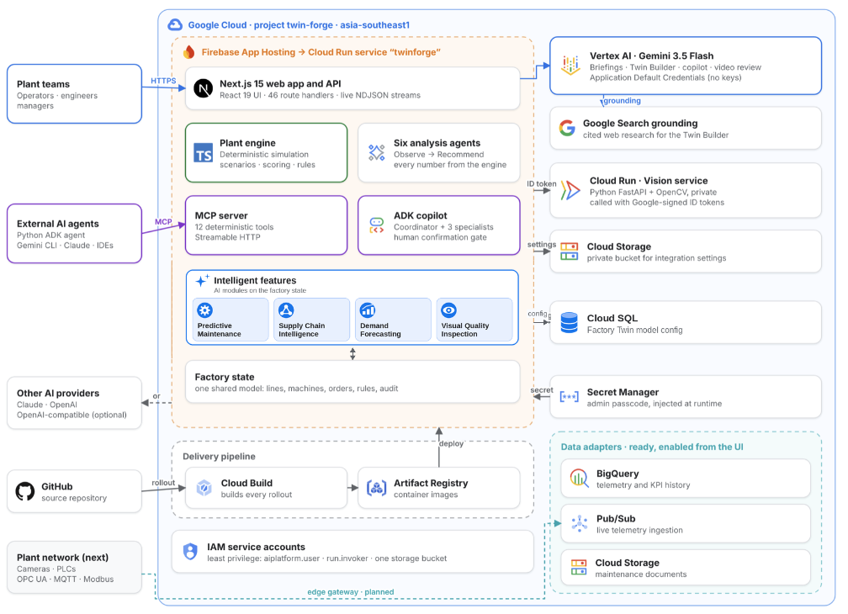
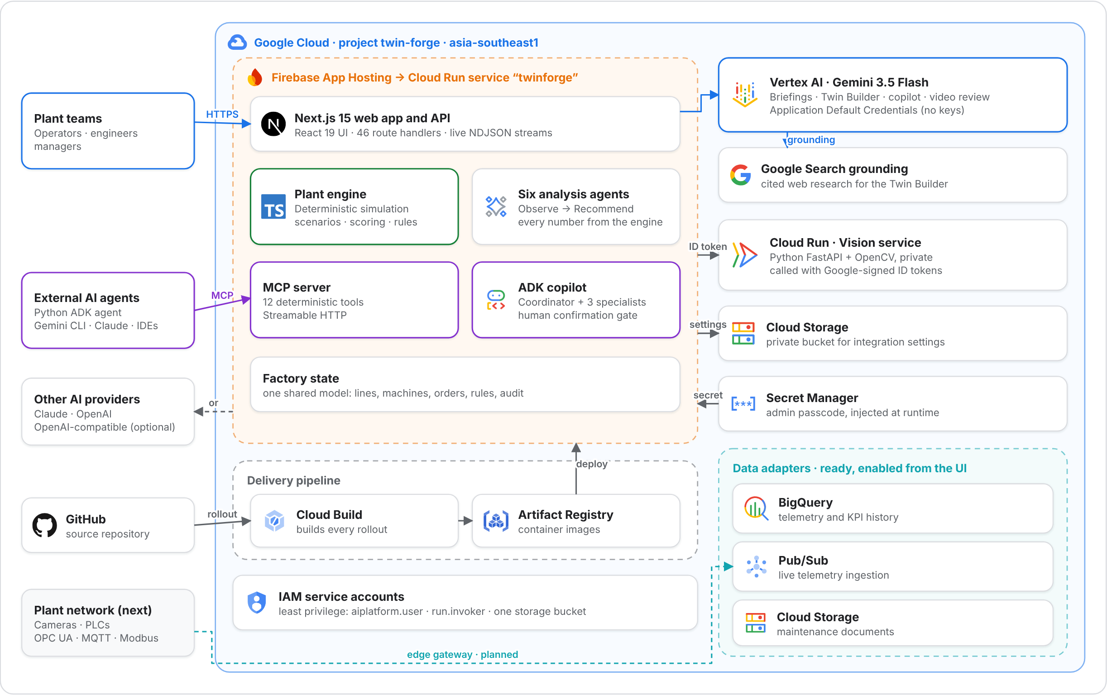
Architecture diagram of the proposed solution
One service
Next.js on Firebase App Hosting (Cloud Run) runs the UI, API, plant engine, ADK copilot and MCP server.
Gemini on Vertex AI
Gemini 3.5 Flash through Application Default Credentials, so no API keys.
Private vision
FastAPI + OpenCV on Cloud Run, called with Google-signed ID tokens.
Secure by default
Secret Manager, a private Cloud Storage bucket and least-privilege IAM.
Ready to scale
BigQuery and Pub/Sub adapters built in; runs in asia-southeast1.

Slide 7
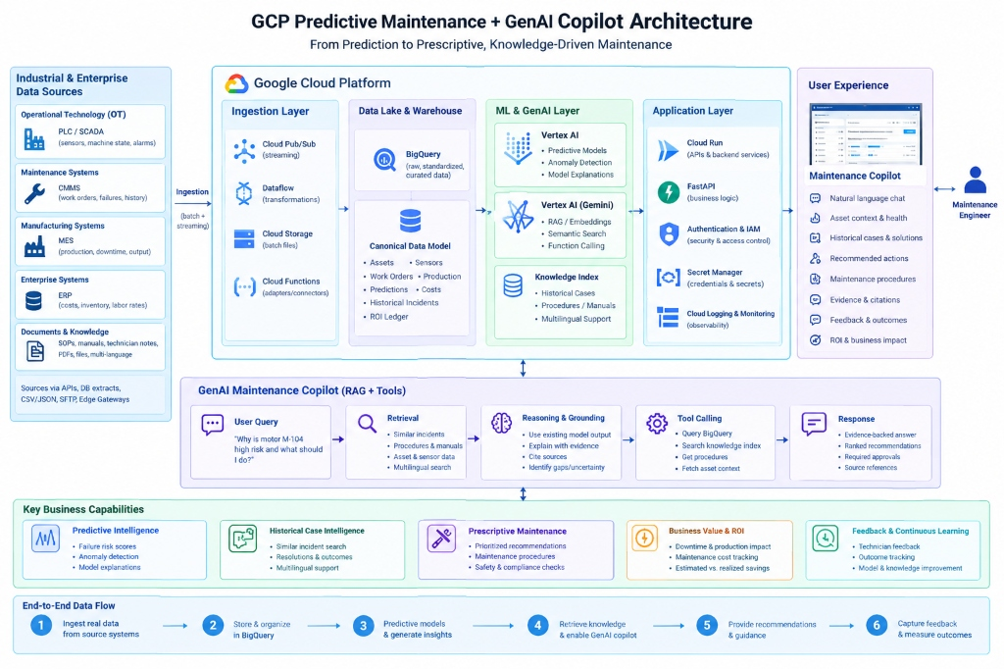
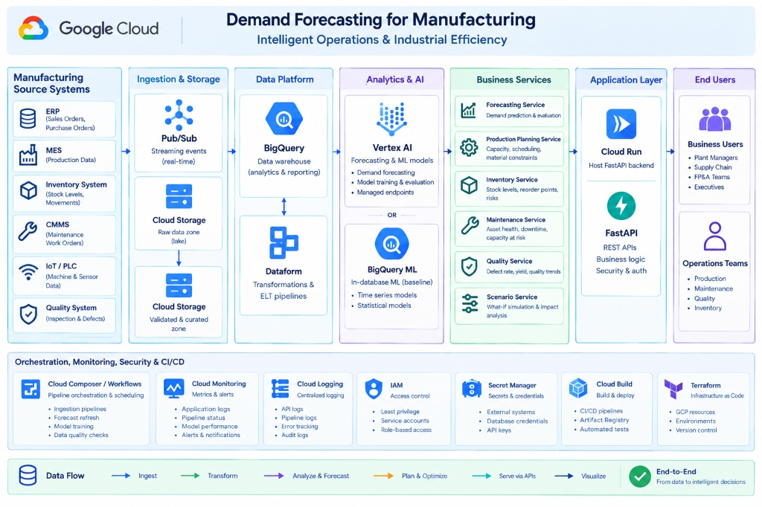
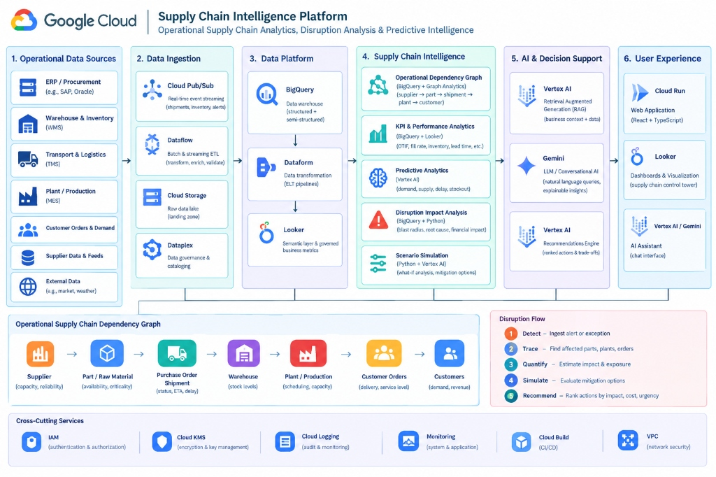
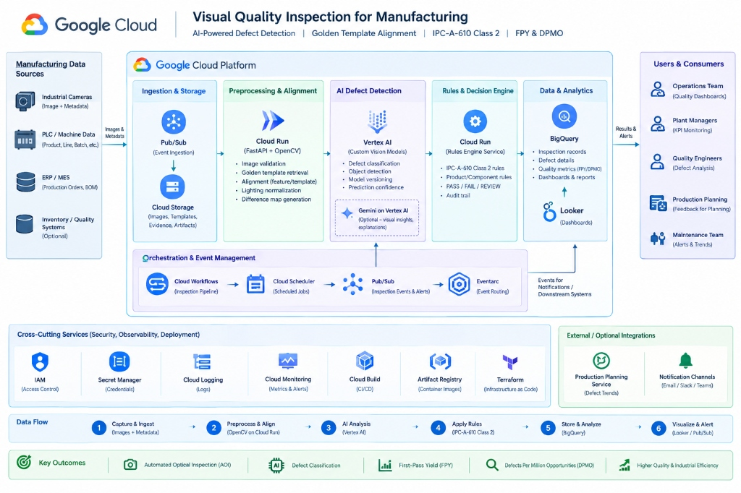
Architecture diagrams of individual features (1/2)

Slide 8
Architecture diagrams of individual features (2/2)

Slide 9


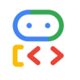



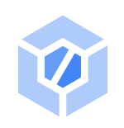
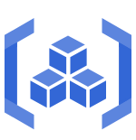
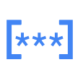




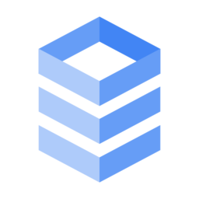

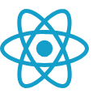
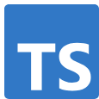


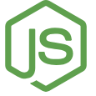

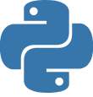

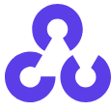
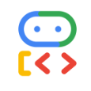


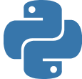

Technologies to be used in the solution
AI and agents
Vertex AI Gemini 3.5 Flash
Google Gen AI SDK
Agent Development Kit TypeScript + Python
Google Search grounding
Model Context Protocol
Google Cloud
Firebase App Hosting
Cloud Run
Cloud Build
Artifact Registry
Secret Manager
Cloud Storage
IAM
BigQuery
Pub/Sub
Cloud SQL
Web application
Next.js
React
TypeScript
Tailwind CSS
Zustand
Zod
React Flow
Recharts
Radix UI
Node.js
3D and media
three.js
React Three Fiber
drei
postprocessing
hls.js
Python services
Python
FastAPI
OpenCV
google-adk[mcp]
Testing
Vitest
Playwright
pytest
GitHub

Slide 10
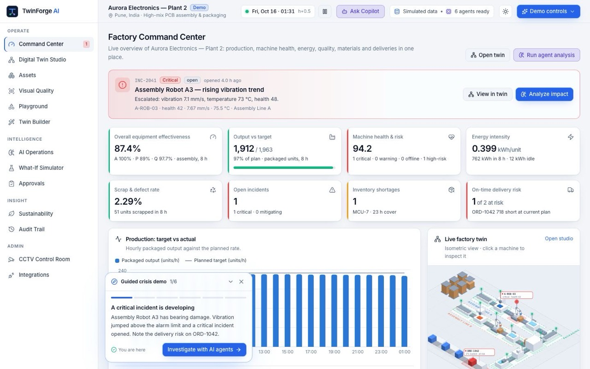
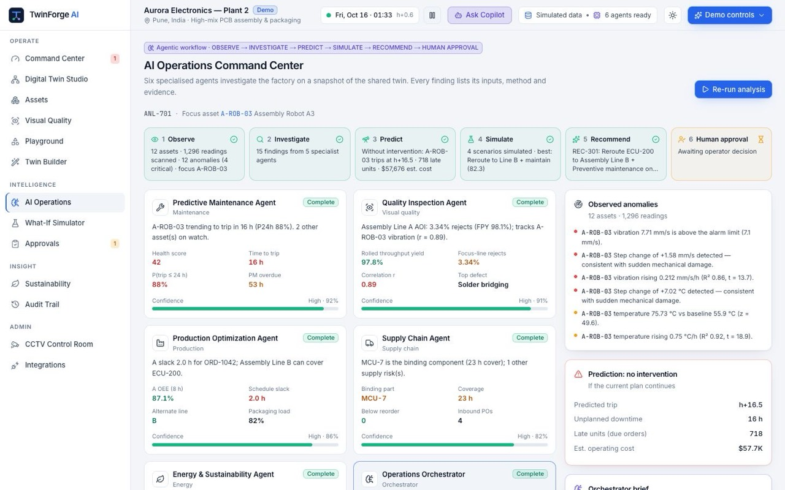
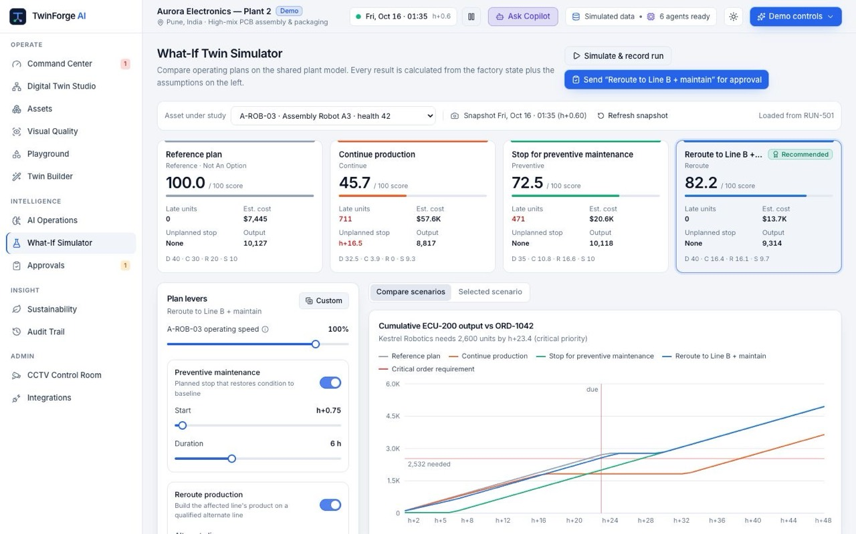
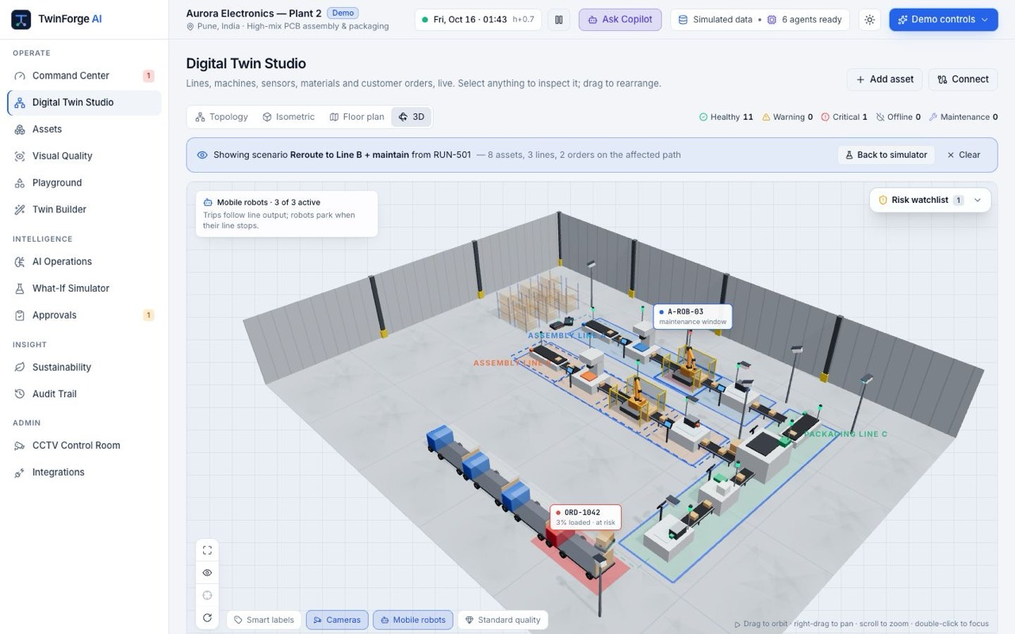
Snapshots of the prototype (1/2)
Command Center
The whole plant on one screen during the crisis, with the guided demo panel.
AI Operations
Six agents stream findings; a trip is predicted about 16 hours ahead.
What-If Simulator
Four plans compared; reroute to Line B + maintain scores 82.2 with no late units.
Digital Twin in 3D
Orbit the live plant; robots animate and the recommended path is highlighted.

Slide 11
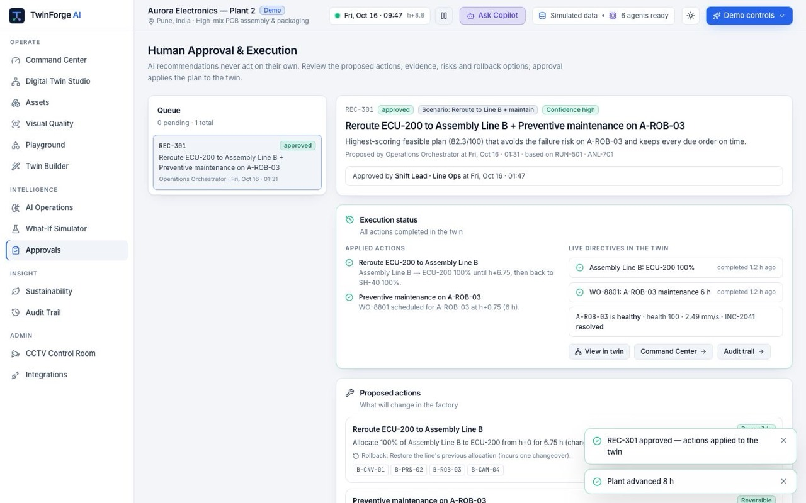
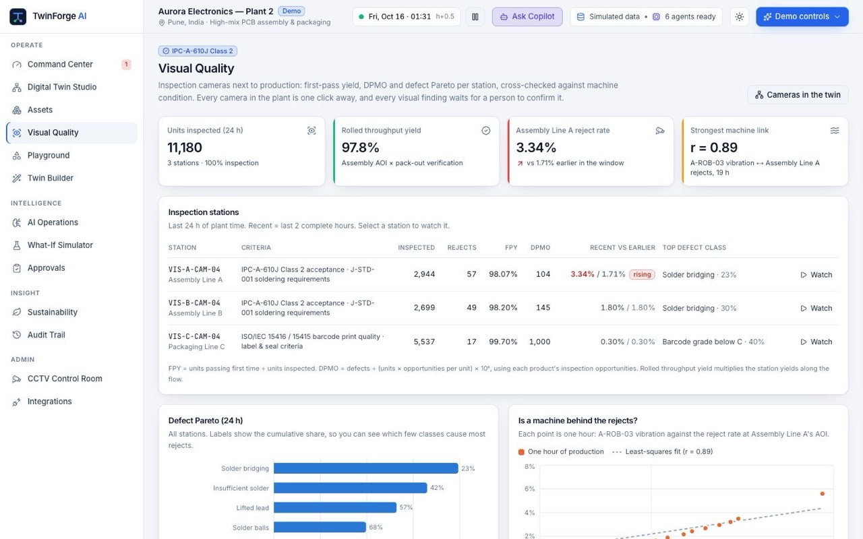
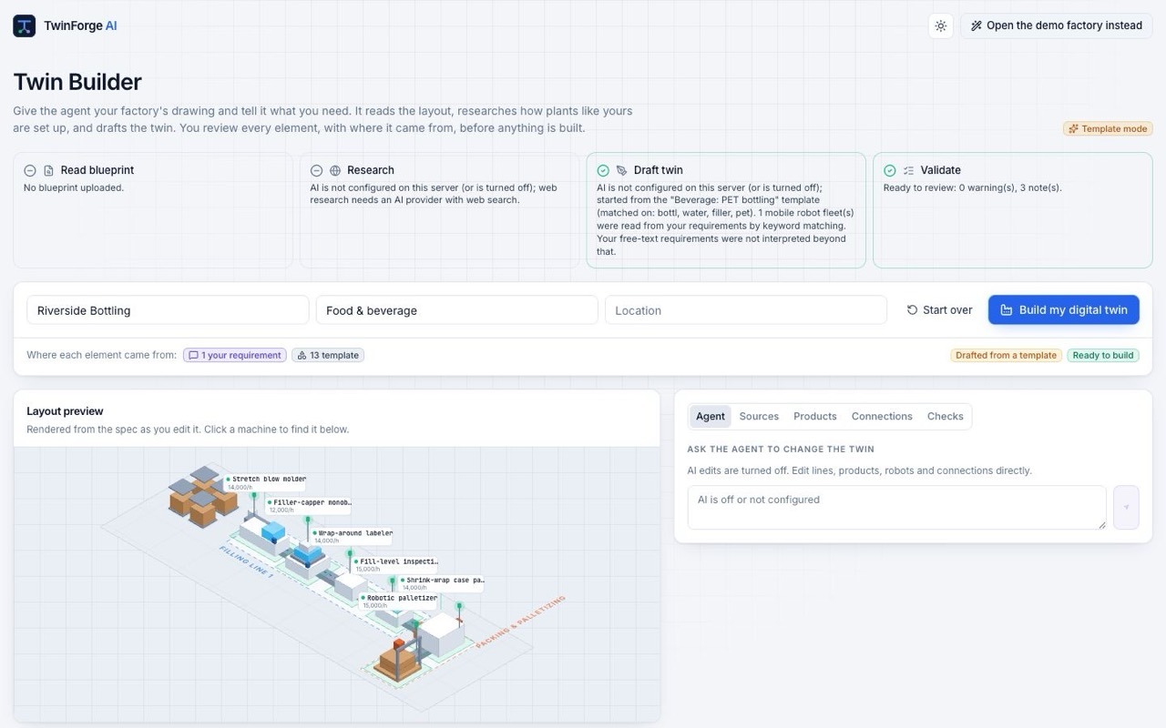
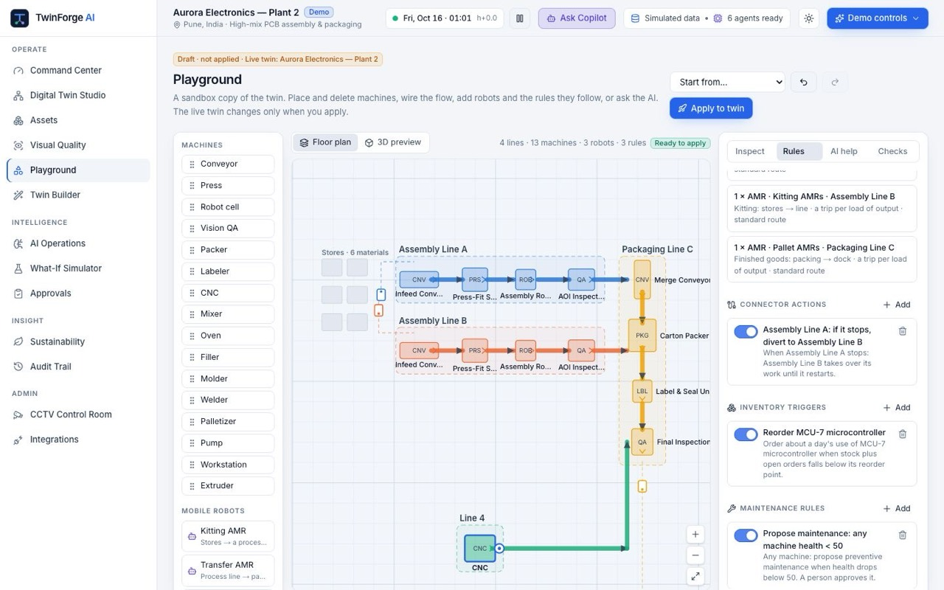
Snapshots of the prototype (2/2)
Approvals
The approved plan ran: Line B took over and the failing robot is healthy again.
Visual Quality
FPY, DPMO and defect Pareto; robot vibration tracks Line A rejects (r = 0.89).
Twin Builder
Review screen with stages, provenance counts and a live layout preview.
Playground
Place machines and robots on the floor and set automation rules.

Slide 12
Prototype Performance report/Benchmarking
Benchmark: plans compared on the twin in the demo crisis model estimates on demo data
Plan | Score / 100 | Late units | Estimated cost | Unplanned stop
Reference plan (asset assumed healthy) | 100.0 | 0 | $7.4K | None
Continue production | 45.7 | 711 | $57.6K | Trip at about h+16.5
Stop for preventive maintenance | 72.5 | 471 | $20.6K | None
Reroute to Line B + maintain (recommended) | 82.2 | 0 | $13.7K | None
Scores weight delivery 40, cost 30, risk 20 and sustainability 10 against the reference plan.
Measured on the live prototype
≈ 5.5 s
8–23 s
≈ 15 s
≈ 78 s
Gemini agent briefing
Copilot answer with tool calls
External Python ADK agent, 4 tool calls
Twin Builder draft with web research
Instant
19 / 19
30×
149
What-If recalculation, in the browser
Copilot figures traced to tool results
Live plant speed against real time
Automated tests: 117 unit, 16 E2E, 16 Python

Slide 13








Additional Details/Future Development (if any)
What comes next
Current scope
Multi-site
Firestore shared state, Firebase Auth sign-in and several factories per tenant.
Runs on a modelled plant with sample data, so results are estimates.
One factory per deployment; state is held per instance.
Live telemetry arrives through Pub/Sub today; OPC UA, Modbus, and MQTT require an edge gateway.
Camera footage in the demo is licensed video from other facilities.
Predictive Maintenance: Demonstrates equipment health monitoring and failure-risk predictions using available sample data.
Supply Chain Intelligence: Demonstrates supply chain visibility, disruption analysis, and recommendations using modelled data.
Demand Forecasting: Generates demand forecasts and production planning recommendations based on sample data.
Visual Quality Inspection: Demonstrates AI-assisted defect detection and quality metrics; inspection results require validation against real production images before operational use.
Plant connectivity
Edge gateway for OPC UA, Modbus and MQTT into Pub/Sub; camera analytics at the edge.
Learned inspection
Trained inspection models, validated with a measurement-system study before use.
A2A Enterprise and Cloud Scheduler
Cloud Scheduler drives the plant clock, with no instance cap; an Agent-to-Agent (A2A) endpoint enables enterprise agents to communicate between factories.
Mobile app
A companion mobile app for plant teams, with real-time alerts and push notifications, on-the-go monitoring of machines and KPIs.

Slide 14



Provide links to your:
GitHub Public Repository
https://github.com/The-OWLabs/twin-forge-ai
Demo Video Link (3 Minutes)
https://drive.google.com/drive/folders/1_74Eehjv1zZRxFji0yO3JNsuIztxNazU?usp=share_link
Final Product Link
https://twinforge--twin-forge.asia-southeast1.hosted.app

Slide 15


