Slide 1
Multi Class Weather Prediction
Guided by: Dr. Anurag singh and Shresth Gupta
Date: 15,May, 2023
Chirag jain 211020454
Shresth Mishra 211020450
Srijan Ratrey 211020454
International Institute of Information Technology, Naya Raipur

Slide 2
Contents
•Introduction & Motivation
•Related Work
•Proposed Methodology
•Results
•Conclusion
•Future scope
•References
*
International Institute of Information Technology, Naya Raipur
‹#›

Slide 3
OBJECTIVE:
The objective of the multiclass weather prediction system is to accurately classify weather conditions into multiple classes, such as sunny, cloudy, rainy, snowy, etc., based on input data and historical weather patterns. The system aims to provide reliable and real-time weather predictions for various locations, enabling individuals, businesses, and organizations to make informed decisions and take appropriate actions based on the expected weather conditions.
*
International Institute of Information Technology, Naya Raipur
‹#›

Slide 4
RELATED WORK
“Weather Forecasting using Machine Learning Techniques" by S. Sharma et al. (2019): This study explores the application of various machine learning algorithms, including decision trees, support vector machines, and artificial neural networks, for weather prediction.
"Multiclass Weather Classification Using Convolutional Neural Networks" by A. Gupta et al. (2020): This research focuses on the use of deep learning, specifically convolutional neural networks (CNNs), for multiclass weather classification.
"Weather Prediction using Ensemble Learning Techniques" by V. Mishra et al. (2018): This work investigates the application of ensemble learning techniques, such as random forests and gradient boosting, for weather prediction.

Slide 5
Proposed Methodology
Data Collection and Preprocessing:
We have downloaded the dataset from given kaggle link. Preprocessed using keras library and changed dimensions of each images height,width to (180,180)
Data normalization:
This step involves scaling the pixel values of the images to a common range, typically between 0 and 1 or -1 and 1. Normalization helps to prevent the model from being biased towards certain pixel values. Image resizing:
The images in the dataset may have different sizes and aspect ratios, which can make it difficult to train the model. Resizing the images to a common size, such as 180x180 or 224x224 or 256x256, can help to ensure that the model can learn useful features from the images.

Slide 6
Proposed Methodology
Data augmentation:
To improve the robustness of the model and increase the size of the dataset, data augmentation techniques such as rotation, flipping, and scaling can be used to generate additional variations of the images.
Model Selection:
Evaluated various machine learning and deep learning models for multiclass weather classification, such as convolutional neural networks (CNNs), recurrent neural networks (RNNs), or deep CNN. We have applied ResNet50 and VGGNet16 Model
Data splitting:
The dataset is split into training, validation, and test sets. The training set is used to train the model, the validation set is used to tune the model hyperparameters, and the test set is used to evaluate the performance of the final model.

Slide 7
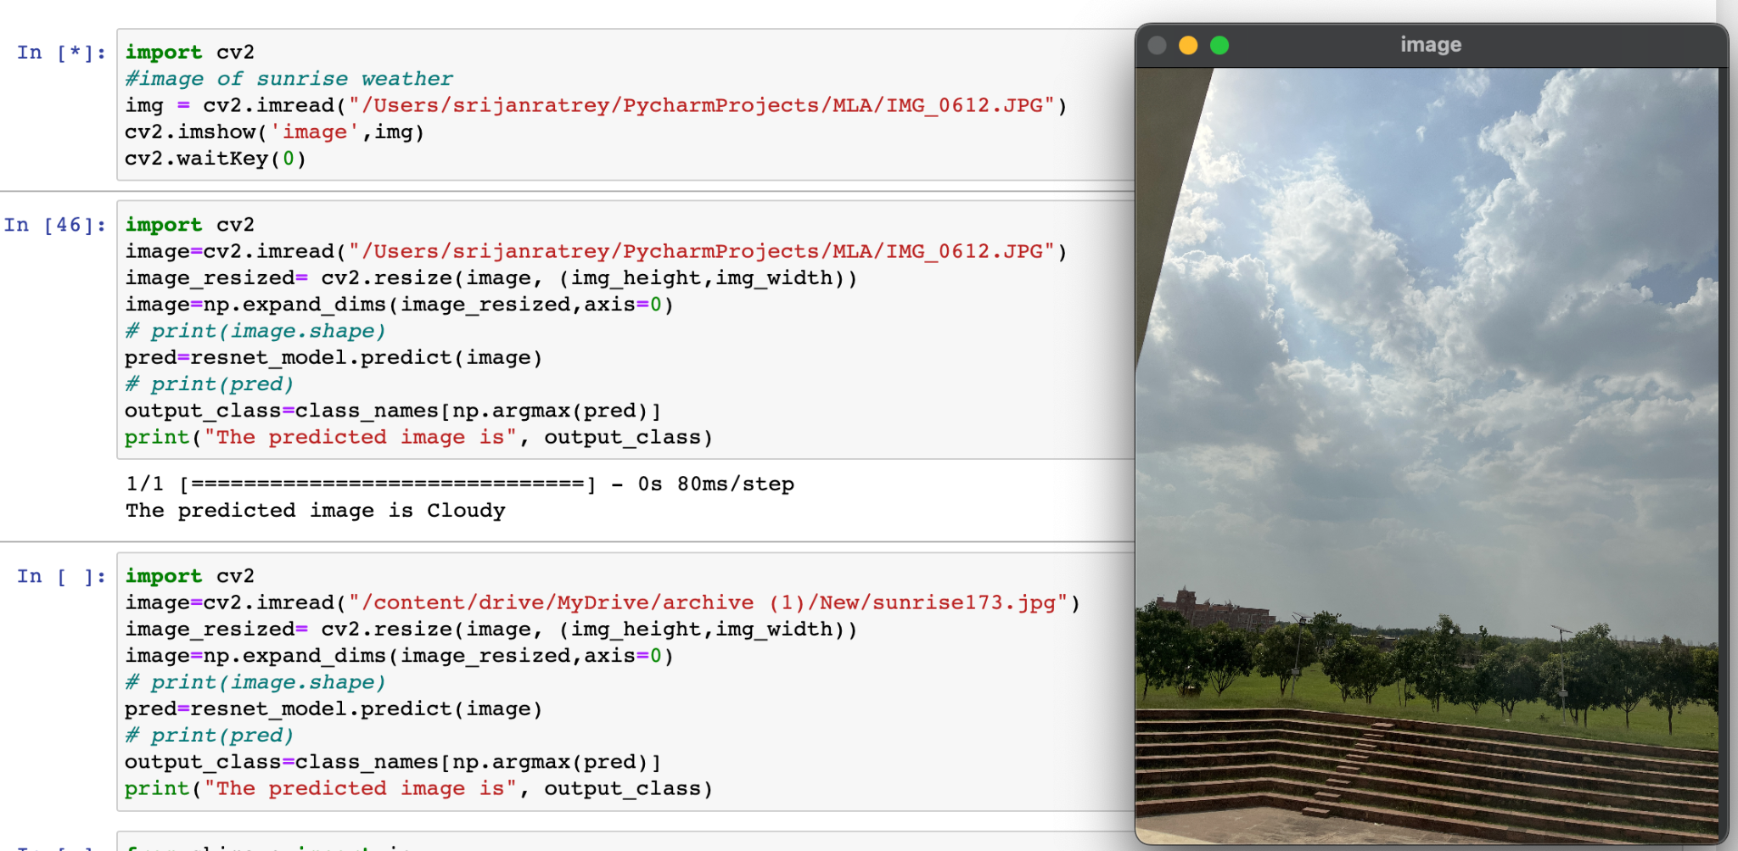
RESULTS
Working of model and predicting a real time image taken from phone.

Slide 8
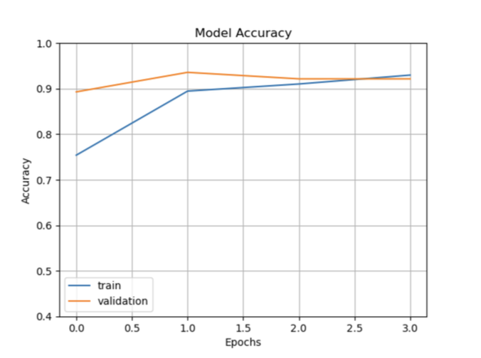
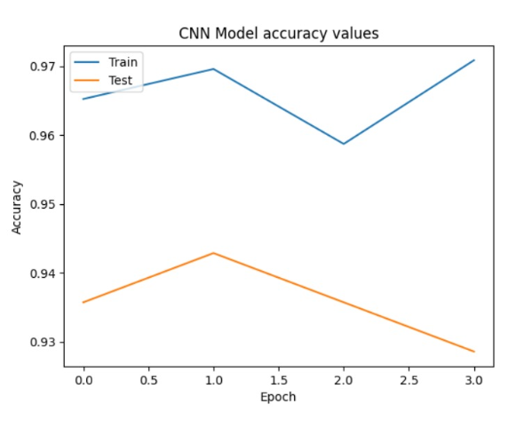
RESULTS
Model Accuracy of ResNet50
Model Accuracy of VGGNet16

Slide 9
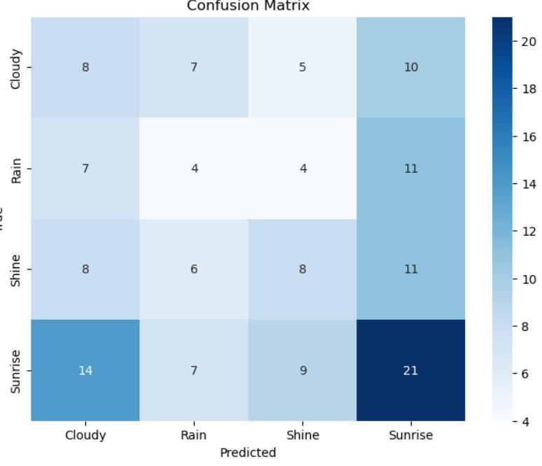
Confusion Matrix

Slide 10

RESULTS
Deployment of model to website using streamlit

Slide 11
Conclusion
In conclusion, the development of a multiclass weather prediction system using machine learning and deep learning techniques holds significant promise for accurate and timely weather forecasting. By leveraging historical weather data and advanced algorithms, this system can classify weather conditions into multiple classes, providing valuable information for individuals, businesses, and organizations to make informed decisions and take appropriate actions based on expected weather patterns.
Through the proposed methodology, we have outlined key steps, including data collection and preprocessing, feature extraction and selection, model selection and training, ensemble learning, and real-time prediction. These steps form a robust framework for building an effective weather prediction system capable of handling diverse weather conditions and providing reliable forecasts.

Slide 12
Future Scope
Integration of additional data sources: Explore the integration of non-traditional data sources, such as social media, satellite imagery, or Internet of Things (IoT) devices, to augment the existing weather data and improve prediction accuracy.
Fine-grained weather classification: Investigate the feasibility of finer-grained weather classification, such as distinguishing between different intensities of rainfall or varying levels of cloud cover, to provide more detailed and precise weather predictions.
Incorporation of spatial-temporal modeling: Explore spatial-temporal modeling techniques to capture the dynamic nature of weather patterns and improve predictions by considering the spatial dependencies and temporal trends in weather data.
Uncertainty estimation: Develop methods to estimate and quantify the uncertainty associated with weather predictions, enabling users to understand the reliability of forecasts and make more informed decisions.
User-centric interfaces and applications: Focus on developing user-friendly interfaces and applications that present weather predictions in an intuitive and actionable manner, catering to the specific needs of different user groups, such as outdoor event planners, farmers, or emergency responders.

Slide 13
References
1. Sharma, S., Singh, A. K., & Singh, K. (2019). Weather Forecasting using Machine Learning Techniques. International Journal of Advanced Research in Computer Science, 10(4), 7-12.
2. Gupta, A., Tyagi, V., & Raghav, R. (2020). Multiclass Weather Classification Using Convolutional Neural Networks. 2020 4th International Conference on Trends in Electronics and Informatics (ICOEI), 1491-1496.
3. Mishra, V., Bajaj, K., & Tyagi, V. (2018). Weather Prediction using Ensemble Learning Techniques. 2018 Second International Conference on Electronics, Communication and Aerospace Technology (ICECA), 1256-1260.
4. Raina, M., Verma, N. K., & Chaudhary, P. (2021). Weather Classification with Deep Convolutional Neural Networks. In Proceedings of the International Conference on Machine Learning, Big Data, and Business Intelligence (pp. 415-423). Springer.
5. Sridhar, K., Sujatha, S., & Kannan, A. (2017). Weather Prediction using Recurrent Neural Networks. International Journal of Computer Science and Information Security, 15(8), 1-6.

Slide 14

Thank You
..
Dr. Shyama Prasad Mukherjee International Institute of Information Technology, Naya Raipur
*
International Institute of Information Technology, Naya Raipur
‹#›

