Slide 1
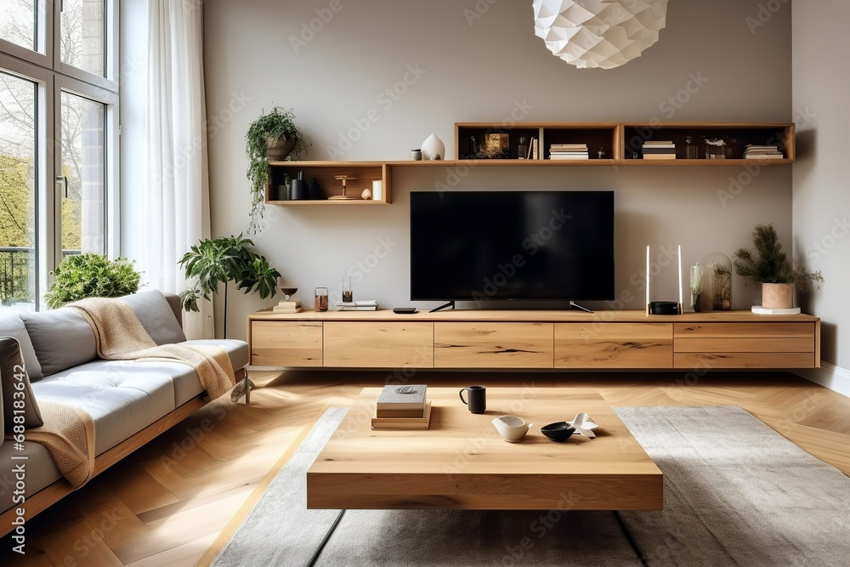
ONLINE
FURNITURE
ORDERING
SYSTEM
Developed By : JANI CHIRAG AND DEV PARMAR

Slide 2
TABLE OF CONTENT
1
5
Input / Output Design
Project Profile
2
6
Testing & Implementation
Project Introduction
3
7
Future Scopes
Project Configuration
4
8
Conclusion
System Design

Slide 3
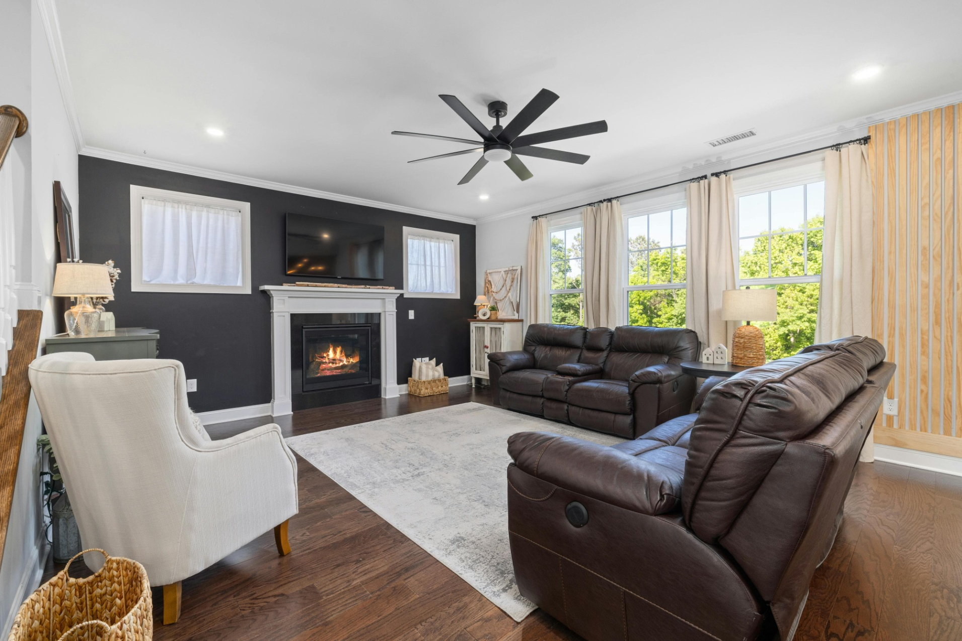
FURNITURE ORDER
1
PROJECT
PROFILE

Slide 4
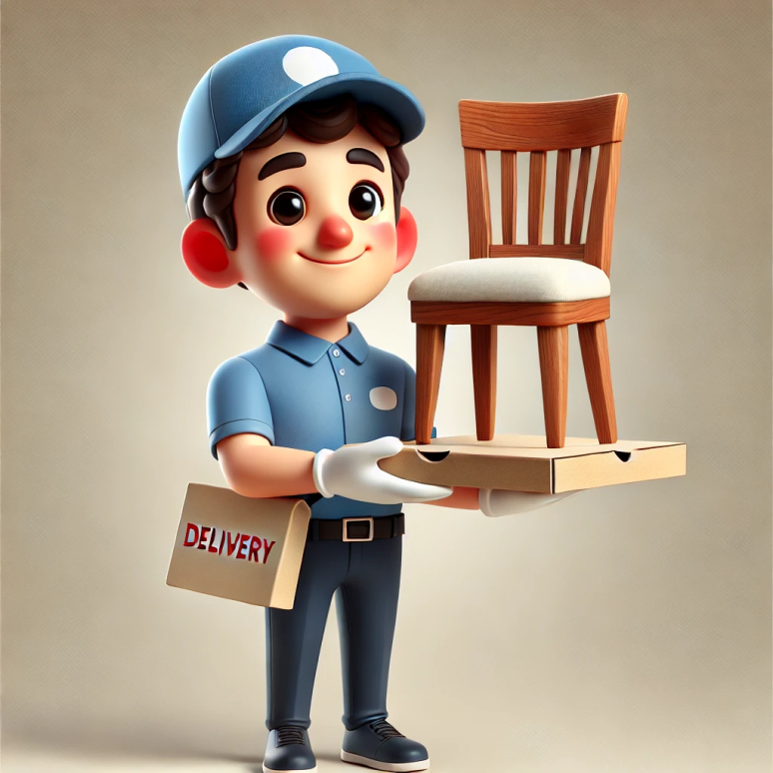
ONLINE FURNITURE
ORDERING SYSTEM
PROJECT PROFILE
Project Title :
My Furni System
Developed For :
Online Furniture Ordering System
Front-end Tool :
Html, Css, Js, Bootstrap
Back End Tool :
Php, MySQL
Language :
Php
Operating System :
Window 10

Slide 5
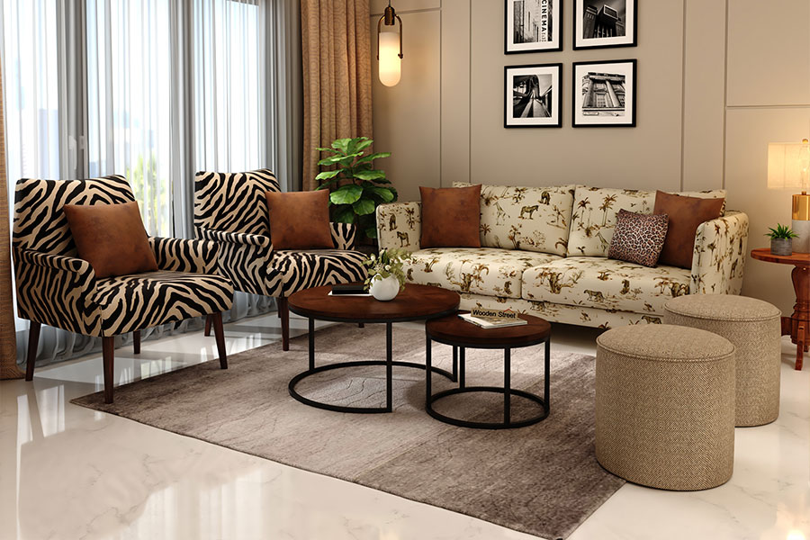
ONLINE FURNITURE
ORDERING SYSTEM
2
PROJECT
INTRODUCTION

Slide 6
ABOUT PROJECT:-
“My furni” is a web-based application that provides facility to user to order Furniture item online.
In the online Furniture order system the user is able to order the Furniture from anywhere after giving his/her authentication online.

Slide 7
OBJECTIVES OF SYSTEM :
01
02
The main objective of this system is simple & secure online furniture item ordering with the help of computer and internet.
Manage the information of Category.
03
04
Provides new user registration facility for the security purpose.
The main objective of this system is to order furniture item from anywhere.

Slide 8

ONLINE FURNITURE
ORDERING SYSTEM
3
PROJECT
CONFIGURATION

Slide 9
1
HARDWARE SPECIFICATION :
Hard Disk : 2Gb or more of free space
RAM : 2GB / 4GB / 8GB RAM.
Processor : Any computer processor of system supported.

Slide 10
2
SOFTWARE SPECIFICATION :
Operating System : Windows 10.
Database : SQL.
Platform Used : Php.
Browser Supported : Google Chrome, Internet Explorer, Yahoo Browser.

Slide 11

ONLINE FURNITURE
ORDERING SYSTEM
3
SYSTEM
DESIGN

Slide 12
USE CASE DIAGRAM
Login
Cart
Manage Category
Signup
Order Furniture
Manage User

Slide 13
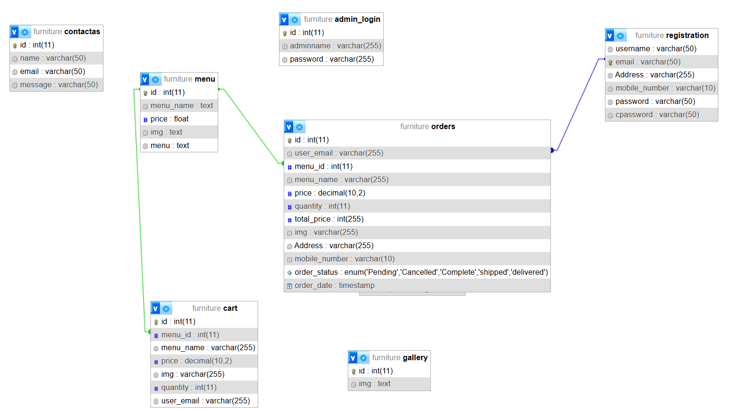
E-R DIAGRAM
E-R diagram show all the relationships between entity sets stored in the database. It illustrates the logical structure of the database. It helps to visualize how data is connected in general ways.
Following diagram representation of E-R diagram:

Slide 14
DATA FLOW DIAGRAM
Data flow diagram is graphical representation of flow of data in an information system. It is capable of depicting incoming data flow, outgoing data flow and stored data. The DFD does not mention anything about how data flows through the system.
There is a prominent difference between DFD and Flowchart. The flowchart depicts flow of control in program modules. DFDs depict flow of data in the system at various levels. DFD does not contain any control or branch elements.
O Level DFD
It is also known as a context diagram. It's designed to be an abstraction view, showing the system as a single process with its relationship to external entities. It represents the entire system as a single bubble with input and output data indicated by incoming/outgoing arrows.

Slide 15
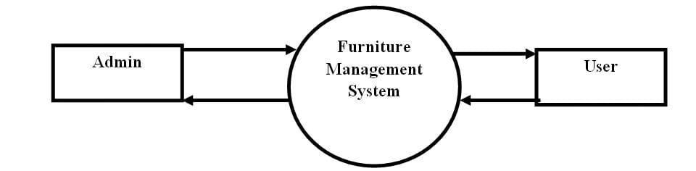
1 Level DFD
  In 1-level DFD, the context diagram is decomposed into multiple bubbles/processes.
  In this level, we highlight the main functions of the system and breakdown the high-level process of 0-level DFD into subprocesses.

Slide 16
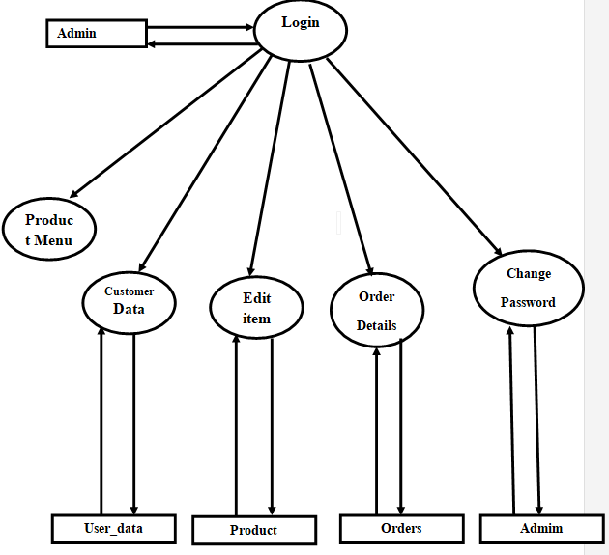
Admin 1 Level DFD

Slide 17
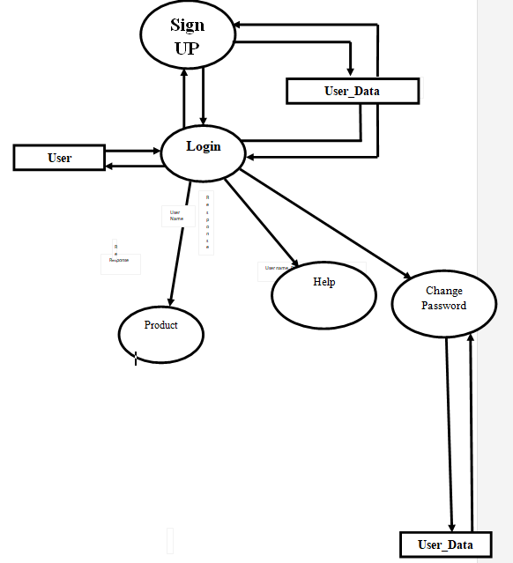
User 1 level DFD

Slide 18
DATA DICTIONARY :
1.Registration table
Table Name :Registration
Primary Key : Email
Foreign Key: -
Description : This table is use to store data of users like id, username, Password
Field Name | Data Type | Size | Constraint | Description
Username | Varchar | 50 | Not null | User name
Email | Varchar | 50 | Pk | User Email
Address | Varchar | 255 | Not null | User Address
Mobile_number | Varchar | 10 | Not null | User mobile_number
Password | varchar | 50 | Not null | User password
cPassword | varchar | 50 | Not null | Comparision between Password and Confirm Password

Slide 19
2.Admin Table
Table Name : admin_Login
Primary Key : ID
Foreign Key: -
Description : this table is use to store data of admin like id, adminname, Password
Field Name | Data Type | Size | Constraint | Description
ID | Int | 11 | PK | Admin Identification id
AdminName | Varchar | 255 | Not null | Admin name
Password | Varchar | 255 | Not null | Admin password

Slide 20
3.Add To Cart Table
Table Name : add_cart
Primary Key : ID
Foreign Key: menu_id
Description : This table is use to store the cart detail like id, menu_id, menu_name, price, image, quantity ,user_email etc.
Field Name | Data Type | Size | Constraint | Description
ID | Int | 11 | PK | Cart id
Menu_ ID | Int | 11 | FK | Menu Id
Menu_Name | Varchar | 255 | Not null | Cart Item Name
Price | Decimal | 10,2 | Not null | Item Price
Image | Varchar | 255 | Not null | Item Image
Quantity | Int | 11 | Not null | Item Quantity
User_email | varchar | 255 | Not null | User email

Slide 21
4.Order Table
Table Name : Order
Primary Key : Id
Foreign Key: -user_Email,menu_id
Description : This table is use to store data of which user order’s the Furniture like order id, User Email, Menu id, Menu Name, price, Quantity,Total_Price,Img,Address,Mobile_Number,Order_status,Order_Date etc.
Field Name | Data Type | Size | Constraint | Description
id | Int | 11 | PK | Order id
User_email | Varchar | 255 | FK | User Email
Menu_id | Int | 11 | FK | Menu Id
Menu_Name | Varchar | 255 | Not null | Menu Name
Price | Decimal | 10,2 | Not null | Price of items
Quantity | Int | 11 | Not null | Quantity Of items
Total_price | Int | 255 | Not null | Total price of the Items
img | Varchar | 255 | Not null | Product Imges
Address | Varchar | 255 | Not null | User Address
Mobile_Number | Varchar | 10 | Not null | User Mobile number
Order_Status | Enum | 'Pending','Cancelled' ,'Complete','shipped', 'delivered' | Not null | Orders Status
Order_Date | timeStamp | ----- | Not null | Order date

Slide 22
5.Add MenuTable
Table Name : Menu
Primary Key : ID
Foreign Key: -
Description : This table is use to Add data of Menu Like id, menu_name, price, Imge, Menu, etc.
Field Name | Data Type | Size | Constraint | Description
ID | Int | 11 | PK | id
Menu_name | Text | --- | Not null | Item name
Price | Float | --- | Not null | Item Price
Image | Text |  | Not null | Item Image
Menu | Text |  | Not null | Menu Name

Slide 23
6.Contacts Table
Table Name :Contacts
Primary Key :ID
Foreign Key: -
Description : This table is use to store data of users like id, name, email,Message
Field Name | Data Type | Size | Constraint | Description
ID | Int | 11 | Pk | ID
Name | Varchar | 50 | Not null | User Name
Email | Varchar | 50 | Not null | User Email
Message | Varchar | 50 | Not null | User Message

Slide 24
7.Gallery Table
Table Name :Gallery
Primary Key :ID
Foreign Key: -
Description : This table is use to store data of Product imges
Field Name | Data Type | Size | Constraint | Description
ID | Int | 11 | Pk | ID
img | Text | -- | Not null | Product img

Slide 25
8.Hero section Table
Table Name :Hero Section
Primary Key :ID
Foreign Key: -
Description : This table is use to store data of product Imges (Slide bar)
Field Name | Data Type | Size | Constraint | Description
ID | Int | 11 | Pk | ID
Name | Text | --- | Not null | Name
Img | Text | -- | Not null | Product Imge
Description | Long Text | -- | Not null | Description

Slide 26
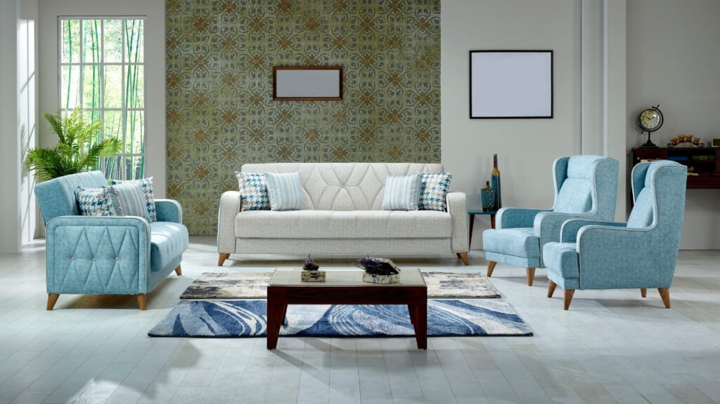
ONLINE FURNITURE
ORDERING SYSTEM
4
INPUT & OUTPUT
DESIGN

Slide 27
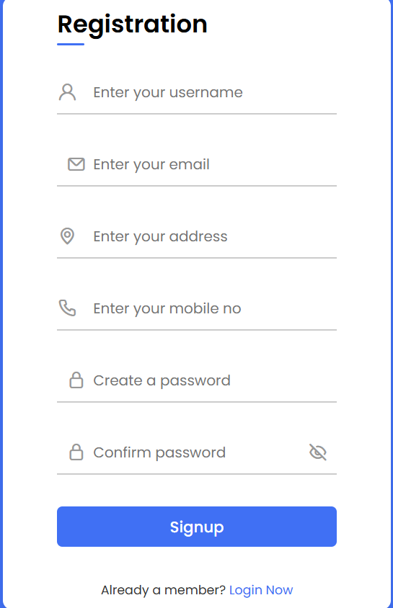
1.SIGNUP PAGE

Slide 28
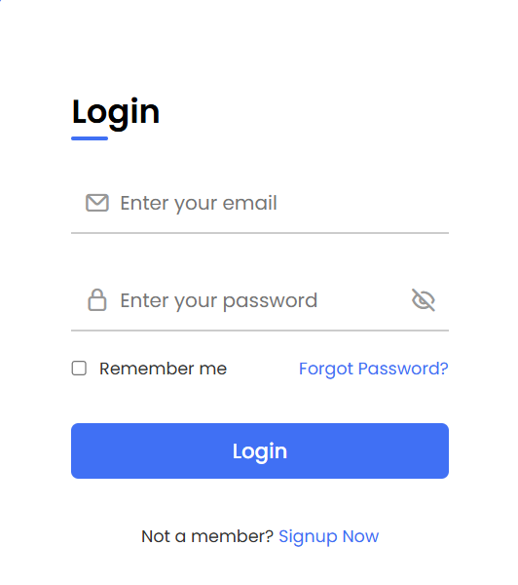
2.LOGIN PAGE

Slide 29
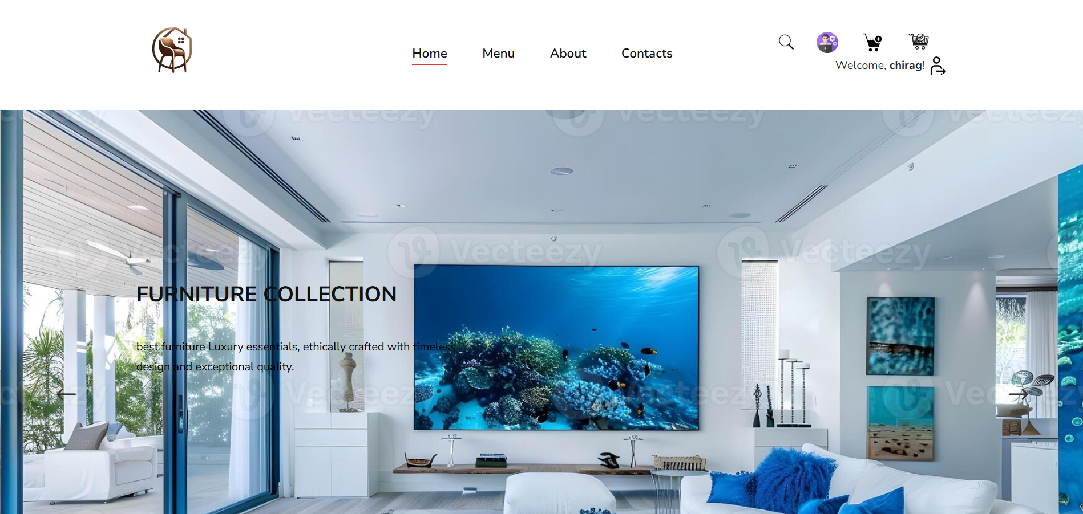
3.HOME PAGE

Slide 30
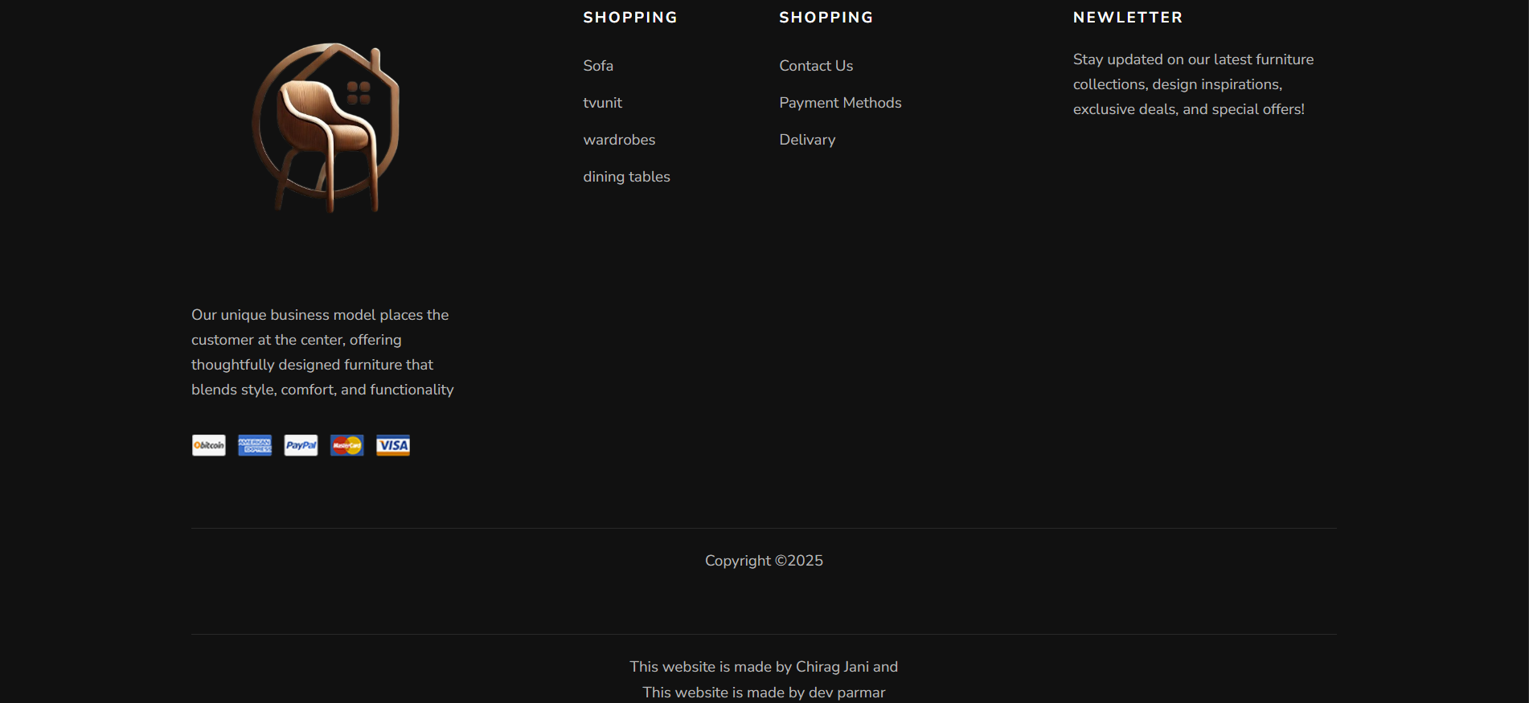
4.FOOTER PAGE

Slide 31
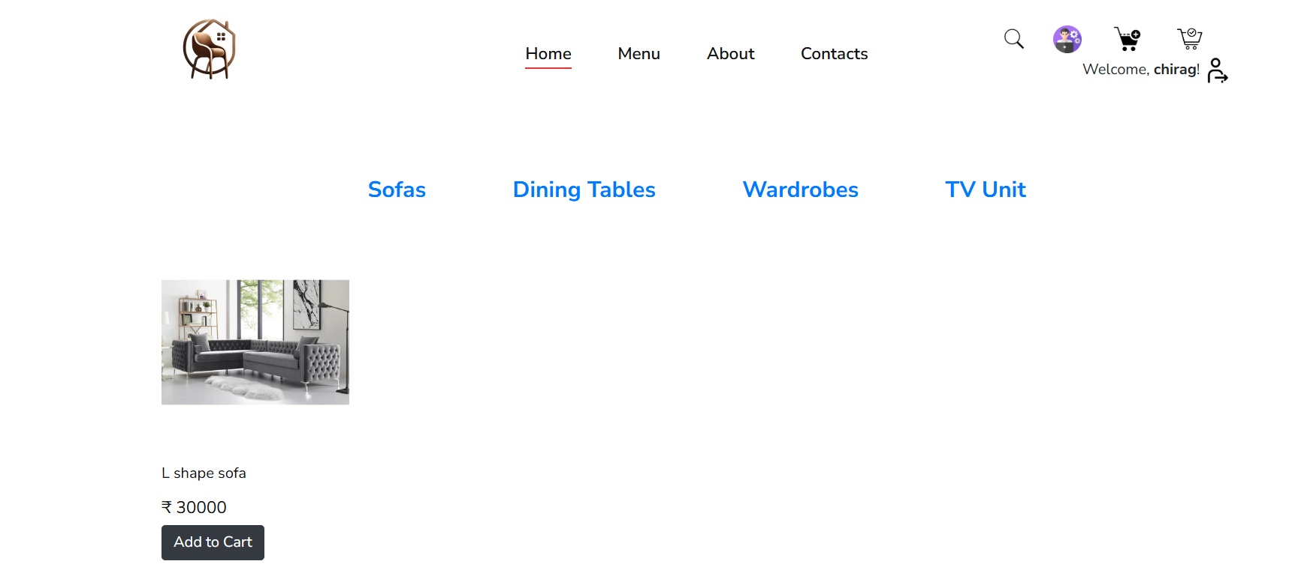
5.MENU PAGE (Sofa)

Slide 32
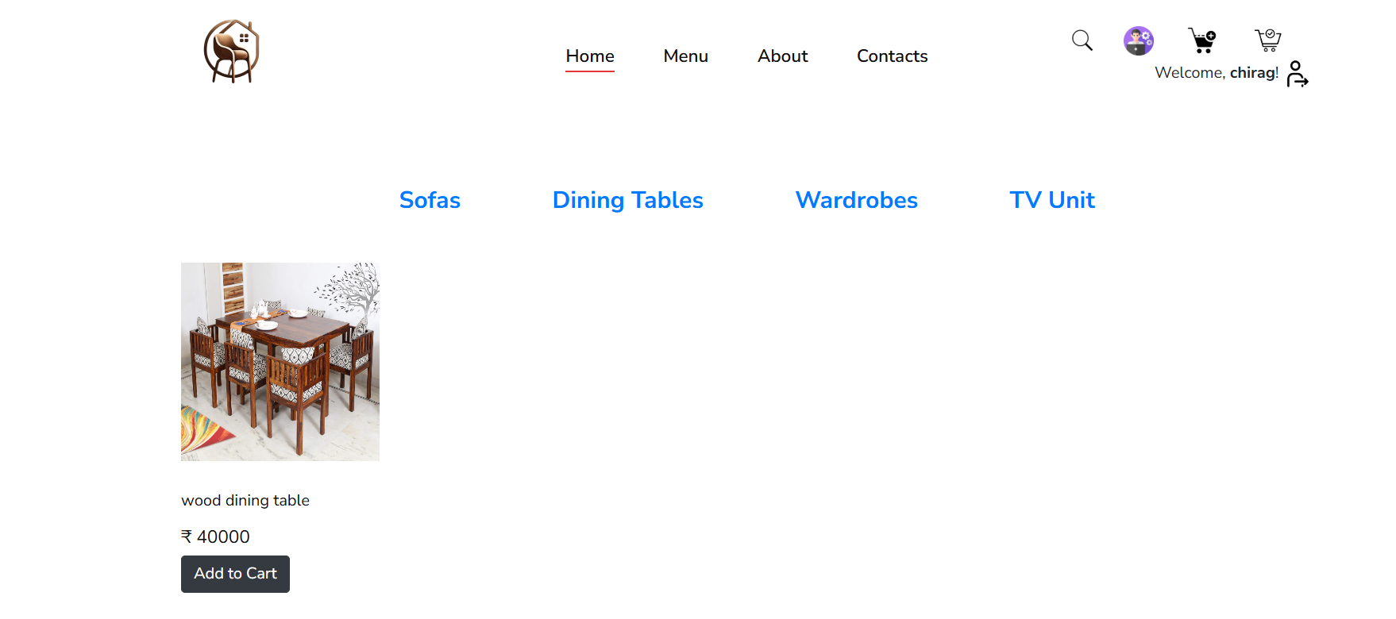
6.MENU PAGE (Dining tables)

Slide 33
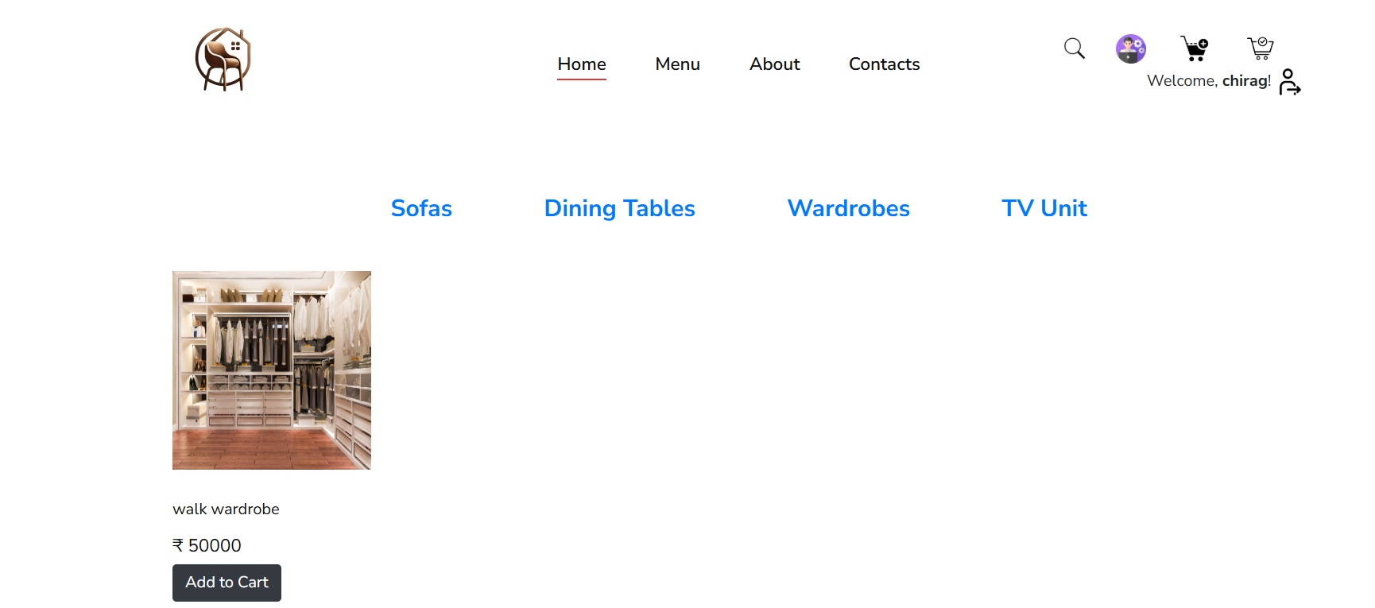
7.MENU PAGE (Wardrobes)

Slide 34
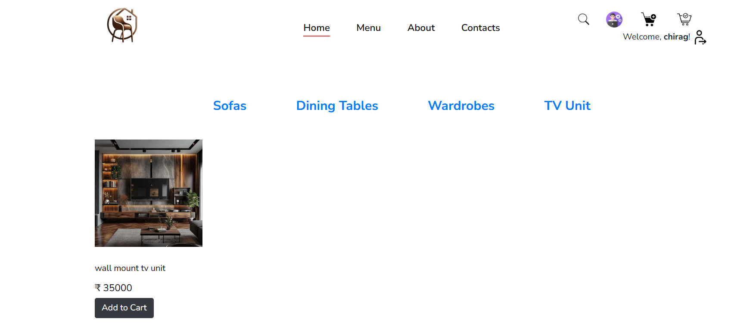
8.MENU PAGE (Tv unit)

Slide 35
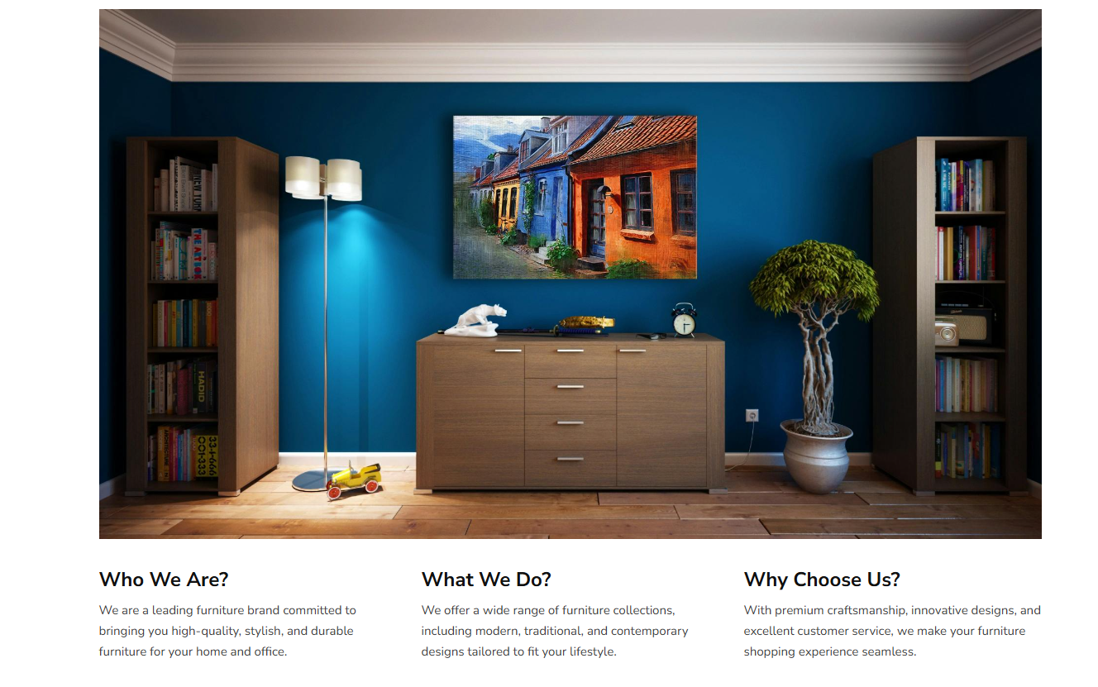
9.ABOUT US PAGE

Slide 36
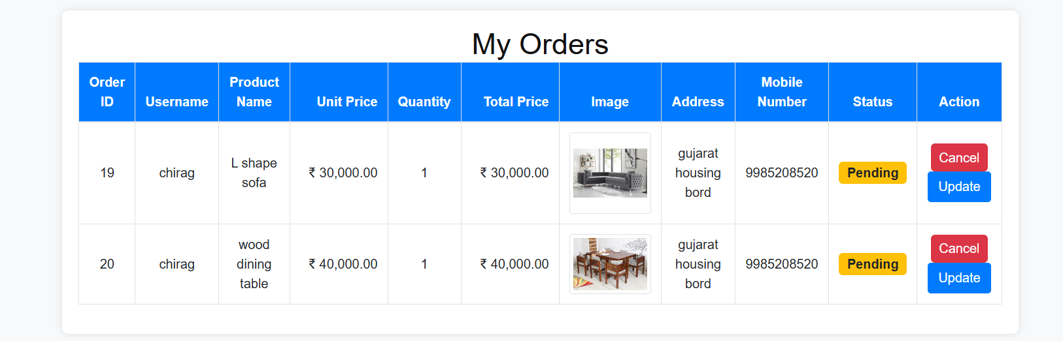
10.ORDER PAGE

Slide 37
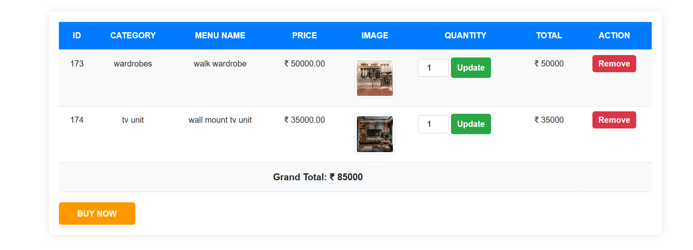
11.ADD CART PAGE

Slide 38
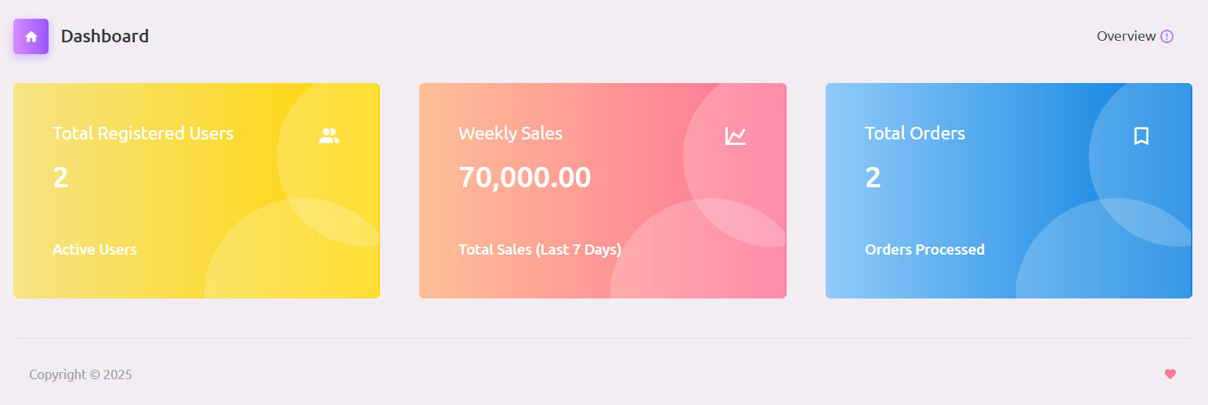
12.ADMIN DASHBOARD PAGE

Slide 39
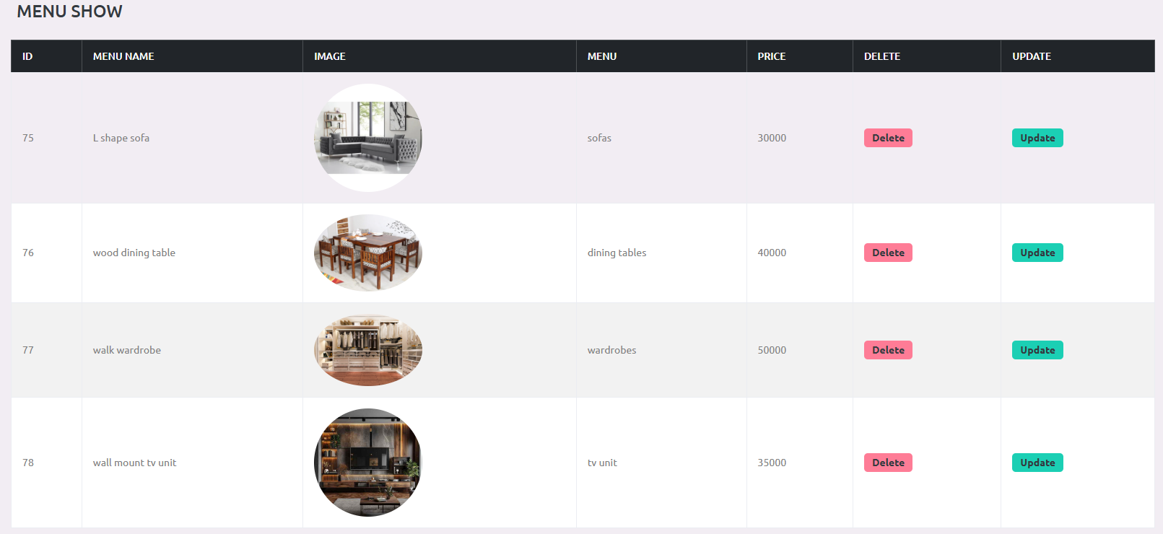
13.MANAGE CATEGORY

Slide 40
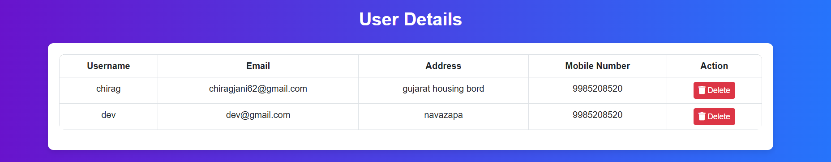
14.USER LIST PAGE

Slide 41
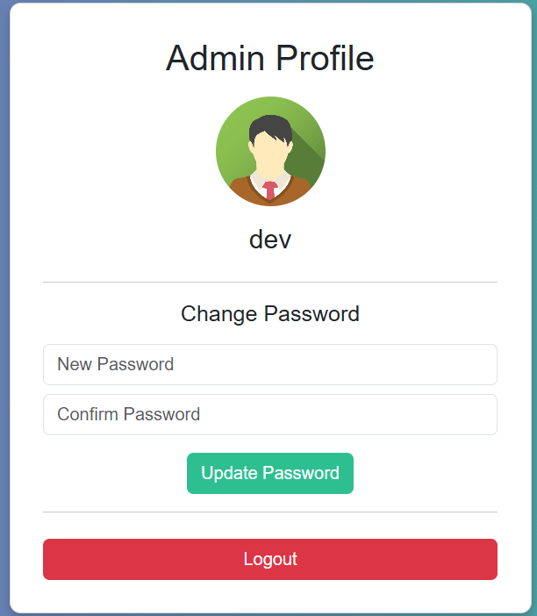
15.ADMIN PROFILE PAGE

Slide 42
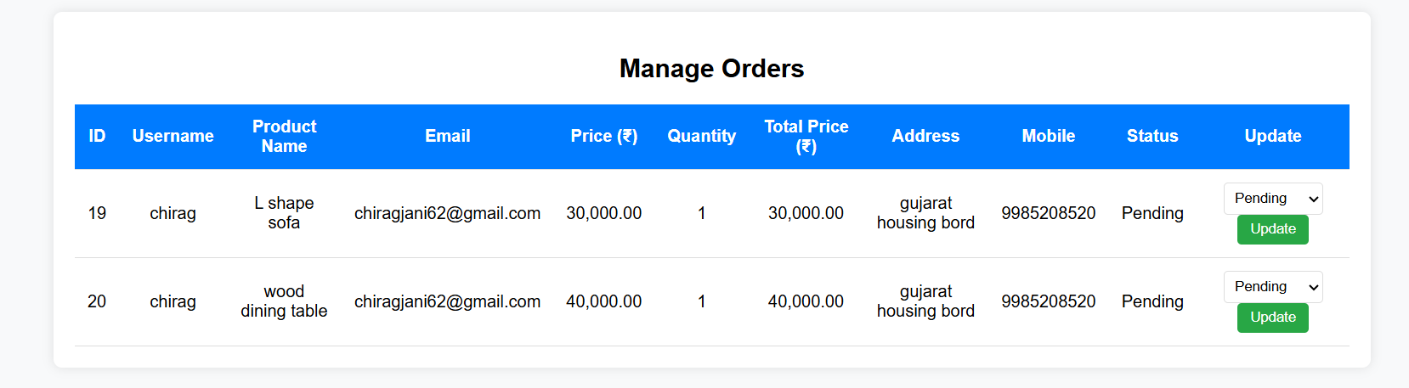
16.MANAGE ORDERS PAGE

Slide 43

ONLINE FURNITURE
ORDERING SYSTEM
5
TESTING
&
IMPLEMENTATION

Slide 44
TYPES OF TESTING
METHODS
BLACK BOX
TESTING
TYPE
OF
TESTING
WHITE BOX
TESTING
GRAY BOX
TESTING

Slide 45
01
BLACK BOX TESTING
02
WHITE BOX TESTING
03
GRAY BOX TESTING
WHITE BOX TESTING, also known as Clear Box Testing, Open Box Testing, Glass Box Testing, Transparent Box Testing, Code-Based Testing or Structural Testing) is a software testing method in which the internal structure/design/implementation of the item being tested is known to the tester.
BLACK BOX TESTING, also known as Behavioral Testing, is a software testing method in which the internal structure/design/implementation of the item being tested is not known to the tester. These tests can be functional or non-functional, though usually functional.
GRAY BOX TESTING, is a software testing method which is a combination of Black Box Testing method and White Box Testing method. In Black Box Testing, the internal structure of the item being tested is unknown to the tester and in White Box Testing the internal structure is known.
Notes:
e49f880e-a299-42d3-bd42-27455dd6a881.source.default.zh-Hans

Slide 46

ONLINE FURNITURE
ORDERING SYSTEM
6
FUTURE
GOALS

Slide 47
FUTURE ENHANCEMENT :-
The Authentication Algorithm Would Be More Accurate.
The same Application Will Be Converted into The Mobile Application
This will make our application more secure & user friendly.
The payment mode will be providing also by online payment services.
We will provide online order tracking option.
The product search option will be provides

Slide 48

ONLINE FURNITURE
ORDERING SYSTEM
7
CONCLUSION

Slide 49
CONCLUSION :
The project entitled Online furniture ordering system was completed successfully.
In conclusion, the development of this online furniture ordering system has been a comprehensive journey, integrating front-end technologies like HTML, CSS, and JavaScript with back-end PHP and MySQL databases to create a seamless and user-friendly platform.
The system not only provides an intuitive interface for customers to browse, select, and purchase furniture but also ensures robust functionality for managing orders, inventory, and user data. By leveraging the power of PHP and MySQL, the platform delivers dynamic content, secure transactions, and efficient data management, making it a reliable solution for both customers and administrators.
This project has reinforced the importance of combining aesthetic design with functional backend systems to create a cohesive user experience. Future enhancements could include integrating advanced features like AI-based recommendations, augmented reality (AR) for virtual furniture placement, and improved mobile responsiveness.
Overall, this online furniture ordering system serves as a scalable and efficient solution, ready to adapt to the evolving needs of the e-commerce industry.

Slide 50
THANK YOU!

