Slide 1

Intelligent AI Teaching Assistant
A Hybrid Reasoning System for Personalized Learning using Neo4j and RAG

Slide 2






The Problem with E-Learning Tools
Dumb Retrieval
Disconnected Facts
Passive Q&A
Standard RAG finds text that *sounds* similar, but doesn't *understand* the underlying concepts. It lacks true academic comprehension.
Tools can't link "photosynthesis" to "glucose" as a prerequisite. Knowledge is "flat," missing the crucial relationships between topics.
Most "AI TAs" are just search engines. They can answer simple questions but can't actively *teach*, *quiz*, or guide a student's learning.

Slide 3

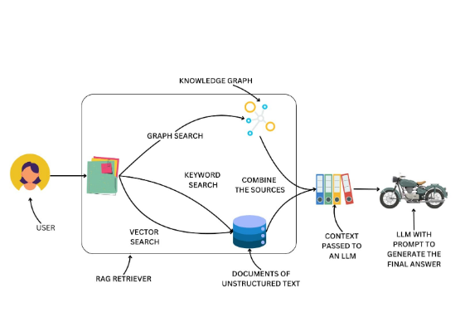
Our Solution: A Hybrid AI TA
A "Hybrid Brain" for Deeper Learning
We built an AI TA that understands academic concepts by combining two forms of knowledge:
•
Unstructured (RAG): The exact, nuanced text from course documents. Provides the "what the professor said."
•
Structured (Neo4j): A Knowledge Graph of all topics, definitions, and prerequisites. Provides the "conceptual blueprint."
By fusing these, our AI moves from simple search to genuine reasoning, understanding both the raw text and the relationships that connect it.

Slide 4
System Architecture Flow
Step 2: Extract
Step 4: Query
Semantic chunking + LLM extraction (Gemini) identifies all concepts, definitions, and formulas.
Hybrid retrieval fuses context from *both* databases to power the final LLM response.
Step 1: Ingest
Step 3: Store (Dual)
Upload PDF, DOCX, or TXT files. Content is extracted for processing.
Populates *both* PGVector (for RAG) and Neo4j (for graph relationships) in parallel.

Slide 5
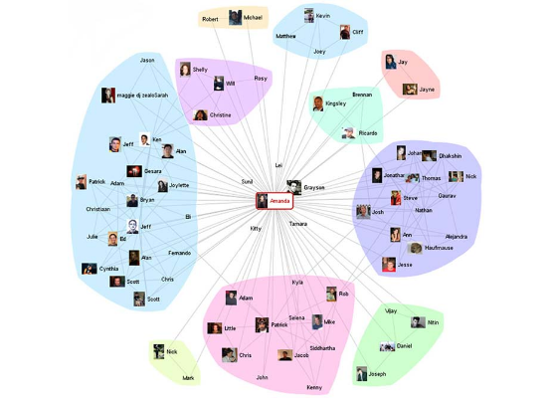
Innovation #1: Automated Knowledge Graph
From Flat Text to Rich Graph
Our system's first novelty is its automated ingestion pipeline. It intelligently converts a flat, 50-page PDF document into a rich, interconnected knowledge graph in Neo4j.
This is achieved by combining:
•
Semantic Chunking: Groups text by meaning, not fixed size, to preserve conceptual coherence.
•
LLM Extraction: Uses an AI to read these chunks and pull out structured data (Topics, Definitions, Prerequisites).
The result is a queryable "brain" of the course, built automatically.

Slide 6


Innovation #2: Hybrid Reasoning
Vector RAG (The "What")
Graph (Neo4j) (The "Why")
The first part of our context comes from a standard vector search in PGVector.
The second part comes from a graph query in Neo4j.
•
Query: "What *is* X?"
•
Query: "What does the text *say* about X?"
•
Result: Finds the formal definition, its subtopics, and what its prerequisites are.
•
Result: Finds specific examples, nuanced explanations, and the exact phrasing from the document.

Slide 7

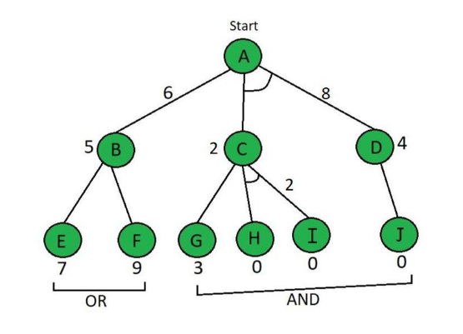
Core Feature: Learning Paths
"How do I get from A to D?"
A key benefit of the knowledge graph is the ability to generate personalized study plans. A user can ask for the path between two concepts.
The system runs a shortest path algorithm on the PREREQUISITE_FOR relationships in Neo4j.
Result: A step-by-step learning path.
1.
First, learn: Basic Cells
2.
Next, learn: Chloroplasts
3.
Then, learn: Light-Dependent Reactions
4.
You are ready for: Photosynthesis

Slide 8
Expected Results & Impact
Quantifiable Learning Gains
By moving from flat text to a relational knowledge graph, we anticipate significant improvements in educational outcomes.
+40%
•
+25-35% Learning Retention: Driven by interactive, graph-informed quizzes and immediate feedback.
•
+60% Student Engagement: Achieved through a conversational UI that provides active, not passive, learning.
Concept Understanding
•
< 3 Sec Response Time: Fast hybrid retrieval ensures a seamless
user experience.
•
>90% Extraction Accuracy: Precision in converting unstructured
text into correct graph concepts.

Slide 9
Future Work
Automated Intent Router: Develop a "router" module that automatically analyzes the user's query to select the best mode: RAG, Graph, or Hybrid.
Live Graph Visualization: Add a frontend module to render the Neo4j graph interactively, allowing students to visually explore the concept map.
LMS Integration: Package the AI TA as a plug-in for major Learning Management Systems like Moodle and Canvas.
Fine-Tuning: Fine-tune the local Ollama model on the extracted knowledge to create a domain-expert AI with reduced API costs.
Advanced Graph-Based Quizzing: Fully implement the quiz generator to test complex relationships (e.g., prerequisites) and provide adaptive difficulty.

Slide 10
Thank You
We've built an AI TA that moves from simple Q&A to a deep, conceptual reasoning engine.
Questions?

Slide 11
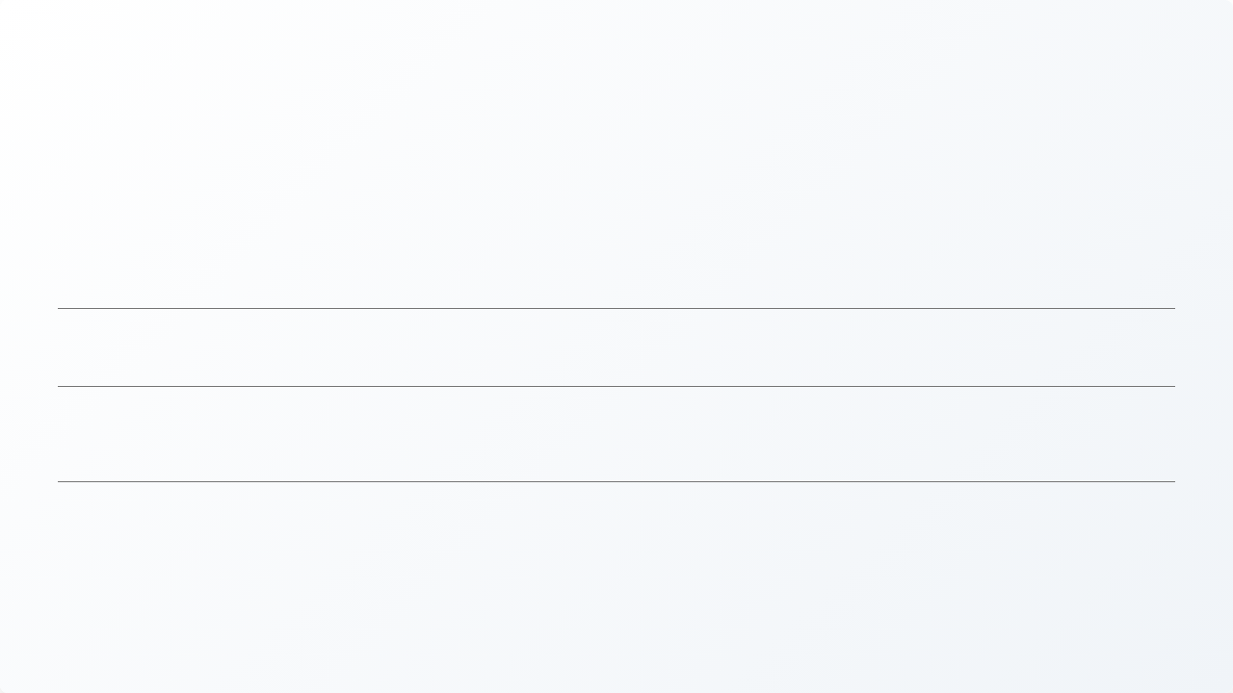




Image Sources
https://miro.medium.com/1*acemTscCfgRoq7OBv8WZvg.jpeg
Source: levelup.gitconnected.com
https://public-media.interaction-design.org/images/encyclopedia/data_visualization_for_human_perception/node-and-link-diagram-social-graph.jpg
Source: www.interaction-design.org
https://static.vecteezy.com/system/resources/previews/056/080/513/non_2x/quiz-interface-trivia-question-ui-layout-quizzing-answer-screen-for-game-quizzes-test-and-exam-multiple-choice-interface-design-modern-quizzes-layout-frame-set-vector.jpg
Source: www.vecteezy.com
https://media.geeksforgeeks.org/wp-content/uploads/20230117011016/777777777-768.jpg
Source: www.geeksforgeeks.org

