Slide 1
SUPER MARIO AI
Rishabh Singh - 2016csb1054
Aditya Tiwari - 2016csb1029
Chirag Khurana - 2016csb1037
Abhishek Goyal - 2016csb1027

Slide 2
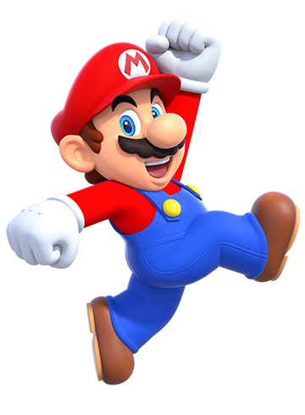
Objective
Create an AI program to navigate successfully through 2D levels based on Super Mario Bros platforming game.

Slide 3
Available Research
Q- Learning
Gabe Grand, Kevin Loughlin. Reinforcement Learning in Super Mario Bros. 2018.
NEAT
Stanley, Kenneth O., and Risto Miikkulainen. "Efficient reinforcement learning through evolving neural network topologies." In Proceedings of the 4th Annual Conference on Genetic and Evolutionary Computation, pp. 569-577. Morgan Kaufmann Publishers Inc., 2002.
A Star
Julian Togelius, Sergey Karakovskiy, and Robin Baumgarten. The 2009 mario ai competition. In IEEE Congress on Evolutionary Computation, pages 1–8. IEEE, 2010.

Slide 4
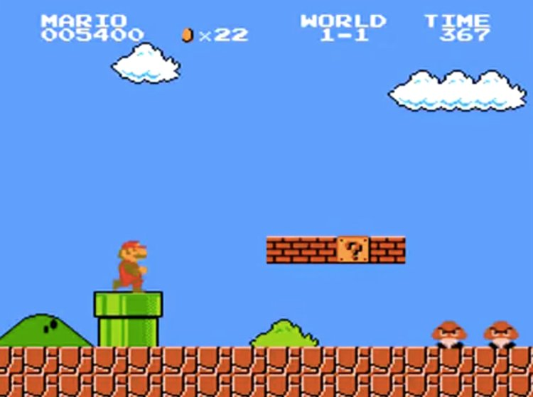
Environment
Partially Observable
Single Agent
Stochastic
Sequential
Discrete

Slide 5
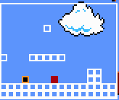
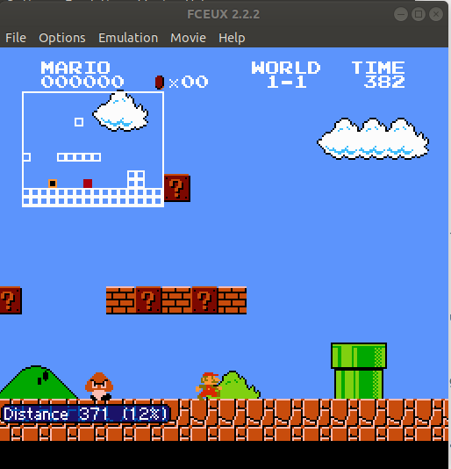
Open AI Gym
FCEUX emulator
Almost Real-Time Environment: Less than 5ms for single frame movement in emulator.
16x13 observation space:
White Block: Platform
Red: Enemy
Black: Mario

Slide 6
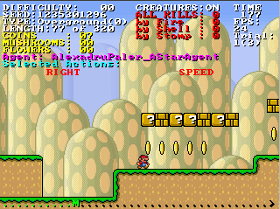
Mario AI Championship
22*22 environment centered at mario (11,11)
Randomized levels
40ms for frame movement
Detailed information of each element in the environment.

Slide 7
Agents/Solution Approach
Simpler Agents:
Forward Jumping Agent
Reflex Agent
For Fixed Levels
NEAT
Deep RL
Custom Randomly Generated levels
A* Search

Slide 8
Reflex Agent

Slide 9
Reflex Agent
Deciding best possible move for mario
Considering current and some previous states for mario.
Predicting current mario velocity based on these states.
Predicting future enemy positions also based on these states

Slide 10
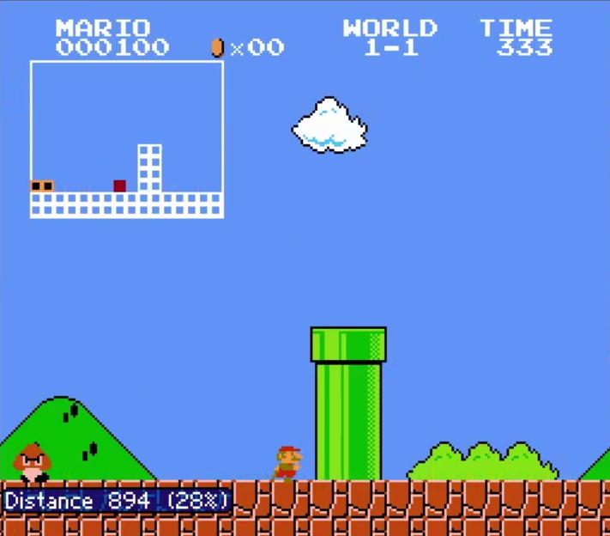
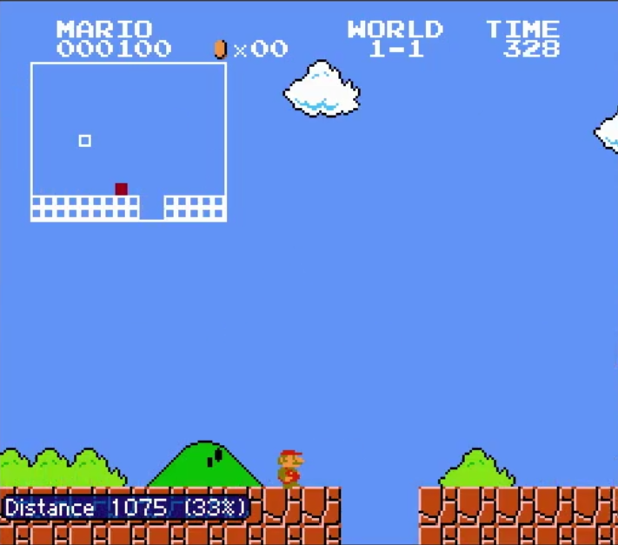
Considered the platform gaps and obstacles in the nearby cells.
Decided the right and up-most cell that mario can move to as the best move.
After considering the next best cell to move into considering the predicted screen enemy moves to ensure mario does not die from them, provided the appropriate movelist to move into that cell.

Slide 11
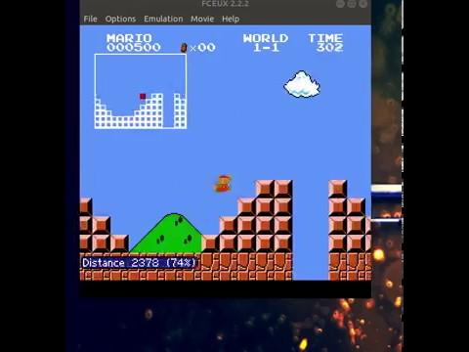
Reflex Agent

Slide 12
NeuroEvolution of Augmenting Topologies
(NEAT)

Slide 13
NeuroEvolution of Augmenting Topologies
A genetic algorithm for the generation of evolving neural networks.
Genetic crossover and mutations alter not just the networks weights but also the topology
Implemented on mario environment with the genome fitness value as the distance travelled by mario with that particular genome

Slide 14
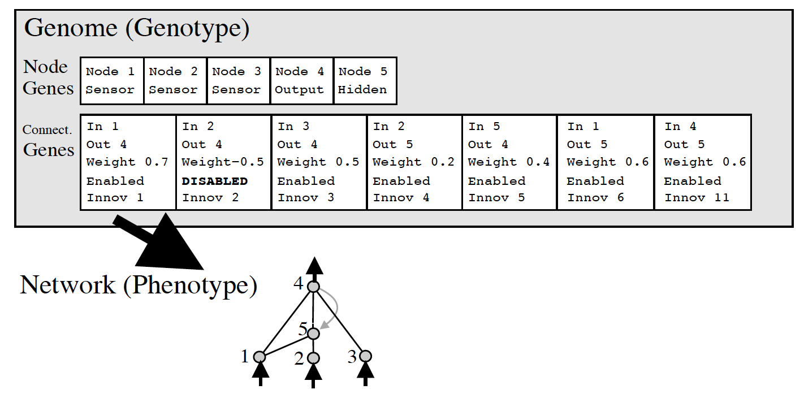
NEAT Genome Encoding
Single Genome consists of the neural network encoded into all the node genes and the connection genes.

Slide 15
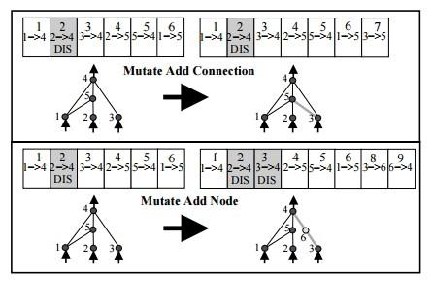
NEAT Mutations
Mutation results in either addition of a new connection between two existing nodes, or adding a new node on an existing connection.
Adding new node on existing connection, the earlier connection is disabled and the previous connection node is connected to new node with previous weight value and the new node is connected to final node of previous connection with randomized weight.
Adding new connection between existing nodes is simpler as the connection is randomized to a weight value.

Slide 16
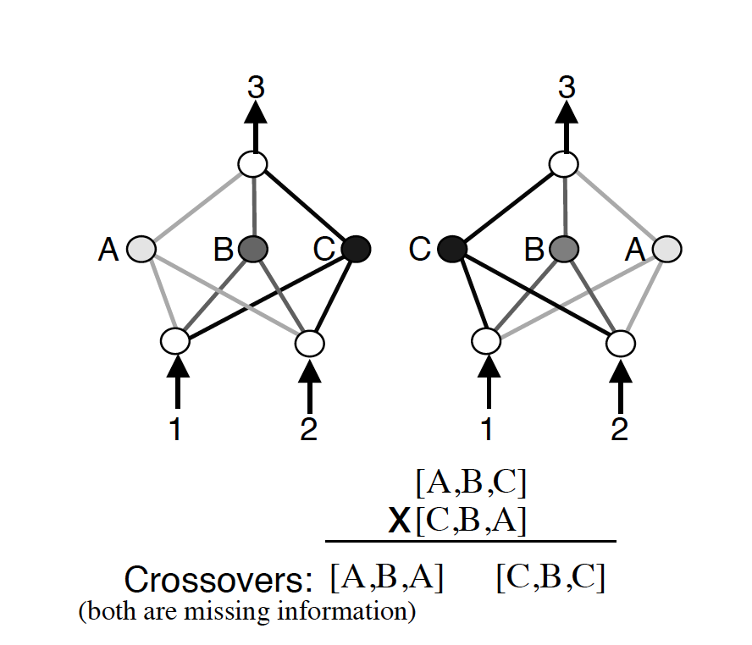
NEAT Crossover
Blind cross-over between two networks may result in mutated, non functioning network. This issue is resolved through the use of historical marking.

Slide 17
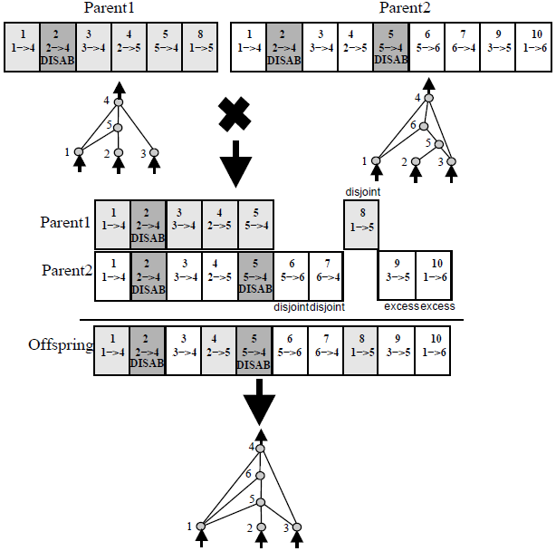
NEAT Crossover
Each connection gene is assigned a historical number and during crossover, same connection genes are aligned to ensure the new neural network is not mutated.
For disjoint genes with same historical marking, the better fit parent gene is chosen for the child.

Slide 18
NEAT Mario Implementation
Used NEAT-python library to implement on the OpenAI Gym Mario environment.
Considered 208 input neurons for the network (corres to 13x16 input space) with 2 output neurons for jump or jump-right move.
Considered fitness value of each genome network to be the furthest distance rightwards that mario travels feeding all the states into that network and obtaining each action.
Implemented parallel processing to evaluate 4 genomes at the same time saving some computation time.

Slide 19

NEAT Training

Slide 20
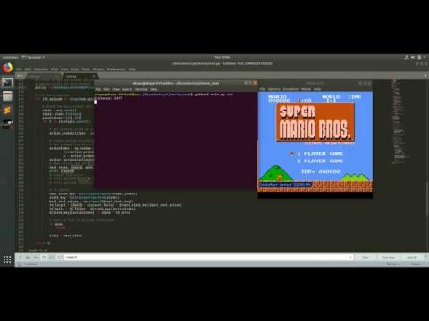
NEAT Result

Slide 21
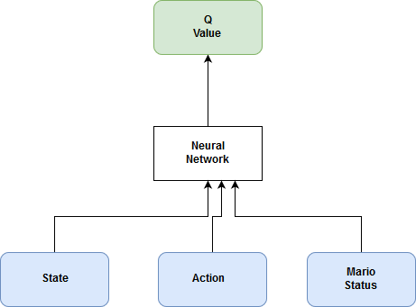
Deep RL
Open AI Gym
Q - Learning
ε-greedy exploration
Large Action State space
4 ^ (16x13) x 32 x 3
Neural Network
Keras
MSE
Reward Function:
Enemies Killed
Mario status
Distance covered
Time left
High computation time

Slide 22
Weighted A*
Simulator Problem
Define Node
Entire world state at a given time t
Action That it is taking currently
Goal Node
Reach right end of the screen
Search
Reach right end of the screen
Plan

Slide 23
Difficulties?
The trouble of predicting future state without actually going there
Relaxation to Admissibility of heuristic.
overestimating heuristic increases speed in expense of accuracy.
Another factor that affect processing time of A* is the frequency of plan recalculation.

Slide 24
Heuristic Experimentation
Weighted Heuristic =w1* Factor1 + w2*Factor2
Factor 1 encapsulates the time to move to the rightmost node, also miscellaneous penalty
Factor 2 encapsulates the time that has elapsed to reach this node
Factor 1 = minimum time to reach the x2 from x1 assuming maximum speed of mario where x2 furthermost node and x1 is current node relaxation in
Factor 2 = actual time elapsed so far

Slide 25
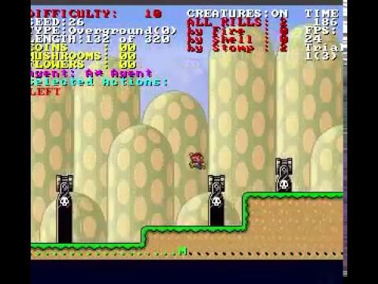
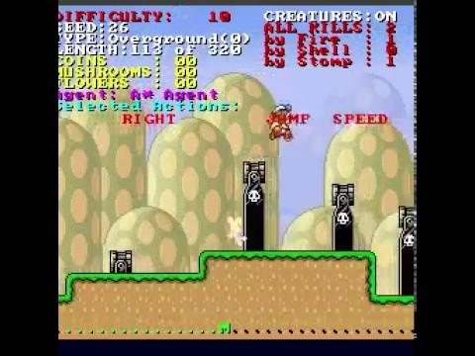
Without Penalty for damage
With Penalty for damage
W1 = 1 and W2 = 0.9

Slide 26
Other methods tried
Approximate Q-Learning
Normal Q-learning does not work due to huge state x action space:- 4^(16x13)x2
Still trying to improve this, current implementation reaches till about 1k distance.

Slide 27
References
https://neuro.cs.ut.ee/demystifying-deep-reinforcement-learning/
http://www.marioai.org/
https://github.com/ppaquette/gym-super-mario

Slide 28

Any Question?

