Slide 1
SMART RAIL
Platform for Railway
Integrated services to Passenger

Slide 2
Inaudible Announcements
Unclean and unhygienic
Theft and misplacement of luggage
Non uniform and price discrimination by vendors
overcrowding at enquiry and ticket counters.
Roaming passengers
PROBLEMS

Slide 3
Don’t worry, we have it covered

Slide 4
Services that a passenger can avail during her travel with Indian Railways.

Slide 5
Enquiry
The Idea of Digital Enquiry Window
NO MORE WAITING IN LONG QUEUES!

Slide 6
Enquiry
User creates enquiry online
Admin receives enquiry
Admin responds to query
User receives official reply ☺

Slide 7
Announcements
Time saving digital announcements panel
I can’t hear the announcements..
Wohoo I got them on my phone!

Slide 8
Announcements
Admin uploads announcements
User receives announcements on app ☺

Slide 9
Safai
Public engrossing station cleaning feature
BE A PART OF
SWACHH BHARAT ABHIYAAN!

Slide 10
Safai
User reports dirty area with optional photograph
Admin receives request with GPS coordinates
Admin assigns cleaner for the task
Cleaner marks it done ☺

Slide 11
UPCOMING FEATURES
Life is path not destination
Rapid Protection Forum

Slide 13

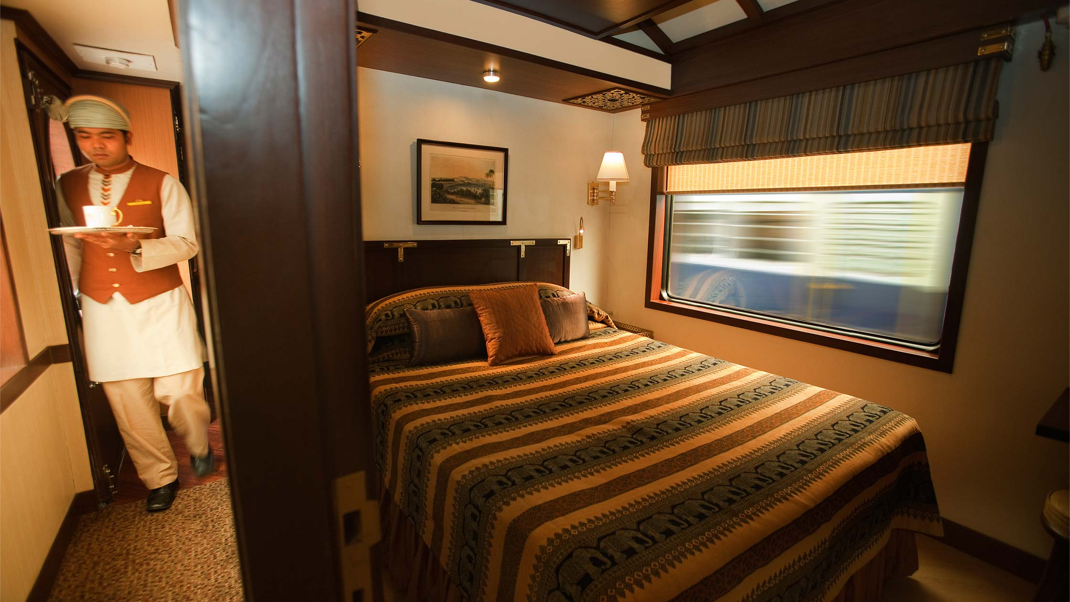
Engagement
Facilities
Onboard tourist Guide
Railway Community

