Slide 1

SMART RAIL
Smart India Hackathon - 2018
Black Caps
Notes:
To use this title animation slide with a new image simply 1) move the top semi-transparent shape to the side, 2) delete placeholder image, 3) click on the picture icon to add a new picture, 4) Move semi-transparent shape back to original position, 5) Update text on slide.

Slide 2
SMART INDIA WANTS A SMART RAIL Railway has a lot to offer, but still struggling to deliver at its full potential.
WHY
?
Traditional and Outdated Approach
Huge Information Gap
Lack of an Integrated Service Platform

Slide 3
OUR AIM
Digitizing Railway Services
Bridging information gap
WE WANT TO POWER THE ENGINE OF INDIA
Virtual Guide of the passengers
Self-evolving Community Framework

Slide 4
HOW
?
BEFORE YOU BOARD
DURING JOURNEY
AFTER DEBOARDING

Slide 5
The Beginning
Before your board
“Get”
Plan your journey.
“Set”
Visit Railway Station.
“Go”
Board your Train.

Slide 6
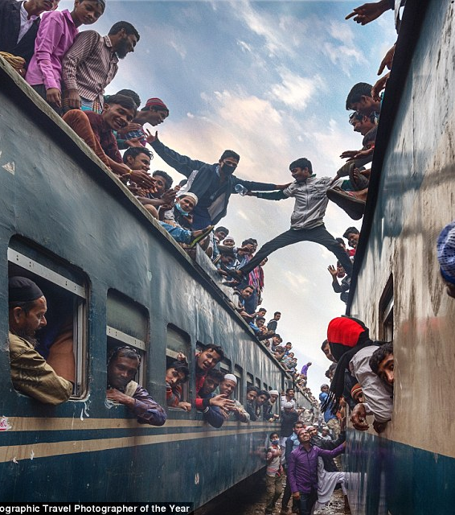
GET
Plan your journey
Learn from other’s experience
Use your past preferences
Predicting Algorithms
Railway Special

Slide 7
SET
Visit Railway Station
Digital Enquiry Window
Digital Announcements
Station Mapping
Digital Safai

Slide 8
GO
Board your Train
Digital Coolie Booking
Navigate to your seat
Get the doors open
SOS

Slide 9
3 C’s
During Journey
“Comfort”
House on the move.
“Communicate”
Get curious.
“Care”
Railway at its best.

Slide 10
The Conclusion
After getting off
“Chill”
Feel at Home.
“Ride”
Get your Taxi.
“Bye”
…

Slide 11
ALONE WE CAN DO SO LITTLE,
TOGETHER WE CAN DO SO MUCH.
—HELEN KELLER

Slide 12
Family First
After getting off
“Chill”
Feel at Home.
“Ride”
Get your Taxi.
“Bye”
…

Slide 13
SMART AND PROFESSIONAL
STRENGTH
Solution to all the problems
Gain passengers trust and increase tourism
General ticket booking
Secondary revenue model

Slide 14
STEP TOWARDS PERFECTION
OPPORTUNITY
Solution to all the problems
Scope of complete automation of the system
General ticket booking
Secondary revenue model

Slide 15
“THE INDIAN RAILWAYS WILL BECOME THE GROWTH ENGINE OF NATION’S ‘VIKASH YATRA’”.
—NARENDRA MODI, PRIME MINISTER OF INDIA

Slide 16
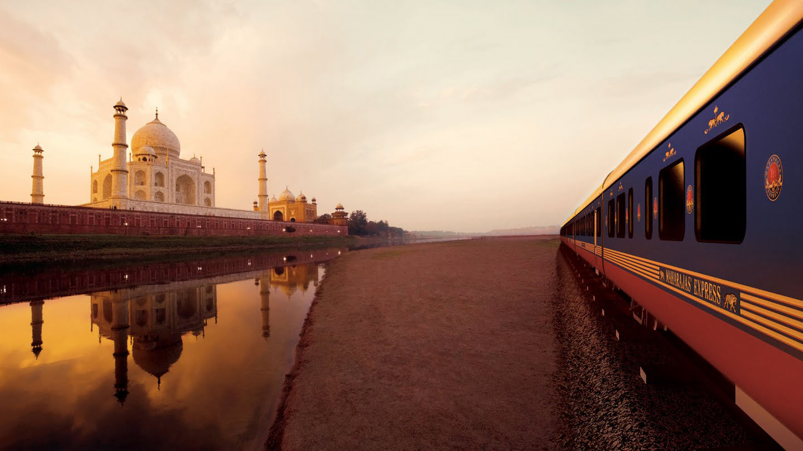
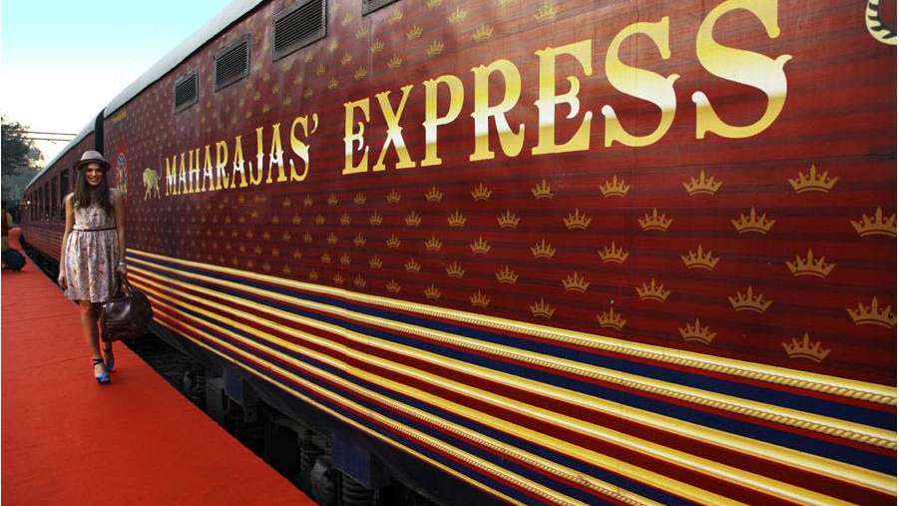
HAVE AN AWESOME DAY!
THANK YOU

