Slide 1
↗
Keep SIP Active GR-1 concept for Groww
01 · Business metric decomposition
A SIP stops counting as active the month a payment goes unpaid, even if the investor never chose to stop
Goal: more first-time investors still active at month 12. The tree shows every way a SIP drops out.
12-month SIP continuation = first-time SIPs with a paid instalment in the 30 days before month 12 ÷ first-time SIPs started
Market check: India, Sept 2026
49.68 lakh
SIPs stopped or matured
Investor cancels
Auto-cancel
Unpaid failure
63.26 lakh
A chosen stop: a break, a tight month, returns
3 skipped, missed or failed instalments in a row cancel the SIP
Last instalment failed and was never paid, so the SIP is inactive
new SIPs in the same month
78.5%
Where each path starts, in the app
stoppage ratio
✓ A payment fails
Targeted
✓ Money is tight
Targeted
✓ Fund blocks a skip
Targeted
₹32,490 cr
monthly SIP inflows
✓ Needs a break
Targeted
– Worried about returns
Out of scope
– Fund house halts SIP
Out of scope
AMFI data via Angel One, 13 Oct 2026
AMFI September report ↗
Metric
Discovery
Research
Segment
Problem
Solution
MVP
Testing
Metrics
Risks

Slide 2
↗
Keep SIP Active GR-1 concept for Groww
02 · Discovery engine findings
Investors stop SIPs about 9 times as often as they skip or lower them, and a third of stops happen at moments a product can reach
An AI engine read 7,600 public posts and coded the action and main reason in 219 first-person accounts.
7,600
2,586
443
344
219
92 vs 10
→
→
→
→
posts collected
about SIPs
about stopping
with a clear reason
first-person accounts
stopped outright vs skipped, paused or lowered
Play Store 3,845 · YouTube 1,569 · Reddit 1,664 · other 522
Main reason per stop moment, % of 188 (live site areas overlap)
In scope: about 35%
Blue bars, 66 of 188: moments the card acts on or explains
How it works
Scrapers → keyword filter → an LLM codes each post's action, reason and who acted. Blind check on 20 hand-labelled posts: action 75%, reason 60%.
Try it: ask or code a post ↗
Metric
Discovery
Research
Segment
Problem
Solution
MVP
Testing
Metrics
Risks

Slide 3
↗
Keep SIP Active GR-1 concept for Groww
03 · User research
Interviews show people miss the lighter options at the moment of risk, and a friend's advice decides what they do
6 interviews with first-time Groww investors aged 22–28 (P1–P6): failed payments, doubts and tight months.
4 of 6
 | SIP | Failed payment | In a tight month | Who decided
P1 | ₹10k | Once, left it | Stopped that month | Roommate
P2 | ₹10k | Never | Lets the payment fail | Colleague
P3 | ₹1k | 2, stipend late | Thought skip = cancel | Friend
P4 | ₹5k | Never | Would lower the amount | Brother
P5 | ₹1.5k | Once, SMS unclear | Thought skip = cancel | Senior
P6 | ₹2k | Often, salary late | Cancelled the SIP | Friend
had a failed payment, and ignored or misread the alert
4 of 6
didn't know they could skip one instalment
3 of 6
were unsure what cancelling does to money already invested
✓ Confirmed the engine
People stop rather than adjust: 92 vs 10 in posts, and 4 of 6 here didn't know a skip existed.
! Challenged the engine
Failed payments: 4% of posts, but 4 of 6 interviewees. Online they read as app bugs, so we kept the moment.
6 of 6
settled their doubt by asking a friend or family member
Metric
Discovery
Research
Segment
Problem
Solution
MVP
Testing
Metrics
Risks

Slide 4
↗
Keep SIP Active GR-1 concept for Groww
04 · Chosen target segment
We target first-year investors whose pay arrives late or unevenly, because their SIPs fail without them choosing to stop
Three groups showed up across the engine and the interviews. One loses SIPs to moments the app can fix today.
✓ TARGET
NOT SELECTED
NOT SELECTED
First SIP, uneven pay
First SIP, steady salary
Returns-anxious stoppers
Stipends, late salaries (P3, P5, P6)
Salary on a fixed date (P1, P2, P4)
Stop after the first red number
Autopay fails when pay is late
Tight months lead to a full stop
Least aware of skip, lower and move date
Rarely fail; an odd tight month
Mostly know what cancel does
Same card helps, less urgent
26% of stops, the largest group
Ask “should I switch or stop?”
Only fixes: explanation or advice
Highest product-fixable churn, and churn they never chose
Lower risk: helped, but not the reason to build
Out of scope: GR-1 can't give investment advice
Who exactly
22–28
First 12 months
₹500–₹10,000
No set goal
early-career, salary or stipend
of their first Groww SIP
a month
started on a friend's tip
Metric
Discovery
Research
Segment
Problem
Solution
MVP
Testing
Metrics
Risks

Slide 5
↗
Keep SIP Active GR-1 concept for Groww
05 · Root cause and problem definition
The options to keep a SIP alive already exist, but nothing in the app surfaces them when a SIP is at risk
How the problem took shape, from metric to interviews, and what people do today instead.
Business metric
Product outcome
AI discovery
Primary research
Problem
Active SIP at month 12
→
Failures fixed; skip, not cancel
→
Stops beat skips 9 to 1; a third reachable
→
Options unknown, payments failing
→
SIPs lost that nobody chose to stop
Problem: first-time investors on uneven pay lose SIPs they never chose to stop, because the right option is invisible when the SIP is at risk.
Root causes
What people do today
Why solve it
1
The alert explains nothing
P5 misread it; P6 stopped reading.
Ask a friend, whose answer decides (6 of 6)
Let the payment fail and hope next month works (P1, P2)
Cancel now, “restart later” (P6, still not back)
For users keep the habit through a bad month, and know what each choice does to their money
2
Help sits behind one icon
GR-1 doesn't know this SIP is at risk.
For Groww unchosen churn is the cheapest to win back, using an AI it already runs
3
Narrow windows in the rules
Skip by 2 days before; 3 misses cancel.
Metric
Discovery
Research
Segment
Problem
Solution
MVP
Testing
Metrics
Risks

Slide 6
↗
Keep SIP Active GR-1 concept for Groww
06 · Solution rationale
Of four approaches, only bringing GR-1 to the at-risk moment fixes awareness and timing together, with an AI Groww already has
Each option judged on: does it reach the moment, show the right action for this SIP, and fit Groww's rules?
Approach | Reaches the moment | Right action | Fits the rules | Effort | Verdict
Clearer failure SMS | ✓ Yes | × No action | ✓ Yes | Low | × Alerts get ignored
Education content | × Only if sought out | × Generic | ✓ Yes | Low | × Not a product fix
New multi-month pause | – Only at cancel | – Partly | × Not in Groww | High | × Skip exists
GR-1 in the moment | ✓ Every entry point | ✓ Ranked for it | ✓ Rules engine | Med | ✓ Chosen
One card, four ways in: only the action it leads with changes
A payment fails
Money is tight
Skip blocked
Taps Cancel
Guardrails by design
Cancel stays two taps.
No fund names, no stop-or-stay.
In hardship, stopping is valid.
Distress gets a helpline, not a pitch.
↓
↓
↓
↓
Pay now, by the pay-by date
Skip or lower, while it still counts
Lower or move the date
Skip a month; cancel still 2 taps
Metric
Discovery
Research
Segment
Problem
Solution
MVP
Testing
Metrics
Risks

Slide 7
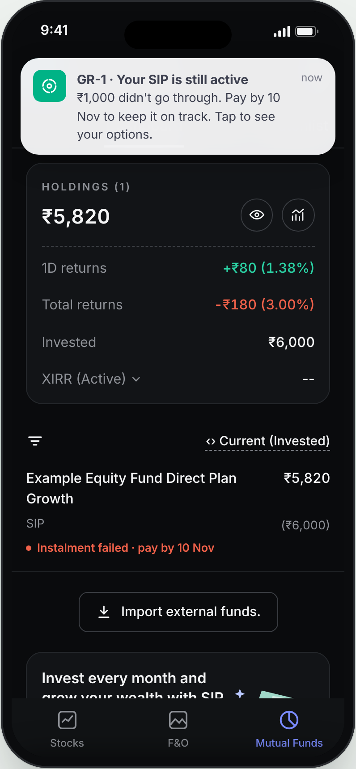
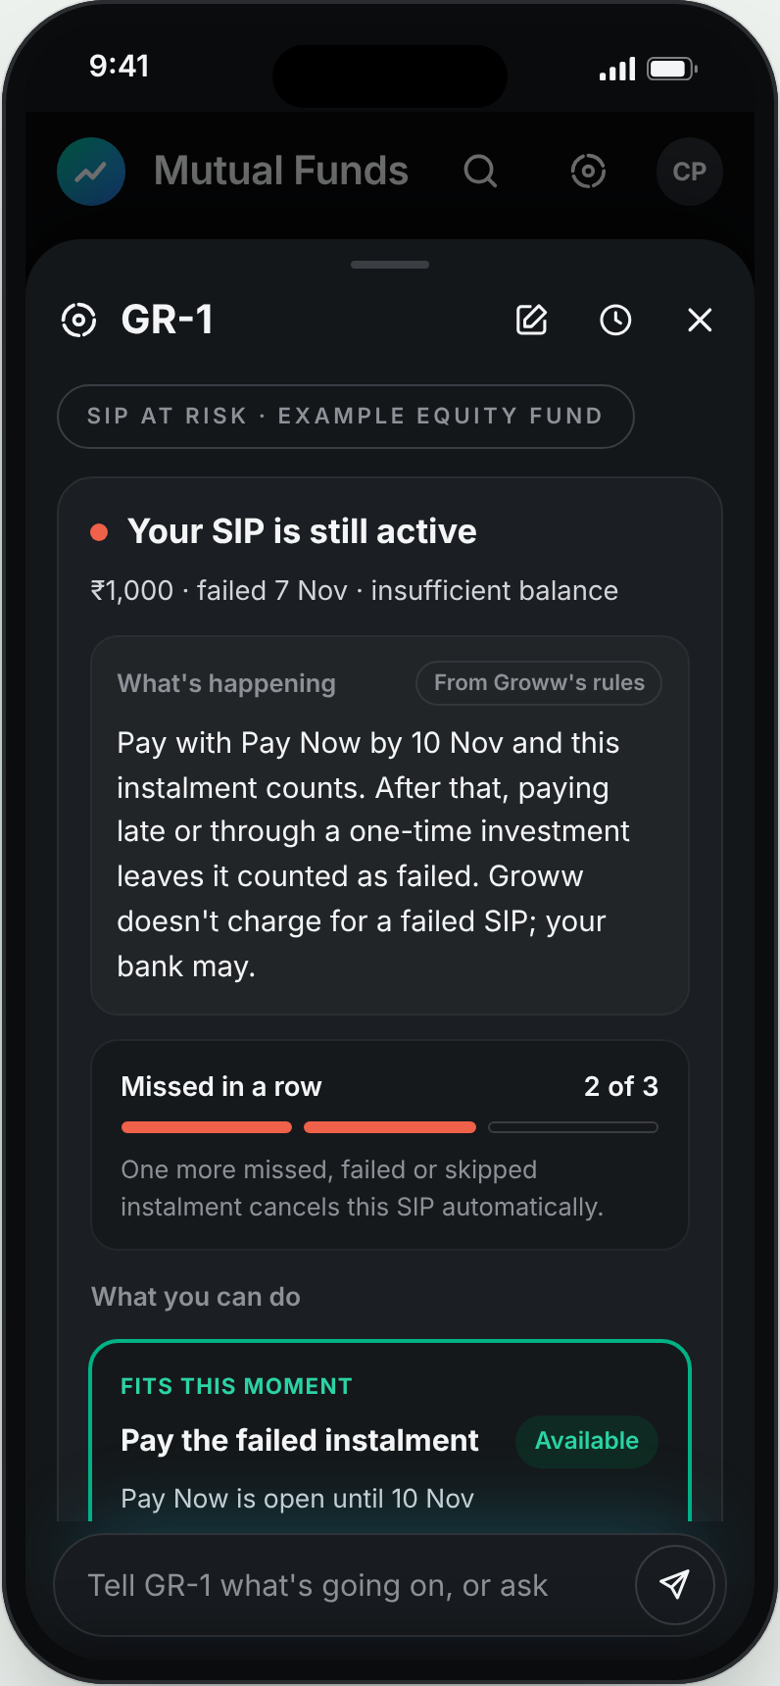
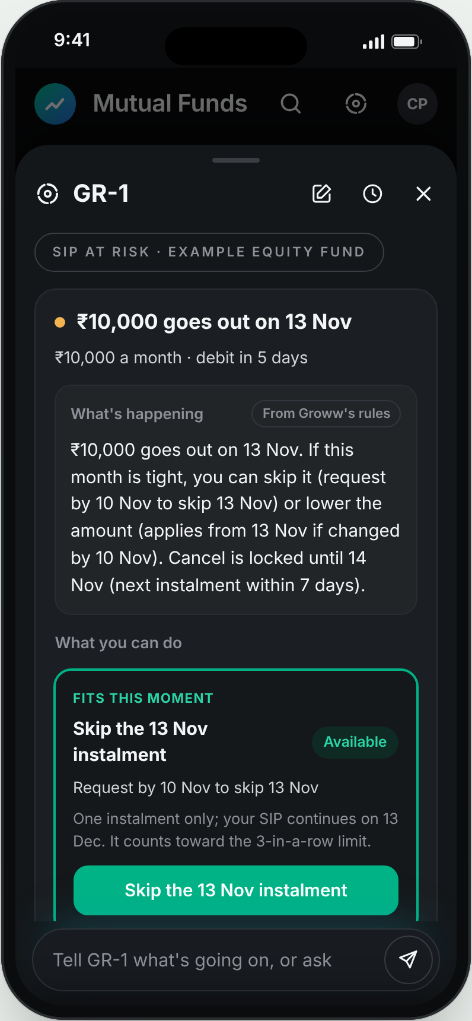
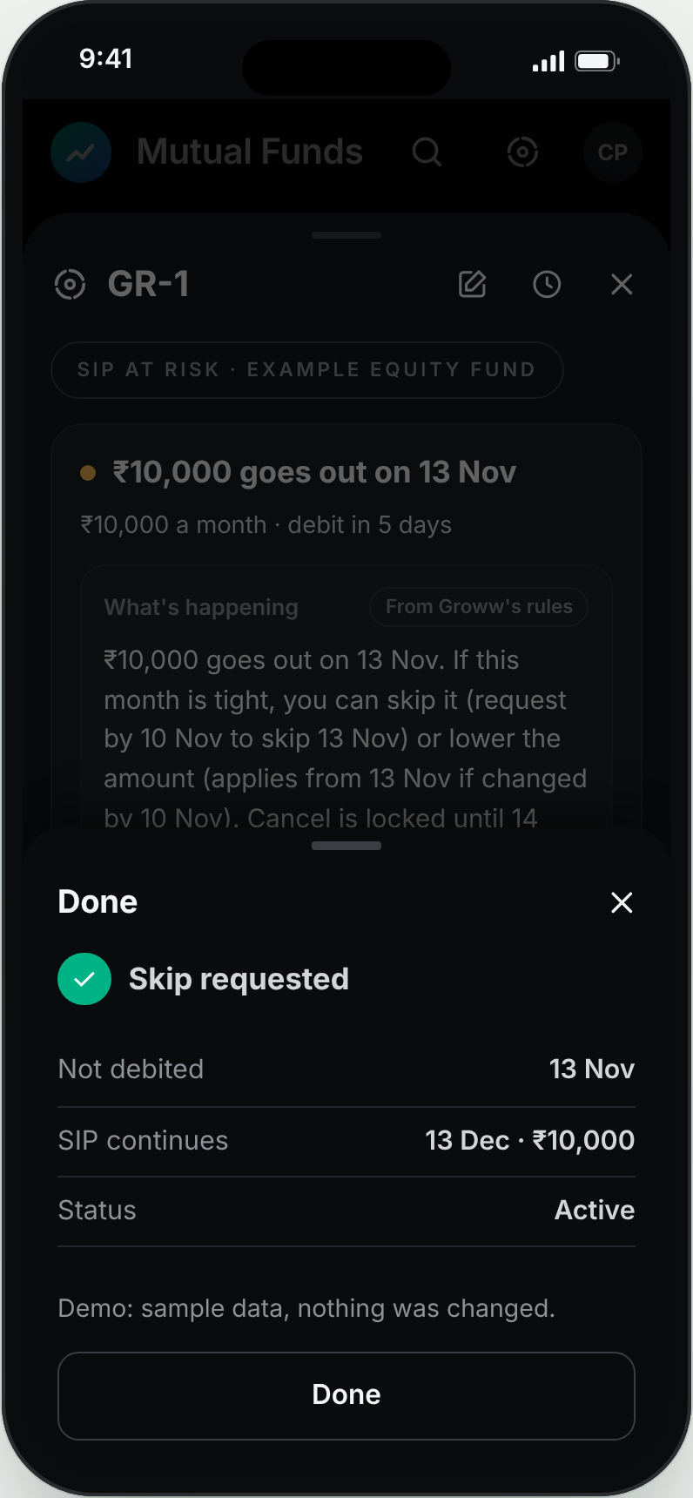
↗
Keep SIP Active GR-1 concept for Groww
07 · MVP
The live MVP opens one GR-1 card at every risk moment: rules decide the options, and AI answers are checked before they show
Deployed on sample SIP data, today's app vs GR-1 for all four moments, labelled “not investment advice”.
Where AI earns its place
Rules set every option and date. AI reads what people type (“stipend late”, Hinglish) and picks the option that fits.
Without AI: a fixed FAQ that can't read a situation or spot hardship.
Each answer passes 5 code checks and an AI reviewer, or a safe reply shows.
Pass rate per eval run, %
1 Alert opens GR-1
2 Missed 2 of 3
3 Tight: skip leads
4 Confirmed
0 unsafe answers in all 7 runs
Live MVP ↗
Quality report ↗
Metric
Discovery
Research
Segment
Problem
Solution
MVP
Testing
Metrics
Risks

Slide 8
↗
Keep SIP Active GR-1 concept for Groww
08 · User testing
All 3 testers chose a way to keep their SIP over cancelling, and their feedback shipped as 3 changes the same day
Sessions with P1, P6 and P2 on the live MVP, 6 Nov, each on the moment that matched their own story.
P1
P6
P2
Hypotheses
Investing ₹10k; one failed payment
Had cancelled his ₹2k SIP
Investing ₹10k; never missed
H2 Pick a non-cancel option
3 of 3
H3 Know money stays put
3 of 3
Chose: Skip this month
Chose: Move the date, or Lower
Chose: a one-month break
H5 Trust needs neutrality
3 of 3
“It gives me alternatives instead of making me think I have to cancel my SIP.”
“I might not have stopped my SIP if I knew I could change the date.”
“Someone who is new to investing might think that stopping the SIP means getting their money back.”
H1 Find it unprompted
Not tested
Shipped the same day
✓ Confirmation after every change
✓ When the SIP continues after a skip
✓ A break worded as a one-month skip
Next iteration
Lower for a few months, then remind
Win back cancelled SIPs
Tested: tight month, failed payment
Tested: failed payment, date, lower
Tested: needs a break, cancel
Metric
Discovery
Research
Segment
Problem
Solution
MVP
Testing
Metrics
Risks

Slide 9
↗
Keep SIP Active GR-1 concept for Groww
09 · Success metrics
Success means more first-year SIPs paid in month 12, with no rise in time to cancel or in people feeling pushed
One north star, leading signals that move within weeks, and guardrails that must not break.
North star share of first-time investors with a paid SIP instalment in the 30 days before their 12-month mark, by start-month cohort
Leading
Guardrails
AI quality
At-risk card reach
opened within 2 days of risk
Time to cancel
median seconds, must not rise
Safety pass
100%: no advice or urgency
Failure recovery
paid, skipped or edited in 7 days
Felt pressured
“Did this feel pushy?” stays low
Facts pass
at least 90% on the golden set
Auto-cancel rate
SIPs lost to 3 misses, per 100
Hardship stops
people in hardship can still stop
Live fallback rate
answers swapped for a safe one
Cancel-flow alternative
Cancel taps ending in skip or edit
Redemptions in 90 days
kept in, but leave anyway
Unsafe answers shown
target 0
Metric
Discovery
Research
Segment
Problem
Solution
MVP
Testing
Metrics
Risks

Slide 10
↗
Keep SIP Active GR-1 concept for Groww
10 · Risks and limitations
The biggest risks are advice, wrong dates and keeping people in who should stop, and each one has a guard built in
Failure modes, how the design limits them, how it would roll out, and what this case study could not test.
Risk | Guard in the design
Reads as investment advice | Code declines fund and stop/stay asks; 5 checks + AI reviewer; never names a fund
States a wrong date or rule | Every date comes from the rules engine; unconfirmed rules get “couldn't confirm”
Keeps in people who should stop | Hardship detected; stopping treated as valid; cancel stays two taps
Feels like a retention trick | No urgency words; cancel shown with the options; “felt pressured” guardrail
Rollout
Phase 1
Failed payments only: clearest trigger, A/B on recovery rate
Phase 2
Add the tight-month heads-up and blocked-skip card
Phase 3
Cancel flow, and GR-1 in the header knows SIP state
Limitations Sample data only. 3 tests, interviewer-led, so discovery and timing weren't measured. Public posts over-represent complaints. Returns-driven stops (26%) left out of scope.
Supporting work
Live MVP ↗
Discovery engine ↗
AI Evidence Log ↗
Quality report ↗
PRD ↗
User test kit ↗
Metric
Discovery
Research
Segment
Problem
Solution
MVP
Testing
Metrics
Risks

