Slide 1
Decrease and Conquer

Slide 2
Three major variations of decrease and conquer
Decrease by a Constant
Decrease by a Constant factor
Variable size Decrease

Slide 3
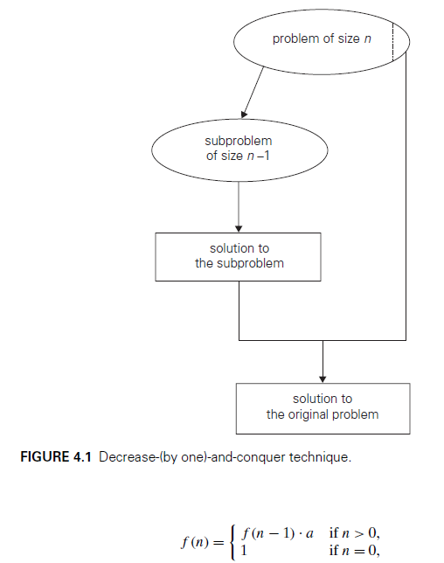

Slide 4
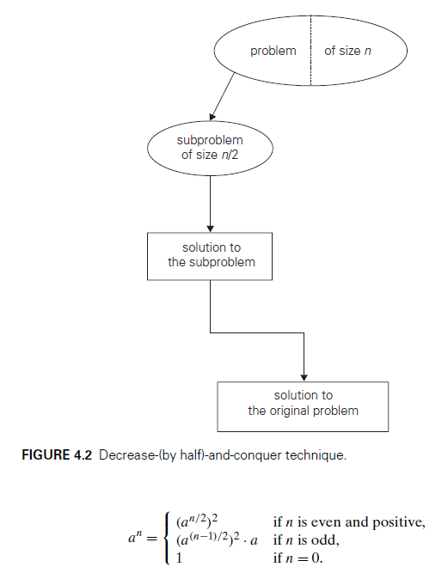

Slide 5
Topics Cover
Insertion Sort
Binary Search
Topological Sorting

Slide 6
Insertion Sort - Already covered

Slide 7
Insertion Sort
Suppose we know how to insert a new element x in its proper place in an already sorted array A of size k, to get a new sorted array of size k+1
Use this to sort the given array A of size n as follows:
Insert A[1] in the sorted array A[0]. So now A[0],A[1] are sorted
Insert A[2] in the sorted array A[0],A[1]. So now A[0],A[1],A[2] are sorted
Insert A[3] in the sorted array A[0],A[1],A[2]. So now A[0],A[1],A[2],A[3] are sorted
…..
Insert A[i] in the sorted array A[0],A[1],…,A[i-1]. So now A[0],A[1],…A[i] are sorted
Continue until i = n-1 (outer loop)

Slide 8
Example of first step
A
5 | 7 | 11 | 13 | 20 | 22
Insert x = 15

Slide 9
Example of first step
A
5 | 7 | 11 | 13 | 20 | 22
Insert x = 15
Compare with 22. x < 22, so move 22 right
5 | 7 | 11 | 13 | 20 | 15 | 22

Slide 10
Example of first step
A
5 | 7 | 11 | 13 | 20 | 22
Insert x = 15
Compare with 22. x < 22, so move 22 right
5 | 7 | 11 | 13 | 20 | 15 | 22
Compare with 20. x < 20, so move 20 right
5 | 7 | 11 | 13 | 15 | 20 | 22

Slide 11
Example of step: Inserting an element in to sorted array
A
5 | 7 | 11 | 13 | 20 | 22
Insert x = 15
Compare with 22. x < 22, so move 22 right
5 | 7 | 11 | 13 | 20 | 15 | 22
Compare with 20. x < 20, so move 20 right
5 | 7 | 11 | 13 | 15 | 20 | 22
Compare with 13. x > 13, so stop
A
5 | 7 | 11 | 13 | 15 | 20 | 22

Slide 12
Sort using the insertion sort
A
7 | 5 | 13 | 11 | 22 | 20
Insert 5 in 7
5 | 7 | 13 | 11 | 22 | 20
Insert 20 in 5, 7, 11, 13, 22
Insert 13 in 5, 7
5 | 7 | 11 | 13 | 20 | 22
5 | 7 | 13 | 11 | 22 | 20
Insert 11 in 5, 7, 13
5 | 7 | 11 | 13 | 22 | 20
Insert 22 in 5, 7, 11, 13
5 | 7 | 11 | 13 | 22 | 20

Slide 13
Insertion Sort Code
void InsertionSort (int A[ ], int n)
{
int i, j, item;
for (i=1; i<n; i++)
{ /* Insert the element in A[i] */
item = A[i] ;
for (j = i-1; j >= 0; j--)
if (item < A[j])
{ /* push elements down*/
A[j+1] = A[j];
A[j] = item ; /* can do this once finally also */
}
else break; /*inserted, exit loop */
}
} Time Complexity O(n²)

Slide 14
Insertion Sort Code
void InsertionSort (int A[ ], int n) Steps
{
int i, j, item; 1
for (i=1; i<n; i++) n
{ /* Insert the element in A[i] */
item = A[i] ; n–1
for (j = i-1; j >= 0; j--) ∑₁^{(n-1)}(i+1)=[n(n+1)/2]-1
if (item < A[j]) ∑₁^{(n-1)}i = (n-1)n/2
{ /* push elements down*/
A[j+1] = A[j]; (n-1)n/2
A[j] = item ; (n-1)n/2
}
else break; /*inserted, exit loop */
}
} Time Complexity O(n²)

Slide 15
Insertion Sort Analysis
Time Efficiency C(n):
Worst Case C_{worst}(n) = θ (n²)
Average Case C_{avg}(n) = θ (n²)
Best Case C_{best}(n) = n-1 = θ (n) (also fast on almost sorted arrays)

Slide 16
Look at the sorting!
void InsertionSort (int A[ ], int size) {
int i,j, item;
for (i=1; i<size; i++) {
printf("i = %d:: ",i);
for (j=0;j<size;j++) printf("%d, ",A[j]);
printf("\n"); item = A[i] ;
for (j=i-1; j>=0; j--)
if (item > A[j])
{ A[j+1] = A[j]; A[j] = item ; }
else break;
} }
8
2
9
4
7
6
2
1
5
i = 1:: 2, 9, 4, 7, 6, 2, 1, 5,
i = 2:: 9, 2, 4, 7, 6, 2, 1, 5,
i = 3:: 9, 4, 2, 7, 6, 2, 1, 5,
i = 4:: 9, 7, 4, 2, 6, 2, 1, 5,
i = 5:: 9, 7, 6, 4, 2, 2, 1, 5,
i = 6:: 9, 7, 6, 4, 2, 2, 1, 5,
i = 7:: 9, 7, 6, 4, 2, 2, 1, 5,
Result = 9, 7, 6, 5, 4, 2, 2, 1,
int main() {
int X[100], i, size;
scanf("%d",&size);
for (i=0;i<size;i++) scanf("%d",&X[i]);
InsertionSort(X,size);
printf("Result = ");
for (i=0;i<size;i++) printf("%d, ",X[i]);
printf("\n"); return 0;
}

Slide 17
Binary Search

Slide 18
Binary Search
Binary search. Given value and sorted array a[], find index i such that a[i] = value, or report that no such index exists.
Invariant. Algorithm maintains a[lo] ≤ value ≤ a[hi]
Ex. Binary search for 33.
6
13
14
25
33
43
51
53
64
72
84
93
95
96
97
0
1
2
3
4
5
6
7
8
9
10
11
12
13
14
lo
hi

Slide 19
Binary Search
Ex. Binary search for 33.
6
13
14
25
33
43
51
53
64
72
84
93
95
96
97
0
1
2
3
4
5
6
7
8
9
10
11
12
13
14
lo
mid
hi

Slide 20
Binary Search
6
13
14
25
33
43
51
53
64
72
84
93
95
96
97
0
1
2
3
4
5
6
7
8
9
10
11
12
13
14
lo
hi

Slide 21
Binary Search
6
13
14
25
33
43
51
53
64
72
84
93
95
96
97
0
1
2
3
4
5
6
7
8
9
10
11
12
13
14
lo
mid
hi

Slide 22
Binary Search
6
13
14
25
33
43
51
53
64
72
84
93
95
96
97
0
1
2
3
4
5
6
7
8
9
10
11
12
13
14
lo
hi

Slide 23
Binary Search
6
13
14
25
33
43
51
53
64
72
84
93
95
96
97
0
1
2
3
4
5
6
7
8
9
10
11
12
13
14
lo
mid
hi

Slide 24
Binary Search
6
13
14
25
33
43
51
53
64
72
84
93
95
96
97
0
1
2
3
4
5
6
7
8
9
10
11
12
13
14
lo hi

Slide 25
Binary Search
6
13
14
25
33
43
51
53
64
72
84
93
95
96
97
0
1
2
3
4
5
6
7
8
9
10
11
12
13
14
lo hi mid

Slide 26
Binary Search
6
13
14
25
33
43
51
53
64
72
84
93
95
96
97
0
1
2
3
4
5
6
7
8
9
10
11
12
13
14
lo hi mid

Slide 27
Binary Search Algorithm
ALGORITHM BinarySearch(A[0..n − 1], K)
//Implements nonrecursive binary search
//Input: An array A[0..n − 1] sorted in ascending order and
// a search key K
//Output: An index of the array’s element that is equal to K
// or −1 if there is no such element
l←0; r ←n − 1
while l ≤ r do
m←(l + r)/2
if K = A[m] return m
else if K < A[m] r ← m − 1
else l ← m + 1
return −1

Slide 28
Binary Search
int binarySearch(int a[], int n, const int x, int l, int r)
{
if(l > r) return -1; // x not found
int m = (l + r)/2;
if (x == a[m]) return m;
else if (x > a[m]) binarySearch(a, n, x, m+1, r);}
else binarySearch(a, n, x, l, m-1);
}

Slide 29
Binary Search Complexity
T(n) = T(n/2) + c , T(1) = d, where d is a constant
T(n) = T(n/2) + c = T(n/2²) + 2c = ….. =T(n/2^{k}) + kc
= kc + d (Assuming n=2^{k} , which implies k = logn)
= O(log n)

Slide 30
Analysis of Binary Search
This is VERY fast: e.g., T(2⁶⁰) = 60
Sequential search will take O (2⁶⁰)
Optimal for searching a sorted array
Limitations: must be a sorted array

Slide 31
Topological Sort

Slide 32
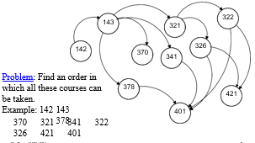

Slide 33
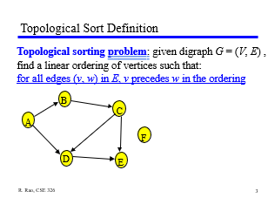

Slide 34
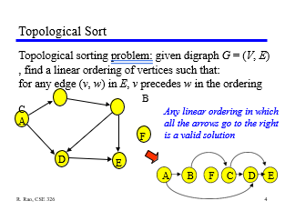

Slide 35
Topological Sort
Topological sort can only be applied to Directed Acyclic Graphs (DAGs). A DAG is a graph that has directed edges with no cycles.
If the digraph contains cycles, it is not possible to find a valid topological ordering.
Topological sorting is commonly used in various applications, such as task scheduling, dependency resolution, and in finding a linear order of events in a system.

Slide 36
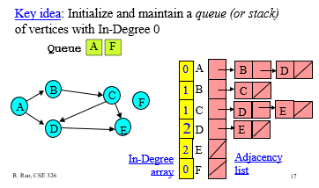

Slide 37
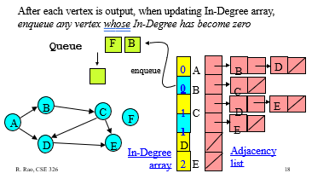





Slide 38
Topological Sort Algorithm #2
Store each vertex’s In-Degree in an array
Initialize a queue with all in-degree zero vertices
While there are vertices remaining in the queue:
➭ Dequeue and output a vertex
➭ Reduce In-Degree of all vertices adjacent to it by 1
➭ Enqueue any of these vertices whose In-Degree
became zero
B
C
A
F
D
E
Sort this digraph!

Slide 39
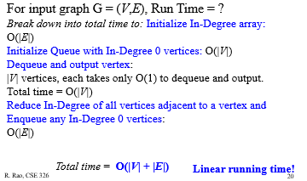
Topological Sort Algorithm: Analysis

Slide 40
Topological Sort DFS Method
Step 1: Create a temporary stack.
Step 2: Recursively call topological sorting for all its adjacent vertices, then push it to the stack (when all adjacent vertices are on stack). Note this step is same as Depth First Search in a recursive way.
Step 3: Finally, print the contents of stack.
Note: A vertex is pushed to stack only when all of its adjacent vertices (and their adjacent vertices and so on) are already in stack.

Slide 41
Topological Sort DFS Method
Step 1: Create the graph by calling addEdge(a,b).
Step 2: Call the topologicalSort( )
Step 2.1: Create a stack and a boolean array named as visited[ ];
Step 2.2: Mark all the vertices as not visited i.e. initialize visited[ ] with 'false' value.
Step 2.3: Call the recursive helper function topologicalSortUtil() to store Topological Sort starting from all vertices one by one.
Step 3: def topologicalSortUtil(int v, bool visited[],stack<int> &Stack):
Step 3.1: Mark the current node as visited.
Step 3.2: Recur for all the vertices adjacent to this vertex.
Step 3.3: Push current vertex to stack which stores result.
Step 4: Atlast after return from the utility function, print contents of stack.

Slide 42
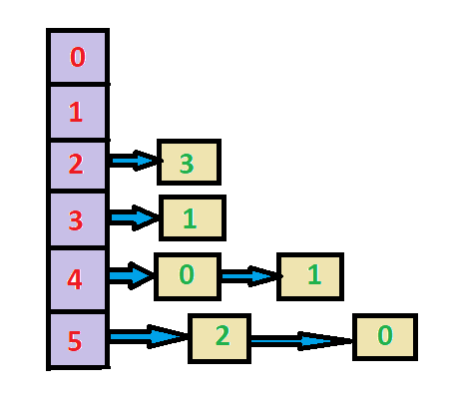
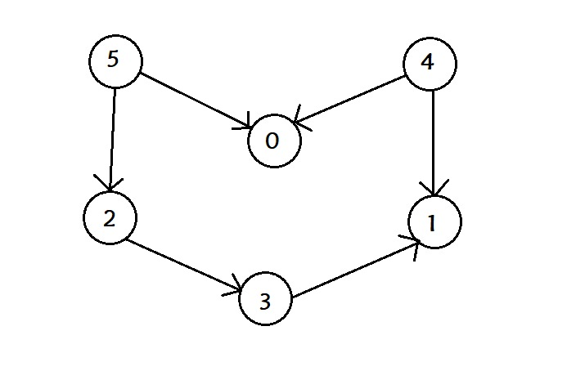

Source:Topological Sorting using Depth First Search (DFS) (opengenus.org)

Slide 43
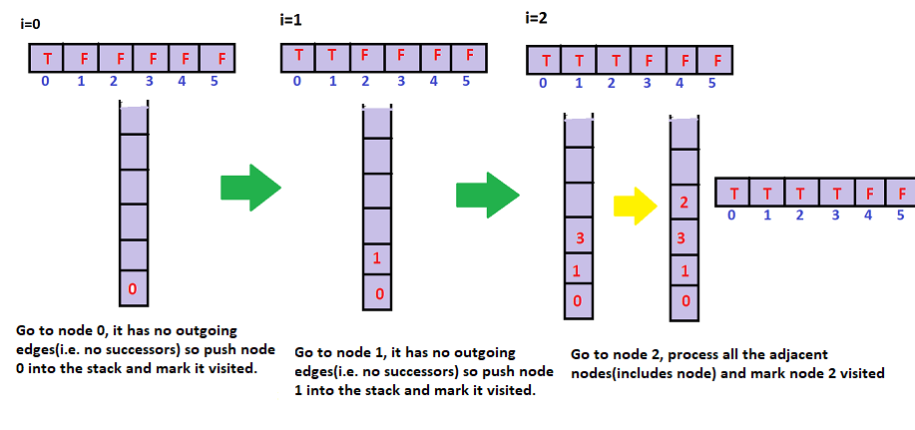

Slide 44
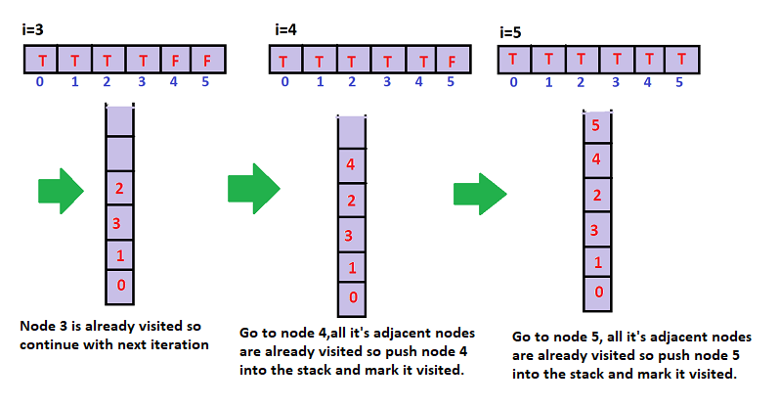

Slide 45
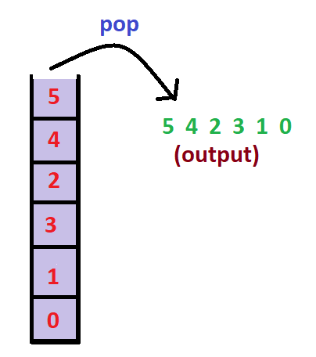
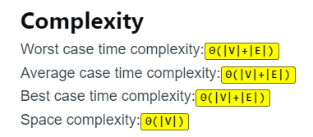

Slide 46
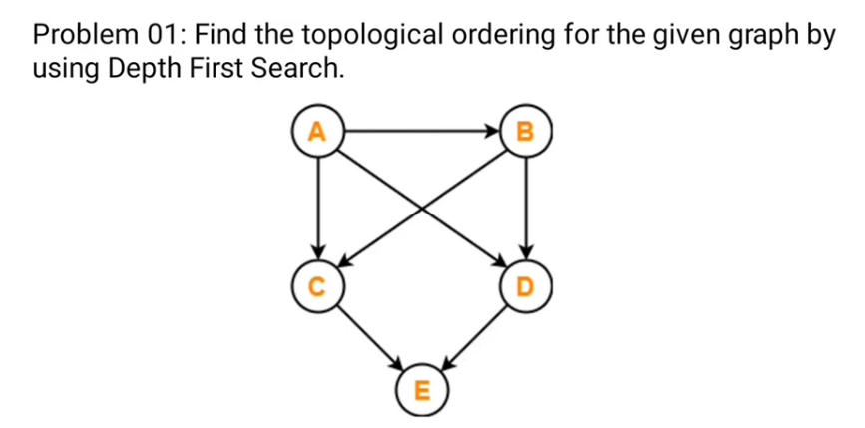
Problem

Slide 47
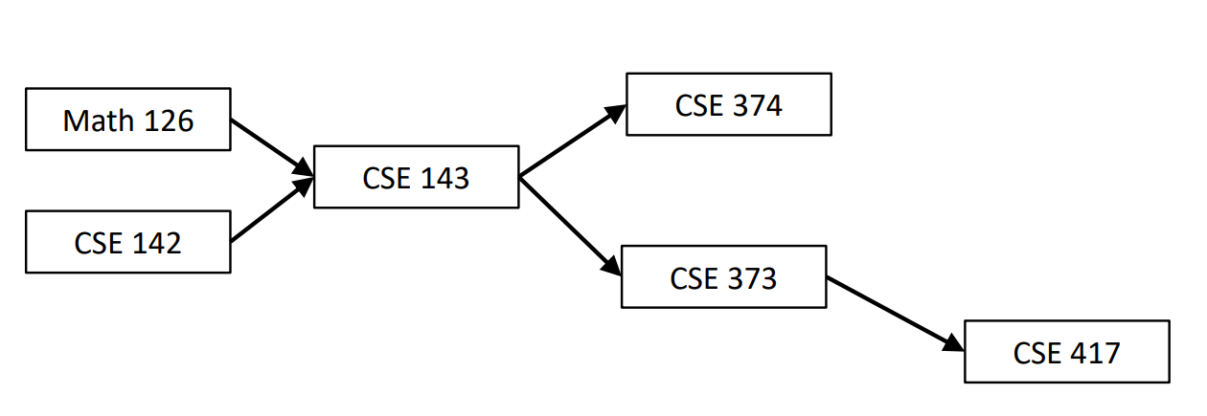
Prerequisite for CSE 143 course is Math 126 and CSE 142
Prerequisite for CSE 373 and CSE 374 is CSE 143
Prerequisite for CSE 417 is CSE 373

Slide 48
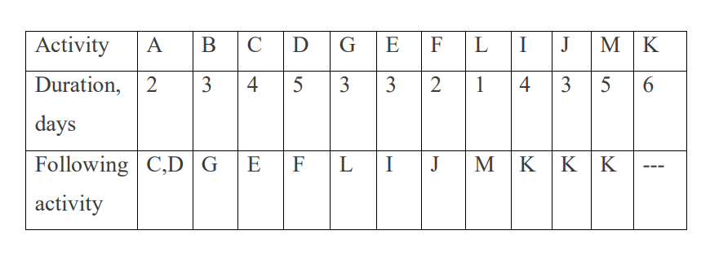
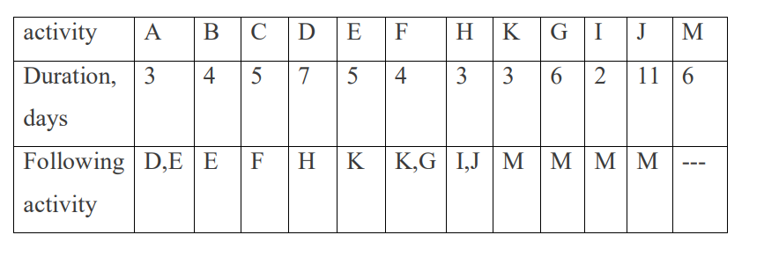

Slide 49
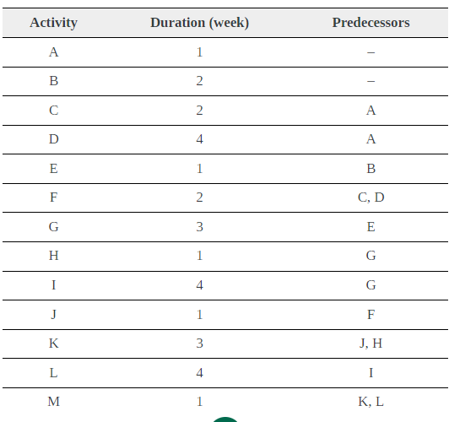
Tutorial
Draw activity network for the given table and sort the activity as per their topological ordering.

