Slide 1

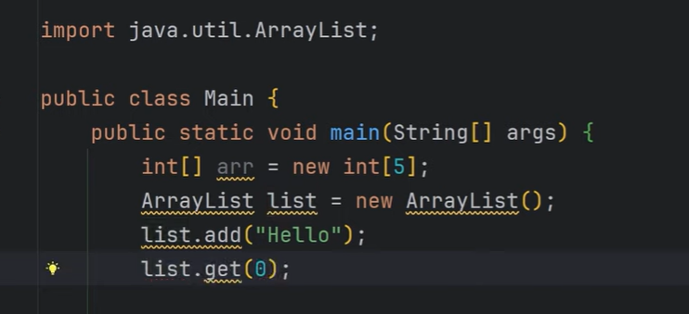
Notes:
Similar to array we have arraylist; arraylist is dynamic.
https://youtu.be/UypoeUL4T_U?si=HbJUOpANxUJfXulj

Slide 2
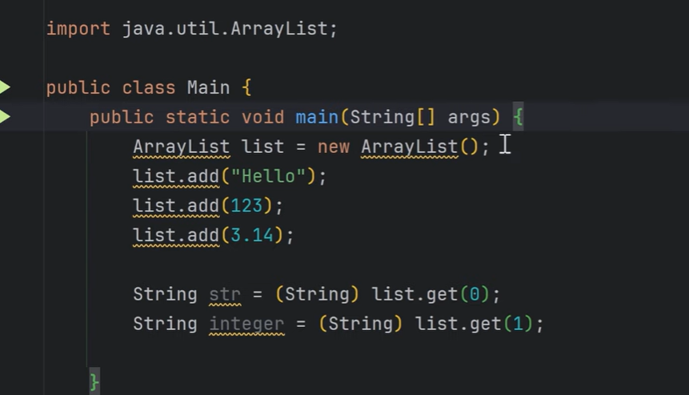
Notes:
Here, we have to manually cast the type; This results in Type safety issue.Henece Generics introduced.
As soon as you have store the string value; it will create string array; Hence manual casting requirement is not required.

Slide 3
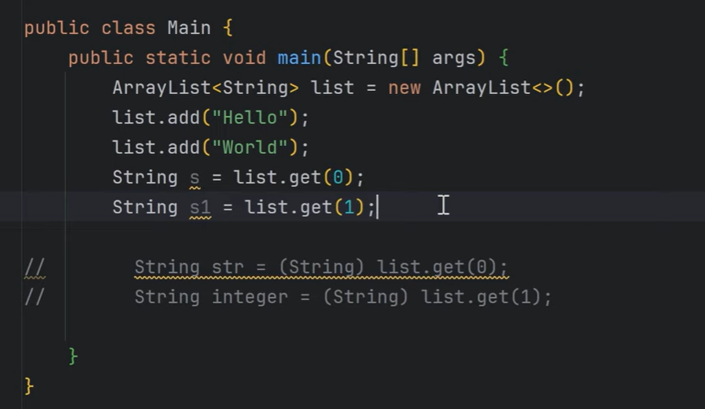
Notes:
ArrayList<String>

Slide 4
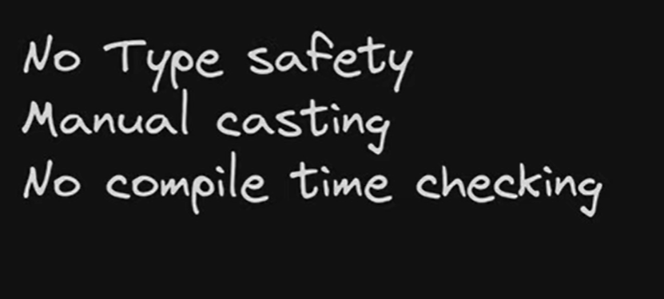

Slide 5
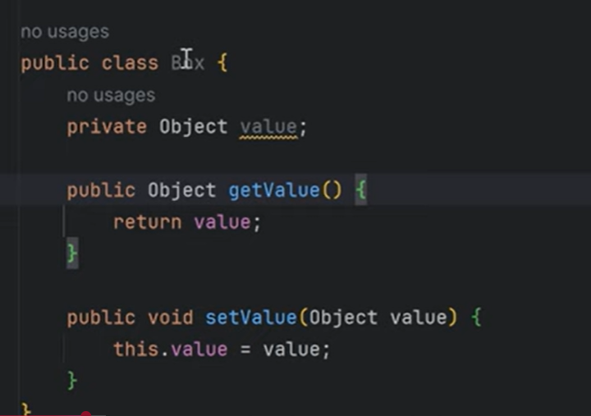
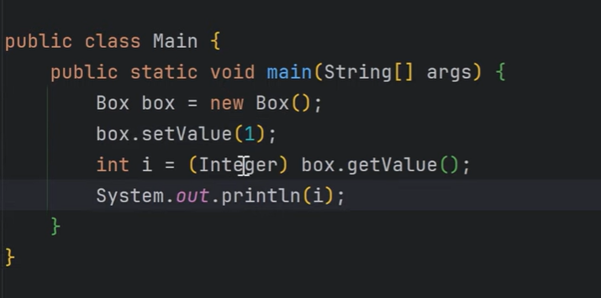
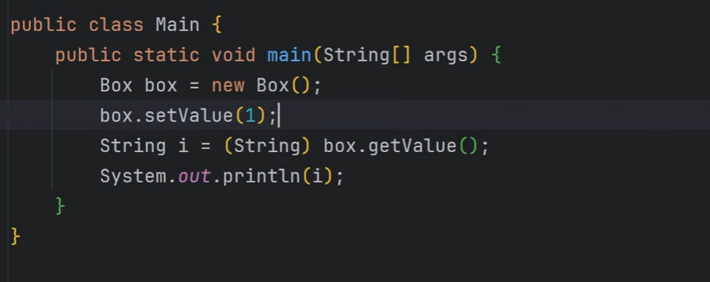
Notes:
Suppose, we accidently write integer, this will throw an error.

Slide 6
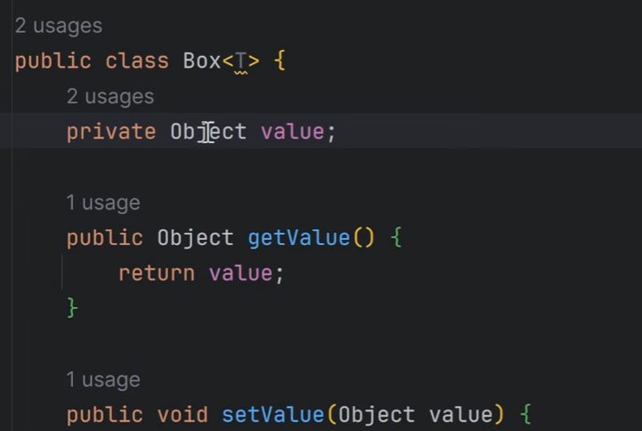
Notes:
Now Box is become Generic Type

Slide 7
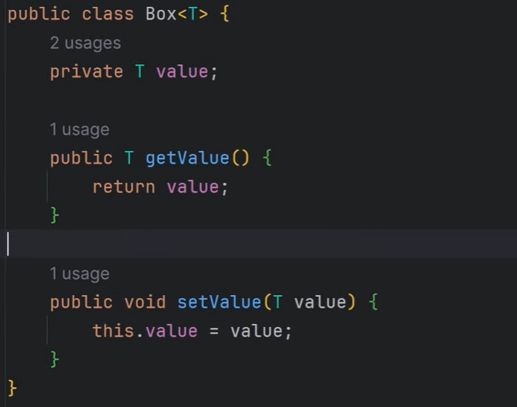

Slide 8
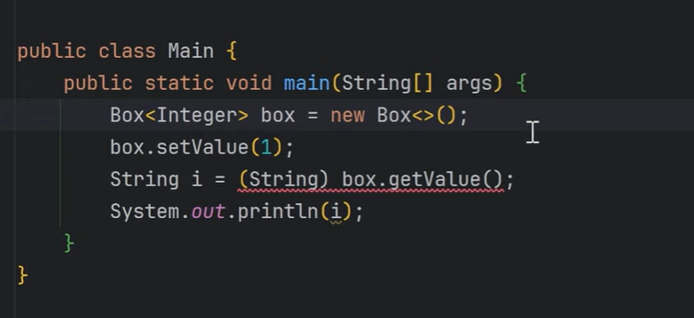
Notes:
We will get the error during compile time.
Box is now type safe.
Generic will allow to play with any type of the data.

Slide 9
Through the use of generics, it is possible to create classes, interfaces, and methods that will work in a type-safe manner with various kinds of data.
With generics, you can define an algorithm once, independently of any specific type of data, and then apply that algorithm to a wide variety of data types without any additional effort.
Perhaps the one feature of Java that has been most significantly affected by generics is the Collections Framework.
With generics, all casts are automatic and implicit.
Thus, generics expand your ability to reuse code and let you do so safely and easily.
Notes:
When generics were introduced in Java (Java 5), the entire Java Collections Framework was redesigned to use generic types.
Before generics:
Collections stored objects as Object.
Required explicit type casting when retrieving elements.
Increased risk of ClassCastException at runtime.
After generics:
Type safety at compile time
No explicit casting required
Cleaner and safer code

Slide 10
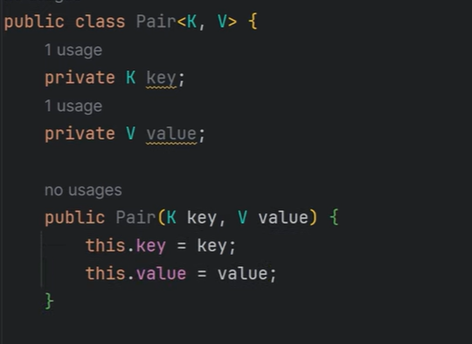
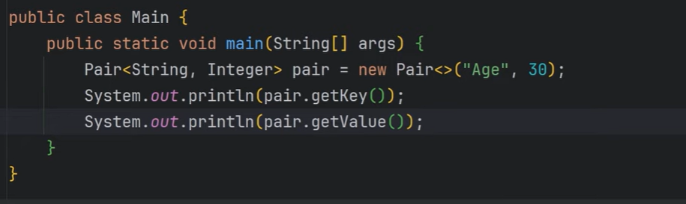
Notes:
It is not necessary we need to have only one value. We can have 2 values as well.
Till now we have seen about the class.

Slide 11


Slide 12
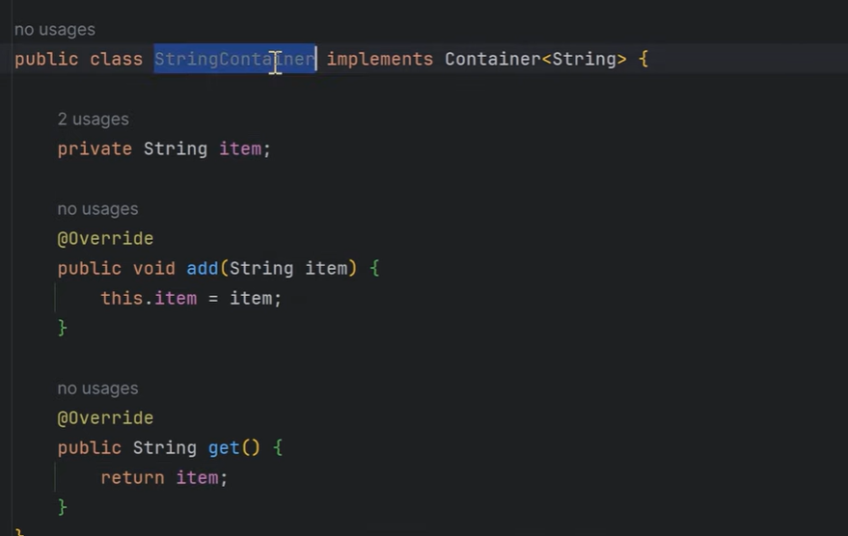
Notes:
Once it is done, we can make StringContainer to be generic.

Slide 13
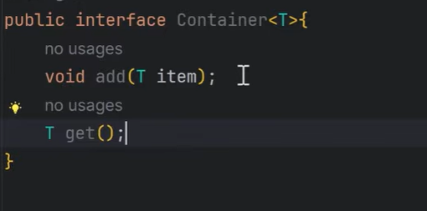

Slide 14
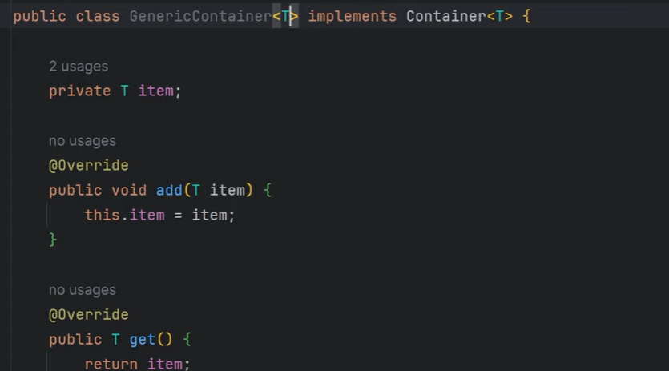

Slide 15


Slide 16
Bounded Types
In the preceding examples, the type parameters could be replaced by any class type. This is fine for many purposes, but sometimes it is useful to limit the types that can be passed to a type parameter.
For example, assume that you want to create a generic class that contains a method that returns the average of an array of numbers.
Furthermore, you want to use the class to obtain the average of an array of any type of number, including integers, floats, and doubles.
Thus, you want to specify the type of the numbers generically, using a type parameter.
To create such a class, you might try something like this:

Slide 17
To handle such situations, Java provides bounded types. When specifying a type parameter, you can create an upper bound that declares the superclass from which all type arguments must be derived.
This is accomplished through the use of an extends clause when specifying the type parameter, as shown here:
<T extends superclass>
This specifies that T can only be replaced by superclass, or subclasses of superclass.
Thus, superclass defines an inclusive, upper limit.

Slide 18
class Stats<T extends Number> {
class Gen<T extends MyClass & MyInterface> { // ...

Slide 19
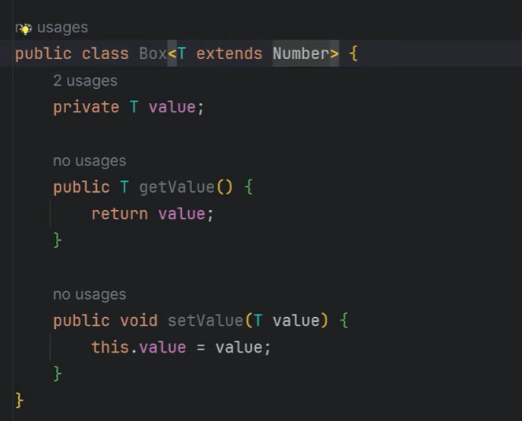
Notes:
‘T’ we have extended from the Number class. Number is a supperclass for the int, float….

Slide 20
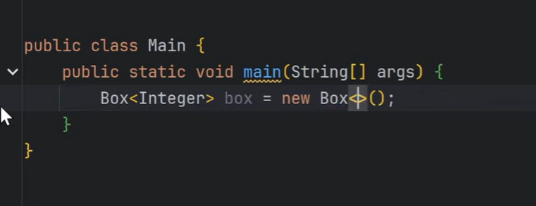
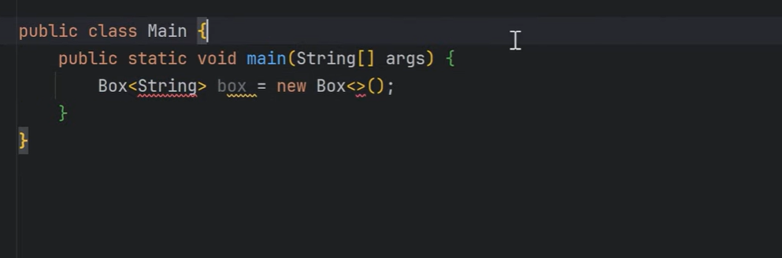
Notes:
If u write String, there will be an error. Because number class extends integer not the string;
T is called as the bounded type parameter.
I am applying the bounds only to the integer

Slide 21
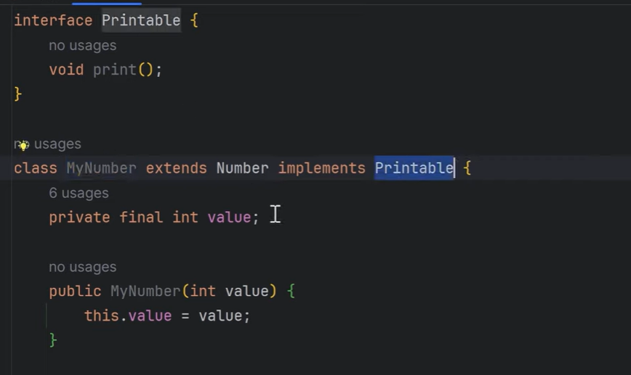
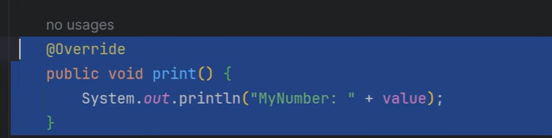
Notes:
Here, MuNumber extends Number, but implements Printable.
There is one filed, and the constructor. And there is one method, it will print.

Slide 22
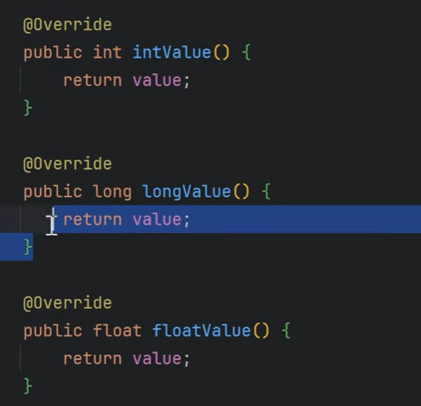
Notes:
These are the overriding methods. Where we are returning the value.

Slide 23
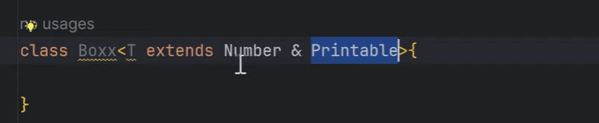
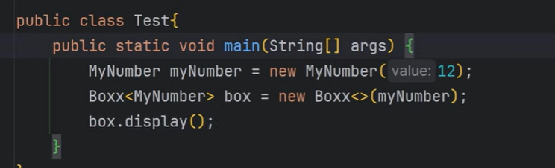
Notes:
Here, first we have to write the class name i.e Number and then the interface Printable.

Slide 24


Slide 25
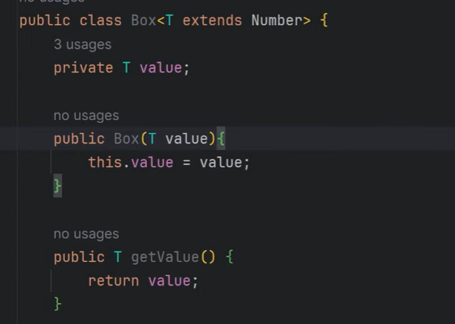
Notes:
Here class is generic and constructor is also generic.
Can we create only constructor is generic, but not the class.

Slide 26
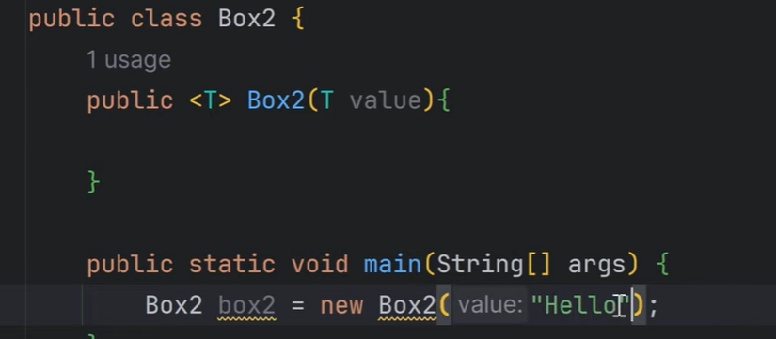
Notes:
This is called as the Generic Type constructor.

Slide 27
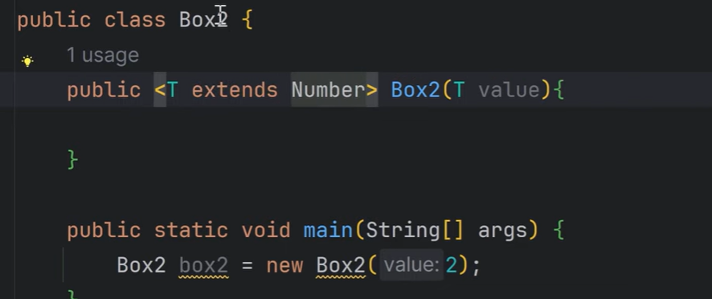
Notes:
Further, we can also extend the Number class as well. Here class is not Generic, but the constructor is Generic.

Slide 28

Notes:
Now we will see, Generic internally how it works??

Slide 29
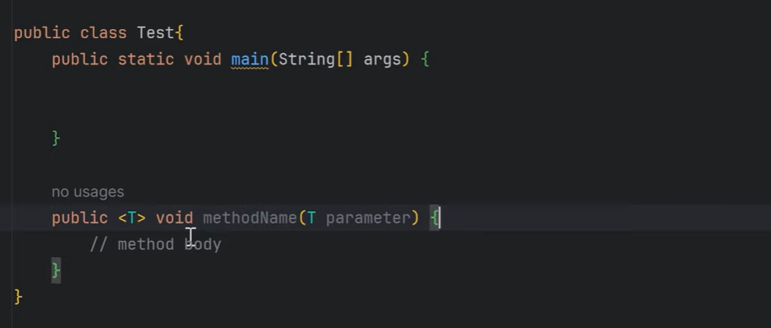

Slide 30
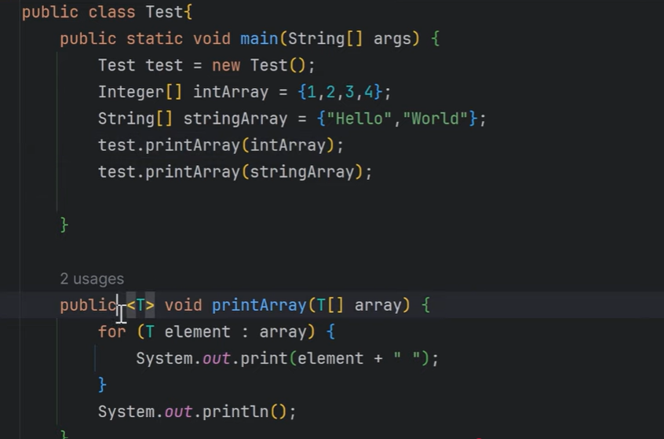

Slide 31


Slide 32
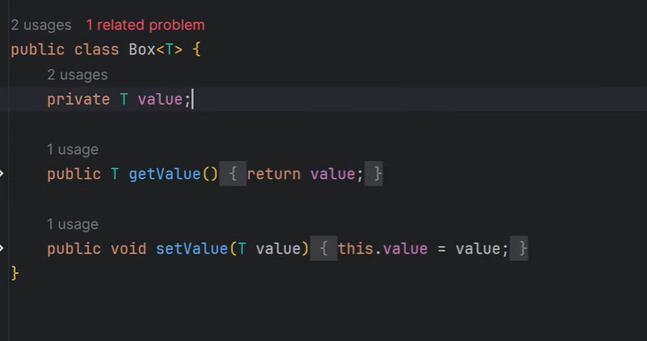

Slide 33
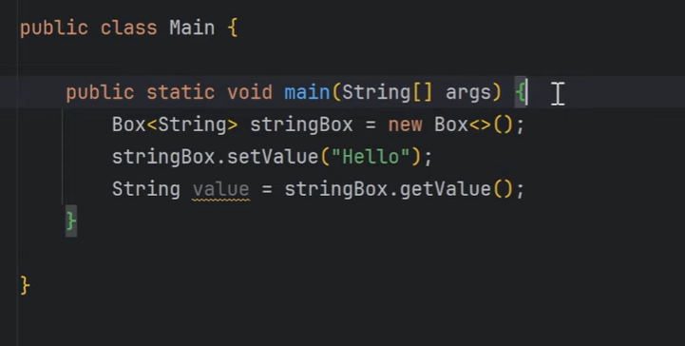
Notes:
Now compiler will check, it’s a string;
Here I have created Box type ka object and I have place string in it.
Byte code
After compilation, compiler will just delete the generic information.
Type means String erased after compilation.

Slide 34
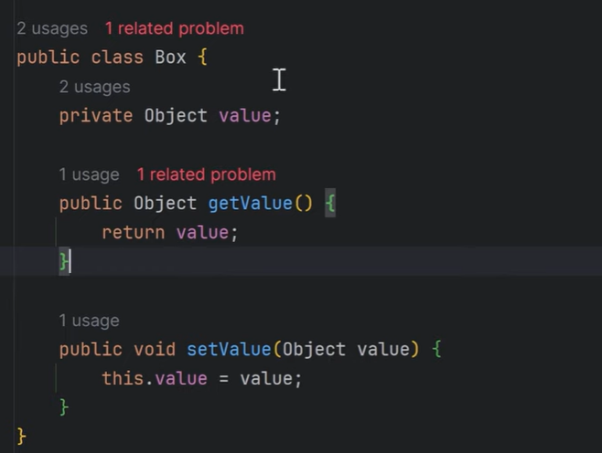
Notes:
Compiler does this. Box like this.; its not visible for us. This happens during object code creation.

Slide 35
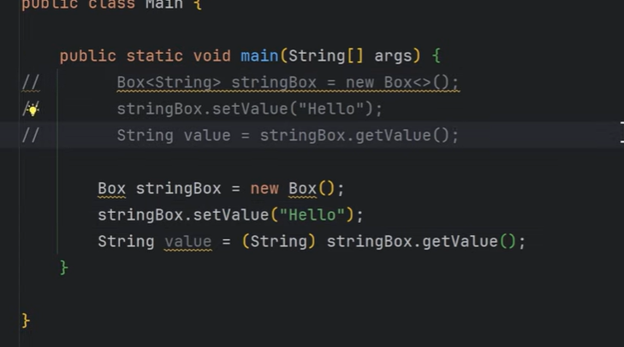

Slide 36
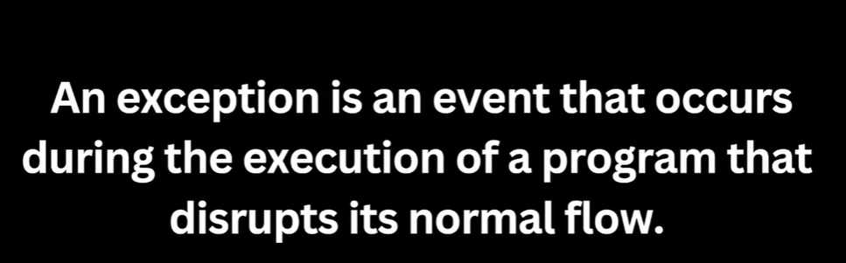

Slide 37
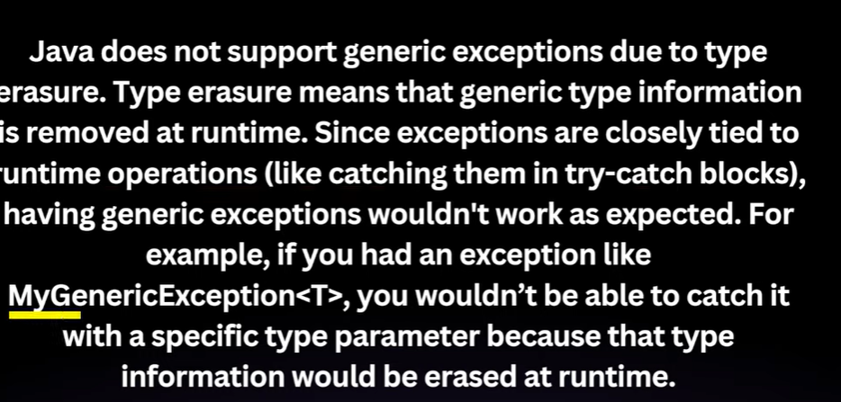

Slide 38
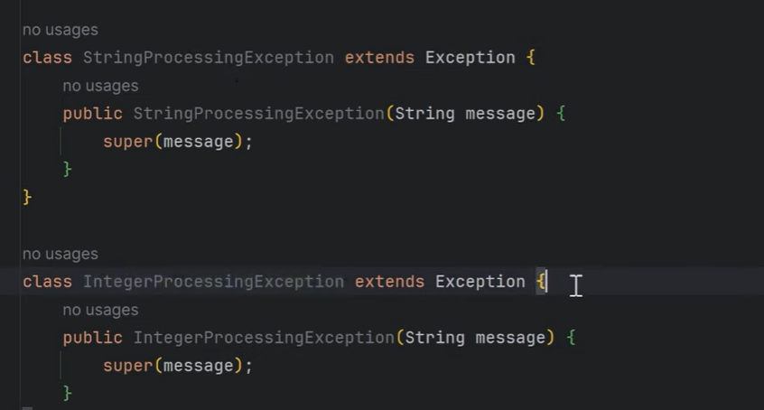
Notes:
Solution is we need to create Type specific classes. Meas for integer IntegerProcessing Exception etc…..

