Slide 1
Generics
Copyright © 2013 by The McGraw-Hill Companies, Inc. All rights reserved.

Slide 2
Generics
A classes, methods and interfaces that use type parameter is called generic.
Java has always supported for generalized classes, methods and interfaces by operating through references of type Object.
Object is the superclass of all other classes, and Object reference can refer to any object.
Copyright © 2013 by The McGraw-Hill Companies, Inc. All rights reserved.

Slide 3
Generics (Parameterized Types)
The advantage of Generics is it provide high level of reusability and type safety
In old code, many classes and methods used Object as the type of data they operated on.
The disadvantage of the old approach is that explicit conversion with typecasting is often necessary to convert to the actual type of the data.
Copyright © 2013 by The McGraw-Hill Companies, Inc. All rights reserved.

Slide 4
Example Without Generics
class KVPair{
Object key, value;
Object getKey() { return key; }
Object getValue() { return value; }
void setKey(Object ob) { key = ob; }
void setValue(Object ob) { value = ob; }
}
Usage: KVPair pair = new KVPair();
pair.setValue("Address");
String v = (String) pair.getValue(); // explicit typecast
Notes:
What is type safety in Java example?
Type-Safety. Arrays are always type-safe that is we can give the guarantee for the type of elements present inside the array. For example, if our programming requirement is to hold String type of objects it is recommended to use String array

Slide 5
Example with Generics
class KVPair<T>{
T key, value;
T getKey() { return key; }
T getValue() { return value; }
void setKey(T ob) { key = ob; }
void setValue(T ob) { value = ob; }
}
Usage: KVPair<String> pair = new KVPair<String>();
pair.setValue("Address");
String v = pair.getValue(); // no typecast
Copyright © 2013 by The McGraw-Hill Companies, Inc. All rights reserved.

Slide 6
Example Explained
class KVPair<T>
The <T> syntax indicates that T is name of a type parameter.
Any valid identifier can be used in place of T, but usage of T is traditional.
Use of generics allows us to avoid the type casting.
That is, generics makes type casts automatic and implicit, and therefore add type safety.
Copyright © 2013 by The McGraw-Hill Companies, Inc. All rights reserved.

Slide 7
Generics Work Only with Reference Types
Reference datatypes in java are those which contains reference/address of dynamically created objects. These are not predefined like primitive data types.
Thus,
Gen<int> intOb = new Gen<int>(53); // compile Error
Because generics can't use primitive type such as int, or char.
To handle this problem we must use type wrappers to encapsulate primitive type.
Notes:
ReferenceType encompasses classes, interfaces, and array types as defined in The Java™ Language Specification . All ReferenceType objects belong to one of the following subinterfaces: ClassType for classes, InterfaceType for interfaces, and ArrayType for arrays.
Reference datatypes in java are those which contains reference/address of dynamically created objects. These are not predefined like primitive data types. Following are the reference types in Java. class types − This reference type points to an object of a class. array types − This reference type points to an array

Slide 8
Wrapper Class
A Wrapper class in Java is a class whose object wraps or contains primitive data types.
When we create an object to a wrapper class, it contains a field and in this field, we can store primitive data types.
In other words, we can wrap a primitive value into a wrapper class object.
The wrapper class in Java provides the mechanism to convert primitive into object and object into primitive.
The automatic conversion of primitive into an object is known as autoboxing and vice-versa unboxing.
Notes:
ReferenceType encompasses classes, interfaces, and array types as defined in The Java™ Language Specification . All ReferenceType objects belong to one of the following subinterfaces: ClassType for classes, InterfaceType for interfaces, and ArrayType for arrays.
Reference datatypes in java are those which contains reference/address of dynamically created objects. These are not predefined like primitive data types. Following are the reference types in Java. class types − This reference type points to an object of a class. array types − This reference type points to an array

Slide 9
Primitive Data Types and their Corresponding Wrapper Class
Primitive Type | Wrapper class
boolean | Boolean
char | Character
byte | Byte
short | Short
int | Integer
long | Long
float | Float
double | Double
Notes:
ReferenceType encompasses classes, interfaces, and array types as defined in The Java™ Language Specification . All ReferenceType objects belong to one of the following subinterfaces: ClassType for classes, InterfaceType for interfaces, and ArrayType for arrays.
Reference datatypes in java are those which contains reference/address of dynamically created objects. These are not predefined like primitive data types. Following are the reference types in Java. class types − This reference type points to an object of a class. array types − This reference type points to an array
Integer wrapper class:
Syntax: public Integer(int b)
Constructors:
Integer(int b): Creates an Integer object initialized with the value provided.

Slide 10
Need of Wrapper Classes
The classes in java.util package handles only objects and hence wrapper classes help in this case also.
Data structures in the Collection framework, such as ArrayList and Vector, store only objects (reference types) and not primitive types.
An object is needed to support synchronization in multithreading.
Notes:
ReferenceType encompasses classes, interfaces, and array types as defined in The Java™ Language Specification . All ReferenceType objects belong to one of the following subinterfaces: ClassType for classes, InterfaceType for interfaces, and ArrayType for arrays.
Reference datatypes in java are those which contains reference/address of dynamically created objects. These are not predefined like primitive data types. Following are the reference types in Java. class types − This reference type points to an object of a class. array types − This reference type points to an array

Slide 11
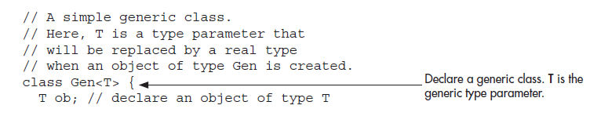
Another Generics Example

Slide 12
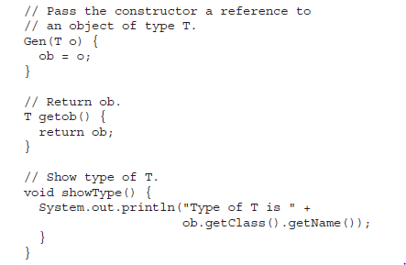
Notes:
getclass() is the method of Object class that returns a Class object that corresponds to the class type of the object on which it is called.
Class is a class defined within java.lang that encapsulates information about the class. getName() is a method of Class, which returns a string( name) representation of the class.

Slide 13
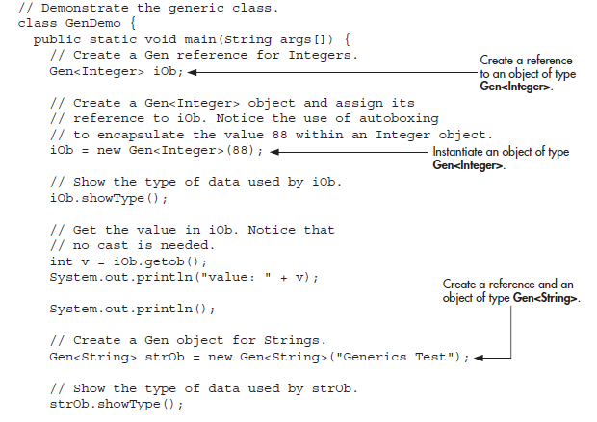
Notes:
Autoboxing is the automatic conversion that the Java compiler makes between the primitive types and their corresponding object wrapper classes. For example, converting an int to an Integer, a double to a Double, and so on. If the conversion goes the other way, this is called unboxing.

Slide 14
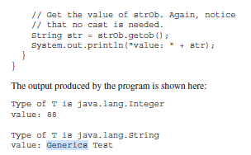

Slide 15
Generic Types Differ Based on Their Type Arguments
iOb = strOb; // Wrong!
Even though both iOb and strOb are of type Gen<T>, they are references to different types because their type arguments differ. This is part of the way that generics add type safety and prevent errors.

Slide 16
Generics with two Type Parameters
You can use two or more type parameters:
class KVPair<K,V>{
K key;
V value;
K getKey() { return key; }
V getValue() { return value; }
void setKey(K ob) { key = ob; }
void setValue(V ob) { value = ob; }
}
USAGE: KVPair<String,Integer> pair =
new KVPair<String,Integer>();
Copyright © 2013 by The McGraw-Hill Companies, Inc. All rights reserved.

Slide 17
The General Form of a Generic Class
class class-name<type-param-list> { // ...
Here is the full syntax for declaring a reference to a generic class and creating a generic instance:
class-name<type-arg-list> var-name = new class-name<type-arg-list>(cons-arg-list);

Slide 18
Bounded Types
a class/method that operates on numbers might only want to accept instances of Number or its subclasses.

Slide 19
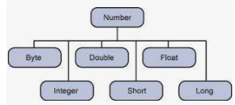
Class Number hierarchy

Slide 20
doubleValue() method of Double class
Double a = 10.5;// Wrapper class Double ( boxing)
// wrapping the Double value
// in the wrapper class Double
Double b = new Double(a);
// doubleValue of the Double Object
double res = b.doubleValue();
// prdoubleing the output
System.out.println("Double value of "
+ b + " is : " + res);
Output:
Double value of 17.47 is : 17.47

Slide 21
Bounded Types Explained
The notation T extends Number means that T must be a Number or a subclass of Number.
Byte, Double, Float, Integer, Long, and Short are subclasses of Number
Other option:
<T, K extends T> means that the second type parameter must be the same as the first parameter or a subclass of the first parameter.
Copyright © 2013 by The McGraw-Hill Companies, Inc. All rights reserved.

Slide 22
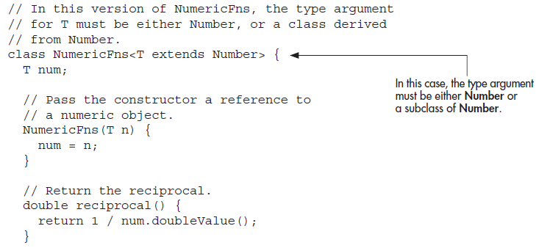

Slide 23
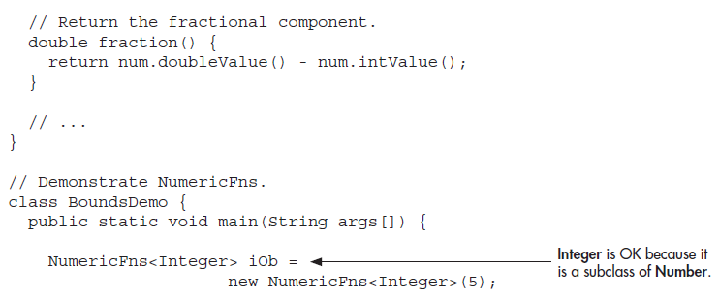

Slide 24
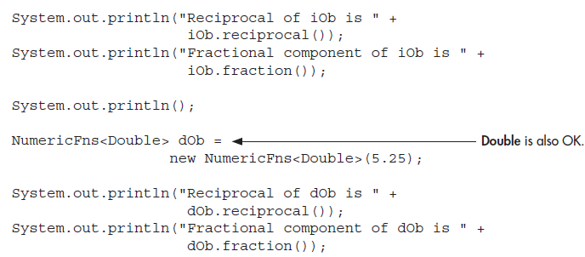

Slide 25
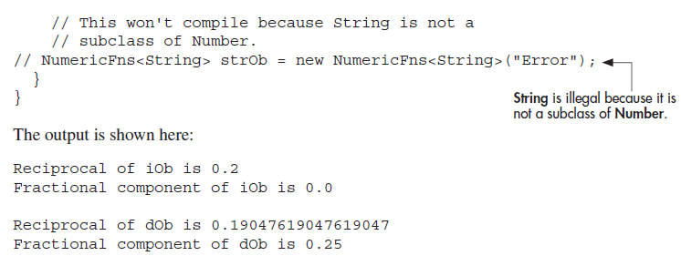

Slide 26
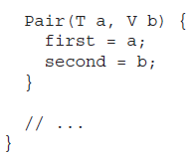


Slide 27
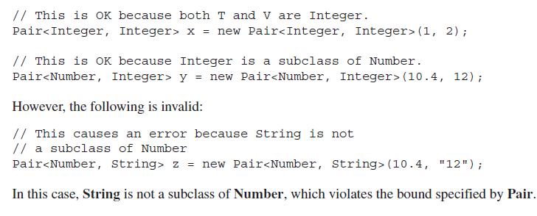

Slide 28
Generic Methods
You can write a single generic method declaration that can be called with arguments of different types.
Based on the types of the arguments passed to the generic method, the compiler handles each method call appropriately.
Copyright © 2013 by The McGraw-Hill Companies, Inc. All rights reserved.

Slide 29
Following example illustrates how we can print an array of different type using a single Generic method −
public class GenericMethodTest {
// generic method printArray
public static < E > void printArray( E[ ] inputArray ) {
// Display array elements
for(E element : inputArray) {
System.out.print(“ “+ element);
}
System.out.println();
}
Copyright © 2013 by The McGraw-Hill Companies, Inc. All rights reserved.

Slide 30
public static void main(String args[]) {
// Create arrays of Integer, Double and Character
Integer[] intArray = { 1, 2, 3, 4, 5 };
Double[] doubleArray = { 1.1, 2.2, 3.3, 4.4 };
Character[] charArray = { 'H', 'E', 'L', 'L', 'O' };
System.out.println("Array integerArray contains:");
printArray(intArray); // pass an Integer array
System.out.println("\nArray doubleArray contains:");
printArray(doubleArray); // pass a Double array
System.out.println("\nArray characterArray contains:");
printArray(charArray); // pass a Character array
}
}
Copyright © 2013 by The McGraw-Hill Companies, Inc. All rights reserved.
Notes:
Output:
Array integerArray contains: 1 2 3 4 5
Array doubleArray contains: 1.1 2.2 3.3 4.4
Array characterArray contains: H E L L O

Slide 31
/*The Util class includes a generic method, compare, which compares two Pair objects:*/
public class Util {
public static <K, V> boolean compare(Pair<K, V> p1, Pair<K, V> p2) {
return p1.getKey().equals(p2.getKey()) &&
p1.getValue().equals(p2.getValue());
}
}
public class Pair<K, V> {
private K key; private V value;
public Pair(K key, V value) {
this.key = key;
this.value = value;
}
public void setKey(K key) { this.key = key; }
public void setValue(V value) { this.value = value; }
public K getKey() { return key; }
public V getValue() { return value; }
}
Copyright © 2013 by The McGraw-Hill Companies, Inc. All rights reserved.
Notes:
Output:
Array integerArray contains: 1 2 3 4 5
Array doubleArray contains: 1.1 2.2 3.3 4.4
Array characterArray contains: H E L L O

Slide 32
Example
The complete syntax for invoking this method would be:
Pair<Integer, String> p1 = new Pair<>(1, "apple");
Pair<Integer, String> p2 = new Pair<>(2, "pear");
boolean same = Util.<Integer, String> compare(p1, p2);
Here, the type has been explicitly provided, as shown in bold.
Generally, this can be left out and the compiler will infer the type that is needed:
Pair<Integer, String> p1 = new Pair<>(1, "apple");
Pair<Integer, String> p2 = new Pair<>(2, "pear");
boolean same = Util.compare(p1, p2);
This feature, known as type inference, allows you to invoke a generic method as an ordinary method, without specifying a type between angle brackets.

Slide 33
Generic Constructor
A constructor can be generic, even if its class is not.
For example, in the following program, the class Summation is not generic, but its constructor is.
Copyright © 2013 by The McGraw-Hill Companies, Inc. All rights reserved.

Slide 34
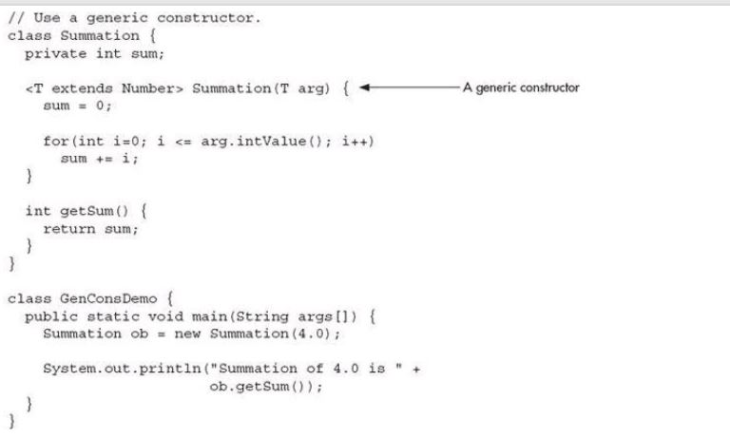
Generic Constructor
Copyright © 2013 by The McGraw-Hill Companies, Inc. All rights reserved.

Slide 35
Inheritance and Generics
A generic class can be a part of class hierarchy as any non-generic class.
A generic class can be a superclass or subclass.
In a generic class any type arguments needed must be passes up by all subclasses.
Example:
class Sub<T,V> extends Sup<T> {
...
}
Copyright © 2013 by The McGraw-Hill Companies, Inc. All rights reserved.

Slide 36
Inheritance and Generics
If a subclass of generic class does not need to be a generic, it still must specify the type parameter(s) required by its generic superclass.
A subclass is also free to add its own type parameter, if needed.
A non-generic class can also be a superclass of a generic class.
Copyright © 2013 by The McGraw-Hill Companies, Inc. All rights reserved.

Slide 37
Interfaces and Generics
Interfaces can also be generic.
Any class that implements a generic interface must also be generic unless it implements a specific type of the interface.
Examples:
class C<T> implements I<T> { ... }
class D implements I<String> { ... }
Copyright © 2013 by The McGraw-Hill Companies, Inc. All rights reserved.

Slide 38
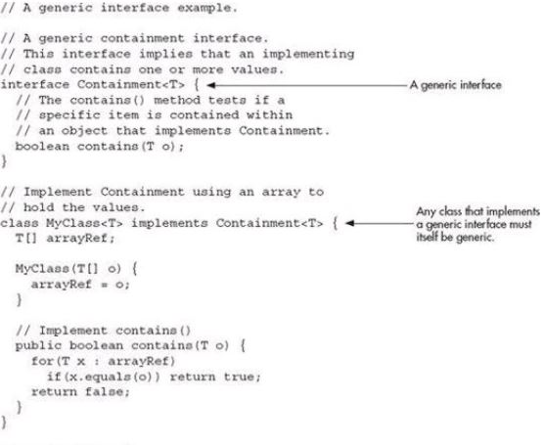
Interfaces and Generics
Copyright © 2013 by The McGraw-Hill Companies, Inc. All rights reserved.
Notes:
We can use == operators for reference comparison (address comparison) and .equals() method for content comparison. In simple words, == checks if both objects point to the same memory location whereas .equals() evaluates to the comparison of values in the objects.
equals(Object[] a, Object[] a2) method returns true if the two specified arrays of objects are equal to one another. The two arrays are considered equal if both arrays contain the same number of elements, and all corresponding pairs of elements in the two arrays are equal.

Slide 39
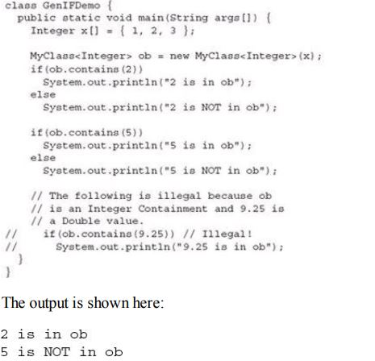
Interfaces and Generics
Copyright © 2013 by The McGraw-Hill Companies, Inc. All rights reserved.

Slide 40
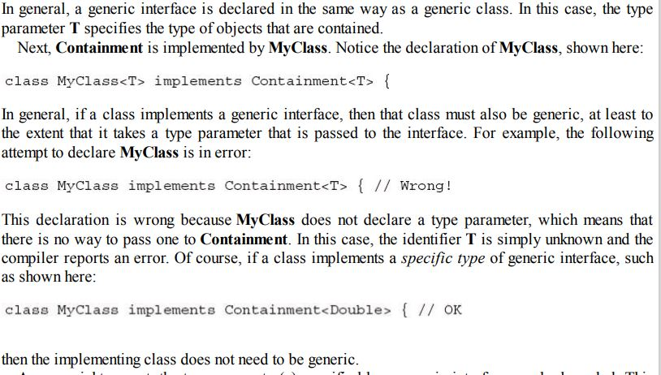
Interfaces and Generics
Copyright © 2013 by The McGraw-Hill Companies, Inc. All rights reserved.

Slide 41
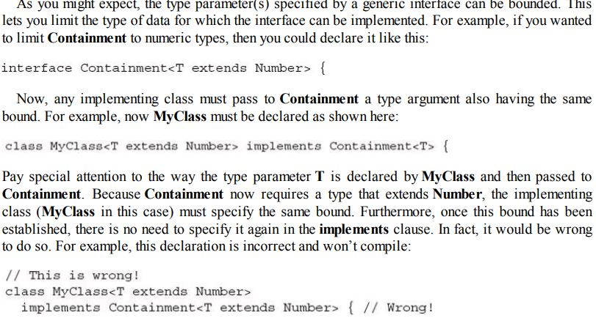
Interfaces and Generics
Copyright © 2013 by The McGraw-Hill Companies, Inc. All rights reserved.

Slide 42
Generic Restrictions
Static variables and methods cannot use the type parameters declared by their generic class (but you can have static generic methods).
ii)You can't create an instance of a type parameter.
(iii) You can't create an array whose element type is the type parameter nor an array of type-specific generic references.
Copyright © 2013 by The McGraw-Hill Companies, Inc. All rights reserved.
Notes:
Even static void getx(T x) is invalid : error “Cannot make a static reference to the non-static type T”

Slide 43
More Generic Restrictions
(iv) Generic Exception Restriction:
A generic class cannot extend Throwable. This means that you cannot create generic exception classes.

Slide 44
Generic Restrictions
(i) Static variables and methods cannot use the type parameters declared by their generic class (but you can have static generic methods).
Example:
class C<T> {
static T x; // illegal
static T getX() { return x; } // illegal
static <W> void setX(W w) { // legal
...
}
}
Copyright © 2013 by The McGraw-Hill Companies, Inc. All rights reserved.
Notes:
Even static void getx(T x) is invalid : error “Cannot make a static reference to the non-static type T”

Slide 45
More Generic Restrictions
ii)You can't create an instance of a type parameter.
Example:
class C<T>
{
T x;
C()
{ x= new T(); // illegal
}
}
(iii) You can't create an array whose element type is the type parameter nor an array of type-specific generic references.
Example:
class C<T> {
T[] x ;
x = new T[10]; // illegal
C<String>[] data= new C<String>[10]; // illegal
C<?>[] data = new C<?>[10]; // legal
}

Slide 46
More Generic Restrictions
(iv) Generic Exception Restriction:
A generic class cannot extend Throwable. This means that you cannot create generic exception classes.

