Slide 1
IO Streams

Slide 2
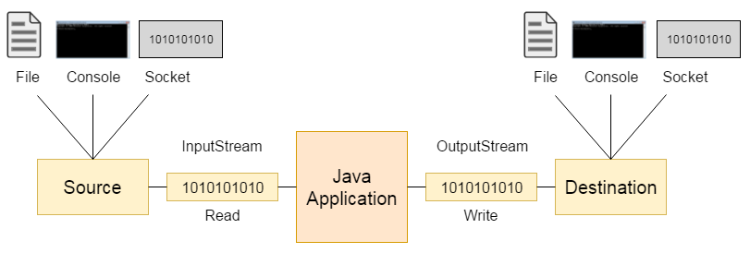

Slide 3
There are many classes and interfaces in the java.io package.

Slide 4
File
A File object is used to obtain or manipulate the information associated with a disk file.
Ex: permissions, time, date, and directory path etc.
File class does not specify how information is retrieved from or stored in files;
It describes the properties of a file itself.

Slide 5
File
A directory in Java is treated simply as a File with one additional property:
List of filenames that can be examined by the list( ) method.

Slide 6
Constructors used to create File objects:
File(String directoryPath)
File(String directoryPath, String filename)
File(File dirObj, String filename)
File(URI uriObj)

Slide 7
Constructors used to create File objects:
File f1 = new File(“c:/mit/ict/cce/prg1.txt");
File f2 = new File(" c:/mit/ict/cce/", “prg1.txt”);
File f3 = new File(" c:/mit/ict/cce/");
File f4 = new File(f3,”prg1.txt”);

Slide 8
Windows:
recognize forward slash(/).
If we use backaword slash, we need to use escape sequence(\\)
Unix :
recognize backword slash(\).

Slide 9
Methods :
String getName()
String getParent()
String getPath()
String getAbsolutePath()

Slide 10
Methods :
boolean exists()
boolean canWrite()
boolean canRead()
boolean isDirectory()
boolean isFile()
boolean isAbsolute()

Slide 11
Methods :
long lastModified()
long length()

Slide 12
Methods :
boolean renameTo(File newName)
newName becomes the new name of the invoking File object.
It will return true upon success and false if the file cannot be renamed.
(if you either attempt to rename a file so that it uses an existing filename).

Slide 13
Creating Directories
boolean mkdir( )
boolean mkdirs( )
mkdirs : To create a directory for which no path exists. It creates a directory and all the parents of the directory.

Slide 14
Creating Directories
File f = new File("D:\\MIT");
if (f.mkdir())
{
System.out.println("Directory is created");
}
else
{
System.out.println("Directory cannot be created");
}

Slide 15
Boolean delete()
To delete file and directory.
To delete directory, it should be empty

Slide 16
Directories
String [] list()

Slide 17
The listFiles( ) Alternative
Variation to the list( ) method.
Which returns File instead of string
File[ ] listFiles( )
File[ ] listFiles(FilenameFilter FFObj)

Slide 18
Using FilenameFilter
To limit the number of files returned by the list( ) method.
To include only those files that match a certain filename pattern, or filter.
Second form of list( ) :
String[ ] list(FilenameFilter FFObj)
FFObj is an object of a class that implements the FilenameFilter interface.

Slide 19
FilenameFilter defines a single method, accept( ), which is called once for each file in a list.
boolean accept(File directory, String filename)
The accept( ) method returns true for files in the directory specified by directory that should be included in the list (that is, those that match the filename argument), and returns false for those files that should be excluded.
The OnlyExt class implements FilenameFilter.

Slide 20
import java.io.*;
public class OnlyExt implements FilenameFilter
{
String ext;
public OnlyExt(String ext)
{
this.ext = "." + ext;
}
public boolean accept(File dir, String name)
{
return name.endsWith(ext);
}
}

Slide 21
import java.io.*;
class DirListOnly
{ public static void main(String args[])
{
String dirname = "/java";
File f1 = new File(dirname);
FilenameFilter only = new OnlyExt("html");
String s[] = f1.list(only);
for (int i=0; i < s.length; i++)
{ System.out.println(s[i]);
}
} }

Slide 22


A stream is a logical entity that either produces or consumes information.
A stream is linked to a physical device by the Java I/O system.

Slide 24
Byte stream
File: "Hello"
Storage in File (Bytes):
+----+----+----+----+----+----+
| 72 |101 |108 |108 |111 | 10 |
+----+----+----+----+----+----+
H e l l o \n
|
| FileInputStream (reads one byte at a time)
v
Program Receives:
72 → 101 → 108 → 108 → 111 → 10

Slide 25
Character stream
File: "Hello"
Storage in File (Bytes):
+----+----+----+----+----+----+
| 72 |101 |108 |108 |111 | 10 |
+----+----+----+----+----+----+
|
| FileReader (decodes bytes to characters)
v
Program Receives:
'H' → 'e' → 'l' → 'l' → 'o' → '\n'

Slide 26
The Stream Classes
Java’s stream-based I/O is built upon four abstract classes:
InputStream,
OutputStream,
Reader,
Writer.
Used to create several concrete stream subclasses.
Programs perform their I/O operations through subclasses.
The top-level classes define the basic functionality common to all stream classes.

Slide 27
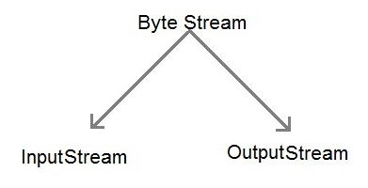
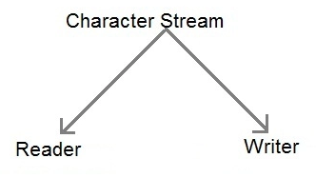
InputStream and OutputStream are designed for byte streams.
Reader and Writer are designed for character streams.
use the character stream classes when working with characters or strings, and use the byte stream classes when working with bytes or other binary objects.

Slide 28
The Byte Streams
Byte stream classes provide a rich environment for handling byte-oriented I/O.

Slide 29
InputStream
InputStream is an abstract class that defines Java’s model of streaming byte input.
Most of the methods in this class will throw an IOException on error conditions.

Slide 30
methods in InputStream.
int read( )
Returns an integer representation of the next available byte of input.

Slide 31
methods in InputStream.
int read( )
int read(byte buffer[ ])
Attempts to read up to buffer.length bytes into buffer and returns the actual number of bytes that were successfully read.

Slide 32
methods in InputStream.
int read( )
int read(byte buffer[ ])
int read(byte buffer[ ], int offset, int numBytes)
Attempts to read up to numBytes bytes into buffer starting at buffer[offset], returning the number of bytes successfully read.
–1 is returned when the end of the file is encountered.

Slide 33
methods in InputStream.
int available( )
Returns the number of bytes of input currently available for reading.

Slide 34
methods in InputStream.
int available( )
long skip(long numBytes)
Ignores (that is, skips) numBytes bytes of input, returning the number of bytes actually ignored.

Slide 35
methods in InputStream.
int available( )
long skip(long numBytes)
void close( )
Closes the input source. Further read attempts will generate an IOException.

Slide 36
methods in InputStream.
boolean markSupported( )
void mark(int numBytes)
void reset( )
Returns true if mark( )/reset( ) are supported by the invoking stream.
Places a mark at the current point in the input stream that will remain valid until numBytes bytes are read.
Resets the input pointer to the previously set mark.

Slide 37
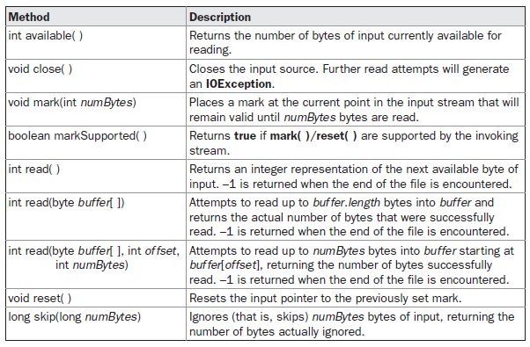
Table 19-1 shows the methods in InputStream.

Slide 38
OutputStream
OutputStream is an abstract class that defines streaming byte output.
Most of the methods in this class return void and throw an IOException in the case of errors.

Slide 39
methods in OutputStream.
void write(int b)
void write(byte buffer[ ])
void write(byte buffer[ ], int offset, int numBytes)
Writes a subrange of numBytes bytes from the array buffer, beginning at buffer[offset].

Slide 40
methods in OutputStream.
void close( )
void flush( )
Closes the output stream. Further write attempts will generate an IOException.
Finalizes the output state so that any buffers are cleared.

Slide 41
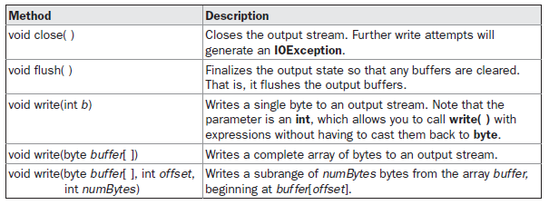
Table 19-2 shows the methods in OutputStream.

Slide 42
FileInputStream
The FileInputStream class creates an InputStream that we can use to read bytes from a file.
FileInputStream(String filepath)
FileInputStream(File fileObj)
Either can throw a FileNotFoundException.
FileInputStream

Slide 43
Example
FileInputStream f0 = new FileInputStream (“c:/mit/ict/cce/prg1.txt");
File f = new File (“c:/mit/ict/cce/prg1.txt");
FileInputStream f1 = new FileInputStream(f);
FileInputStream

Slide 44
FileOutputStream
FileOutputStream creates an OutputStream that you can use to write bytes to a file.
FileInputStream
FileOutputStream

Slide 45
FileOutputStream
FileOutputStream(String filePath)
FileOutputStream(File fileObj)
FileOutputStream(String filePath, boolean append)
FileOutputStream(File fileObj, boolean append)
They can throw a FileNotFoundException.
If append is true, the file is opened in append mode.
Creation of a FileOutputStream is not dependent on the file already existing.
FileOutputStream will create the file before opening it for output when we create the object.
In the case where you attempt to open a read-only file, an IOException will be thrown.

Slide 46
// Demonstrate FileOutputStream.
import java.io.*;
class FileOutputStreamDemo
{ public static void main(String args[]) throws IOException
{
String source = "Now is the time for all good men\n"
+ " to come to the aid of their country\n"
+ " and pay their due taxes.";
byte buf[] = source.getBytes();
OutputStream f0 = new FileOutputStream("file1.txt");
for (int i=0; i < buf.length; i += 2)
{ f0.write(buf[i]);
}
f0.close();

Slide 47
OutputStream f1 = new FileOutputStream("file2.txt");
f1.write(buf);
f1.close();
OutputStream f2 = new FileOutputStream("file3.txt");
f2.write(buf,buf.length-buf.length/4,buf.length/4);
f2.close();
}
}

Slide 48
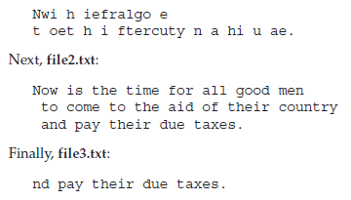
The first, file1.txt, will contain every other byte from the sample.
The second, file2.txt, will contain the entire set of bytes.
The third and last, file3.txt, will contain only the last quarter.
String source = "Now is the time for all good men\n"
+ " to come to the aid of their country\n"
+ " and pay their due taxes.";

Slide 49
The Character Streams
Top of the character stream hierarchies are the Reader and Writer abstract classes.

Slide 50
The Character Streams
The byte stream classes provide functionality to handle any type of I/O operation, they cannot work directly with Unicode characters.
Character streams : direct I/O support for characters.
NOTE :
The character I/O classes were added by the 1.1 release of Java.
Because of this, we may still find legacy code that uses byte streams where character streams would be more appropriate

Slide 51
Reader
Reader is an abstract class that defines Java’s model of streaming character input.

Slide 52
Reader methods
int read( )
int read(char buffer[ ])
int read(char buffer[ ], int offset, int numChars)
Returns an integer representation of the next available character from the invoking input stream.
Attempts to read up to buffer.length characters into buffer and returns the actual number of characters that were successfully read.
Attempts to read up to numChars characters into buffer starting at buffer[offset], returning the number of characters successfully read.
–1 is returned when the end of the file is encountered.

Slide 53
Reader methods
long skip(long numBytes)
void close( )
Skips over numChars characters of input, returning the number of characters actually skipped.
Closes the input source. Further read attempts will generate an IOException.

Slide 54
Reader methods
boolean markSupported( )
void mark(int numChars)
void reset( )
Returns true if mark( )/reset( ) are supported on this stream.
Places a mark at the current point in the input stream that will remain valid until numChars characters are read.
Resets the input pointer to the previously set mark.

Slide 55
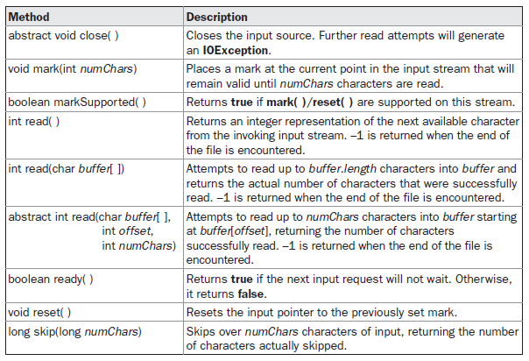
Table 19-3 provides a synopsis of the methods in Reader.

Slide 56
Writer
Writer is an abstract class that defines streaming character output.
All of the methods in this class throw an IOException in the case of errors.

Slide 57
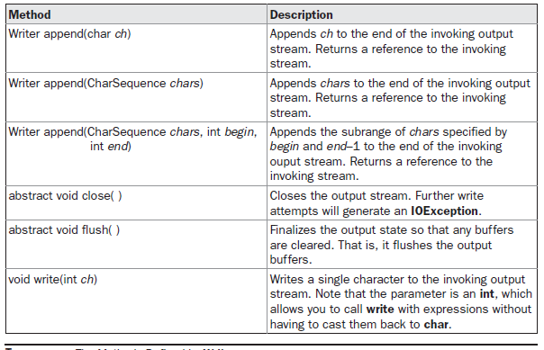
Table 19-4 shows a synopsis of the methods in Writer.

Slide 58
……….
……….
FileReader
FileWriter

Slide 59
FileReader
FileReader class creates a Reader that can be uses to read the contents of a file.
Its two most commonly used constructors are:
FileReader(String filePath)
FileReader(File fileObj)
Either can throw a FileNotFoundException. Here, filePath is the full path name of a file, and fileObj is a File object that describes the file.

Slide 60
// Demonstrate FileReader.
import java.io.*;
class FileReaderDemo
{ public static void main(String args[]) throws IOException
{
FileReader fr = new FileReader("FileReaderDemo.java");
int i;
while((i = fr.read()) != -1)
{ System.out.println((char)i);
}
fr.close();
}}

Slide 61
FileWriter
FileWriter creates a Writer that we can use to write to a file.
Its most commonly used constructors are:
FileWriter(String filePath)
FileWriter(String filePath, boolean append)
FileWriter(File fileObj)
FileWriter(File fileObj, boolean append)
They can throw an IOException.
If append is true, then output is appended to the end of the file.
Creation of a FileWriter is not dependent on the file already existing. FileWriter will create the file before opening it for output when you create the object. In the case where you attempt to open a read-only file, an IOException will be thrown.

Slide 62
// Demonstrate FileWriter.
import java.io.*;
class FileWriterDemo
{ public static void main(String args[]) throws IOException
{
String source = "Now is the time for all good men\n"
+ " to come to the aid of their country\n"
+ " and pay their due taxes.";
char buffer[] = new char[source.length()];
source.getChars(0, source.length(), buffer, 0);
FileWriter f0 = new FileWriter("file1.txt");
for (int i=0; i < buffer.length; i += 2) {
f0.write(buffer[i]);
}
f0.close();

Slide 63
FileWriter f1 = new FileWriter("file2.txt");
f1.write(buffer);
f1.close();
FileWriter f2 = new FileWriter("file3.txt");
f2.write(buffer,buffer.length-buffer.length/4,buffer.length/4);
f2.close();
}
}
The first, file1.txt, will contain every other character from the sample.
The second, file2.txt, will contain the entire set of characters.
Finally, the third, file3.txt, will contain only the last quarter

Slide 64
void write(int b);
void write(byte buffer[]);
void write(byte buffer[], int index, int size);

Slide 65
Differences
Aspect | Byte Stream | Character Stream
Unit of Data | Byte (8 bits) | Character (16 bits, Unicode)
Data Type | Binary data | Text data
Encoding | No character encoding | Uses character encoding (UTF-8, UTF-16)
Base Classes | InputStream, OutputStream | Reader, Writer
Example Classes | FileInputStream, FileOutputStream | FileReader, FileWriter
Suitable For | Images, audio, video, PDFs | Text files, documents, logs
Portability | Lower for text | Higher for text
Conversion | No encoding conversion | Handles encoding/decoding

