Slide 1
IO Streams

Slide 2
Additional Exercises
Write a java program to find the occurrence of word in a given file

Slide 3
Consider a directory MIT/ICT which contains java files, out of which one file is the replica of another file. Write a java program to find those 2 files.

Slide 4
Write a java program to remove the comments from file.

Slide 5
Consider a file student.txt which contains flowing information.
regno : name : mark
Where the fields are separated by :
Write a java program to display the student who scored highest mark.

Slide 6
Write a java program to write all palindrome into a new file.

Slide 7
Serialization
The process of writing the state of an object to a byte stream.
To save the state of our program to a persistent storage area, such as a file.
At a later time, we may restore these objects by using the process of deserialization.
Serialization is also needed to implement Remote Method Invocation (RMI).
An object may be supplied as an argument to that remote method. The sending machine serializes the object and transmits it. The receiving machine deserializes it.

Slide 8

Serialization

Slide 9
Serializable
Only an object that implements the Serializable interface can be saved and restored by the serialization facilities.
The Serializable interface defines no members.
  It is simply used to indicate that a class may be serialized.
  If a class is serializable, all of its subclasses are also serializable.
static variables are not saved.

Slide 10
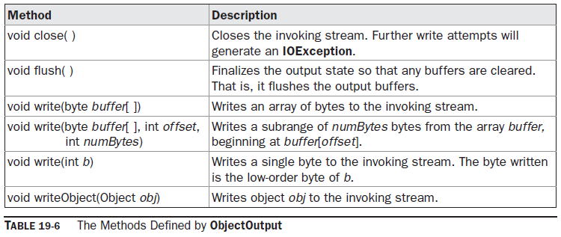
ObjectOutput
The ObjectOutput interface extends the DataOutput interface and supports object serialization. Follwing are the methods.
The writeObject( ) method is called to serialize an object.
All of these methods will throw an IOException on error conditions.

Slide 11
ObjectOutputStream
The ObjectOutputStream class extends the OutputStream class and implements the ObjectOutput interface.
It is responsible for writing objects to a stream.
ObjectOutputStream(OutputStream outStream) throws IOException
outStream is the output stream to which serialized objects will be written.
Several commonly used methods in this class are shown in Table 19-7.
They will throw an IOException on error conditions.

Slide 12
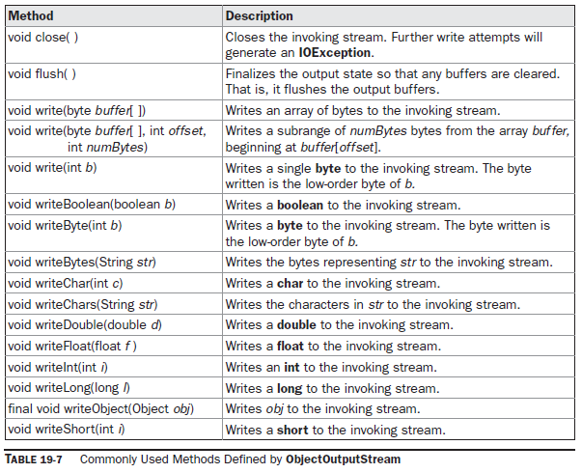

Slide 13
ObjectInput
The ObjectInput interface extends the DataInput interface and defines the methods shown in Table 19-8.
It supports object serialization.
The readObject( ) method is called to deserialize an object.
All of these methods will throw an IOException on error conditions.
The readObject( ) method can also throw ClassNotFoundException.

Slide 14
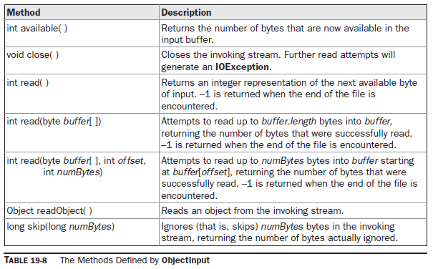

Slide 15
ObjectInputStream
The ObjectInputStream class extends the InputStream class and implements the ObjectInput interface.
ObjectInputStream is responsible for reading objects from a stream.
ObjectInputStream(InputStream inStream) throws IOException
inStream is the input stream from which serialized objects should be read.
Several commonly used methods in this class are shown in Table 19-9.
They will throw an IOException on error conditions. The readObject( ) method can also throw ClassNotFoundException.

Slide 16
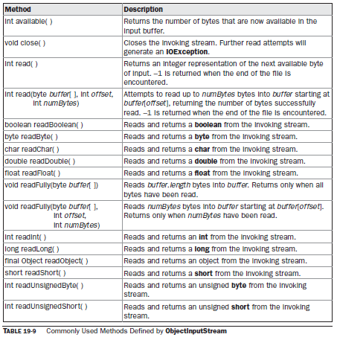

Slide 17
DataOutput
OutputStream
ObjectOutput
ObjectOutputStream
DataOutputStream

Slide 18
DataInput
InputStream
ObjectIntput
ObjectInputStream
DataInputStream

Slide 19
class MyClass implements Serializable
{
String s;
int i;
double d;
public MyClass(String s, int i, double d)
{ this.s = s;
this.i = i;
this.d = d;
}
public String toString()
{ return "s=" + s + "; i=" + i + "; d=" + d;
}
}

Slide 20
public class SerializationDemo
{ public static void main(String args[])
{ // Object serialization
try
{
MyClass object1 = new MyClass("Hello", -7, 2.7e10);
System.out.println("object1: " + object1);
FileOutputStream fos = new FileOutputStream("serial");
ObjectOutputStream oos = new ObjectOutputStream(fos);
oos.writeObject(object1);
oos.flush();
oos.close();
}
catch(IOException e)
{ System.out.println("Exception during serialization: " + e);
System.exit(0); }

Slide 21
// Object deserialization
try
{
MyClass object2;
FileInputStream fis = new FileInputStream("serial");
ObjectInputStream ois = new ObjectInputStream(fis);
object2 = (MyClass)ois.readObject();
ois.close();
System.out.println("object2: " + object2);
}
catch(Exception e) { System.out.println("Exception during deserialization: " + e);
System.exit(0); }
}
}

Slide 22
Create a class student with name and sessional mark as its data members, use constructor to initialize the object and a method to display the student details.
Write a program to write 5 student objects into a “student.txt” file.
Also read the contents of the file and display only those students detail whose sessional marks are above 10.

Slide 23
Write a java program to insert following details into the student.txt.
Anil 12 13
Sunil 8 9
Rahul 13 11
Write a java program to read the students detail from student.txt file and display only those students details whose total mark is more than 20;

Slide 24
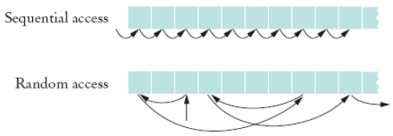
RandomAccessFile
Random access files are files in which records can be accessed in any order

Slide 25
RandomAccessFile
RandomAccessFile class to allow a file to be read from and write to at random locations.
RandomAccessFile is special because it supports positioning requests: we can position the file pointer within the file.
It is not derived from InputStream or OutputStream.
It implements the interfaces DataInput and DataOutput, which define the basic I/O methods.

Slide 26
RandomAccessFile(File fileObj, String access) throws FileNotFoundException
RandomAccessFile(String filename, String access) throws
FileNotFoundException
access determines what type of file access is permitted.
If it is “r”, then the file can be read, but not written.
If it is “rw”, then the file is opened in read-write mode.

Slide 27
seek( ) : to set the current position of the file pointer within the file:
void seek(long newPos) throws IOException
newPos specifies the new position (in bytes), of the file pointer from the beginning of the file.
After a call to seek( ), the next read or write operation will occur at the new file position.

Slide 28
long getFilePointer() throws IOException
Returns the current offset, in bytes, from the beginning of the file to where the next read or write occurs.

Slide 29
int skipBytes(int n)
Add n to the file pointer. Returns actual number of bytes skipped. If n s negative, no bytes are skipped.

Slide 30
void setLength(long len) throws IOException
This method sets the length of the invoking file to that specified by len.
This method can be used to lengthen or shorten a file.
If the file is lengthened, the added portion is undefined.

Slide 31
long length()
returns the length of the file in bytes.

Slide 32
int read();
int read(byte buffer[]);
int read(byte buffer[], int index, int size);

Slide 33
void write(int b);
void write(byte buffer[]);
void write(byte buffer[], int index, int size);

